Slide 1


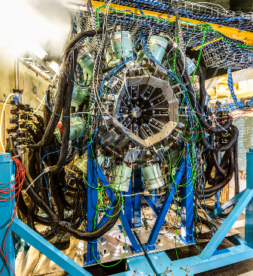
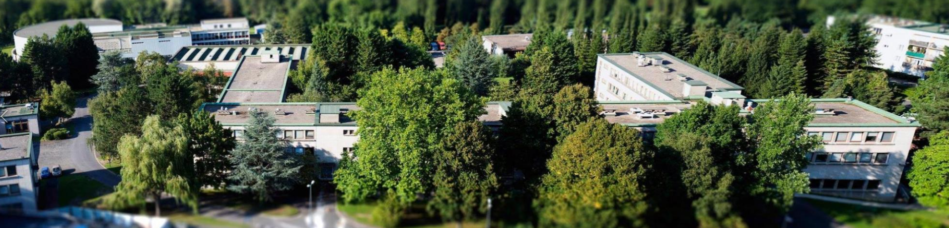
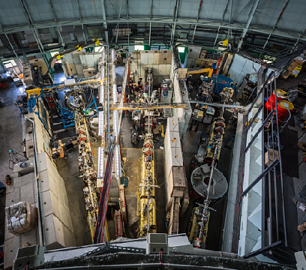
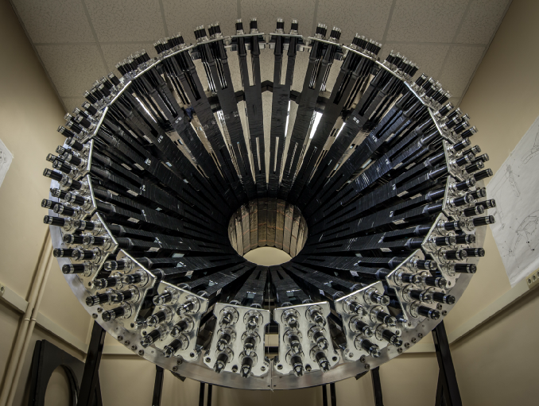
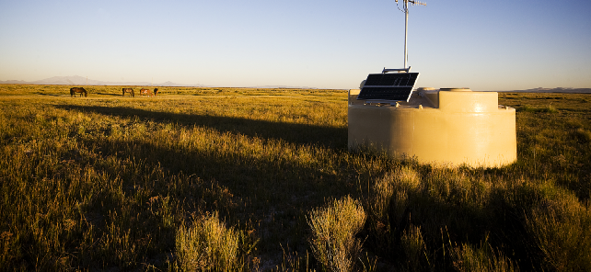
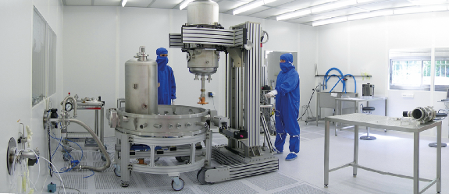
HCERES evaluation of
Laboratoires de la vallée d’ rsay
CSNSM
IMNC
IPNO
LAL
LPT
Institut de
Physique Nucléaire
d’Orsay
Director: M. Guidal
UMR8608 with « tutelles »
IN2P3/CNRS and Univ. Paris-Sud/Paris-Saclay
Reminder directorship:
2015-2016: F. Azaiez
2016: B. Espagnon
2017-2019: M. Guidal
14-17 january 2019

Slide 2
PLAN
Plan
Global view of the laboratory and main data
Structure and scientific policy
Technical infrastructures
Highlights of the last contract (2015-2019)
International, national and local environment
Conclusions

Slide 3



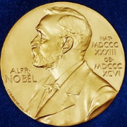
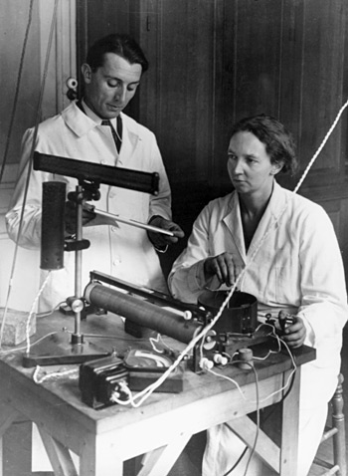
1956 the first buildings on the future Orsay campus
Nobel prize in chemistry 1935
Creation of IPN on the initiative of Irène Joliot-Curie to install a synchrocyclotron. Willingness to develop nuclear physics in France.
First lab (with LAL) on the Orsay campus.
Frédéric Joliot-Curie first director.

Slide 4
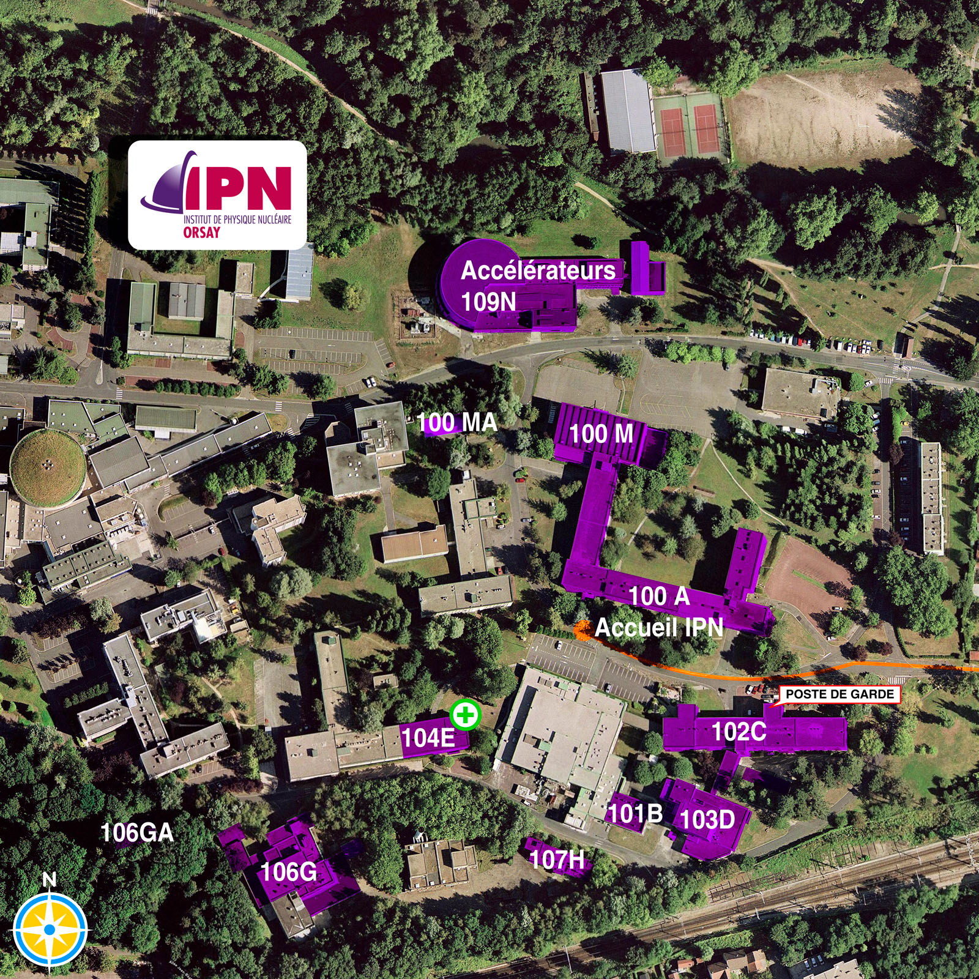

~ 300 personnel
~ 22000 m2

Slide 5
Main data : Human resources
Active staff 30/06/18 | CNRS | Univ | Total
Full professors |  | 4
Assistant professors |  | 11
Full time research directors | 20
Full time research associate | 34
Other scientists
High school teachers |  | 0
Supporting personnel (ITAs, BIATSS…) | 143 | 10
Permanent staff |  |  | 222
Non-permanent professors |  |  | 1
Non-permanent full time scientists |  |  | 25
PhD Students |  |  | 42
non-permanent supporting personnel |  |  | 23
Non permanent staff |  |  | 91
Total |  |  | 313

Slide 6
Main data : Budget
Tutelles: CNRS | 2017
Basic funds | 400 000
Specific funds | 1 263 620
Calls
Infrastructure | 1160000
Total tutelles | 2 823 620
Contracts | 2017
International funds
European programs | 208 052
ERC
European structural funds
ANR (not PIA) | 95 967
PIA | 427 236
Other public funds on calls
Local governing bodies
CPER
Foundations, charities
Industrial contracts | 29 834
Consulting | 416 678
Institut Carnot
Innovation (SATT, BPI, …)
Patents
Other funds | 9 925 444
Total contracts | 11 103 211
Tutelles: Univ | 2017
Basic funds | 92 100
Specific funds
Calls
Infrastructure
Total tutelles | 92 100

Slide 7
PREVENTION &
RADIATION PROTECTION
Jean-François LE DU
DIRECTOR
Michel GUIDAL
DEPUTY DIRECTOR
Bruno ESPAGNON
Executive Assistante: Martine ROUX
DOSIMETRY ACTIVITY
Aurore LERMITAGE
Communication – scientific and technical information
Valérie FROIS
VALORISATION « Vallée »
Souleymane KAMARA
PROJECT MANAGERS
Project ALTO : Fadi IBRAHIM
Correspondent Valorisation : Véronique POUX
Cultural Heritage : Jean-Pierre DIDELEZ & Denis JOUAN
Coordinator «CPER» for laboratories of IN2P3 Orsay: Valérie CHAMBERT
ADMINISTRATOR
Catherine SALOU
General Affairs
Martine ROUX
RESEARCH DIVISION
Director : Marcella GRASSO
Assistante : Elisabeth SEIBERT
ACCELERATOR DIVISION
Director : Sébastien BOUSSON
Administrative and financial management officer : Virginie QUIPOURT
INSTRUMENTATION
& COMPUTING
DIVISION
Director : Bernard GENOLINI
Assistante : Laurence BERTHIER
ADMINISTRATION
&
INFRASTRUCTURE
DIVISION
Director : Catherine SALOU
Nuclear Structure & Dynamics
Iulian STEFAN
Nuclei Material Ions
Marin CHABOT
FACILITIES
Facilitie ALTO
Facility manager
Abdelhakim SAÏD
Scientific Coordinator
Matthieu LEBOIS
SUPRAtech-R&D
Cavities and Cryogenics
Guillaume OLRY
Financial Service
Marie-France
GRANDISSON
As of Dec.2018
Service
R&D Détectors
Giulia HULL
Research contracts
Valérie SCHEUBLE
High Energy Physics
Silvia NICCOLAI
Platform SUPRATECH
Richard MARTRET
Design Office
Patricia DUCHESNE
Physical Electronics Service
Eric WANLIN
Human Resources
Continuing Education
Nathalie CHEREL
Theoretical Physics
Michaël URBAN
ANDROMEDE
Scientific leader
Serge DELLA NEGRA
Technical manager
Jean LESREL
Modeling
Calculations
Luc PERROT
Technical Group
Infrastructure
Jean-Michel ESTEVE
Downstream of the Cycle and Spallation Physics Xavier DOLIGEZ
Radiochemistry
Sylvie DELPECH
FACILITIES
CONTINUOUS TRAINING ACTIVITIES
IT Department of the Institute
Vincent LAFAGE
Building studies & building monitoring
Bruno BOUE
PhD school
Electronic Accelerators
Christophe JOLY
Store/Logistics
Purchasing Department
Noëlle BORGET
(CH)₂
Masters studies

Slide 8
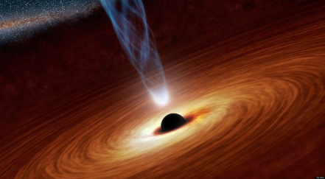
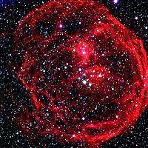
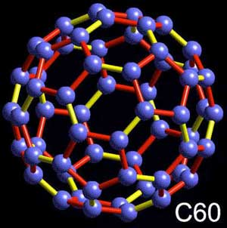
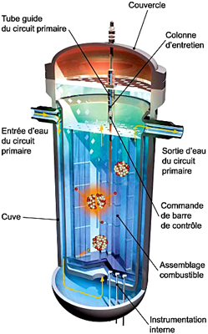
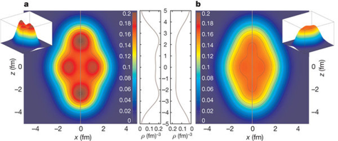
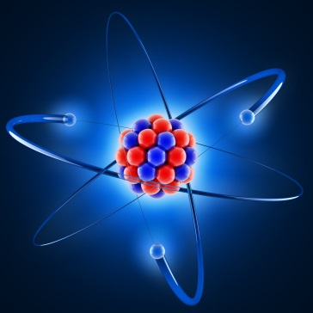
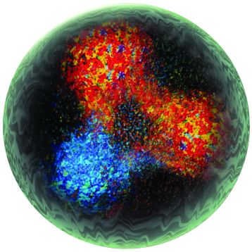
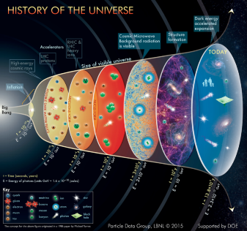
Structure : Main themes and groups
To infinitely big…
From infinitely small…

Slide 9
Structure : Main themes and groups
Nuclear Physics:
  -nuclei far from stability
  -nuclear resonances
  -nuclear astrophysics
  -EOS and phase transitions
  -cluster interactions
  -molecular studies
  -AGAT
  -FAZIA
  -MUST2/MUGAST/GRID
  -PARIS
  -SIRIUS
  -REGLIS
  -MLLTRAP,…
  -GANIL
  -ISOLDE
  -RIKEN
  -ALTO
  -ANDROMEDE
  -…
Hadronic Physics:
  -QGP
  -nucleon structure
  -nucleon resonances
  -ALICE@CERN
  -PHENIX@BNL
  -Jefferson Lab
  -Prorad@PRAE
  -HADES@GSI
Theory:
  -QCD and hadronic physics
  -few-body physics
  -nuclear structure and reactions
  -nuclear astrophysics
  -ultracold atoms
  -fundamental symmetries
Nuclear energy:
  -nuclear data (ntof@CERN and SOFIA@GSI)
  -nuclear energy scenarios
  -radiochemistry (aqueous actinides
  chemistry, actinide chemistry in
  non-aqueous solvents, nuclear
  wastes storage)
Astroparticles:
  -UHECR
  -γ-ray astronomy
  -Auger
  -CTA
  -LHAASO
Accelerators:
  -ESS
  -SPIRAL2
  -MYRRHA
  -…
15/01/2019
9
Instrumentation/Detectors: -all

Slide 10
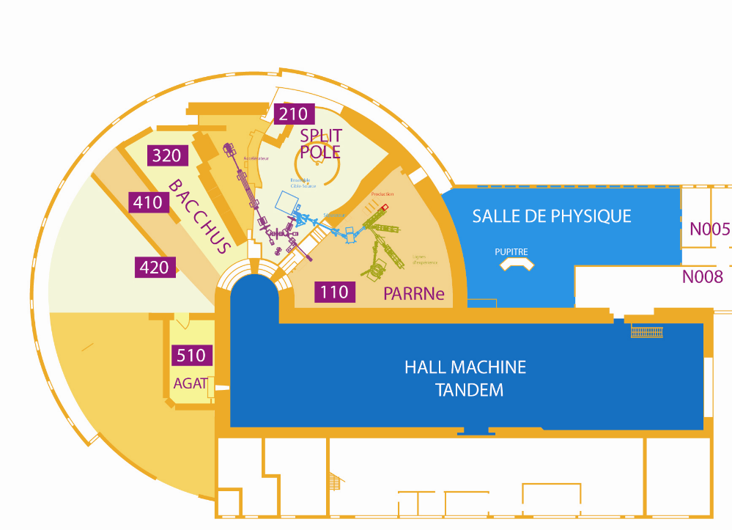
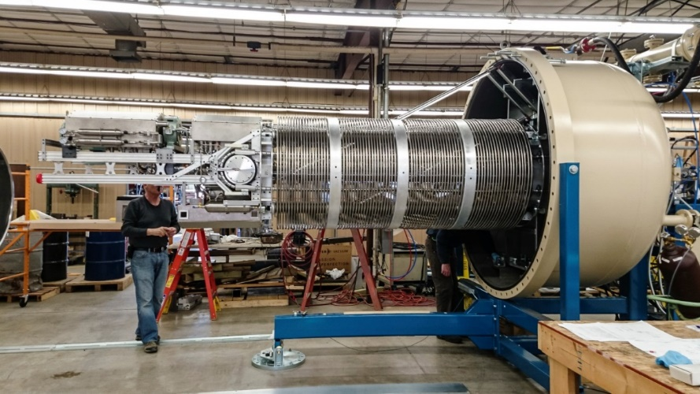
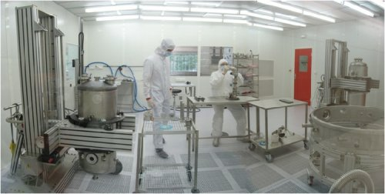
Structure : technical infrastructures
ALTO
15 MV tandem, 50 MeV e⁻ linac, ISOl facility γ-fission, Ucx targets
ANDROMEDE (laureate Equipex 2010)
4 MV Van de Graaf, nanoparticles and clusters
All three with « IN2P3 platform label »
SUPRATECH
White room, design, cryomodules and cavities tests, R&D,…
+ (CH)₂ , PANAMA, dosimetry, Virtual Data, …

Slide 11
Structure : scientific policy
MAIN NEW AXES TO BE DEVELOPPED IN THE COMING YEARS
Platforms:
ALTO2.0
Establish a common strategy (physics, R&D, technology,…)
with GANIL (S3, DESIR)
Opening to industry, training,
define a financial model
ANDROMEDE
Opening to health, (exo)biology,…
11
SUPRATECH
European coordination (AMICI)
Development of valorisation in general
New scientific axis foreseen: SPIRAL2, EIC, DAMIC (Darkside?), DUNE/PIP-II, MYRRHA, PERLE,…
Restructuration in the Orsay valley: « refondation » project

Slide 12
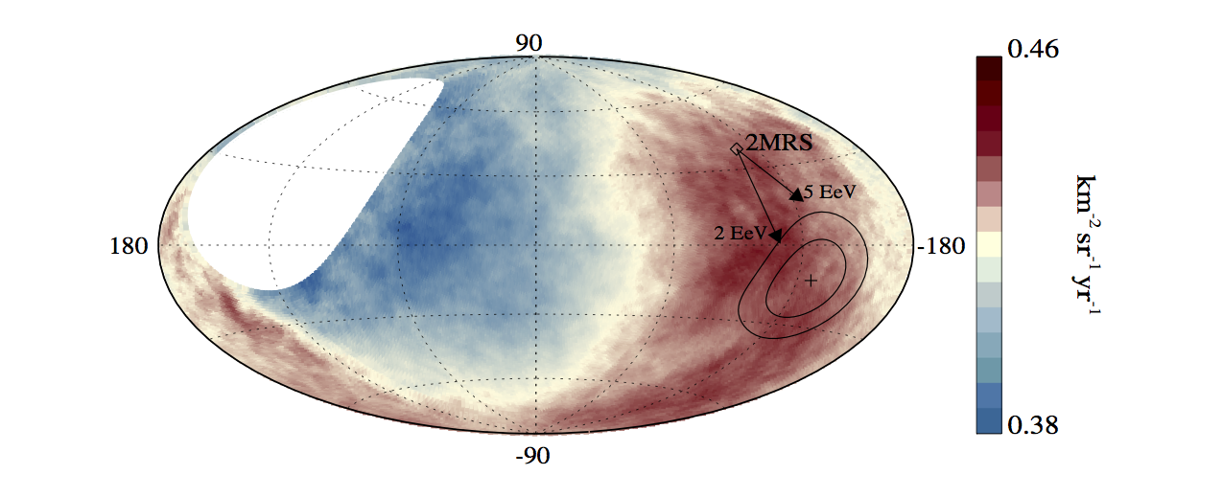
Highlights 1
Astroparticles
Hadronic physics
J/Ψ are less suppressed at LHC (2.76 and 5.02 TeV) than at RHIC (0.2 TeV) in central events -> J/Ψ regeneration
Galactic map of UHECR (> 8 EeV) intensity
First discovery of a large-scale UHECR anisotropy
-first exp. proton space-momentum tomography of quarks in the nucleon
-first exclusive measurement of Deeply Virtual Compton Scattering off 4He (tomography of nuclei)
-neutron detector installation at JLab
-nucleon resonances studies at HADES/GSI
-nuclear modification factor J/psi at 2.76 TeV and 5 TeV (also Z⁰)
-first evidence of the recombinaison phenomenon of charmonia at LHC energies
-fixed target at LHC studies
…
  -TA-Auger comparisons,
  -joining CTA in 2015
  -responsibility of the design and production of the single photo-electron calibration system and reflective target of NectarCAM
  -contribution to the “extragalactic” chapter of the CTA scientific white paper
  -…

Slide 13
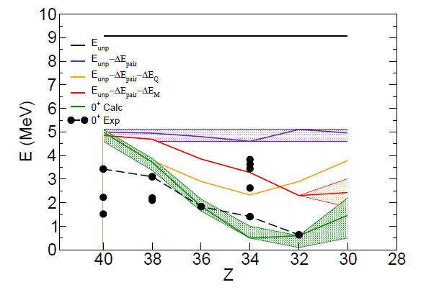
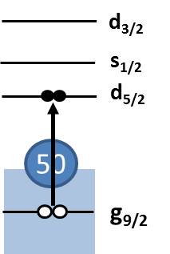
Highlights 2
Shape coexistence around Ni78 at ALTO
unperturbed
Also:
-8-months nu-ball campaign at ALTO,
-record production of ultra-pure radioactive beams with the ALTO laser ion-source,
-measurement of sizes and shapes of Nobelium isotopes by laser spectroscopy,
-fast neutron tomography at ALTO with the LICORNE source
-high precision 3-α Hoyle state decay at Legnaro
-dynamics of quasi-fission at Canberra
-first spectroscopy of 79Cu at RIKEN
-first spectroscopy of neutron-rich 98,100Kr at RIKEN
-Study of 60Fe nucleosynthesis, nuclear astrophysics
-installation and first experiments with ANDROMEDE
-clusters and molecular studies
-…
pairing
monopole
quadrupole
TOTAL
NEW
Disappearing of magic numbers in neutron-rich nuclei
With a pure 80Ga produced with the ISOL technique at ALTO,
evidence of a monopolar electric E0 transition, signing that
the first 80Ge excited state is 0+, instead of 2+ like usual.
This configuration which is not « natural » indicates a deformed state.

Slide 14
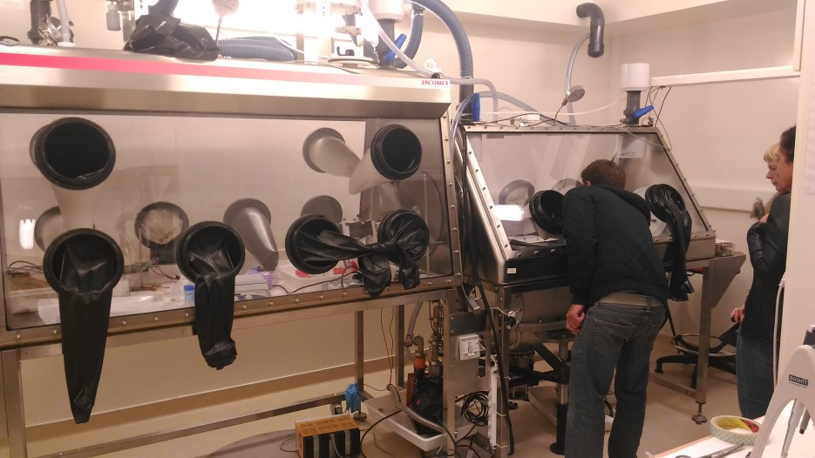
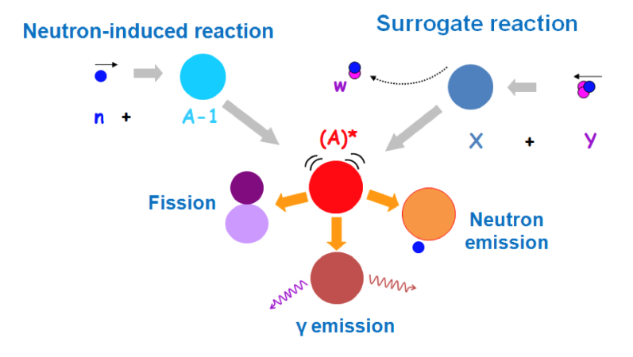
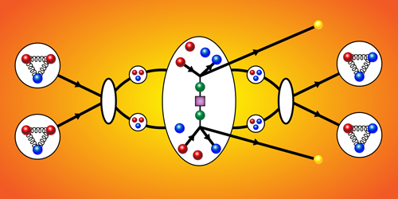
Highlights 3
Theory
Energy
Short range interactions in nuclei: a new contribution to neutrino-less beta decay.
Under-estimation of a critical effect for the interpretation of experiments ?
Production of a ²⁴⁰Pu target for an experiment at ALTO
(Jurado et al.: Investigation of the surrogate-reaction method via the simultaneous measurement of g-emission and fission probabilities in ³He + ²⁴⁰Pu reactions).
Connection with nuclear physics, nuclear data,…
-observation of gluon shadowing in heavy nuclei in p-Pb collisions at LHC
-microscopic description of the spontaneous fission of 258Fm
-bridging density functional theories with EFT/ ab initio approaches
-…
-fission cross-section measurements at n-Tof and fission product yields at SOFIA
-aqueous actinide chemistry (biology, environment,…)
-innovative nuclear energy systems and scenarios
-…
15/01/2019

Slide 15

Highlights 4
Accelerator activities
Contribution to FAIR on RF sources for the proton linac
6 klystrons (+ 1 pre-series) were delivered to GSI and commissioned ! (3 MW peak, 200 µs pulse length, 4 Hz rep. rate).
ALICE/Dimuon (CERN)
Front-end boards design & production start:
20,000 boards, 650 k€
Control scripts: run start speed ×9, data taking efficiency from 72 to 95%
CLAS12 (JLab)
Design, assembly of 144 scintillators + PMTs
-> talk IEEE-NSS 2014
Successful assembly at JLab -> NIMA 2018
GASPARD (SPIRAL)
Analog electronics + signal processing
-> NIMA 2013, EPJA 2015, NIMA 2018
Analog ASIC (iPACI v1) + in-beam tests@ALTO
ALTO
data flux up to 3 Tb/day (nu-ball)
Storage & data analysis at CC IN2P3 & Virtual Data platforms
R&D: 5 papers + 4 proc. (instrum. to computing)
Contribution to SPIRAL-2
Last of the 7 high energy cryomodule delivered to Ganil in March 2015, after preparation, assembly and test at IPNO. All cryomodules installed and successfully cooled-down at 4K.
All BPMs fabricated, characterized and delivered to GANIL
MYRRHA
Increase of R&D pace with the contract signed with SCK-CEN. Record performance obtained on a Myrrha cavity prototype with a quality factor of Qo = 7.10¹⁰ after heat treatment and without any post-treatment.
New experimental lines at ALTO (Terra incognita)
Installation of new beam lines at ALTO for RIB experiments has started (MLLTrap, LINO, Polarex)
Contribution to the European Spallation Source (ESS)
Important milestones achieved: Cryogenic test of the prototype spoke cryomodule and valve box; All series production launched and already first experimental results on series spoke cavities with performances far above specifications.
15
15/01/2019

Slide 16


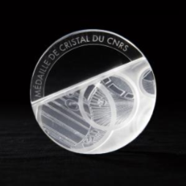
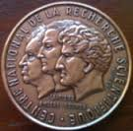
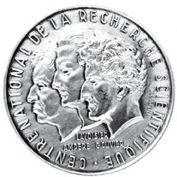

Local environment
Regular collaborations with CSNSM, LAL, IMNC, LPT, LLR, CEA Saclay
Part of Labex P2IO, Univ. Dpt P2I (head of dpt from IPN), CPER P2IO, Virtual Data, PHENIICS ED (head of ED from IPN)
Recipients (in partnership with above labs) of several Ile-de-France SESAME programs (HPS, Retien, AXE-SRF),
« starting ERC »
Education: IPN staff (Univ.+CNRS, researchers + ITs) teaching at all levels of University (L1 to M2)
University managing responsibilities: associate dean for research in science faculty, chair of physics department,
members of CCSU and CNU, « chargé de mission Diffusion des Sciences et Patrimoine scientifique » for the Dean
of the Science Faculty, « chargé de mission enseignement for IN2P3 »,…
Outreach: yearly participation to « fête de la science », « fête du patrimoine », master classes, high-school training sessions,…
AWARDS:
Thibaut prize
2014
Joliot-Curie prize SFP 2014
Langevin prize
SFP 2015
Cristal du CNRS 2015
« Grand Prix » SFP Félix Robin 2015
Bronze medal
CNRS 2015
Silver medal CNRS 2016
EPS Lise-Meitner prize 2018
HCERES evaluation – Laboratory Presentation

Slide 17
Conclusions
IPN: the oldest (with LAL) lab of the Orsay campus and one of the three biggest labs of IN2P3
~300 personnel and ~10 MEuros budget (salaries not included)
International recognition and scientific achievements in the fields of nuclear physics, hadronic physics, astroparticle physics,
nuclear energy, radiochemistry, theory, detector/instrumentation and accelerator physics
More than 200 scientific publications per year, about 200 conference talks per year.
Collaborations with US, Russia, Japan, China, Australia, all over Europe,…
Currently about 40 PhD students and 20 postdocs
Strong local presence in the Paris-Sud/Paris-Saclay University with important teaching duties and responsibilities
three accelerators
Operation of three platforms among which of international level
In a context of decreasing human resources and of increasing overlap of interests and activities between our laboratories,
the « refondation » may be seen as an opportunity (with its risks)

