Slide 1
Fundamental Solid-State Physics
Context and aims of our research
Nuclear physics
Particle physics
Cosmology
Cold atomic gases
Many fermions
+
Strong interactions
Low dimensionality
Competing ground states
Collective excitations
AND
T
Strongly Correlated
Electron Systems (SCES)
Phase transitions
New states of matter
Exotic order parameters
AFM
HO
Other…
NFL
Heavy
FL
SC
δ, P, H

Slide 2


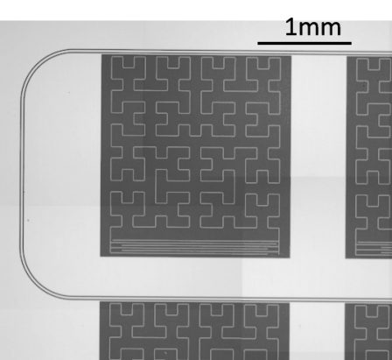
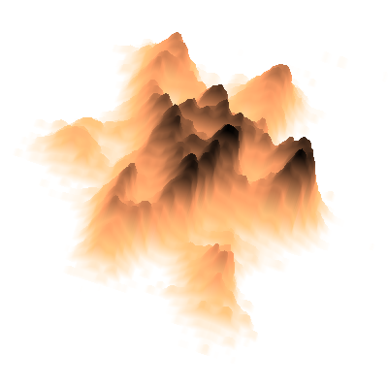
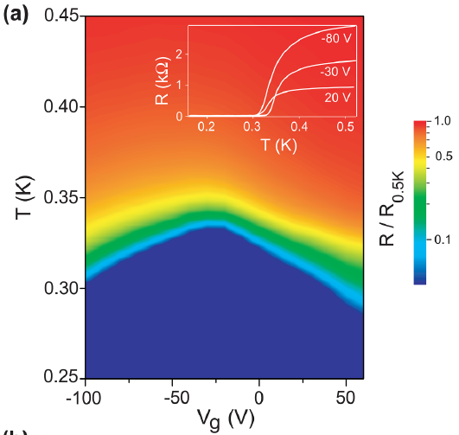
HCERES evaluation of
Laboratoires de la vallée d’ rsay
CSNSM
IMNC
IPNO
LAL
LPT
Solid-State Physics
Speaker : A. F. Santander-Syro
On behalf of the Solid State Physics group @ CSNSM
14-17 January 2019

Slide 3
Human resources
Permanent members @ 12/2018:
3 Maîtres de Conférences UPSud
3 CNRS (CR)
2 Research Engineers
1 Emeritus CNRS (DR)
+ 3 Engineers (Instrumentation Group) involved in our projects
Non-permanent @ 12/2018:
2 PhD students
Other members 2014-2018:
1 PostDoc
3 PhD students
5 Internships
3 Senior researcher visitors

Slide 4
Finances
(PI = Principal Investigator)
ANR
4 ANR Blancs (2 as PI)
2 ANR Jeunes (1 as PI)
LabEx
4 LabEx PALM (3 as PI)
1 LabEx Nano-Saclay
Other:
2 RTRA (1 as PI)
1 DIM OxyMORE (PI)
2 PICS-CNRS (2 as PI)
Origin of resources 2014-2018
1 M€
84%
External Contracts
200 k€
16%
Soutien de Base

Slide 5
Teaching
M2 Fundamental Concepts in Physics (M2-iCFP)
M2 Grands Instruments
M2 Outils et Systèmes de l’Astronomie et de l’Espace (M2-OSAE)
M2 Chimie
M1 & Magistère de Physique Fondamentale d’Orsay
M1 Matériaux Paris-Saclay
M1 Advanced Materials Engineering
M1 SERP+ Chemistry
L3 Physique
L1 Maths-Physique-Informatique (MPI)
PolyTech – Paris-Sud
Préparation aux cursus scientifiques d’Orsay
Formation Permanente Paris-Sud
Institut Villebon Georges Charpak
Teaching Responsibilities:
Vice-President CSU-28 Université Paris-Sud
Head of Studies – L3 Magistère de Physique Fondamentale
Alumni Relations Officer – Magistère de Physique Fondamentale
Member of the Commission Innovation Pédagogique Paris-Sud
Web management – Magistère de Physique Fondamentale d’Orsay
Teaching Publications: 1 Am. J. Phys; 1 Papers in Physics
Teaching Prizes: Passion Enseignement et Pédagogie dans le Supérieur

Slide 6
Outreach
Science Fair CSNSM
Jury – French Physicists Tournament
Presentations – French Physical Society
Scientific Boards: CSU-28 (UPSud), Conference on Low Temperature Detectors, LabEx PALM.
Referee work: Science, Nature, Nat. Commun., Nat. Mater., Nat. Phys., Nat. Quantum Mater., Adv. Mater., PRL, PRB, …
Reviews: ANR (FR), NSERC (CA), FOM (NL), Swiss-NSF (CH), IBS (South Korea), NCN (Poland), MSTS (Israel)

Slide 7
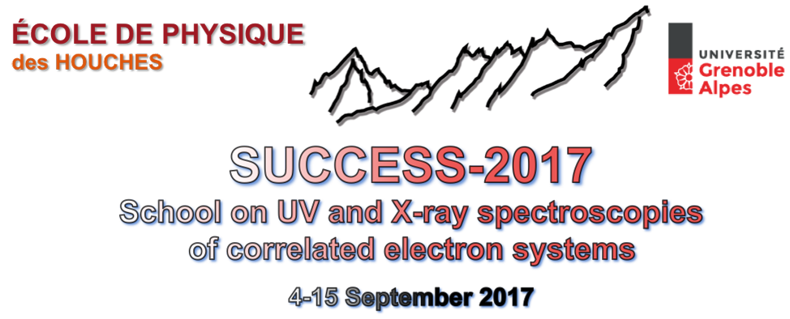
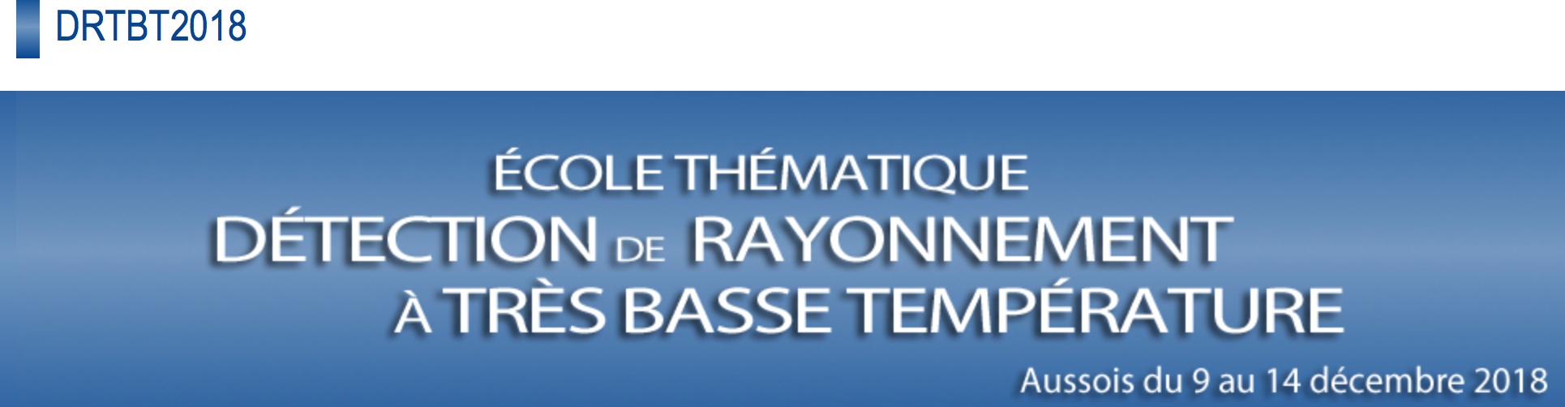
Organization of Schools
Les Houches
School on UV and X-Ray Spectroscopies of Correlated-Electron Systems
SUCCESS-2014
SUCCESS-2017
Aussois
Ecole 2018: Détection de Rayonnements à Tres Basse Température
Other
GDR 2016: Quantum Mesoscopic Physics

Slide 8
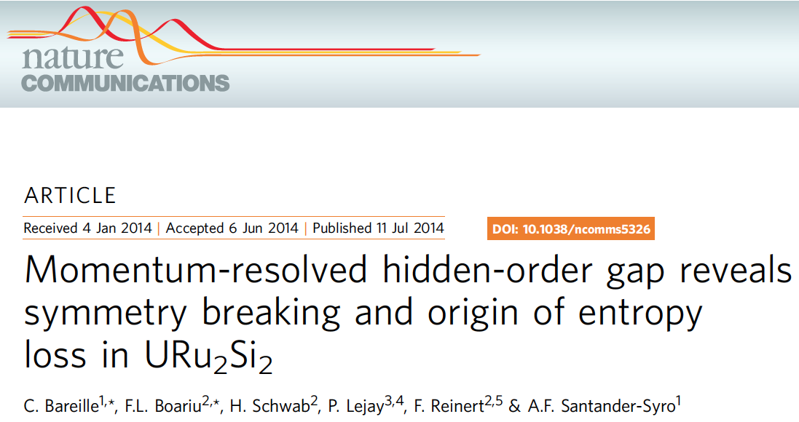
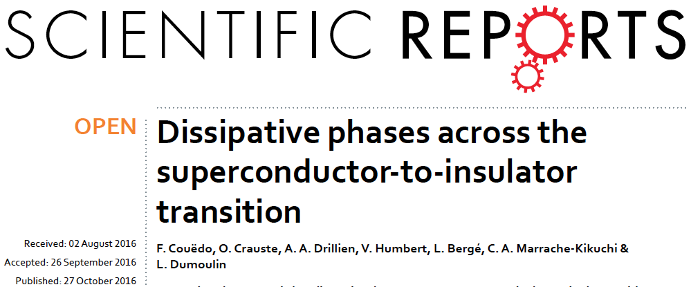
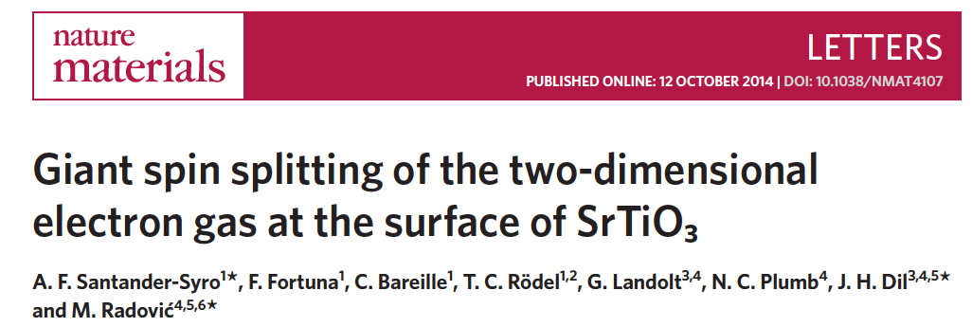
Publications
Peer-reviewed journals: 46 papers
Including, as corresponding authors:
  Nature Materials (1)
  Nature Communications (2)
  Advanced Materials (1)
  Phys. Rev. Materials (2)
  Phys. Rev. B – Rapids (5)
  Phys. Rev. B (2)
  Scientific Reports (2)
Proceedings: 39 papers
Talks
INVITED – Conferences: 21
INVITED – Schools: 5
Contributed: 4
Seminars: 37

Slide 9



Prizes/Honors
Junior Chair – Institut Universitaire de France (2011 – 2016)
BQR “Emploi” – Université Paris-Sud (2016)
Invited Professorships
Institute of Solid-State Physics – University of Tokyo (2014, 6 months)
HiSOR Synchrotron – Hiroshima University (2017, 6 months)

Slide 10
Fundamental Solid-State Physics
Context and aims of our research
TOPICS
Correlated-electron systems
Low-dimensional materials
Detectors for astrophysics and HEP
T
Strongly Correlated
Electron Systems (SCES)
AFM
HO
Other…
NFL
Heavy
FL
SC
δ, P, H
GOALS: Study and Understand…
Novel electronic states of matter
Interplay disorder – 2D superconductivity
Radiation-matter interaction → Detectors

Slide 11
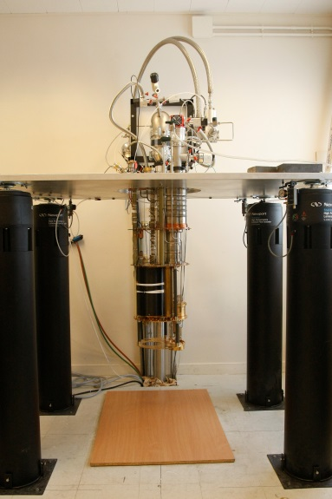
Fundamental Solid-State Physics
Techniques and collaboration networks
TECHNIQUES
Low-T (<1K) transport
High-frequency (GHz)
μ-fabrication (clean room)
ARPES & XPS
Focused Ion Beam & TEM
Numerical simulations
hν
ARPES
e⁻
COLLABORATIONS
France: LPS, ICMMO, Thales, C2N, SOLEIL, X, SPEC (CEA), NEEL, CRISMAT, LOMA
International: UCSD (San Diego), MagLab (Tallahassee), LANL (Los Alamos), Uni-Campinas (BR), CNEA (AR), DIPC (San Sebastián, ES), Uni-Würzburg (DE), Uni-Frankfurt (DE), Uni-Twente (NL), ISSP (JP), HiSOR (JP), Uni-Kyoto (JP), Bar-Ilan University (IL), Weizmann Institute (IL)…

Slide 12
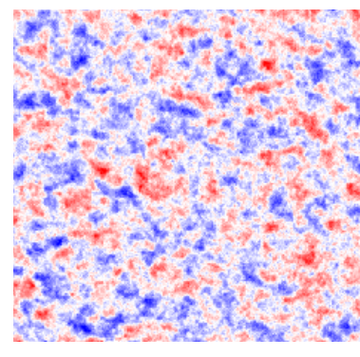
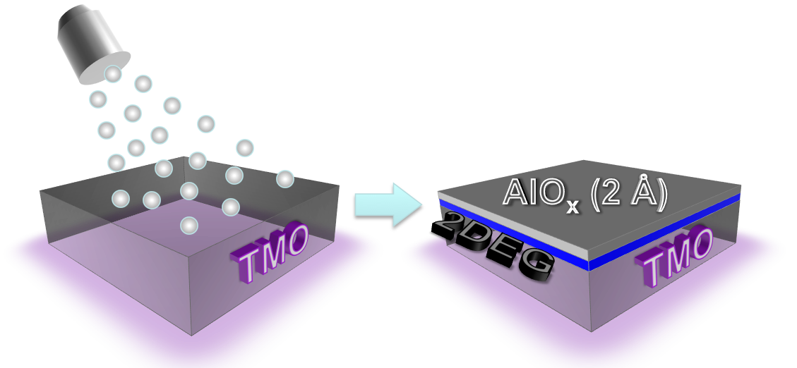
Research Highlights
Novel 2DEGs in transparent oxides
Tunable Superconductivity
Nano-magnetism
1 μm
Universal fabrication
Nature Mater. 13, 1085 (2014)
Nature Commun. 7, 11781 (2016)
Adv. Mater. 28, 1976 (2016)
Phys. Rev. App. 1, 51002 (2014)
J. App. Phys. 124, 213902 (2018)

Slide 13
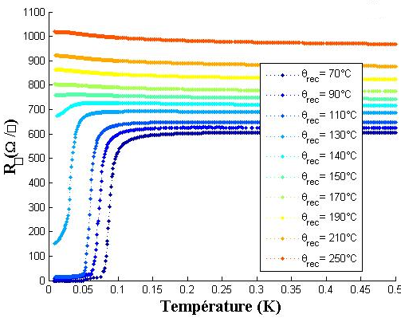
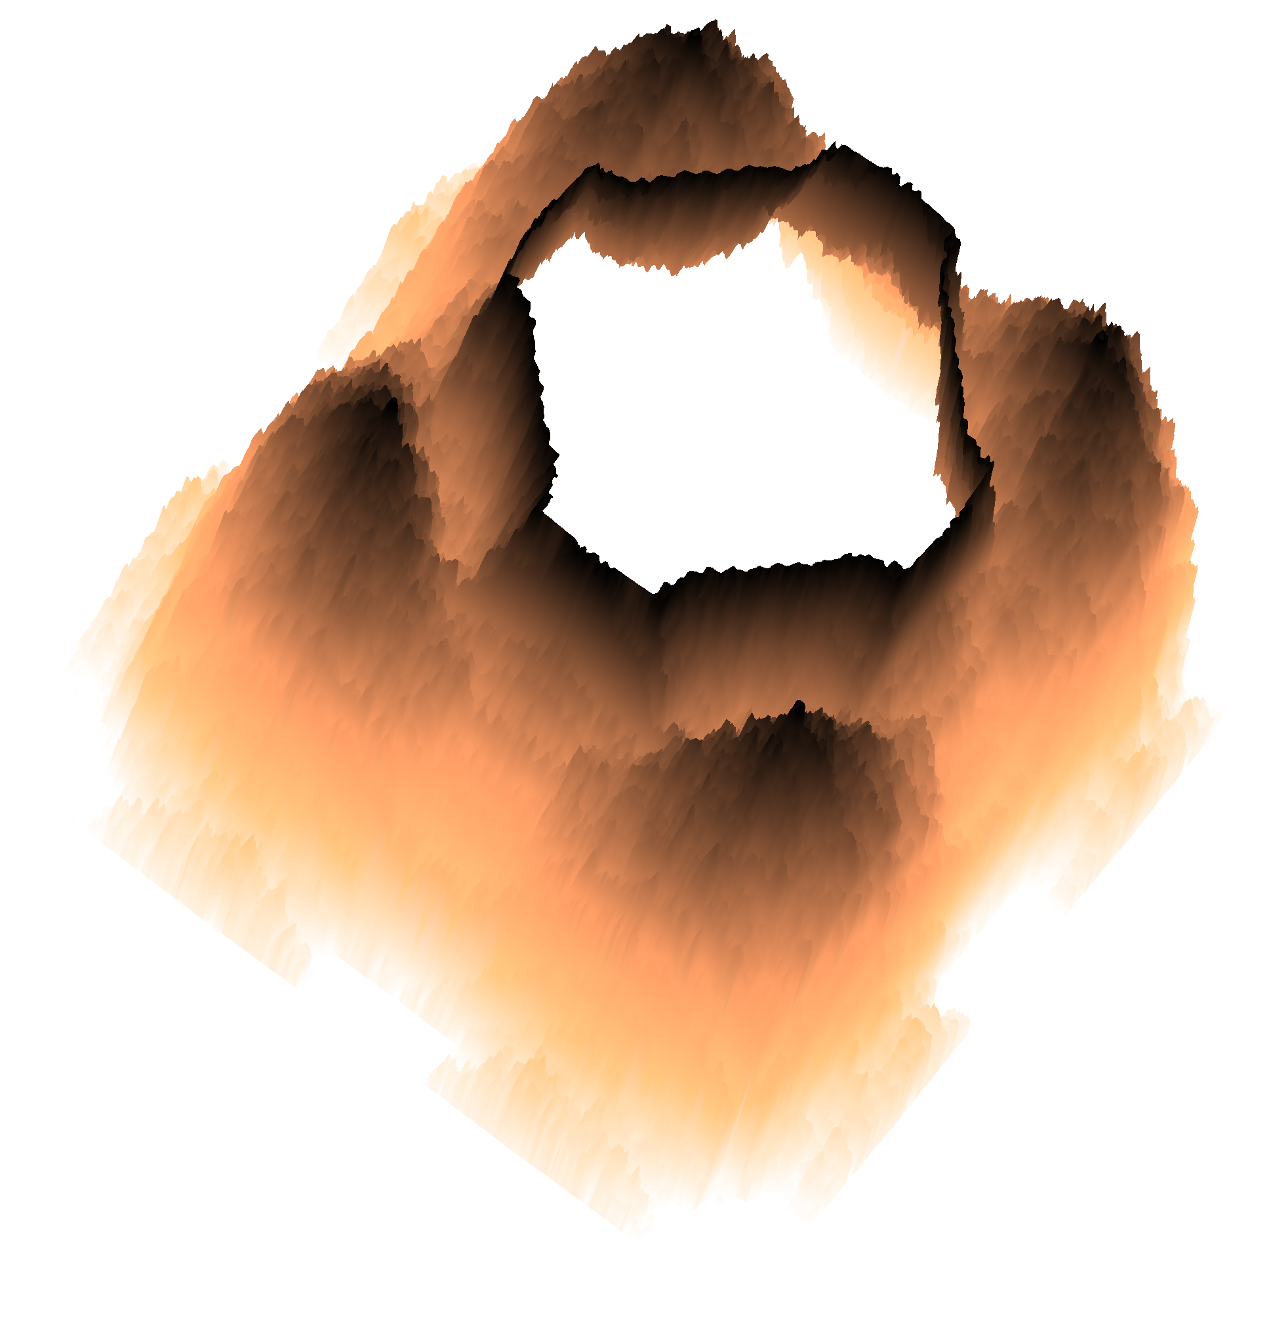
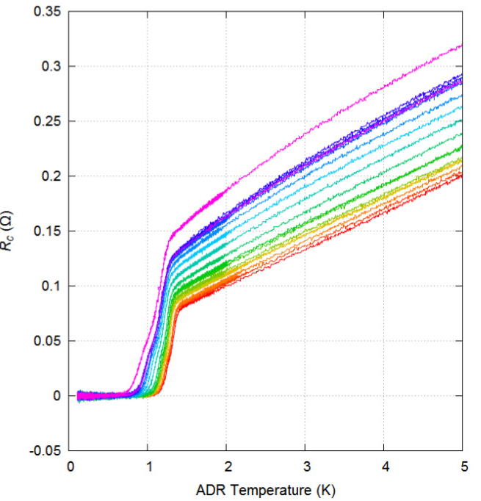
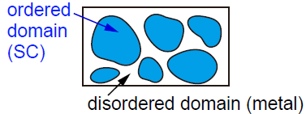
Research Highlights
Exotic classical and quantum phase transitions
a-NbSi: SC-Insulator transition
20K
1K
URu₂Si₂:
“Hidden-order” transition
Electronic granularity in organic superconductors
Nature Commun. 5, 4326 (2014)
Sci. Reps. 6, 35834 (2016)
PRB 97, 014521 (2018)
R (Ω)
T (K)

Slide 14
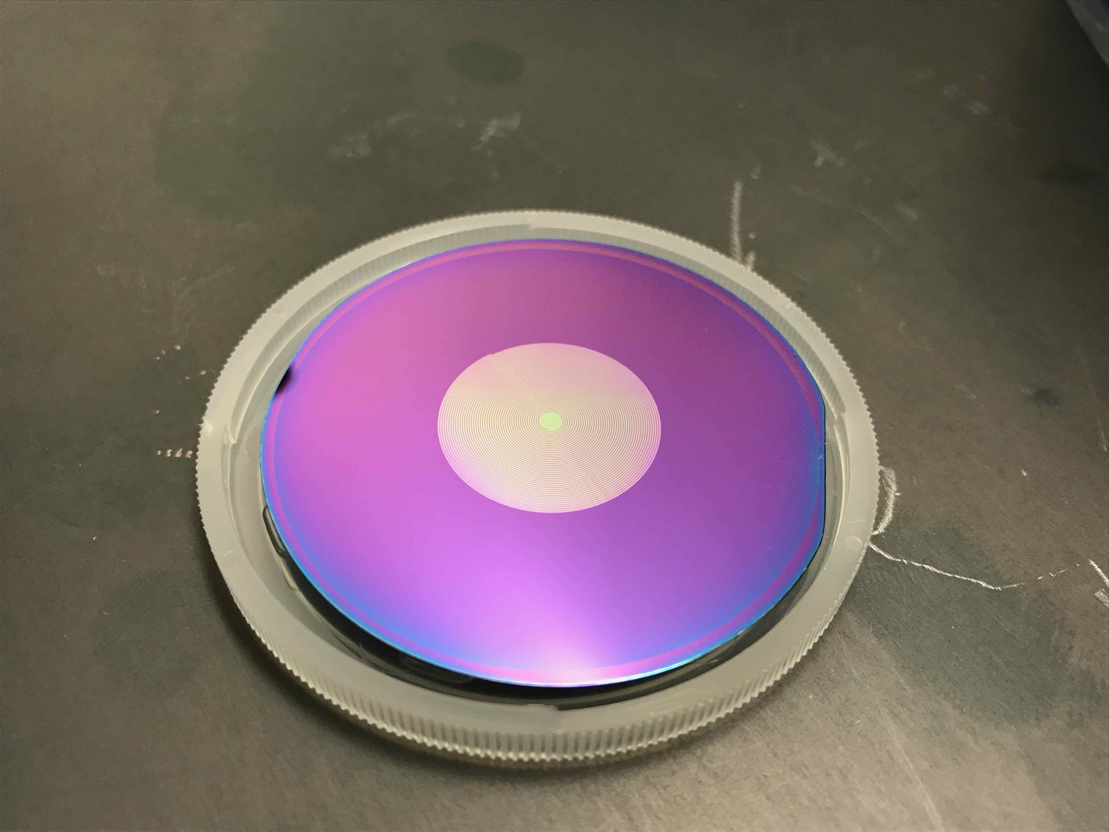
Research Highlights
Application of Condensed-Matter Physics to DETECTORS
20mm
Development of high- and low- impedance Transition Edge Sensors (TES)
→ Cryogenic sub-Kelvin detectors
→ Edelweiss, QUBIC and LUMINEU
Understand the electrodynamics of disordered superconductors and proximity effect multilayers:
→ Kinetic Inductance Detectors
→ High efficiency photon detectors
Modeling of radiation-matter interaction
→ Very low T bolometers
→ For Edelweiss experiment

Slide 15
Project 2019-2023
Correlated electron systems & ARPES
2D electron systems in correlated and functional oxides
  Aim 1: Realization of novel types of 2D electron systems in correlated oxides
  Aim 2: Exploration and tailoring of their electronic structure
  Aim 3: Study the interplay between 2D quantum confinement and spin-orbit interaction, correlations, and collective phenomena (e.g. superconductivity) in the properties of 2D electron systems in functional oxides.
Towards Applications
  Realization of (nano-)devices using 2DEGs in functional oxides.
Low-temperature (1K) & high-resolution (1meV) ARPES setup
  Setup and characterization of a laboratory ARPES machine (2D electron detection)
  He-free sample cooling down to 1K
  In-situ fabrication of samples (MBE)

Slide 16
Project 2019-2023
Exotic classical and quantum phase transitions
Quantum critical transitions in heavy-fermion materials
  Aim 1 : understand the relation between changes in electronic structure and symmetry breakings across a Quantum Phase Transition (QPT)
  Aim 2: explore experimentally the analogies between QPTs and problems in Cosmology (e.g., black holes)
Superconductor-to-Insulator transition
  Aim 1: settle long-standing controversy on the existence of 2D metallic states by specific heat measurements, tunneling measurements
  Aim 2: model systems for high energy physics problems. Universal behavior close to critical points in correlated systems
  a-NbSi, YSi, NbN, AlO_{x}/SrTiO₃
Exotic superconductivity
  Visual proof of granular superconductivity in clean crystalline samples
  Organic Superconductors (coll. LPS, Kyoto Univ., INSP)

Slide 17
Project 2019-2023
Application of Condensed-Matter Physics to DETECTORS
Development of very low energy threshold sensors:
  Essential for EDELWEISS and RICOCHET
  Single charge detection in massive Ge crystals
  Thermodynamic temperature fluctuations limited macro-bolometers
R&D on superconducting sensors for temperature and charge read-out :
  Out of equilibrium athermal phonon sensors
  Superconducting Single Photon Detectors technology for charge read-out
Modeling of radiation-matter interaction in cryogenic detectors for EDELWEISS:
  Aim: model charge collection with special reference to near-surface interactions, taking into account the phonon-wind-driven expansion of the electron-hole cloud generated by particle interaction (Steranka et al, PRL 53 2181 (1984)).
  Development of a dedicated code & comparison with experimental data
R&D on superconducting sensors for event discrimination (for CROSS) :
  Aim: surface event tagging thanks to superconducting thin films

Slide 18
Perspectives:
Teaching – Outreach – Valorization
Teaching :
  Continue our strong implication in the teaching and administrative activities of the Physics Department, from L1 to M2 and Doctoral Studies.
  Setup of a platform for lab-practices in photoemission
  Outreach :
  Realization of MOOCs on Condensed-Matter Physics and Correlated Electron Systems
  Valorization :
  Patents for devices using functional oxides

Slide 19
Perspectives:
Human resources
Researchers & Engineers:
  1 CNRS/Faculty: Compensate for the departure in 2019 of 1 CNRS researcher at the interface between condensed-matter research and applications to detectors.
  1 Research Engineer: Evolution of complex state-of-the-art equipment in ARPES and ultra-low temperature measurements.
Technical staff:
  1 Assistant Engineer/Technician: Maintenance of photoemission, transport and nano-fabrication instruments.

Slide 20
Expectations:
Funding
Local & National Funding :
  LabEx: 3-4 projects for PhDs, post-docs, and equipment (100-200 k€)
  ANR: 2-3 projects as Principal Investigators, 2-3 projects as partners
  PICS: 2-3 projects to continue our successful collaborations (Japan, Argentina) establish new ones (Brazil, Netherlands, Israel,…)
European & International Funding :
  ERC: Postulate to 1 Advanced and 1-2 Consolidator grants

Slide 21
STRENGTHS
High quality research (papers, invitations).
Successful in a large field of frontier subjects & techniques.
Worldwide recognition in our field.
Strong international collaborations.
Remarkable capability to attract funds at all levels (regional, national, European).
Numerous PhDs and undergrad trainees.
WEAKNESSES
Dilute manpower in the different projects.
Lack of a permanent young researcher expert in low-T detector technology and related astroparticle physics applications.
Only partial exploitation of the possible links among the particle-detector and the fundamental-solid-state-physics components of the group.
Scarce funding from IN2P3 for our basic-research activities (essentially SB only).
OPPORTUNITIES
Prospects to play a crucial role in major astroparticle and astrophysics projects.
Exploitation of basic research.
Strong potential for applications.
Frequent use of international large scale facilities leads to fruitful transversal collaborations.
Active participation in international review committees provides a deep view of the state-of-the-art research worldwide
THREATS
The fusion of the laboratories will dilute the representative power of the Solid-State Physics team.
Importance of keeping a research in fundamental Solid-State Physics, not subject to development of detectors.
Some of the fabrication techniques uniquely developed by us strongly rely on the know-how of just one researcher.

