Slide 1
“Future FNAL and CERN test beams”
LAL participation to UA9 2019-2024 workshop
LAL, France (12 March 2019)
Marco Garattini
CERN / Imperial College London
UA9 Collaboration
[In collaboration with L. S. Esposito (CERN-EN-STI)]

Slide 2
Outline
Scientific and technological program
FNAL test beams in 2020
CERN test beams in 2021-2024

Slide 3
Scientific and technological program
Test of LHC crystals
Test of big angle (long) crystals for double crystal experiment
Test of crystals for SPS extraction
Test of high-dose irradiated crystals
Test of focusing crystals
Test of MediPix detectors
Test of CpFM detector
Other proposals?

Slide 4
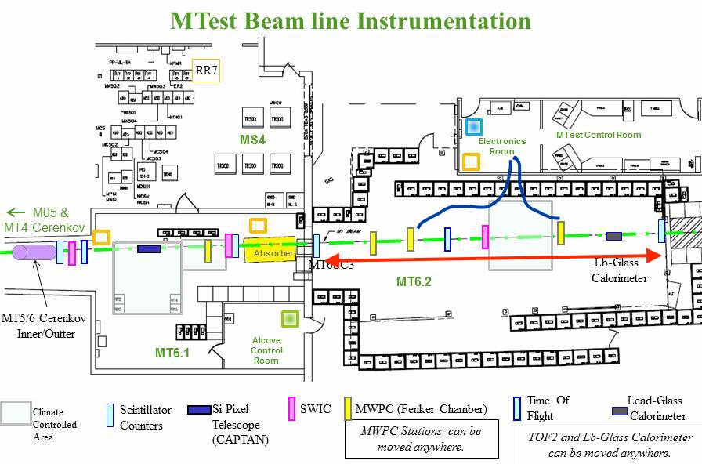
FNAL test beams
Available beam:
120 GeV protons (~1-300 KHz)
- Divergence = ???
- Dimension = ~5 mm (may be smaller)
Test beam time slots
2019: 2 surveys at FNAL
2020: test beams
2 weeks in January
2 weeks in June-July
Available area length ~ 20 m
Counting room
Access and safety courses:
- Some remotely on-line
- Some are frontal on site
~20 m
Beam area

Slide 5
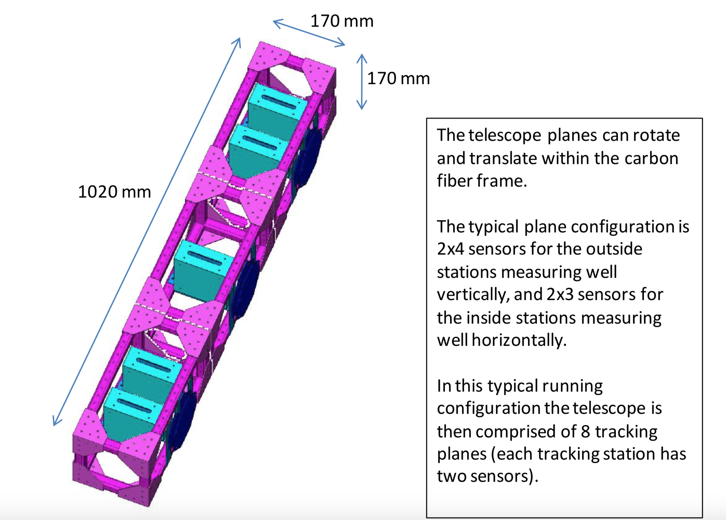
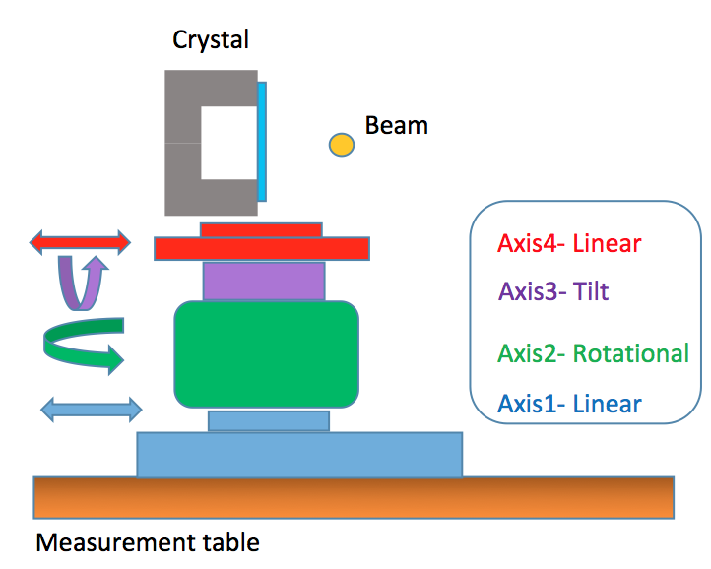
Basic instrumentation
TELESCOPE
PLAN A (FEASABLE)
FNAL CMS-like telescope to be adapted for:
Distances of silicon strip planes
(from ~1 m to ~20 m)
UA9 H8 DAQ system from ICL
PLAN B (DIFFICULT)
transport our H8 Telescope to USA
4 AXIS GONIOMETER
The old H8 gonio is not working perfectly
PLAN A: buy a full new gonio (~47 KCHF)
(it will be useful also from 2021 at CERN)
PLAN B: repair the old one (difficult)

Slide 6
Main issues to face for FNAL
Financial resources (pending…)
Technical feasibility (good!)
People availability (to be discussed…)
Almost sure the Russian colleagues absence (big problem!):
No Russian crystal experts on site
No crystal alignment experts
At least 2 shifter operators less

Slide 7
CERN H8 test beams
Same scientific and technological general program, but it depends on what we will be able to do at FNAL
Starting from 2021
To be requested to CERN management
(SPSC approved or MD-like)
Standard configuration + new goniometer

Slide 8
Thank you for your attention and hope to see you on the beam lines !!!

