Slide 1
Timepix and Timepix3 installations in SPS for monitoring of crystal channelled BEAM
F.Murtas, J. Alozy, P.Burian, A.Natochii,
R. Seidenbinder & W.Scandale
Ua9 experiment layout 2017 and 2018
Timepix vs Timepix3
Mode of acquisitions and linearity
Physics measurements
Future programs

Slide 2
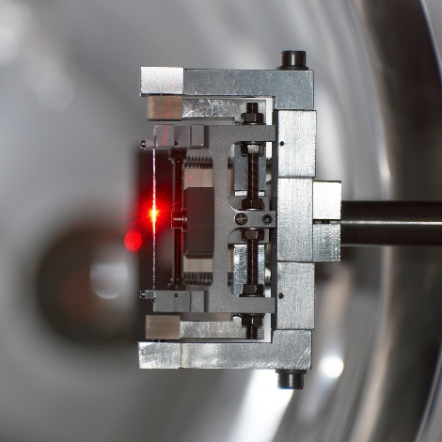
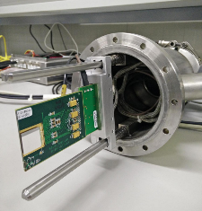
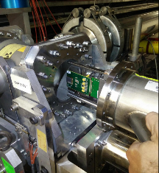
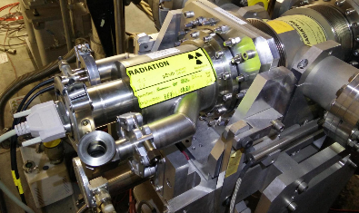
The UA9 SPS experimental setup 2017
~ 50 m
~ 43 m
~ 85 m
2 Timepixes
Crystal
1 2
Crystal
3 4
Collimator
Graphite 1m
RP1
RP3
Beam Pipe
QF 52210
QF 52010
QD 52310
Primary Beam
QD 52110
Absorber
W 60cm
Absorber
W 100cm
IHEP
GONIO1
IHEP
GONIO2
Collimator
Graphite 1m
RP1
CpFM
RP3
BLM
BLM
BLM
BLM
BLM
BLM
BLM
M
L
B
1 new Timepix
3 Timepix installed inside the beam pipe in secondary vacuum Roman Pot

Slide 3
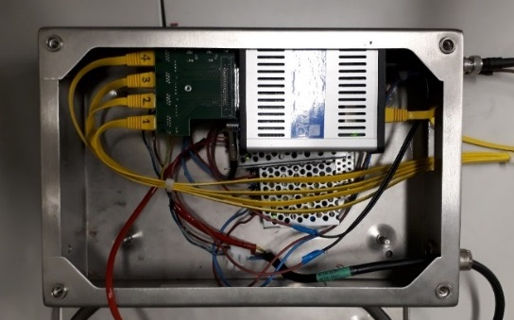
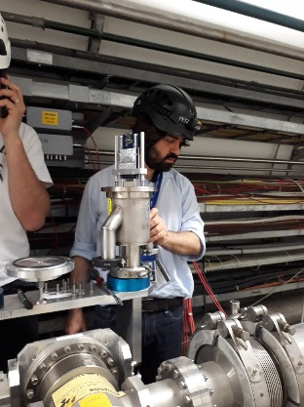
The UA9 SPS experimental setup 2018
~ 44 m
~ 6 m
~ 43 m
~ 85 m
Crystal
1 2
2 Timepixes
Crystal
3 4
Collimator
Graphite 1m
1 Timepix3
2 Timepixes
RP0
RP1
RP3
Beam Pipe
QF 52210
QF 52010
QD 52310
Primary Beam
QD 52110
Absorber
Absorber
W 60cm
Absorber
W 100cm
IHEP
GONIO1
RP0
IHEP
GONIO2
RP1
CpFM
RP3
BLM
BLM
Collimator
Graphite 1m
BLM
BLM
BLM
BLM
BLM
M
L
B
1 Timepixes
We doubled the number of Timepix detectors
A third Roman Pot was installed on
January 2018 with 2 Timepixes
A new Timepix3 has been installed in June
on Roman Pot 1 external side
Katrine readout of Timepix3
(P. Burian)

Slide 4
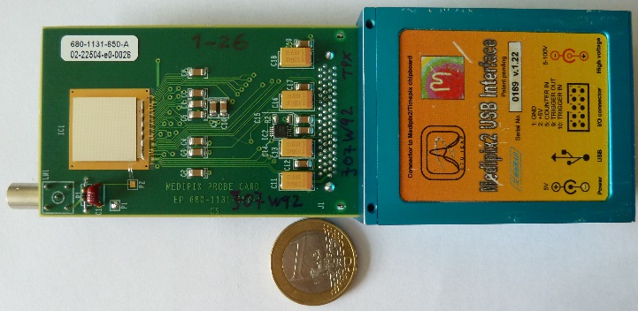
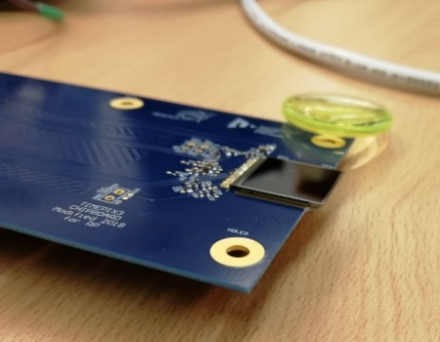
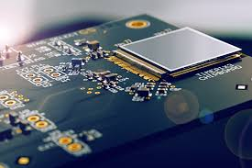
Timepix family
Timepix :
Time frame oriented
Counting mode or
Time of arrival or
Charge
Dead Time
> 5 keV
10 ns resolution
kB/s
Timepix3
Pixel oriented
Counting mode and
Time of arrival and
Charge
Continous measurement
> 3 keV
1.5 ns resoution
MB/s
High Temperature
Timepix2
Pixel oriented
Time frame oriented
?
?

Slide 5
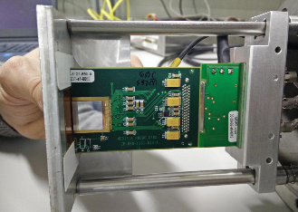
The UA9 detectors : Timepix
Based on silicon sensor 300 μm thick
About 20 readouts per seconds
  200 μs with 20 ns resolution or
  2 ms with 200 ns resolution
Cluster reconstruction offline (was online in 2016)
Synchronized readout with SPS Radiofrequency
We have five assemblies installed with 14x14 mm² active area (2 cm²)
2 Timpixes on Roman pot #0 (after the first Gonio crystals 1 and 2 image of the channeled beam)
1 Timepix on Roman pot #1 (after the second Gonio crystals 3 and 4 image of the double channeled beam)
2 Timpixes on Roman pot #3 (dispersive area for extracted beam image)
The detector is read in ToA (Time of Arrival) to measure the particle flux versus time
with a memory of 10 or 100 beam turns and Medipix mode for a high statistic images.
Rate of 10-20 fames per second with dead time (can be improved )

Slide 6

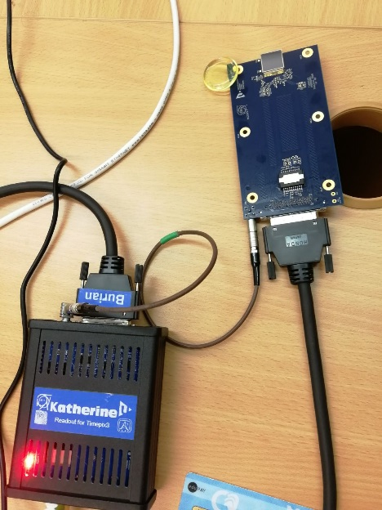
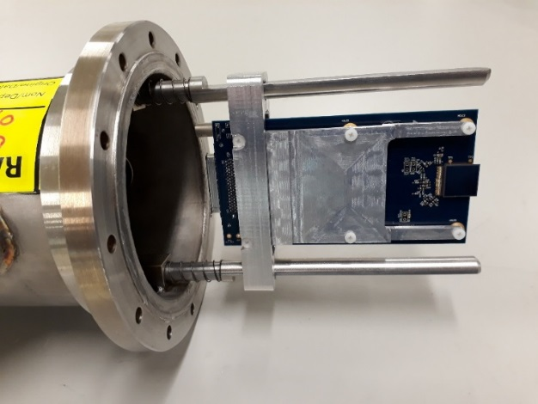
The UA9 detectors : Timepix3
Based on silicon sensor 300 μm thick 14x14 mm² active area (2 cm²)
Chips provided by Medipix Collaboration
Timepix3 board designed and built by University of West Boemia and IEAP in Prague
Also the holder was realized by the same group
designed also for the chip heat extraction
Data acquisition with time frame and continuous
  1.56 ns resolution
  charge and time at the same time
Possibility to read the beam without dead time
(Data Driven Mode)
Petr Burian (Technical Coordinator)
Pavel Broulím (HW designer)
Lukáš Pušman, (mechanics designer)
Benedikt Ludwig Bergmann (data evaluation)
holder
Timepix3 data acquisition system

Slide 7
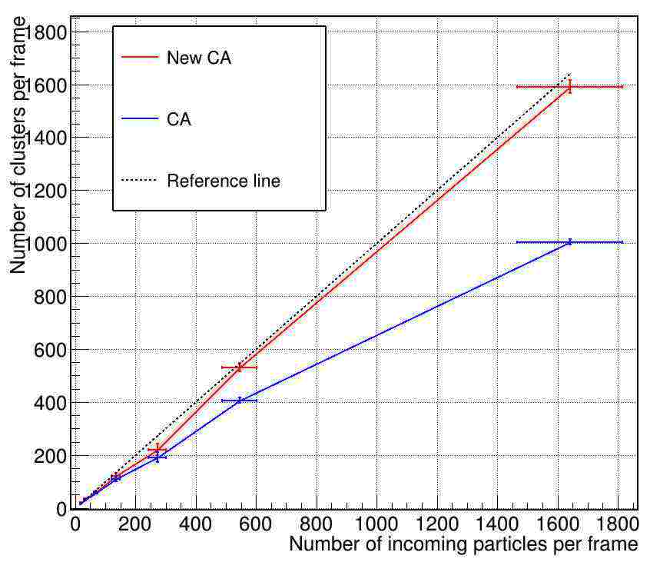
Timepix linearity with new Cluster Analysis
In ToT mode we measure the total charge but the OLD Clusters Analysis fail
increasing the time window
ToA mode
In ToA mode we take only first hit of the pixel but we recognize better the clusters
Saturation limit for CA:
~ 600 p/frame
A. Natochi 2017

Slide 8
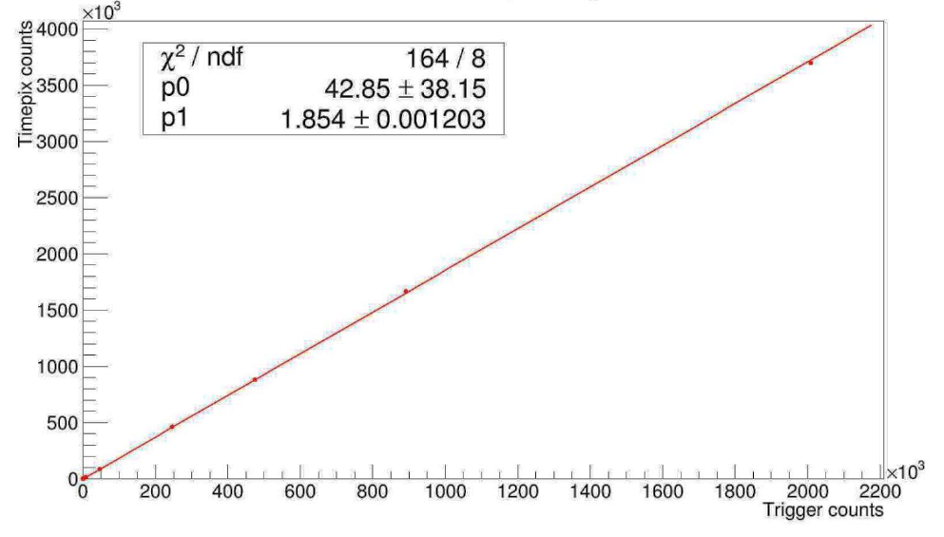
Counting mode linearity
H8 run
Pion beam May 2017
A. Natochi 2017
256
~1.85 pixels per particle
Timepix integrated counts in the pixels (Medipix mode) vs trigger counts. Without CA.
With Timepix3 we’ll have the three modes at the same time !

Slide 9
Physics Measurements

Slide 10
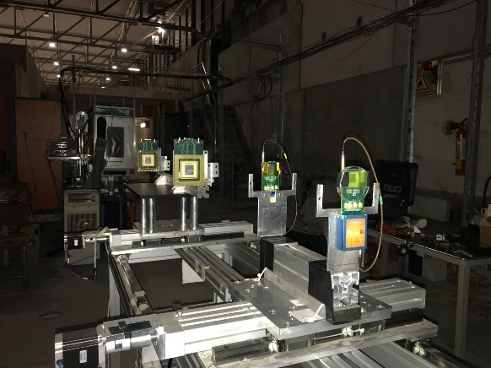
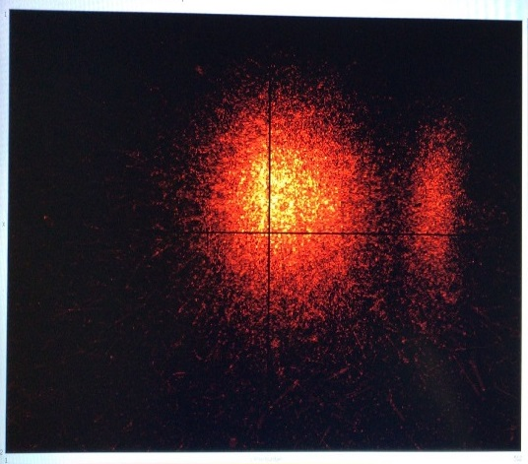
Timepix telescope for crystal tests
We have used two quads and two timepix as telescope
for measurements with track reconstruction using the ToA mode.
The telescope was 100 meters from the crystals
The result are comparable with the CMS tracker used up to now
This is the image of main and the channeled beam
produced by the crystal on test.

Slide 11
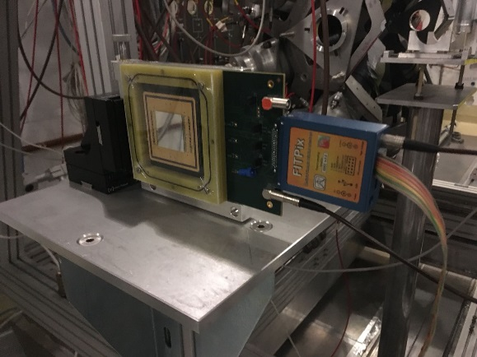
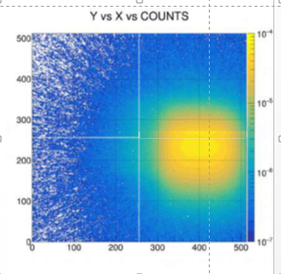
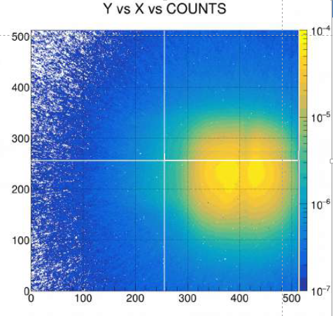
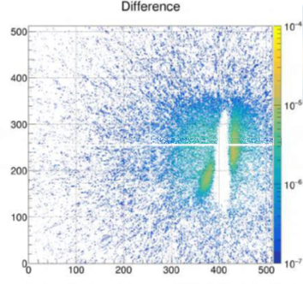
TimepixQuad detector for test on beam extraction
Without any object
on the beam
Crystal in VR
+ septum
subtraction
We have used two quads as beam monitor near the crystals
in counting mode for studies on beam extraction
Image subtraction
Volume
Reflection
Chanelling
F.Murtas, A. Natochi, W.Scandale

Slide 12
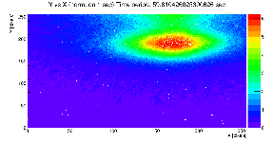
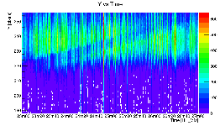
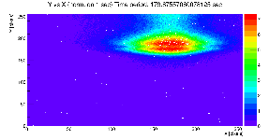
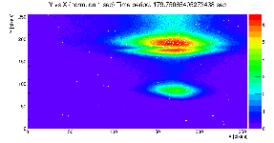
Double Channelling seen by Timepix in UA9 2017
Beam Characteristics :
Single bunch
Intensity 1.2 10¹¹ p/bunch
Momentum 270 GeV/c
User LHCMD3 Qh =20.13 Qv= 20.18
Vertical
14mm
Main
Beam
On October 17th double crystal experiment was performed :
a second crystal was inserted in the channeled beam
Horizontal 14mm
2nd crystal shadow
on channeled beam
2nd crystal shadow
set for channeling
Horizontal 14mm
2nd crystal shadowduring insertion
Time
2nd channeled beam
Horizontal profile vs time
F.Murtas, A. Natochi, W.Scandale

Slide 13
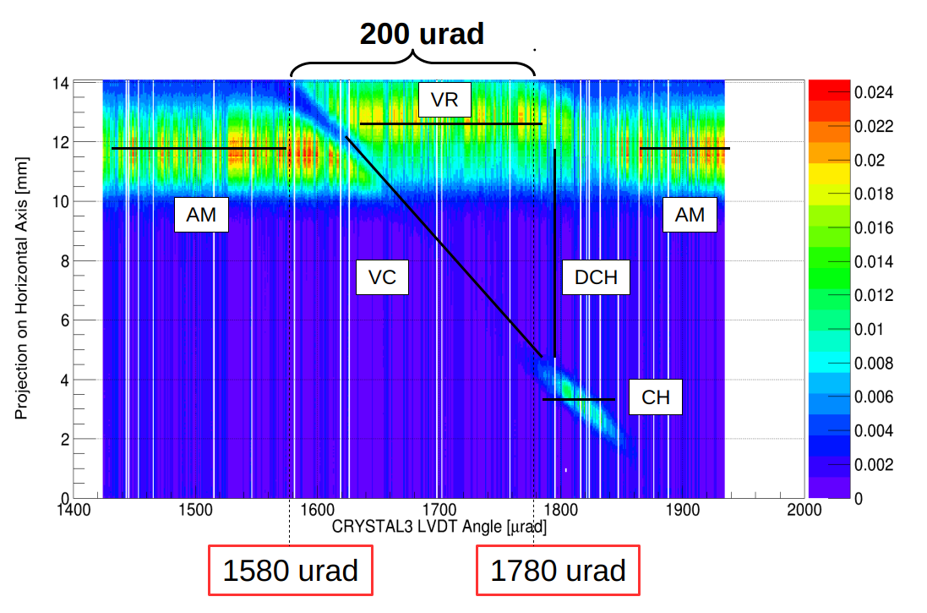
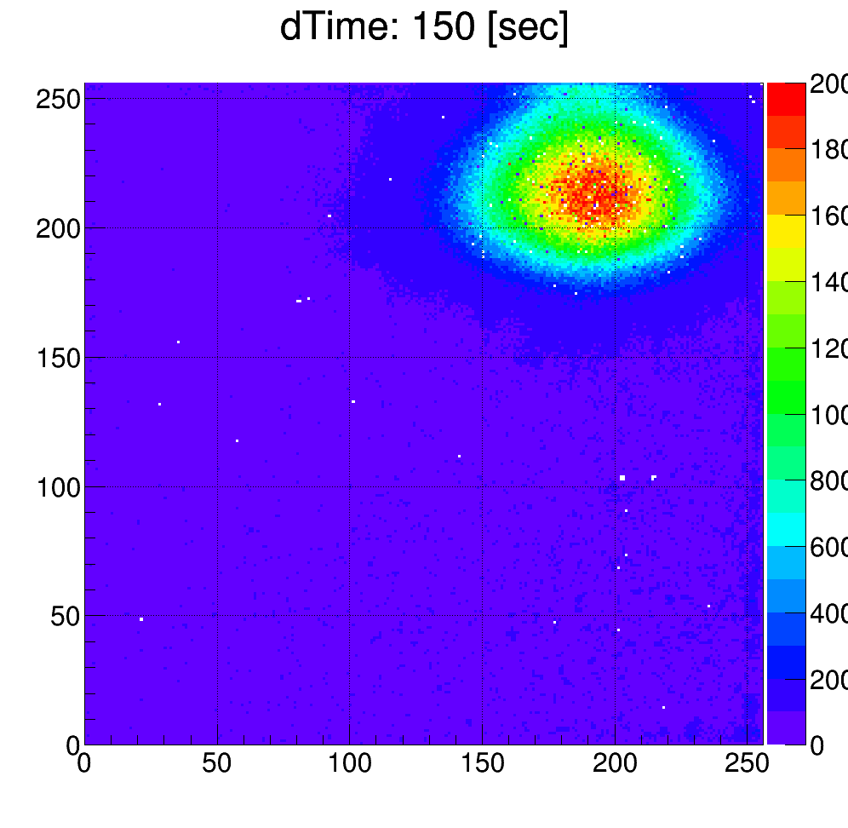
Double Channeling in 2018

Slide 14
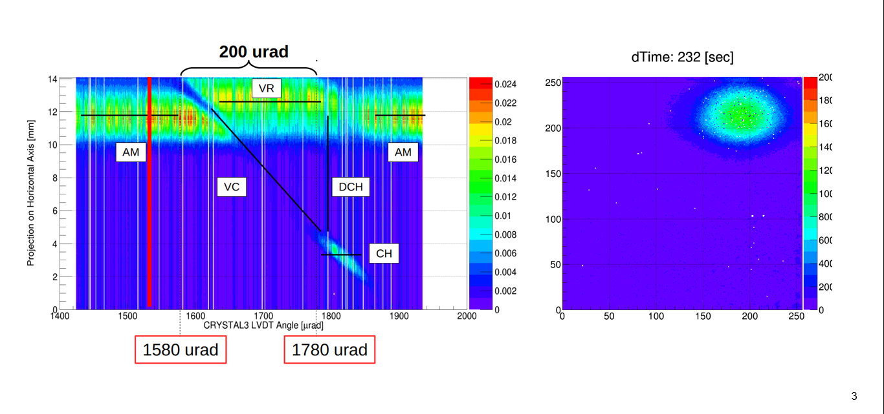
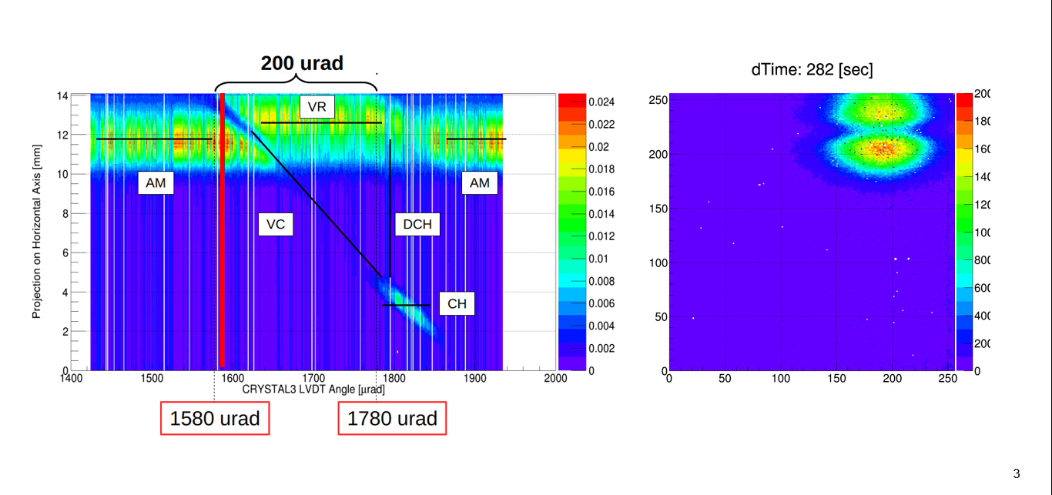
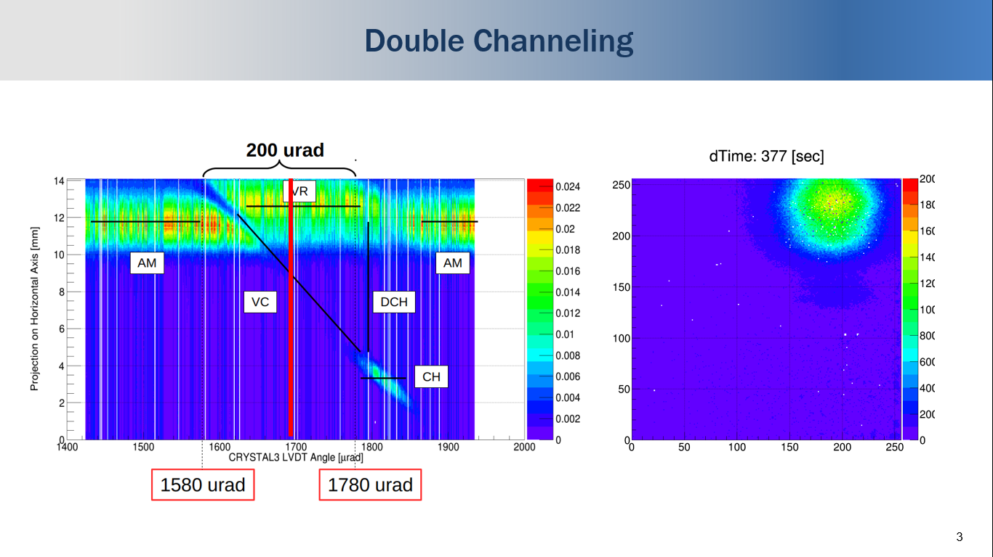
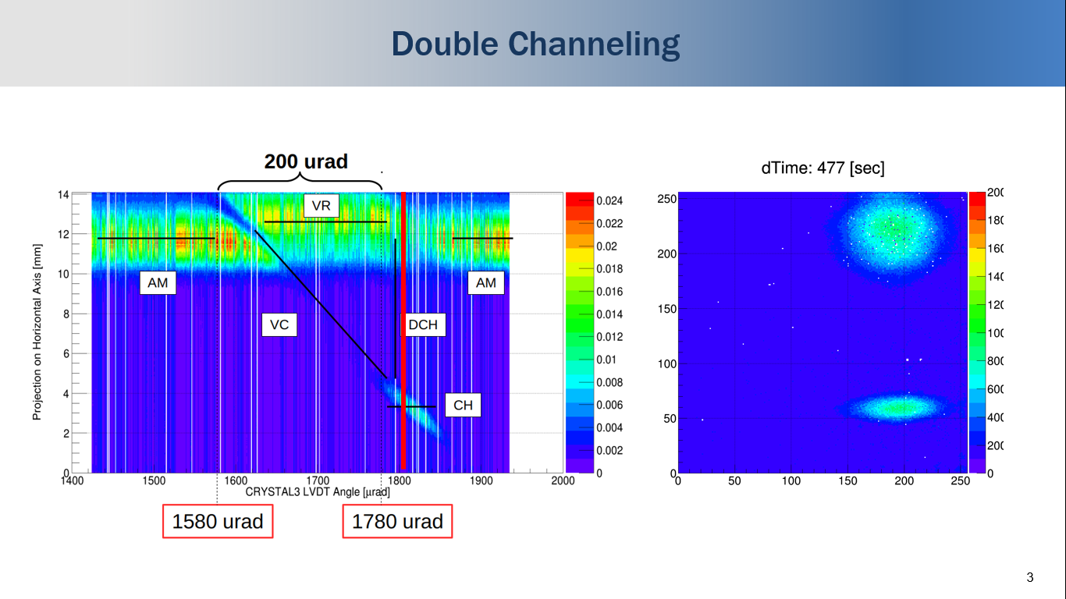
Double Channeling in 2018

Slide 15
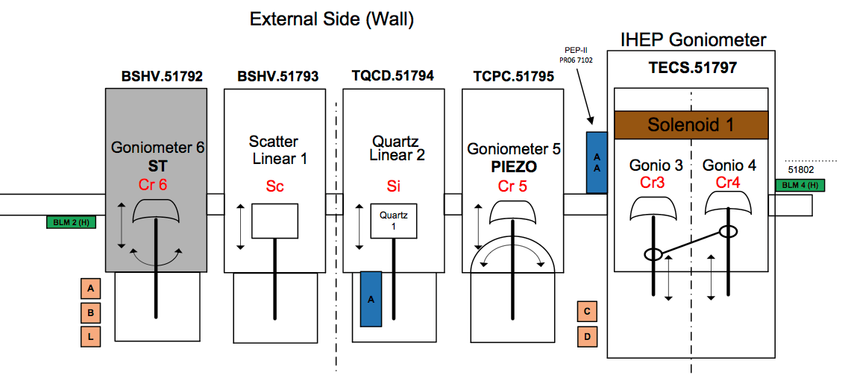
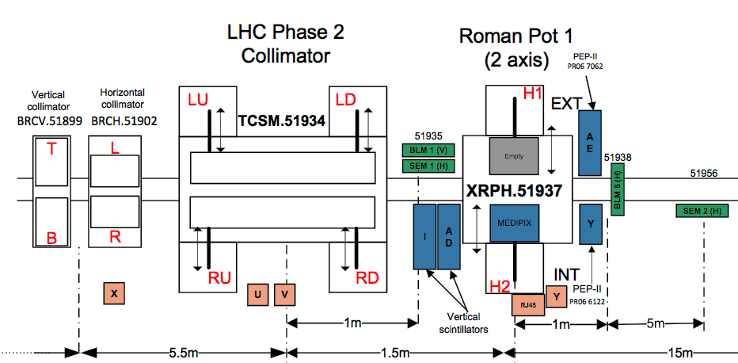
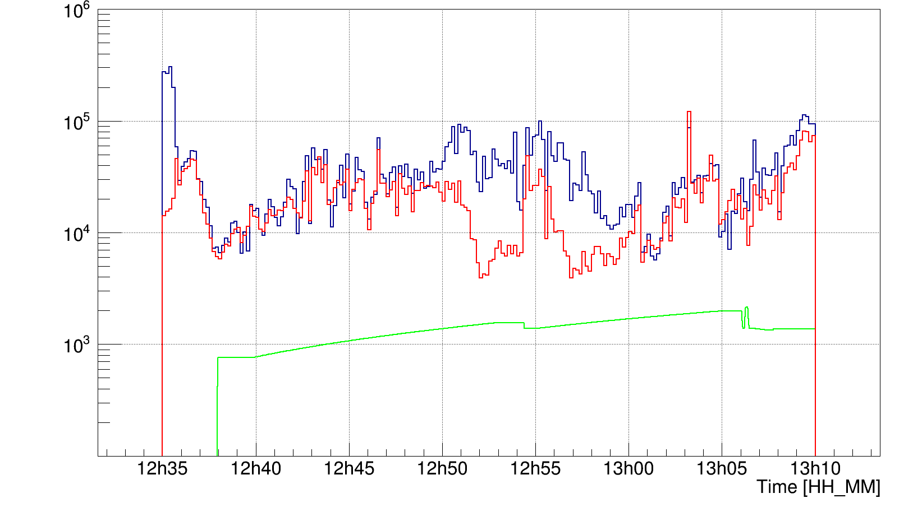
Timepix & BLM Correlation
Crystal4 (angle in urad)
BLM4 (number of counts)
Timepix (number of fired pixels)
During angular scan with a crystal we confirmed a
good correlation between Timepix and BLM counts.
The only difference which was observed in
the special crystal position is related to
channeling orientation of the crystal.
For BLM it's counts of losses and for
Timepix is deflected beam.
But it still keeps the same behavior (Magenta circles).
Thus one can use Timepix detector
also like Beam Loss Monitor.
Angular scan with Crystal 4
CH

Slide 16
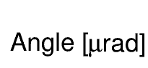
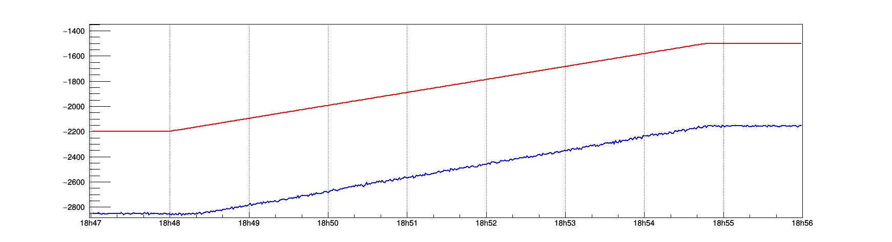
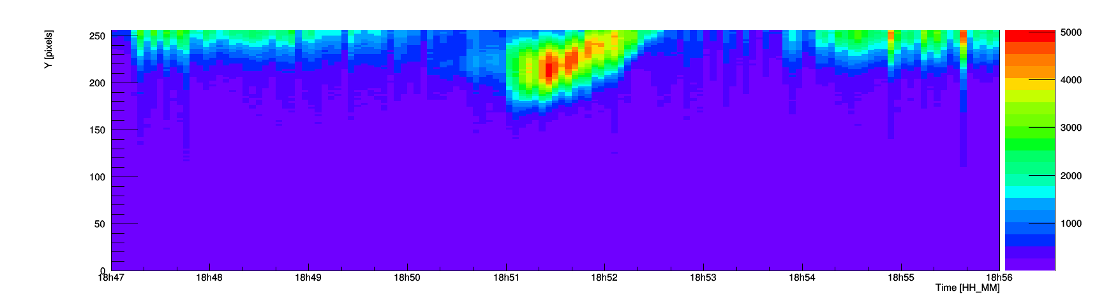
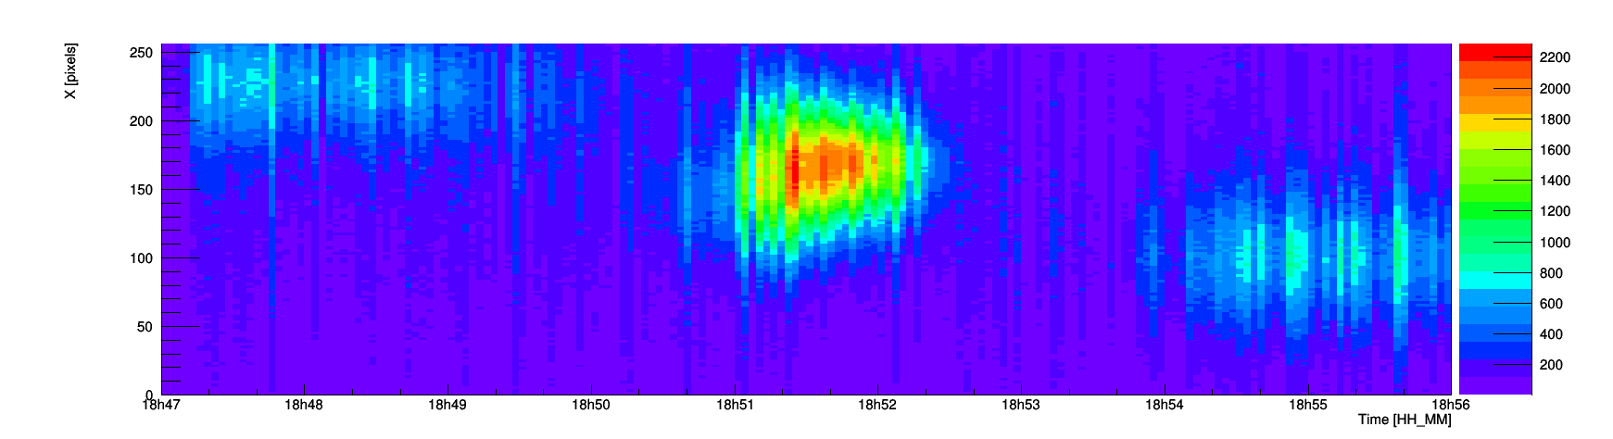
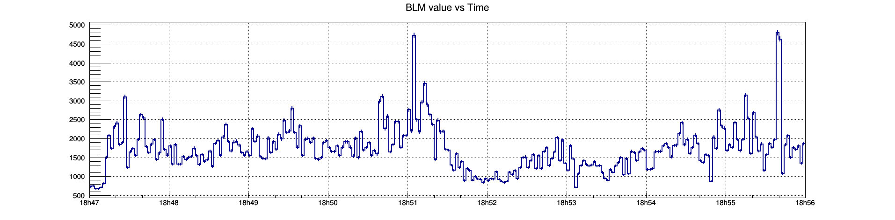
Skew planes for QM crystal 2
CRY2
Angular scan with Crystal 2
ADT: switch = ON,
gain = 10%
CTRL
LVDT
Position RP1_INT:
35.5 mm
Horizontal axis
Skew plane 1
Main plane
Skew plane 2
Vertical axis
BLM3 counts

Slide 17
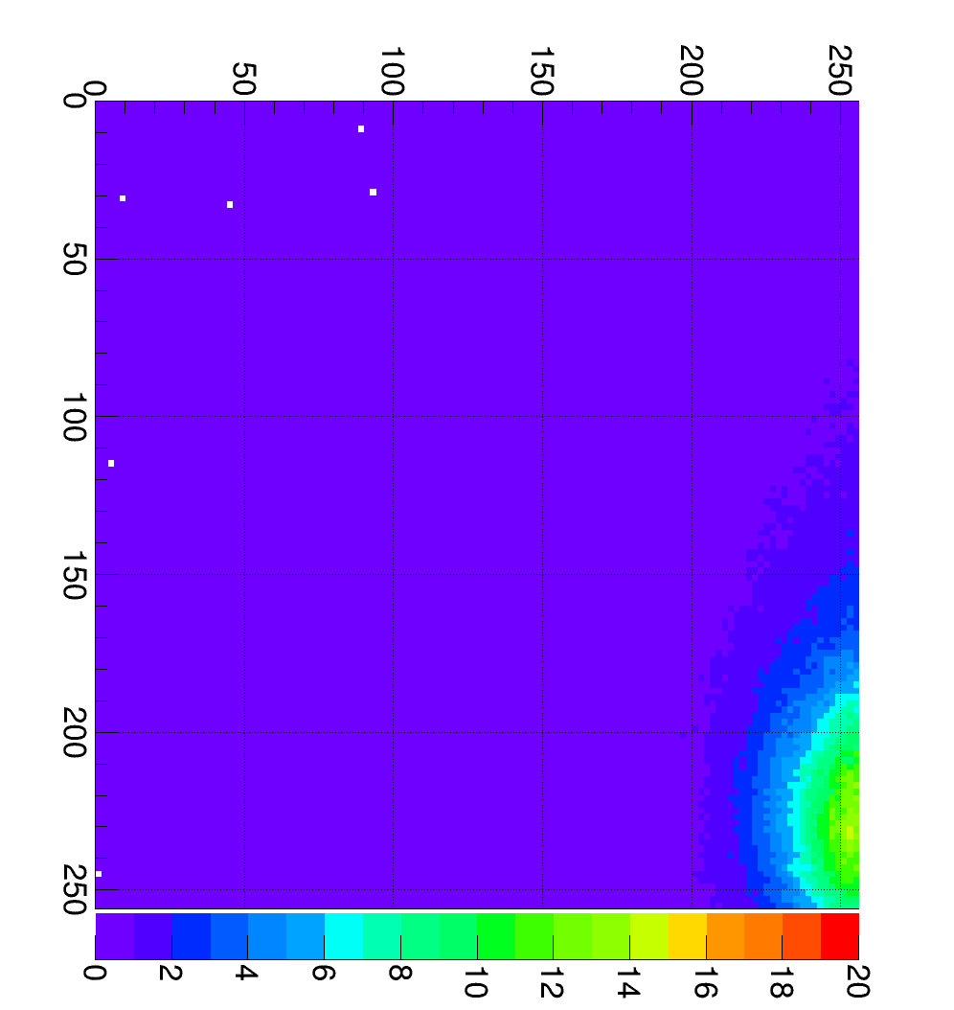
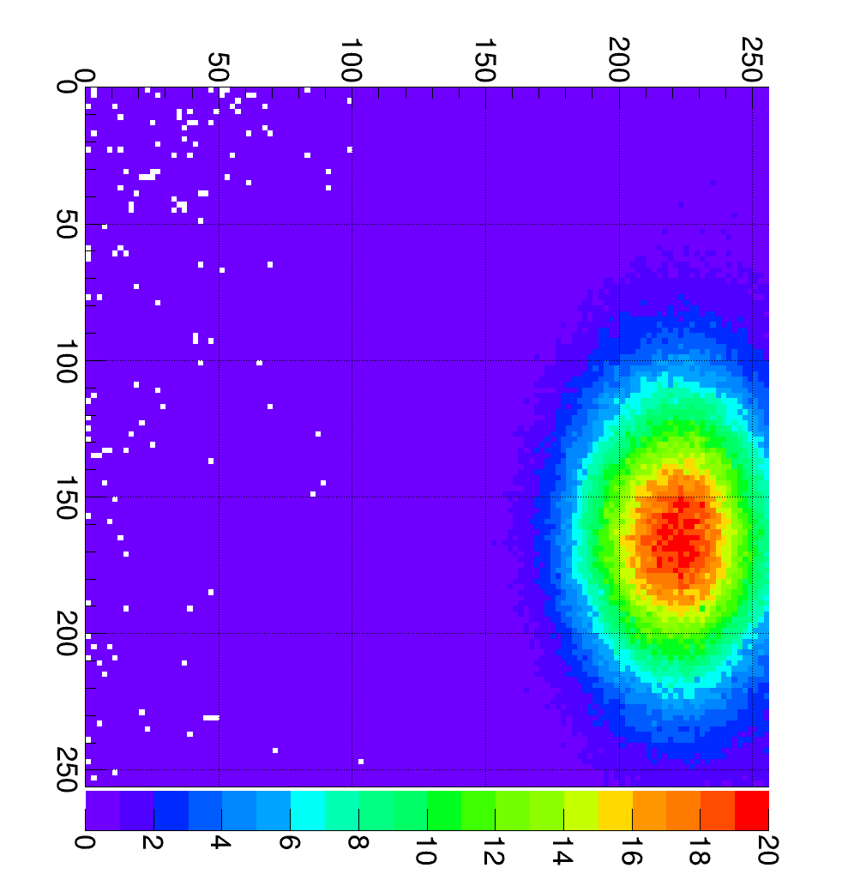
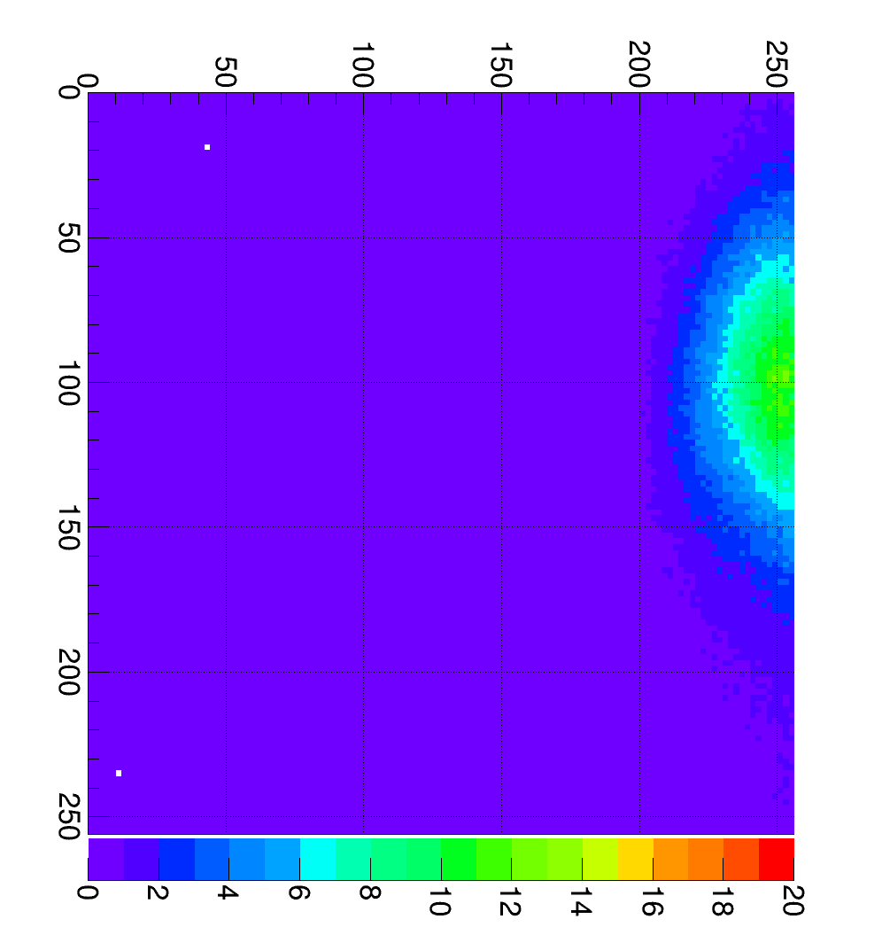
Skew planes for QM crystal 2
During angular scan with QM crystal were observed three different positions of the deflected beam.
Each spot correspond to different deflected planes of the crystal.
65 pixels
[3.575 mm]
35 pixels
[1.925 mm]
65 pixels
[3.575 mm]
Crystal orientation:
[-2200;-2100 urad]
Crystal orientation:
[-1900;-1800 urad]
Crystal orientation:
[-1600;-1500 urad]
Vertical axis
Vertical axis
Vertical axis
Skew plane 1
[2 minutes]
Main plane
[1 minute]
Skew plane 2
[2 minutes]
Normalized on 1 sec
Normalized on 1 sec
Normalized on 1 sec
Horizontal axis
Horizontal axis
Horizontal axis

Slide 18
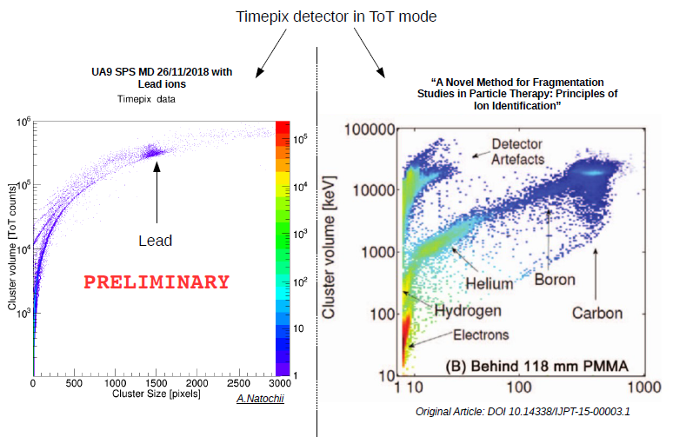
Measurements of fragments with Timepix3

Slide 19
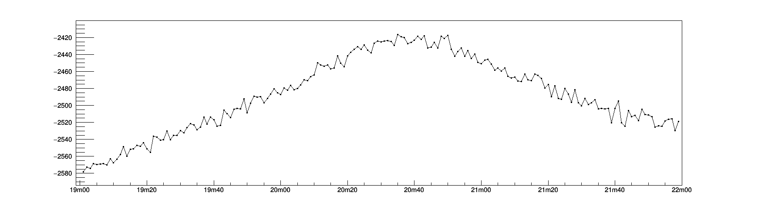
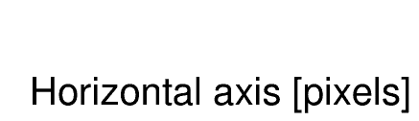
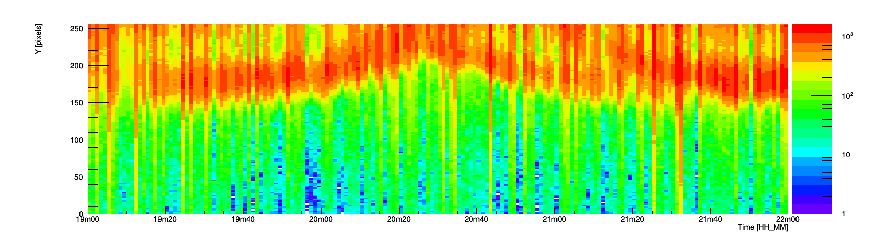
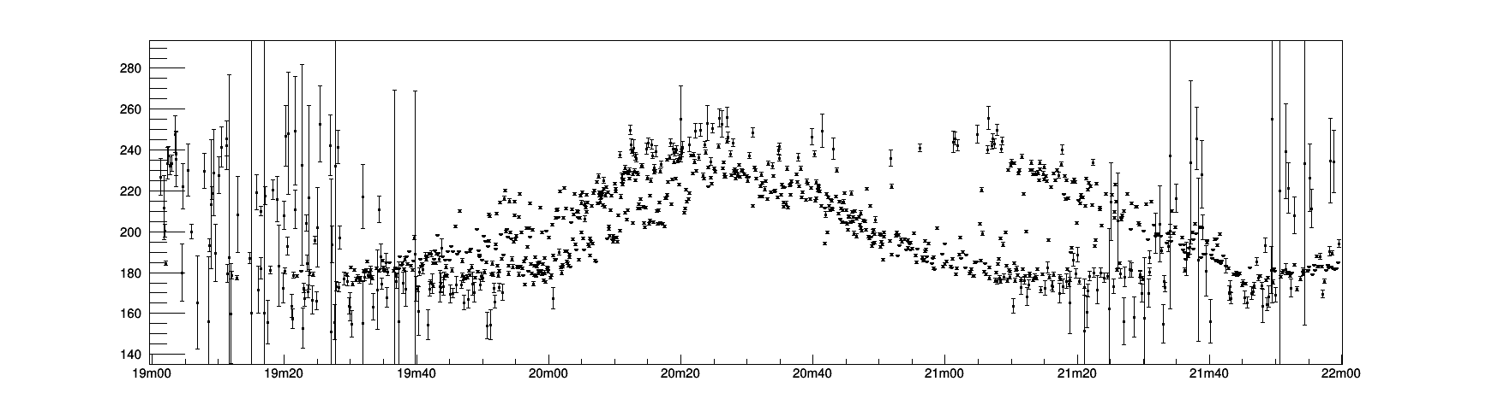
Goniometer vibrations
CRY2 Angle LVDT [urad]
Upstream Goniometer
1.5e-6 rad/sec
Angular scan with Crystal 2
Projection of the frame on the horizontal axis
Jumping amplitude
is around 1.0 mm
Jumping amplitude
is around 3.3 mm
Beam spot position
in horizontal direction
[pixels]
Forward movement of the goniometer
Backward movement of the goniometer

Slide 20
Future program

Slide 21
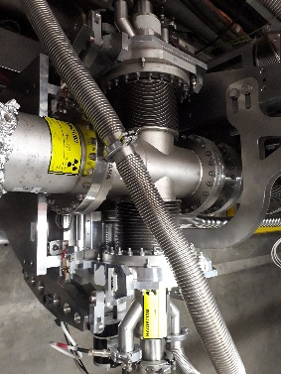
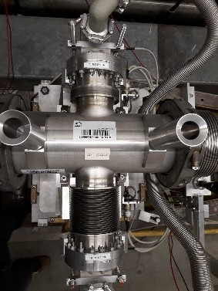
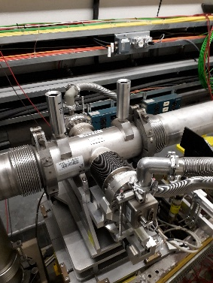
New Roman Pot for Timepix3
10 m
220 V PS
Katherine box
Timepix3 cable
RP
TTL trigger
Timepix3 PS 5V
2 optical data out
2 optical data out
Timepix3 BIAS
1 remote switch
1 new Roman Pot with position control (Regis-Calviani) about 30 keuro
The new Roman Pot will be designed to allow :
replace current Roman Pots with different mechanical characteristics
fast detector insertion to reduce the installation time
more reliability on detector alignment
RP0
RP1
RP3
Two possible active area : 14x14 mm² and 28x28 mm²
If the wider area is needed the roman pot should
be designed for both solutions

Slide 22
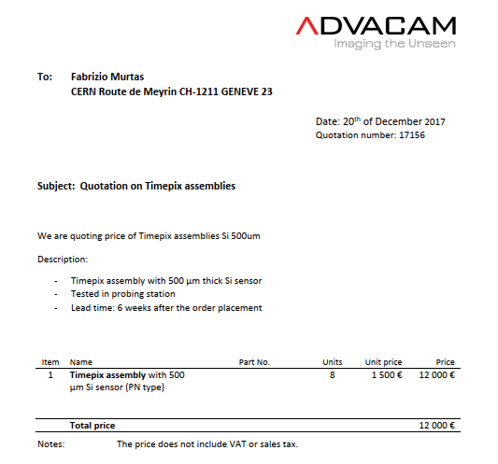




Detector Timepix3
Timepix3 Asic 0.3 keuro
Timepix3 silicon sensor 1.5 keuro
Timepix3 wirebonding 0.1 keuro
Timepix3 board 0.5 keuro
Timepix3 holder 0.5 keuro
Cables and connector 0.3 keuro
Kateherine DAQ 2.0 keuro
Radiation hard PS 5V 0.1 keuro
Eth- optical interface 0.1 keuro
Katherine box and connector 0.5 keuro
Cable Katerine - Timepix3 0.1 keuro
Total 6.0 keuro

Slide 23


Detector Timepix3 quad
Timepix3 Asic 1.2 keuro
Timepix3 silicon sensor 3.0 keuro
Timepix3 wirebonding 0.4 keuro
Timepix3 board+mezzanine 0.8 keuro
Timepix3 holder 0.5 keuro
Cables and connector 0.3 keuro
Eth- optical interface 0.1 keuro
Kateherine DAQ 2.0 keuro
Katherine box and connector 0.5 keuro
Radiation hard PS 5V 0.1 keuro
Cable Katerine - Timepix3 0.1 keuro
Total 9.0 keuro

Slide 24



New Timepix3 board and Roman Pot Layout
No pcb behind the chip

Slide 25





Diamondpix : a radiation tollerant detector
Made by Element6 and Fraunhofer IZM
Gold cathode on diamond
upward surface
Pads on diamond
downward surface
Timepix3 Pads
Two Diamondpixes have been tested on
charged and neutron beam for future applications.

Slide 26



Timepix3 in LHC ?

Slide 27
Summary
Timepixes (Timepix, Timepix3, Quads, Diamondpix )
show good performances in high intensity beam monitoring.
They have been installed successfully and they provide useful information on beam characteristics and they become important for future project.
The design of new Roma Pot is in progress (CERN and LNF).
Some studies on new radiation tolerance sensor and readout devices are in progress
with the Medipix collaboration, Pilsen and Prague colleagues
Improvement on firmware, acquisition software, offline analysis
and radiation tolerance are fundamental

