Slide 1
The Gamma Factory: Tools made from Light
Based on material from the following people with particular thanks to Witold Krasny

Slide 2
Contents
Introduction
Ions in LHC
Gamma Factory Principles
Progress
Gamma Factory Applications
Next steps - Proof of Principle
Conclusions

Slide 3
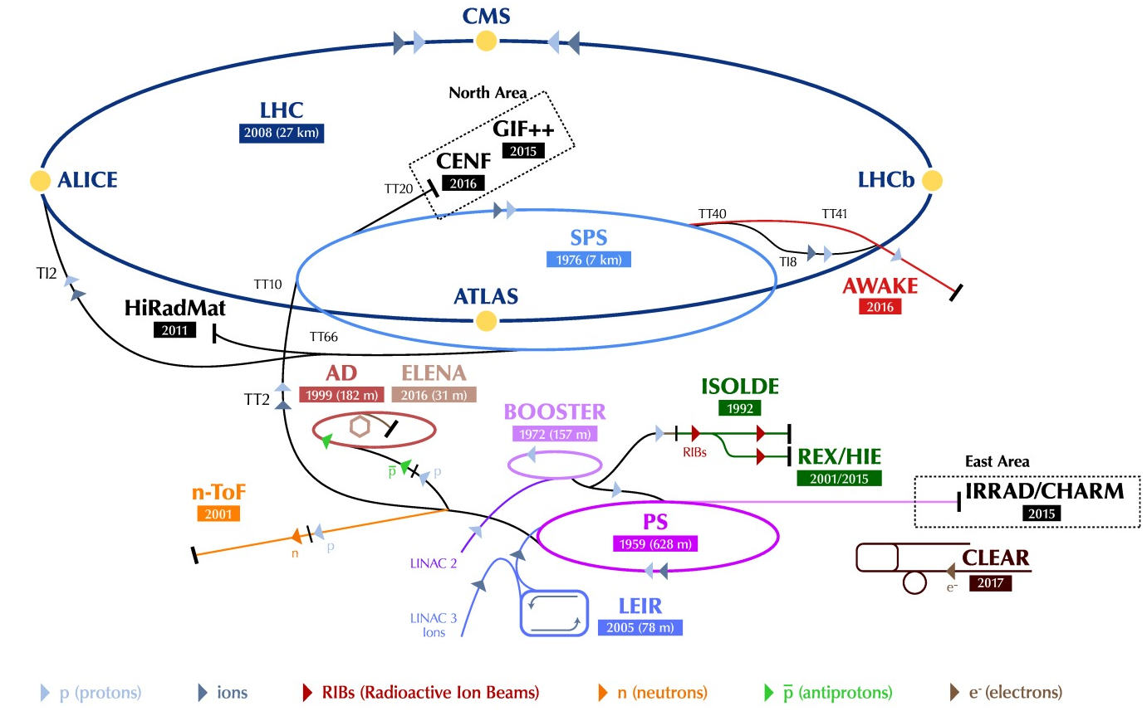
CERN Complex
LINAC 4

Slide 4
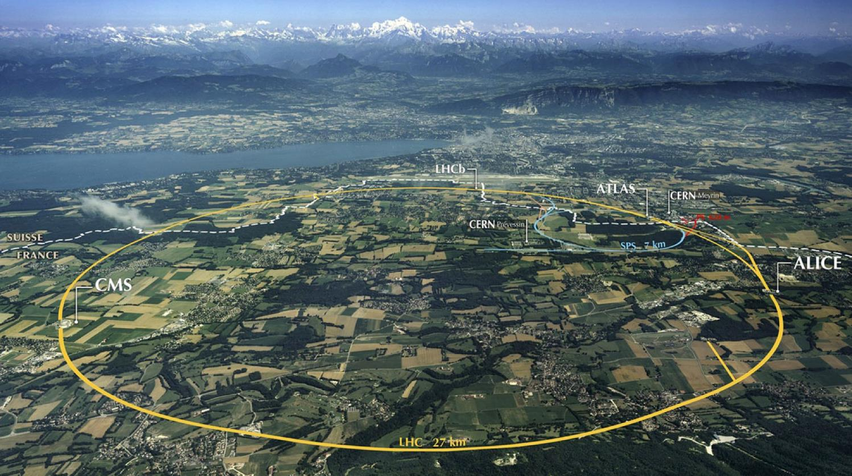
LHC: big, cold, high energy
Collimation
Injection B2
Beam dumps
Injection B1
Collimation
RF: 8 s/c cavities/beam
1720 Power converters
> 9000 magnetic elements
7568 Quench detection systems
1088 Beam position monitors
~4000 Beam loss monitors
150 tonnes helium, ~90 tonnes at 1.9 K
~350 MJ stored beam energy
1.2 GJ magnetic energy per sector at 6.5 TeV

Slide 5
Ion production at CERN
Electron Cyclotron Resonance (ECR) ion source (2005)
  Provides highest possible intensity of e.g. Pb29+
RFQ - Linac3
  Accelerate to LEIR injection energy
  Strip to Pb54+
LEIR (2005)
  Accumulate and cool Linac3 beam
  Prepare bunch structure for PS
  Accelerate to PS injection energy
Main clients: NA61, LHC (ATLAS, CMS, ALICE, LHCb, LHCf)

Slide 6
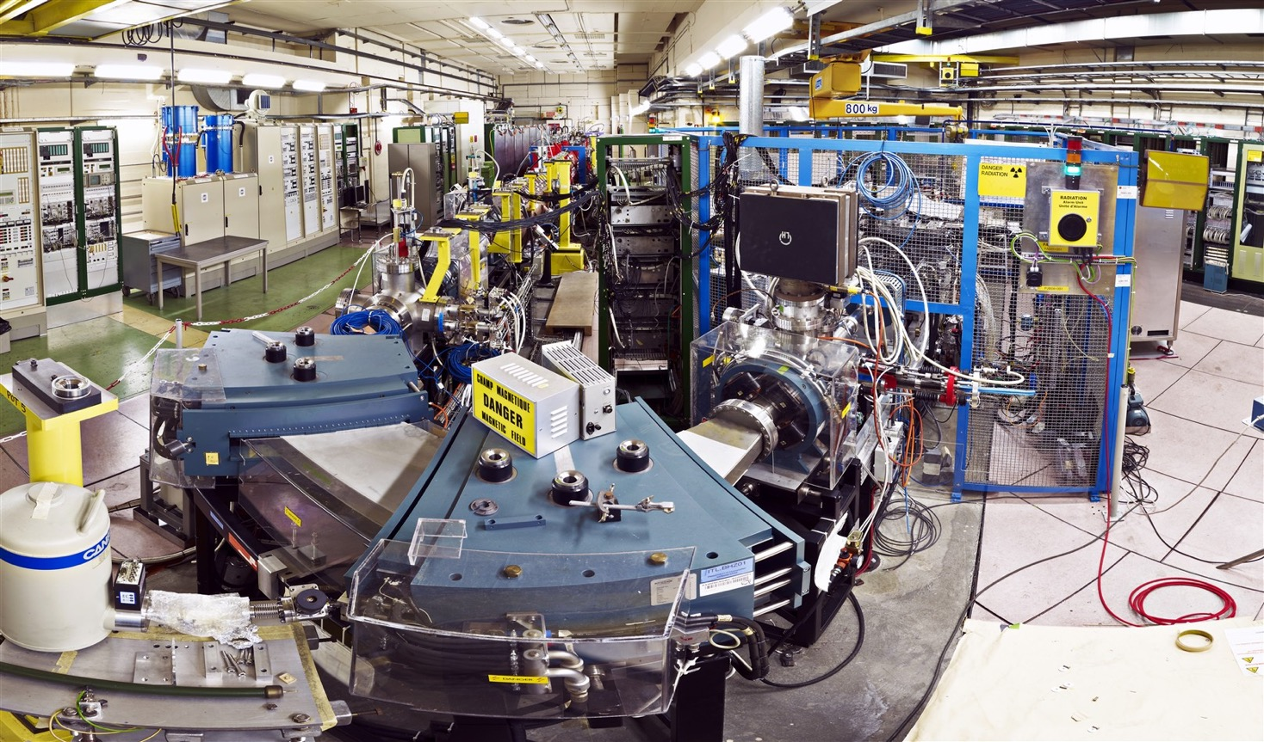
Linac3
Stripping foil Pb29+ ➔ Pb54+
Stripping Efficiency is 20%
Interdigital-H (IH) linac 4.2 MeV/nucleon
Pb29+ 2.5 keV/nucleon
RFQ

Slide 7
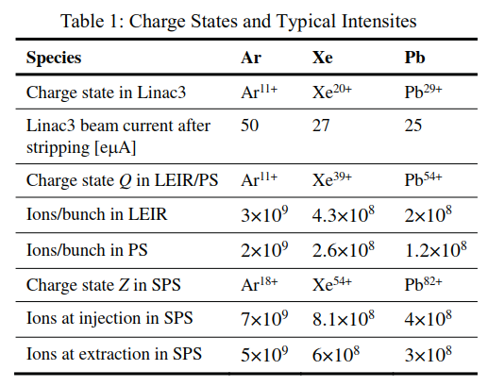
Species to date
Oxygen incoming

Slide 8
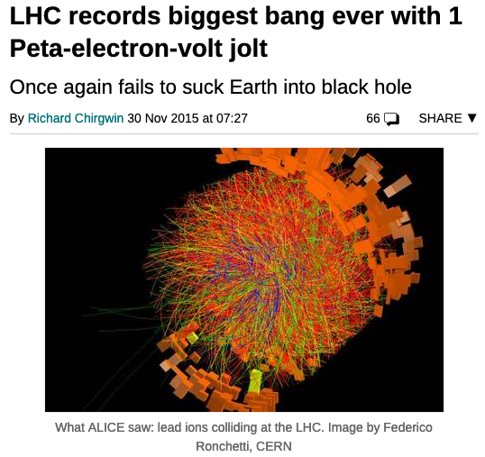
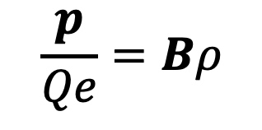
Ions in the LHC
$$\frac{p}{Qe}=Bρ$$
Momentum of fully stripped Pb: 7.0 Z TeV/c = 574 TeV
Centre of mass energy = 1.148 PeV

Slide 9
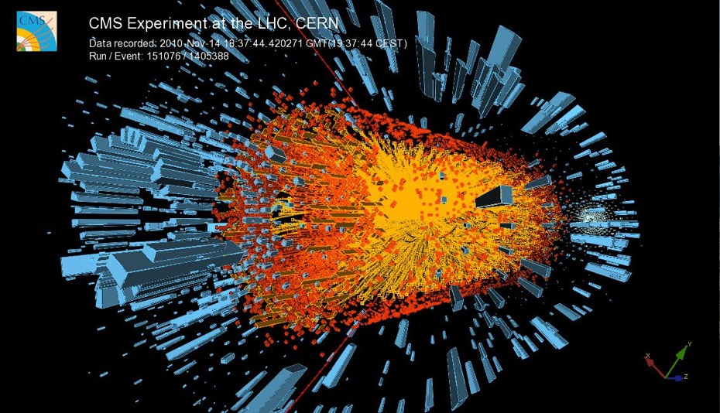
LHC Ion Program
So far:
Lead-lead
Proton-lead and vice versa
Xeon-xeon (16 hours)
Partially Stripped Ions (MD)

Slide 11
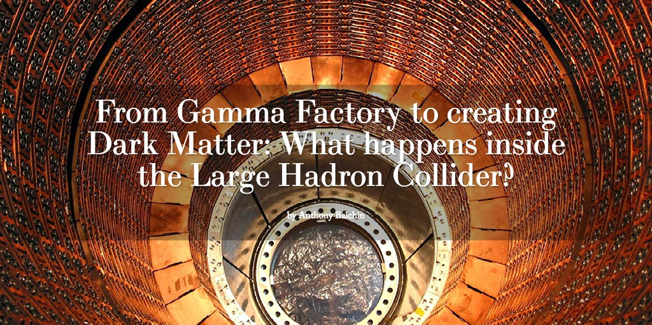
Gamma Factory Principles

Slide 12
The idea
Replace an electron beam by a beam of highly ionised atoms (Partially Stripped Ions - PSI)

Slide 13

Enjoy relativistic magic twice
Spontaneous de-excitation of the ion produces a photon - angular distribution isotropic in the ion frame.
Boosting back to the lab frame:
• the emitted photons are concentrated in a small angle ≃ 1/γ in the forward direction of the ion beam.
• the angular frequency ω′′ of the photon propagating back along its incoming direction is boosted by another factor 2γ such that:
Optical photon of angular frequency $ω$ travelling against the PSI is boosted in the ion frame

Slide 15
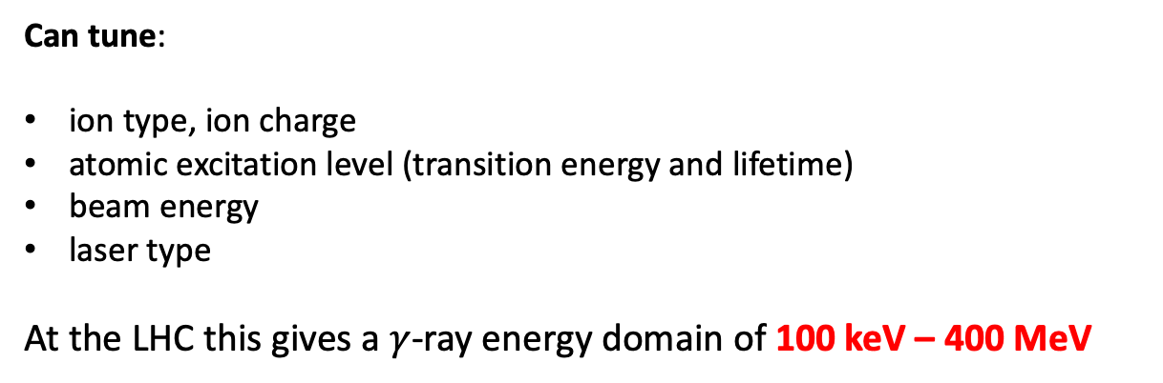
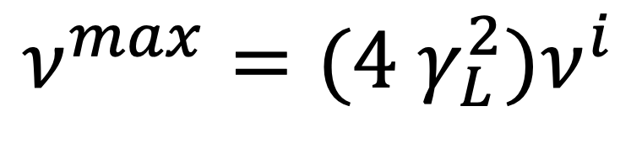
PSI beam as a frequency converter
$$ν^{max}=(4{ γ}_{L}^{2})ν^{i}$$
Can tune:
ion type, ion charge
atomic excitation level (transition energy and lifetime)
beam energy
laser type
At the LHC this gives a $γ$-ray energy domain of 100 keV – 400 MeV

Slide 16
Example: H-like Xe (1s -> 2 p)_{1/2}

Slide 17
Cross-section
The cross-section for the resonant absorption of laser photons by the atomic systems is in
the giga-barn range cf. the cross-section for electrons which is in the barn range.
→ Expect each atom to undergo ~4 excitation/de-excitations per beam/laser crossing
As a consequence the PSI-beam-driven light source intensity could be higher than those of the electron-beam-driven facilities by a significant factor.
For the light source working in the regime of multiple photon emissions by each of the beam ion, the photon beam intensity is expected not to be limited by the laser light intensity but by the available RF power of the ring in which partially stripped ions are stored.
For example, the flux of up to 10¹⁷ photons/s could be achieved for photon energies in the 10 MeV region already with the present 16 MV circumferential voltage of the LHC cavities.

Slide 18
Basic ingredients for:

Slide 19
Start to worry about…!
Beam dynamics
  effect of energy loss/turn to photons
  beam lifetime
  transverse longitudinal heating/cooling
  induced cooling
Interaction of laser with beam at interaction point
  momentum spread in the beam
  wavelength, power
  overlap
  maintaining a high level of excitation

Slide 20
Energy loss
Stable ion beam, even in the regime of multi-photon emission per turn.
The source intensity is driven by the power of the RF cavities (and sufficient ions).
However, the effects of small losses can mount up!

Slide 21
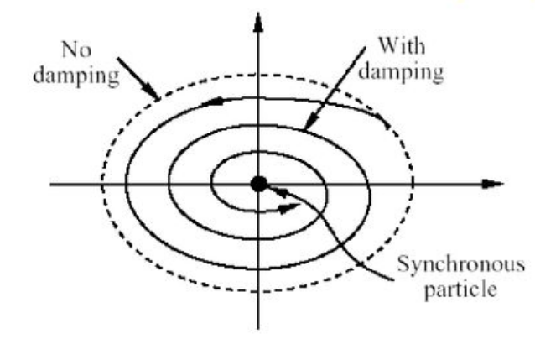


Effect of radiation on ion beam dynamics
Transverse cooling: all components of ion momentum are lost due to the photon scattering but only the longitudinal component is restored in the RF cavities.
Longitudinal heating: because energy loss per emission is stochastic
Longitudinal cooling: if energy loss grows with ion energy
$$Δt$$
$Δ$E

Slide 22
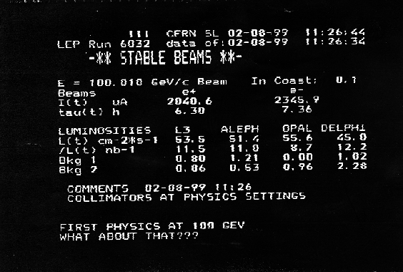
Energy loss
We have some experience from LEP: 3 GeV out of 100 GeV lost to synchrotron radiation per turn!
Beam naturally finds the appropriate stable phase at the RF cavities to compensate the energy loss (in LEP the RF system provided ~3.6 GV)
Synchrotron motion around this stable phase
Quantum emission of photons as a stochastic heating process balanced by damping due to differential energy loss

Slide 23
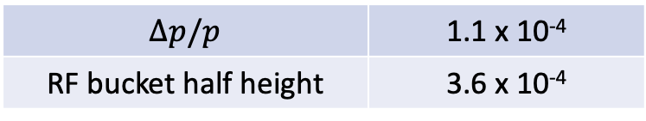
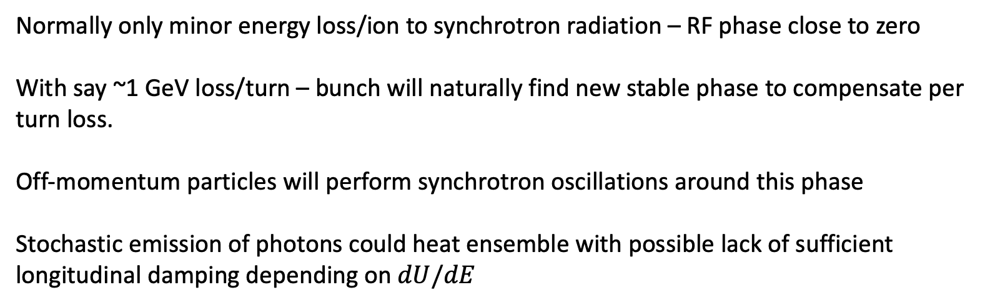
Energy loss
GF somewhat different – single region of emission – at possibly non-dispersive location
Normally only minor energy loss/ion to synchrotron radiation – RF phase close to zero
With say ~1 GeV loss/turn – bunch will naturally find new stable phase to compensate per turn loss.
Off-momentum particles will perform synchrotron oscillations around this phase
Stochastic emission of photons could heat ensemble with possible lack of sufficient longitudinal damping depending on $dU/dE$
$$Δp/p$$ | 1.1 x 10⁻⁴
RF bucket half height | 3.6 x 10⁻⁴

Slide 24
The LHC H-like Pb example:
Ion charge Z = 81, mass A = 208, γ = 2719, p_{z} = 526.5 TeV/c,
ℏω′ = 69 keV (Lyman-alpha line), laser ℏω = 12 eV (98 nm),
emitted gamma ℏω_{1,max}= 373 MeV, typical angle of emission θ₁ ~ 1/γ ~ 0.3 mrad.
Typical transverse kick due to gamma emission:
p_{x}/p_{z}~ ℏω′/p_{z}c ~ 69 keV / 527 TeV ~ 10^{‒7} mrad.
Typical transverse beam parameters at the LHC interaction point for example:
Transverse beam size = 0.026 mm, angular spread = 0.026 mrad (10⁵ times higher).
Typical energy spread in the beam is Δp/p ~ 10^{‒4}, while the average δp_{z} due to the photon emission is 200 MeV/c => δp_{z} / p_{z} = 200 MeV / 527 TeV = 3.7· 10^{‒7} => Δp/δp ≈ 300, and even with one scattering per turn the longitudinal effects will be significant in ~100-1000 turns.
Alexey Petrenko

Slide 25
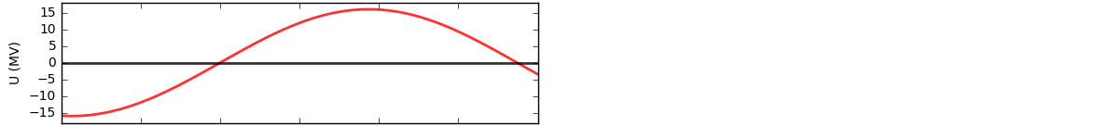
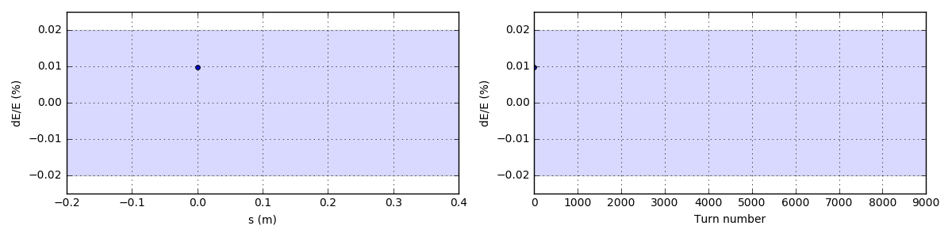
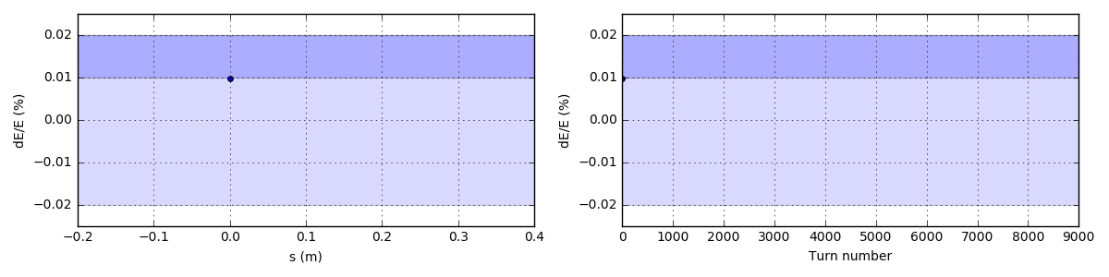
Longitudinal laser cooling is important to stabilize the ion motion:
The important effect of photon emissions on ion beam dynamics is in the energy loss of the partially stripped ion. This energy loss is randomly distributed from 0 to 400 MeV in this case of Pb ion with one remaining electron in the LHC. This randomness excites uncontrolled growth of synchrotron oscillations leading to a loss of ion from the RF-bucket:
4.0 scatterings
per ion
per turn
The synchrotron oscillations can be stabilized by a small change in the spectral distribution of the laser beam (or by adding another low-power laser):
4.4 scatterings
4.0 scatterings
per ion
per turn
Alexey Petrenko
Simulation details: http://www.inp.nsk.su/~petrenko/misc/ion_cooling/animations/

Slide 26
Laser
Aurelien Martens

Slide 27
Efficient Excitation of Relativistic Ions
Simon Rochester

Slide 28

Progress

Slide 29
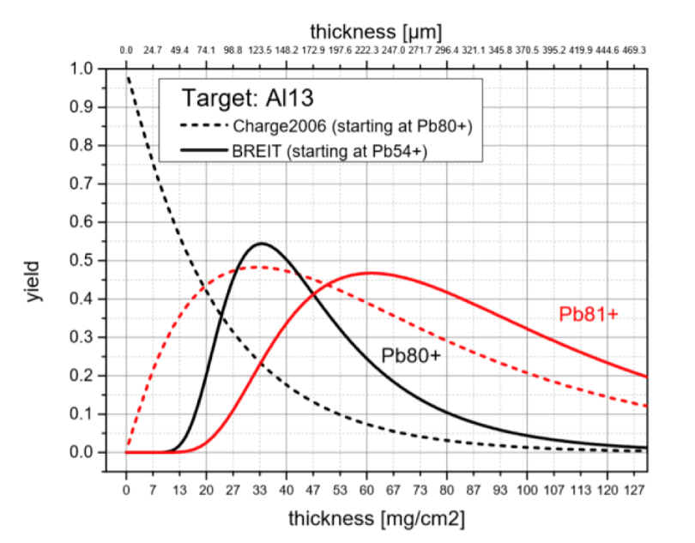
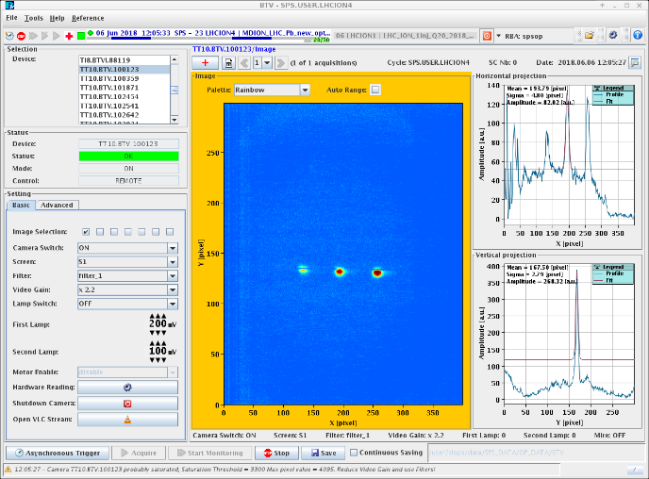
Stripping - June 2018 Machine Development
26.01.2018
The 150μm ( 212μm crossed by the beam as installed at 45 degrees) thick Al foil has been installed on the FT16.BTV352 in the TT2 line!
Pb80+
GF _Aluminium stripper
+80,+81,+82
BCT measurements suggest:
30% stripping efficiency for 80+
50% stripping efficiency for 81+

Slide 30
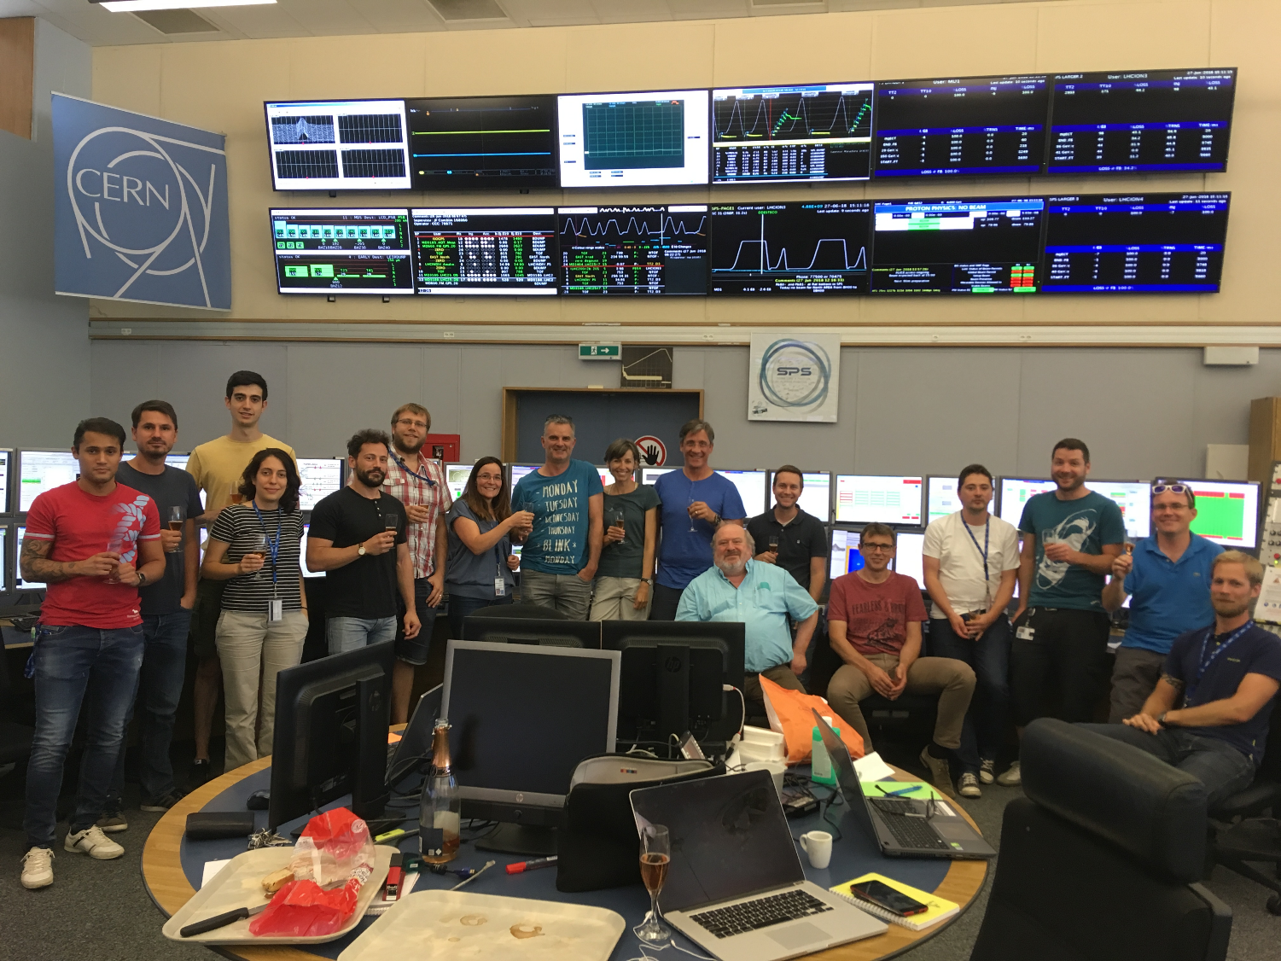
Pb80+
Pb81+
Pb80+
Pb81+

Slide 31
Goals of initial test in the LHC
12 hours LHC Machine Development (MD) time on 25.07.2018
Inject new particle “species” in the LHC
  Well-known Pb-208, but with one remaining electron
Establish a few circulating bunches.
Acceleration and storage of partially stripped ions.
  Study of beam lifetime and beam parameter evolution at injection and top energy
  Beam loss characterization
-
²⁰⁸Pb⁸¹⁺
Michaela Schaumann

Slide 33
Results

Slide 34
Results
Lifetime of Pb81+ beams have been studied in LHC at 450 GeV and 6.5 TeV proton equivalent energy.
Main observations:
  dominant limit of the beam intensity is the collimation efficiency
  as expected, e.g. from IBS, lifetime decreases with intensity
Lifetime decreases with storage time
  Average lifetime at Injection: ~20h
  Average lifetime at Flat top: ~50h
Preliminary beam dynamic simulations including IBS, radiation damping and debunching showed promising results but more studies needed.
Michaela Schaumann

Slide 35
Other ongoing studies

Slide 36
Potential

Slide 37
Caveat: should bear in mind that relativistic electrons are somewhat easier to produce than high energy PSIs!

Slide 38
Doppler upshifting of intense laser sources; “monochromatic” source; intense electron beam needed

Slide 39
Gamma Factory

Slide 41
Collider schemes

Slide 42
Secondary beams

Slide 43
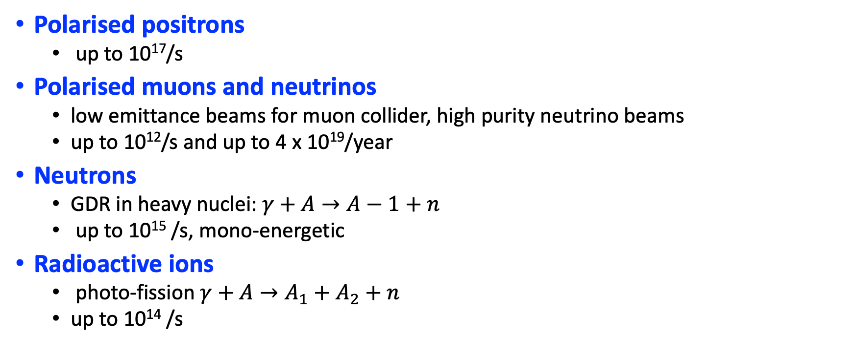
Initial estimates for secondary beam sources
Polarised positrons
  up to 10¹⁷/s
Polarised muons and neutrinos
  low emittance beams for muon collider, high purity neutrino beams
  up to 10¹²/s and up to 4 x 10¹⁹/year
Neutrons
  GDR in heavy nuclei: $γ+A→A−1+n$
  up to 10¹⁵ /s, mono-energetic
Radioactive ions
  photo-fission $γ+A→A_{1}+A_{2}+n$
  up to 10¹⁴ /s
For the quoted flux the RF voltage would need to be increased and/or number of stored ions increased by a factor 2 to 3

Slide 47
Active interest in the possibility of a muon collider
Big challenge is the production of intense, low emittance muons beams:
  Proton driver
  LEMMA
  (45 GeV positron ring → …)

Slide 48
Phasing in
GF potential looks impressive, however investment for full-scale implementation is in competition with existing, and proposed, projects
Staged approach to demonstrate full-scale feasibility…
Scenario | Ion beam | Eγ (max)
S1 | Li-like Pb in LHC (2s→3p)_{1/2} | 87 MeV | Minimal interference with ion programme
S2 | Li-like Pb in LHC (2s→2p)_{3/2} | 15 MeV | Minimal interference with ion programme
S3 | H-like Xe (1→2p)_{1/2} | 182 MeV | Going to highest gamma energies GF high energy frontier – DM searches
S4 | He-like Ca (1s→2p)_{3/2} | 26 MeV | GF high intensity frontier – Nuclear Physics & Applied Physics
S5a | Li-like Ca (2s→3p)_{1/2} (SPS) |  | SPS cooling, followed by Ca-Ca collisions in the LHC L_{Ca-Ca} = 6.2 x 10³¹ cm⁻²s⁻¹ – present program
S5b | H-like Pb (say) |  | LHC electron-proton collisions – present program

Slide 49
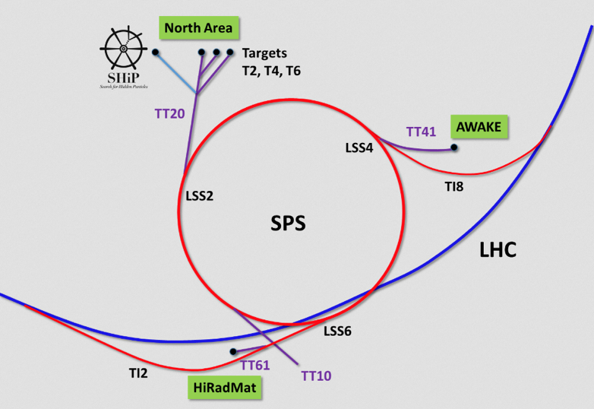
Next Step: Proof of Principle - SPS

Slide 50
Main objectives
Verify of simulations on rate of atomic excitation
Demonstrate matching of characteristics of ion bunches to those of the laser bunches, match laser spectrum to width of the atomic excitation and achieve resonance for adequate fraction of ion population
Measure emitted X-rays, characterisation of flux and spectrum, and demonstration of photon extraction from the collision zone
Demonstrate integration and operation of laser and Fabry-Perot cavity in a hadron storage ring
Demonstrate laser cooling of relativistic beams and investigation of the different approaches
Demonstrate feasibility of relativistic Atomic Physics measurements.
Ambition/complexity/cost cut-off
Brennan Goddard

Slide 51
Choice of ion for PoP experiment

Slide 52
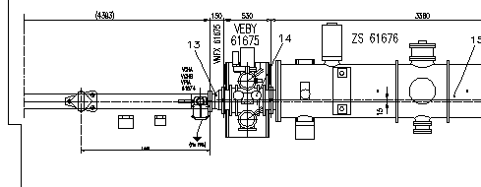
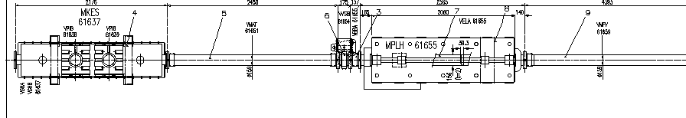
Laser-PSI interaction region: tentatively SPS LSS6
About 4.4 m flange-flange between MPLH and ZS (VV)
2.6 degree cavity, 4 mJ laser pulse energy at IR

Slide 53
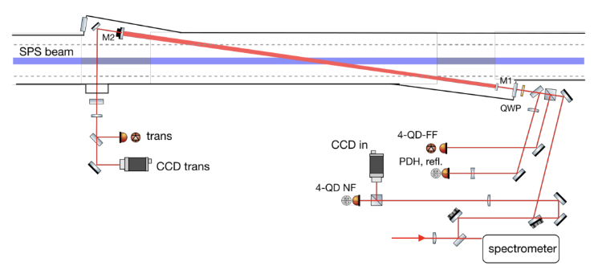
FP cavity on SPS beam (vertical crossing?)

Slide 54
Diagnostics
Assuming a ring shaped detector (transverse size 1cm) located around the beam (d=80 mm)
• Measure beam overlap
• Measure X-ray photon beam properties
• Measure beam cooling
Photon Flux
Large flux of x-ray photons in > 10 keV range after 10 m
Camilla Curatolo

Slide 55
Status / open questions!
Ion species and transition: defined (pb79+, 2s→2p)
Ion beam parameters: defined
IR location: identified (IR6). Confirm?
SPS optical parameters: Defined (for LSS6)
IR layout & FP design: proposed 2.6 deg crossing.
Laser characteristics: in progress.
Timing & synchronisation aspects: in progress
Radiation aspects: 2018 dosimetry measurements: in progress
Simulation benchmarking: in progress
Parameter list (including uncertainties): in progress
Emitted photon distribution f(t): in progress
PSI beam 6D evolution f(t): in progress
Detector requirements: in progress
Experimental procedures: in progress
Atomic physics prospects: to define
Brennan Goddard

Slide 56
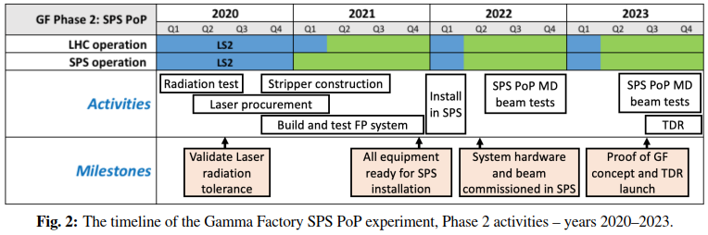
PoP Deadlines: phase 2
Systems ready for installation: End December 2021 (30 months)
Beam tests: 2022 and 2023

Slide 57
Gamma Factory Project Milestones
Production, acceleration and storage of “atomic beams” at CERN
Development “ex nihilo” the requisite Gamma Factory software tools.
Proof-of-Principle experiment in the SPS tunnel.
Realistic assessment of the Gamma Factory performance figures.
Physics highlights of the Gamma Factory based research program.
Gamma Factory TDR

Slide 58
Conclusions
Over the last 1.5 years the Gamma Factory initial ideas developed into a well defined project involving a group of around 50 physicists.
Progress has been impressive. The next steps are clear.
The target of the GF initiative is to develop the potential of a variety of novel research tools which could potentially open new opportunities in a broad domain of basic and applied science.
It’s an interesting phase for accelerator based HEP research – with no strong theoretical guidance for the mass scale of new physics, nor a mature, affordable technology for a leap into high energy “terra incognita” – high risk, high gain initiatives become important.
This what we should be doing!

