Slide 1
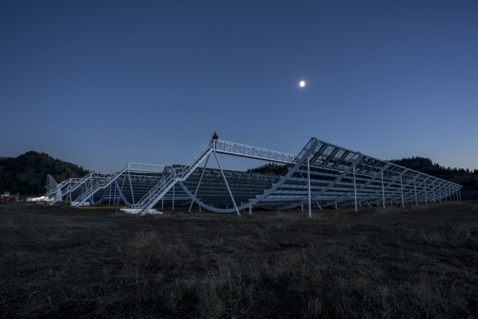
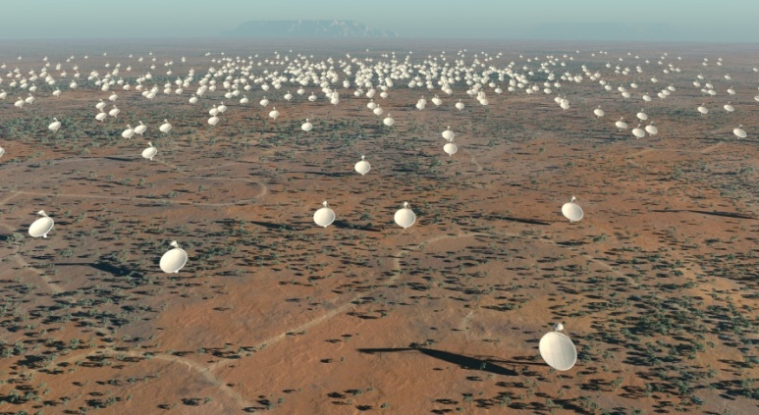
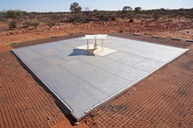
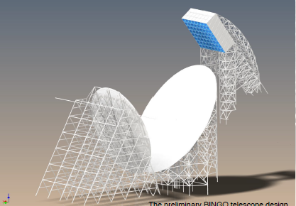
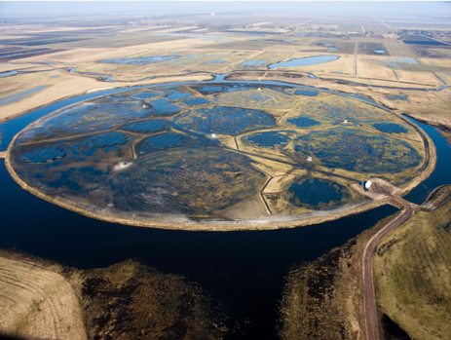
21cm as a cosmological probe!
Filipe B. Abdalla

Slide 2
Outline:
Background of the 21cm: EoR and IM
Current status on IM.
One of the main problems: Foreground subtraction.
Looking forward

Slide 3
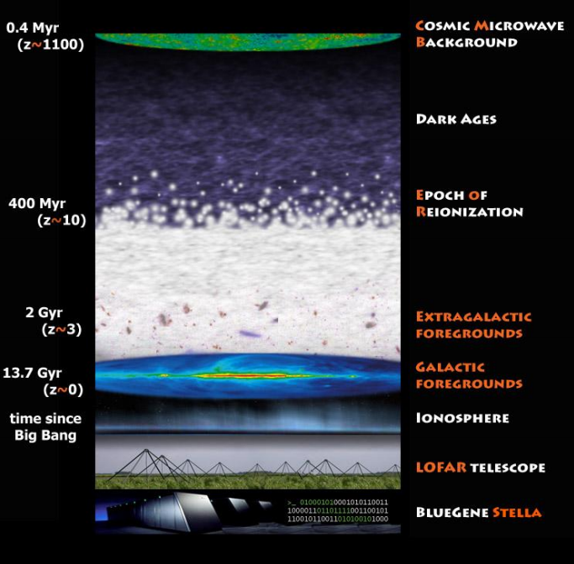
The History of our Universe.
We have a extremely well measured CMB sky.
We are a long way measuring the LSS of the Universe near us.
The EoR and the dark ages remain a mystery and unmeasured territory.

Slide 4
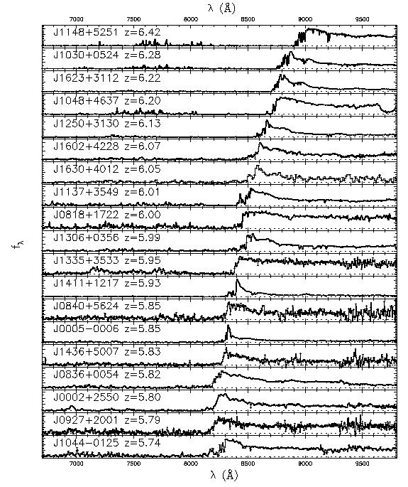
Gunn-Peterson Effect toward z~6 SDSS QSOs
Fan et al 2006

Slide 5
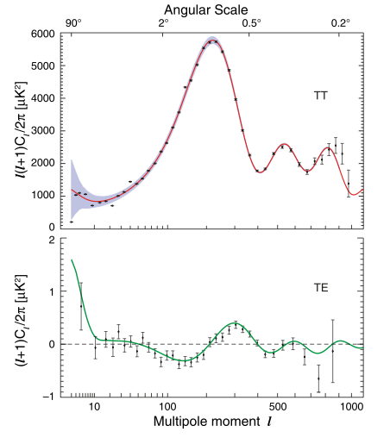
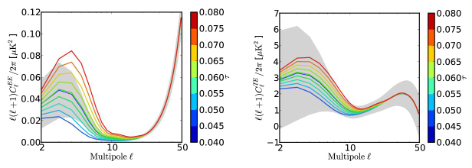
Constraint: CMB large scale polarization WMAP

Slide 6
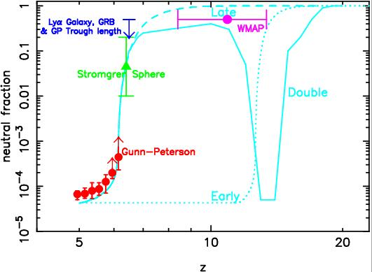


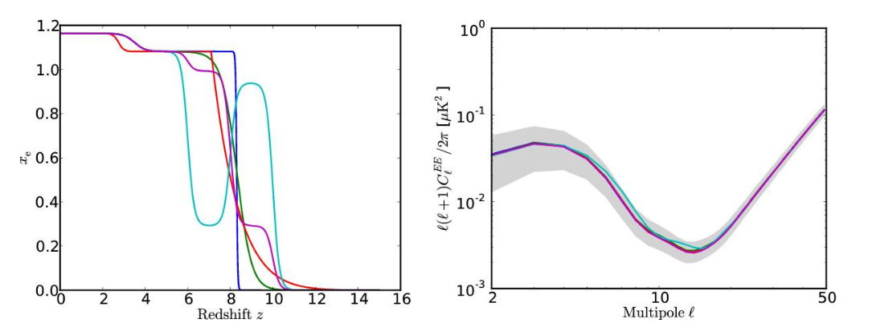
Combined CMB + GP constraints on reionization
τe = integral measure to recombination=>
allows many IGM histories …. Further constraints from kSZ…

Slide 7
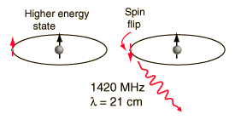
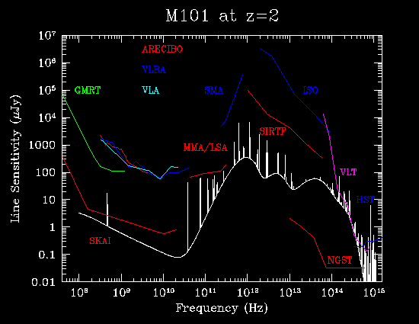
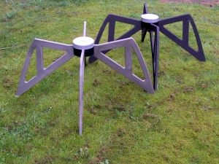
21cm Radiation
So, for redshift ~ 9, we would observe the radiation as having 2m wavelength

Slide 8
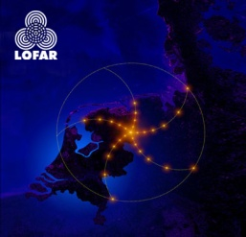
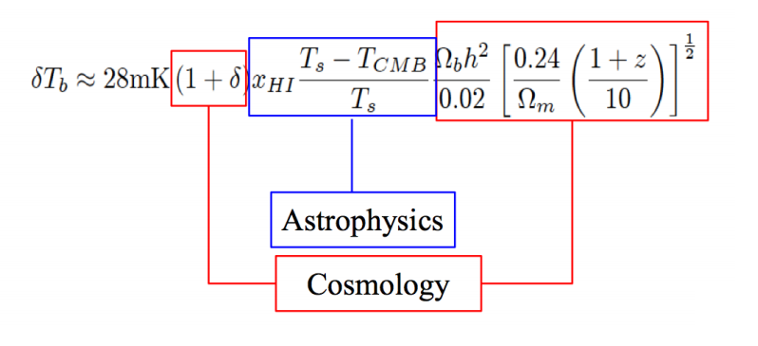
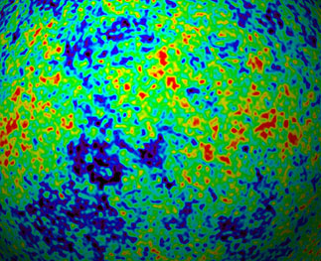
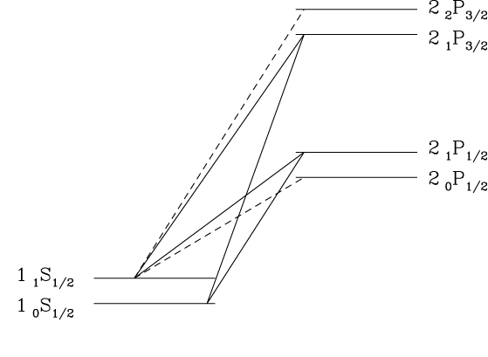
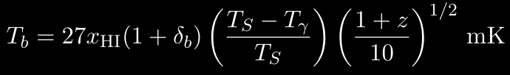

21 cm basics
Use CMB backlight to probe 21cm transition
HI hyperfine structure
T_{S}
T_{b}
n₁
T_{γ}
1₁S_{1/2}
λ=21cm
HI
1₀S_{1/2}
n₀
T_{K}
z=13
z=0
n₁/n₀=3 exp(-hν_{21cm}/kT_{s})
f_{21cm}=1.4 GHz
f_{obs}=100 MHz
3D mapping of HI possible - angles + frequency
21 cm brightness temperature
21 cm spin temperature
Coupling mechanisms:
  Radiative transitions (CMB)
  Collisions
  Wouthuysen-Field

Slide 9
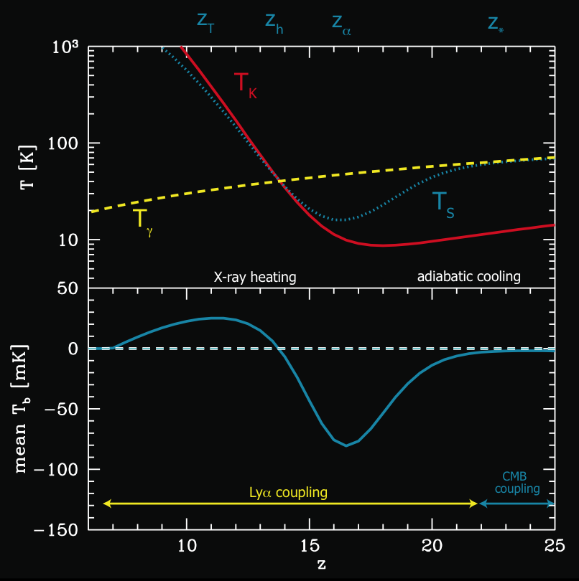
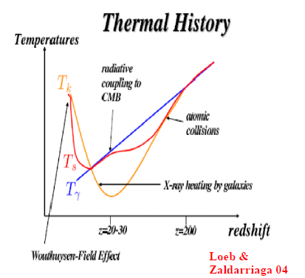
The global evolution of the spin temperature
Ts is coupled to the CMB at high redsfhits.
Collisional processes make the spin temperature decouple from the CMB temperature. At this stage we an observe a difference between both.
At lower redfshits, the first sources produce Lyman alpha and heat the gas. This makes a temperature change and a signal in emission may be seen

Slide 10
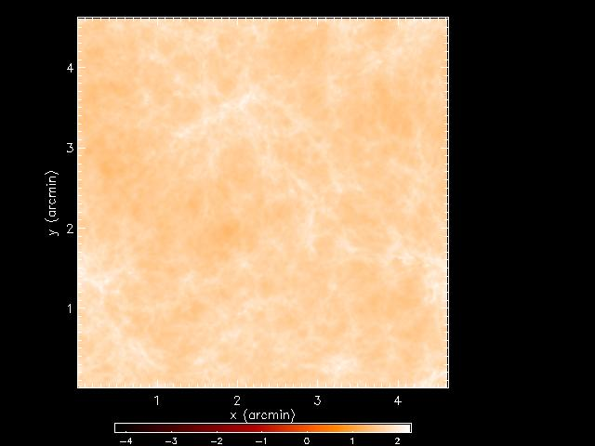
21 cm Observations: Emission
z=18.3
10 Mpc comoving
Δν=0.1 MHz
Furlanetto et al. (2003)

Slide 11
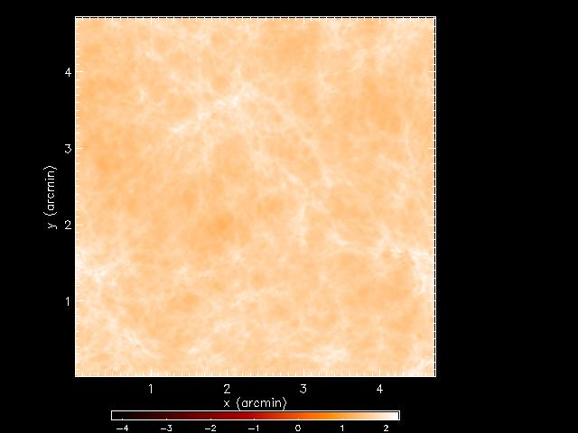
21 cm Observations: Emission
z=16.1
10 Mpc comoving
Δν=0.1 MHz
Furlanetto et al. (2003)

Slide 12
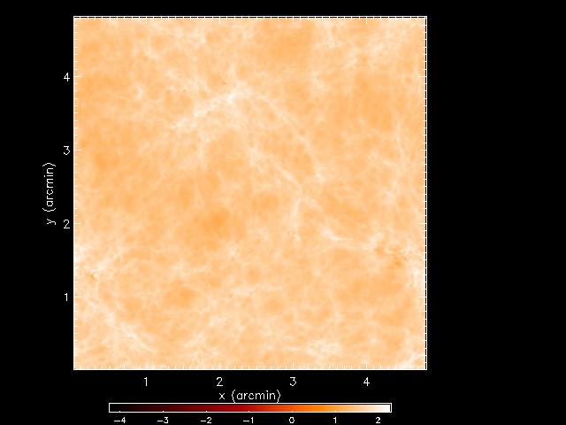
21 cm Observations: Emission
z=14.5
10 Mpc comoving
Δν=0.1 MHz
Furlanetto et al. (2003)

Slide 13

21 cm Observations: Emission
z=13.2
10 Mpc comoving
Δν=0.1 MHz
Furlanetto et al. (2003)

Slide 14

21 cm Observations: Emission
z=12.1
10 Mpc comoving
Δν=0.1 MHz
Furlanetto et al. (2003)

Slide 15
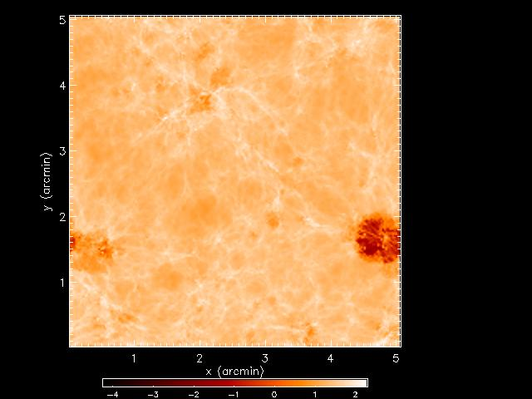
21 cm Observations: Emission
z=11.2
10 Mpc comoving
Δν=0.1 MHz
Furlanetto et al. (2003)

Slide 16
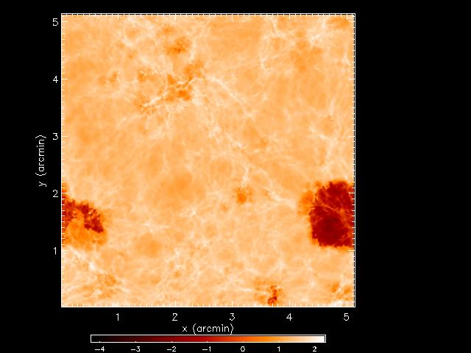
21 cm Observations: Emission
z=10.4
10 Mpc comoving
Δν=0.1 MHz
Furlanetto et al. (2003)

Slide 17
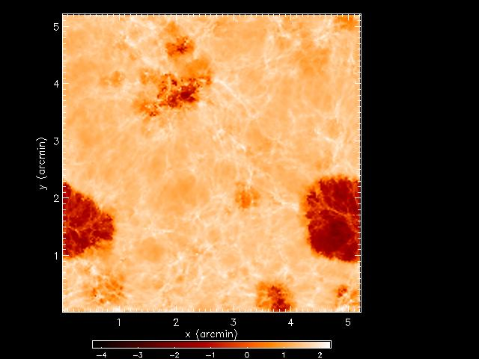
21 cm Observations: Emission
z=9.8
10 Mpc comoving
Δν=0.1 MHz
Furlanetto et al. (2003)

Slide 18
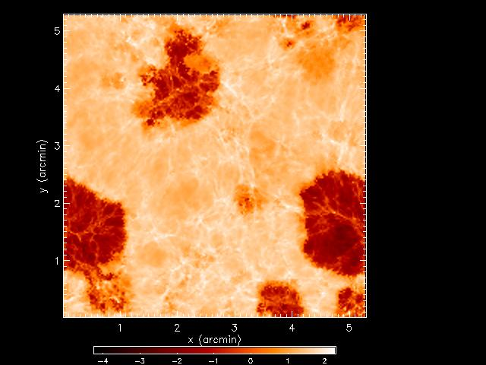
21 cm Observations: Emission
z=9.2
10 Mpc comoving
Δν=0.1 MHz
Furlanetto et al. (2003)

Slide 19
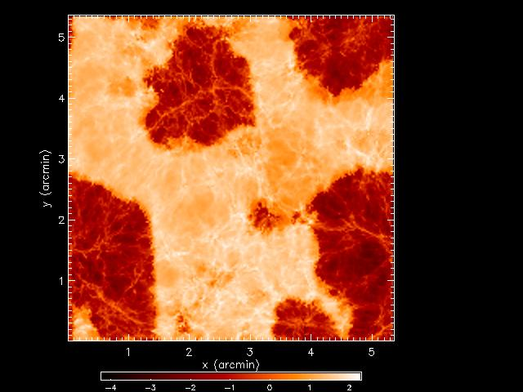
21 cm Observations: Emission
z=8.7
10 Mpc comoving
Δν=0.1 MHz
Furlanetto et al. (2003)

Slide 20
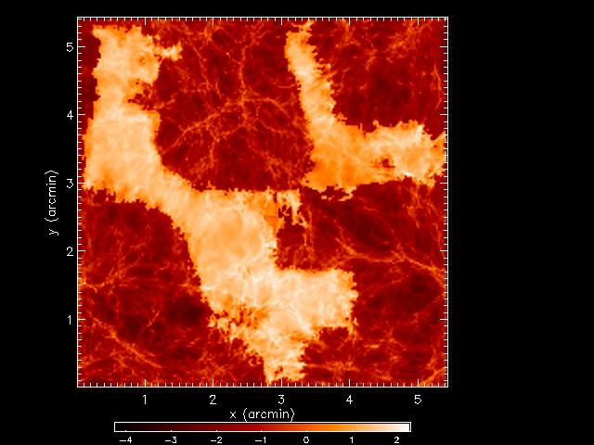
21 cm Observations: Emission
z=8.3
10 Mpc comoving
Δν=0.1 MHz
Furlanetto et al. (2003)

Slide 21
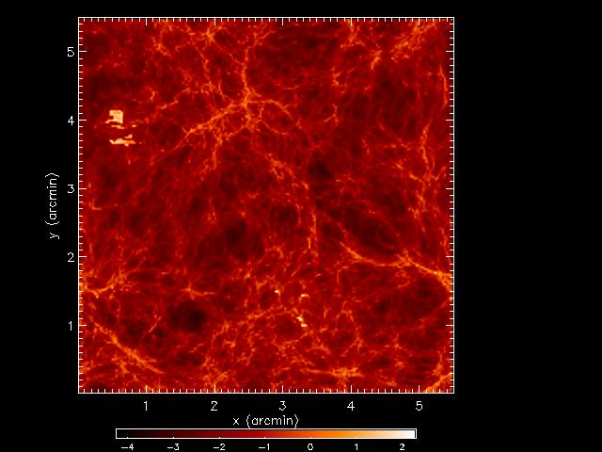
21 cm Observations: Emission
z=7.9
10 Mpc comoving
Δν=0.1 MHz
Furlanetto et al. (2003)

Slide 22
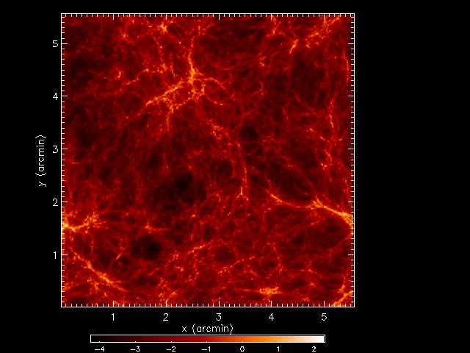
21 cm Observations: Emission
z=7.5
10 Mpc comoving
Δν=0.1 MHz
Furlanetto et al. (2003)

Slide 23
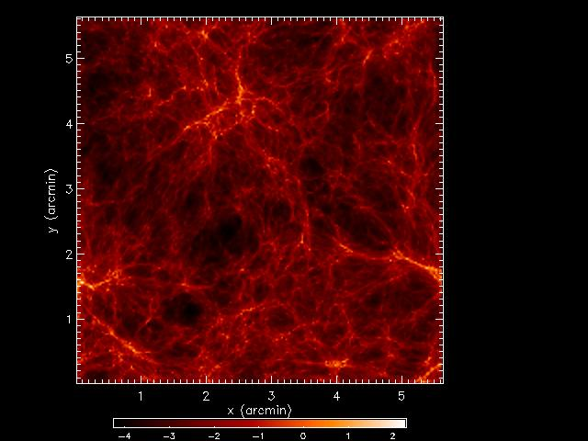
21 cm Observations: Emission
z=7.2
10 Mpc comoving
Δν=0.1 MHz
Furlanetto et al. (2003)

Slide 24
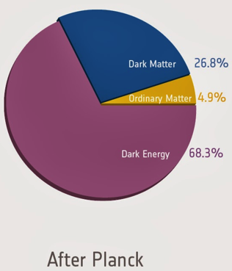
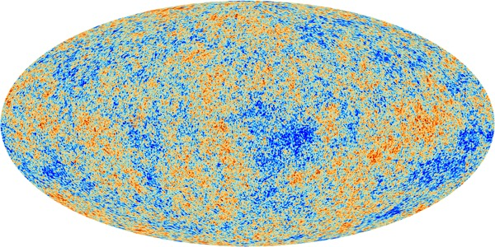

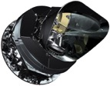
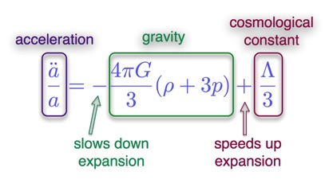
Era of precision cosmology
Cosmology is now in a golden area
  Standard ΛCDM model appears to be the best descripton so far!
But still major questions remain!
  Inflation (t<10⁻³² s)
  Dark energy
CMB map from Planck collaboration et al. (2016)

Slide 25
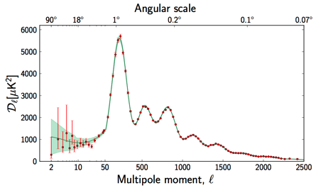
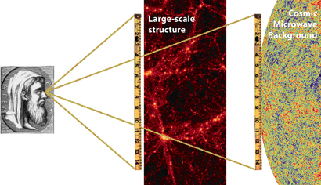
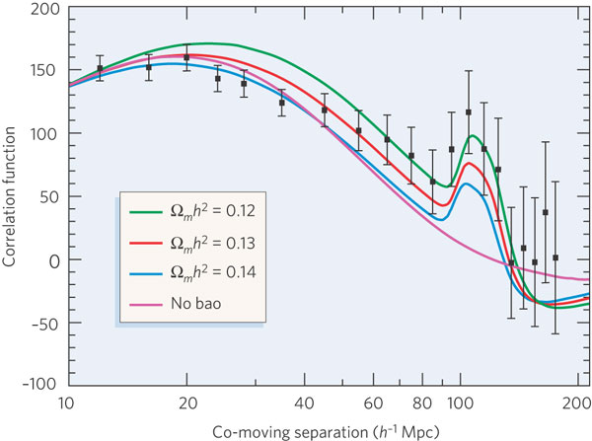
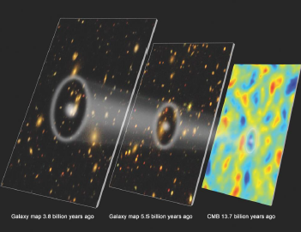
Baryon Acoustic Oscillations (BAOs)
Acoustic waves imprinted on CMB 380,000 years after Big Bang
Acoustic scale set by distance light travelled at that time
  Known precisely from CMB power spectrum
  D=149 ± 0.6 Mpc
BAO scale imprinted on all matter in the Universe
  Use as a “standard ruler”
Planck collaboration (2016)
Credit: Chris Blake

Slide 26
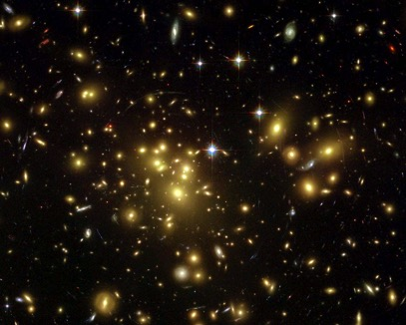
Alternative to optical BAO: HI Intensity mapping
Use relatively large beam on the sky
  Measure HI *fluctuations*
  Similar to CMB, using
HI intensity mapping can be used as mass tracer, probing distortions in redshift space
No competition in the radio
Complementary to large optical surveys
Large beam on the sky (≈1 deg) contains many galaxies.
HI signal is measured through its overall intensity

Slide 27
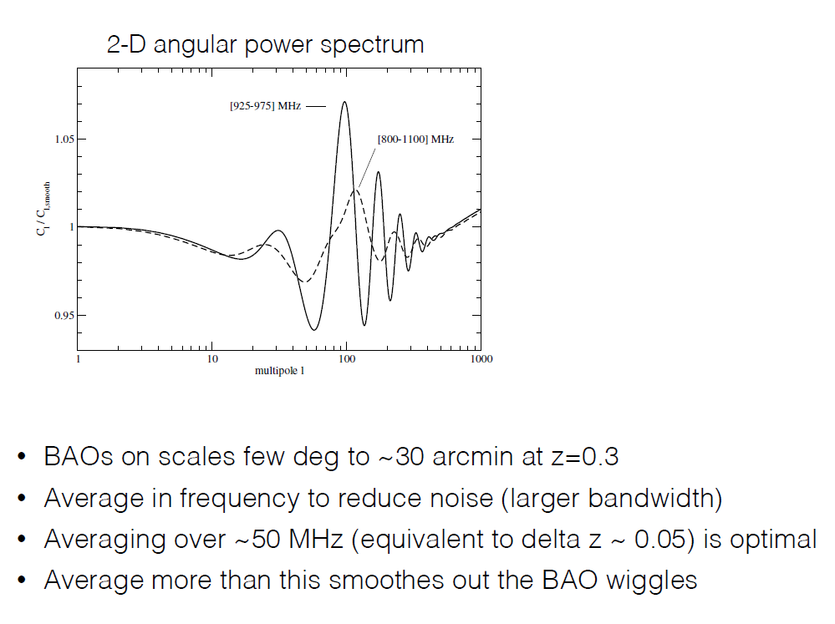
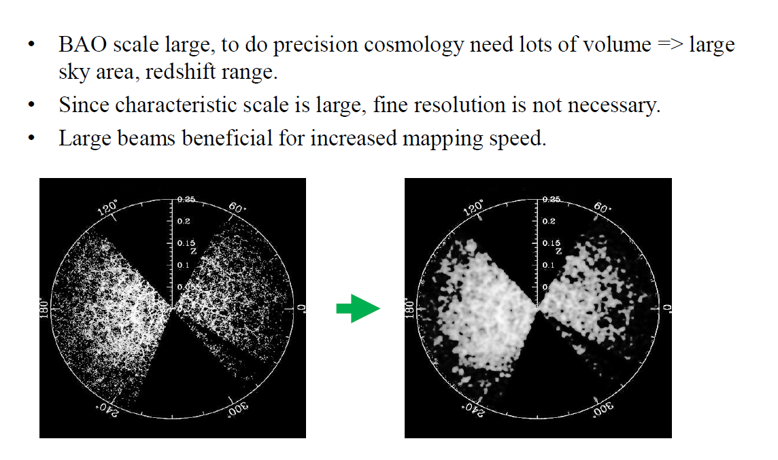
BAOs in Intensity mapping.

Slide 28
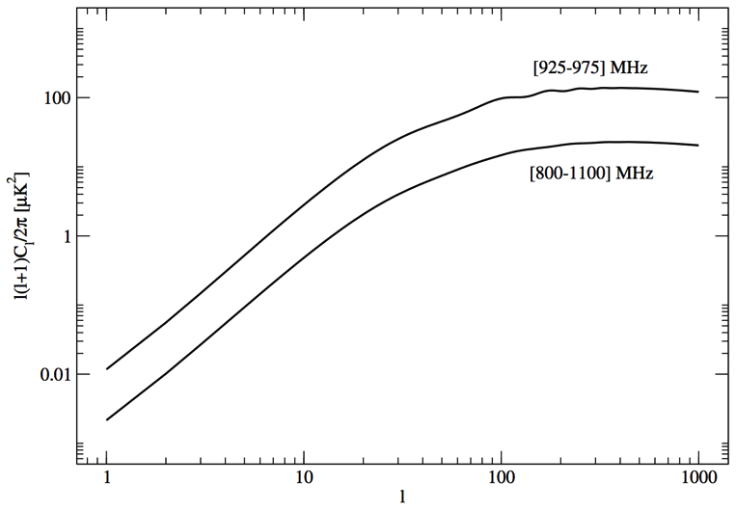
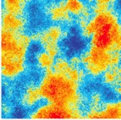
The HI signal power spectrum
Cosmological HI signal is weak! (≈100 μK rms) and on degree scales
BAOs
Total HI signal
l≈(200/θ) degrees

Slide 29
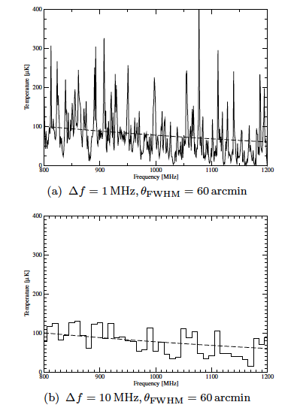
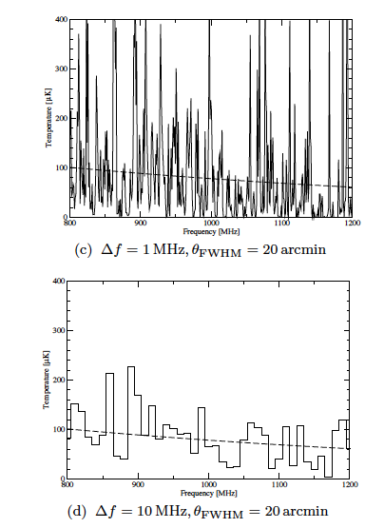
Frequency windows and FWHM
graphs from Battye et al., 2013
Notes:
The simulated HI signal for dierent telescope beam
resolution and frequency bin size combinations, FWHM and f
respectively. A smaller frequency bin or telescope beam size re-
sults in larger uctuations, as expected, since going to smaller
values of FWHM and f means that one is probing a smaller
volume of the Universe and uctuations in the HI density are ex-
pected to be larger on smaller scales, as they are in the cold dark
matter. In each case the dashed line is the average temperature
computed using (9). The objective of 21cm intensity mapping ex-
periments is to measure the dierence between the signal and this
average.

Slide 30
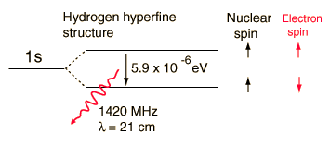
Why BAO in radio and maybe in total intensity?
Complementary to optical data, different systematics
Decay time of HI hyperfine transition is ~ 10^15 seconds, but, 75% of visible matter in the Universe is made of H…
Efficient alternative for measuring a large number of galaxies individually (plus integrating the signal “alla” CMB allows for the reuse of a vast experiment in instrumentation and data analysis)
Interferometers are excellent instruments for these measurements, can be… expensive and hard to operate/maintain
Single-dish instruments have been used for a first detection of the 21m line in cross correlation, (although for interferometers one should wait for CHIME and FAST)
Approach: single-dish, many horns X single horn per dish
Battye, R.A. et al. MNRAS (2013) and arXiv:1610.06826
Wuensche, C. A. et al. arXiv:1803.01644

Slide 31
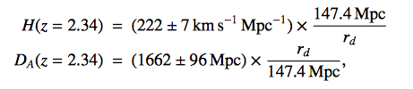

Importance of confirmation!
Baryon Acoustic Oscillations in the Lyα forest of BOSS DR11 quasars.
T. Delubac et al. [BOSS Collaboration] – A&A 574, A59 (2015), arXiv: 1404.1801
From adjusting the BAO peaks and combining with the ΛCDM fiducial values from Planck+ WMAP:
Values differ: 1.8σ from Planck+WP;
1.6σ from WMAP9+ACT+SPT
Constraints on (D_{A}/r_{d},D_{H}(=H/c)/r_{d})
Conclusion:
Approximately 2σ below the value of D_{H}
And 2σ above the value of D_{A}
compared to the ΛCDM prediction.
NOT THE ONLY TENSION IN THE MODEL!

Slide 32
Outline:
Background of the 21cm: EoR and IM
Current status on IM.
One of the main problems: Foreground subtraction.
Looking forward

Slide 33

Detection in cross correlation!

Slide 34


Experiments
- HIREX(SA)

Slide 35



Experiments

Slide 36







There are many forecasts in the literature… EoR and BAO
Looking back in time in the Universe
CREDIT: WMAP & SDSS websites

Slide 37





Returning to reionisation:
Redshift space disortions:
There are many forecasts in the literature… EoR and BAO
Barkana & Leob 10
Mao et al 08.11.

Slide 38
Outline:
Background of the 21cm: EoR and IM
Current status on IM.
One of the main problems: Foreground subtraction.
Looking forward

Slide 39

EoR-IM: the FG problem
featureless power law
variation in spectral
index with position
on the sky and with
frequency
(~29 %)
(~ 1 %, β ~ -2.15)
(~70 %, T_{b} ~ 240±2 K, β ~ -2.55)
SIMULATIONS: 5º x 5º filed of view, ~ 0.6 arcmin resolution and freq. range: 115-180 MHz
Jelic et al., 2008, MNRAS

Slide 40


Slide 41


Simulations: Foregrounds, Noise, Signal
Foregrounds: Simulations from Jelic V., Zaroubi S., Labropoulos P. et al. 2008, MNRAS, 389, 1319:
  Galactic synchrotron radiation, galactic free-free emission
  Extragalactic radiation from radio galaxies and clusters
21cmFAST (Mesinger A., Furlanetto S., Cen R., 2011, MNRAS, 411,955)
  10°x10° x170 slice in frequency, d\nu=0.5 Mhz. Frequency 115 to 200 MHz (z ~ 11.3 – 6.1)
  Box size of 1.8 Gpc over 512 pixels ~3MPc/pixel.
Noise: an MS of our simulation was filled with a Gaussian distribution
  e.g. 52mK at 150MHz for 600 hours of LOFAR observing time.
Foreground map at 150MHz for a 10°x10° observing window. Temperature scale in K.

Slide 42


Problem Outline
21cm signal dominated both by foregrounds and by noise.
Currently most foreground cleaning methods are parametric, e.g. polynomial.
Non-parametric methods have emerged - Wp smoothing (Harker 09).
Other, powerful techniques have been used on the CMB...
Notes:
Red = cs * 10 -1
Purple = noise
Blue = 21-cm+fg+no
Black = fg

Slide 43
Problem Outline techniques used:
Spectral smoothness allows separation of 21cm. Options:
1 Fit power law to maps
2 Remove low order polynomials or some constraint fit
3 Measure components and model components
4 Measure modes of the foregrounds from a given FG model
5 Use sparse or indepenent components of the FG model.
6 .....
Issues:
- Mode mixing of angular and frequency fluctuations by
frequency-dependent beams (esp. interferometers.
- Robustness Biasing introduced if foreground model poorly
understood (esp. non-gaussianities).
- Statistical Optimality Need to keep track of transformations
on statistics, for optimal PS estimation
- Model Dependent [4] although in simulatons there are excellent results.
Notes:
Want to detect the 21cm radiation. Unfortunately foregrounds are ~3-5 magnitudes larger and noise also dominates.
So, how do we remove it?
Method presented here, like a lot of recent methods is a spectral analysis technique – exploits the smoothness off the foregrounds compared to the uncorrelated noise and cs.

Slide 44


Effects on the power spectrum

Slide 45


Investigating using Bispectrum and phase analysis to test the foreground subtraction method.
Method of choice here was GNILC used by the Bingo collaboration.
Maps foregrounds were subtracted as discussed and analysis tools were created to benchmark phase correlations and bispectrum of residuals.

Slide 46
Residual Projection
We can project different signal elements onto the source space using the mixing matrix (A) calculated by GMCA in order to understand the amount of leakage.
R_{fg} = fg – ( A (A^{T} A)⁻¹ A^{T} ) fg
Amount of foreground leakage into reconstructed nocs
C_{nocs} = ( A (A^{T} A)⁻¹ A^{T} ) (no+cs)
Amount of simulated no+cs leakage into the reconstructed foregrounds.
N_{nocs} = ( A (A^{T} A)⁻¹ A^{T} ) (no) -> could try to correct for that!

Slide 47
Conclusions… Looking forward.
21cm is a very rich area of research
Lots to be done, relating to astrophysics, cosmology, statistical methods (component separation), etc...
We have to firm up a detection of IM in order to hopefully bring all the promises which we theoretically know exist in this area of science.
The reconstructed maps will have a huge wealth of not only comsological but also astrophysical data.
Future Questions:
What are the future hurdles that the projects we will heard about this week will have… Possibly calibration and foreground subtraction, but we should hear from the different projects themselves.

