Slide 1
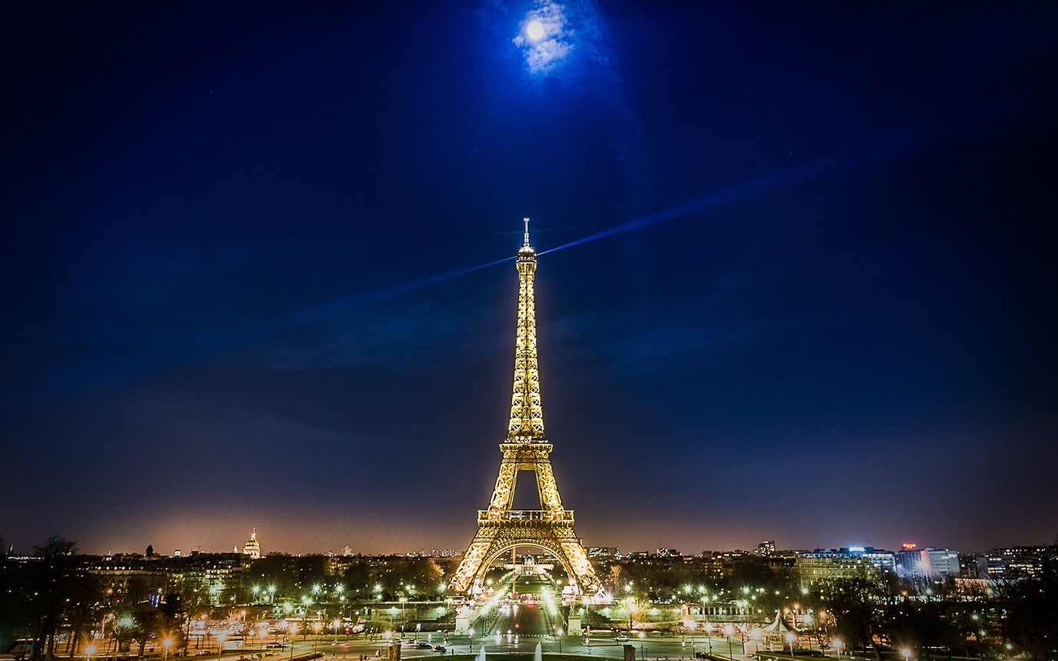
Tianlai and the lunar orbit array
21cm cosmology workshop
2019.10.22 Paris-Saclay
Xuelei Chen
NAOC
2019.10.22 Paris-Saclay

Slide 2
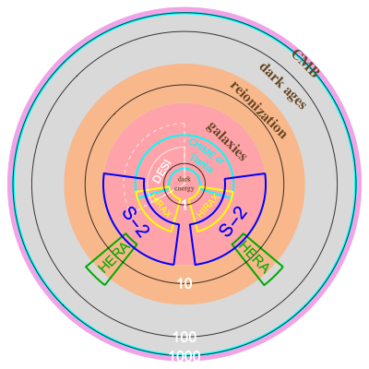
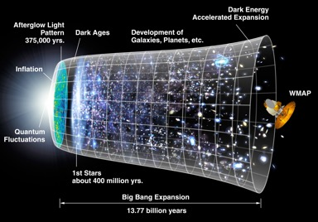
Cosmic Cartography: uncharted
area ∝ volume
parameter accuracy ~ nmode^{-1/2}
nmode ~ volume
2D: CMB [SPT/ACT/S4]
large area galaxy imaging/spectroscopy
2D: single band imaging [APM]
2D⁺: + multi-band photo-z’s [DES/LSST]
3D⁻: + lo-res spectroscopy [PAU/JPAS/SphereX/MKIDS]
3D: + hi-res spectroscopy [APM/SDSS/DESI/4MOST/Euclid/WFIRST]
intensity imaging of galaxies/LSS
3D: + hi-res HydrogenIntensityMapping [CHIME/Tianlai/HIRAX/BINGO/SKA/S-2]

Slide 3
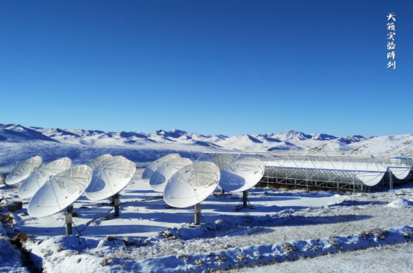
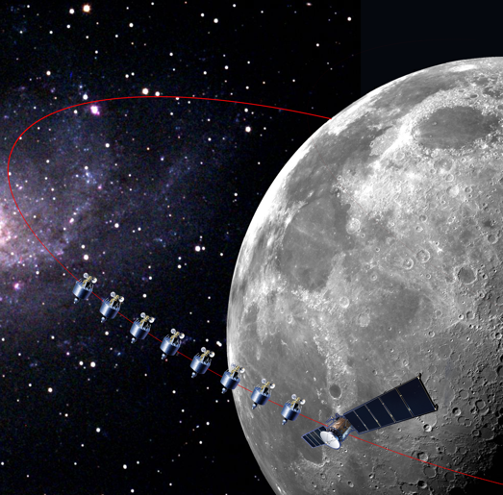
The Status of the Tianlai Array
Discovering the Sky at the Longest wavelength (DSL)

Slide 4
The Status of the Tianlai Array
Discovering the Sky at the Longest wavelength (DSL)

Slide 5
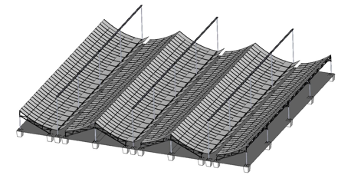
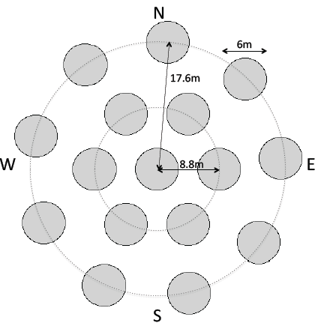
Hydrogen Intensity Mapping: The Tianlai Pathfinder
Pathfinders to demonstrate basic principle
and encounter all issues rapidly
Band 685-810MHz (0.77<z<1.3)
512 frequency channels
(Δν=125MHz δν=244kHz δz=0.0002)
tunable in 600-1420MHz (0<z<1.5)
Cylinder Array 3 x 15m x 40m cylinders
96 dual polarization feeds
4 sec sampling
Dish Array 16 x 6m dishes
16 dual polarization feeds
1 sec sampling
Pathfinder+ Cylinder Array
216 dual polarization feeds
4 sec sampling
Proposed Full Cylinder Array 8 x 15m x 120m
2048 dual polarization feeds
400-1420MHz

Slide 6
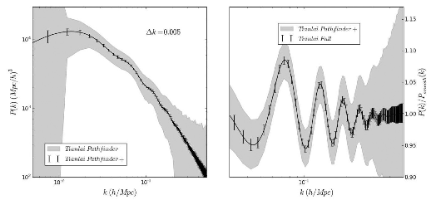

Tianlai ~ “Heavenly Sound”
Hydrogen Intensity Mapping: The Tianlai Project

Slide 7
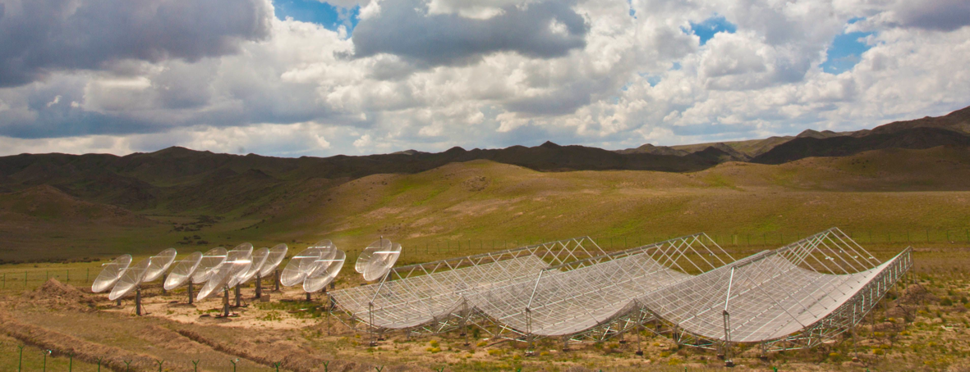
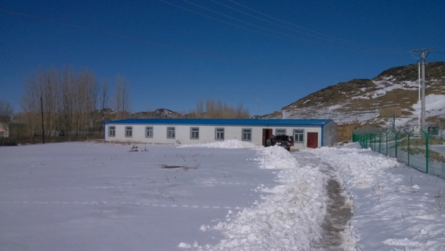
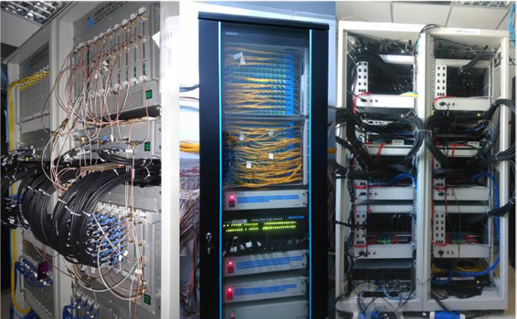
Hydrogen Intensity Mapping: The Tianlai Pathfinder

Slide 8
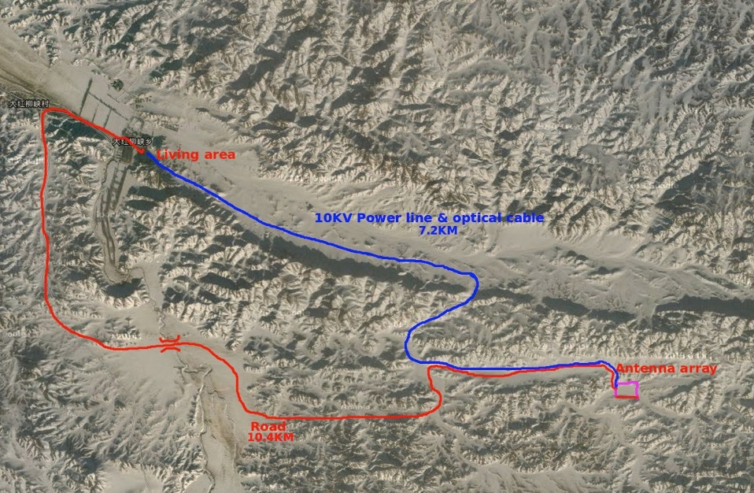
Hydrogen Intensity Mapping: The Tianlai Site
correlators

Slide 9
Tianlai data processing
Dish and Cylider array
~4TB data per day
Multi-step
Automatic pipeline
Scalable
Flexible
Zuo et al., in preparation

Slide 10
Tianlai Dish Array: highly-repeatable visibilities
one visibility
staring at NCP for 10 nights

Slide 11
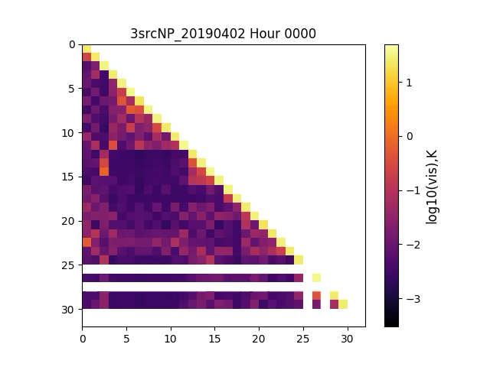
Tianlai Dish Array: correlation matrix movies
1 uncalibrated visibility
quick-look at data quality
  over 25 days

Slide 12
Tianlai Dish Array: Gain stability
Gain measured for 1 baseline using transits of Cas A over 11 days
Visibility (uncal’d)
Frequency
Visibility (uncal’d)
Probability Density
Minutes
Percentage variation
Notes:
Check gain stability vs. NS

Slide 13

noise integrates down
Uncalibrated ${∆T}_{rms}$
Integration time (s)

Slide 14
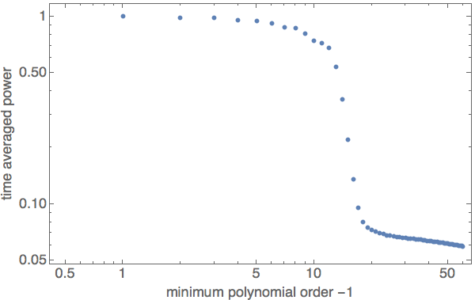
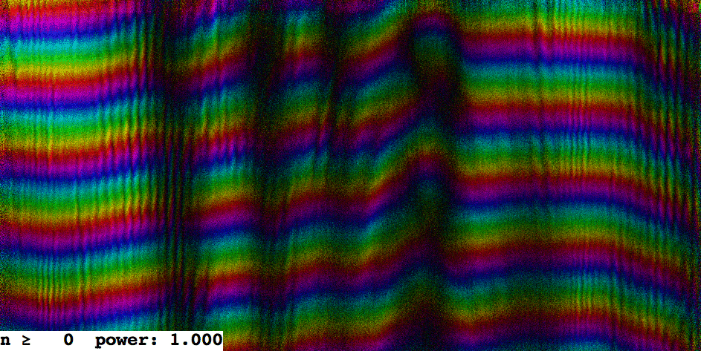
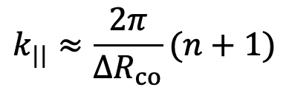
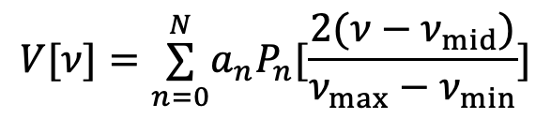
Tianlai Visibility: Foreground Subtraction
$$V[ν]=\overset{N}{\underset{n=0}{∑}}a_{n}P_{n}[\frac{2(ν−ν_{mid})}{ν_{max}−ν_{min}}]$$
10 night median averaged visibility discrete polynomial subtraction.
residuals n>60!
$$k_{||}≈\frac{2π}{ΔR_{co}}(n+1)$$

Slide 15
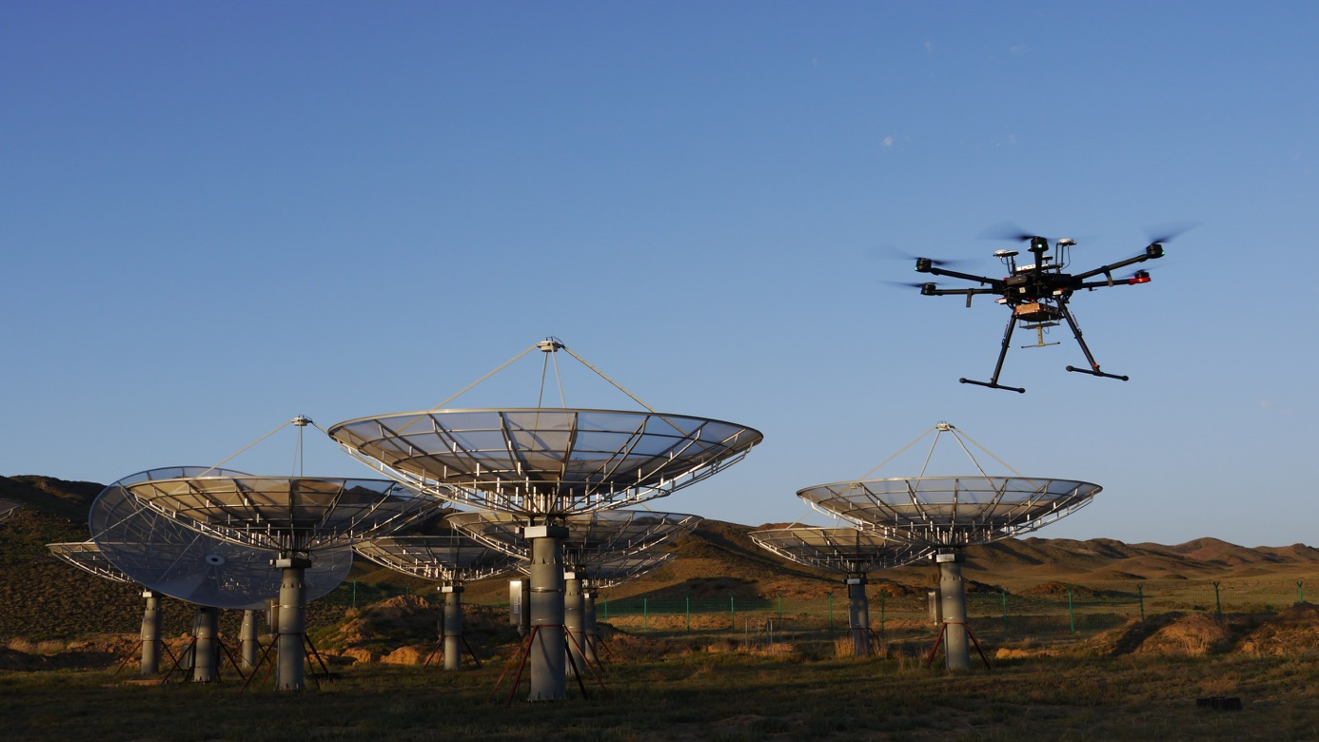
Beam Calibration Experiment with Drone
Juyong Zhang et al., in preparation

Slide 16
UAV
DJI Matrice 600 PRO
DJI Matrice 600 PRO
Length | 1.8m
Width | 1.6m
Height | 0.78m
Max Payload | 6 kg
Usual Max Flight Height (Limited by Government ) | 500 m
Max Hovering Time | 32 min(TB47S) 38 min(TB48S)
Hovering Accuracy | Vertical: 0.5 m; Horizontal: 1.5 m
Hovering Accuracy (With D-RTK) | Vertical: 2 cm; Horizontal: 1 cm
Payload (RF noise source, battery, dipole antenna) | 0.7 kg

Slide 17
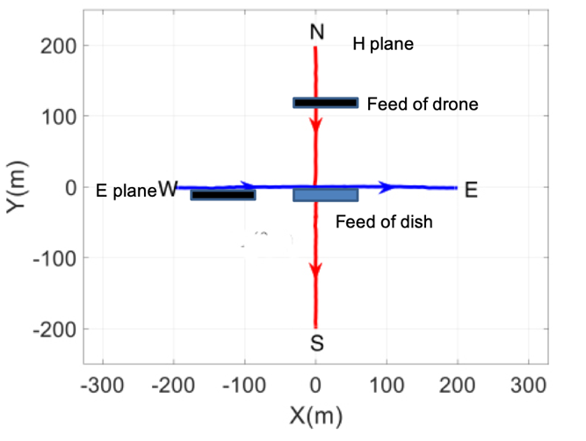
Measurement on H plane & E plane
Feed of drone
half-wave dipole beam pattern
Feed of dish

Slide 20

RFI Flagging
SumThreshold Offringa et al. 2010
Comare the sum of data samples with
the given thresholds
SIR operator Offringa et al. 2012
Effectively fill in the gaps in the
previous results.

Slide 21
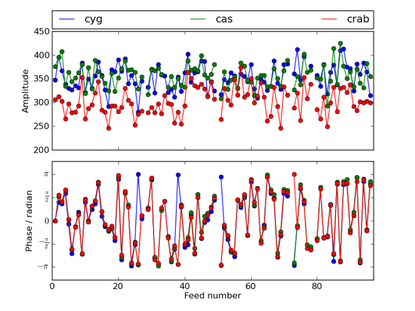
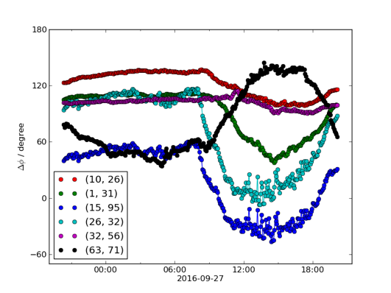
Calibration
sky point source calibration
Use an Eigenvector-based point
source calibration method.
noise source calibration
Corrects for the time variation
of the phase.
Zuo et al. 2018

Slide 22

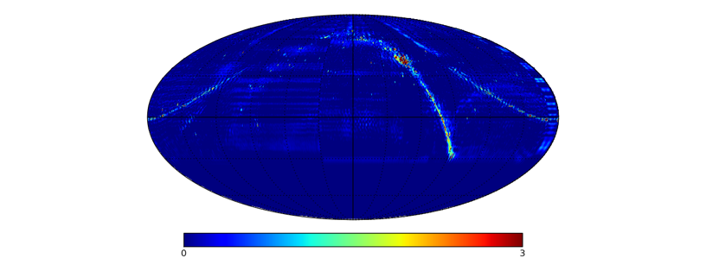
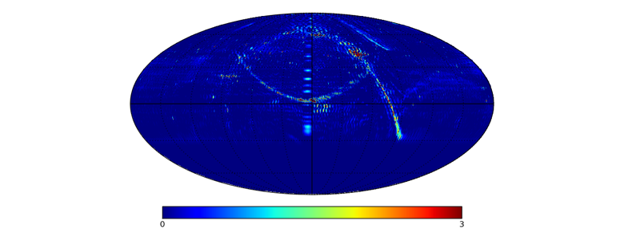
Map-making
Using the m-mode analysis method (Shaw et al. 2014, Zhang et al. 2016)
Tikhonov regularization
2016/09/27 – 2016/10/02
2018/03/22 – 2018/03/28

Slide 23
Map-making
simulated imaging map
observation imaging map

Slide 24
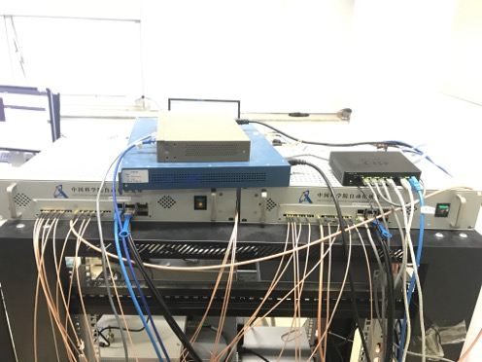
Next: FRB search
  32-channel FRB backend
  --Install on site before the end of 2019
  2 snap2 boards, each with 16 RF input ports (working separately)
  GPU de-dispersion
  192-channel FRB backend
--2020
beam former
de-dispersion

Slide 25
Tianlai Summary
The Tianlai pathfinders have been operating for a few years, validation analysis in progress
Prelimnary results indicate the arrays are stable
FRB search backends coming soon

Slide 26

The Status of the Tianlai Array
Discovering the Sky at the Longest wavelength (DSL)

Slide 27
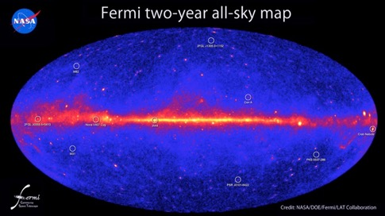
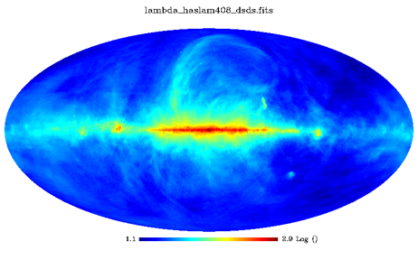
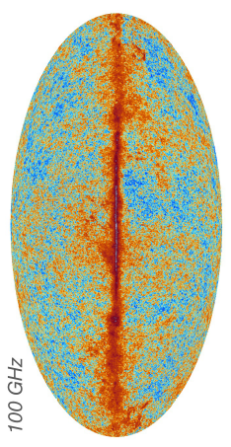
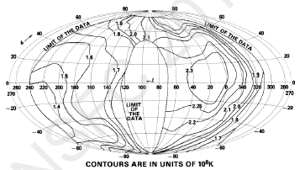
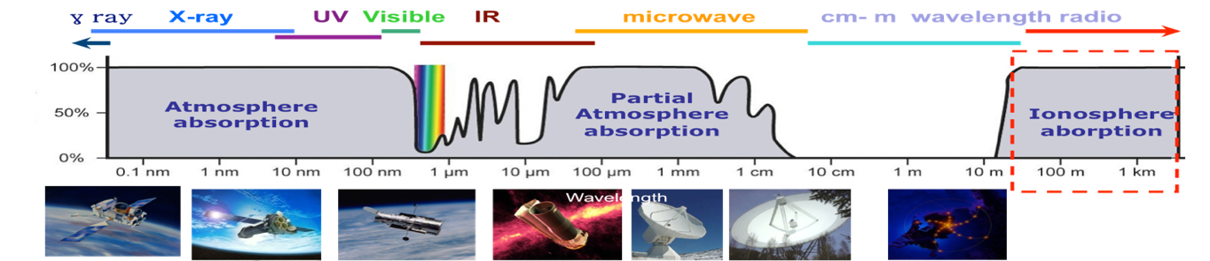
Sky in different wavelengths
408 MHz Sky Map
Gamma-ray Sky Map (Fermi Satellite)
Due to ionosphere absorption, the sky below 30MHz is still largely unknown
mm Sky Map (Planck Satellite)
Low Frequency (RAE-2 satellite)

Slide 28
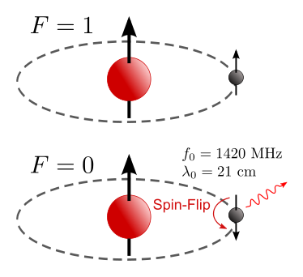
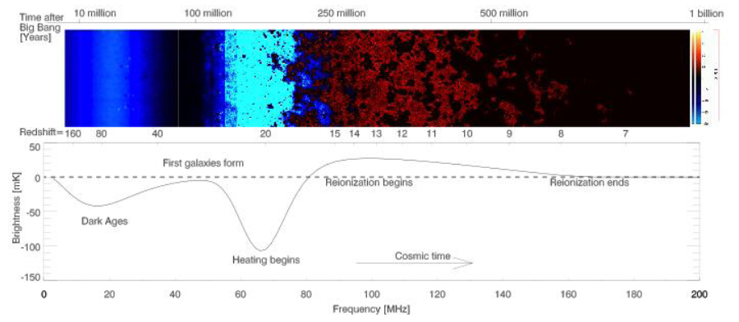
The Light in the dark age——21cm line
Neutral Hydrogen（HI）produce spectral line of 1420MHz in Frequency or 21cm in wavelength, superimposed on the radiation background
Strong Absorption line can be produced by Dark Age and Cosmic Dawn (XC & J. Miralda-Escude 2004,2008)
These are now redshifted to low frequencies

Slide 29
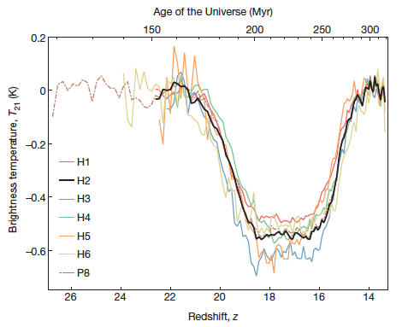
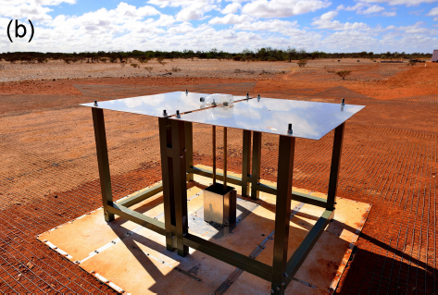
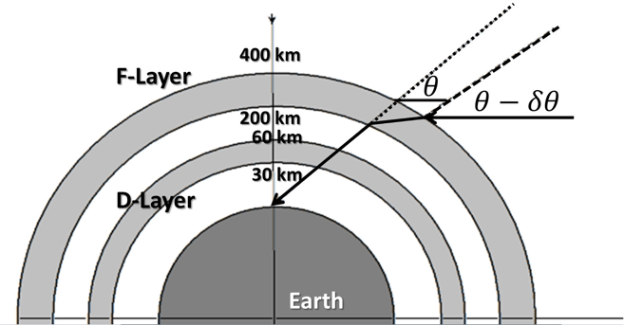
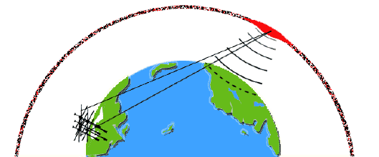
New Results from the EDGES Experiment
Bowman et al. 2018, Nature
Vedantham & Koopermans (2015）

Slide 30
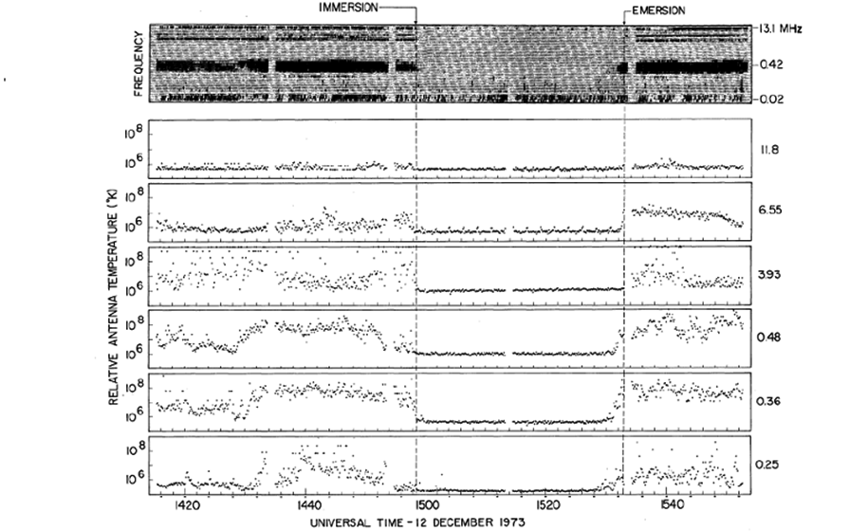
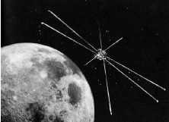
The advantage of the Lunar Orbit
RAE-2 satellite and its spectrum measurement
The Moon can block the radiation from Earth
Lunar surface—need to solve the problem of data transmission relay, and power supply during long lunar night
lunar satellite: observe in the backside of moon, and transmit data back in front side
Lunar orbit period is a few hours, can use solar power

Slide 31
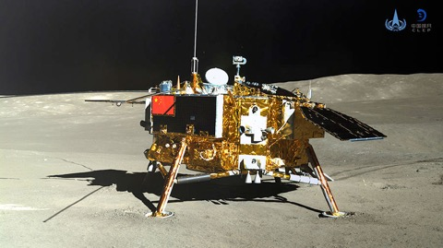
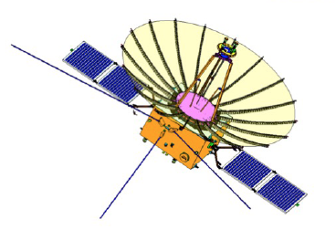
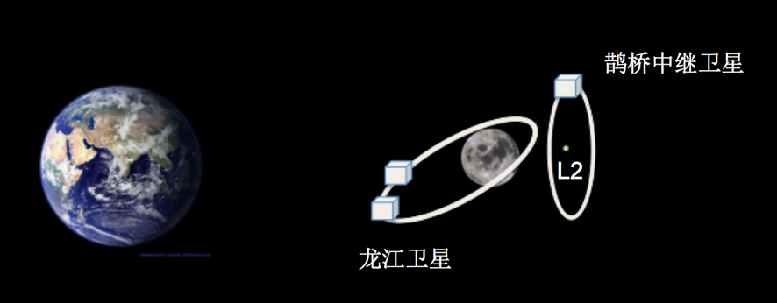
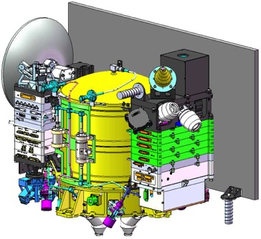
Experiments during CE-4 mission
CE-4 Lander
Netherland-China Low frequency Experiment (Relay Satellite)
Longjiang Orbiting satellites (piggy-back on relay satellite launch)

Slide 32
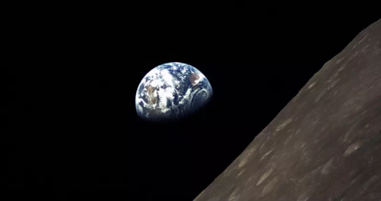
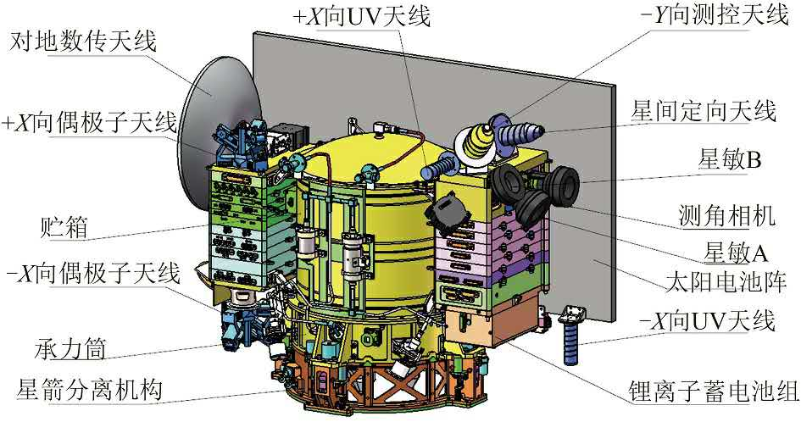
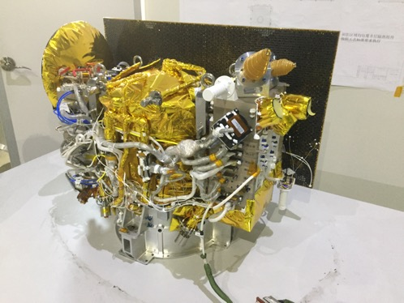
Longjiang:
Orbit: 21 hour elliptic orbit, 350 – 13700 km
working time per orbit: 10-20 min.
LJ-1 lost shortly after launch

Slide 33
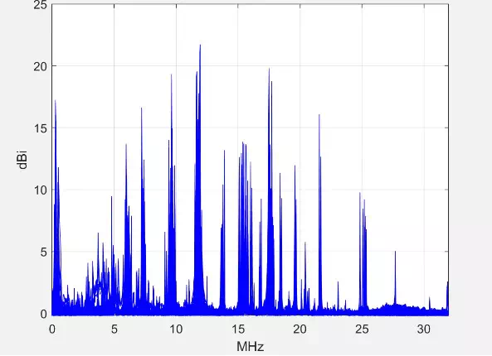
Problems
self-generated RFI

Slide 34
Result

Slide 35
Lunar Orbit Array DSL
An interferometer array with one mother satellite and 5~8 daughter satellites, on a 300km circular orbit
To obtain high resolution sky map at ultralong wavelength, openning up new window in eletromagnetic spectrum
high precision measurement of global spectrum, to probe dark age and cosmic dawn

Slide 36
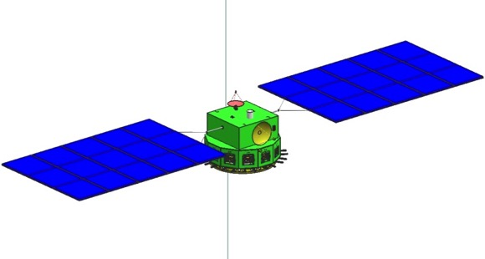
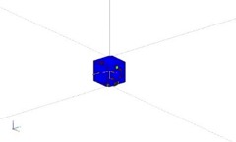
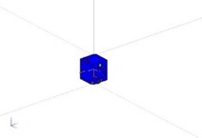
Interferometer Array Realization
No need for high precision adjustment of satellite positions, but do need high precision of relative position measurement
Synchronization, Distance Measurement, Data Communication: microwave link between mother and daughter satellites
Angular position: mother satellite carrying blinking LED lamp, daughter satellites use star sensor to determine position
mother satellite：
synchronization, angular measurement target, distance measurement, global spectrum, collecting data, downlink communication
daughter satellites：
angular measurement, interferometry measurement, inter-satellite communication with mother satellite
θ
Star background
for angle measurement
communication, ranging and synchronization through microwave link

Slide 37
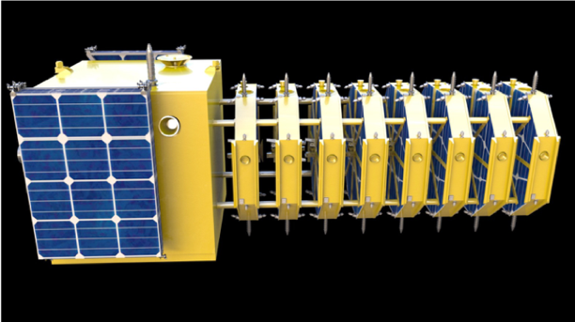
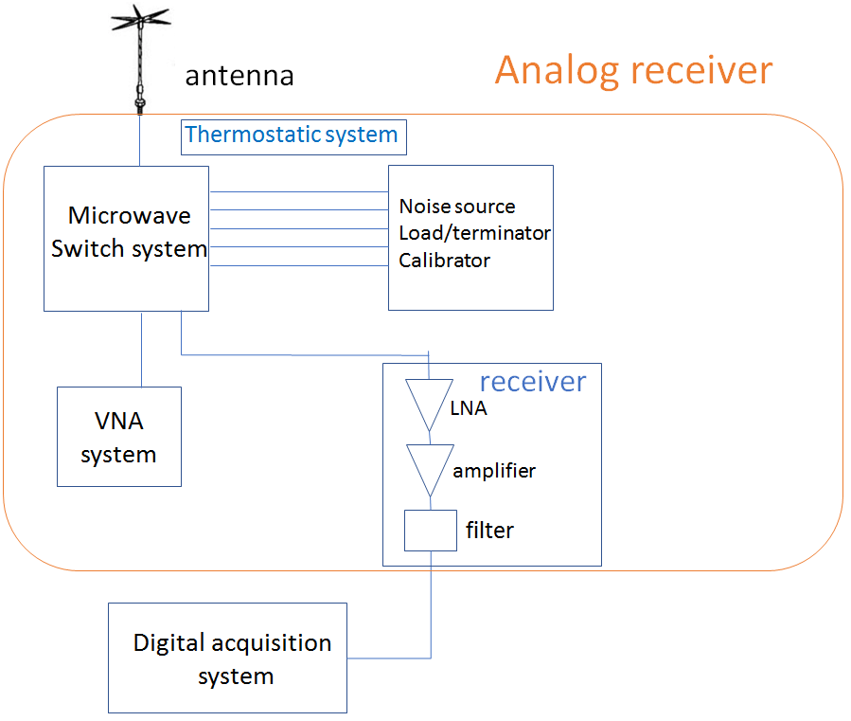
Key Technology and Challenges
Satellite Formation Fly in lunar orbit with large variation on scales
Precision Measurement of Relative Positions and synchronization
High precision calibration of phase and amplitude
Imaging algorithm with large field of view, 3D baseline distribution, and time-dependent blockage
Electromagnetic interference (EMI) suppresion and removal
Spectrometer

Slide 38
Some Key Parameters
System | Parameter
Number of Satellites | 1 mother + 5~8 daughters
Orbit | 300km lunar cirlcular orbit，about 30⁰ inclination
Baselines | 0.1~100km
Sensitivity | <0.1K@30MHz（1 year integration,1MHz BW）
angular resolution | <0.2 degree@1MHz，0.012 degree@30MHz
Individual
Polarization | 3 linear polarization
Frequency | 1MHz~30MHz（interferometry incl. spectrum） 30MHz~120MHz（global spectrum）
Baseline prescision in each direction (1σ) | < 1m
Synchronization | <3.3ns
Inter-satellite data communication | >20Mbps each daughter satellite

Slide 39



System Performance Analysis
Angular Resolution
Dispersion and Scattering
Δt= 4.15 x 10³ DM (ν/MHz)⁻² s
ISM and IPM scattering
Observing pulsars and FRBs would be hard due to very large dispersion delays
Depolarization
Diffraction Limit
 | 10 km baseline | 30 km baseline | 100 km baseline
1 MHz | 1.7° | 0.57° | 0.17°
10 MHz | 0.17° | 0.057° | 0.017°
30 MHz | 0.057° | 0.019° | 0.0057°
At this frequency, linear polarization is greatly reduced by depolarization. Circular polarization may be observable.
The angular resolution is limited by scattering, 100km baseline sufficient

Slide 40





Synthesis Imaging with Lunar Orbit Array
Interferometer Equation:
Conventional radio astronomy interferometer array: For nearly planar array, small field of view, small-w approximation: 2D FFT
For large FOV, or non-planar array, needs to take into account of the w-term:
3D Fourier transform:
w-projections:
w-stacking:

Slide 41


Problems
But here we face the following problems:
whole sky field of view,
problem of mirror symmetry,
3D distribution of baselines
Position-dependent blockage
mirror symmetry
baselines
Kill two birds with one stone: 3D baselines actually solves the mirror symmetry problem
Position-dependent blockage by moon:
visibility for each baseline has different part of sky blocked by the Moon!

Slide 42


Image Reconstruction
Fundamentally, the relation between the sky intensity and visibility is a time-dependent (but known) linear map.
So one can invert the map and obtain the image.
Spherical Harmonic Expansion can be employed to reduce computation
B=A S(t) I, S: screening by Moon

Slide 43



Break mirrow symmetry by 3D baselines
3D baseline distribution
planar baselines
70% planar baselines
full 3D baselines

Slide 44


Reconstruction Results
input map
Q. Huang et al.:
AJ 156, 43 (2018)
blockage
reconstructed map

Slide 45

Errors in the reconstruction result
pixel space reconstruction
harmonic space reconstruction
Reconstructed
Map
Relative Error

Slide 46

Image with asymmetric baselines

Slide 47

Problems to be solved
Effect of noise and sensitivity
Varying Sources
Antenna Directionality
Error in Position Measurement and Synchronization
Calibration Method
Reflection of the Moon
Optimal Strategy
Simulated fringes (Zuo et al. in progress)

Slide 48

Project Status
Currently undergoing intensive study, look for 2023-2025 launch.
PI: Xuelei Chen (NAOC), Technology Chief: Jingye Yan (NSSC)
International Collaboration Welcome!
Interested researchers welcome to join the Science Working Group, to discuss the science cases and key technologies
An ISSI-BJ forum report has been put published (arxiv:1907.10853). Also discussed in Peering into the Dark (Ages) with Low-Frequency Space Intergerometers (ESA Voyage 2050 white paper, arxiv:1908.04296)

Slide 49

Thanks!

