Slide 1
Pavel Martyshkin, Roman Lapik
Budker Institute of Nuclear Physics, Novosibirsk, Russia

Slide 2
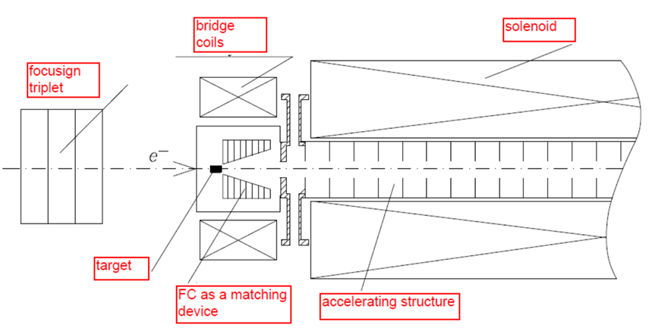
Sketch of conventional positron system unit layout

Slide 3
Classical Flux Concentrator
FC includes 2 parts
primary exciting winding
body with center cavity and narrow slit from center to a side
Peak magnetic field and Tapering field parameter are defined by a diameter value of a small hole and angle of conical cavity.
exciting winding
Mechanical structural strength of FC body is not enough.
Mounting of exciting winding is not reliable and well technical solution doesn’t exist.
First and last turns of winding have not well magnetic force compensation. Stage-by-stage winding failure is observed as a result.
Life time of device is less of 10⁹ pulses.
Peak field is about 4 Tesla.

Slide 4
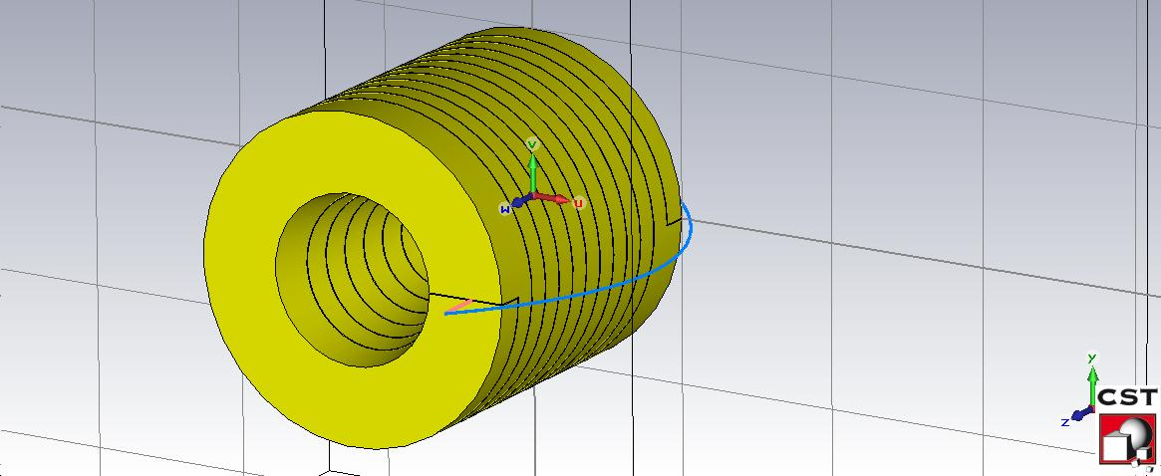
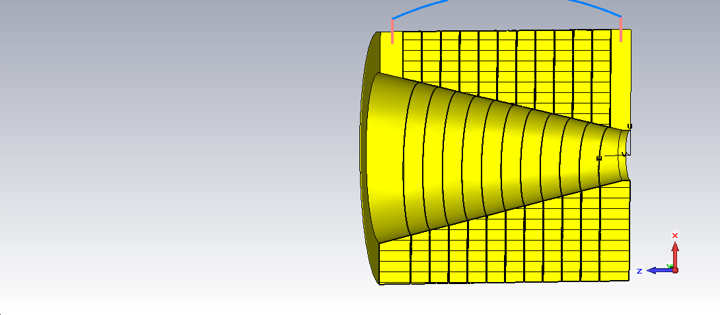
Spiral Flux Concentrator (SFC) computer model
(SLAC, SuperKEKB)
SFC diameter is 100mm
SFC length is 100mm
Min cone diameter is 7mm
Max cone diameter is 52 mm
12 turns
Current profile is a half of sine with a pulse length of 6 µs, extremely high voltage as a result
Peak field is not higher of 5 Tesla

Slide 5
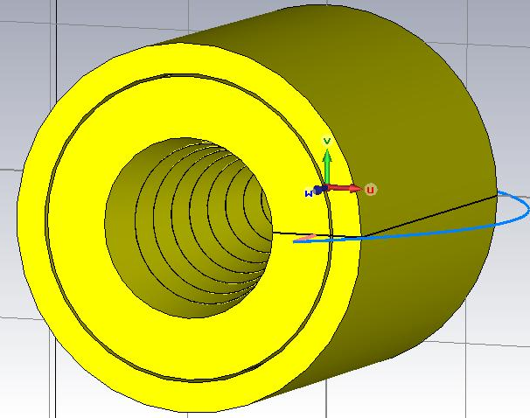
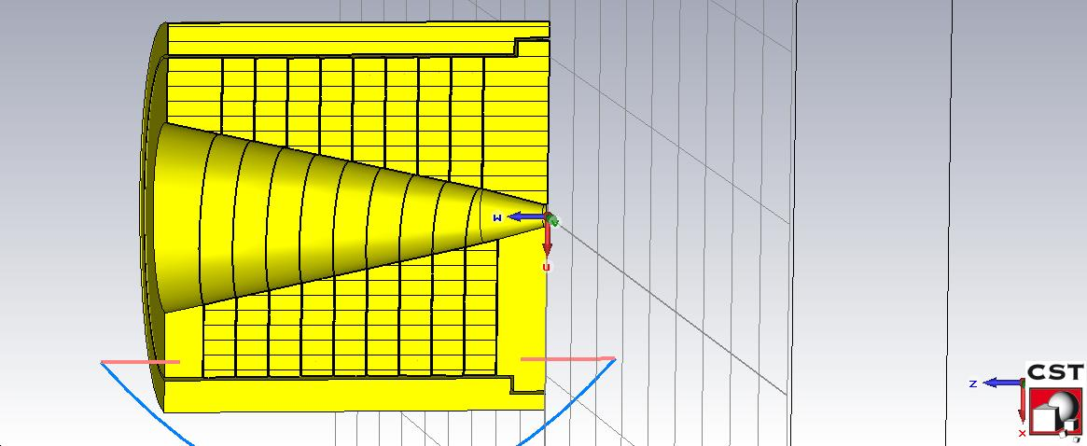
SFC with shielding computer model
SFC spiral diameter is 100mm
SFC length is 120mm
Min cone diameter is 7mm
Max cone diameter is 52 mm
Coil has10 turns
Current profile is a half of sine with a pulse length of 25 µs
Gap between turns is 0.3mm
Gap between coil and shield is 1 mm
Gap between spiral and shield is 1mm
Width of first turn is 15.4 mm
Turns width is 11.4 mm
Peak field is not higher of 7 Tesla (breakdowns)

Slide 6
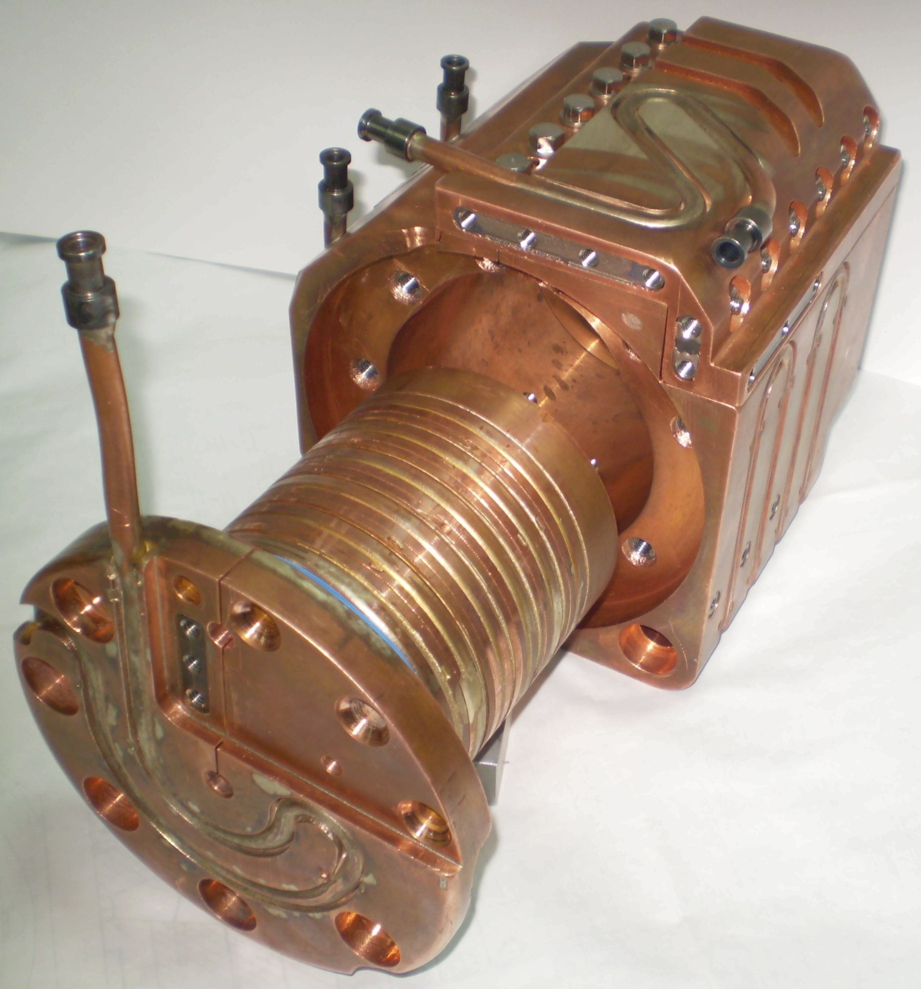
Flux Concentrator casing
Disassembled Spiral Flux Concentrator prototype of SuperKEK-B positron source
Flux Concentrator spiral

Slide 7
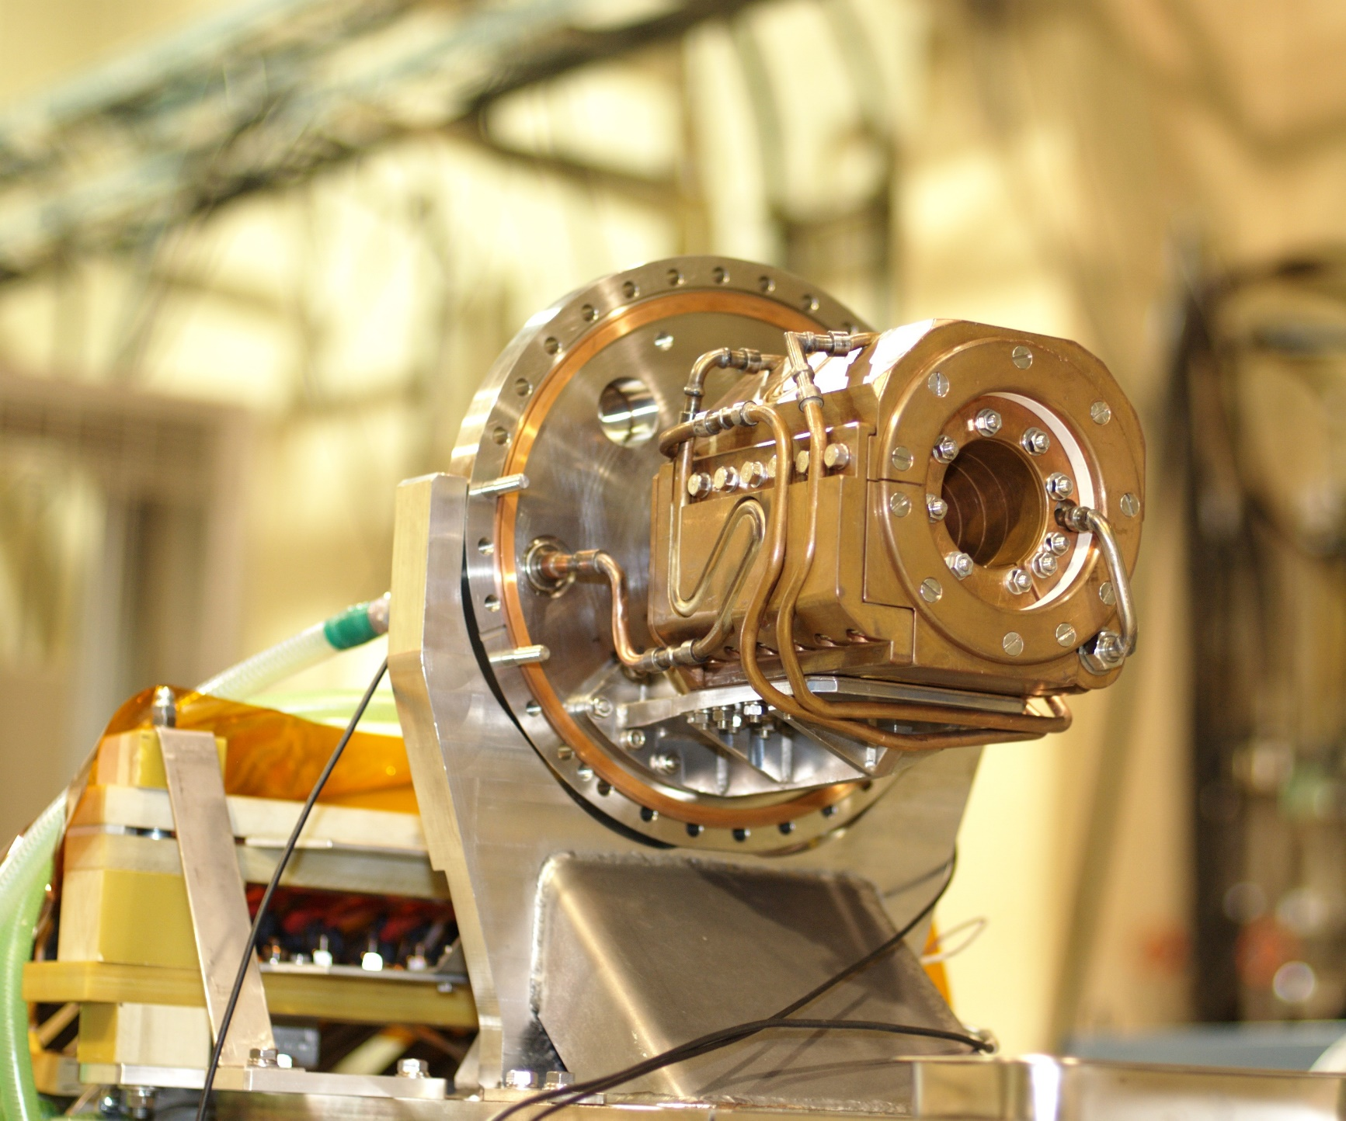
Spiral Flux Concentrator mounted into vacuum vessel (KEK December 2010)
Holding flange of vacuum vessel
Spiral FC body
Unstable operation with a magnetic field higher of 7.5 Tesla (spontaneous electrical breakdown between spiral and casing).
Reason was not clear.
Cooling pipes

Slide 8
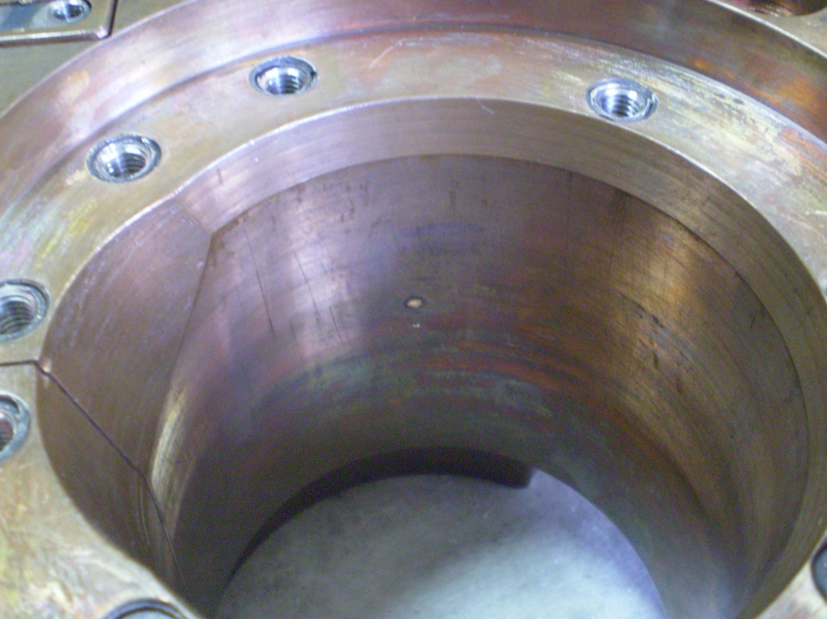
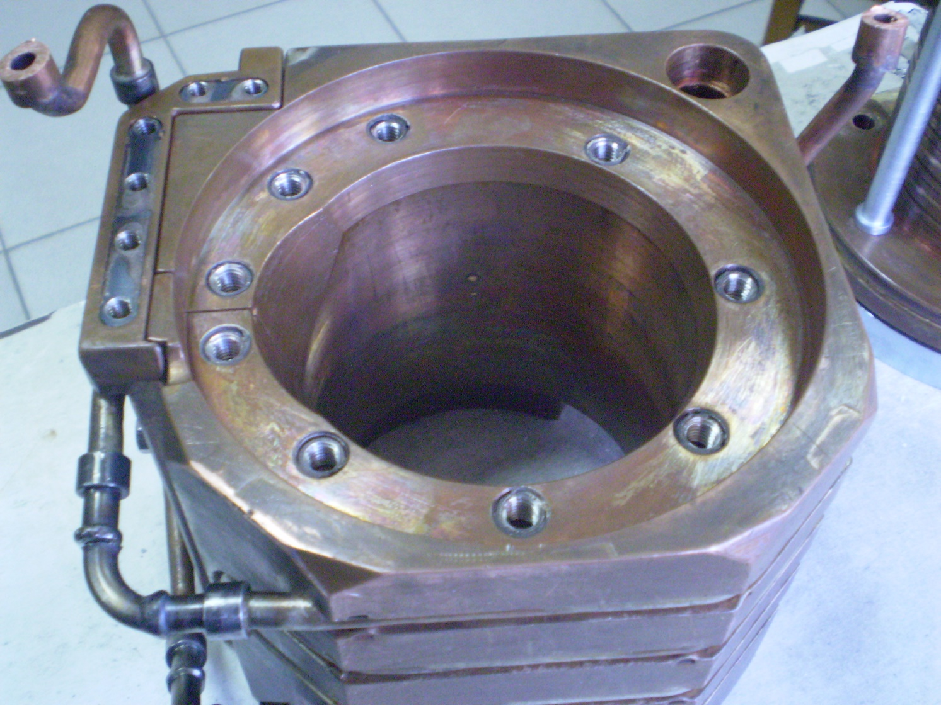
breakdown spot

Slide 9
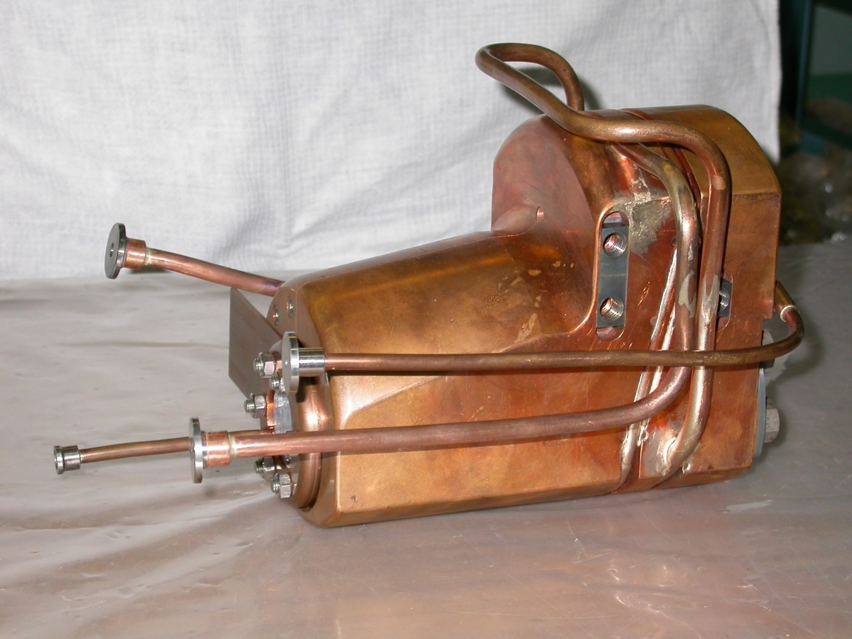
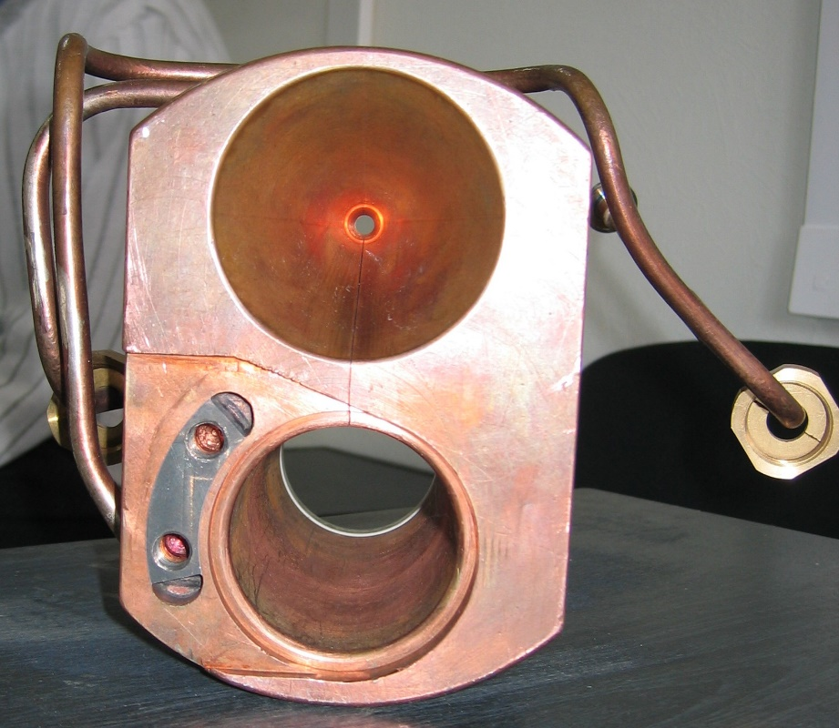
Budker INP Injector Complex Flux Concentrator
Total length is140 mm
Conical part length is 70 mm
Min cone diameter is 6 mm
Max cone diameter is 60 mm
Cone angle is ≈45 degrees
Conical cavity for a positron beam passing and cylindrical cavity for eddy current excitation are separated one from another.
FC body hasn’t any slit and is enough structural strength as result.
Exciting winding is placed into cylindrical hole and well centered by a magnetic force. Fist and last turn are well fixed with FC body.
Operated from 2001.

Slide 10
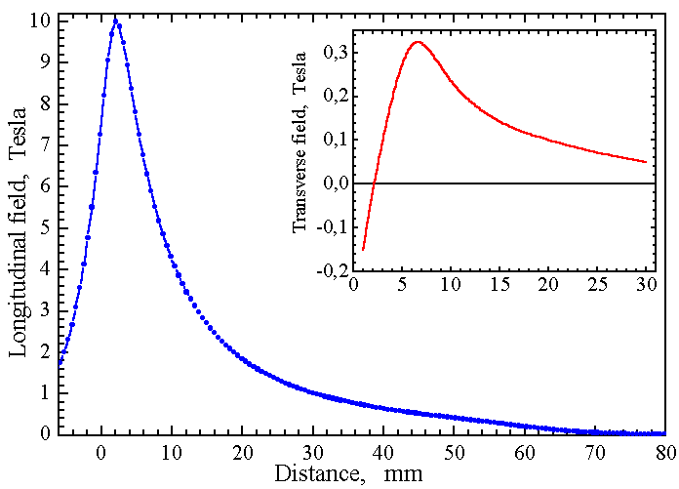
BINP Injector Complex Flux Concentrator fields

Slide 11
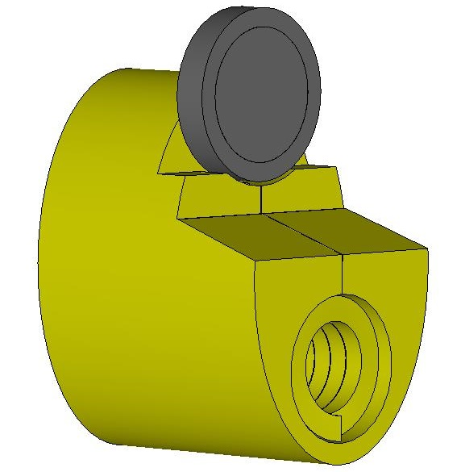
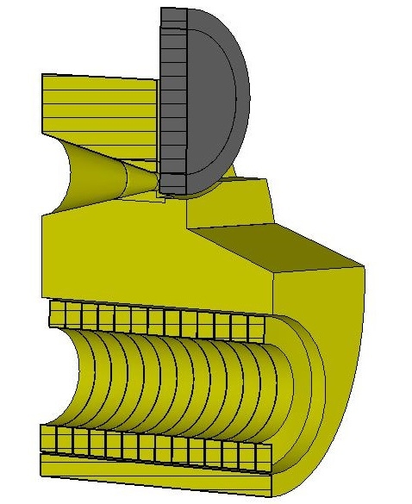
FCC-ee FC Computer model with positron production target
Elliptical cylinder 120x180 mm
Total length is140 mm
Conical cavity length is 70 mm
Min cone diameter is 8 mm
Max cone diameter is 44 mm
Cone angle is ≈29 degrees
Cylindrical hole diameter is 70 mm
Coil has 13 turns
Current profile is a half of sine with a pulse length of 25 µs
Peak current is ~ 20 kA (peak field is 7 Tesla)
Gap between coil turns is 0.4 mm
Gap between coil and FC body is 1 mm
Turns size is 9.6x14 mm
Target (W74Re26) diameter is 90 mm, thickness is 15.8 mm
Gap between target and FC front face is 2mm

Slide 12
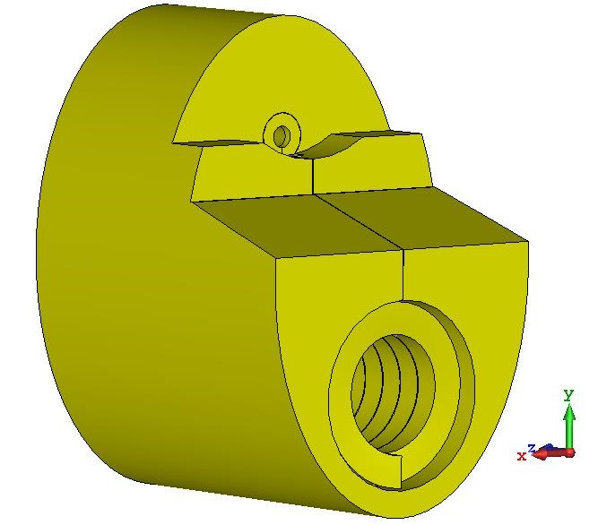
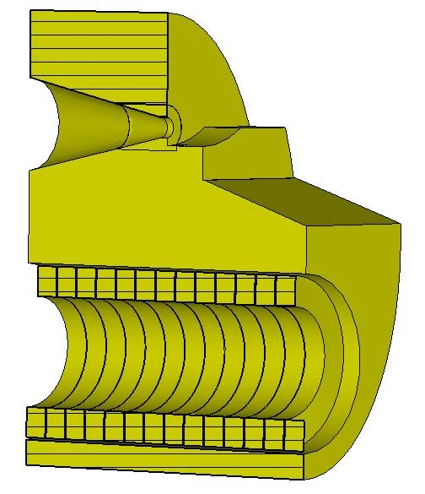
FCC-ee FC Computer model without of positron production target
Elliptical cylinder 120x180 mm
Total length is140 mm
Conical part length is 70 mm
Min cone diameter is 8 mm
Max cone diameter is 44 mm
Cone angle is ≈29 degrees
Cylindrical hole diameter is 70 mm
Coil has 13 turns
Current profile is a half of sine with a pulse length of 25 µs
Peak current is ~ 20 kA (peak field is 7 Tesla)
Gap between coil turns is 0.4 mm
Gap between coil and FC body is 1 mm
Turns size is 9.6x14 mm
Target (W74Re26) diameter is 90 mm, thickness is 15.8 mm
Gap between target and FC front face is 2mm

Slide 13
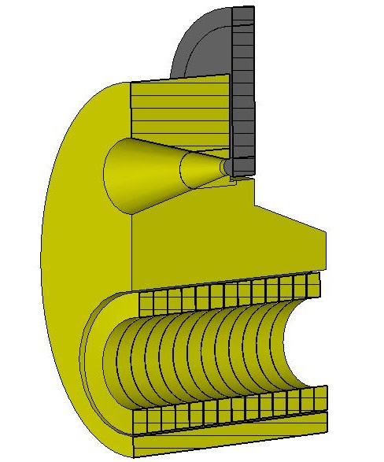
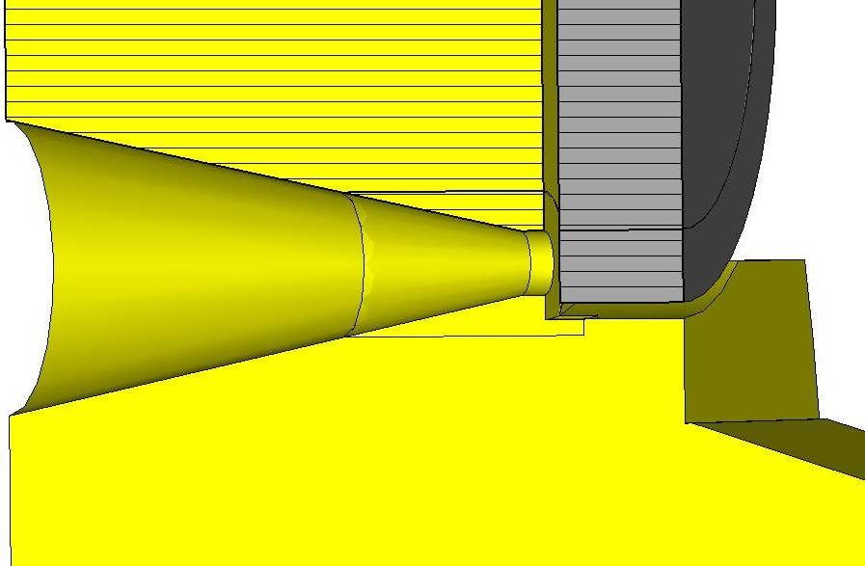
‘0’ position
Current profile is a half of sine with a pulse length of 25 µs
Gap between coil turns is 0.4 mm
Gap between coil and FC body is 1 mm
Turns size is 9.6x14 mm
Elliptical cylinder 120x180 mm
Total length is140 mm
Conical part length is 70 mm
Min cone diameter is 8 mm
Max cone diameter is 44 mm
Cone angle is ≈29 degrees
Cylindrical hole diameter is 70 mm
Coil has 13 turns
Target (W74Re26) diameter is 90 mm, thickness is 15.8 mm
Gap between target and FC front face is 2mm

Slide 14
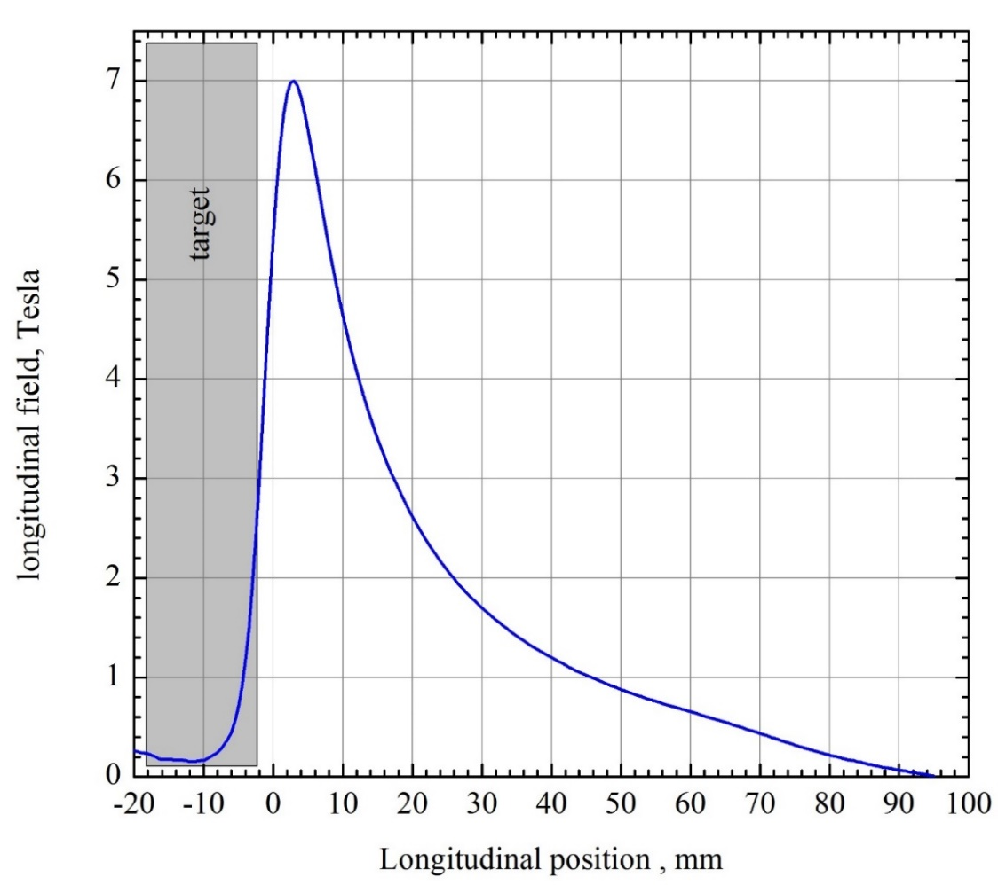
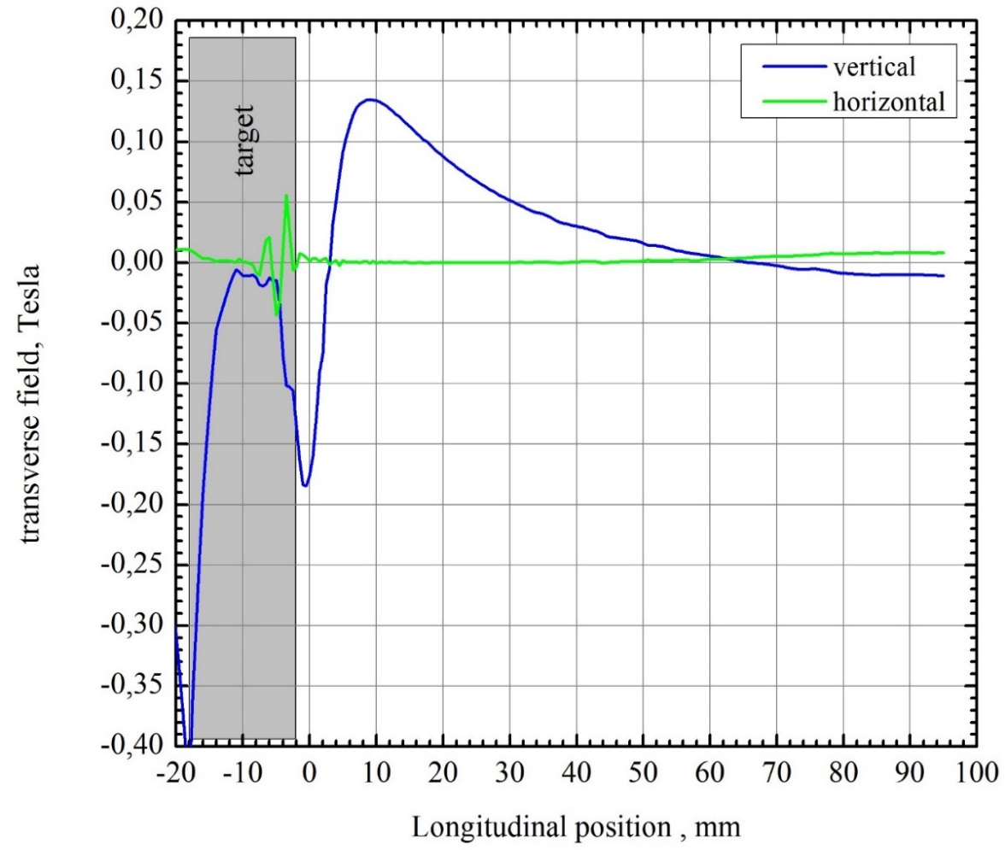
Magnetic fields on geometrical axis of Flux Concentrator
Target position end face is -2 mm
Peak field position is 3 mm
Target position end face is -2 mm
Peak field position is 9 mm

Slide 15
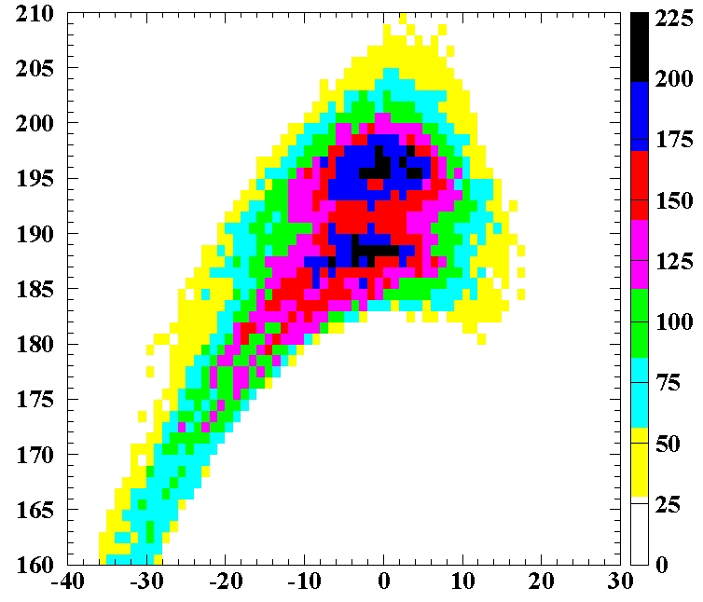
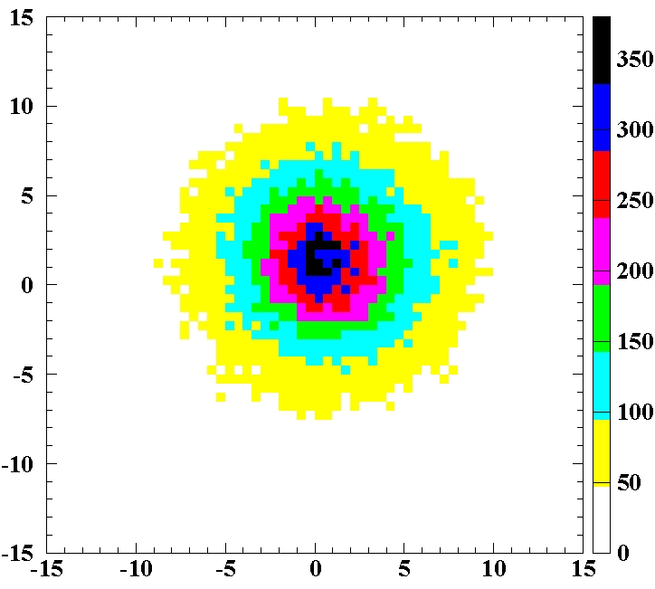
Positron bunch energy RF-phase distribution at the solenoid exit
Accelerating structure aperture is 30mm
Accelerating gradient is 20 MeV/m
Number of accelerating structures in solenoid is 3
FC peak field is 8 Tesla
Solenoid field is 0.7÷0.8 Tesla
Electron bunch length is 2mm (σ), transverse size on a target is 0.5 mm (σ)
Expected Positron Yield should be about 1.4÷1.48
Expected RMS emittance of positron bunch should be 21÷22 µm
Energy (MeV)
RF-phase (degrees)
Positron bunch transverse size at solenoid exit σ ~ 4.5 mm
horizontal offset is about 0.6 mm
vertical offset is about 1.2 mm
Y (mm)
X (mm)

Slide 16
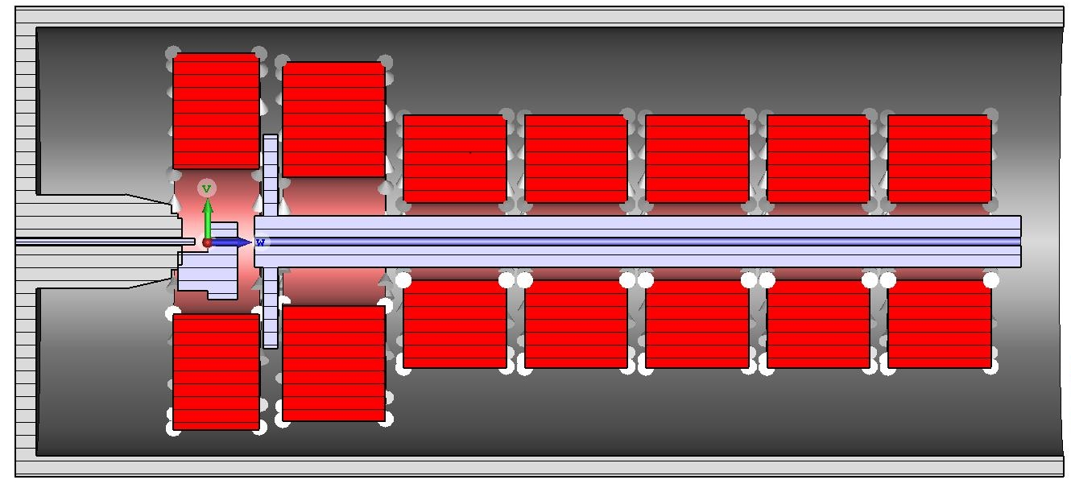

Slide 17
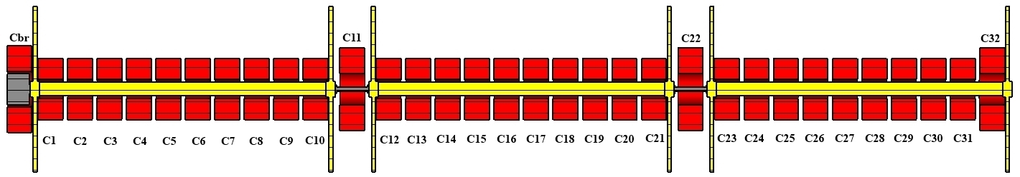
Coil # | I×N, kA•turn | Turns | Dint, mm | Dext, mm | Coil width, mm
C1÷C10, C12÷C21, C23÷C31 | 168 1 kA/turn | 168 (14×12 layers) (16×16 mm) | 180 | 590 | 240
C11,C22 | 288 1.3 kA/turn | 224 (14×16 layers) (16×16 mm) | 300 | 840 | 240
C32 | 178 0.8 kA/turn | 224 (14×16 layers) (16×16 mm) | 300 | 840 | 240
Cbr | — | — | — | — | —

Slide 18
FC parameters optimization
The nose part of FC is not optimized from point of view close location of a ferromagnetic yoke. The design with shorter nose part is preferable (20÷30 mm).
The conical angle defines FC efficiency (peak current -> peak field transformation) and vertical dipole component peak strength. The optimization of conical angle value should be done to find a some compromise between FC efficiency and dipole component value.
To check another idea how to suppress a dipole component. (???)

