Slide 1



High Energy High Luminosity e⁺e⁻ Collider using Energy-Recovery Linacs
Vladimir N Litvinenko^{1,2}, Thomas Roser² and
Maria Chamizo Llatas³
¹ Department of Physics and Astronomy, Stony Brook University, Stony Brook, NY, USA
² Collider-Accelerator Department, Brookhaven National Laboratory, Upton, NY, USA
² Nuclear and Particle Physics Directorate, Brookhaven National Laboratory, Upton, NY, USA
We present an alternative approach for a high-energy high-luminosity electron-positron collider. Present designs for high-energy electron-positron colliders are either based on two storage rings with 100 km circumference with a maximum CM energy of 365 GeV or two large linear accelerators with a high energy reach but lower luminosity, especially at the lower initial CM energies. A shortcoming of the collider based on storage rings is the high electric power consumption required to compensate for the beam energy losses from the 100 MW of synchrotron radiation power [1]. We propose to use an Energy Recovery Linac (ERL) located in the same-size 100 km tunnel to mitigate this drawback. We show that using an ERL would allow large reduction of the beam energy losses while providing higher luminosity in this high-energy collider. Furthermore, our approach would allow for colliding longitudinally polarized electron and positron beams and for extending the CM energy to 500 GeV, which would enable double-Higgs production, and even to 600 GeV for production and measurements of the top Yukawa coupling.
Seminar at LAL/Orsay/France, February 19,2020

Slide 2
Content
e⁺e⁻ colliders under discussons
Energy recovery linac e⁺e⁻ collider
  Concept
  Luminosity
  Beam-beam effects
What we need to study further
Conclusions

Slide 3
Under discussions
Japan
CERN
China

Slide 4
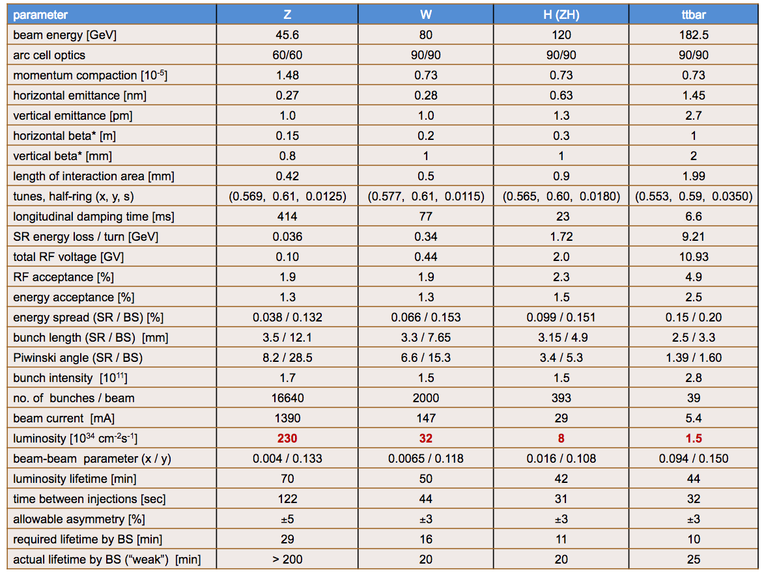
The ring-ring FCC e⁺e⁻ collider is power hungry
100 MW SR losses, ~ 200 MW wall plug power
FCC-ee: The Lepton Collider, M. Benedikt et al., Eur. Phys. J. Spec. Top. (2019) 228: 261

Slide 5
What ERL can offer: energy and particles recycling in a green e⁺e⁻ collider with 30% of FCC ee power consumption
Luminosity scales linear with SR power but 100 MW SR power is not what we are proposing
Number of detectors can be determined by the relevant physics. Luminosity can be shared by multiple detectors (split in any desirable proportions) by alternating beam collision points.

Slide 6
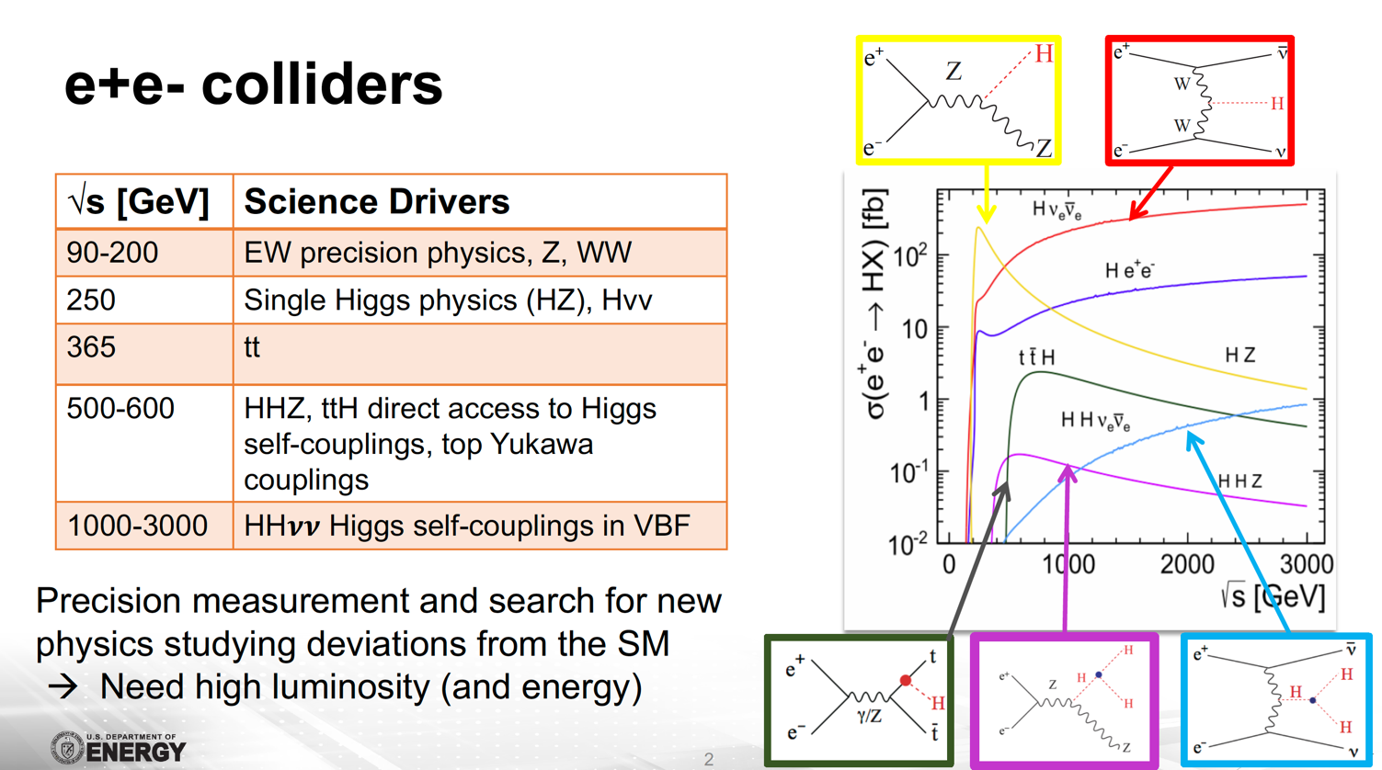
e⁺e⁻ colliders
FCC ee
ERL ee
An ERL e⁺e⁻ collider would provide higher luminosity and high-energy up to c.m. energy of 500 or 600 GeV to enable double-Higgs and ttH production
_

Slide 7
Comparison of ERL and Ring colliders
In storage rings there are strong limitations on maximum allowable beam-beam tune shift and IP chromaticity (e.g. how small is β*). It favors larger emittances and higher collision frequencies.
Linear and ERL colliders, where beams collide only once, do not have such limitations!
Reduction of SR power, e.g. beam currents in both beams while keeping the luminosity high requires reduction of one, two or all factors in the luminosity denominator
.
For simplicity and better comparison, we decided to use the same IR and β* as in FCC ee design
.

Slide 8
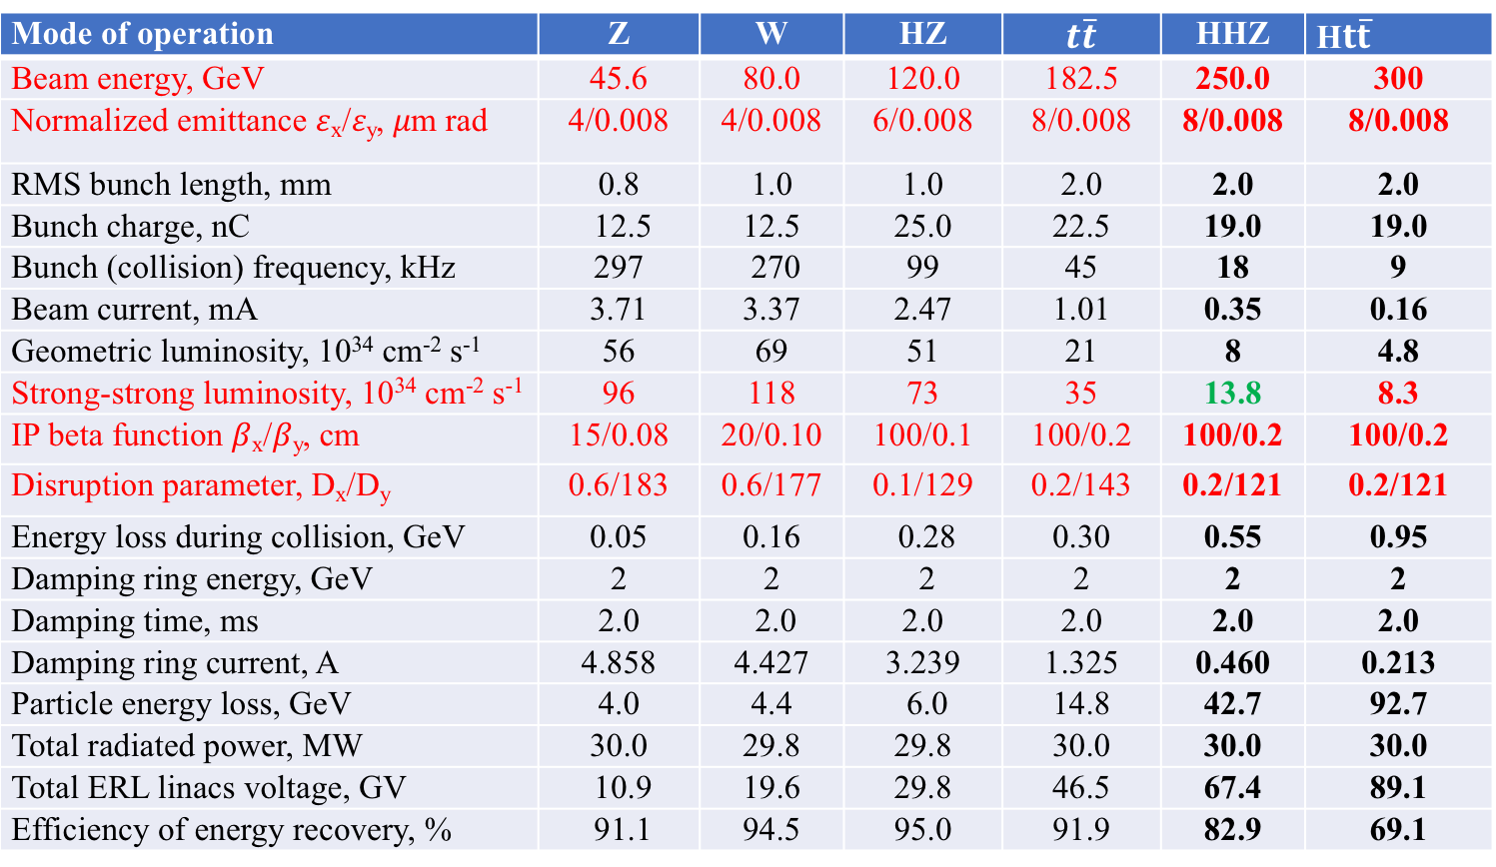
ERL collider can go to higher energy with higher luminosity
ERL e⁺e⁻ collider
FCC ee
Mode of operation | Z | W | HZ | $$t\overline{t}$$ | HHZ | H$t\overline{t}$
Beam energy, GeV | 45.6 | 80.0 | 120.0 | 182.5 | 250.0 | 300
Normalized emittance 𝜀_{x}/𝜀_{y}, 𝜇m rad | 4/0.008 | 4/0.008 | 6/0.008 | 8/0.008 | 8/0.008 | 8/0.008
RMS bunch length, mm | 0.8 | 1.0 | 1.0 | 2.0 | 2.0 | 2.0
Bunch charge, nC | 12.5 | 12.5 | 25.0 | 22.5 | 19.0 | 19.0
Bunch (collision) frequency, kHz | 297 | 270 | 99 | 45 | 18 | 9
Beam current, mA | 3.71 | 3.37 | 2.47 | 1.01 | 0.35 | 0.16
Geometric luminosity, 10³⁴ cm⁻² s⁻¹ | 56 | 69 | 51 | 21 | 8 | 4.8
Strong-strong luminosity, 10³⁴ cm⁻² s⁻¹ | 96 | 118 | 73 | 35 | 13.8 | 8.3
IP beta function 𝛽_{x}/𝛽_{y}, cm | 15/0.08 | 20/0.10 | 100/0.1 | 100/0.2 | 100/0.2 | 100/0.2
Disruption parameter, D_{x}/D_{y} | 0.6/183 | 0.6/177 | 0.1/129 | 0.2/143 | 0.2/121 | 0.2/121
Energy loss during collision, GeV | 0.05 | 0.16 | 0.28 | 0.30 | 0.55 | 0.95
Damping ring energy, GeV | 2 | 2 | 2 | 2 | 2 | 2
Damping time, ms | 2.0 | 2.0 | 2.0 | 2.0 | 2.0 | 2.0
Damping ring current, A | 4.858 | 4.427 | 3.239 | 1.325 | 0.460 | 0.213
Particle energy loss, GeV | 4.0 | 4.4 | 6.0 | 14.8 | 42.7 | 92.7
Total radiated power, MW | 30.0 | 29.8 | 29.8 | 30.0 | 30.0 | 30.0
Total ERL linacs voltage, GV | 10.9 | 19.6 | 29.8 | 46.5 | 67.4 | 89.1
Efficiency of energy recovery, % | 91.1 | 94.5 | 95.0 | 91.9 | 82.9 | 69.1

Slide 9
ERL collider concept
Interaction Regions
CERN Courier News:
“US proposal teases FCC-ee energy boost”
https://cerncourier.com/a/us-proposal-teases-fcc-ee-energy-boost/
SRF linac 1
SRF linac 2
2 GeV electron ring
2 GeV positron ring
Flat beams cooled in 2 GeV rings with “top off”
Bunches are ejected with collision frequency
Beams accelerated with SRF linacs over four 100 km long passes by-passing the IR
After collision at top energy rf phases are changed to deceleration returning most energy to SRF linac
Decelerated beams are reinjected into cooling rings, after 2 damping times (~ 4 ms) the trip repeats
ERL collider recycles (polarized) electrons and positrons
After acceleration, collision, and deceleration all electrons and positrons are reinjected into the cooling rings. Only beam losses must be made up through top-off injection.
Depolarization during acceleration, collision, and deceleration is expected to be minimal. First estimates shows 0.5% polarization loss from collision.
If this depolarization is less than the polarization build-up during the 4 ms time in the cooling rings, the electron and positron beams will eventually be longitudinally polarized.

Slide 10
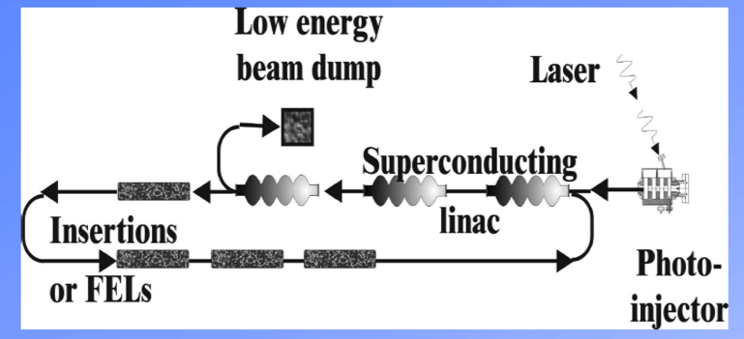
Superconducting RF Energy Recovery Linac
Invented by M. Tigner, Nuovo Cimento 37 1228 (1965)
followed by Stanford, BINP, Jefferson Lab, JAERI, BNL, Cornell, LBNL, Daresbury and more ...

Slide 11
The e⁻ and e⁺ beam energy evolutions
in a 4-pass ERL
-
2 x 182.5 GeV: 365 GeV CM GeV tt
2 x 250 GeV: 500 GeV CM HHZ
Energy losses for SR: total 14.8 GeV
Energy losses for SR: total loss 42.7 GeV
E, GeV
E, GeV
Two 23.3 GV SRF linacs
Two 33.7 GV SRF linacs
Energy boosts
in linacs
Energy recovery into
into the SRF linacs.
Efficiency – 91.9%
Energy boosts
in linacs
Energy recovery into
into the SRF linacs
Efficiency – 82.9%
Notes:
Z

Slide 12
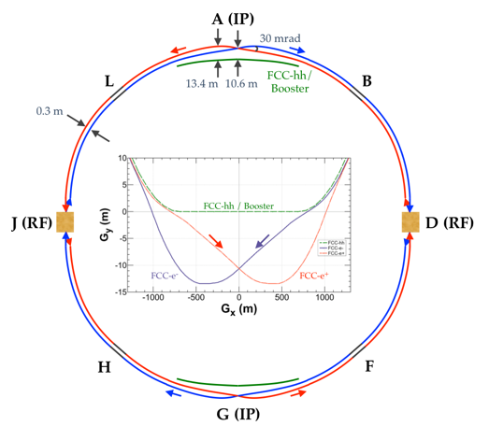
Why is the power consumption of an ERL collider lower?
In an ERL collider beam bunches collide only once (like in a linear collider). This allows much larger disruption of the bunches by the beam-beam interaction and therefore much more luminosity for a given bunch intensity. This is a more efficient use of the beam particles.
This allows to either lower the beam current (and synchrotron radiation power) for the same luminosity or increase the luminosity for same current or some of both.
A linear collider can make the same efficient use of the beam particles, but the beam is dumped after use and all the beam energy is lost.
In an ERL all the beam energy is recovered during deceleration except for the radiated synchrotron light. A high energy ERL collider can be much more energy efficient than a linear collider for a large enough circumference, about 100 km for about 300 GeV beam energy.
ERL collider
FCC-ee
ILC (Japan)
same scale

Slide 13
Beamstrahlung
Beamstrahlung is synchrotron radiation emitted due to the strong EM field of the opposing beam
Beamstrahlung can cause energy loss resulting in large energy spread and even particle loss.
Using very flat beams minimizes beamstrahlung by minimizing the EM fields
The level of beamstrahlung is expressed by the beamstrahlung parameter 𝛶, the EM field in the particle’s rest frame in units of the critical field B_{c} where nonlinear QED effects start.
The ERL collider has 𝛶 = 0.004, which corresponds to a field of about
50 T and causes an energy spread of about 0.16%
Using very flat beams is the main way of mitigating this effect
Courtesy of D. Schulte

Slide 14
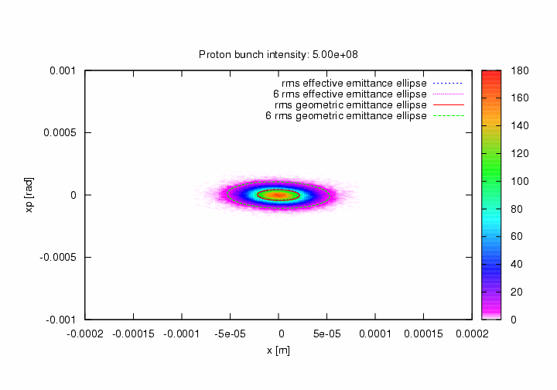
Colliding beam disruption
In ERL collider beam-beam tune shift is no longer relevant. The relevant number is the disruption parameter, where σ_{z} is RMS bunch length. :
Courtesy of Y. Hao
As part of the ERL-based eRHIC studies we demonstrated that disruption parameter up to 200 for electron beam colliding with hadron beam can be tolerated : transverse beam emittance will double in a single collision, but the beam than can be comfortably energy recovered. Movie shows evolution of electron beam distribution when beam propagate though proton beam with total disruption parameter ~ 150.

Slide 15
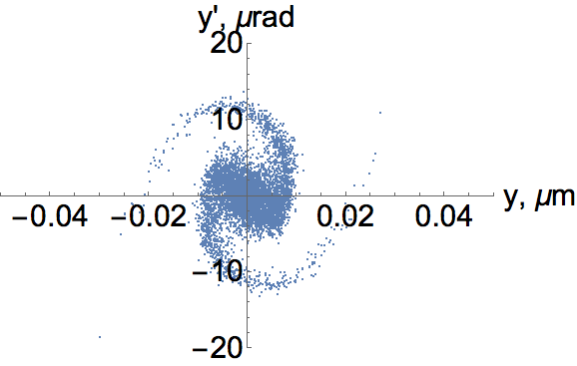
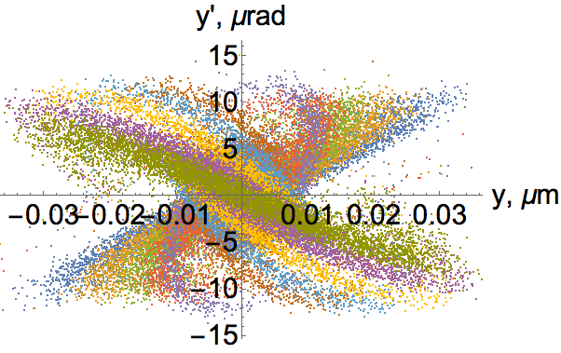
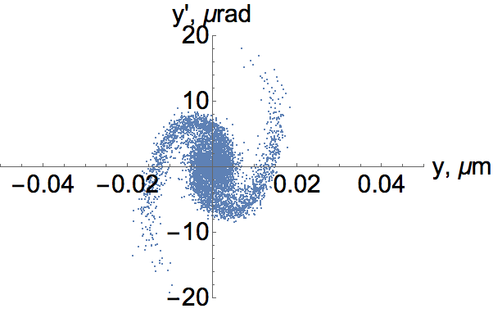
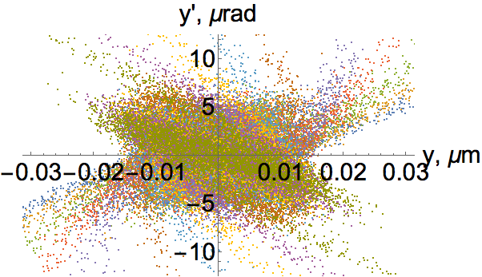
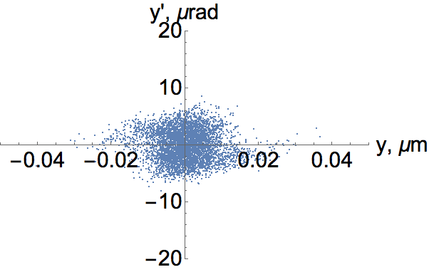
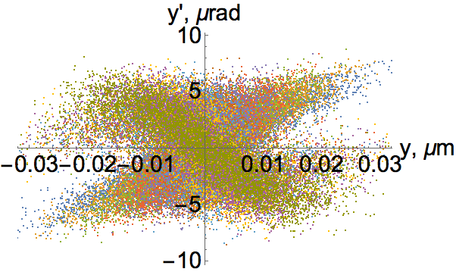
Strong-strong collisions of flat beams in ERL e⁺e⁻ collider
(a) (b)
(c) (d)
https://arxiv.org/pdf/1909.04437.pdf
(e) (f)
Beam distribution in the vertical phase space after the collision. Distributions of the central slice are on the left and combinations of 10 slices covering evenly -3σ_{z} < z< 3σ_{z} , are on the right: (a-b) are for center particles at x=0; (c-d) are for those at x= σ_{x}, (e-f) is for that at x= 2σ_{x}. The horizontal axes are the vertical coordinate and the vertical axes are vertical angle of the particle

Slide 16
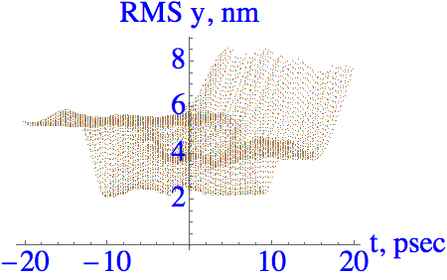
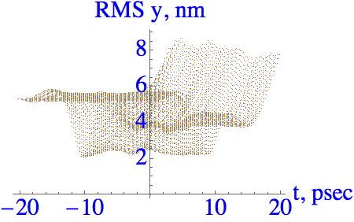
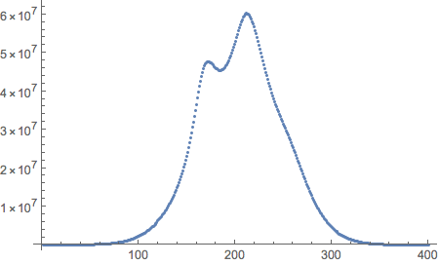
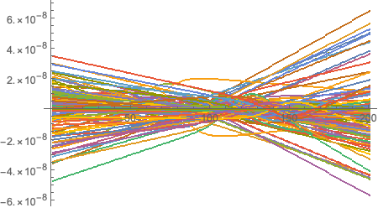
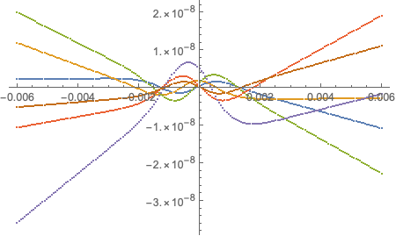
Details on head-on collisions: 2 beams x 250 GeV
Electron beam
Positron beam
Instantaneous luminosity (a.u.)
Random sample of electron’s trajectories
Pinch effect on luminosity
x/σ_{x}

Slide 17
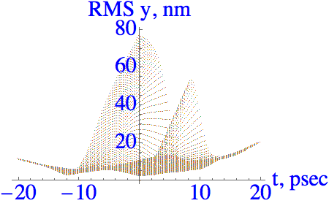
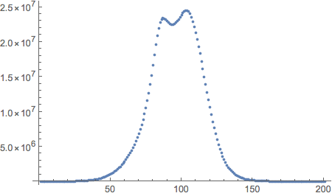
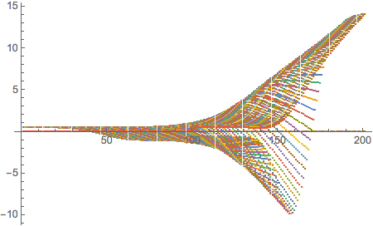
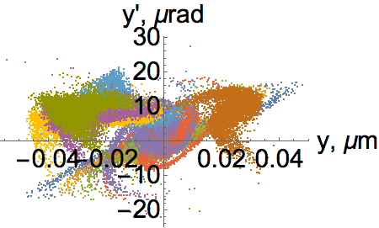
Effect of beam’s offsets in IP
Initial beam axis separation is Δy=1σ_{y}
Beam centroids evolution in units
of σ_{y} at the beam waist.
Instantaneous luminosity (a.u.)
Faster drop
after the IP
center
L/L_{max}
Δy/σ_{y}
Main effect from offsets: RMS vertical beam emittance increases ~ 10X after collisions. It does not present any problems for the energy and particles recovery. It may require to increased time in the cooling rings to three-to-four damping times – this should be optimized for actual orbit deviations
Reduction of the luminosity is modest – actually the pinch effect continued delivering significant gain at all deviations of beam orbits

Slide 18
Key differences
Parameter | Ring-Ring @185.5 GeV | ERL-ERL @185.5 GeV | ILC @250 GeV | CLIC @190 GeV
Norm. emittance 𝜀_{x}/𝜀_{y}, 𝜇m rad | 518/0.964 | 8/0.008 | 10/0.035 | 1/0.030
IP beta function 𝛽_{x}/𝛽_{y}, cm | 100/0.20 | 100/0.20 | 10/0.05 | 80/0.01
RMS bunch length, mm | 2.00 | 2.00 | 0.30 | 0.07
Bunch charge, nC | 46.2 | 22.5 | 3.2 | 0.8
Bunch frequency, kHz | 116.9 | 45 | 6.5 | 17.6
Beam current, mA | 5.400 | 1.010 | 0.021 | 0.015
Disruption parameter, D_{x}/D_{y} | N/A | 0.20/143.0 | 0.30/24.3 | 0.24/12.5
Crossing angle | YES | NO | YES | YES
Energy spread at collision, % | 0.18 | 0.16 | - | -
Particle energy loss, GeV | 9.2 | 14.8 | 250.0 | 190.0
Total radiated power, MW | 100.0 | 30.0 | 10.4 | 5.6

Slide 19
Status of our studies
This preliminary study was done by us on our own time without any official support from BNL or an US agenicy. It is limited in both in the scope and the depth.
Clearly, a detailed in-depth study, similar to those done for the ILC/CLIC and FCC ee designs, is needed to fully authenticate this concept and to take into consideration both the complexity and construction cost.
We currently obtained limited support from BNL PD (Program Development) program to support a PhD student from Stony Brook University and a portion of accelerator physicist time to further explore this concept
We definitely interested to hear from HEP community how important is the increasing luminosity at high energies and extending c.m. energy to 500 GeV (or even 600 GeV) or/and availability of longitudinally polarized beam

Slide 20
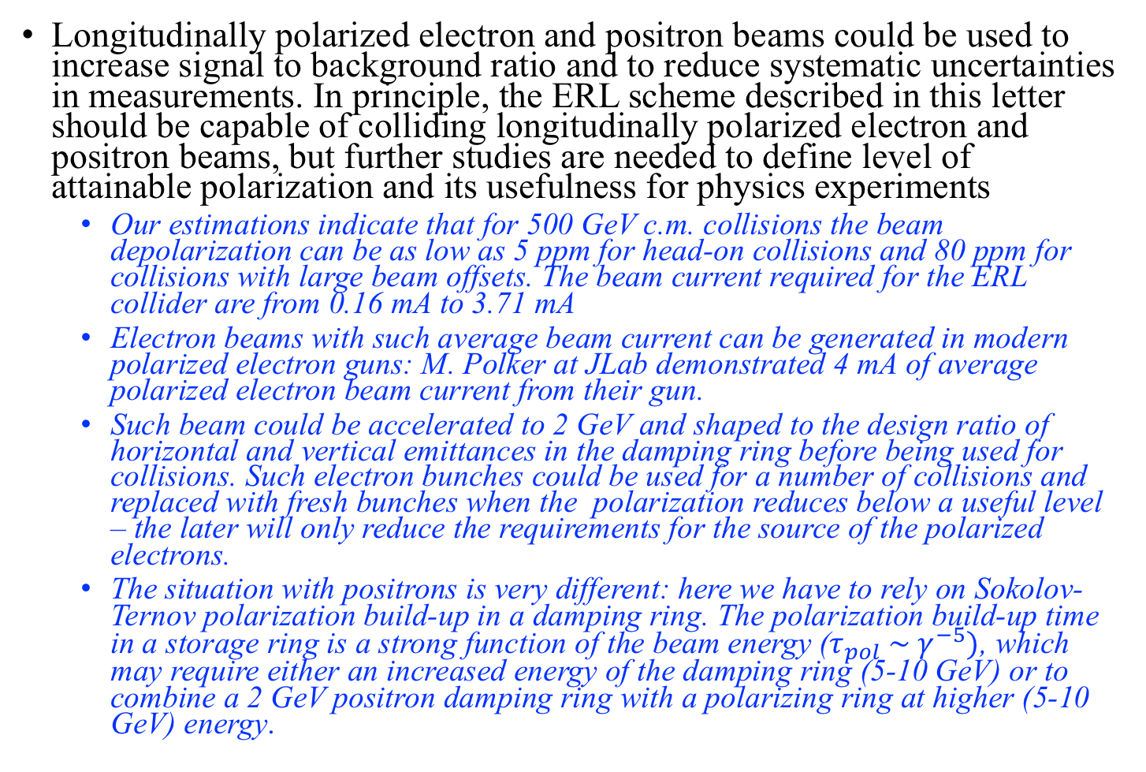
Status of our studies … cont
Longitudinally polarized electron and positron beams could be used to increase signal to background ratio and to reduce systematic uncertainties in measurements. In principle, the ERL scheme described in this letter should be capable of colliding longitudinally polarized electron and positron beams, but further studies are needed to define level of attainable polarization and its usefulness for physics experiments
  Our estimations indicate that for 500 GeV c.m. collisions the beam depolarization can be as low as 5 ppm for head-on collisions and 80 ppm for collisions with large beam offsets. The beam current required for the ERL collider are from 0.16 mA to 3.71 mA
  Electron beams with such average beam current can be generated in modern polarized electron guns: M. Polker at JLab demonstrated 4 mA of average polarized electron beam current from their gun.
  Such beam could be accelerated to 2 GeV and shaped to the design ratio of horizontal and vertical emittances in the damping ring before being used for collisions. Such electron bunches could be used for a number of collisions and replaced with fresh bunches when the polarization reduces below a useful level – the later will only reduce the requirements for the source of the polarized electrons.
  The situation with positrons is very different: here we have to rely on Sokolov-Ternov polarization build-up in a damping ring. The polarization build-up time in a storage ring is a strong function of the beam energy ($τ_{pol} \sim γ^{−5})$, which may require either an increased energy of the damping ring (5-10 GeV) or to combine a 2 GeV positron damping ring with a polarizing ring at higher (5-10 GeV) energy.

Slide 21
Important challenges
Transport beamline lattice preserving a small vertical emittance
Using small gap magnets to reduce power consumption of these beamlines
Spreaders and combiners to propagate beams through the SRF linacs
High-order mode (HOM) damping of the SRF cavities to avoid transverse beam-breakup instability (TBBU)
Absolute beam energy measuring systems with accuracy ~ 10⁻⁵ (similar to that implemented for CEBAF) at IRs
Attaining a high degree of longitudinal polarization of colliding beams
High repetition rate ejection and injection kickers for 2 GeV damping rings
Compressing and de-compressing electron and positron bunches to match energy acceptance of the 2 GeV damping rings

Slide 22
Optimal number of ERL passes N?
The ERL cost typically has three major components:
  Infrastructure – constant or nearly constant
  SRF linac system (RF, cryo, cavities) – scales ~ 1/N
  Magnetic and vacuum system – scales ~ N
  Graph shows how optimum changes when cost of the magnets/vacuum system changes four times
  Minima are always rather broad
4 passes used in this studies was an optimum for CEBAF design
In addition to cost one also should consider complexity of the machine, which calls for fewer (2 or 3?) passes
SRF linac cost for ERL based collider is ~ 1/2N of that for ILC-type linear collider having the same c.m. energy
Even with a single pass, the ERL collided will need a half of the SRF linac
N

Slide 23
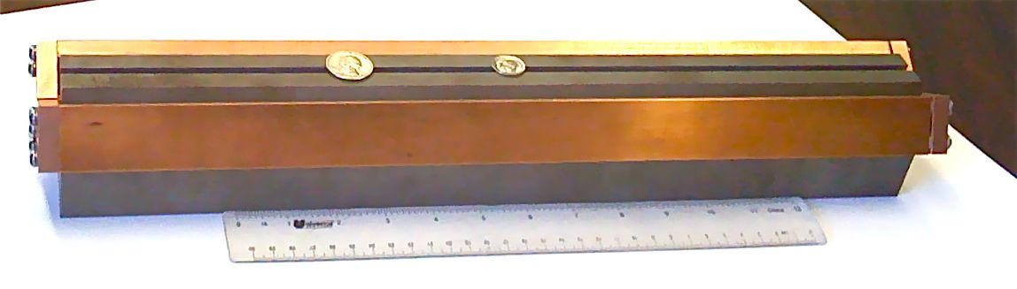
Possible arcs layout for 4-path of 182.5 GeV ERL
Electrons and positrons alternate the inside and outside passes
IRs side arcs (after linac 2)
Main portion (5/6) of the ring arcs
e⁻
e⁺
2 GeV decel.
e⁻
e⁺
14.45 GeV decelerating
e⁻
25.25 GeV accelerating
61.02 GeV decelerating
37.7 GeV decel.
182.25 GeV
colliding e⁺e⁻
48.5 GeV accel.
71.74 GeV accelerating
84.33 GeV decel.
108.28 GeV decelerating
94.86 GeV accel.
118.02 GeV accelerating
131.85 GeV decel.
158.33 GeV decelerating
140.24 GeV accel.
163.12 GeV accelerating
Small gap magnets with 5 mm gap
Prototyped for eRHIC at 0.43 T: FCC ee needs only 0.04 T,
e.g. it is very low power consumption magnet
Important question to answer – what it optimal number of ERL passes: 1,2, 3, 4?

Slide 24
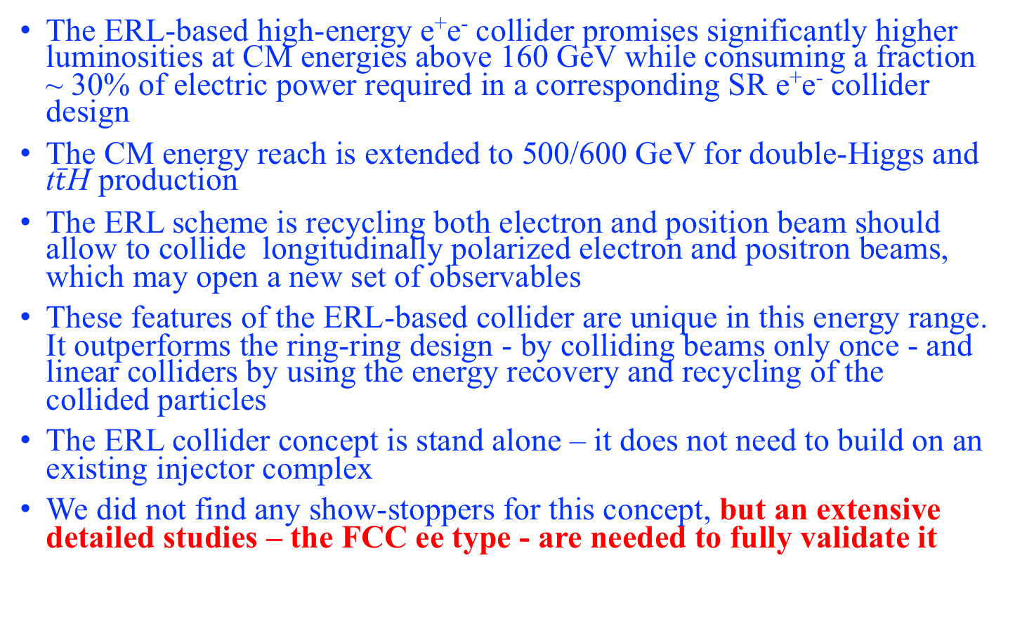
Conclusions
The ERL-based high-energy e⁺e⁻ collider promises significantly higher luminosities at CM energies above 160 GeV while consuming a fraction ~ 30% of electric power required in a corresponding SR e⁺e⁻ collider design
The CM energy reach is extended to 500/600 GeV for double-Higgs and t$\overline{t}$H production
The ERL scheme is recycling both electron and position beam should allow to collide longitudinally polarized electron and positron beams, which may open a new set of observables
These features of the ERL-based collider are unique in this energy range. It outperforms the ring-ring design - by colliding beams only once - and linear colliders by using the energy recovery and recycling of the collided particles
The ERL collider concept is stand alone – it does not need to build on an existing injector complex
We did not find any show-stoppers for this concept, but an extensive detailed studies – the FCC ee type - are needed to fully validate it

Slide 25
  In short: let’s avoid excesses
  Authors would like to thank Dr. Frank Zimmerman and FCC-design team at CERN for opportunity to present and discuss this option at their working meeting and to Dr. Andrei Seryi for pointing out importance of transverse beam offsets .
  Vladimir Litvinenko would like to acknowledge support by NSF grant PHY-1415252 “Center for Science and Education at Stony Brook University”.

Slide 26
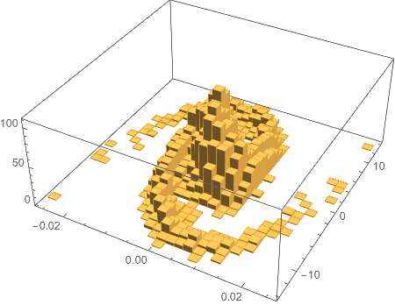
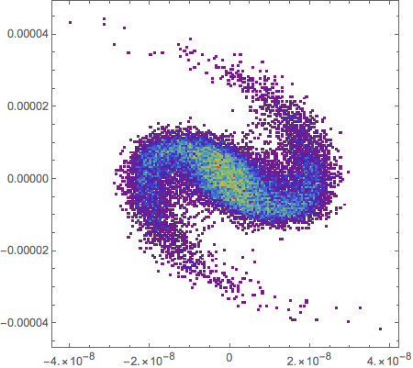
Samples: Phase space diagrams

Slide 27
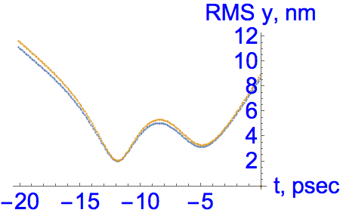
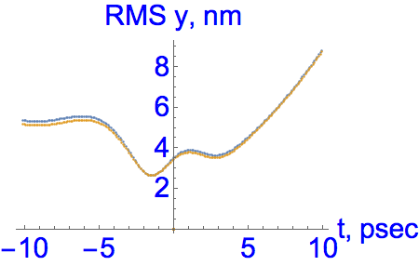
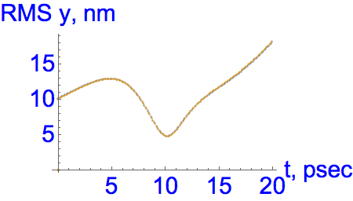
Samples: RMS beam size evolution
Head
Center
Tail

Slide 28
Samples: RMS beam size evolution
Head
Center
Tail

