Slide 1
Self-Organizing Maps (SOM) in High Energy Physics
27.04.2022
Kai Habermann, Eckhard von Toerne

Slide 2
Overview
Motivation
Self-organizing maps (SOM)
Training Alogrithms
Dataset
Analysis of data composition
Study of Higgs-enriched region

Slide 3
Why SOM in Physics?
Maschine Learning
Supervised
Unsupervised
Classification
Dimensionality reduction
Clustering
ANN, MLP, …
Trained with MC
Self-Organizing Maps

Slide 4
Unsupervised learning
Machine learning without the need for pre-classified data
SOMs are a common example of unsupervised learning
  Maps data out and provides information on clusters and the structure of the data
  Discretizes data -> clustering
  PCA is an example of unsupervised learning
We will apply SOM to particle physics data

Slide 5
Why SOM in Physics?
Maschine Learning
Supervised
Unsupervised
Classification
Dimensionality reduction
PCA
Clustering
Kmeans
ANN, MLP, BDT, …
Trained with MC
Self-Organizing Maps

Slide 6
Maschine Learning
Supervised
Unsupervised
Classification
Dimensionality reduction
PCA
Clustering
Kmeans
ANN, MLP, BDT, …
Trained with MC
Self-Organizing Maps

Slide 7
Why SOM in Physics?
Visualization
Data driven Analysis
  Simulation independent data exploration
  Problem: complex data
Clustering for feature detection
Aid in the search for rare processes

Slide 8
What is SOM?
Input Layer:
  Size of input vectors
Output Layer:
  Layer of neurons organized in a 2
  dimensional lattice
Prototype vector the size of the input
for each neuron of output layer
Topology preservation via ordering
of neurons in lattice
Mapping via distance to Prototype
vectors
„Hands-On Machine Learning with Scikit-Learn, Keras, and TensorFlow:
Concepts, Tools, and Techniques to
Build Intelligent Systems“, Aurelien Geron

Slide 9
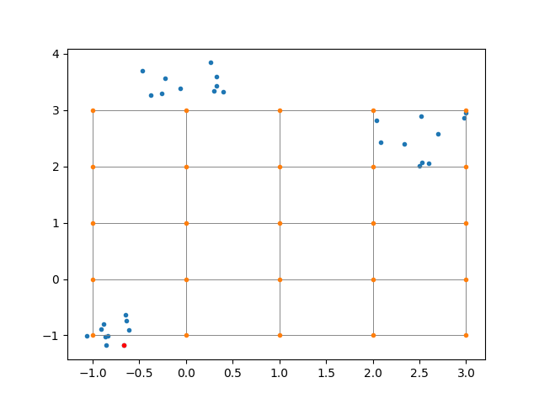
Training algorithm
Initalize weight vectors.
Select one input vector from training sample $v_{j}$.
Calculate euclidean distance $∥v_{j}-w_{i}∥$to the weight vector of each neuron $n_{i}$ and choose neuron $n_{best}$ with lowest distance.
Renew weights depending on $n_{best}$.
Repeat steps 2-4 until iteration limit is reached.
$$w_{k}^{t+1}=w_{k}^{t}+(v_{j}-w_{k}^{t})⋅β(r_{k},σ)⋅l$$
Orange: Weight vectors
Blue: Training data
Grey: Neighborhood relations
Weights will be moved closer to $v_{j}$.
$β(r,σ)=F_{gauss}(r,σ)$, $r$ distance to $n_{best}$ in the output space.
Immediate neighbors of $n_{best}$will be altered the most.
Distance relations from input space are mostly conserved.
Clustering is encouraged.
Convergence through decreasing $l$ and $σ$.

Slide 10
Training
Goal:
  Find best prototype vectors
  Preserve Topology and distance relations
Method:
  Competitive + collaborative
  Neurons compete for inputs + update neighbors [1]
Orange: Prototype vectors
Blue: Training data
Grey: Neighborhood relations

Slide 11
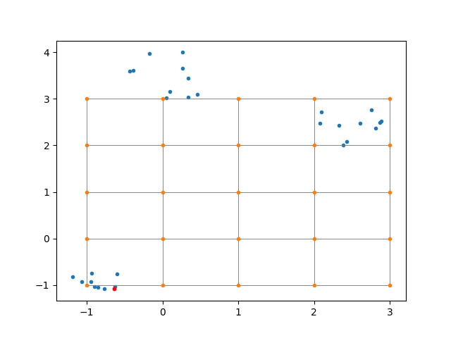
Training
Goal:
  Find best prototype vectors
  Preserve Topology and distance relations
Method:
  Competitive + collaborative
  Neurons compete for inputs, then update neighbors
Orange: Prototype vectors
Blue: Training data
Grey: Neighborhood relations

Slide 12
Improved training algorithms
Batch-SOM:
  Present entire dataset at once
  Weight vectors become $β$-weighted mean of all input vectors
Batch-SOM adjusted:
  Present a portion of the data at once
  Neuron will be updated with the $β$-weighted mean of all vectors in the batch
  Convergence again via learning rate

Slide 13
Data Sample
ATLAS Open Data¹ with $\sqrt{s}=13TeV$
Openly available dataset from ATLAS (meant for educational use)
We chose electron-muon dilepton final states $+N_{jet}≥0$ (500k events)
  Contributions from $t\overline{t}$, $Z→τ\overline{τ}$, $WW$ and Higgs
Remove 77 events with energies of more then $13TeV$
Opposite charge for leptons
$m_{T}^{ll}>70GeV$, Isolation < 0.1 (applied only after training)
Quantile transform to pull outliers in
¹http://opendata.atlas.cern/release/2020/documentation/index.html

Slide 14
Input variables
Aim: cover most of the phase space within the variables
Variables :
Transverse masses
Transverse momenta
Isolation of leptons
MV2 b-tagging
$N_{jet}$
Invariant masses
$$h=∑|p_{T}|$$
$ΔR$ between leptons
$Δϕ$ between leptons

Slide 15
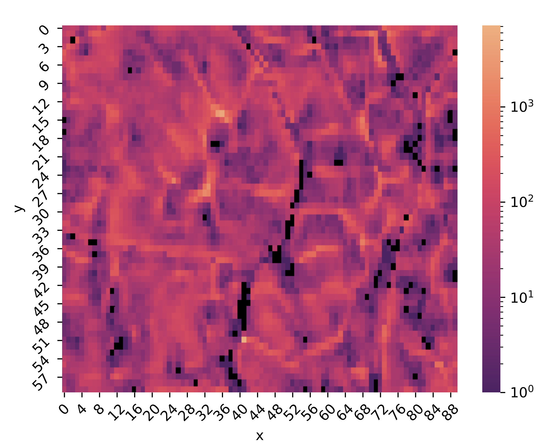
Mapped out data
SOM with 60x90 neurons
Training with batches of 500 datapoints
Each pixel represents a single neuron
z-axis shows events per neuron

Slide 16
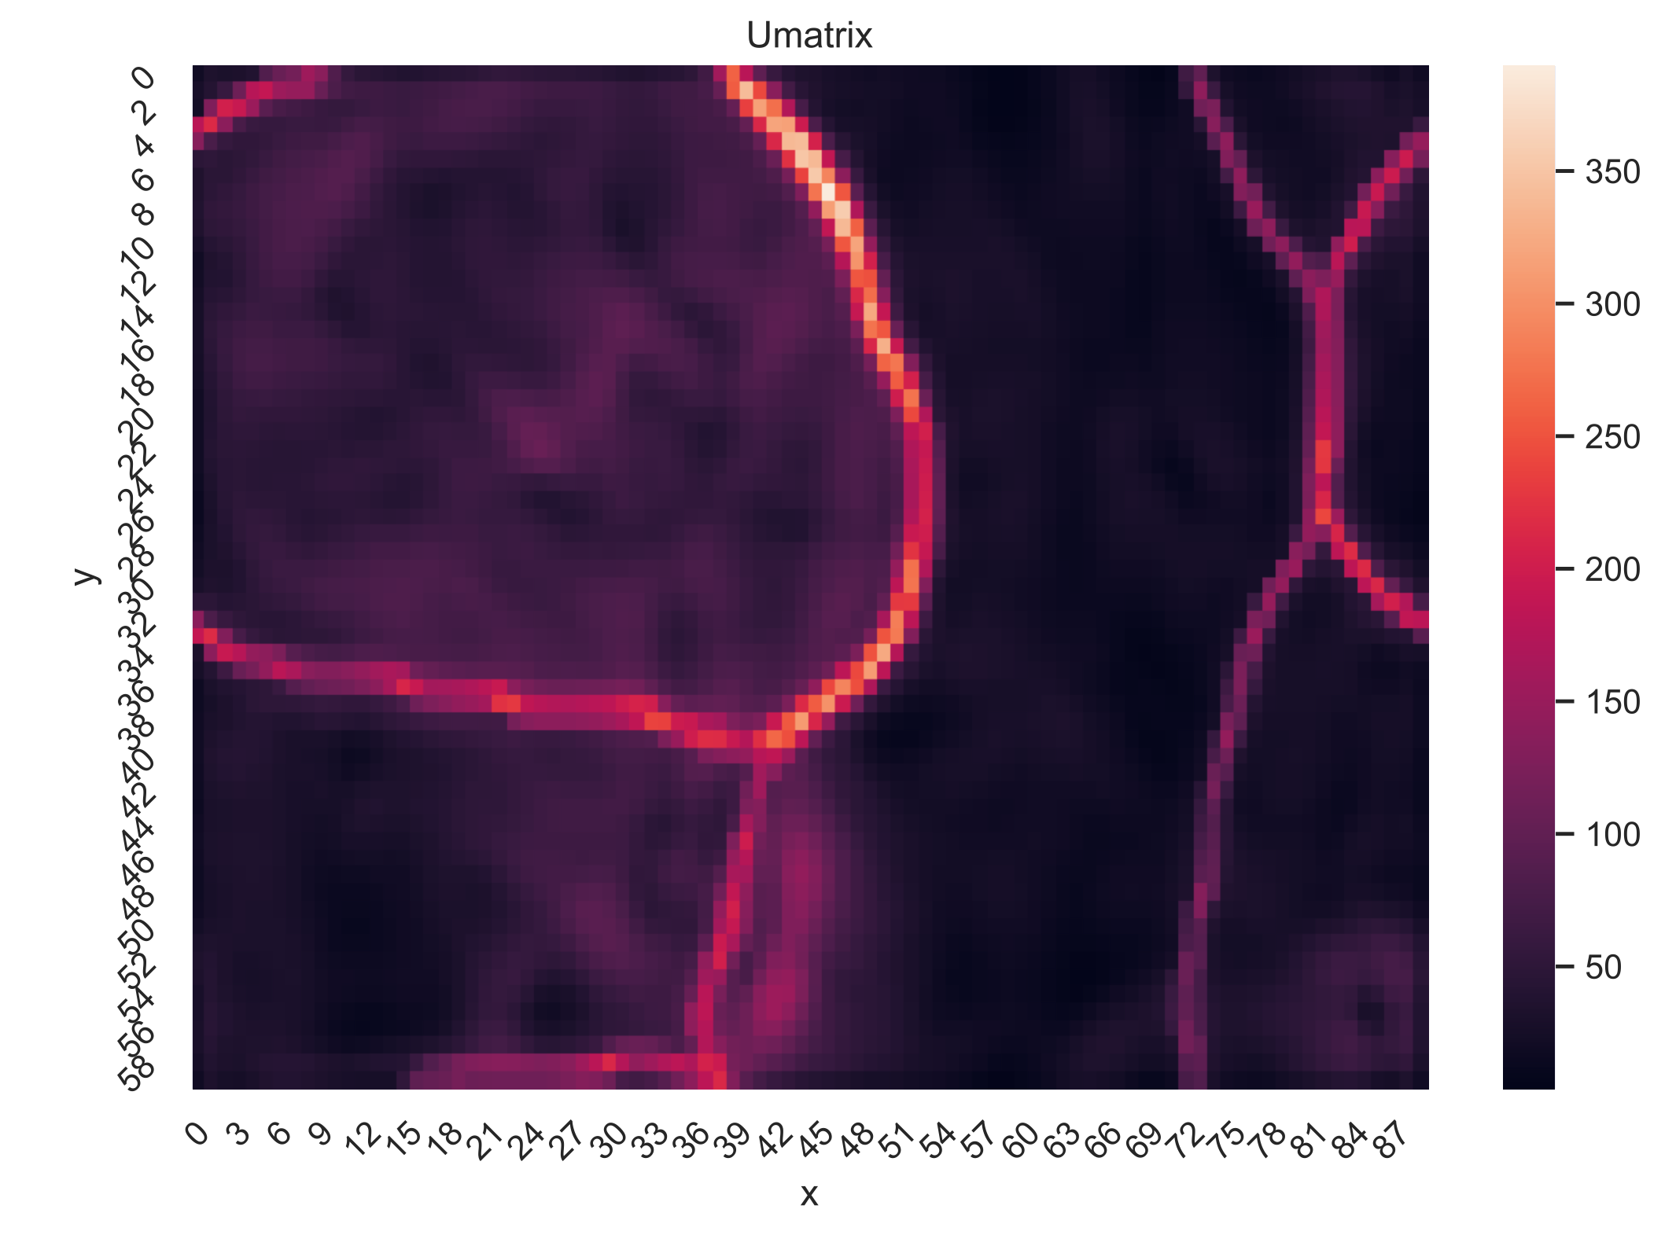
Unified Distance Matrix (U-Matrix)
$u_{ij}=\overset{i+1}{\underset{k=i-1}{∑}}\overset{j+1}{\underset{m=j-1}{∑}}|w_{km}-w_{ij}|$
$w_{ab}$ are weight vectors of the neurons.
Clusters of different amounts of jets
0: No jets
1: One jet
2: 2 or more jets
1
2
2
0
1
1

Slide 17
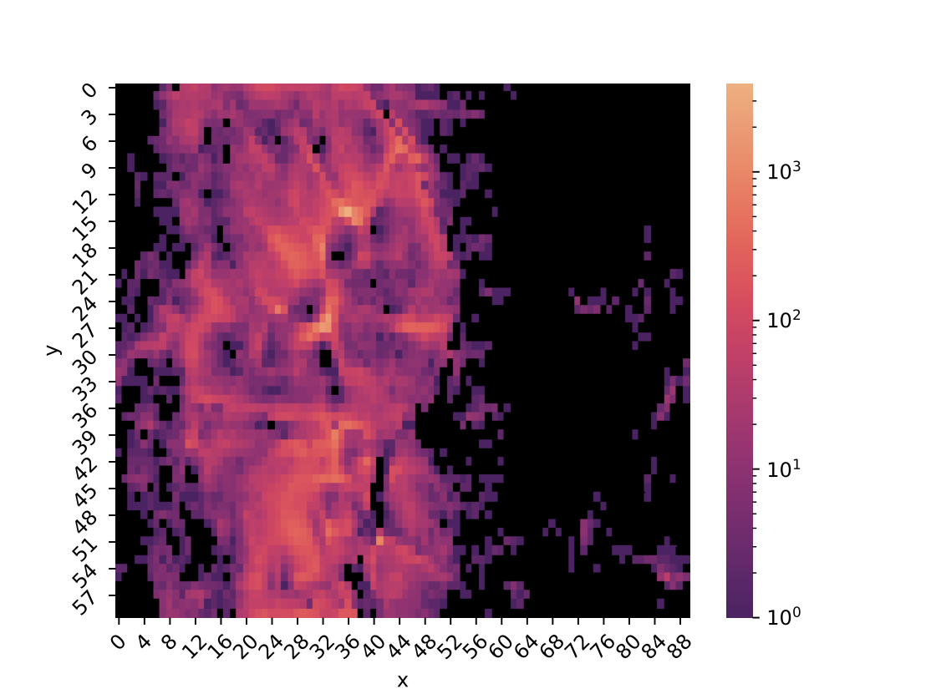
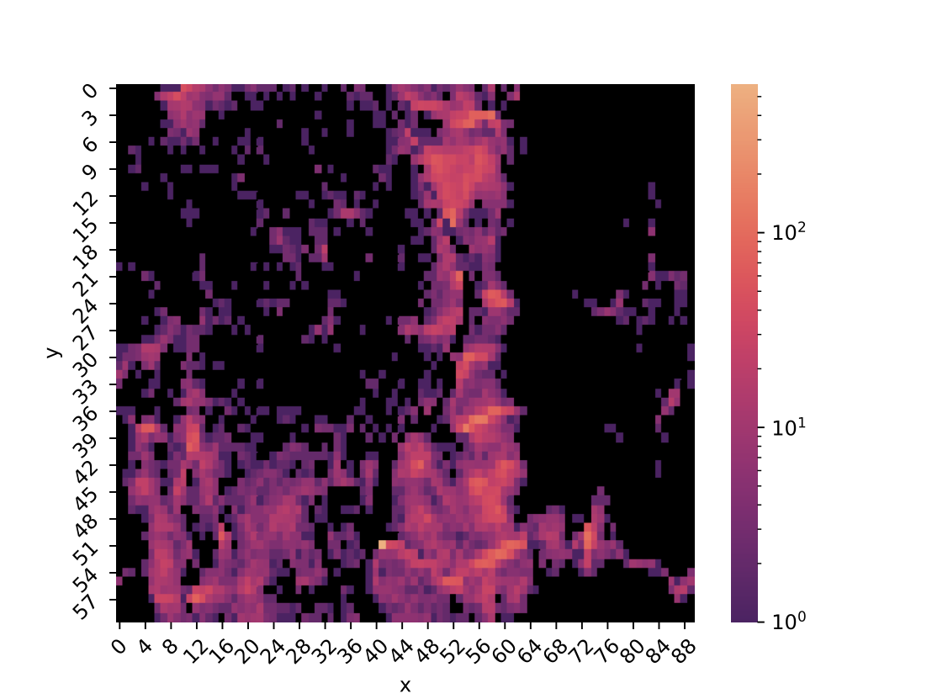
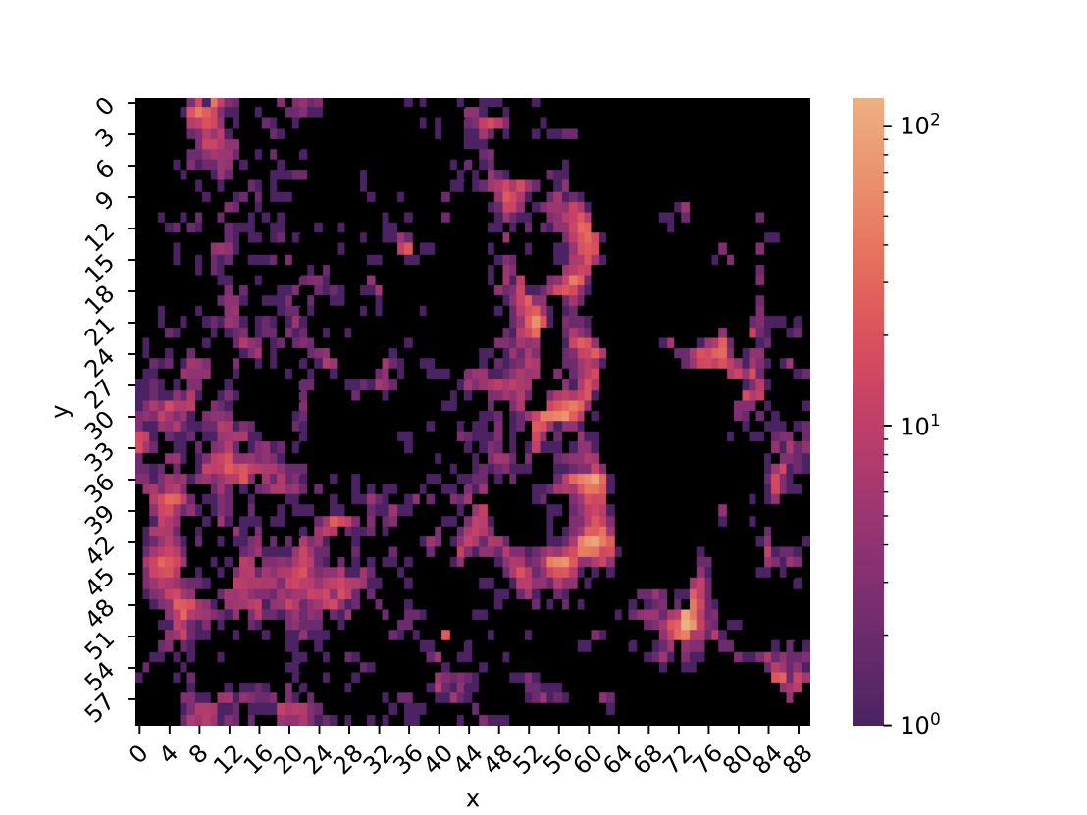
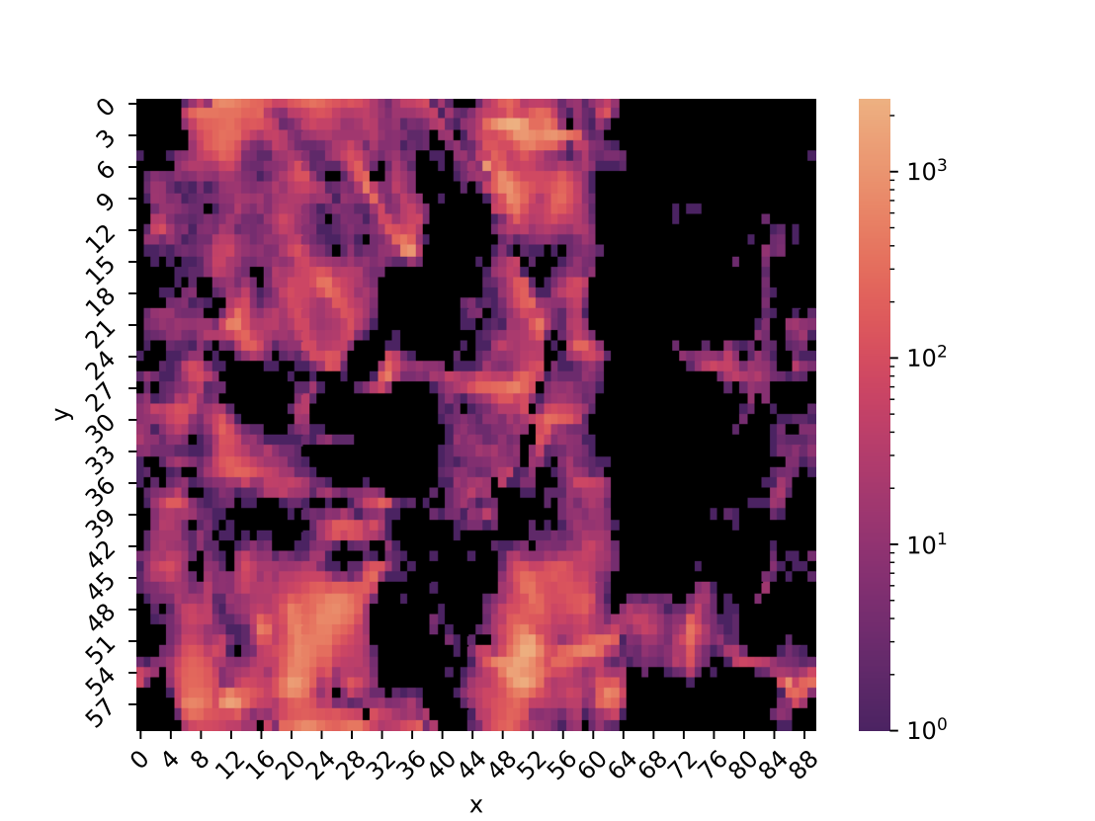
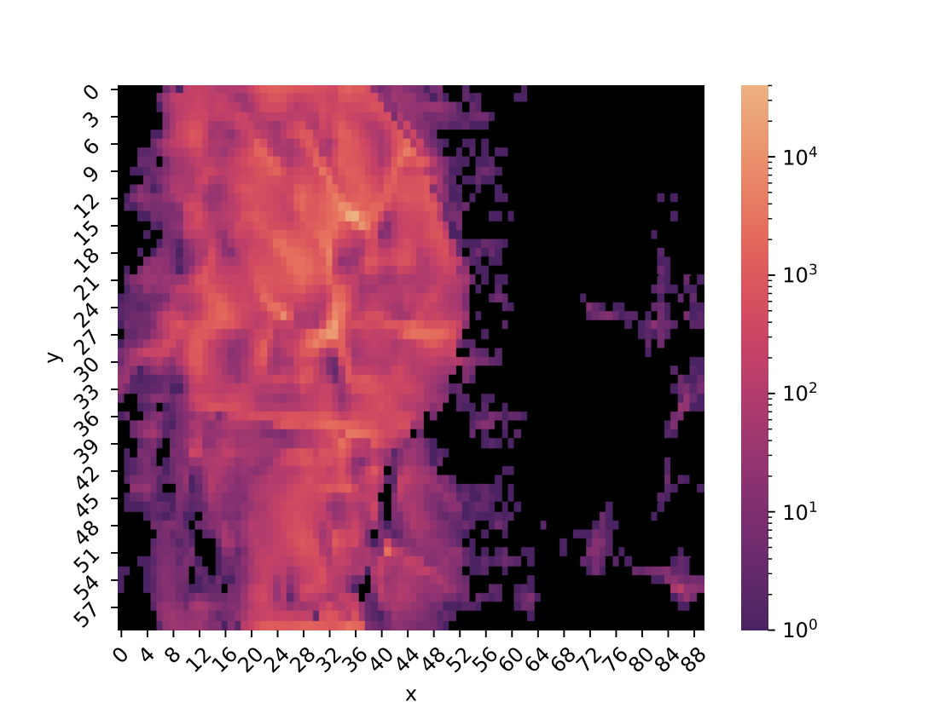
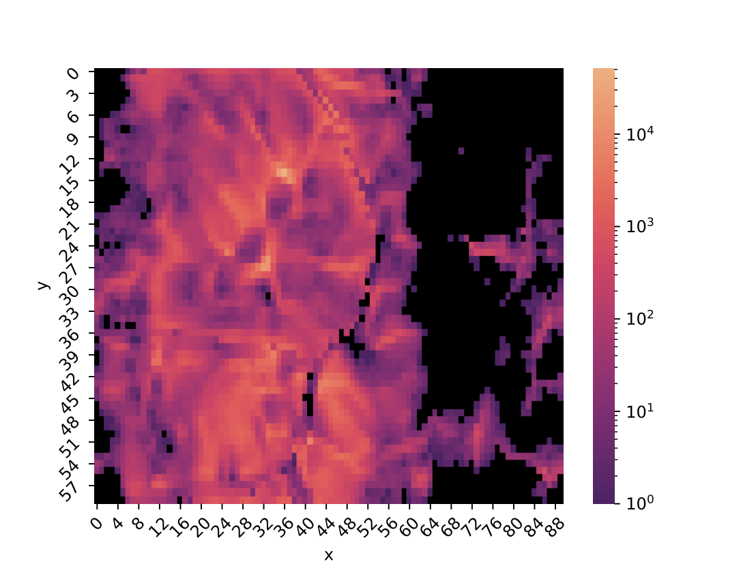
Mapped MC data ($m_{T}^{ll}$ cut included)
Single Top
Single W
$$Z→τ\overline{τ}$$
$$H→WW^{*}$$
$$t\overline{t}$$
$$W\overline{W}$$

Slide 18
Fit of output distribution
Perform a fit of MC templates to the real data
For the fit:
  Map MC data onto SOM trained with real data
  Try to replicate density of real data on the SOM as sum of MC densities on the SOM
After fit:
  Search for regions of well isolated processes

Slide 19
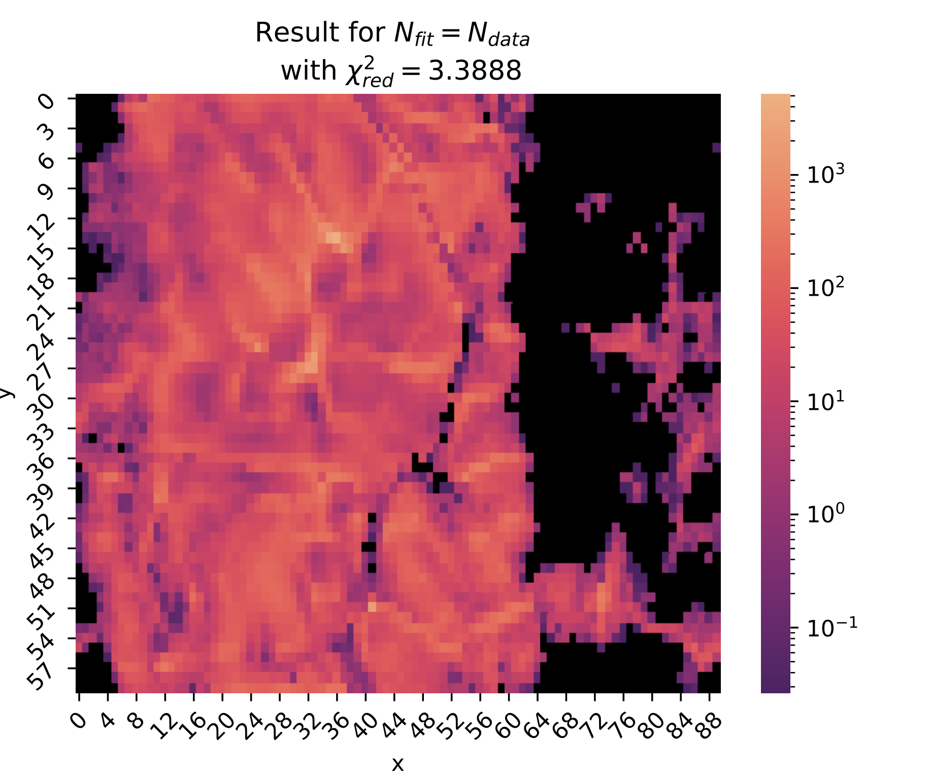
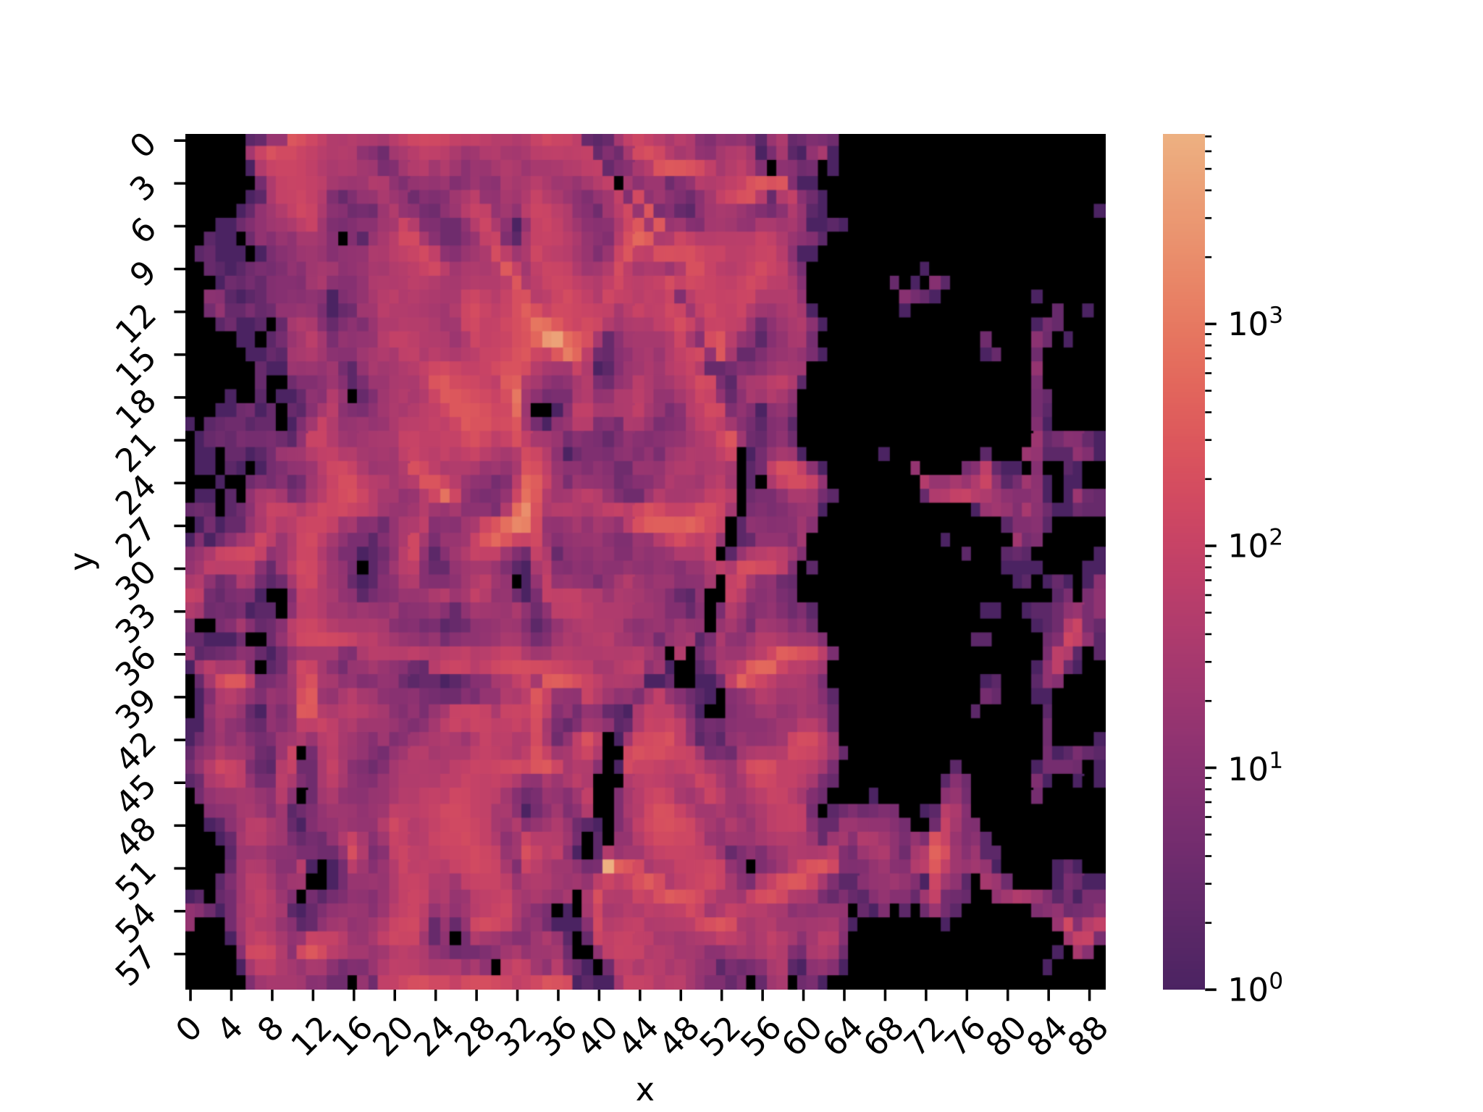
Fit result
Real data

Slide 20
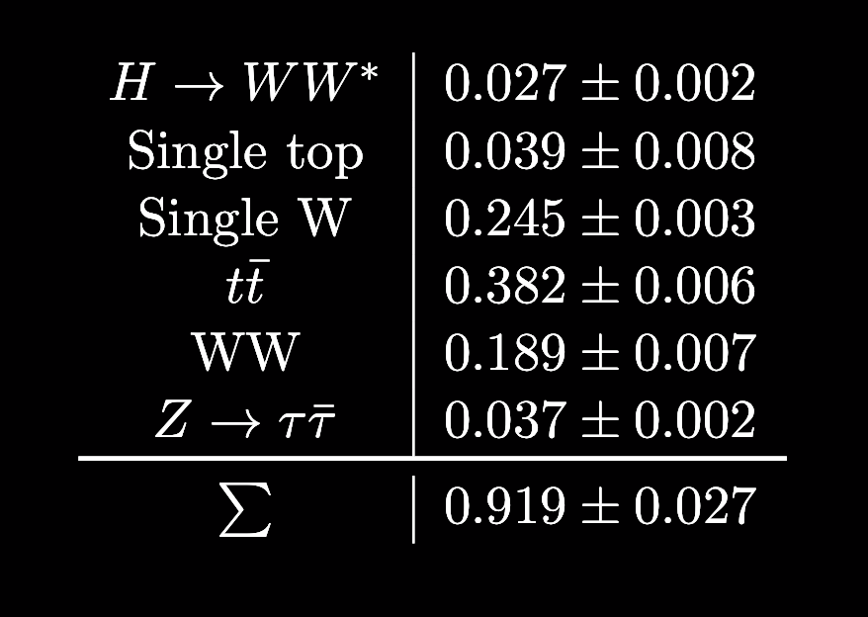
Fit Results
Isolation has to be smaller than 0.1 to reduce QCD
$m_{T}^{ll}>70GeV$ to reduce Drell Yan $τ\overline{τ}$$\frac{χ^{2}}{N_{df}}=3.39$
Bad $χ^{2}$ probably due to missing QCD

Slide 21
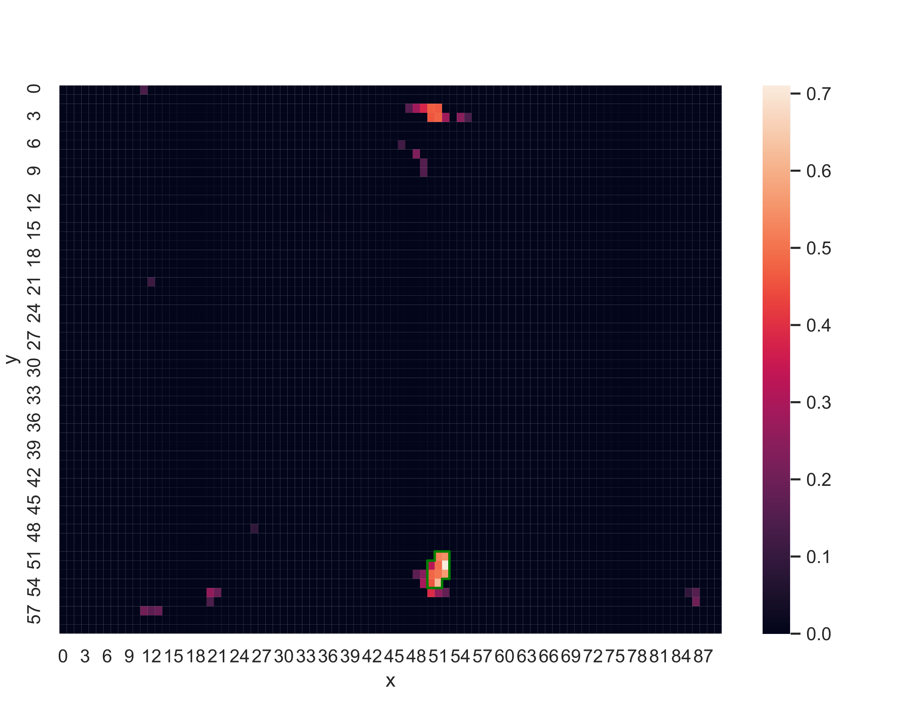
Relative amount of $H→WW^{*}$
$$H→WW^{*}$$
Real data

Slide 22
Relative amount of $H→WW^{*}$
$$H→WW^{*}$$
Real data

Slide 23

Relative amount of $H→WW^{*}$
$$H→WW^{*}$$
Real data

Slide 24
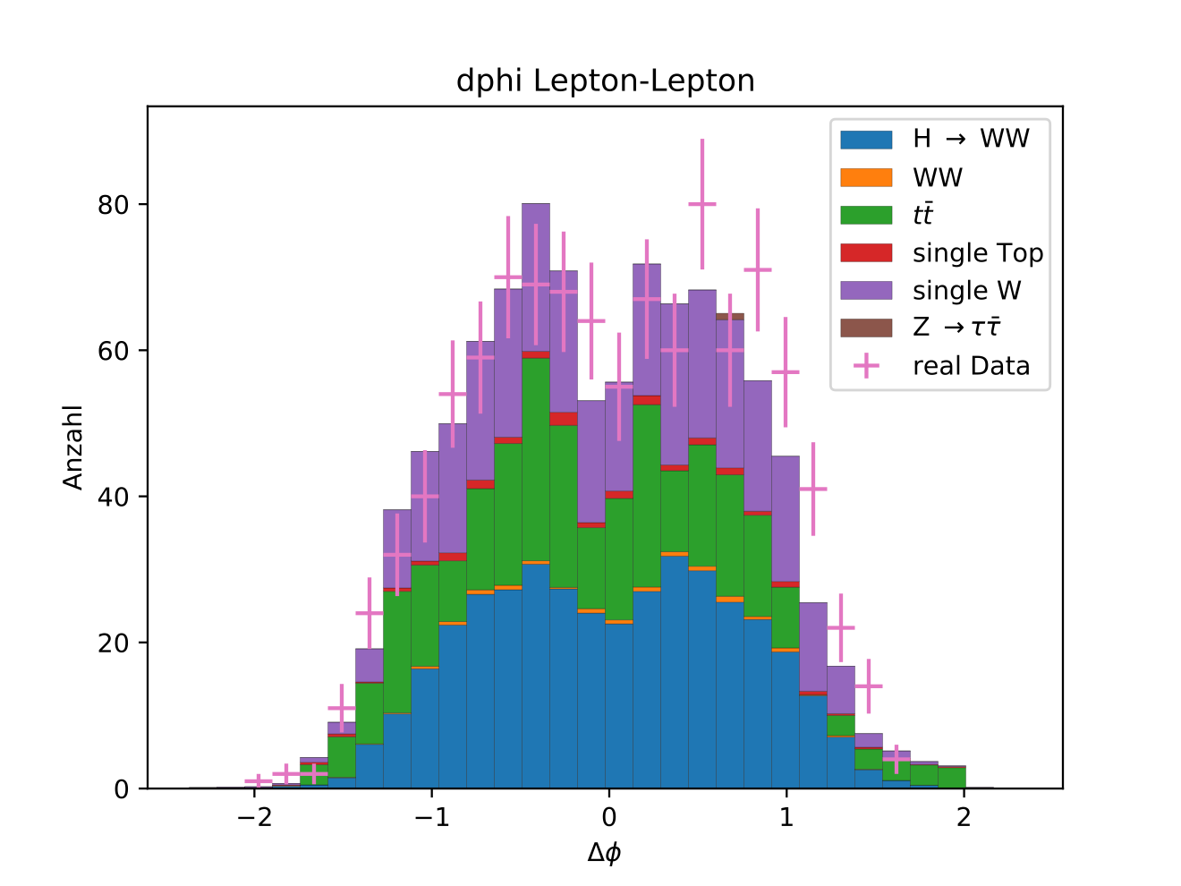
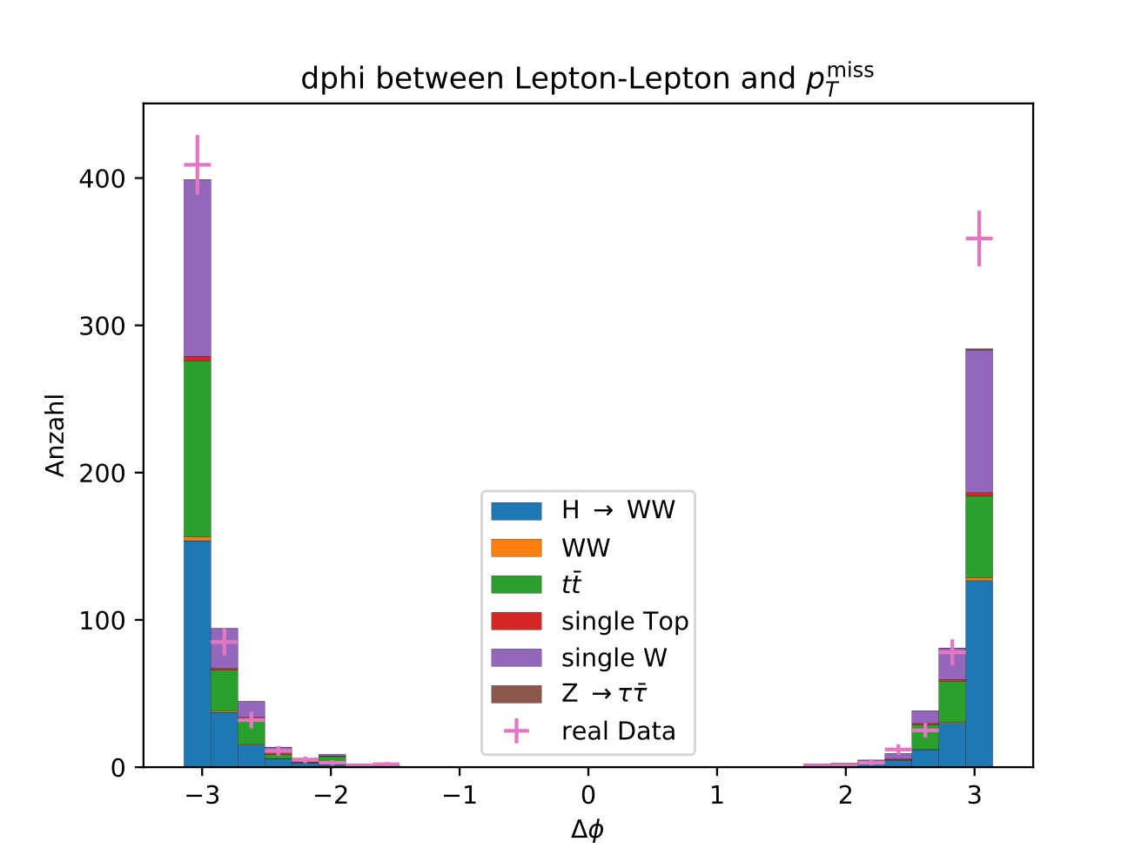
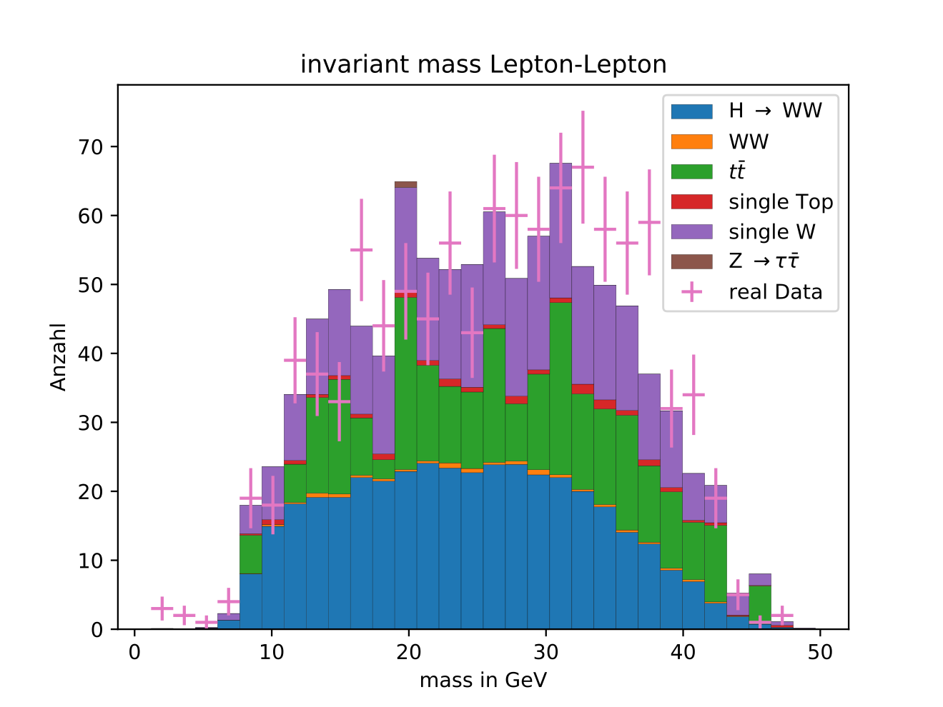
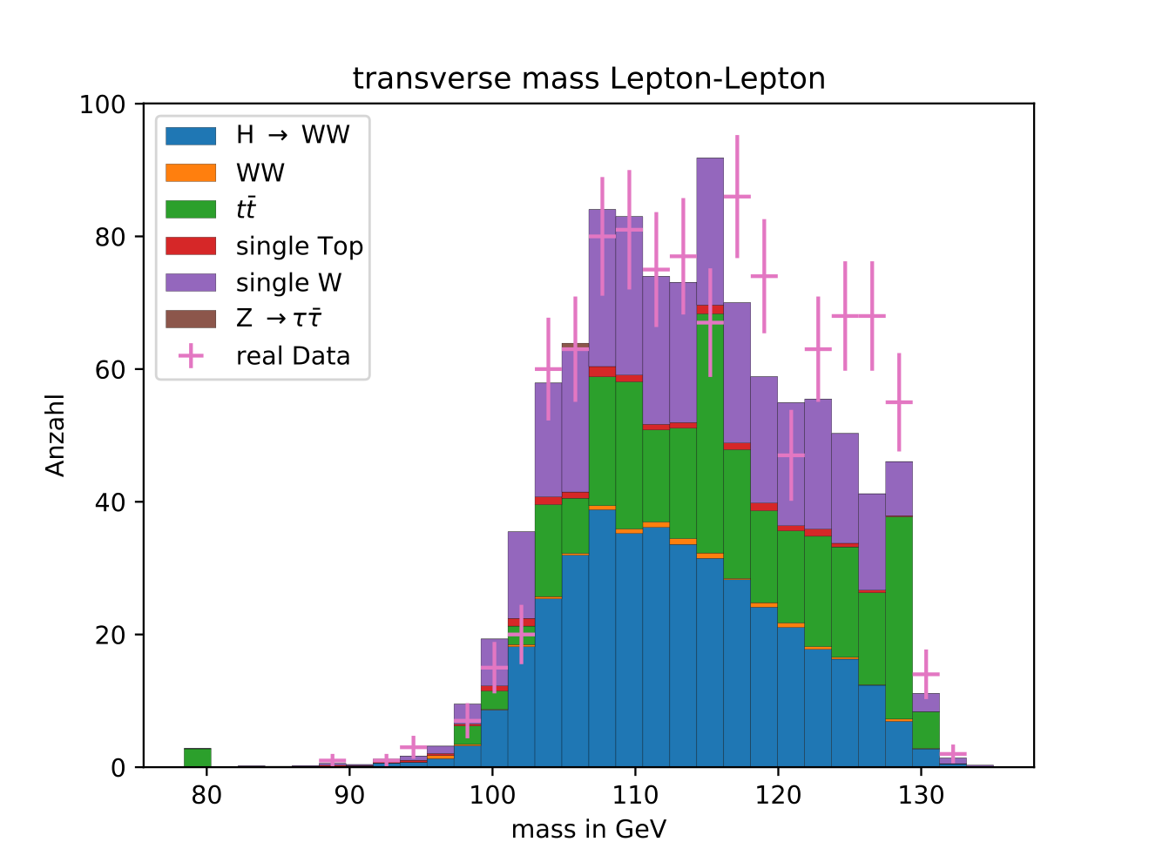
Isolated data
6099 $H→WW^{*}$ events in total
396 $H→WW^{*}$ events in subdataset
Purity of 0.39$M_{T}^{ll}=\sqrt{2E_{T}^{ll}E_{T}^{miss}(1-cos(θ_{ll,miss}))}$

Slide 25
Summary and conclusion
SOM can create low dimension map of data
We can find clusters in the data
SOM can be utilized to perform cuts on the data:
  We can isolate 396 out of 6099 $H→WW^{*}$ processes with a purity of 0.39

Slide 26
Thank you for listening!

Slide 27
Sources
Kohonen, T. Self-organized formation of topologically correct feature maps. Biol. Cybern. 43, 59–69 (1982). https://doi.org/10.1007/BF00337288
Used Code: https://github.com/kai-git-stuff/SOM

Slide 28
Training algorithm
Initalize weight vectors.
Select one input vector from training sample $v_{j}$.
Calculate euclidean distance $∥v_{j}-w_{i}∥$to the weight vector of each neuron $n_{i}$ and choose neuron $n_{best}$ with lowest distance.
Renew weights depending on $n_{best}$.
Repeat steps 2-4 until iteration limit is reached.
$$w_{k}^{t+1}=w_{k}^{t}+(v_{j}-w_{k}^{t})⋅β(r_{k},σ)⋅l$$
Orange: Weight vectors
Blue: Training data
Grey: Neighborhood relations
Weights will be moved closer to $v_{j}$.
$β(r,σ)=F_{gauss}(r,σ)$, $r$ distance to $n_{best}$ in the output space.
Immediate neighbors of $n_{best}$will be altered the most.
Distance relations from input space are mostly conserved.
Clustering is encouraged.
Convergence through decreasing $l$ and $σ$.

Slide 29
Fit procedure
Fitresult
Real data
Map out MC-data on pre-trained SOM
Normalize histograms
Fit normalized real data histogram as weighted sum of normalized MC-data

Slide 30
Fit Results
Isolation has to be smaller than 0.1 to reduce QCD
$m_{T}^{ll}>70GeV$ to reduce Drell Yan $τ\overline{τ}$$\frac{χ^{2}}{N_{df}}=3.39$
Bad $χ^{2}$ probably due to missing QCD

