Slide 1
Quantum Generative Models for muonic force carriers events
Oriel Kiss, Michele Grossi, Enrique Kajomovitz, and Sofia Vallecorsa
Learning to Discover
19-29 April 2022

Slide 2
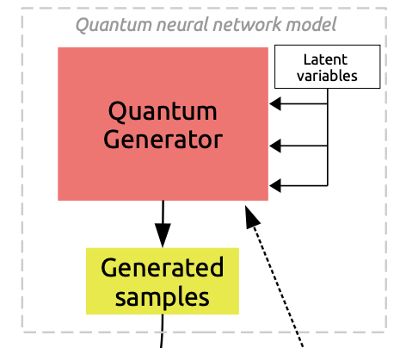
Quantum Generative models:
Quantum computing proposes an alternative to neural networks.
Pros: - continous
- low number of qubits
Cons: - high number of shots
- 1 sample = many shots
- no clear advantage
QNN with classical random source [1]
1
Pros: - uses true quantum randomness
- 1 shot = 1 sample
- fundamentaly different approach
Cons: - discrete
- needs more qubits
Born machines using quantum randomness [2,3]
2
[1] Style-based quantum generative adversarial networks for Monte Carlo events, Carlos Bravo-Prieto et al (2021) https://arxiv.org/abs/2110.06933
[2] Differentiable Learning of Quantum Circuit Born Machine, Jin-Guo Liu and Lei Wang (2018) https://arxiv.org/abs/1804.04168
[3] The Born supremacy: quantum advantage and training of an Ising Born machine, Brian Coyle et al, (2021) https://www.nature.com/articles/s41534-020-00288-9
Notes:
Basic structure plus an image that may support the summary or the introduction of the topic discussed

Slide 3
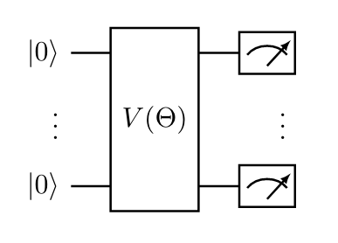
Quantum Circuit Born machine
Sample from a variational wavefunction $|\left.ψ(θ)\right\rangle$ with probability given by the Born rule: $p_{θ}\left(x\right)=|\left\langle x|ψ(θ\left.)\right\rangle |^{2} \right.$
Only able to generate discrete PDFs (continuous in the limit #qubits $→∞$)
Training: metric (KL, MMD,…), trainable discriminator (quantum or classical NN), …
Maximum Mean Discrepancy: MMD(P,Q) = $𝔼_{\begin{aligned}X\sim P \\ Y\sim P\end{aligned}}\left[K\left(X,Y\right)\right]+𝔼_{\begin{aligned}X\sim Q \\ Y\sim Q\end{aligned}}\left[K\left(X,Y\right)\right]−2𝔼_{\begin{aligned}X\sim P \\ Y\sim Q\end{aligned}}\left[K\left(X,Y\right)\right],$ with K a gaussian kernel.
Pros: relativly easy to optimize, Cons: empircally less efficient than an adversarial approach
n dimensional binary strings
map to 2^{n} bins of the discretized dataset
Notes:
Add hybrid loop

Slide 4
Variational Quantum Algorithms
Use Classical computation in order to keep the circuit shallow making use of an optimization based/learning based approach. The gradient is exactly computed with 2*d (d=#parameters) forward (sampling) passes.
Figure 1. Schematic diagram of a Variational Quantum Algorithm (VQA) [4]
[4] Variational quantum algorithms, https://arxiv.org/pdf/2012.09265.pdf

Slide 5
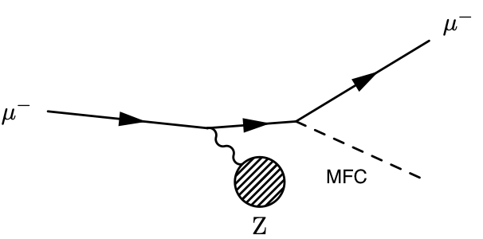
Muonic Force Carriers
MFCs appear in different theoretical hypothesis, as a constituent of dark matter and could explain the anomalous magnetic dipole moment of the muon or the anomaly in the measurement of the proton radius.
2 use cases: a) muon fixed-target collision (FASER).
b) muon interactions in the ATLAS⁵ calorimeter.
We are interested to generates following features for the outgoing muon and MFC: energy (E), transversal momentum (pt) and pseudorapidity ($η$).
[5] Galon, I, Kajamovitz, E et al. "Searching for muonic forces with the ATLAS detector". In: Phys. Rev. D 101, 011701 (2020)

Slide 6
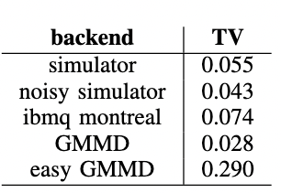
One dimensional distribution outgoing muon’s energy at 50 GeV
Comparison metric:
Perfect simulator
Noisy simulator
IBMQ Montreal
Classical GMMD of size (15,128, 256,128,16,1)
Easy GMMD ~ QCBM in size

Slide 7
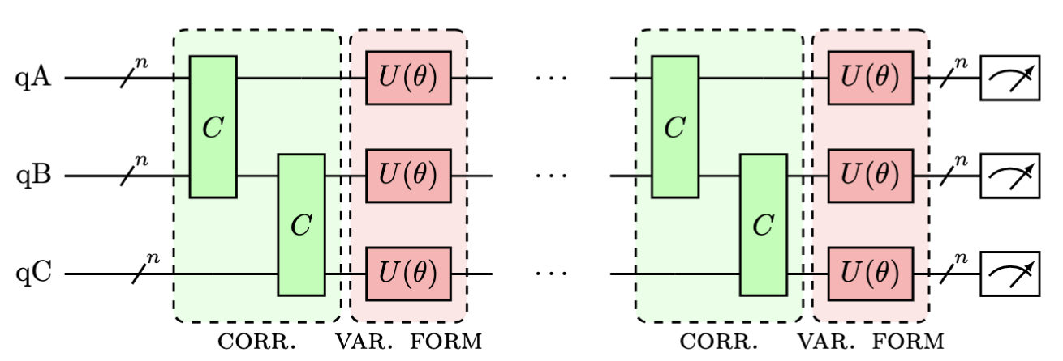
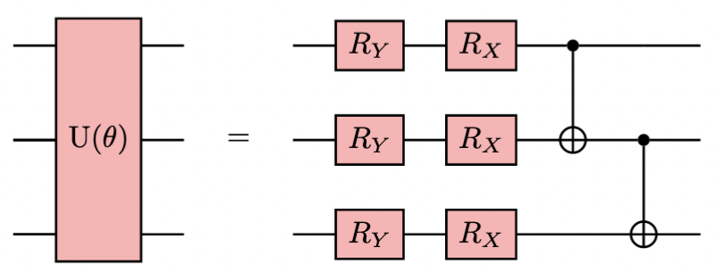
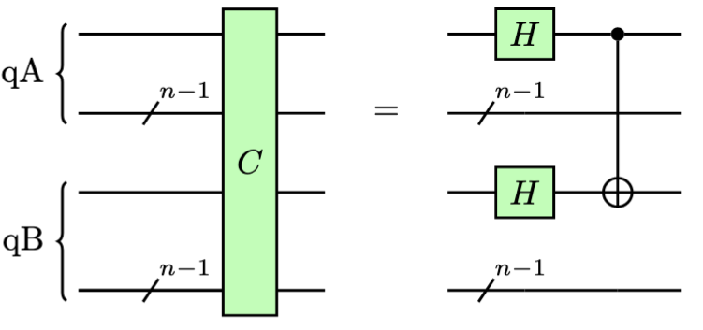
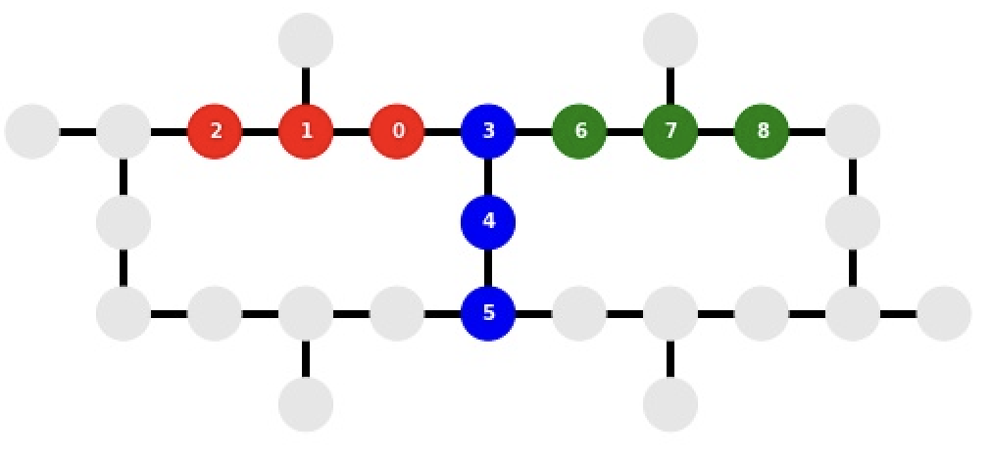
Born machine: multiples features⁶
Local: learns the individual PDFs,
time evolution of an Ising type Hamiltonian,
conjectured to be difficult to simulate classicaly.
Use multiples quantum registers
energy
pt
$$η$$
Can be mapped without swap gates on ibmq_mumbai
C: creates a corelated state between the first qubit in each register.
[6] Elton Yechao, Sonika Johri et al, “Generative Quantum Learning of Joint Probability Distribution Functions” In: arXiv 2109.06315

Slide 8
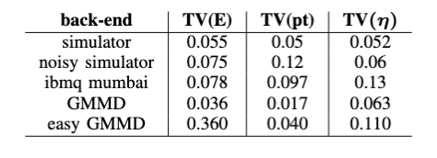
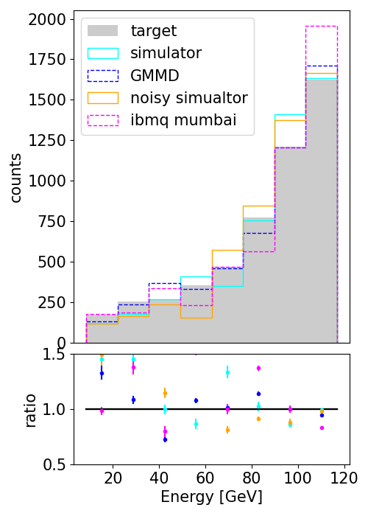
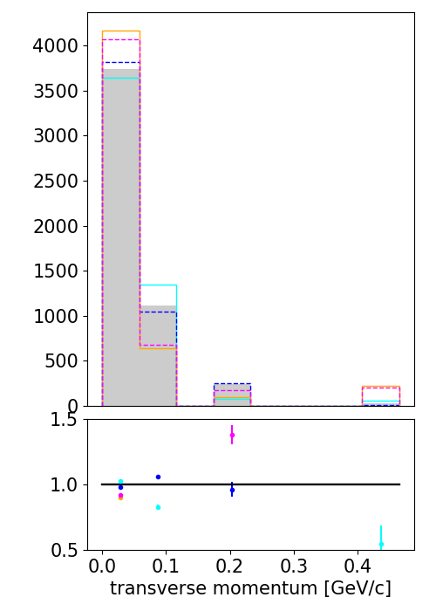
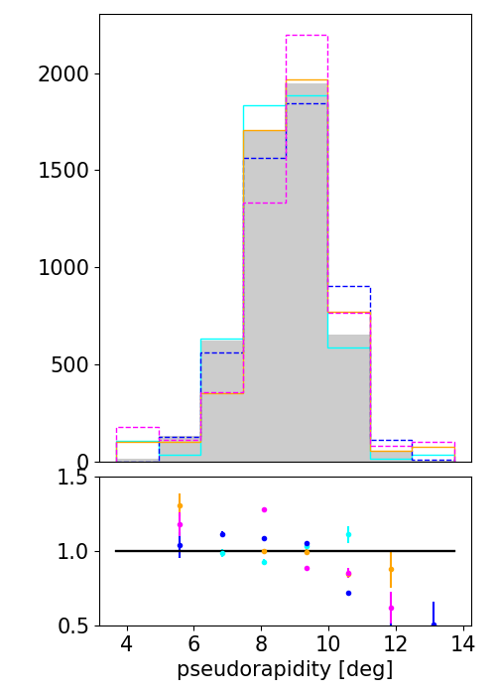
Results (125 GeV)
Notes:
Discrete becaue limitations, same data set for training, same GAN retrained on discrete, fix TV

Slide 9
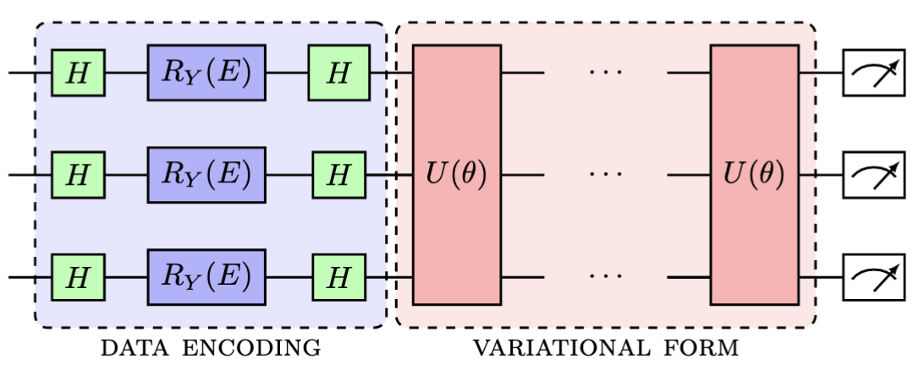
Conditional Born machine
green: fixed gates
blue: data encoding gates
red: trainable gates
Data encoding: via data-parametrized rotations
Input: binning energy E (scaled between $\left[0,1\right]$ and preprcoessed with arcsin())
Interpolation: train only on certain energy bins and the model should learn to predict in between.
Data re-uploading makes the quantum circuit more expressive as function of the data.
Notes:
How to encode data

Slide 10
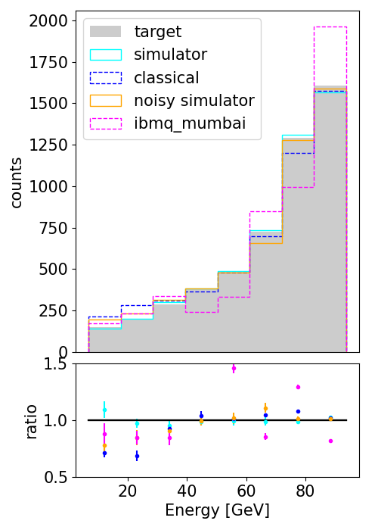
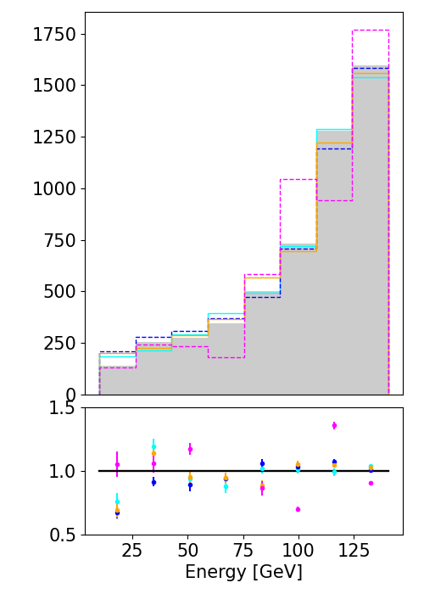
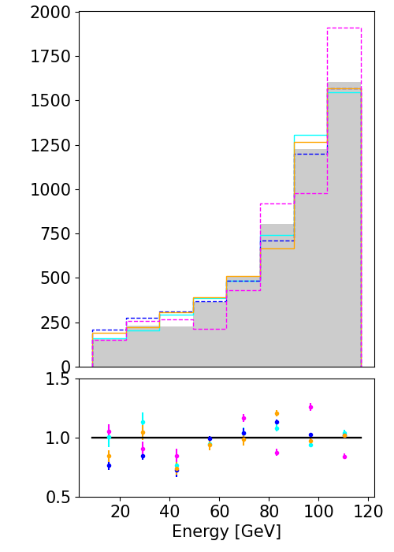
C-Born machine: results
a) train: 100 GeV b) train 150 GeV c) test 125 GeV

Slide 11
Conclusion:
Use a quantum circuit Born machine to generate MFC events.
The Born machine is currently able to handle multivariate and conditional distributions and is competitive against GMMD of similar complexity.
Training on quantum hardware is important in order to assimilate the noise.
Futur work is devoted to scale the QCBM, in terms of number of qubits and register, and also to generate conditional multivariate distributions.

Slide 12
Thanks for your attention! Questions?
oriel.kiss@cern.ch
sofia.vallecorsa@cern.ch

