Slide 1
Unbinned measurements in global SMEFT fits from machine learning
Jaco ter Hoeve
Work done in collaboration with R. Gomez Ambrosio, M. Madigan, J. Rojo, V. Sanz

Slide 2
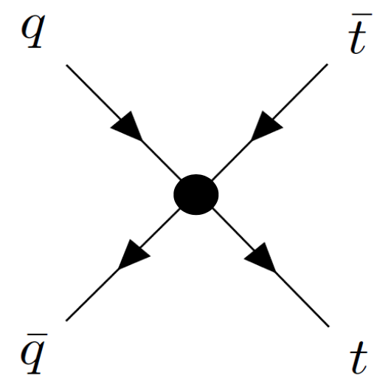
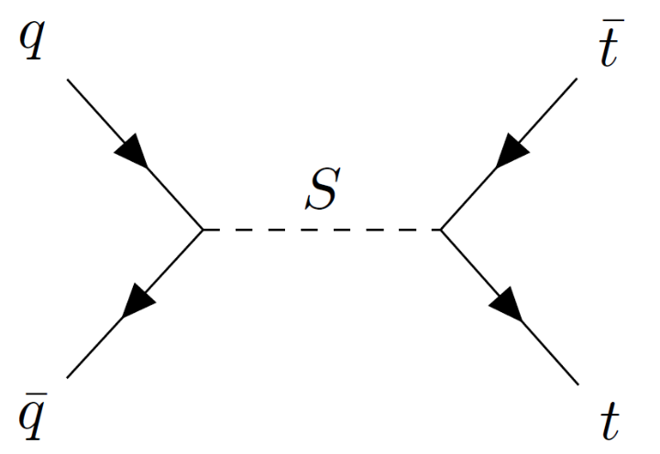
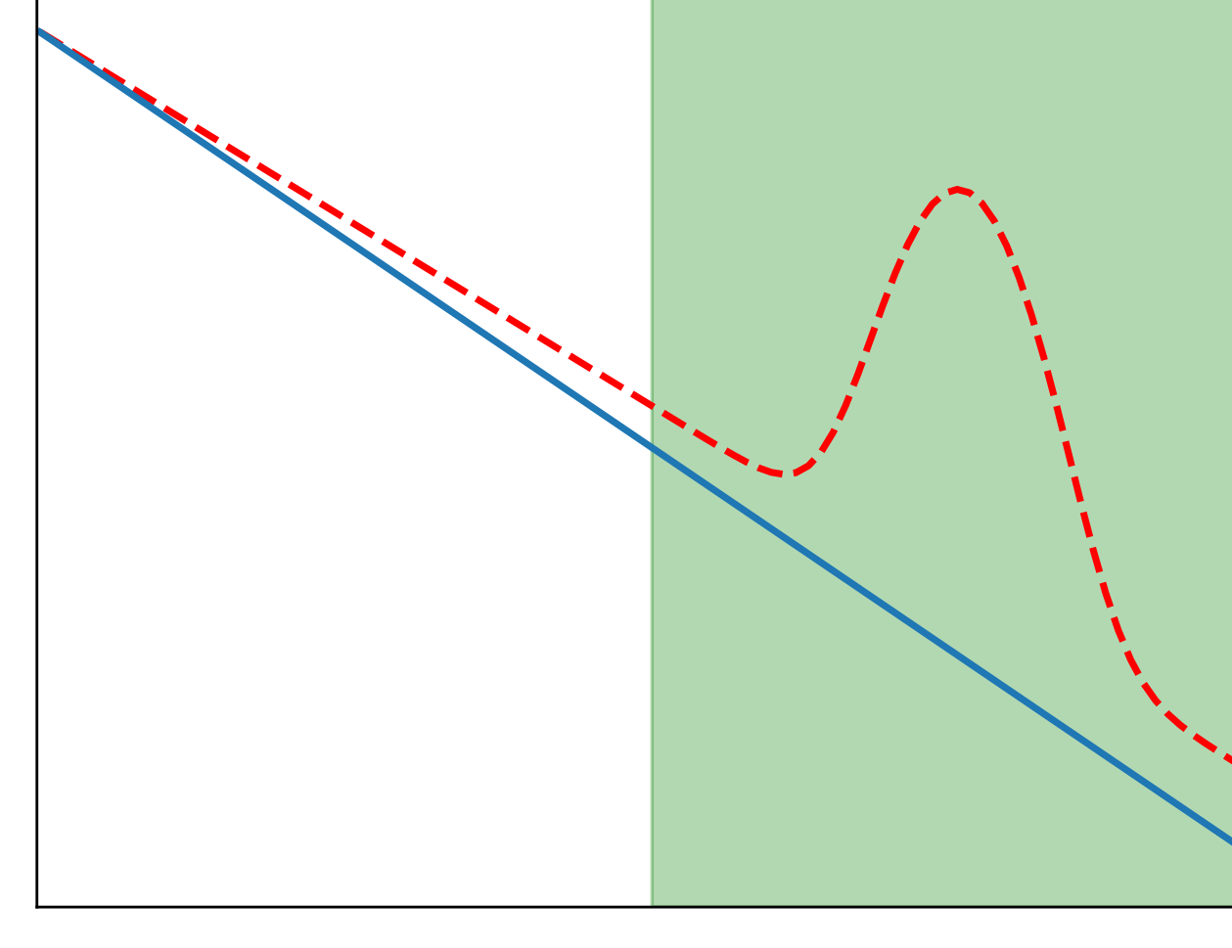
The Standard Model Effective Field Theory
Systematic parameterisation of the theory space close to the Standard Model
Study the fingerprints of NP at low energies through higher dimensional operators
Assumes the SM field content and gauge symmetries
NP
SM
$$E_{LHC}$$
$$Λ$$
$$E$$

Slide 3
The Standard Model Effective Field Theory
Systematic parameterisation of the theory space close to the Standard Model
Study the fingerprints of NP at low energies through higher dimensional operators
Assumes the SM field content and gauge symmetries
NP
SM
Interference
Quadratic corrections
$$E_{LHC}$$
$$Λ$$
$$E$$

Slide 4
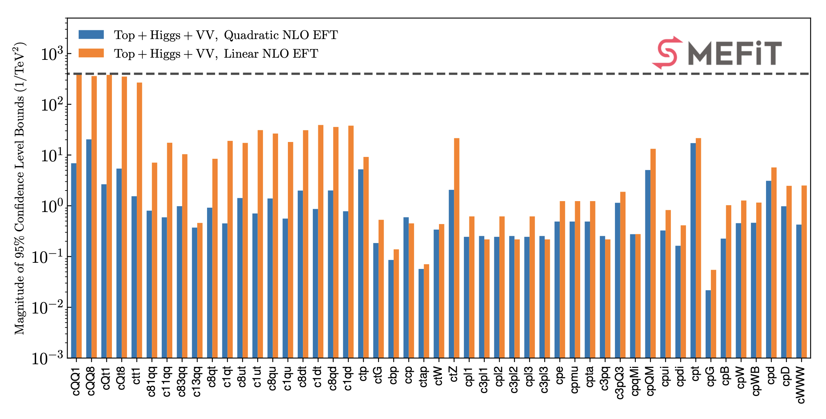
So what then are global SMEFT fits?
A global SMEFT analysis needs to explore a huge parameter space (2499 at dim 6)
Studies the intricate interplay between the top, Higgs and diboson sectors
Requires state-of-the-art theory calculations in both the SM (NLO QCD + NNLO K-factors) and EFT
J.J. Ethier et al.
[2105.00006]

Slide 5
So what then are global SMEFT fits?
A global SMEFT analysis needs to explore a huge parameter space (2499 at dim 6)
Studies the intricate interplay between the top, Higgs and diboson sectors
Requires state-of-the-art theory calculations in both the SM (NLO QCD + NNLO K-factors) and EFT
Based on unfolded cross sections not tailored for EFT studies!
Can we extend global SMEFT fits with ML based observables?

Slide 6
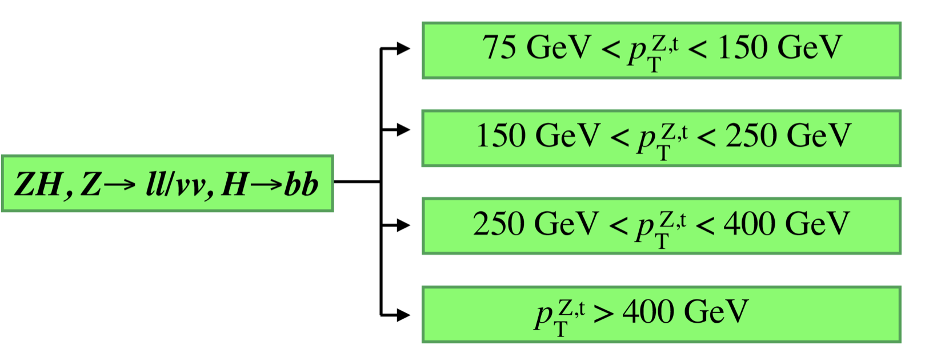
Statistically optimal observables from ML
Which kind of measurement is most sensitive to SMEFT operators?
Difficult question to answer in general, since SMEFT measurements can be
Inclusive or (1, 2, 3) - differential (in which variables?)
Binned (choice of binning?) or unbinned
Goal: deploy unbinned measurements to determine the optimal sensitivity using ML techniques
ATLAS-CONF-2021-051
Useful diagnosis tool!

Slide 7
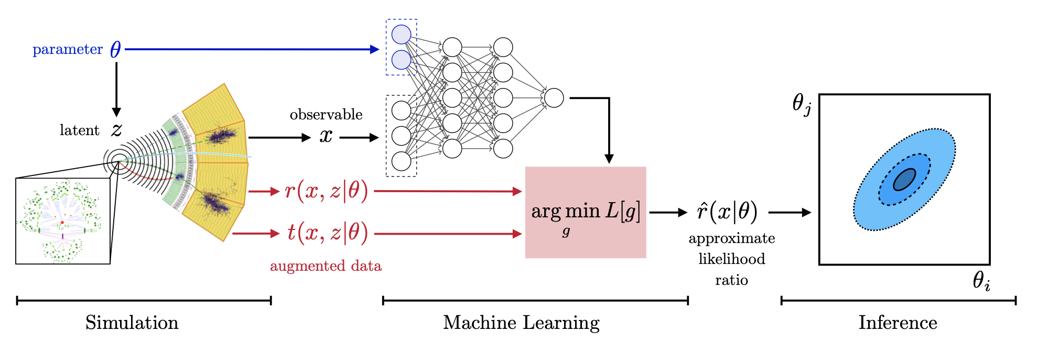
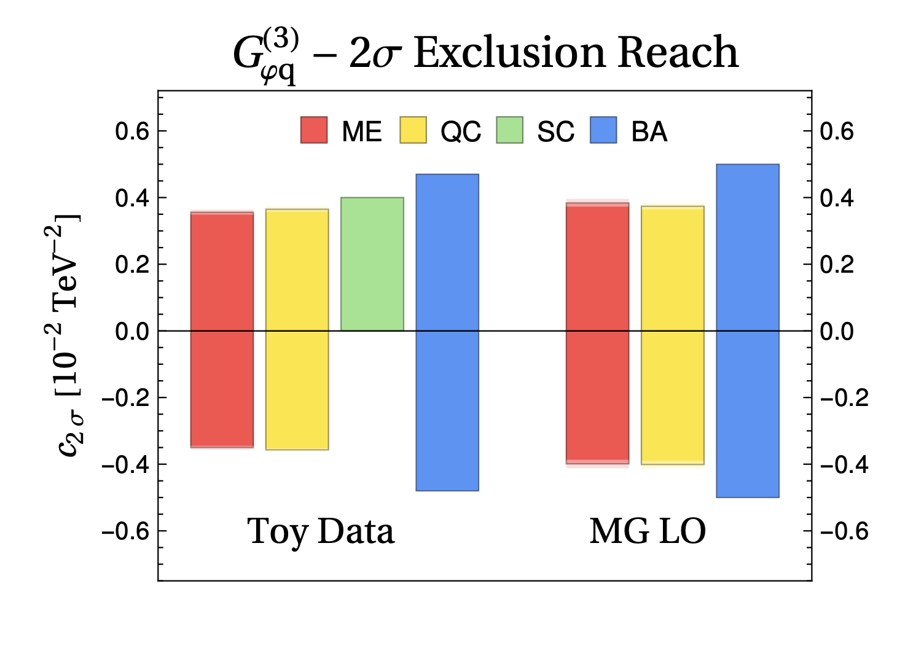
Related work
The likelihood ratio as central object
Parameterise the likelihood ratio with Neural Networks
Current studies are limited to only a small number of EFT coefficients
J. Brehmer et al. [2010.06439]
S. Chen, A. Glioti, G. Panico, A. Wulzer
[2007.10356]

Slide 8
Statistically optimal observables from ML
Carry out EFT analysis with different variants of the same measurement
Binned Gaussian Likelihood
Binned Poissonian Likelihood
Unbinned extended likelihood
We consider processes that are dominated by statistical uncertainties, adding systematics is WIP

Slide 9
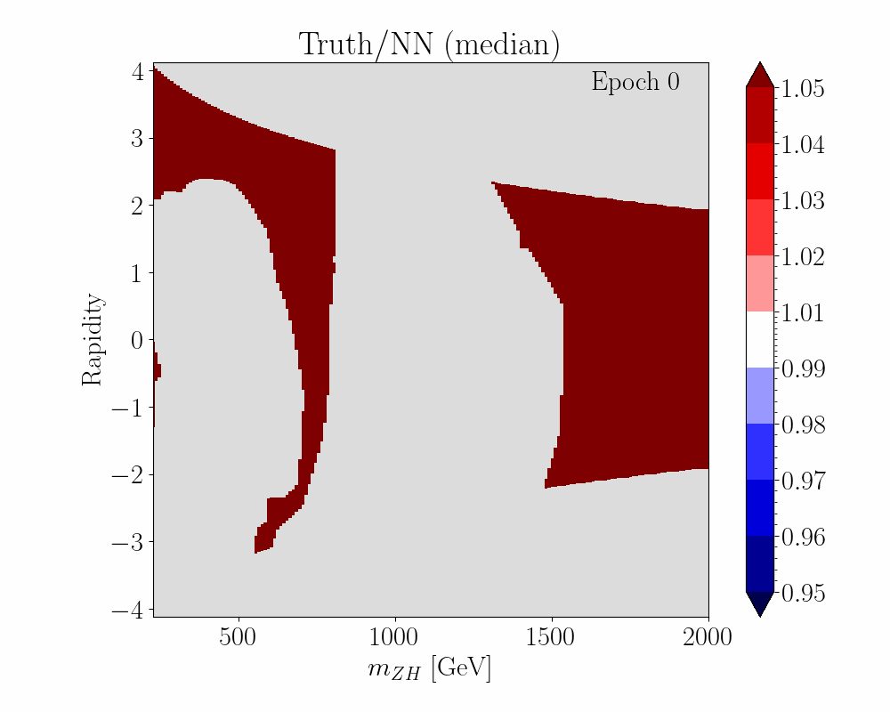
Statistically optimal observables from ML
Dependence of cross-section* on all (independent) kinematic variables and all EFT coefficients is parameterised by a feed-forward NN trained to Monte-Carlo simulations, benchmarked with analytical calculations
*Actually the likelihood ratio
Challenge: correctly describing tails of distributions (low stats)

Slide 10
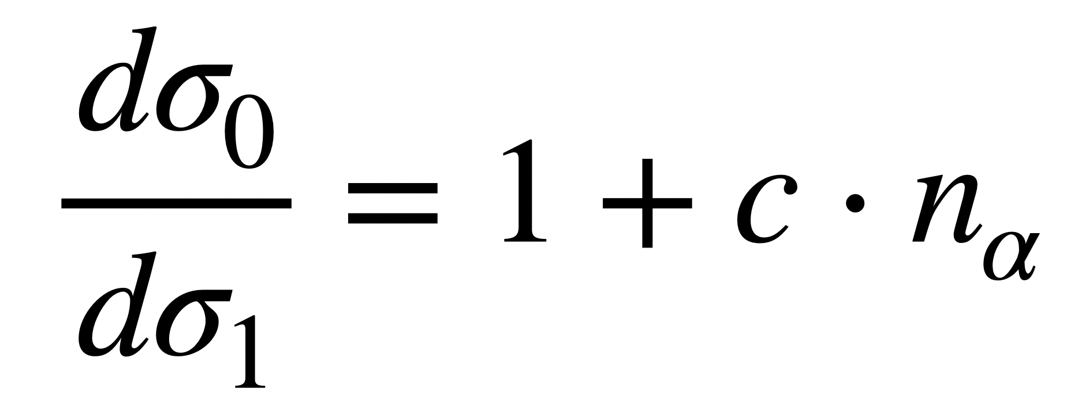
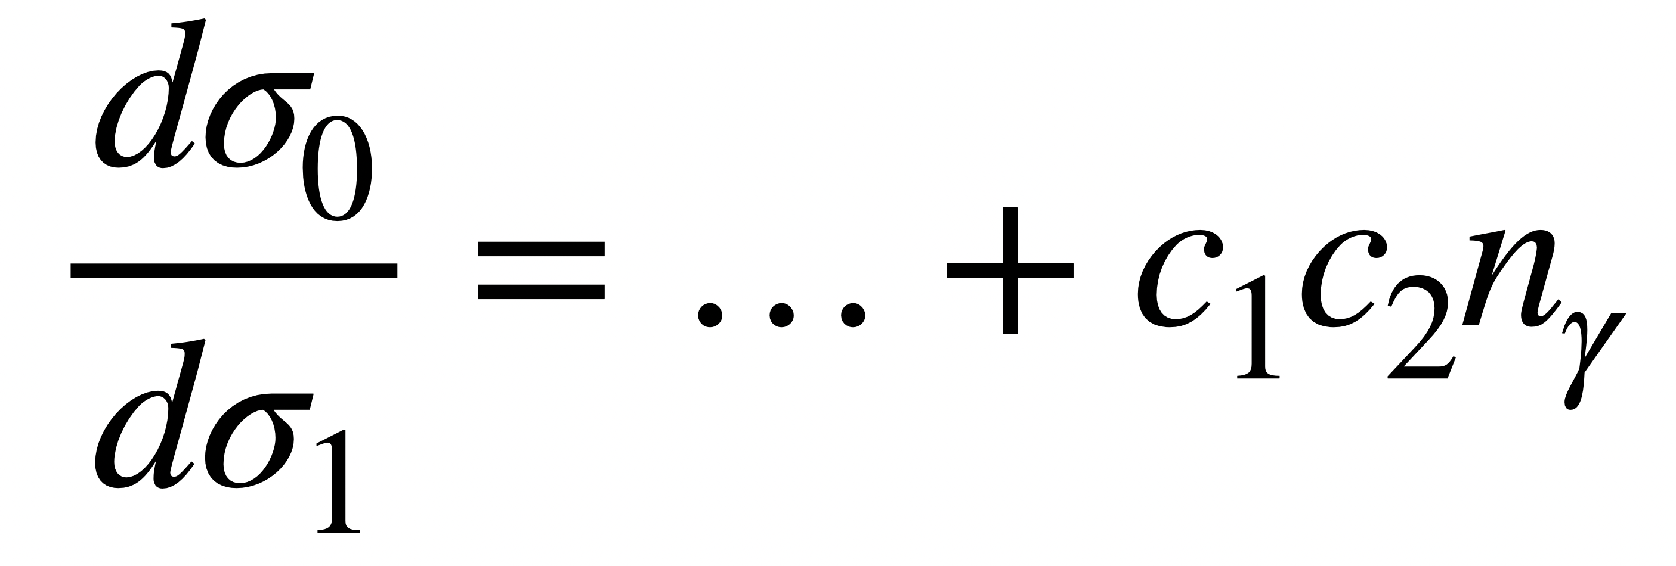
Training formalism
Finding the likelihood ratio can be formulated in terms of an optimisation problem on a balanced training set
EFT events
SM events
Cross section positivity is enforced through e.g. Lagrange multipliers
Exploit the polynomial structure of the EFT coefficients to parallelise the training
1. Linear term
2. Quadratic term
3. Cross term

Slide 11
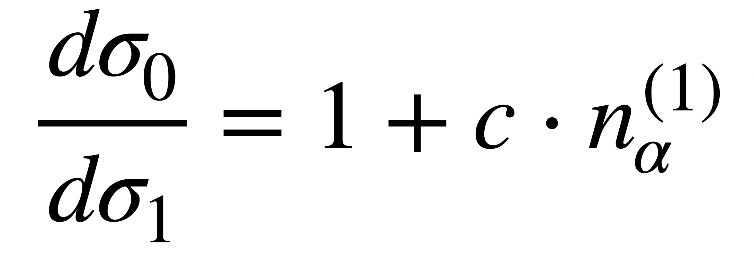
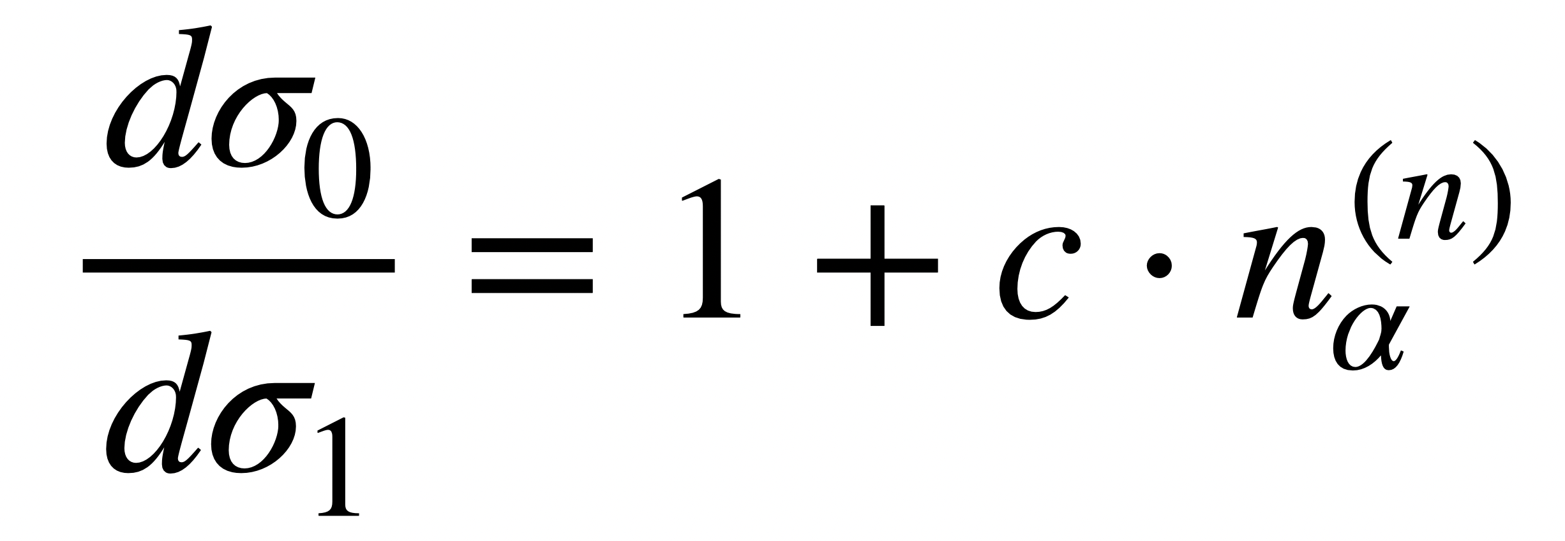
Scaling behaviour
Our method scales efficiently with the number of EFT coefficients and can be parallelised
Trained in parallel
Trained in parallel
Trained in parallel
2. Quadratic terms
3. Cross terms
1. Linear terms

Slide 12
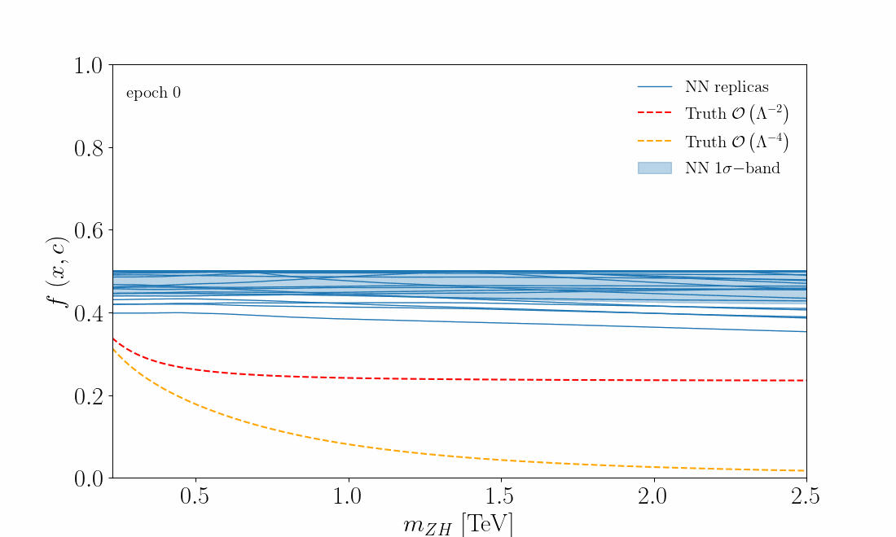
The Monte Carlo replica method
We train a collection of 50 NN instances on independent MC datasets to estimate the NN uncertainty
Training settings
LO QCD MC dataset (100K)
PyTorch Implementation
Validation loss is monitored to avoid overfitting
Training takes ~30 min per core (1 replica/core)
5 hidden layers (30 units)
ReLU activation functions

Slide 13
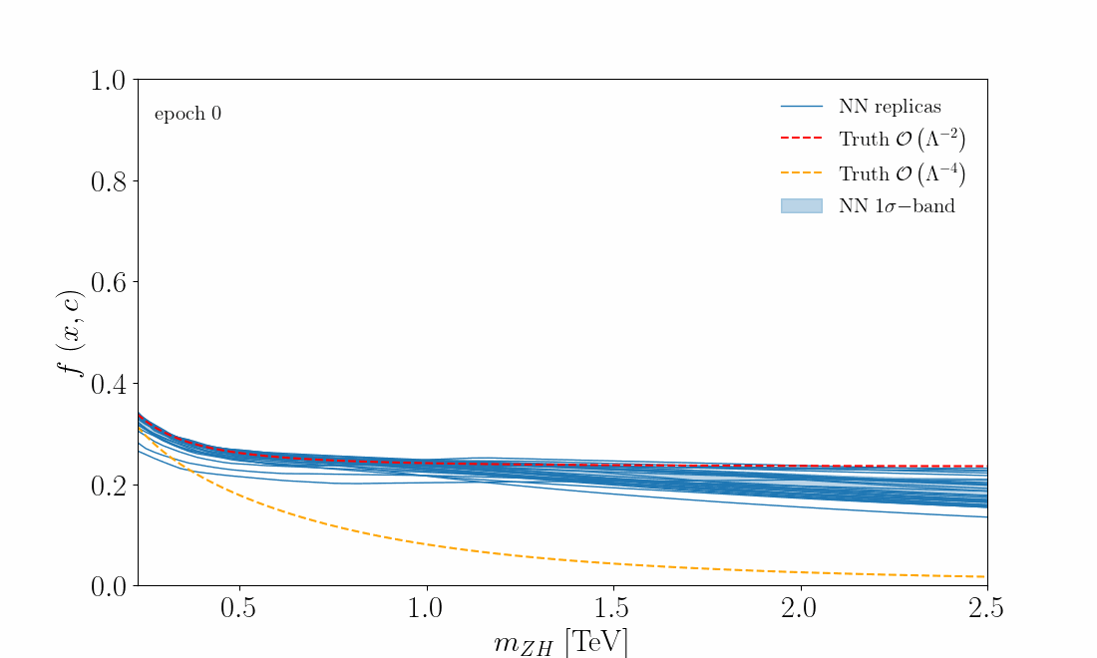
The Monte Carlo replica method
We train a collection of 50 NN instances on independent MC datasets to estimate the NN uncertainty
Training settings
LO QCD MC dataset (100K)
PyTorch Implementation
Validation loss is monitored to avoid overfitting
Training takes ~30 min per core (1 replica/core)
5 hidden layers (30 units)
ReLU activation functions

Slide 14
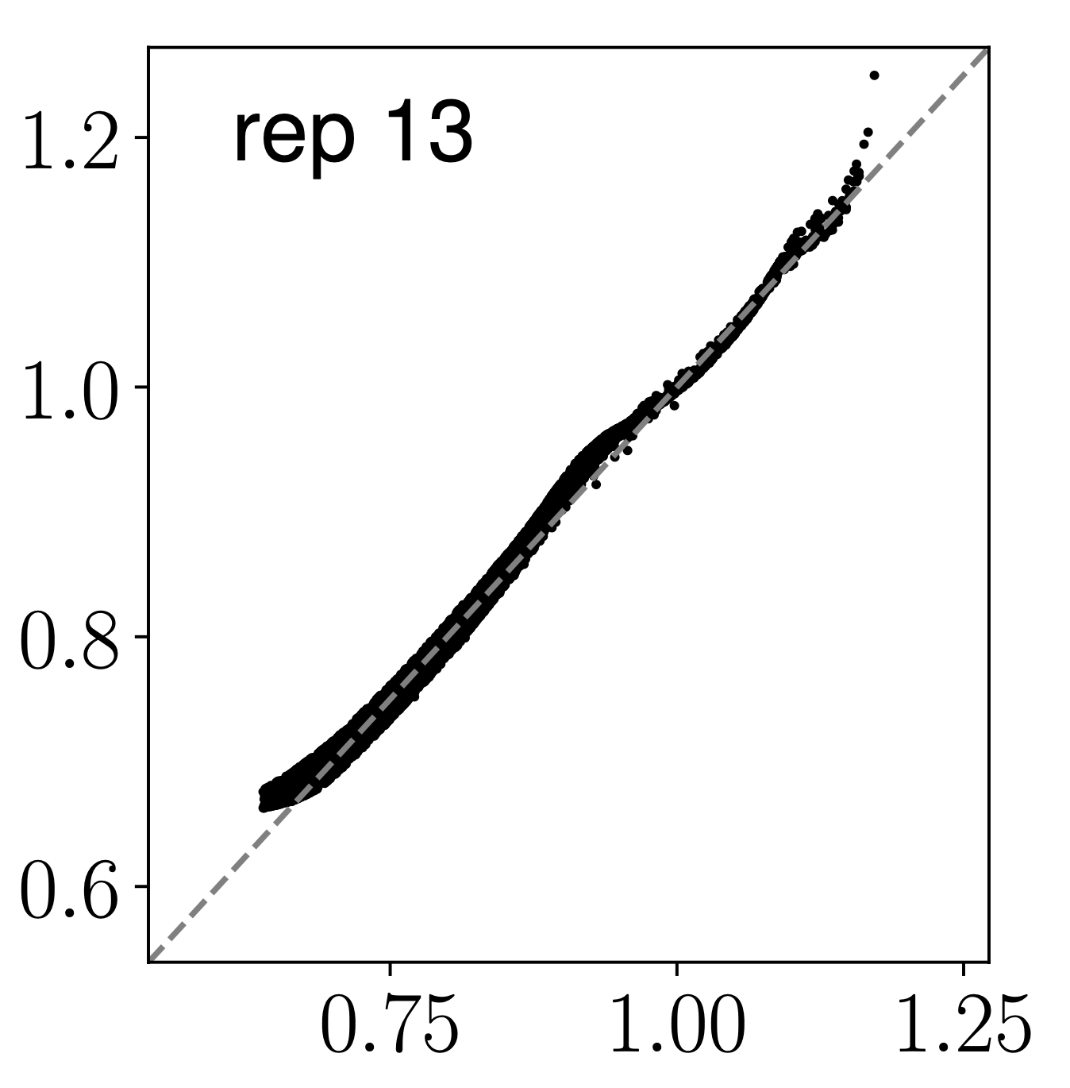
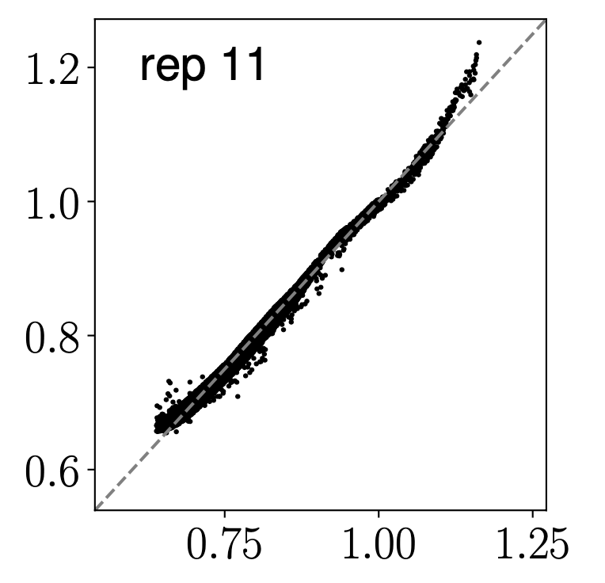
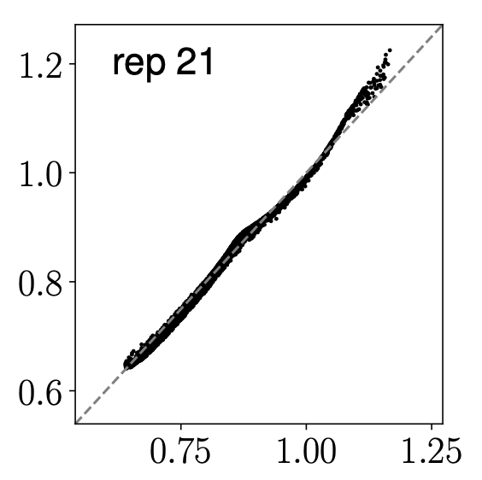
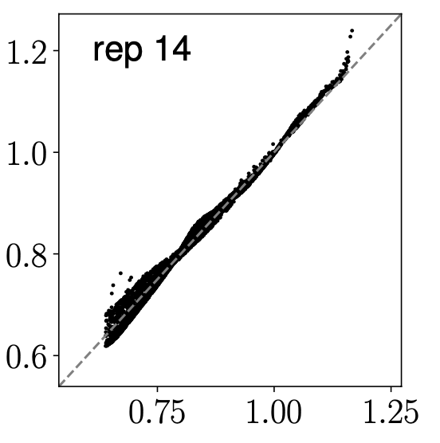
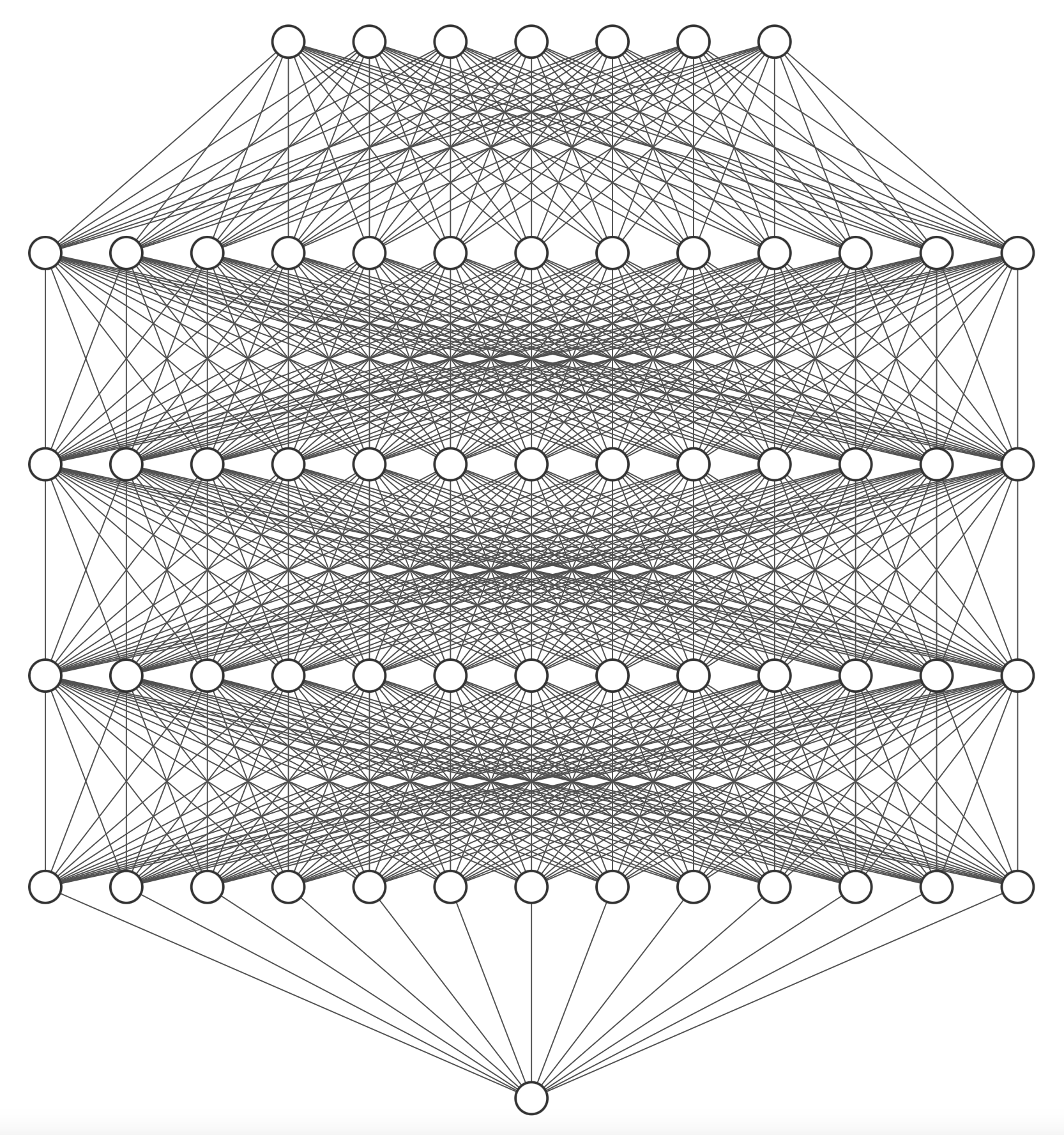
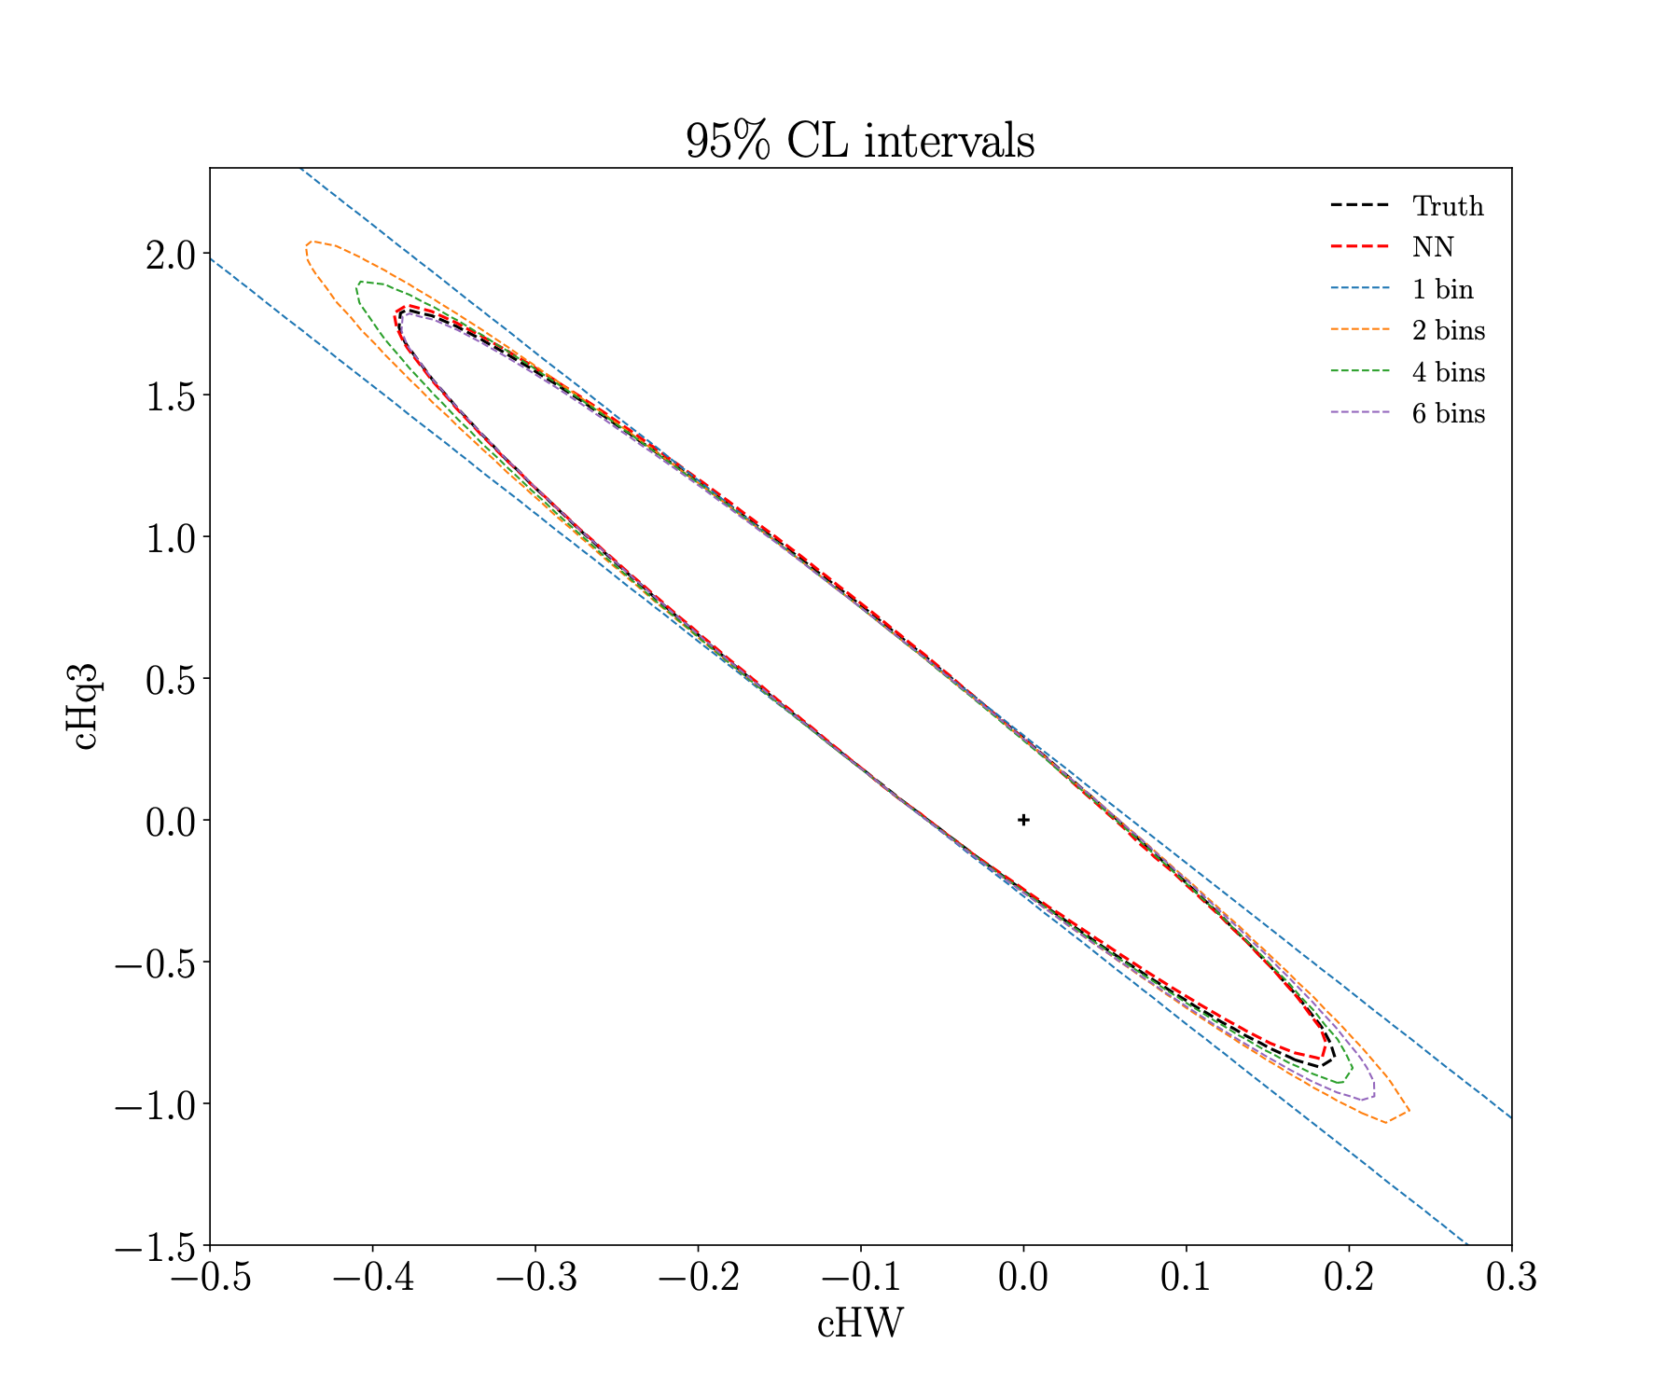
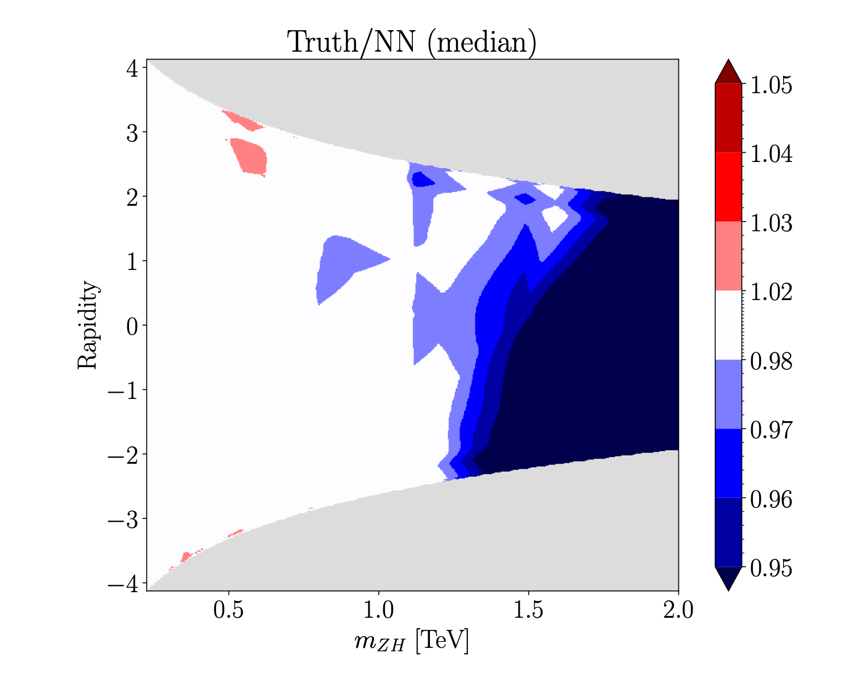
Training
Inference
Profile Likelihood Ratio

Slide 15
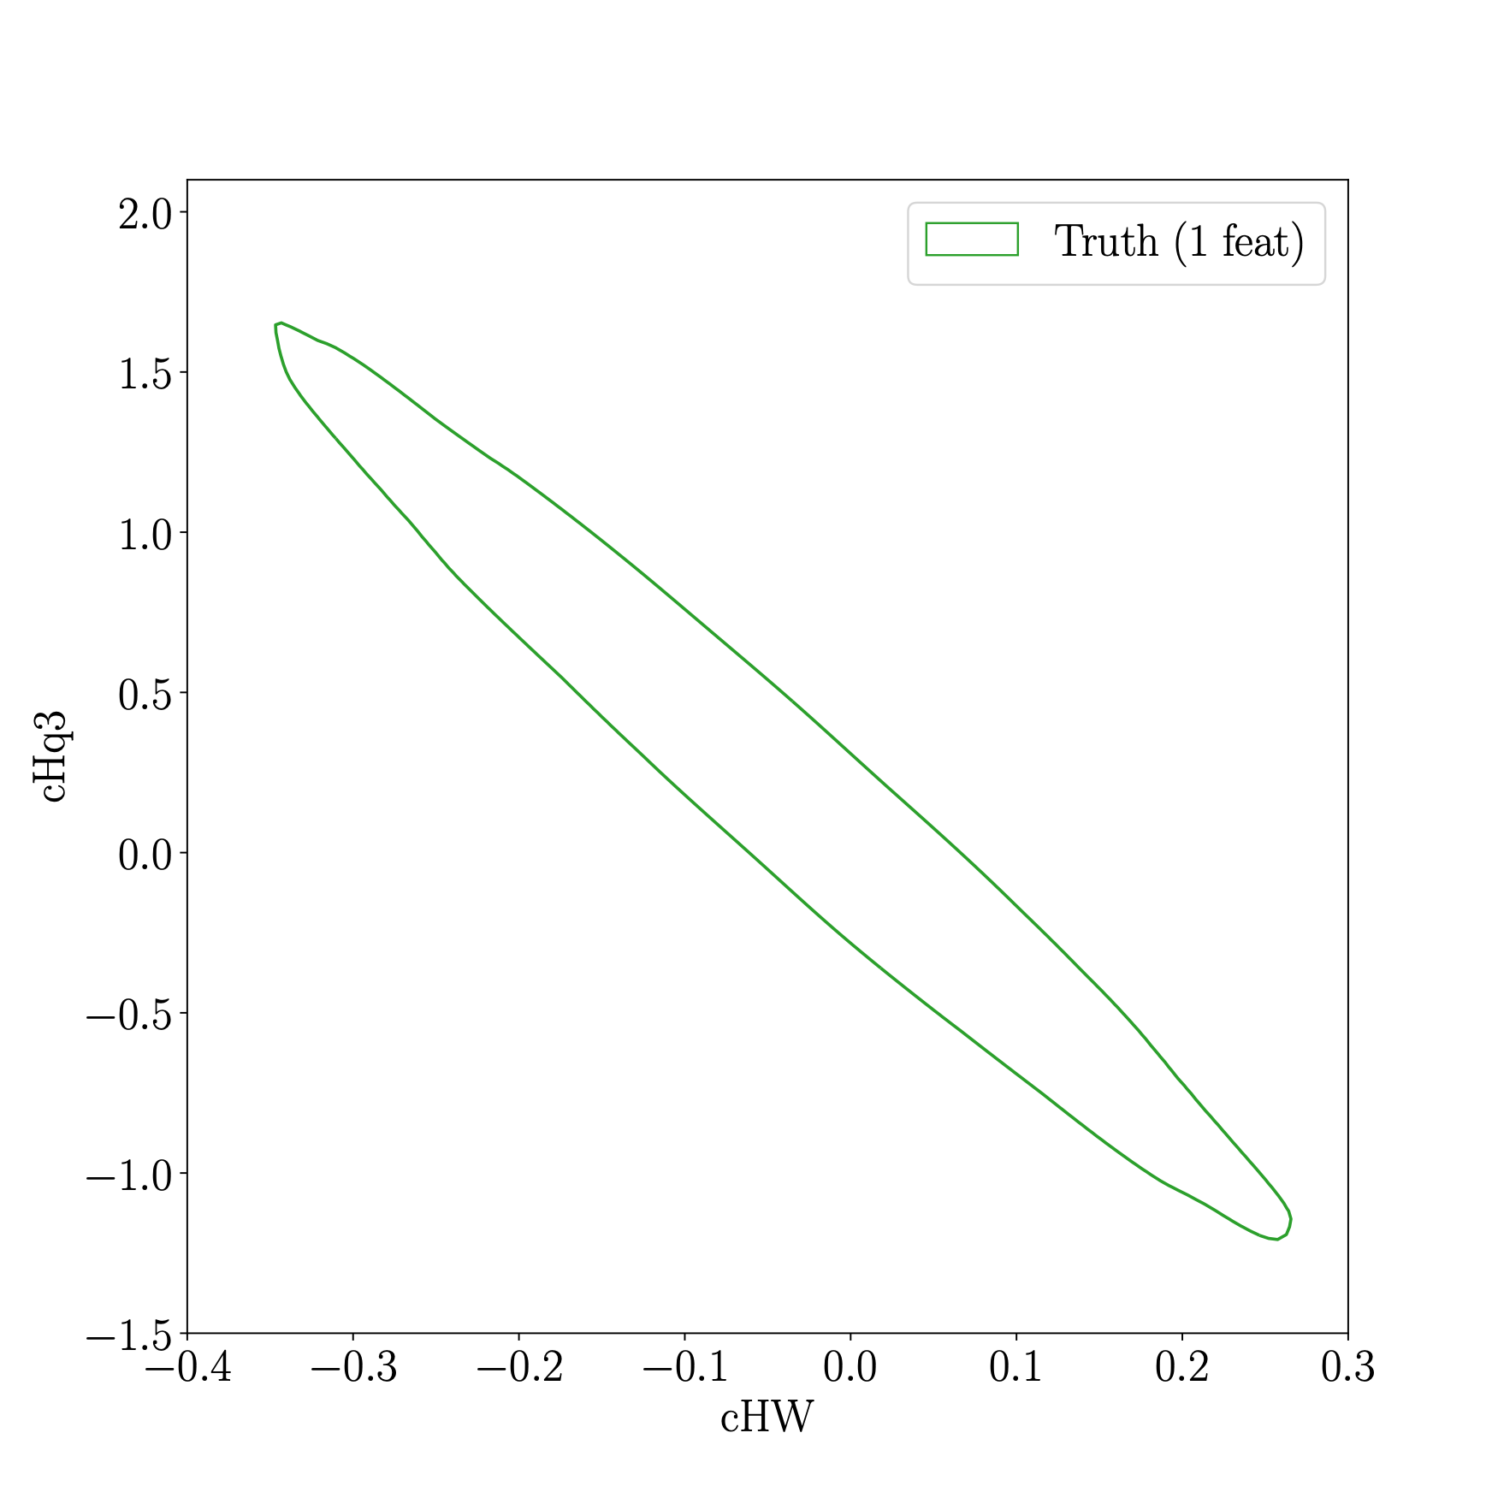
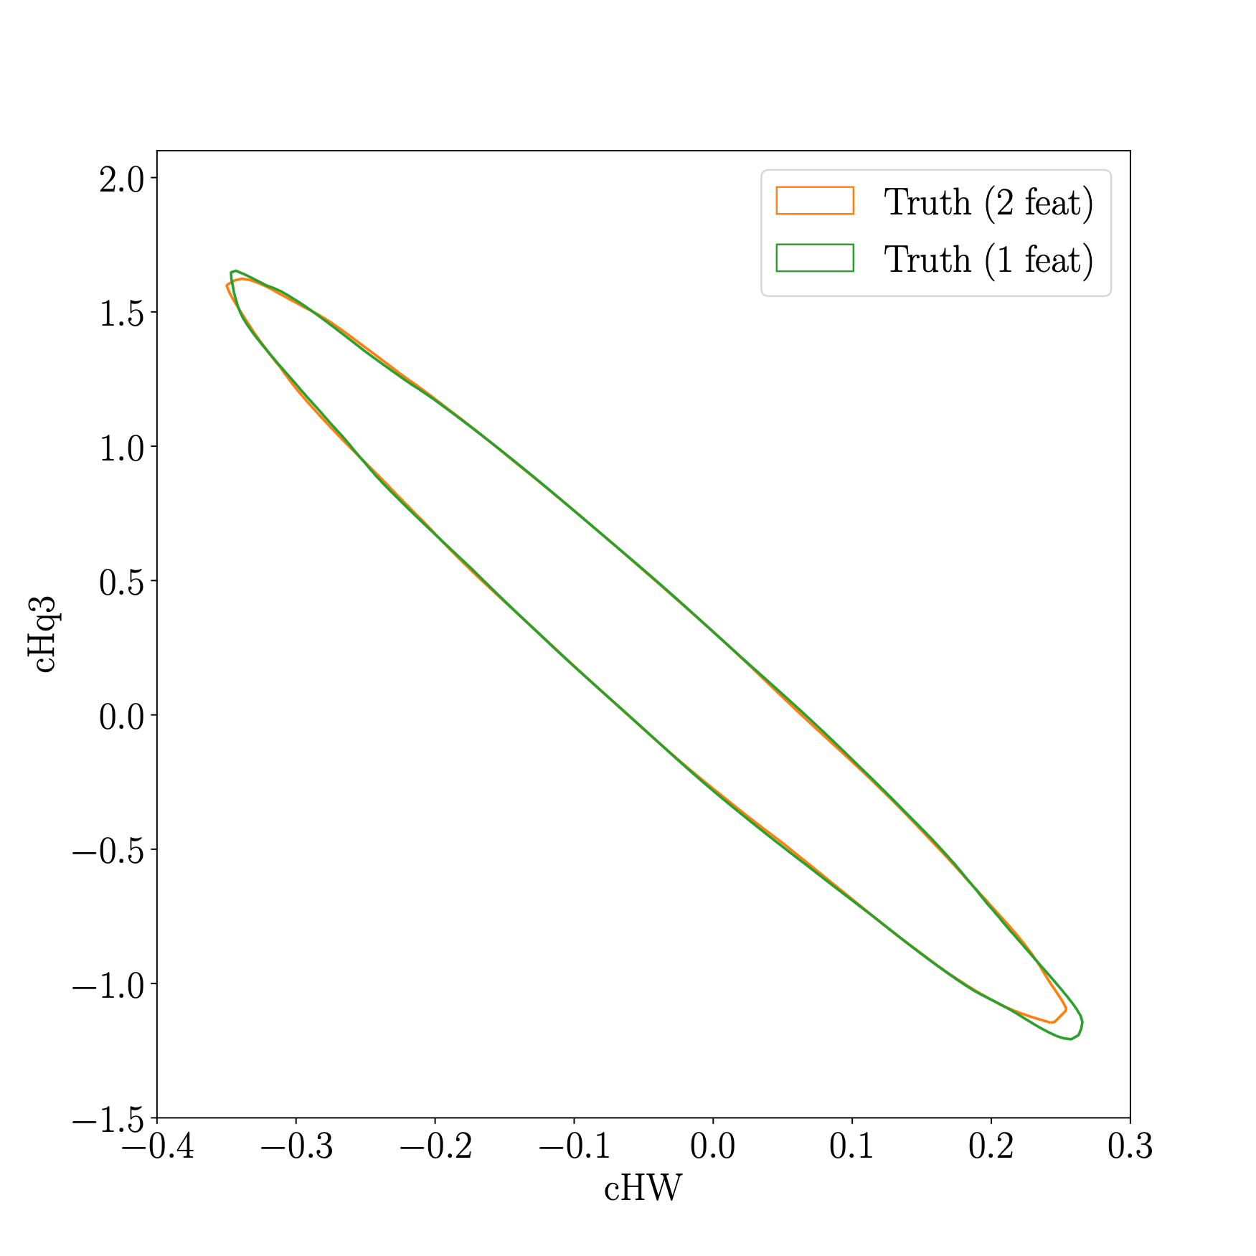
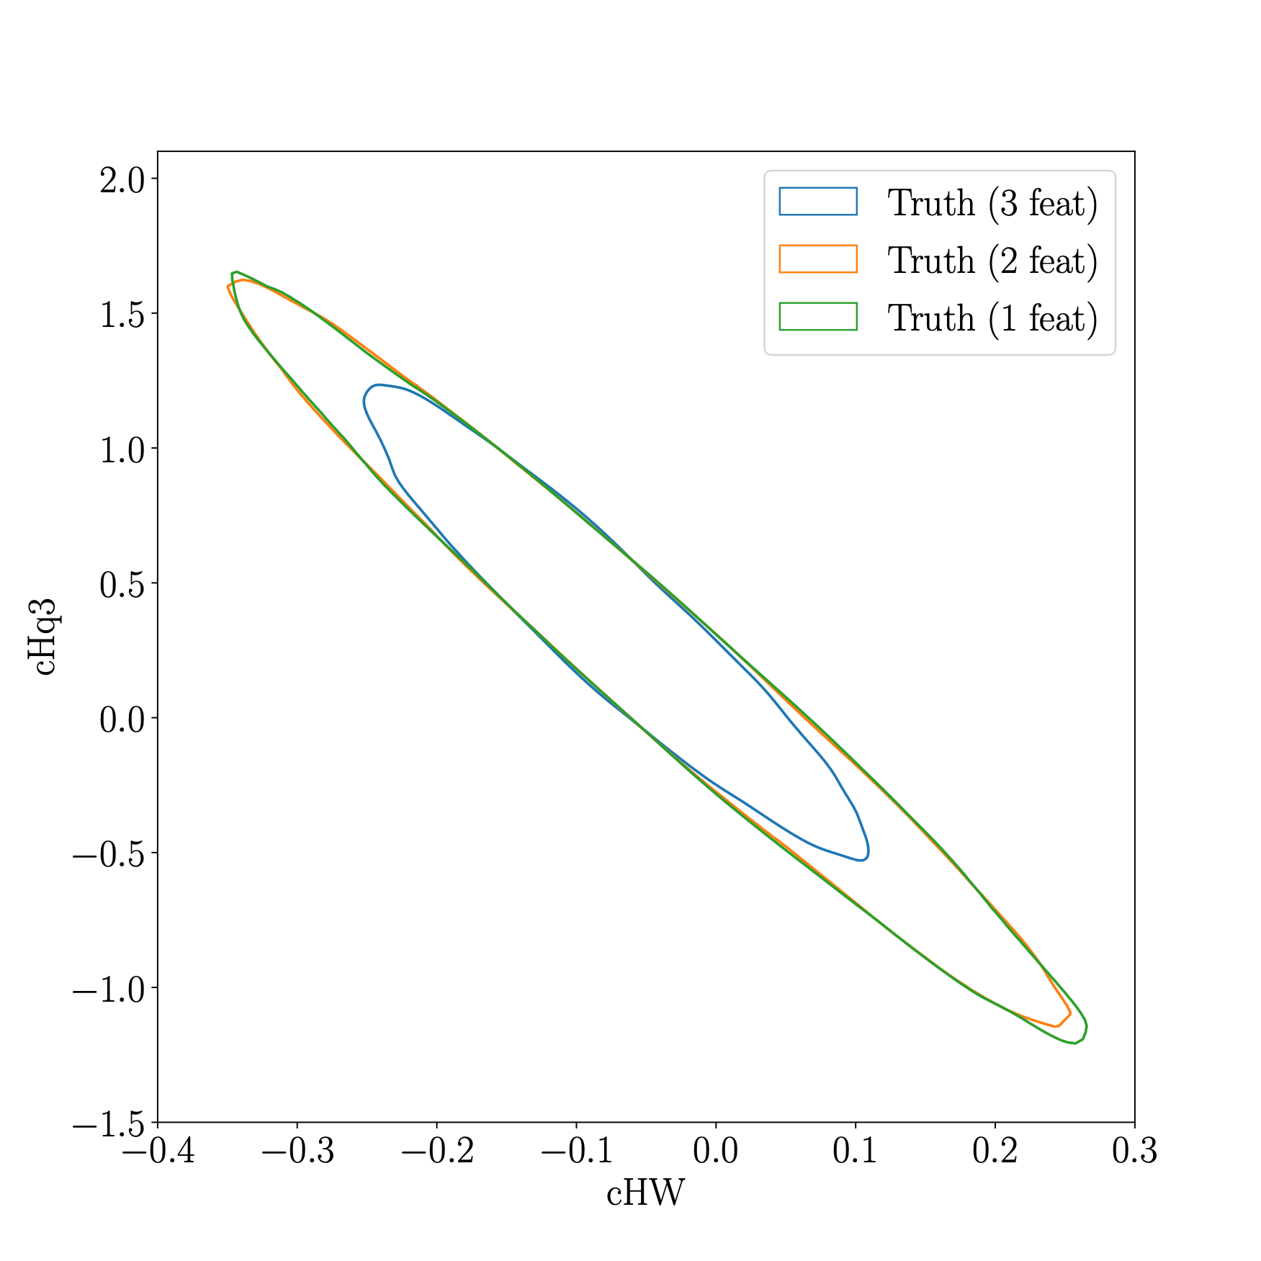
Results
Use Nested Sampling to draw posterior samples
A ground truth analysis with a combination of either performs best with all features included
F. Feroz et al. [1306.2144]

Slide 16
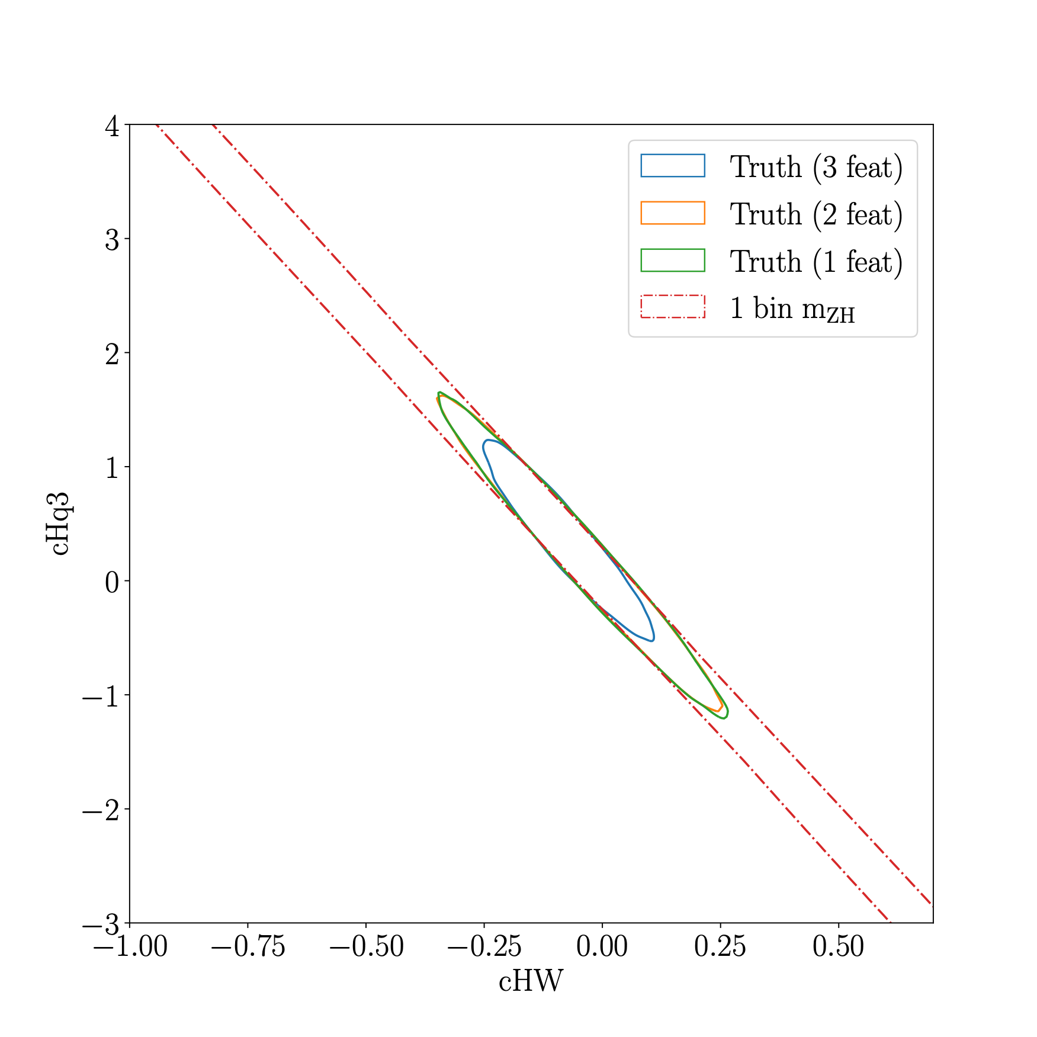
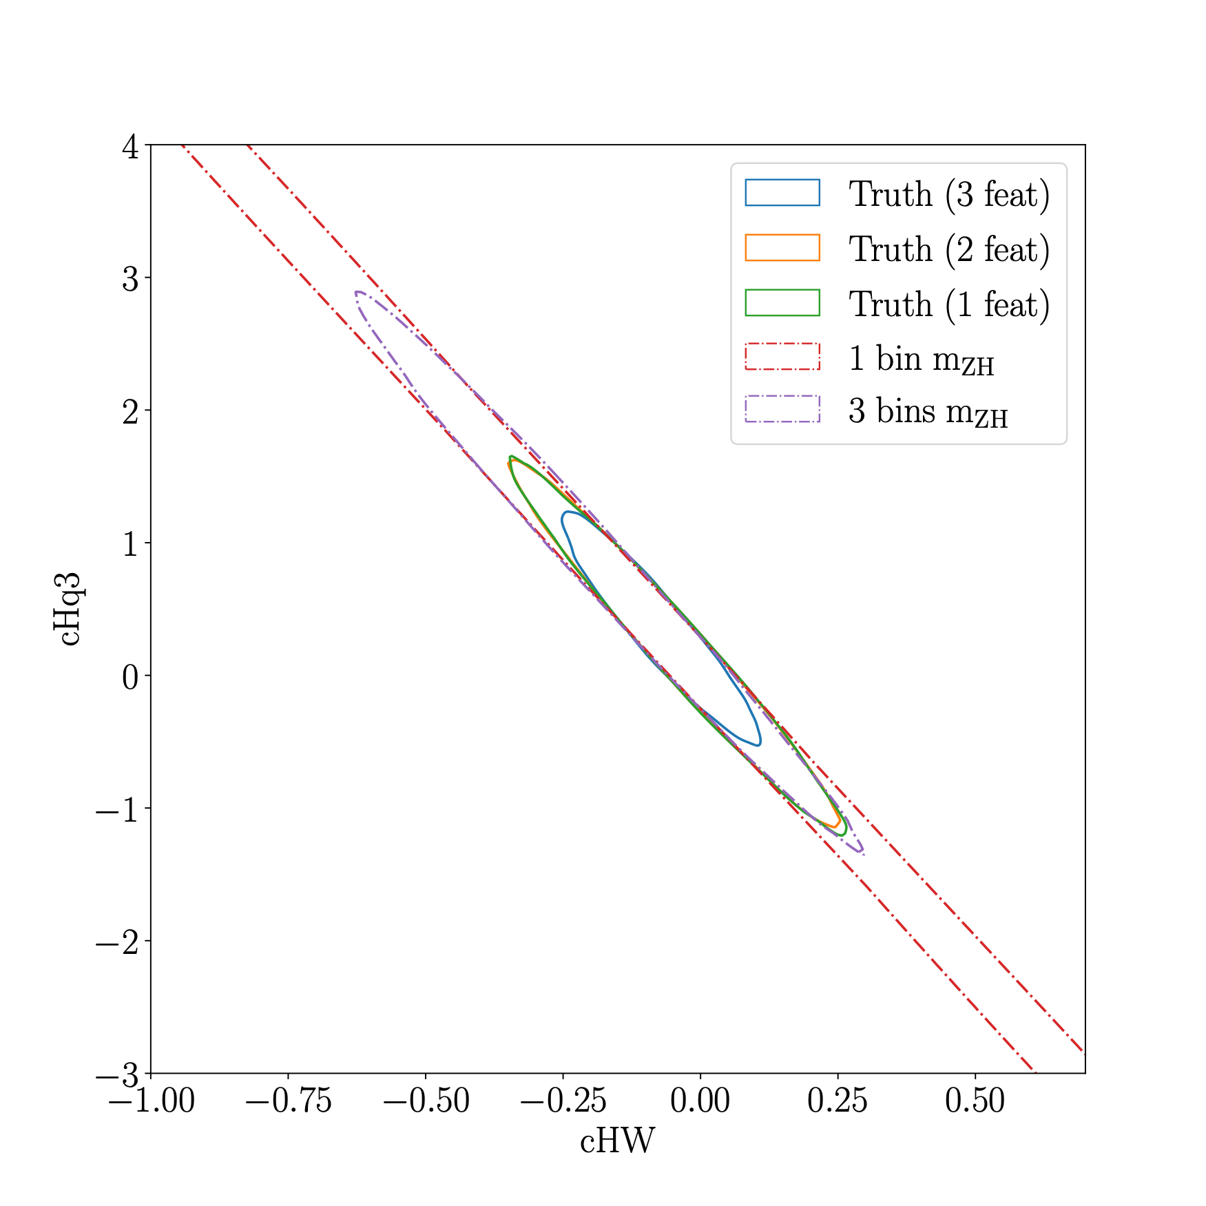
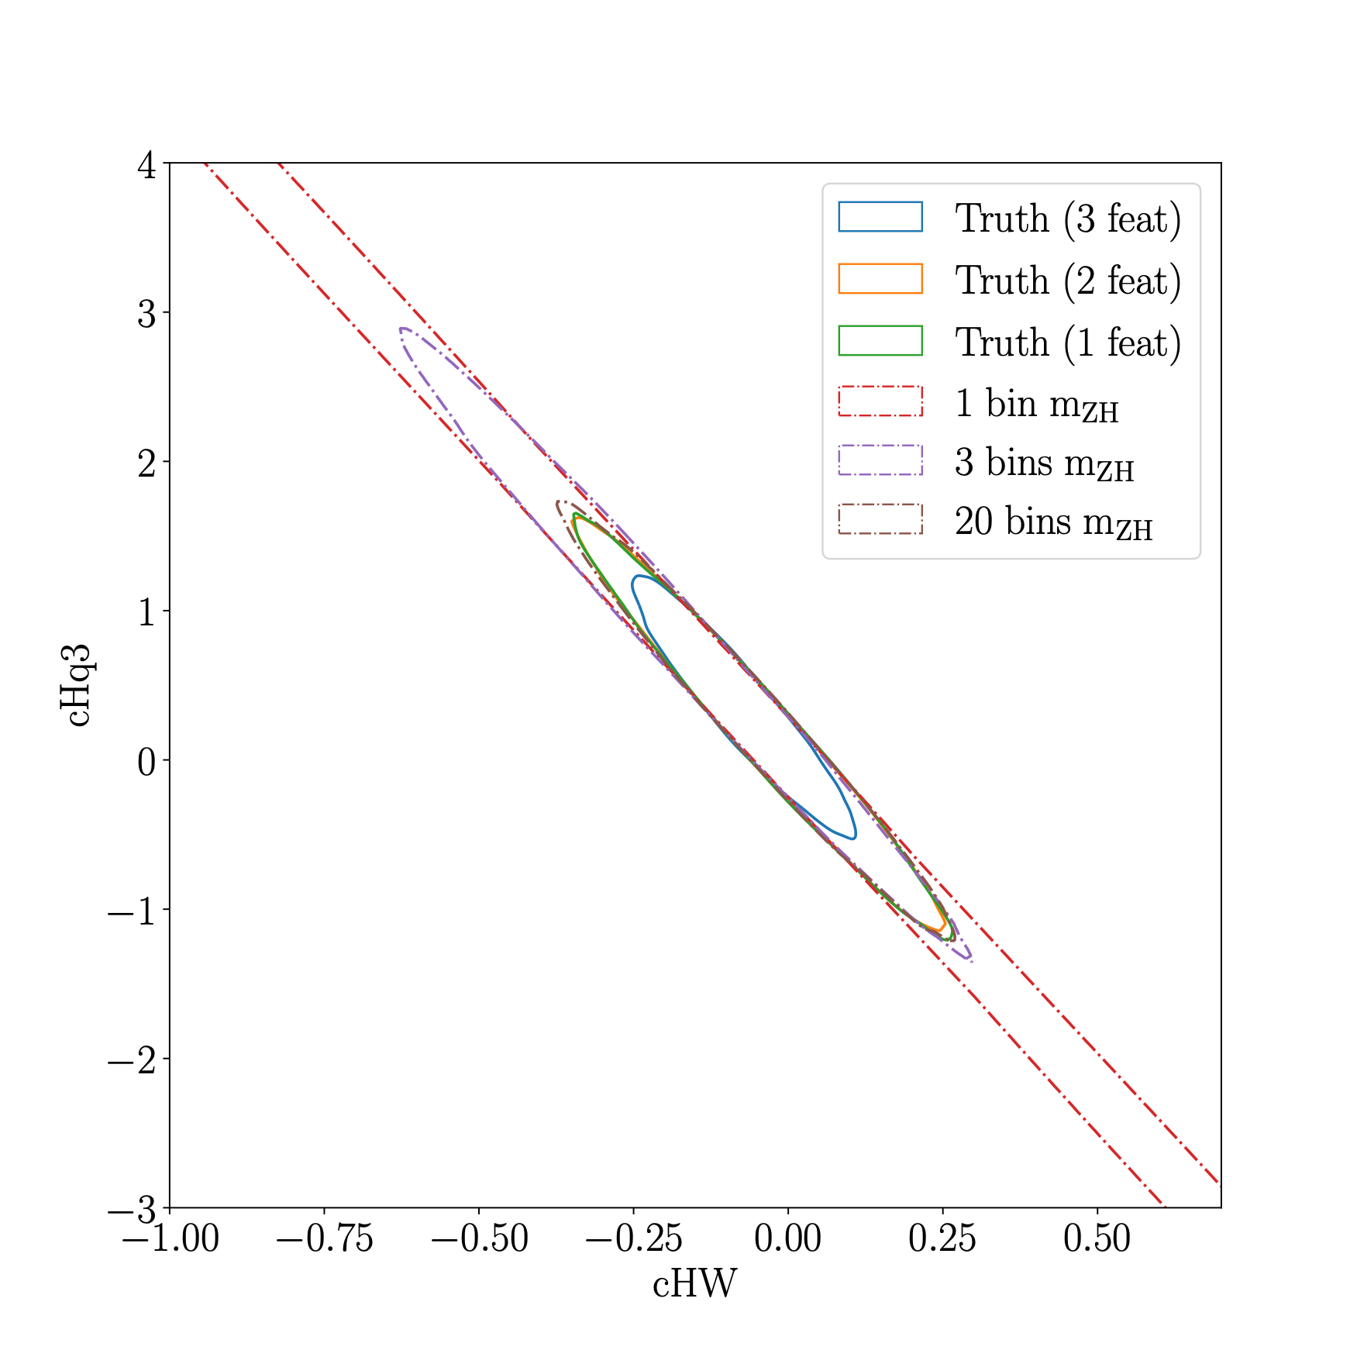
Results
Use Nested Sampling to draw posterior samples
A ground truth analysis with a combination of either performs best with all features included
Binned analyses eventually saturate to unbinned case
F. Feroz et al. [1306.2144]

Slide 17
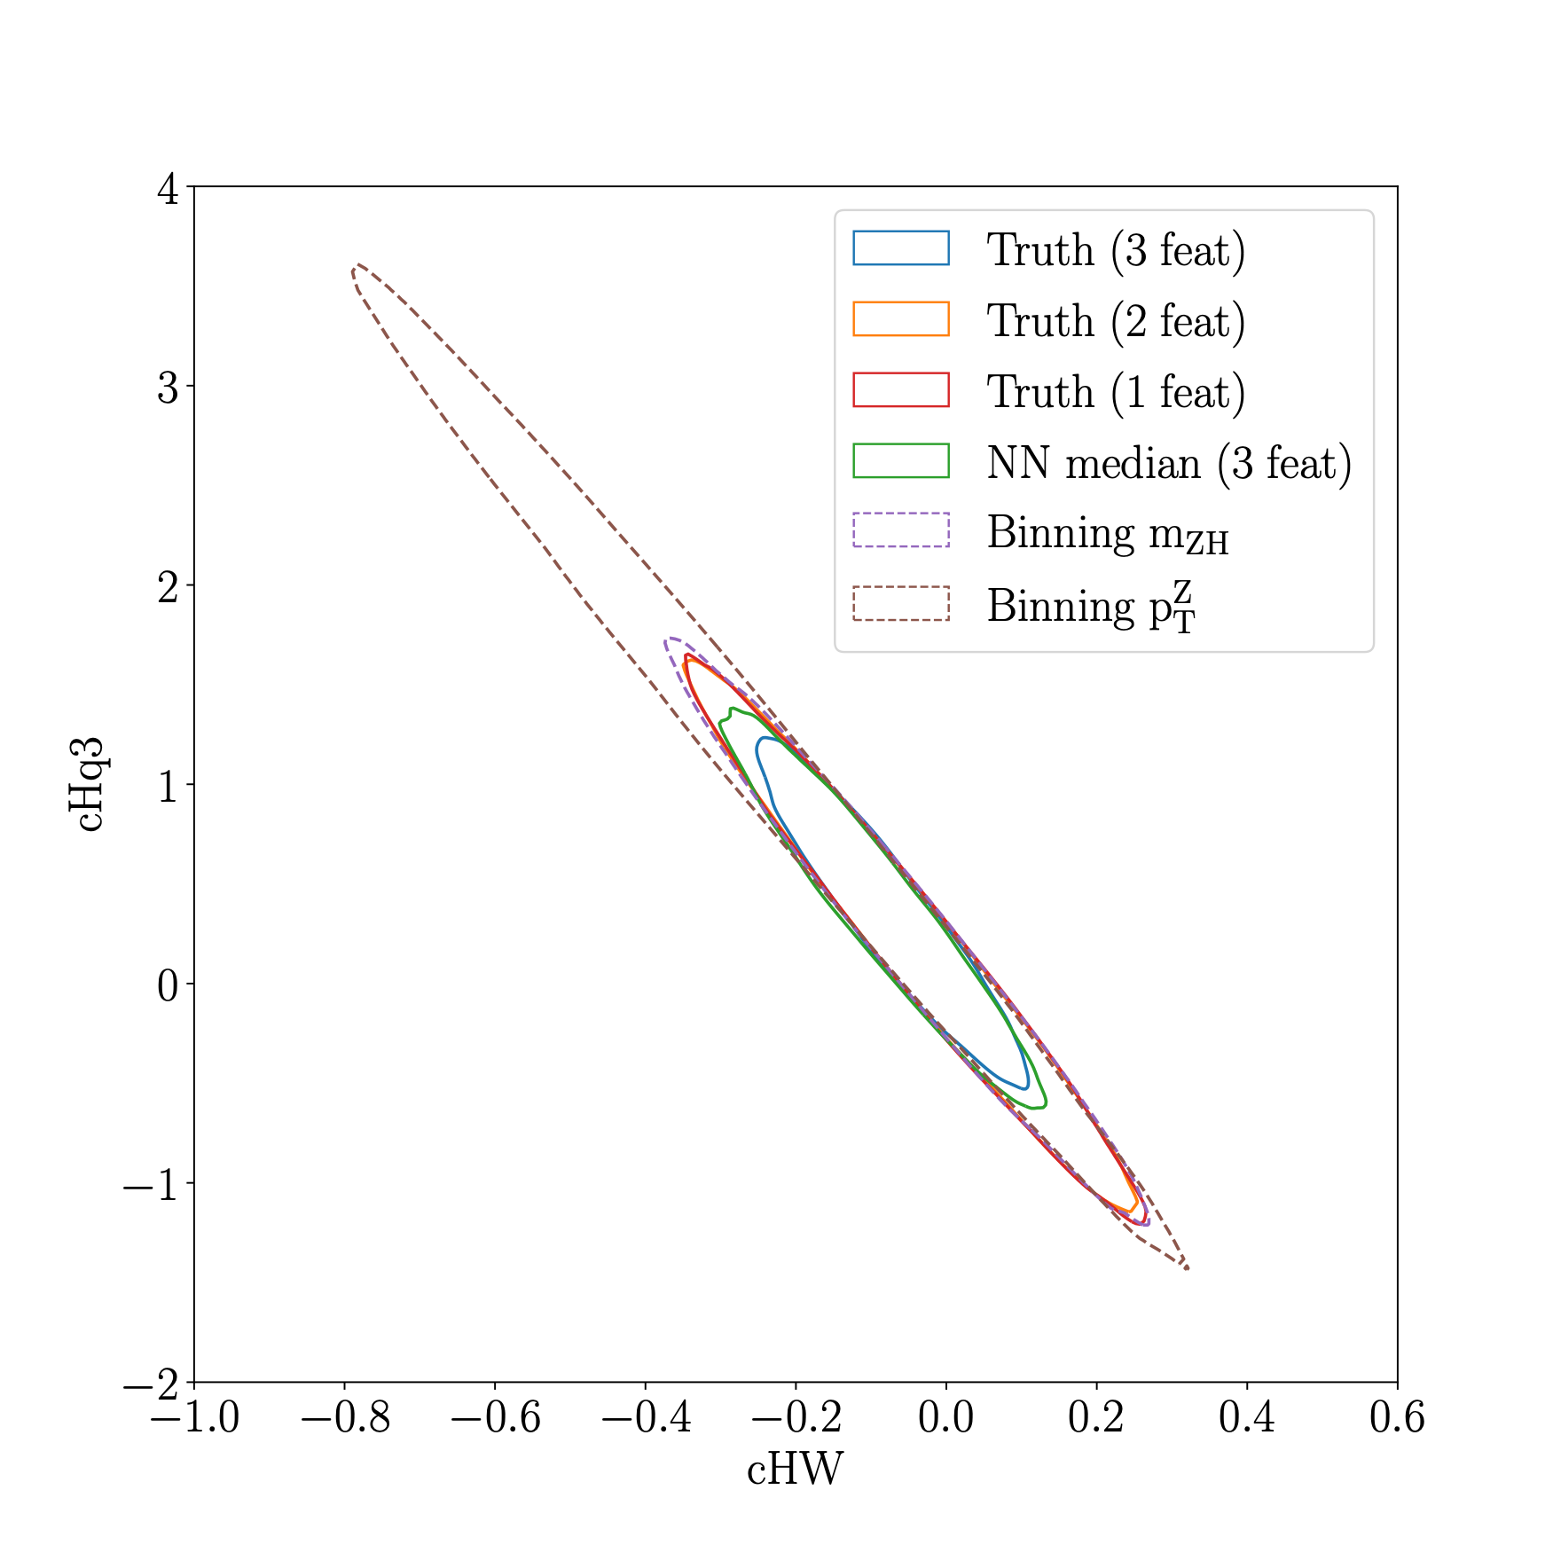
Results
Use Nested Sampling to draw posterior samples
A ground truth analysis with a combination of either performs best with all features included
Binned analyses eventually saturate to unbinned case
Binning in $p_{T}^{Z}$ is suboptimal, i.e. STXS
F. Feroz et al. [1306.2144]
ATLAS-CONF-2021-051

Slide 18
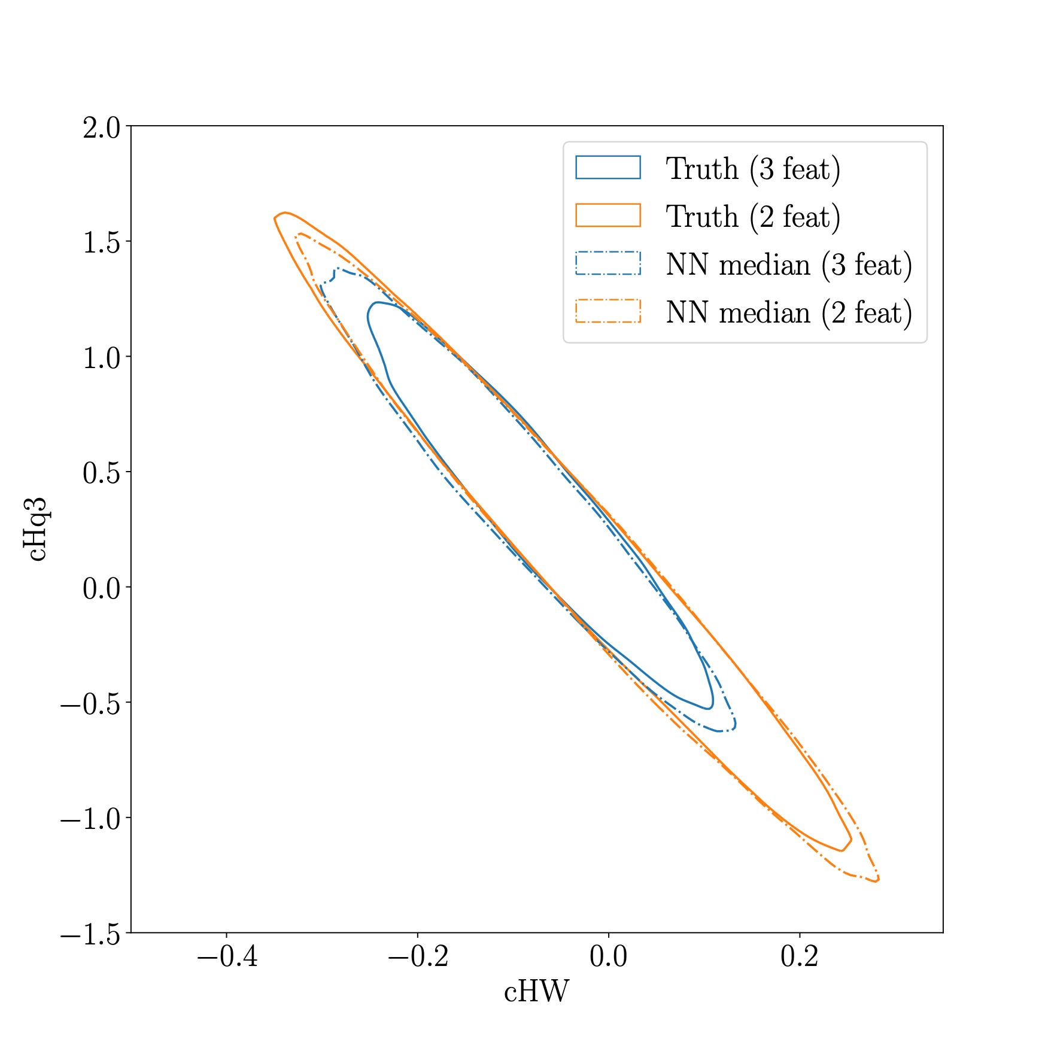
Results
Use Nested Sampling to draw posterior samples
A ground truth analysis with a combination of either performs best with all features included
Binned analyses eventually saturate to unbinned case
Binning in $p_{T}^{Z}$ is suboptimal, i.e. STXS
NN reproduces the truth (within uncertainties?)
F. Feroz et al. [1306.2144]

Slide 19
Conclusion and Outlook
The SMEFT allows for a model independent framework to search for New Physics, taking correlations from different sectors into account
Traditional SMEFT analyses can and should be complemented with unbinned measurements to optimise the constraining power on the Wilson coefficients
Likelihood ratio parameterisations with NN are a promising way forward, and should be implemented in true global EFT fits

Slide 20
Thank you! Questions?

Slide 21
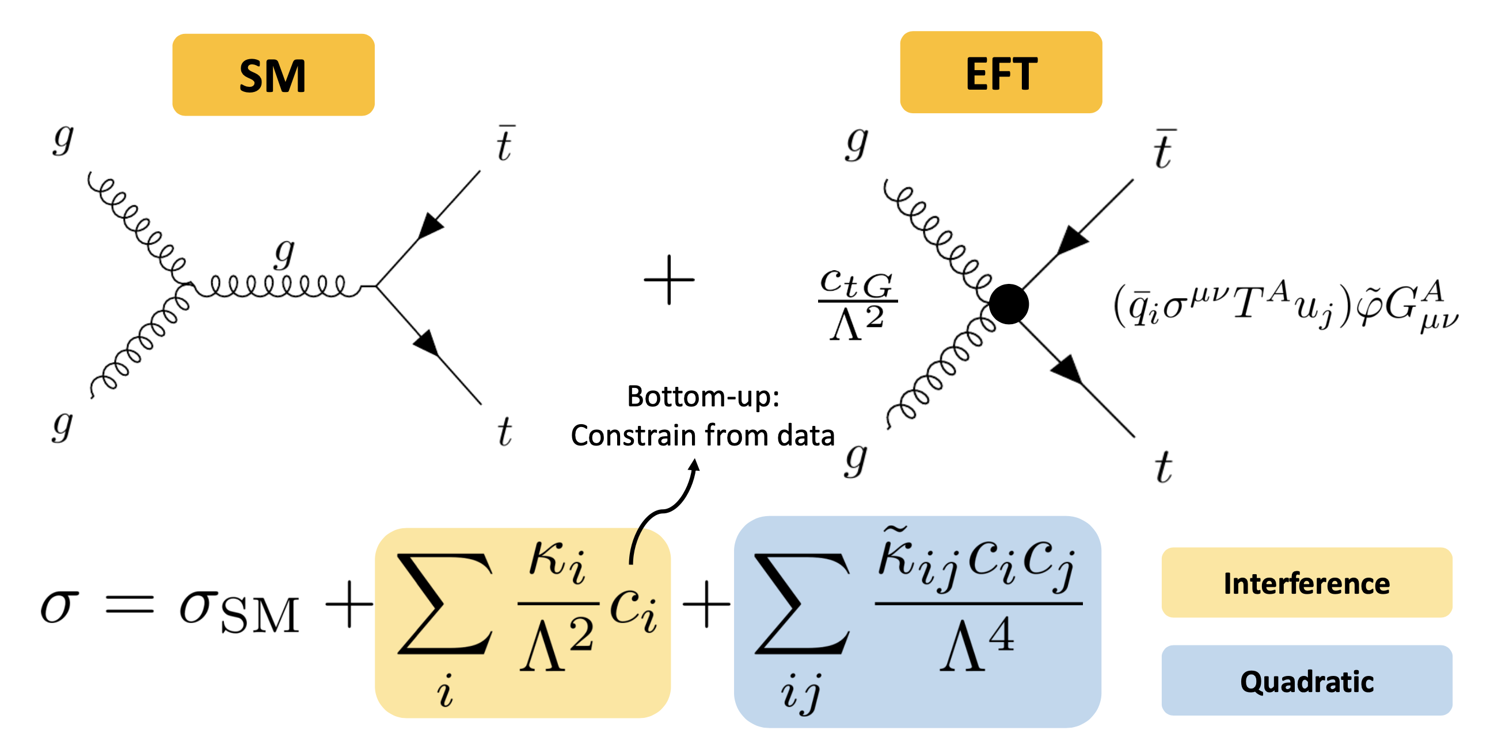
The SMEFT modifies LHC observables!

Slide 22
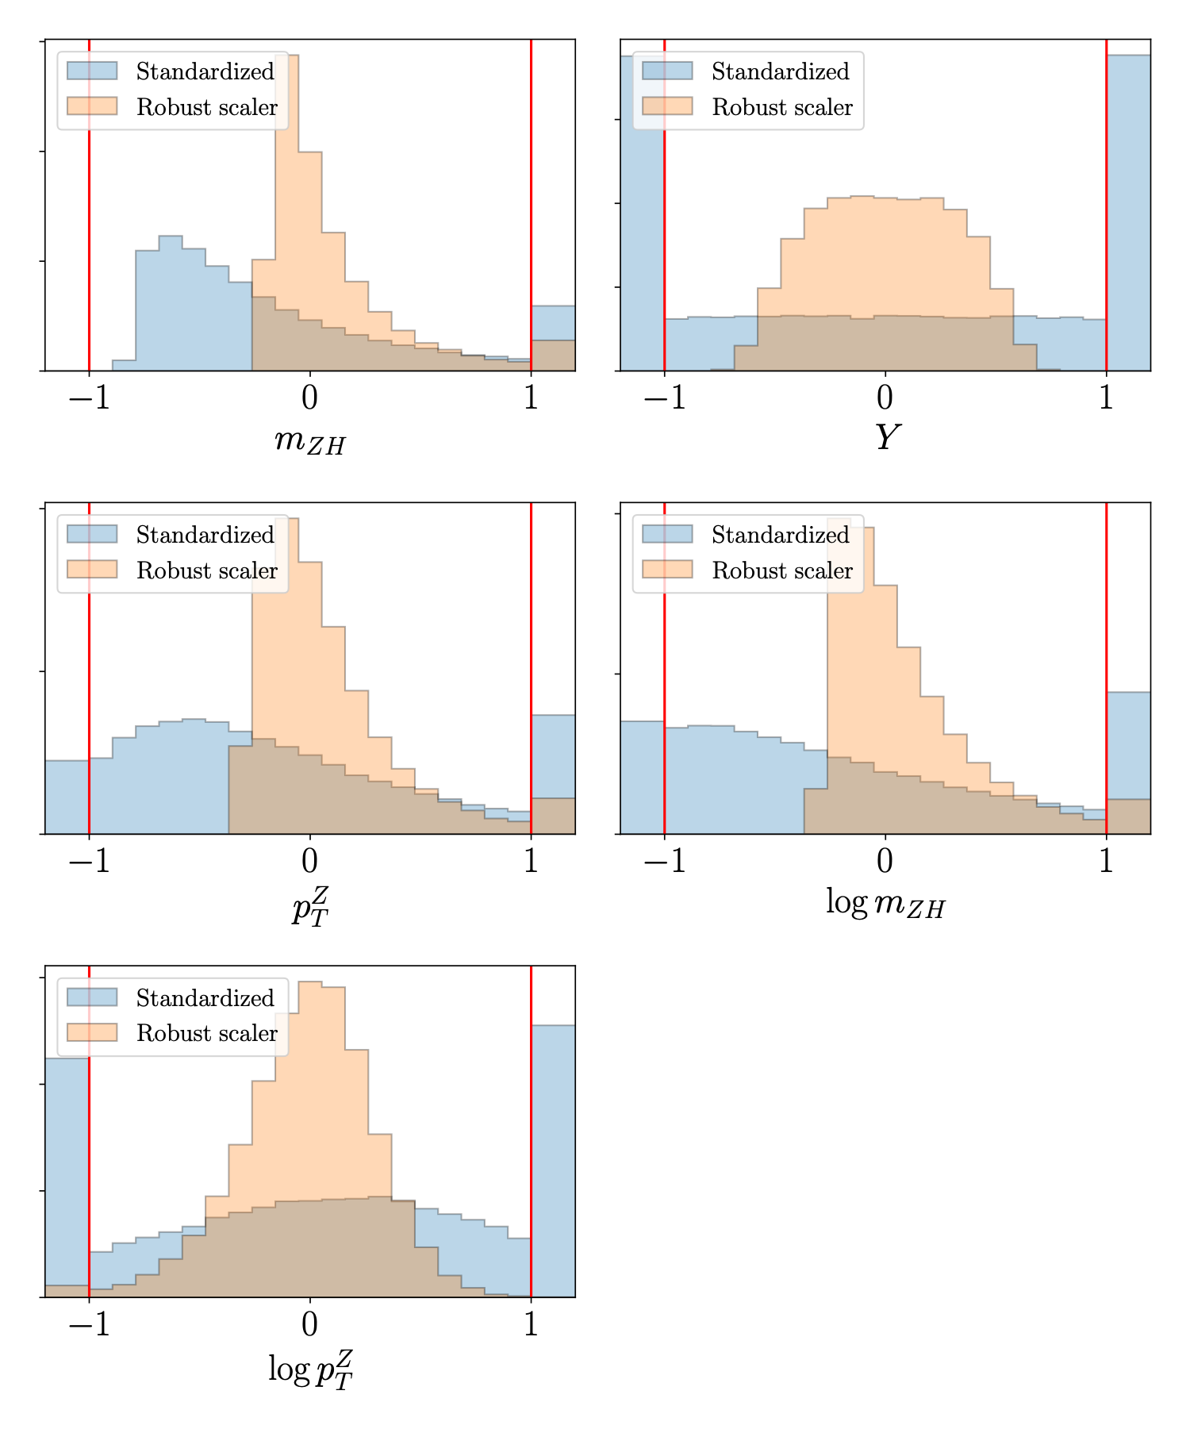
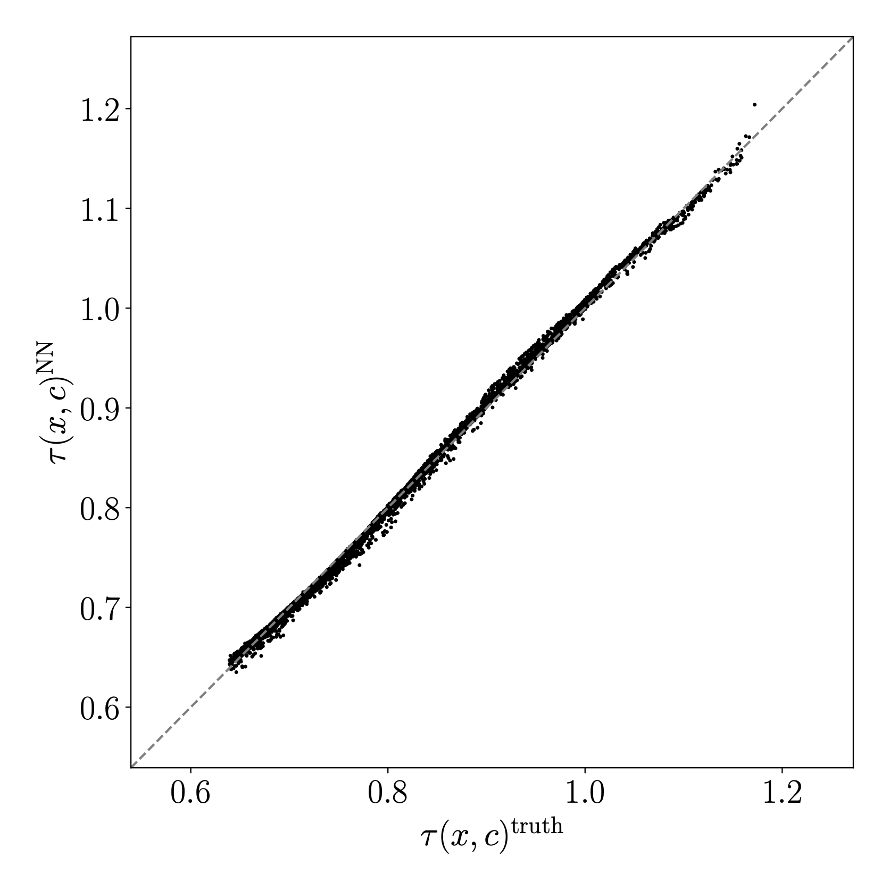
Backup

Slide 23
