Slide 1
Model Agnostic Prediction Interval Estimator :
a scikit-learn-contrib library
21/04/2022
Nicolas Brunel
Laboratoire de Mathématiques et Modélisation d’Evry,
ENSIIE, Univ. Paris Saclay
nbrunel@quantmetry.com
Vianney Taquet
Senior Data Scientist
vtaquet@quantmetry.com
Vincent Blot
Data Scientist
vblot@quantmetry.com
Thomas Morzadec
Data Scientist
tmorzadec@quantmetry.com

Slide 2
Outline
1
QuantLab
2
Uncertainty Quantification : why and how
3
Principles of Conformal Prediction
4
Principles of MAPIE
5
MAPIE for regression
6
MAPIE for time series
7
MAPIE for classification
8
What’s next for MAPIE

Slide 3
1
QuantLab
R&D at Quantmetry

Slide 4
Quantmetry
French consulting company located in Paris since 2011
Pure player in AI, dedicated to analyse, develop and deploy AI applications in all fields of activities (Industry, Transport, Services,…)
All clients or partners can have any type of data, and data maturity
Consulting in Data
Model &Data Science
Architecture & implémentation
Notes:
- Nous travaillons à Quantmetry, un cabinet de conseil spécialisé dans la data et l'IA, créé il y a plus de 10 ans
- Quantmetry consacre environ 20% de sa masse salariale à des projets R&D nous permettant de repousser l'état de l'art sur des sujets clés d'IA
A Quantmetry, l'expertise complémentaire de nos consultants nous permet de développer et de déployer des systèmes d'IA sur tout type de cas d'usage rencontrés lors de nos missions et allant des series temporelles au NLP ou à la CV
Nous devons donc nous s'assurer que ces systèmes soient robustes Durant leur déploiement, intelligibles pour nos clients, et conformes aux réglementations en vigueur

Slide 5
QuantLab and R&D activities
QuantLab is the AI Lab for Applied ML research at Quantmetry
Develop methodologies, tools, codes for improving perfomance and reliability
Trustworthy AI (Fairness, Transparency, Explainable AI, Uncertainty, Robustness)
Scaling Performance (Deep Learning, Generative AI, MLOps, Open Source)
Integration of AI in Business (Maturity and organisation, Operations Research)
Big thrust from EU (AI Act), Industry (consortium confiance.ai), ACPR (Regulator for Banking and Insurance)…
Notes:
- Nous travaillons à Quantmetry, un cabinet de conseil spécialisé dans la data et l'IA, créé il y a plus de 10 ans
- Quantmetry consacre environ 20% de sa masse salariale à des projets R&D nous permettant de repousser l'état de l'art sur des sujets clés d'IA
A Quantmetry, l'expertise complémentaire de nos consultants nous permet de développer et de déployer des systèmes d'IA sur tout type de cas d'usage rencontrés lors de nos missions et allant des series temporelles au NLP ou à la CV
Nous devons donc nous s'assurer que ces systèmes soient robustes Durant leur déploiement, intelligibles pour nos clients, et conformes aux réglementations en vigueur

Slide 6
The SimAI project in a nutshell
4
partners
1
goal
2
lines of work
AI assistance of engineer in the design of tires
AI Models Certifications
AI tire generation

Slide 7
2
Uncertainty Quantification:
Why and how

Slide 8
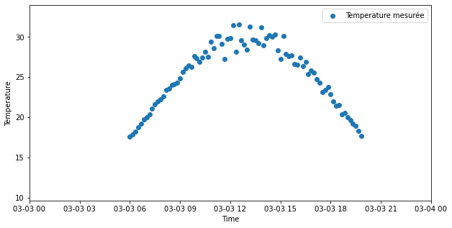
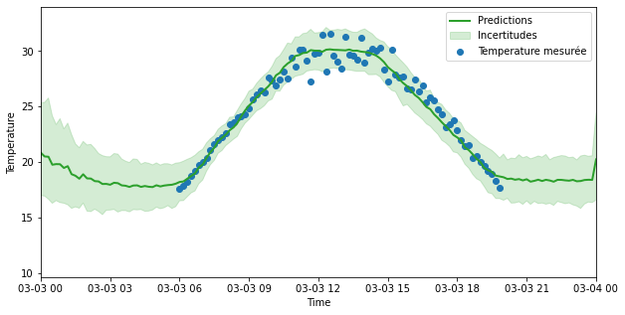
Different Sources of Uncertainty (1)
Example : temperature measurement as function of time
Uncertainty induced by noise of the data : aleatoric
Measured Temperature
Predictions
Uncertainties
Prediction Interval
Uncertainty due to lack of data : epistemic
Notes:
Estimer les incertitudes associées aux predictions d’IA permet d’orienter l’acquisition de nouvelles données

Slide 9
Different Sources of Uncertainty (2)
Example : Image segmentation for autonomous cars
Image shot by car
Segmentation made by AI
Why is this sidewalk misidentified ?
Uncertainty decomposition :
Uncertainty due to image quality (aleatoric)
Uncertainty due to image quantity (epistemic)
Kendall & Gal (2017)
Aleatoric
Epistemic
Notes:
Niveau de confiance lié aux incertitudes ?

Slide 10
Uncertainty quantification : why bothering ?
Uncertainty quantification is key for developing and deploying reliable AI models
Better knowledge of AI model predictions
Can uncertainties help me debug my model ?
Are the model predictions valid on new data ?
Mandatory is mandatory in critical domains
Are AI models compliant with the regulation ?
Data Scientists
Regulators
Better risk management
Can I use the AI predictions for making my business decision ?
Make AI more trustworthy
Are decisions taken by AI about me reliable ?
AI operators
Impacted people

Slide 11
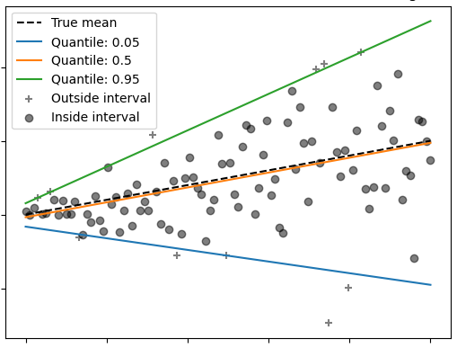
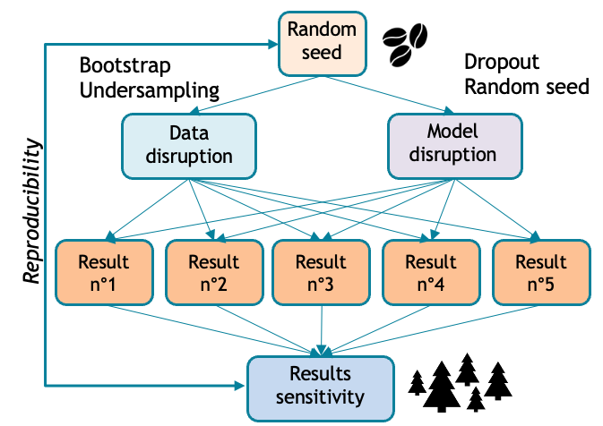
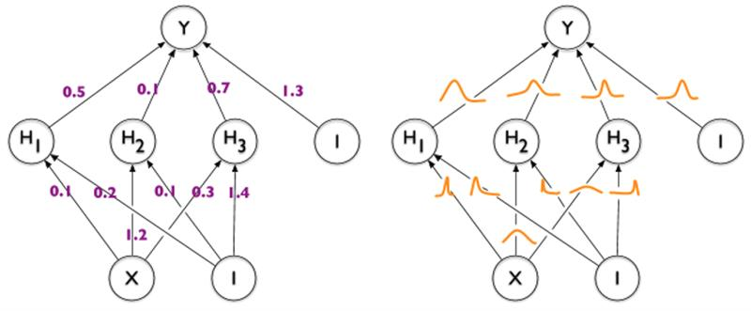
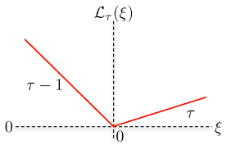
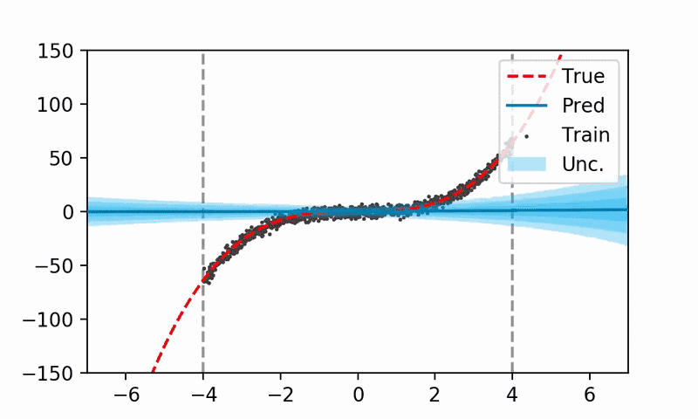
Common approaches for computing Confidence Intervals
Quantile Regression
Model and Data perturbations
Bayesian Inference
Deep learning
Bayesian
Deep learning
Pinball loss
UQ360

Slide 12
3
Principles of
Conformal Prediction

Slide 13
Conformal prediction and confidence sets

Slide 14
Split conformal regression

Slide 15
Valid coverage for split conformal prediction

Slide 16
Limits of split conformal prediction

Slide 17
Split conformal prediction for classification

Slide 18
Cross-conformal : Jackknife+

Slide 19
Prediction interval for general ML model

Slide 20
Coverage guarantees

Slide 21
Better coverage with stability assumptions

Slide 22
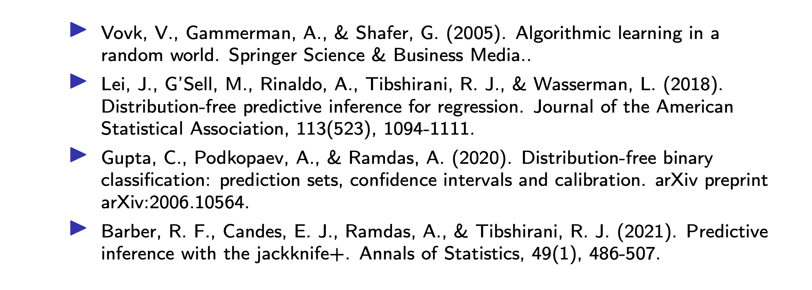
References

Slide 23
4
Principles of MAPIE

Slide 24
Why starting the MAPIE project ?
We aim at building a Python library that computes confidence sets with three objectives :
Theoretical guarantees on the coverage probabilities
Algorithmic transparency for trustworthy AI
Model and use case agnostic
Theoretical guarantees on the coverage probabilities of the estimated prediction sets or intervals
Mild assumptions of the data distributions or the model
Address any “scikit-learn compatible” regressor or classifier (as a starter) to ease deployment and commoditize uncertainty
Deep Learning, Time Series, NLP and CV should be addressed
Open source implementation in Python
Extensive tests and documentations
Notes:
Supprimer le tableau et insister sur les 3 critères qui ont permis de déclencher le projet MAPIE
Le faire sous forme de timeline

Slide 25
Why starting the MAPIE project ?
We aim at building a Python library that computes confidence sets with three objectives :
Theoretical guarantees on the coverage probabilities
Algorithmic transparency for trustworthy AI
Model and use case agnostic
Method | Theoretical guarantees | Model Agnostic | Open-Source Implementation
Quantile Regression
Data Perturbation (Bootstrap, Jackknife)
Conformal Prediction
Model Perturbation (Random seed, MC Dropout)
Bayesian inference
Notes:
Bootstrap : pas valide pour modèles ML avec grand nombre de paramètres et processus de selection de features

Slide 26
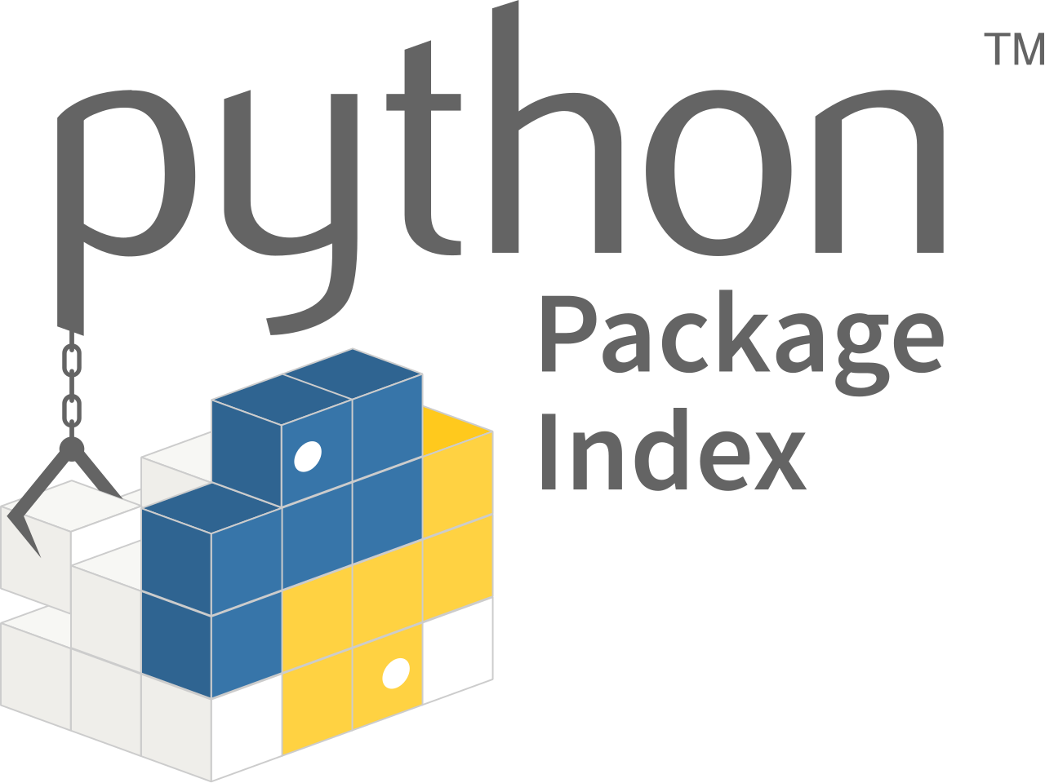
MAPIE in 2021
 |  | 2021 | 2021
 |  | March | April | May | June | July | August | September | October | November | December
Genesis
First release on pypi
First release on conda
Inclusion in scikit-learn-contrib
MapieClassifier Release
Participate to confiance.ai
Regression |  | Jackknife+ / CV+ | Jackknife+ / CV+ |  |  |  |  | Jackknife+-after-Bootstrap
 |  |  |  |  |  |  |  |  | Adaptative Prediction sets
Regression
Classification
Regression |  | Jackknife+ / CV+ | Jackknife+ / CV+
Regression |  | Jackknife+ / CV+ | Jackknife+ / CV+
 |  |  |  |  |  | Split-Conformal Prediction
Y. Romano, M. Sesia and E. J. Candès (2020)
Rina Foygel Barber et al. (2021)
A. Angelopoulos, S. Bates, M. Jordan and J. Malik (2021)

Slide 27
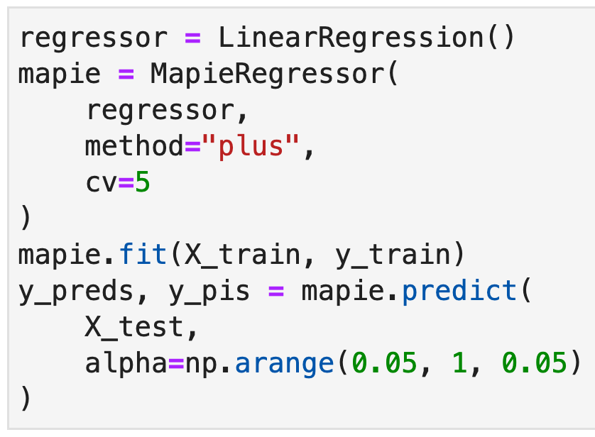
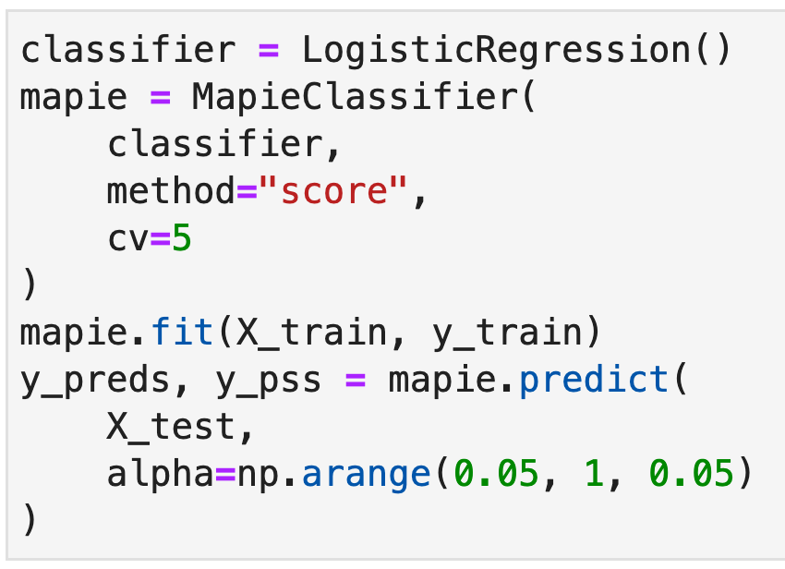
General principles of MAPIE
Two counterpart classes for regression and classification tasks :
MapieRegressor
MapieClassifier
GitHub repository : https://github.com/scikit-learn-contrib/MAPIE
Documentation : https://mapie.readthedocs.io/en/latest/

Slide 28
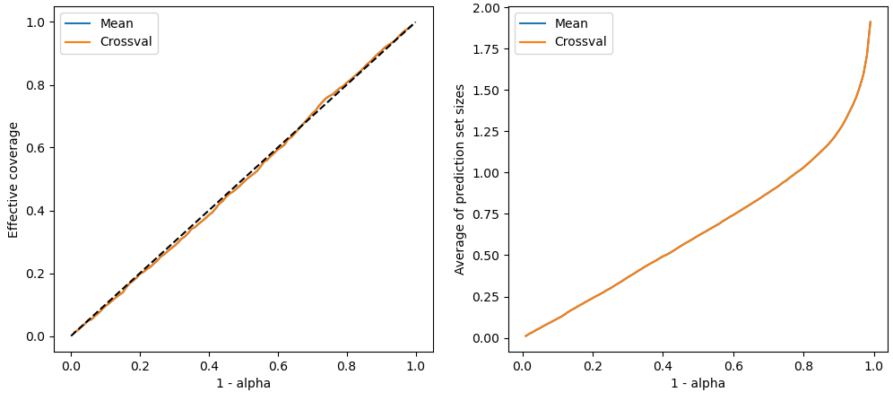
General principles of MAPIE
MAPIE easily allows you to compare UQ methods through :
Calibration plot : effective vs target coverage
Sizes of prediction sets vs target coverage

Slide 29
5
MAPIE for Regression
(cross-conformal)

Slide 30
MAPIE for Regression
$$X_{n+1}$$
Input
$${\hat{Y}}_{n+1}$$
Prediction
$$\hat{C}\left(X_{n+1}\right)$$
Prediction Interval
$$Y_{n+1}$$
Observation
$→$Guarantee on the marginal coverage :
$$ℙ\left\{Y_{n+1}∈\hat{C}(X_{n+1})\right\}≥1−α$$
Example: target coverage 90% = Guarantee that at least 90% of observations lies in the prediction set.
Remark: It is an average, hence a global not local error rate (i.e conditional).
Conditional coverage : $ℙ\left\{Y_{n+1}∈\hat{C}(X_{n+1})|X_{n+1}=x\right\}≥1−α$ for almost all x.
$$ℙ\left\{Y_{n+1}∈\hat{C}(X_{n+1})\right\}=𝔼(ℙ\left\{Y_{n+1}∈\hat{C}(X_{n+1})|X_{n+1}=x\right\})$$
Notes:
- Ajouter que les donnés

Slide 31
Example : Calculate a function value of an indicator
We do not know the function but some samples to train a ML estimator.
MAPIE offers to estimate the function with prediction intervals
MAPIE works with all scikit-learn compatible models
Polynomial function
XGBoost
Keras Multilayer Perceptron

Slide 32
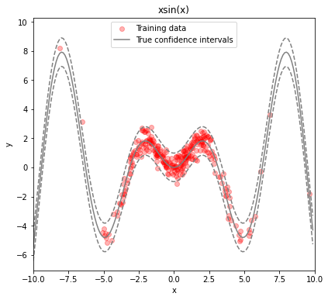
Five implemented methods
« MapieRegressor » offers five methods: Naive, Jackknife, Jackknife +, CV +, Jackknife + -after- Bootstrap
Example : Uncertainty intervals on the estimation of $xsin\left(x\right)$ by a Random Forest, with targeted marginal coverage 90%.
Notations:
$\hat{\text{μ}}(X)$ : prediction at X of the estimator $\hat{\text{μ}}$
$R=|y −\hat{\text{μ}}(X)|$: absolute value of the residual of $\hat{\text{μ}}$
${\hat{\text{μ}}}_{−i}(X)$ : prediction at X of an estimator ${\hat{\text{μ}}}_{−i}$ trained on a leave-One-Out
subsample
$R_{i}^{LOO}=\left|y_{i} −{\hat{\text{μ}}}_{−i}\left(X_{i}\right)\right|$: absolute value of the residual of ${\hat{\text{μ}}}_{−i}$ at $X_{i}$

Slide 33
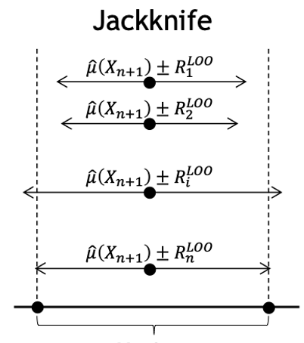
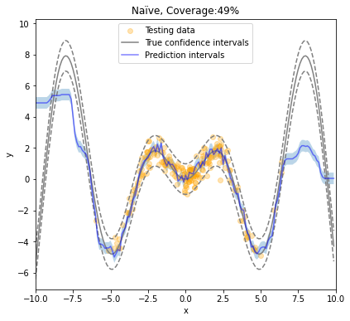
« Naive » Method
Consider the absolute values of the residuals of the ML estimator on the training set. Without refitting.
No guarantee on the coverage control
notably in case of overfitting
Naive

Slide 34
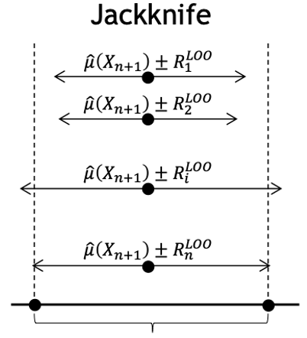
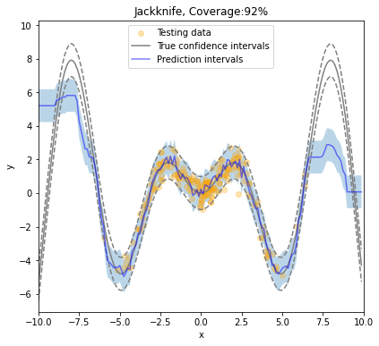
« Jackknife » Method
On the training set, consider the absolute values of the residuals of the estimators refitted on «Leave-One-Out» subsamplings
No guarantee on the coverage control
Jackknife

Slide 35
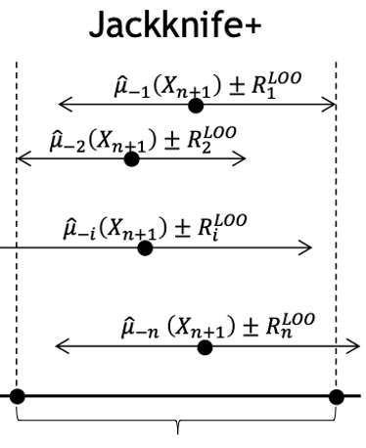
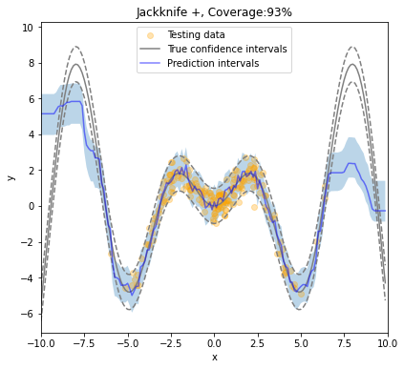
« Jackknife + » Method
Similar to the Jackknife method, plus, on the validation set, not only consider the prediction of a single estimator, but the predictions made by the refitted estimators.
Coverage control guaranteed
Jackknife +
Predictive inference with the jackknife+
(Foygel Barber and al., 2020)

Slide 36
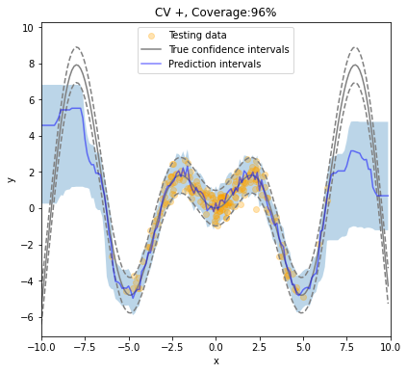
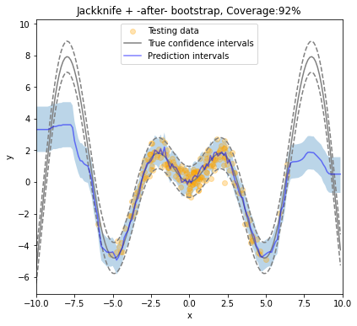
« CV + » and « Jackknife - plus -after- Bootstrap » Methods
Jackknife + implies refitting the model for every sample of the training set, that can be expensive
MapieRegressor offers two solutions:
CV + : K-fold subsampling
Jackknife -plus-after- Bootstrap: bootstrapping.

Slide 37
Another regression case: Characterisation of exoplanet properties
Stay tuned !

Slide 38
6
MAPIE for Time Series

Slide 39
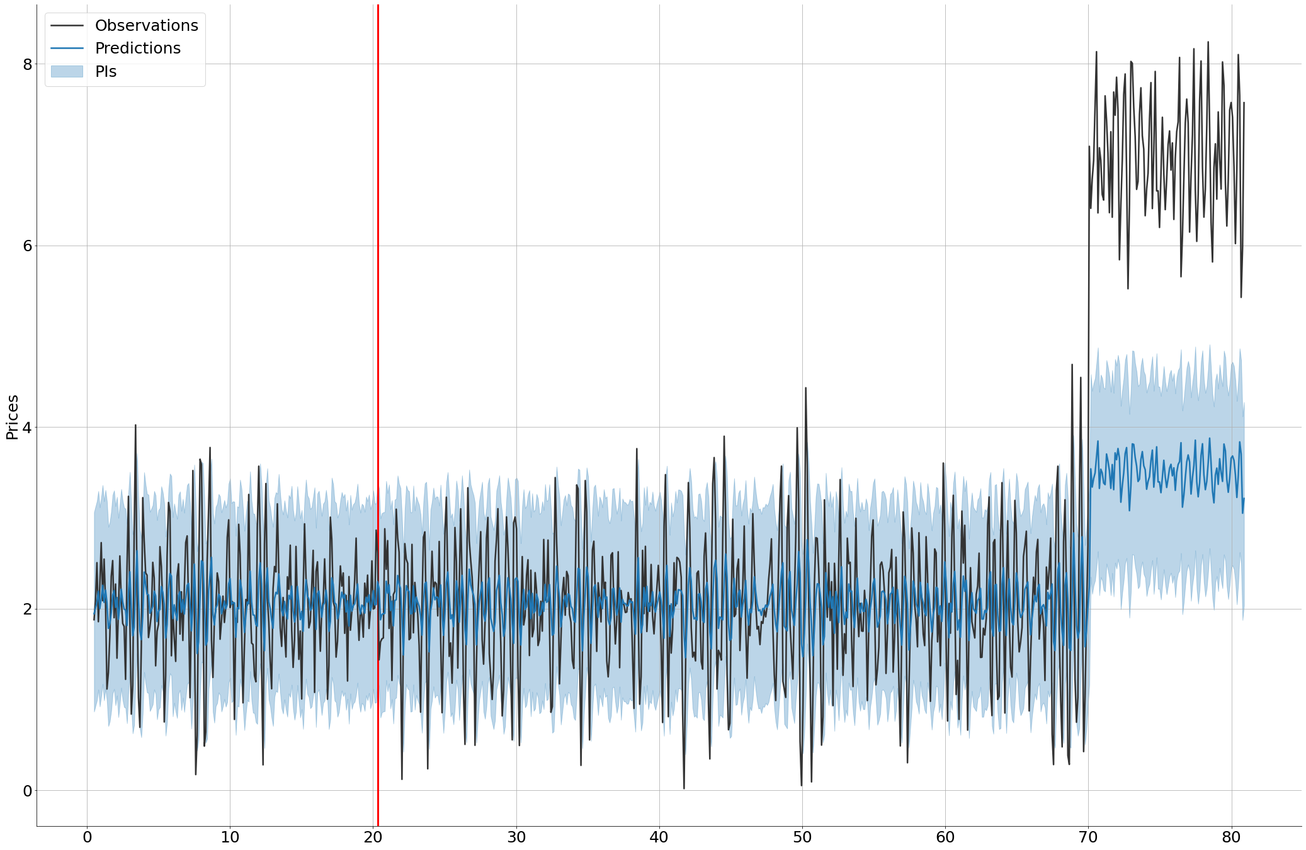
MAPIE for Time Series
Key points:
The guarantee on the coverage control is based on exchangeability (~independence).
It is not always relevant, notably for time series.
Example:
Try to estimate a dynamical course. There are
Correlations between data
Change points
Training set
Errors not taken into account
MapieRegressor gives no guarantee on the coverage control

Slide 40
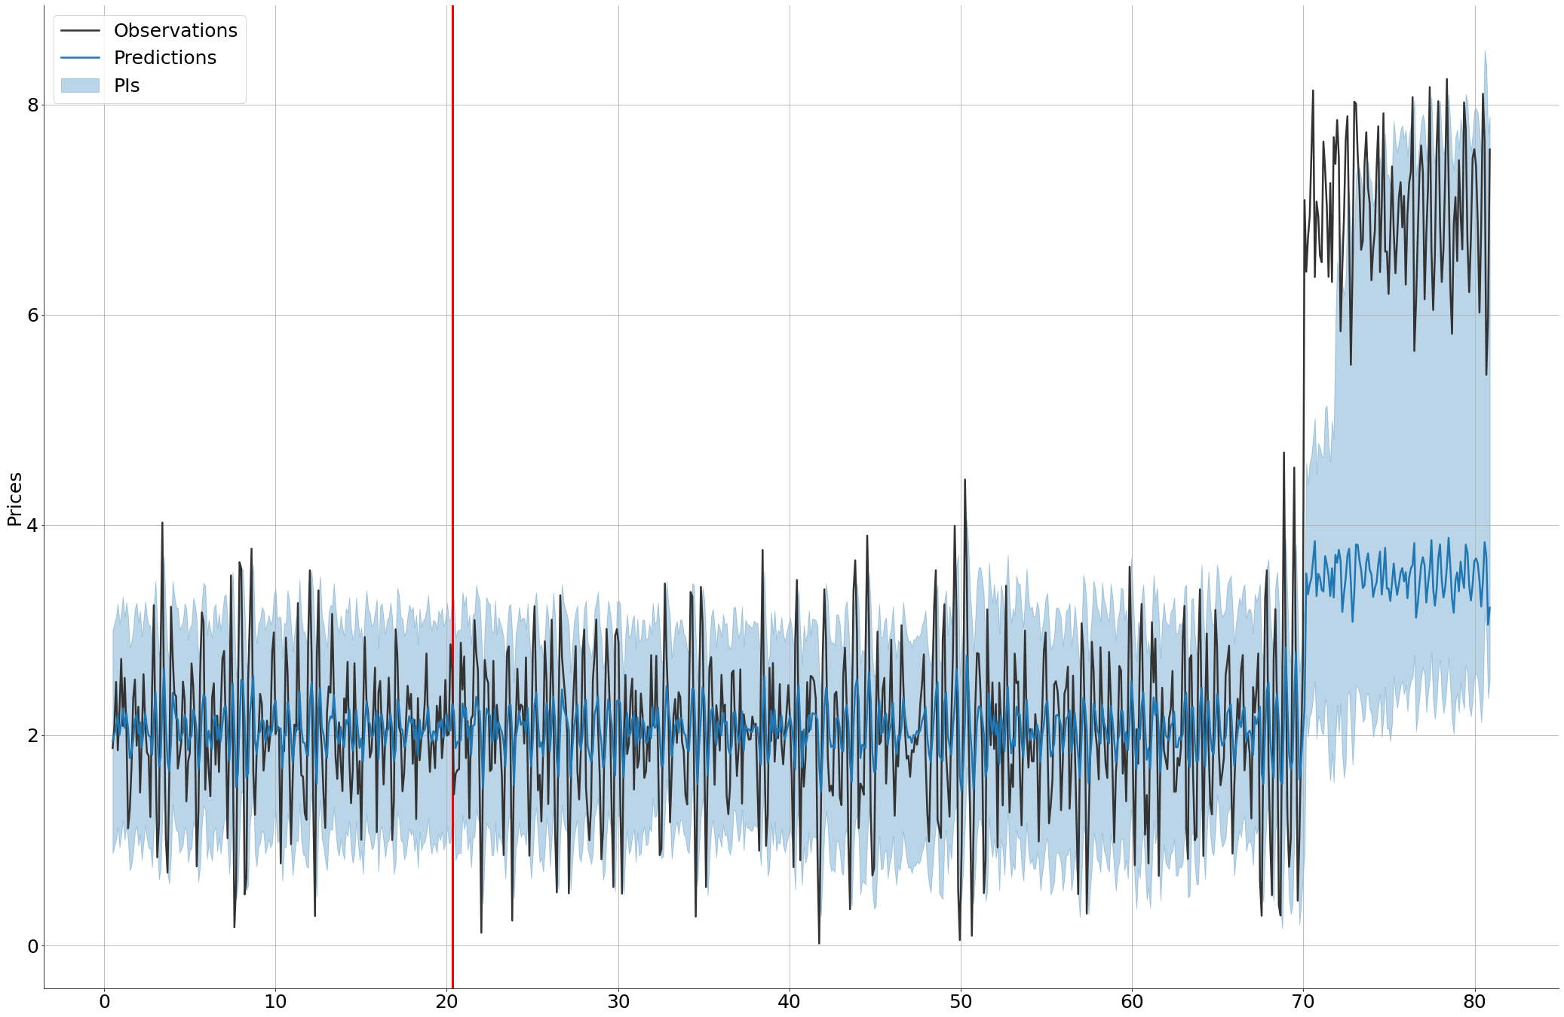
MAPIE for Time Series
MapieTimeSeriesRegressor:
Stronger hypotheses on:
Estimations quality:
Small mean of squared errors between the predictions of LOO refitted estimators and signal.
The LOO estimators separate the signal from the noise
Errors are short-term i.i.d
Dynamical update of the residuals during the prediction
Training set
Errors taken into account
Conformal Prediction Interval for Dynamic Time-series
(Xu & Xie 2021a)
Notes:
Illustrer le cas d'usage de séries temporelles concret :
- prix de l'immobilier ?

Slide 41
7
MAPIE for classification

Slide 42
How are the prediction sets build ?
$$q_{1−α}$$
$$q_{1−α}$$
Softmax output of the model
Softmax output of the model
True class
Counts
0 1 2 3 4 5
0 1 2 3 4 5
Class
Scores {s_{i}}
Class
Predictions on the calibration set
Distribution of the conformal score and $1−α$ quantile calculation
Application of quantile to test data to create prediction sets

Slide 43
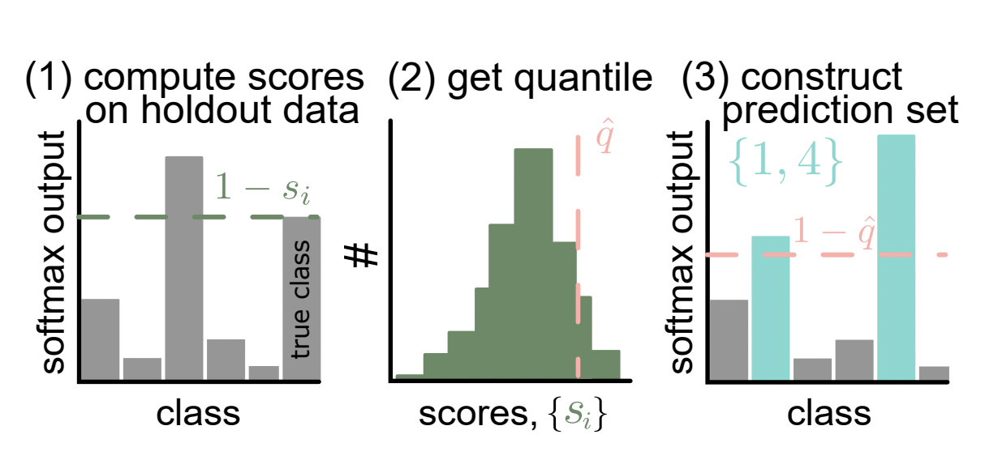
Adaptive Prediction Sets in MAPIE : ”Score” method
Conformity Score :
$$s_{i}(X_{i}, Y_{i})=1−\hat{μ}{\left(X_{i}\right)}_{Y_{i}}$$
(one minus the softmax of the true label)
Empirical quantile :
$\hat{q}=Quantile(s_{1},…, s_{n} ; \frac{\left\lceil (n+1)(1−α)\right\rceil }{n})$ with n the number of observations in the calibration set.
Prediction sets :
$$𝒯\left(X_{test}\right)=\{y :\hat{μ}{\left(X_{test}\right)}_{y}≥1 −\hat{q} \}$$
: include all labels with a high-enough softmax score
Class

Slide 44
Adaptive Prediction Sets in MAPIE : ”Cumulative score” method
$$s_{i}\left(X_{i}, Y_{i}\right)=\sum_{j=1}^{k}{\hat{μ}{\left(X_{i}\right)}_{π_{j} } where} Y_{i}=π_{j}$$
Conformity Score :
: sum of the sorted softmax outputs until reaching the score of the true label
Empirical quantile :
$\hat{q}=Quantile(s_{1},…, s_{n} ;\frac{\left\lceil (n+1)(1−α)\right\rceil }{n})$ with n the number of observations in the calibration set.
$$𝒯\left(X_{test}\right)=\left\{π_{1}, …, π_{k}\right\} where k=inf \{k :\sum_{j=1}^{k}{\hat{μ}{\left(X_{test}\right)}_{π_{j} }≥\hat{q}}\}$$
Prediction sets :
: include all labels until the sum of their softmax if greater thant the empirical quantile
Sort model output by descending order and get cumulative output of the true class
Get quantiles from cumulated score distribution
Estimate prediction sets
{0, 3, 5}
s_{i}
$$\hat{q}$$
$$\hat{q}$$
Cumulative softmax output
#
Cumulative softmax output
True class
1 5 0 3 4 2
Cumulated scores {s_{i}}
3 5 0 1 4 2
Class
Class
Estimate prediction sets
Class

Slide 45
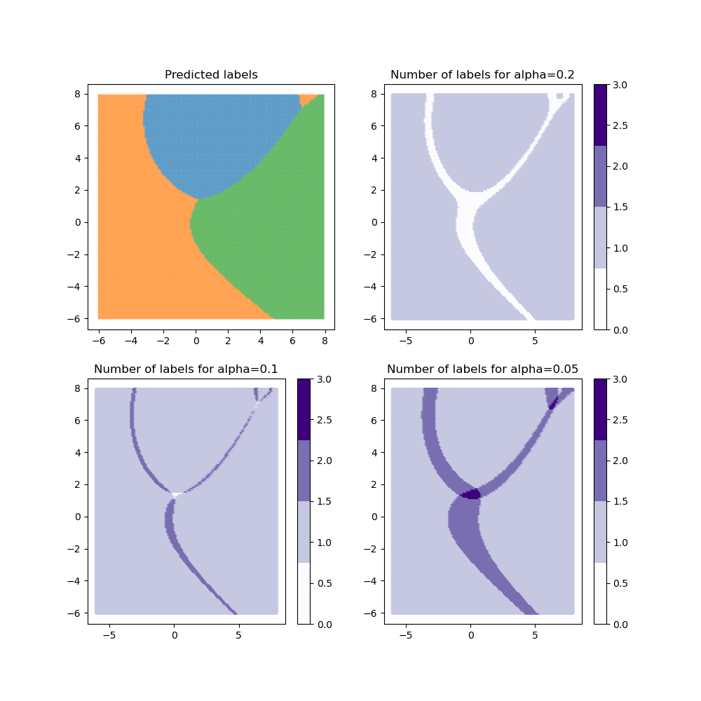
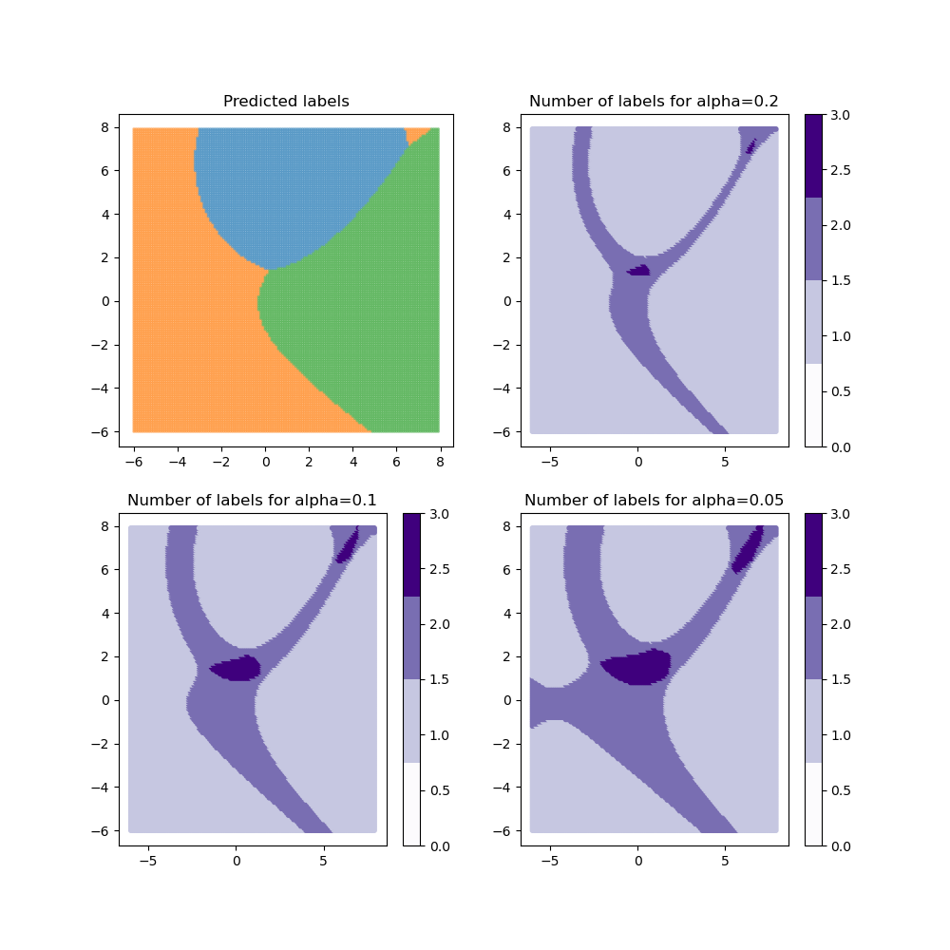
Evolution of the size of the prediction sets according to alpha
Dataset : 3 gaussian distributions with different means and standard deviation
Task : classification task with 3 classes (one for each distribution)
Score method
Cumulative score method
Predicted labels
Alpha = 0.2
Predicted labels
Alpha = 0.2
Empty prediction
Set
Prediction set with
one label
Prediction set with
two labels
Prediction set with
all labels
Alpha = 0.1
Alpha = 0.05
Alpha = 0.1
Alpha = 0.05
As alpha decreases, the size of the prediction sets increases.
Note : an empty prediction set means a high uncertainty (for the score method) as none of the labels have a high-enough softmax score

Slide 46
Demo time

Slide 47
8
What’s next for MAPIE

Slide 48
Perspectives on MAPIE
Main limits of MAPIE :
Difficult to distinguish aleatoric vs epistemic uncertainties with Conformal Predictions
Does not capture « heteroscedastic » variation of the uncertainties but only a global estimate
$→$ Conformalized quantile regression
Recommandations for MAPIE:
Fit good predictive models so we can have Confidence Intervals of varying and optimal lengths.
Relaxation of exchangeability assumptions (for distribution shift or complex dependencies in the data) but remains difficult to evaluate the impact on coverage.

Slide 49
The MAPIE roadmap for 2022
3 main objectives :
Address more complex tasks
Optimize lengths of confidence sets
Control conditional coverage
 | 2022
January | February | March | April | May | June | July | August
Multi-class conformal ¹
Conformal Methods for Time Series (EnbPI) ²
Conformalized Quantile Regression ³
Regularized APS for classification ⁴
1: Romano et al. (2020)
2: Xu & Xie (2021)
3: Romano et al. (2019)
4: Angelopoulos et al. (2021)
5: Bates et al. (2021)
RCPS for image segmentation ⁵

Slide 50
How can I contribute to MAPIE ?
https://github.com/scikit-learn-contrib/MAPIE
pip install mapie conda install mapie
Add a star
Submit a new implementation

Slide 51
Thanks
In particular to our partners

