Slide 1
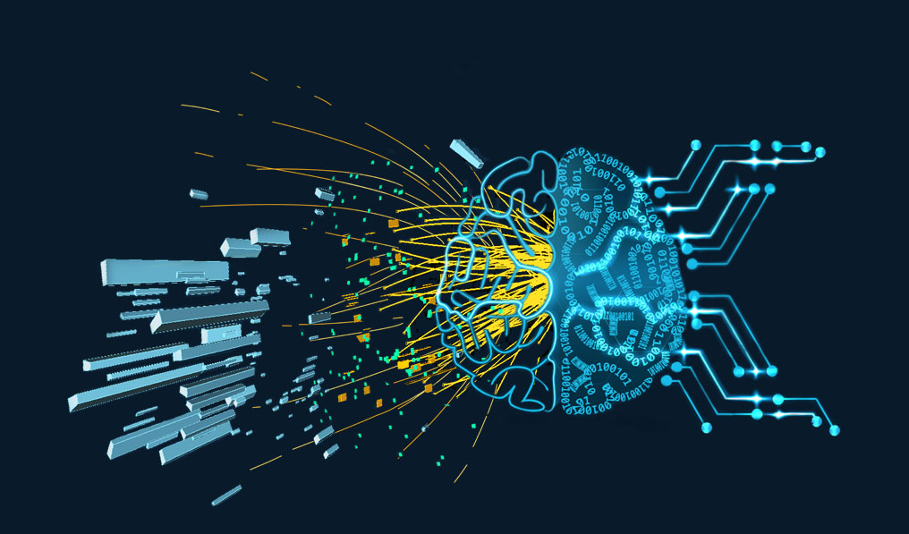
Institut Pascal Learning to Discover 19th-29th April 2022
Conference introduction
See also Denis Ullmo Institut Pascal director
presentation in the agenda Tuesday 20th morning

Slide 3
Program
19-20th Apr : Representation workshop
21-22nd Apr : Dealing with uncertainties workshop
25-26th Apr : Generators workshop
Spirit : a few long talks and many semi-organised discussion sessions
27-29 : final conference
Spirit : more regular conference with 45’, 30’ and 15’ talks (discussion included!)
Each workshop : ~55 on-site participants + ~75 remote
One summary talk each during the conference
Final conference : 110 on-site + 80 remote

Slide 4
Social Events
Lunch buffet every day
Thursday 28th April
6:30PM visit and dinner at Musée d’Orsay in Paris
You should already have confirmed.
No later than 6:30PM at entrée B (river side) of Musée d'Orsay (reserved for groups). Then, visit on your own, with audioguide.
We reconvene no later than 8:30PM at the restaurant on the second floor.
From Le Guichet RER B station, please count 50' : RER B to Paris, change at Saint-Michel, RER C to Musée d'Orsay (towards Versailles Rive Gauche, other directions work as well, but not Versailles-Chantiers!), best is to use the app Citymapper, Google Map works as well but less clear on directions. RER will still run after dinner.

Slide 5
Covid
No official mask mandate any more in France except in public transport and medical premises
However, we would all like to attend on-site till the last day
Mask wearing recommended at all time
Use outside areas (terrace and rooftop) when possible
CO₂ monitored in the amphitheaters
Video-transmission in the small amphi next door to maximise distancing

Slide 6
3rd of a series
15-26 Jul 2019: Real time analysis workshop
14-25 Oct 2019: Advanced Pattern recognition
Learning to discover : Jul 2020, Feb 2021, Feb 2022, April 2022!

Slide 7
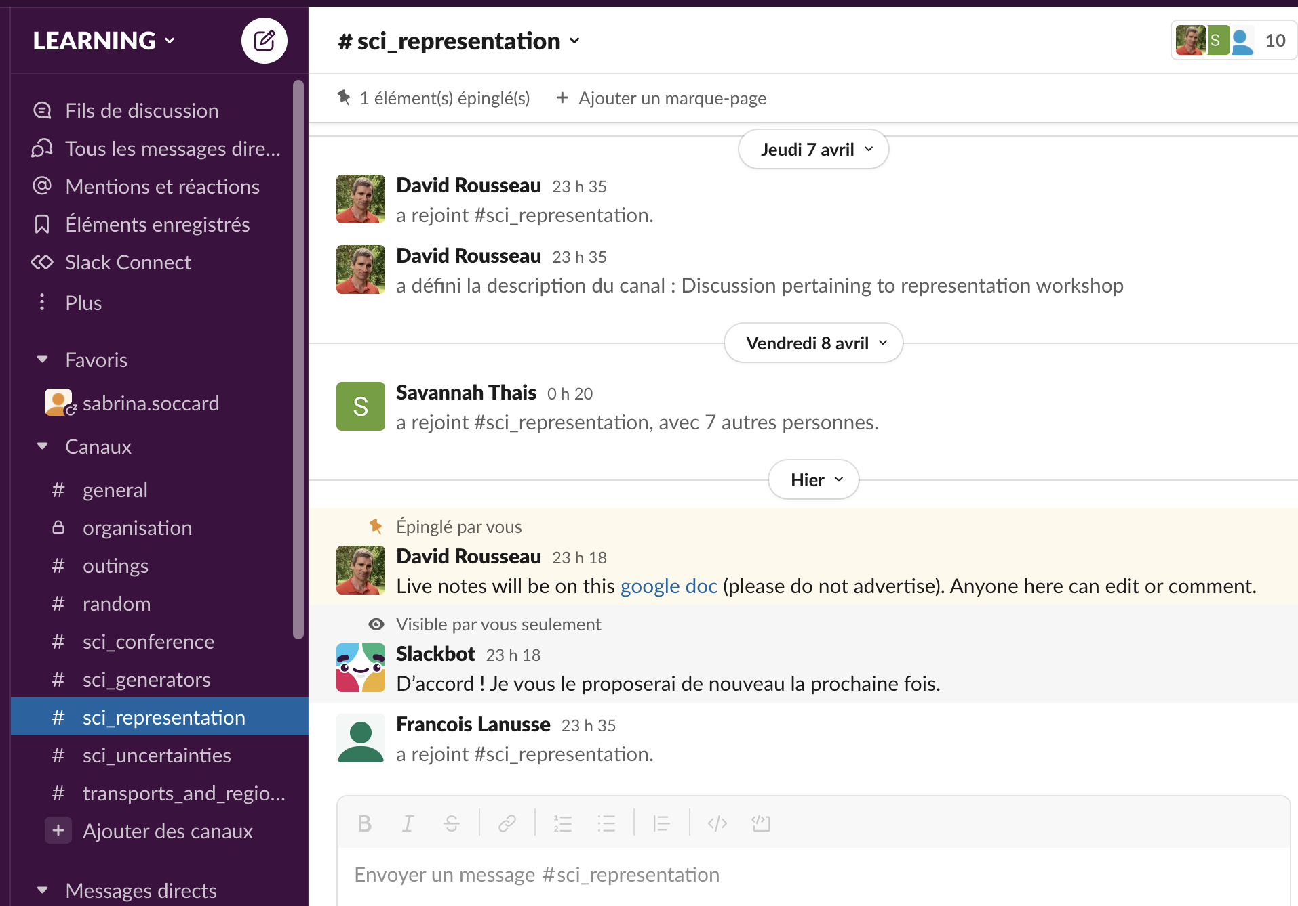
slack
Primary channel of communication
172 participants as of this morning. Make sure you’re connected (ask your neighbour)

Slide 8
Zoom
Zoom in meeting mode (no waiting room, everyone sees every one else connection)
Link, meeting ID and code distributed on slack
Please do not advertise beyond workshop and conference
Zoom chat (volatile) only to be used for connection issues
Use slack for scientific exchanges : #sci_conference

Slide 9
Organising committee
Sabrina Soccard, Program Manager at Institut Pascal
Peter Battaglia, senior scientist at Google Deepmind
Anja Butter, ITP Heidelberg : generator models and uncertainties in ML for Particle Physics
Cécile Germain : Emeritus professor (computer science) Université Paris-Saclay, LRI-CNRS, and INRIA TAU team, organiser of the 2014 HiggsML and 2018-2019 TrackML challenge
Tobias Golling, associate professor at Université de Genève, generative models and anomaly detection for particle physics
Vladimir Vava Gligorov, CNRS/IN2P3 LPNHE, leader of the LHCb Real Time analysis project, organiser of the Real Time Analysis Institut Pascal Workshop
Eilam Gross, Weizmann Institute, organiser of the Hammers and Nails 2017 and 2019 workshop
Michael Kagan, SLAC, co-coordinator of CERN Interexperiment Machine Learning group
Danilo Rezende, Researcher on Probabilistic Methods for Decision Making, Senior Staff Researcher and Team Lead at Google Deepmind
David Rousseau, CNRS/IN2P3 IJCLab : former co-coordinator of ATLAS Machine Learning group, co-coordinator of the LHC Interexperiment Machine Learning Group, organiser of the 2014 Higgs Machine Learning challenge, and of the 2018-2019 TrackML challenge
Andreas Salzburger, CERN, coordinator of the ATLAS software upgrade group, organiser of the 2018-2019 TrackML challenge and organiser of the Advanced Pattern Recognition Institut Pascal Workshop
Savannah Thais, Princeton, representation learning for Particle Physics, AI and ethics
Jean-Roch Vlimant, Caltech, co-coordinator of CMS Machine Learning group, organiser of the 2018-2019 TrackML challenge
Slava Voloshynovskiy, head of Stochastic Information Processing group, Université de Genève

Slide 10
Sponsors

