Slide 1
Data-Centric Artificial Intelligence
Romain Egele, Isabelle Guyon, Prasanna Balrakash

Slide 2
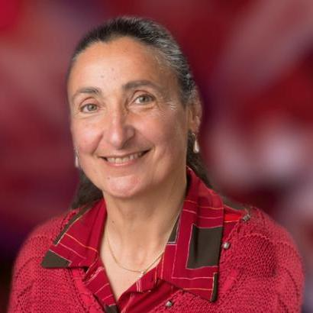
Introduction
Romain Egele
PhD Student
Isabelle Guyon
Prof. at UPSaclay
Prasanna Balaprakash
Computer Scientist
at Argonne

Slide 3
Outline
Introduction
A ToolBox Example: Data-Centric AI
Frontiers in Active Learning

Slide 4
Introduction

Slide 5
What is Data-Centric AI?
http://datacentricai.org
Notes:
Data-centric AI is a trend launched by Prof. Andrew Ng during a Youtube livestream in 2021.
Andrew Ng is known to have helped democratizing the use of deep neural networks. He is also the co-founder of Google Brain.
Data-centric AI aims at at improving the data-engineering of machine learning algorithms.
Data-engineering includes all the steps to prepare the data before using a machine learning algorithms. For example, collection, transformation, evaluation.
All ML is data centric by definition. However, when you want to contribute to data-centric AI (as a research topic) you focus on providing a new methodology to improve the systematic engineering of data such as creation of data, transformation of data, evaluation of data, documentation of data. You look for ways to automate, standardize, justify something that was previously done by hand with intuition.

Slide 6
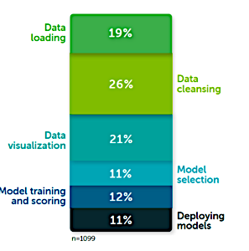
Why is Data-Centric AI interesting?
45% Loading + Cleaning
66% of time is spent on Data
Data collection?
From: https://www.anaconda.com/state-of-data-science-2020?utm_medium=press&utm_source=anaconda&utm_campaign=sods-2020&utm_content=report
Notes:
Everyone does it in a kind of secret, hidden place and often does not publish it or share it.
Redundant and time consuming.
Error prone because a human brain alone cannot process it.
Even inside the same team it can be challenging to reuse multiple times the same data pipeline.
A survey from anaconda!

Slide 7
Why is Data-Centric AI interesting?
Training
Data
Model
Testing
Data
Notes:
This is repetitive, development/deployment! And New data comes in! New situations!
We need to identify the impact of new data: does it improve performance? Worsen a bias? Break everything?
Are the new data outliers? Are they informative? Are they unidentified special cases?
Often in papers the dataset is fixed and the model is searched. But, in a real setting the data is more dynamic. Data-shifts happens for example after a maintenance/update of a physical system that is studied!
Moreover with the automation of data acquisition through connected sensors and automated experiments the quantity of data is so big that we must filter and reject what is “not interesting”

Slide 8
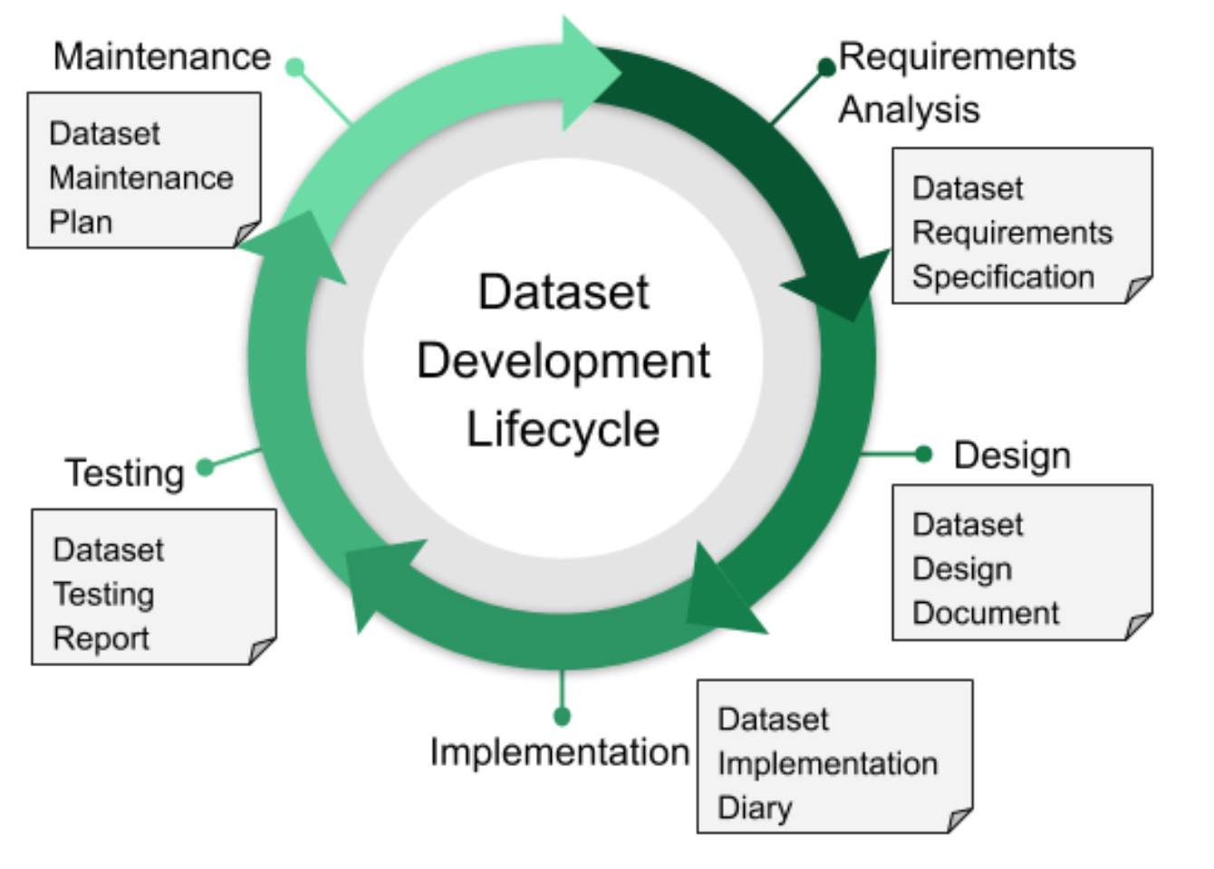
The Data Life-Cycle
From Hutchinson, Ben, et al. [1]
Notes:
Having a clear description of the data life-cycle is important.
What are the requirements of the system? What is the specification of data collection (sampling frequency, precision required) ?
What is the data designed for (purpose)?
Where/how is the data documented?
How can we verify the quality of our data (bias, outliers, corruptions)?
When/Why does the data needs to be updated (e.g., cleaning)?

Slide 9
Datasheets for Datasets
Link to the template
Link to the paper
Motivation
DATA
MODEL
Composition
Collection Process
Preprocessing / Cleaning / Labeling
Uses
Distribution
Maintenance
From Gebru, Timnit, et al. [2]
Notes:
A big part of the contribution of your research is often the data itself. The scientific method is based on the collection of data to disprove a given hypothesis.
The dataseets for datasets methodology was proposed to document the creation of a dataset. Documenting a dataset makes it more transparent, accessible and encourage trust.

Slide 10
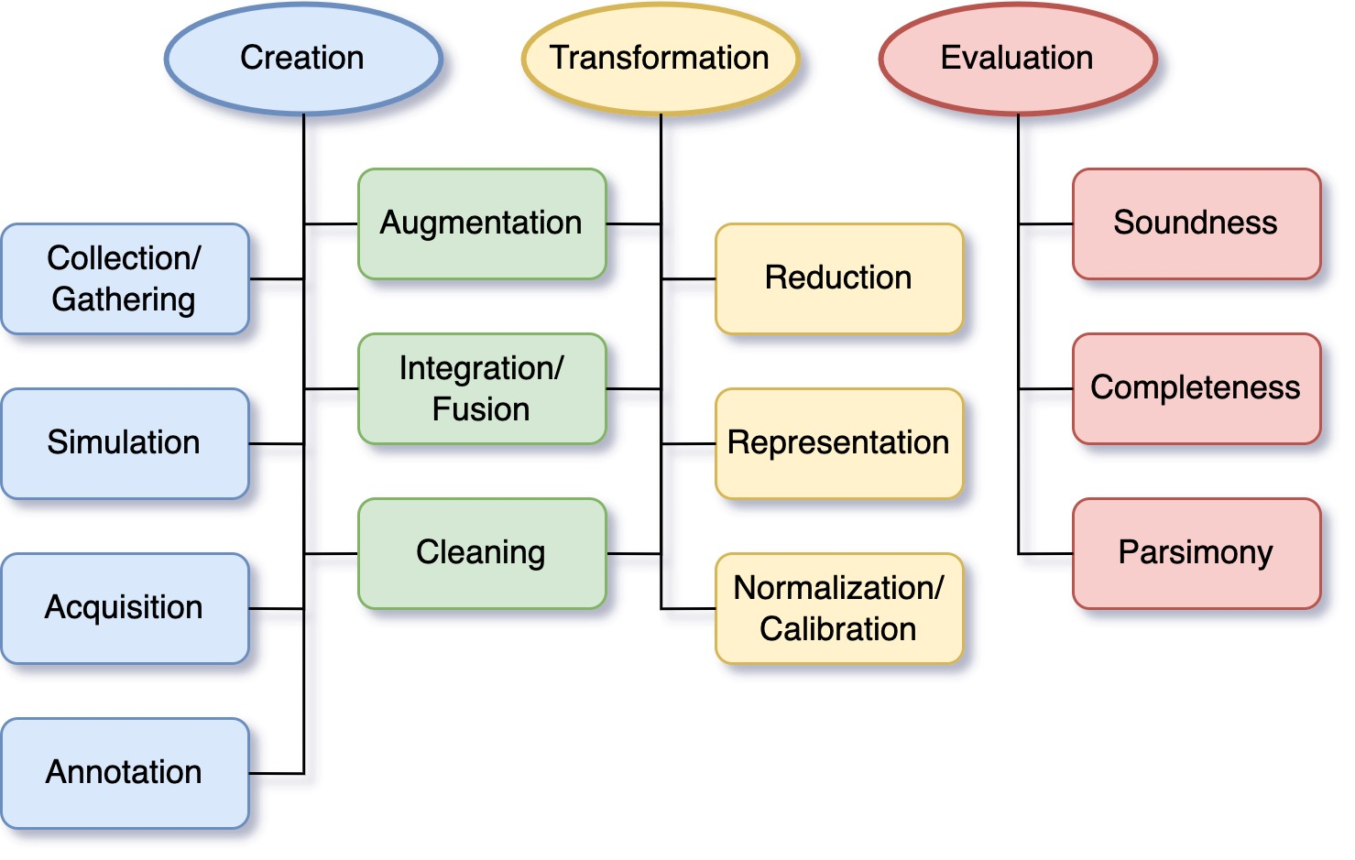
A classification of data-centric domains

Slide 11
A ToolBox Example: Data-Centric AI

Slide 12
The Toolbox of Data-Centric AI
Creation
Exploratory Analysis
Transformation
Management
http://datacentricai.org
Evaluation
Ingestion
Notes:
DCAI provides software tools to help streamline the data-engineering.
Automation of preprocessing
Synthetic Data Generation/Augmentation
Data-Management (Storage, Versioning, Movement)
Diagnostic of Dataset (e.g., automated, with visualization)
Data-Science Project Management:
Data Centric Projects: https://github.com/ydataai/awesome-data-centric-ai

Slide 13
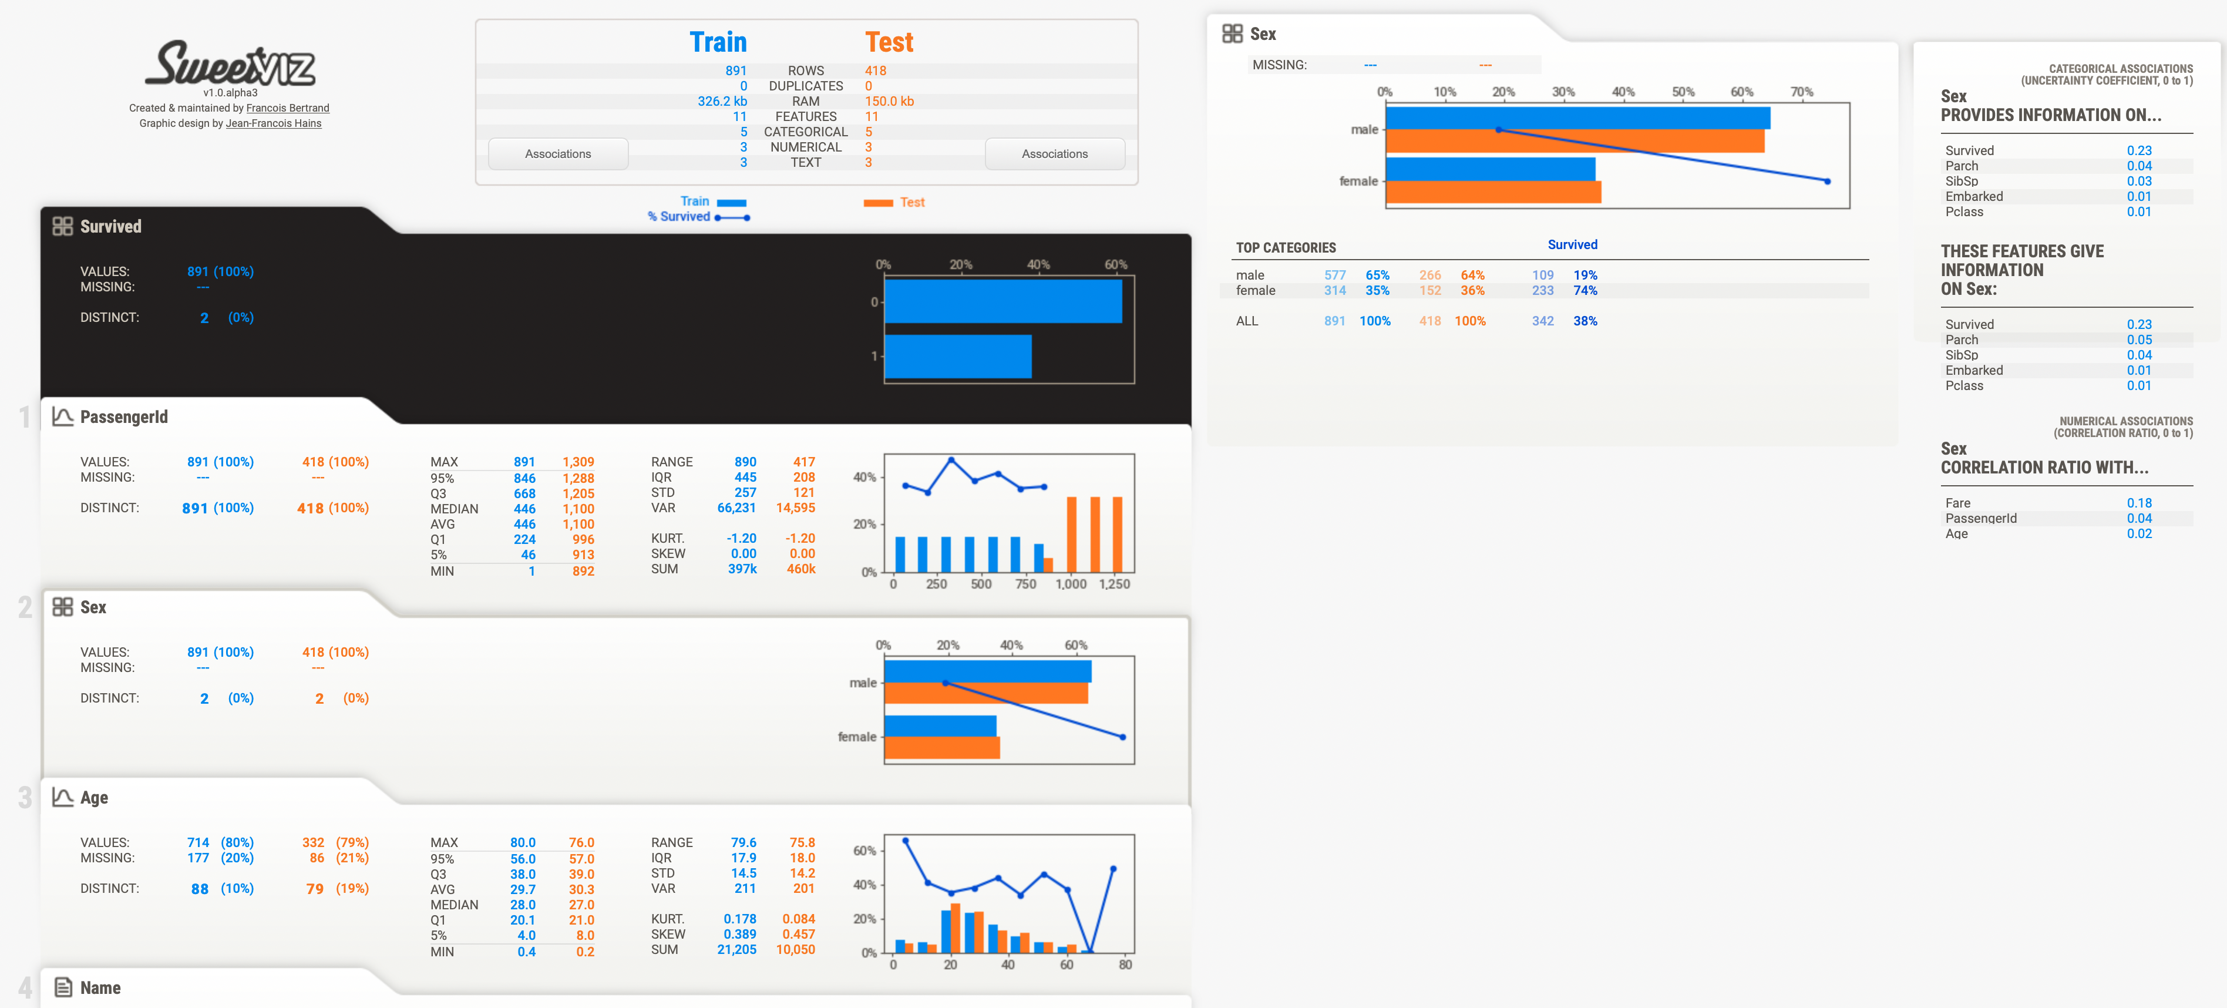
Exploratory Data Analysis
Data Types
Uniqueness
Bias
SweetViz: github.com/fbdesignpro/sweetviz
SandDance: microsoft.github.io/SandDance
Notes:
Understand the data.
Visualize the distributions.
Visualize the bias.

Slide 14
Data Augmentation
Rule-Based
Learning-Based
Applying known transformations
On existing data to new data
Learn a generative model from
Which we can sample new data
Example for Images:
Random-Crops, Rotations, Translations
Example Models:
Variational Auto-Encoders,
Generative Adversial Networks,
Gaussian Kernel-Density Estimator
Data Augmentation can introduce Bias! (Balestriero et al.)
The Synthetic Data-Vault: github.com/sdv-dev/SDV
Notes:
Understand the data.
Visualize the distributions.
Visualize the bias.

Slide 15
Frontiers in Active Learning

Slide 16
Systematic Collection of Data with Active Learning
Agent
World
Goal: Query most informative samples from a(n) (expensive) simulator
Open-Source → ModAL: Modular Active Learning (modal-python.readthedocs.io)
Sivaraman, G., et al. “Machine-learned interatomic potentials by active learning: amorphous and liquid hafnium dioxide.”
Settles, Burr. "Active learning literature survey." (2009).
Notes:
Quality is better than quantity (for the planet, for interpretation, for robustness, for costs)
Sivaraman, G., Krishnamoorthy, A.N., Baur, M. et al. Machine-learned interatomic potentials by active learning: amorphous and liquid hafnium dioxide. npj Comput Mater6, 104 (2020). https://doi.org/10.1038/s41524-020-00367-7

Slide 17
The Active Learning Loop
Query
new samples (from a pool/support)
”Annotate”
Simulate New
Uncertain Situation(s)
Train
Agent
Update
Training Data
Notes:
Track changes in data.

Slide 18
Query in Active Learning
https://jacobgil.github.io/deeplearning/activelearning
Uncertainty Sampling
Diversity Sampling
Information from the Agent
No information from the agent
Example Acquisition Functions
Entropy
Variation Ratio
Query By Committee Sampling
”disagreement” between models
From an ensemble
Notes:
Track changes in data.

Slide 19
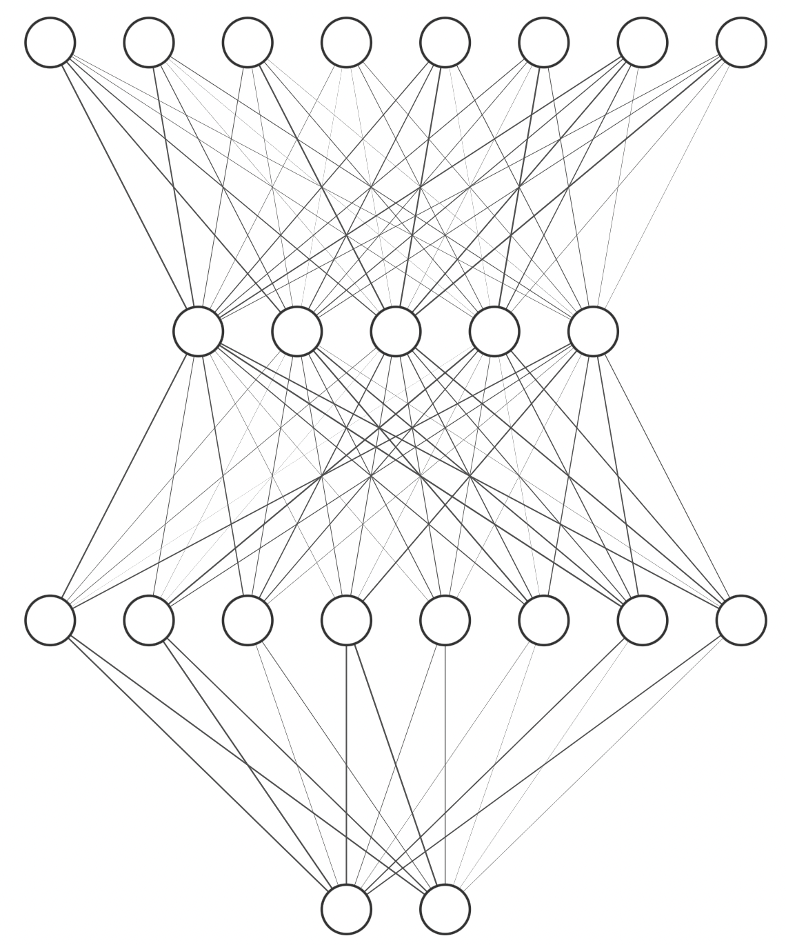
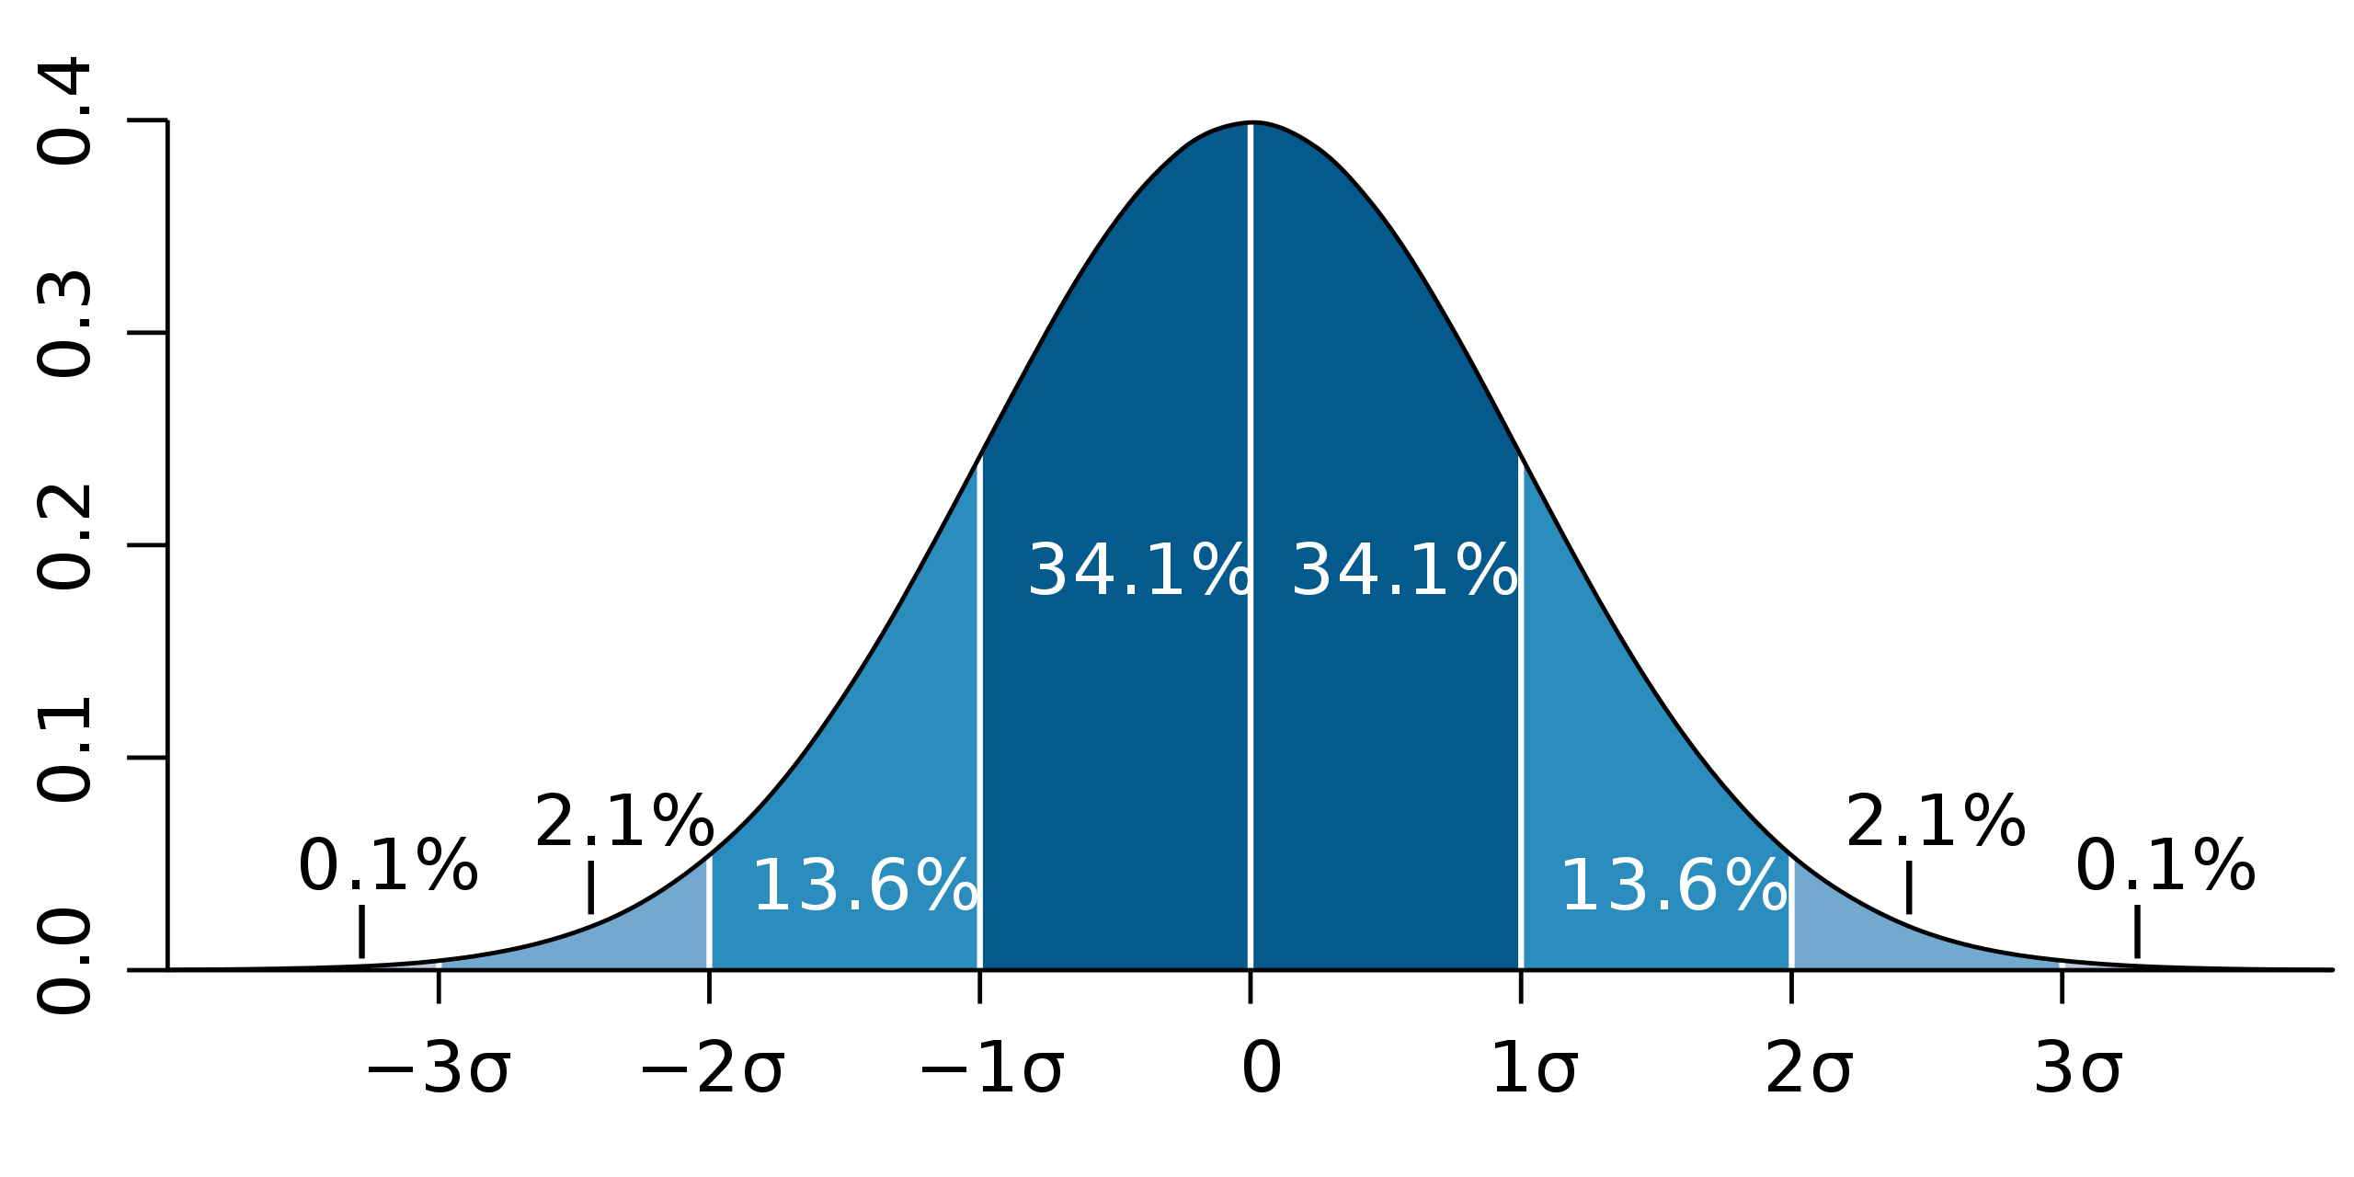
Modeling Uncertainty
$$p\left(y | x\right)$$
$$x$$
$$p\left(y | x;θ\right)∼𝒩\left(μ_{θ}\left(x\right),σ_{θ}^{2}\left(x\right)\right)$$
$$μ_{θ}\left(x\right)$$
Model
$$μ_{θ}(x)$$
$$σ_{θ}(x)$$
$$σ_{θ}^{2}\left(x\right)$$
Notes:
Track changes in data.

Slide 20
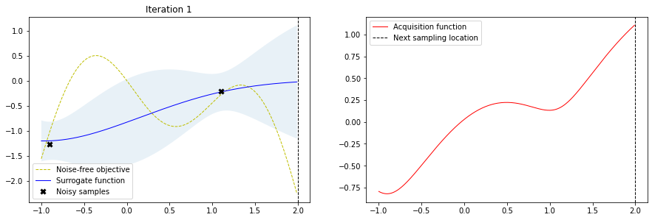
Query in Bayesian Optimization
The goal is to “maximise”!
Y - Output
X - Input
Upper Confidence Bound
$$α\left(x\right)=μ\left(x\right)+κ⋅σ(x)$$
mean
standard dev.
https://krasserm.github.io/2018/03/21/bayesian-optimization/
Notes:
Learn from your uncertainty

Slide 21
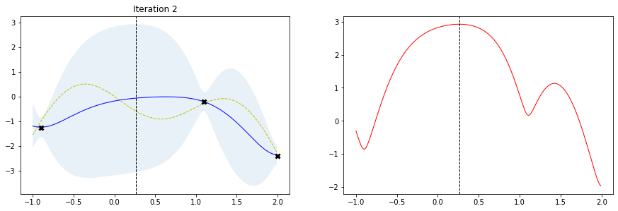
Query in Bayesian Optimization
Notes:
Track changes in data.

Slide 22
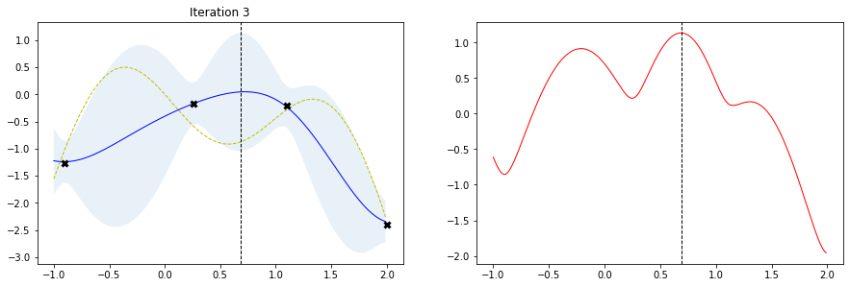
Query in Bayesian Optimization
Bayesian Active Learning by Disagreement
Notes:
Track changes in data.

Slide 23
Query a Sample - BALD Bayesian Active Learning by Disagreement
Maximizing mutual information between model parameters and model output
“Entropy of the Average”
High disagreement
Between models
(epistemic)
“Average of the Entropy”
Low per model
Uncertainty
(aleatoric)
BUT Only following uncertainty can lead to mode collapse and unbalanced Dataset!
Yarin G., et al. “Deep Bayesian Active Learning with Image Data.”
Notes:
The first term looks for images that have high entropy in the average output.
The second term penalizes images where many of the sampled models are not confident about. This keeps only images where the models disagree on.
To get the first term, we make many runs, average the output, and measure the entropy.
To get the second term, we make many runs, measure the entropy of every run, and take the average.

Slide 24
A visual example
Aleatoric Uncertainty
$$σ=0.5$$
$$σ=1.0$$
High
Epistemic Uncertainty
Notes:
Track changes in data.

Slide 25
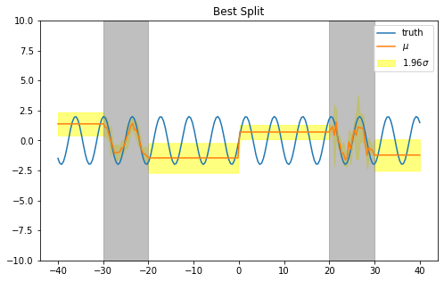
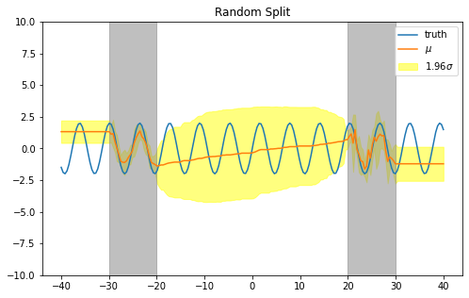
Uncertainty with Ensembles (Random-Forest)
The decision-tree splitter matter (diversity is better)!
Hutter, F., et al. “Algorithm Runtime Prediction: Methods & Evaluation.”
Notes:
Track changes in data.

Slide 26
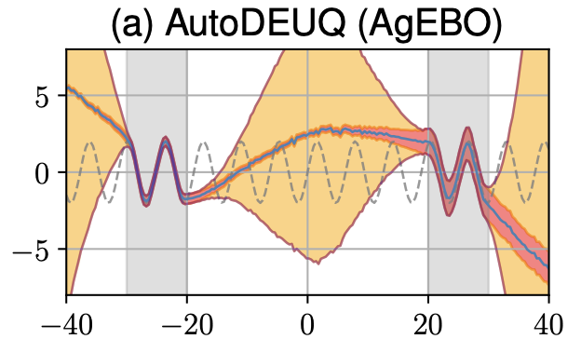
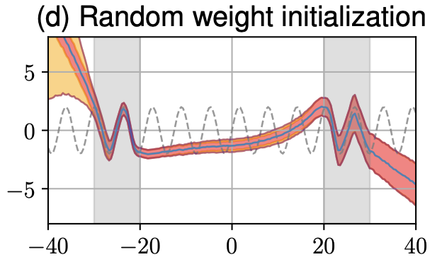
Uncertainty with Ensembles (Neural Networks)
Diversity matter!
deephyper.readthedocs.io
≠ Weights
≠ Neural Architectures
≠ Training Hyperparameters
≠ Weights
= Neural Architectures
= Training Hyperparameters
Egele, R., et al. “AutoDEUQ: Automated Deep Ensemble with Uncertainty Quantification.”
Notes:
Track changes in data.

Slide 27
Conclusion
The DCAI ToolBox (systematic engineering of data)
Creation
Transformation
Evaluation
Active Learning with Simulations to automate the creation of datasets

Slide 28
Thank you for attending! ☺ Questions?

Slide 29
References (Papers)
Hutchinson, Ben, et al. "Towards accountability for machine learning datasets: Practices from software engineering and infrastructure." Proceedings of the 2021 ACM Conference on Fairness, Accountability, and Transparency. 2021.
Gebru, Timnit, et al. "Datasheets for datasets." Communications of the ACM 64.12 (2021): 86-92.
Balestriero, Randall, et al. “The Effects of Regularization and Data Augmentation Are Class Dependent.” ArXiv:2204.03632 [Cs, Stat], Apr. 2022. arXiv.org, http://arxiv.org/abs/2204.03632.
Hutter, Frank, et al. “Algorithm Runtime Prediction: Methods & Evaluation.” ArXiv:1211.0906 [Cs, Stat], Oct. 2013. arXiv.org, http://arxiv.org/abs/1211.0906.

Slide 30
References (Workshops)
DCAI Workshop at NeurIPS21: datacentricai.org/neurips21/
The Future of DCAI (Snorkel): future.snorkel.ai
DCAI Workshop at Stanford: hai.stanford.edu/events/data-centric-ai-virtual-workshop

Slide 31
References (Softwares)
This presentation has been made with images from Flaticon.com
SweetViz: github.com/fbdesignpro/sweetviz
SandDance: microsoft.github.io/SandDance
The Synthetic Data-Vault: github.com/sdv-dev/SDV
ModAL: modal-python.readthedocs.io
DeepHyper: deephyper.readthedocs.io

