Slide 1
Purely Data-Driven Approaches to Weather Prediction: Promise and Perils
Suman Ravuri, DeepMind
ravuris@deepmind.com
On behalf of the DeepMind - Met Office Collaboration Team

Slide 2
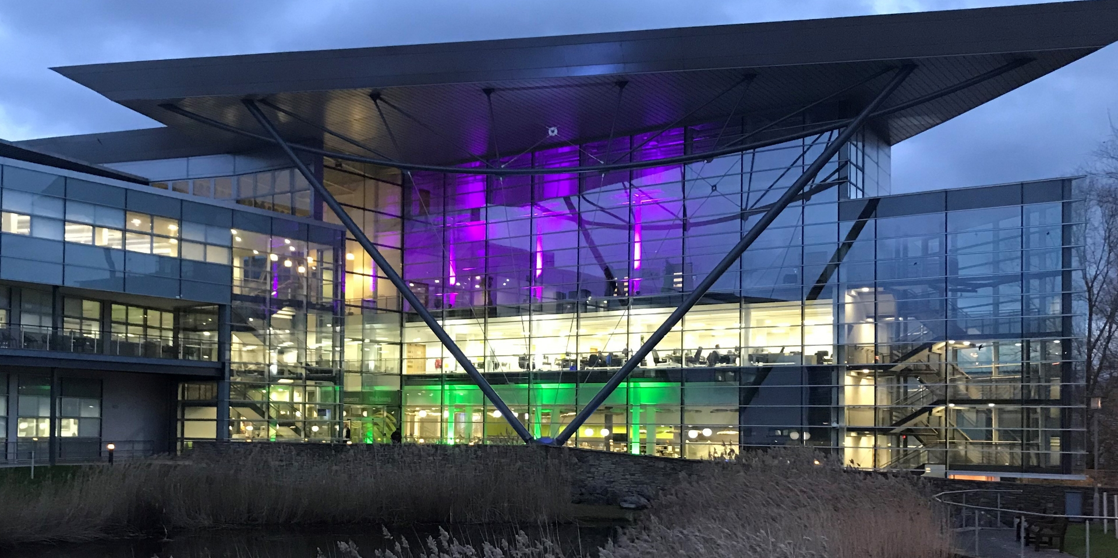
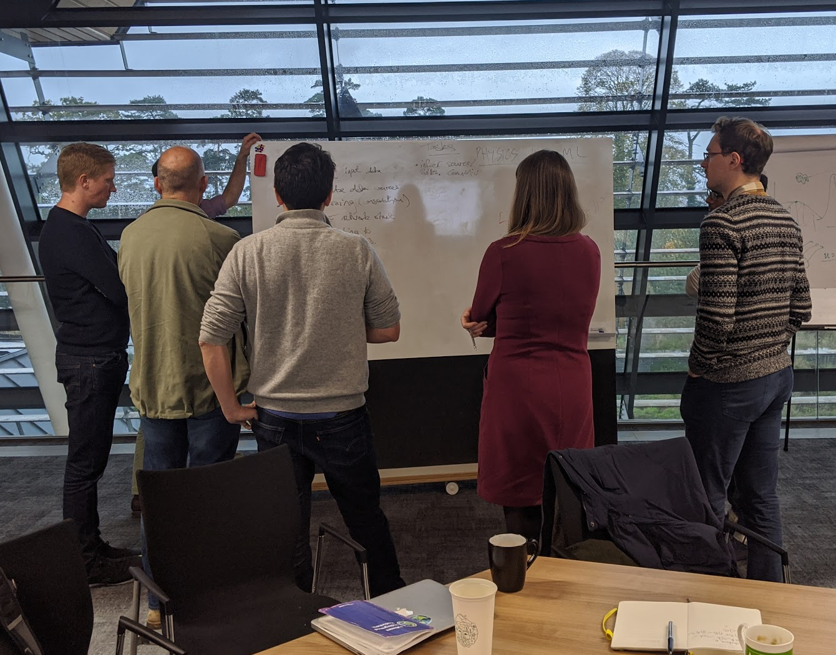
DeepMind - Met Office Collaboration
Two research-driven organisations working together for 3 years (since 2018), meeting weekly.
Bringing together expertise in atmospheric science and AI.
Wonderful learning experience, we’ve met 3x a week every week for these past few years.
Image credits: Met Office, Construction Specialties, Suman Ravuri, Ellen Clancy
Notes:
I work at DeepMind, a research lab in AI that is part of Alphabet, and like several of my colleagues, I am interested in applications of AI to the real world. For this project, we needed a partner and additional expertise. So, we joined our forces with the Informatics Lab at the British Meteorological Office - the Met Office in short. Founded in 1854, the Met Office has pioneered the science of meteorology, and, as an anecdote, is responsible for having moved D-Day from 5th to the 6th of June 1944, because of unfavourable weather conditions for the allies.
In this project, our aim was to combine our strengths, as two research-driven organisations, to build a deep scientific collaboration. This was a wonderful learning experience for all us, as we have met multiple times a week, every week, for these past three years.
Starting from initial meetings at the end of 2017, we explored many types of questions related to weather forecasting and to climate, confronted our approaches: machine learning vs. numerical weather prediction models, and found that precipitation nowcasting stood out as the perfect opportunity for applying ML techniques.

Slide 3
Case Study for this Talk
Disclaimer: This presentation has a Machine Learning researcher’s perspective
Image credits: MetOffice, Construction Specialties, Suman Ravuri
Notes:
And, after a couple of years of research, involving a long writing and revisions process, we managed to publish our work in Nature. This presentation covers that work, from the perspective of a researcher in Machine Learning.

Slide 4
Problem statement and data
Baseline Models…
… or why we need generative models
Deep Generative Models of Radar
Quantitative verification and its limitations
Expert evaluation
Conclusion
Notes:
This talk will be in 7 small parts

Slide 5
Problem statement and data
1
Notes:
Let's start with a statement of the problem.

Slide 6
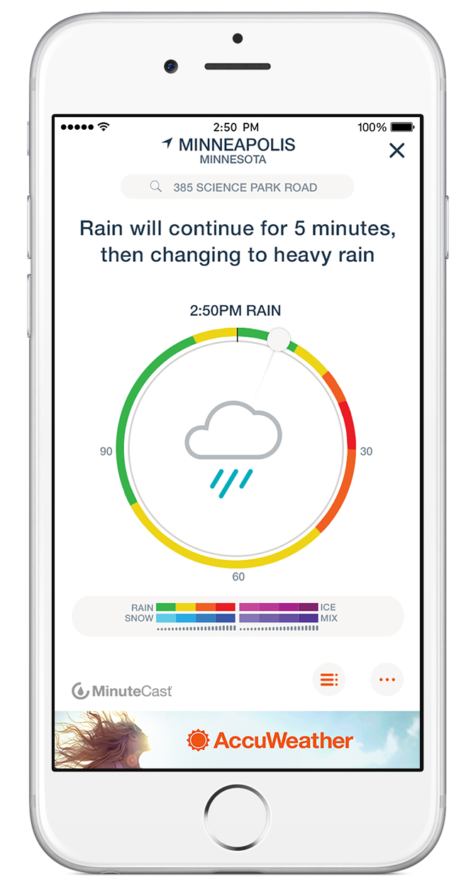
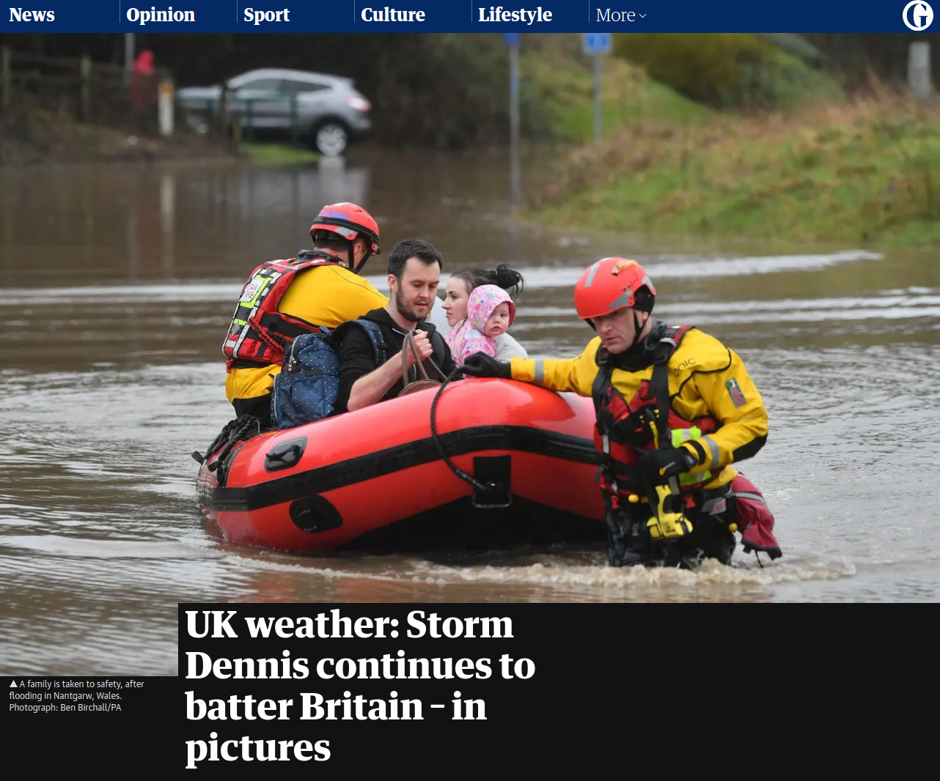
Precipitation Nowcasting
High-resolution (1km x 1km) rainfall estimates in the short term (5-90 minutes)
Used by expert meteorologists to:
Issue flood warnings
Perform air traffic control
Marine services
Important statistical questions:
Prediction at multiple temporal and spatial scales
Accounting for uncertainty
Capturing rare events
NWPs perform poorly here
Data-driven approaches should be strong
Notes:
Precipitation nowcasting.
We know that precipitation nowcasting is the high-resolution forecasting of rainfall up to two hours into the future. It is crucial for weather-dependent decision-making.
Nowcasting informs the operations of a wide variety of sectors, including flood early-warning systems, air traffic control and marine services, emergency services, energy management, etc.
We believe that that the nowcasting problem is interesting from a data science perspective for three distinct reasons:
For nowcasting to be useful in these applications the forecast must first, provide accurate predictions across multiple spatial and temporal scales.
Second, they must account for uncertainty and be verified probabilistically,
and third, perform well on heavier precipitation events that are rarer, but do more critically affect human life and economy.

Slide 7
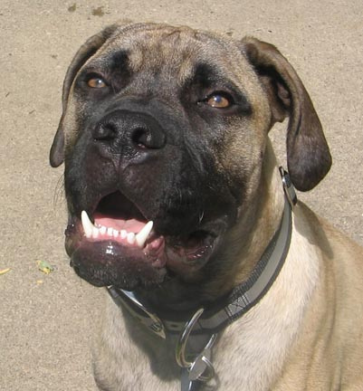
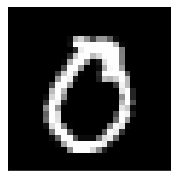
Precipitation Data from the UK
Very large radar fields
Met Office RadarNet4 Data
Every 5 minutes, 288/day
1536 x 1280 pixels
1km x 1km grids
Data from 2016-
Data agreement through MO data provisioning team
ImageNet Sample
MNIST Sample
Notes:
As you may have guessed already, our work focused on the UK. Our nowcasting models were trained and evaluated on data from a collection of doppler radars from the Met Office RadarNet4 network, which comprises more than 15 operational radars covering 99% of the UK. We can visualise that data as a grid of 1,536 × 1,280 pixels, where each grid cell of that composite image represents the surface-level precipitation rate over a 1 km × 1 km region, expressed in mm/h. The UK uses a custom projection and coordinate system centered on the UK.
Thanks to the Met Office data provisioning team, we were given radar composite images every 5 minutes since early 2016.
That's a few TB of data - we are definitely in a proper big data regime, with a data size that is dwarfing the size of MNIST digits or ImageNet samples that some of us grew accustomed to.

Slide 8
Multi-resolution Multi-scale Data (US)
Data over continental United States from 2017-2019
0.01^{ο} (lat, long) grids of 3584 × 7168
Asynchronous updating and poor radar on West Coast.
Notes:
We assessed the generalisation of our techniques by retraining our model on slightly different data from the continental United States, using radar composites from the Multi-Radar Multi-Sensor (MRMS) system and acquired with a network of 146 radars covering the USA and 30 Canadian radars, with 0.01deg resolution (about a kilometer for each step of 0.01deg of latitude, and between 1.1km in Florida and 0.6km in Seattle for each 0.01 degree of longitude).
However, MRMS data was not as nice as our UK data.
First of all, nobody will be surprised if I say that it does not rain as much in the US as it does in the UK. Rain is a cultural phenomenon in the UK. According to the BBC, there was a study saying that nine in 10 Brits have talked about the weather… in the last six hours. I guess that does not include sleep. But more seriously, we noticed that precipitation dynamics present “skipping" patterns, with measurements from different radars updating asynchronously every 2 minutes. So we reduced the effective temporal resolution to 6 minutes to mitigate this “skipping" effect and to make the temporal resolution comparable to the UK dataset.

Slide 9
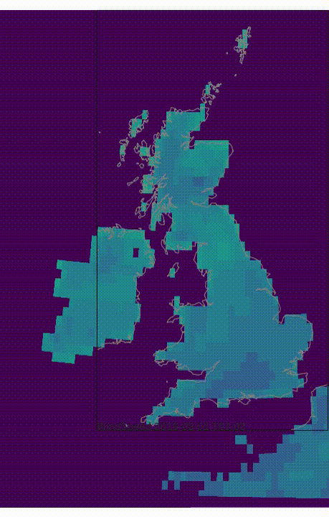
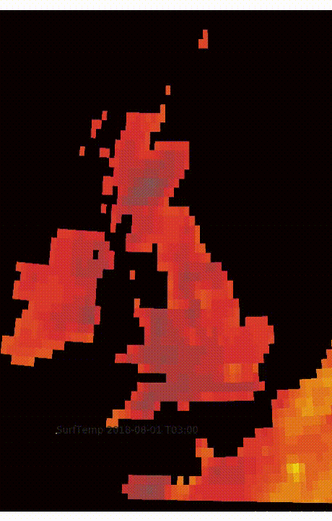
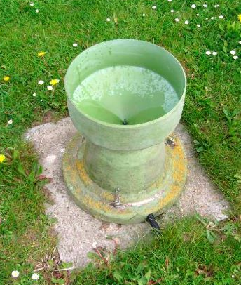
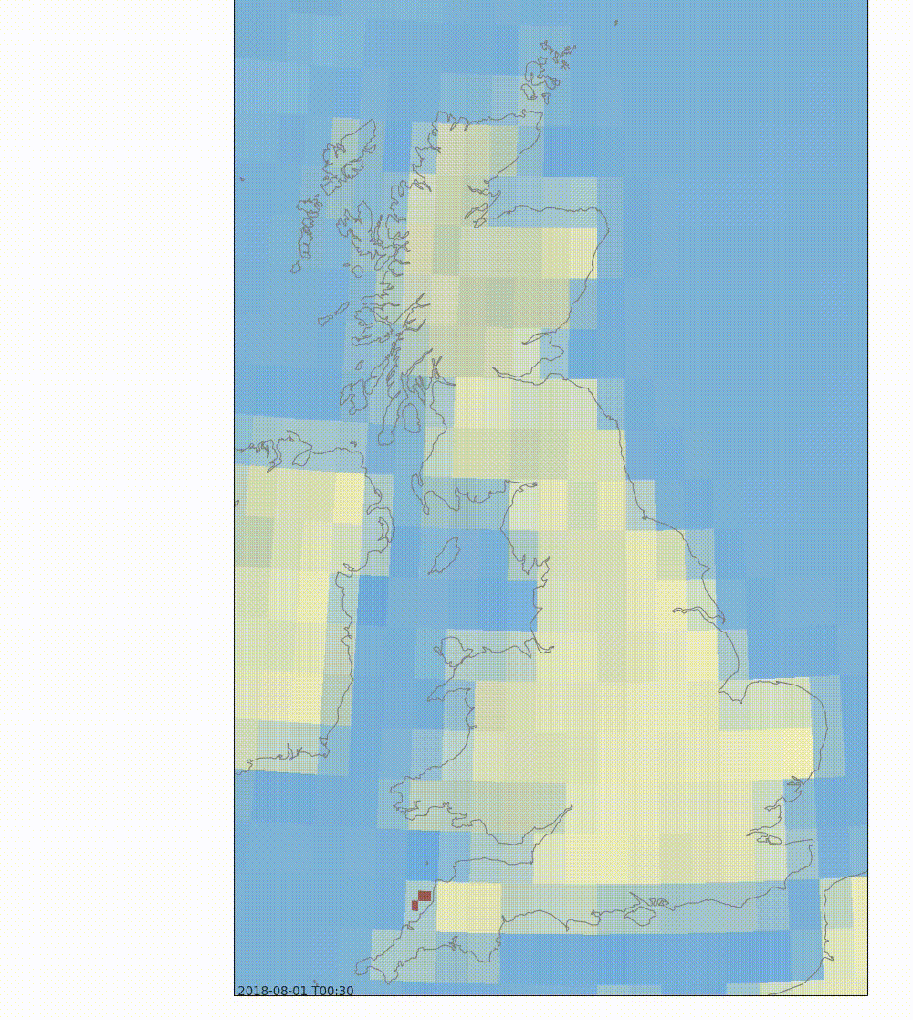
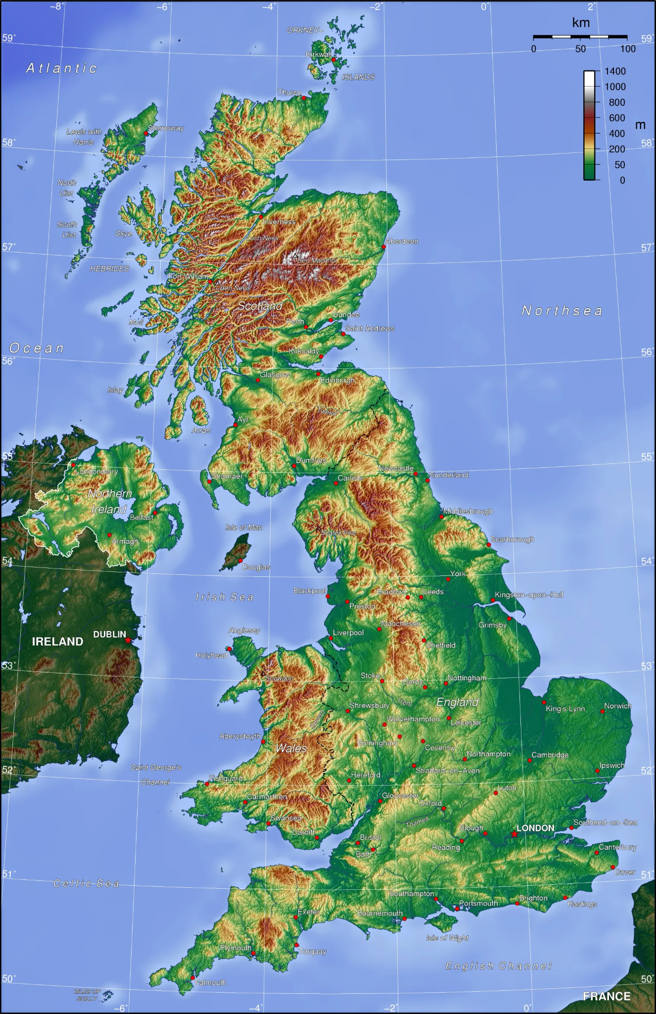
Additional data sources?
Wind Speed
Temperature
Numerical Weather Prediction (NWP)
UKV model
Work on lead time > 3h
Rainflux used as baseline
Rain gauges
For calibration
Orography, land cover
Investigated…
… but not used
Did not use satellite data either!
Precipitation
Orography
Notes:
I need to say a few words about ensemble numerical weather prediction (NWP) systems, which simulate coupled physical equations of the atmosphere and generate multiple realistic precipitation forecasts. NWP would be natural candidates for forecasting as one can derive probabilistic uncertainty estimates. But, for our nowcasting horizon of up to two hours, NWPs tend to provide poor predictions as two hours is less than the time needed to spin-up the model and because of difficulties in data assimilation of radar. So the only way in which we used the UKV deterministic forecast (the rainflux) was as baseline.
Rain gauges: data was messy, so we used it only for calibrating radar.
Surprisingly, orography and land cover was not needed to achieve good nowcasting results, probably because of conditional independence given recent radar measurements. Finally, unlike the MetNet study, we did not use satellite data.

Slide 10
Baseline Models…
2
Notes:
Now, onto our baselines

Slide 11
A Quote
“All models are wrong, but some are useful”
George Box (Statistician)
Notes:
Precipitation nowcasting.
We know that precipitation nowcasting is the high-resolution forecasting of rainfall up to two hours into the future. It is crucial for weather-dependent decision-making.
Nowcasting informs the operations of a wide variety of sectors, including flood early-warning systems, air traffic control and marine services, emergency services, energy management, etc.
We believe that that the nowcasting problem is interesting from a data science perspective for three distinct reasons:
For nowcasting to be useful in these applications the forecast must first, provide accurate predictions across multiple spatial and temporal scales.
Second, they must account for uncertainty and be verified probabilistically,
and third, perform well on heavier precipitation events that are rarer, but do more critically affect human life and economy.

Slide 12
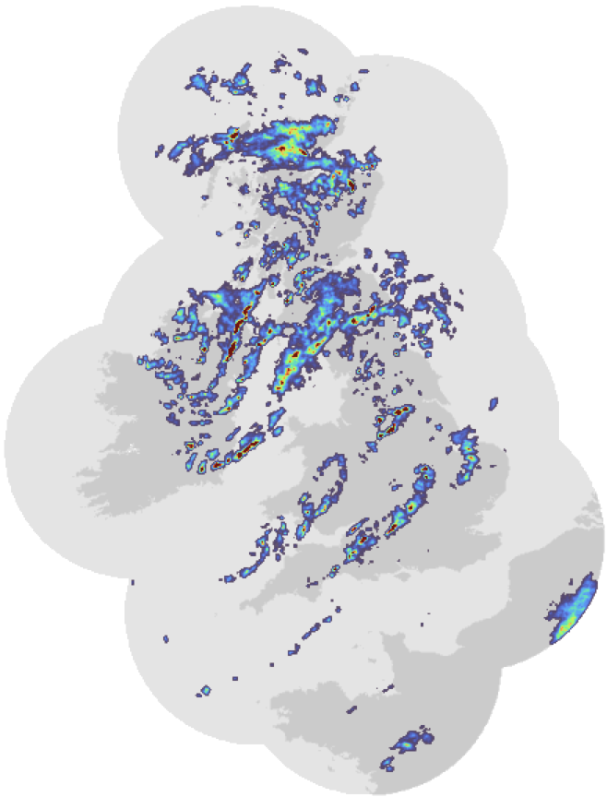
Useful Physics-Inspired Baselines: Lagrangian Persistence & PySTEPS
Optical Flow
Extrapolate
Advection Field
Input
Prediction
Stationary optical flow (e.g., Lucas Kanade) (Bowler et al, 2004)
Future obtained with Semi-Lagrangian extrapolation (Germann et al, 2002)
What’s wrong: advection only, struggles with orography
Bowler et al., 2004. Development of a precipitation nowcasting algorithm based upon optical flow techniques. Journal of Hydrology.
Germann et al., 2002. Scale-dependence of the predictability of precipitation from continental radar images. Part I: Description of the methodology. Monthly Weather Review.
Notes:
STEPS and the corresponding open-source Python library PySTEPS, are industry standard models for probabilistic precipitation nowcasting that rely on multiscale optical flow. The optical flow is estimated from the most recent consecutive radar images, with some smoothness penalties, and used to define a 2D motion field called advection field. Using that advection field, we can extrapolate, using semi-Lagrangian extrapolation, the most recent radar images to make predictions.
Because of the application of stochastic perturbations of rainfall intensity and of the motion field, we can obtain different realisations for ensemble nowcasts, from which we can derive both probabilistic and deterministic forecasts at multiple spatial scales.

Slide 13
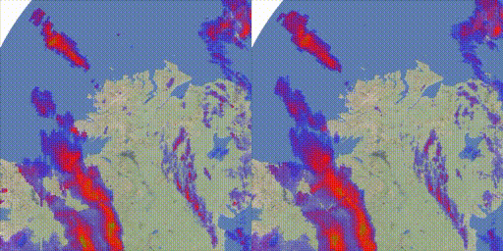
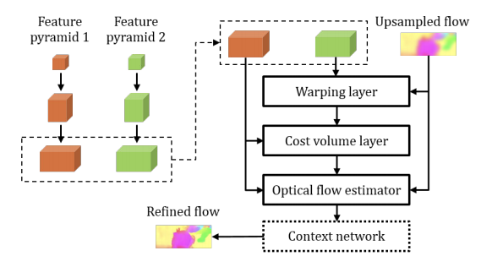
Neuralizing: Extending Optical Flow with PWC-Nets
Differentiable approach to optical flow estimation (Sun et al, 2017)
Ground truth
Prediction (PWC-Net)
Sun et al., 2017, PWC-Net: CNNs for Optical Flow Using Pyramid, Warping, and Cost Volume. CVPR 2018
Notes:
Early in our research, we tried to improve upon the optical flow-based methods by trying to learn a differentiable approach to optical flow. We used state-of-the-art PWC-Nets, as in Pyramidal Warped Cost-volume networks, which work well for learning to estimating optical flow from sequences of consecutive images without labels. The problem was: the boundaries of the images, where information was missing: the neural network would find creative ways to make up predictions, basically smudging the edge of the image, which was not physically plausible.
So, we ended up not using PWC-Nets.

Slide 14
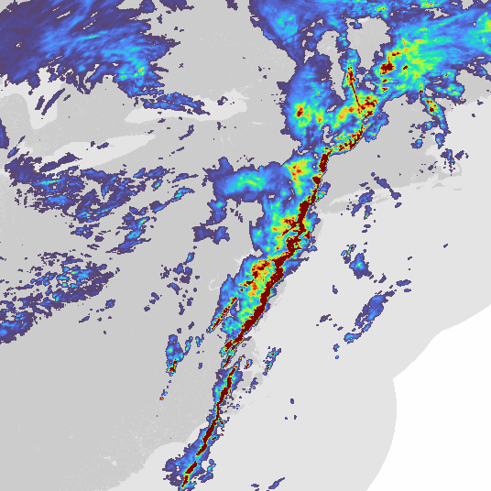
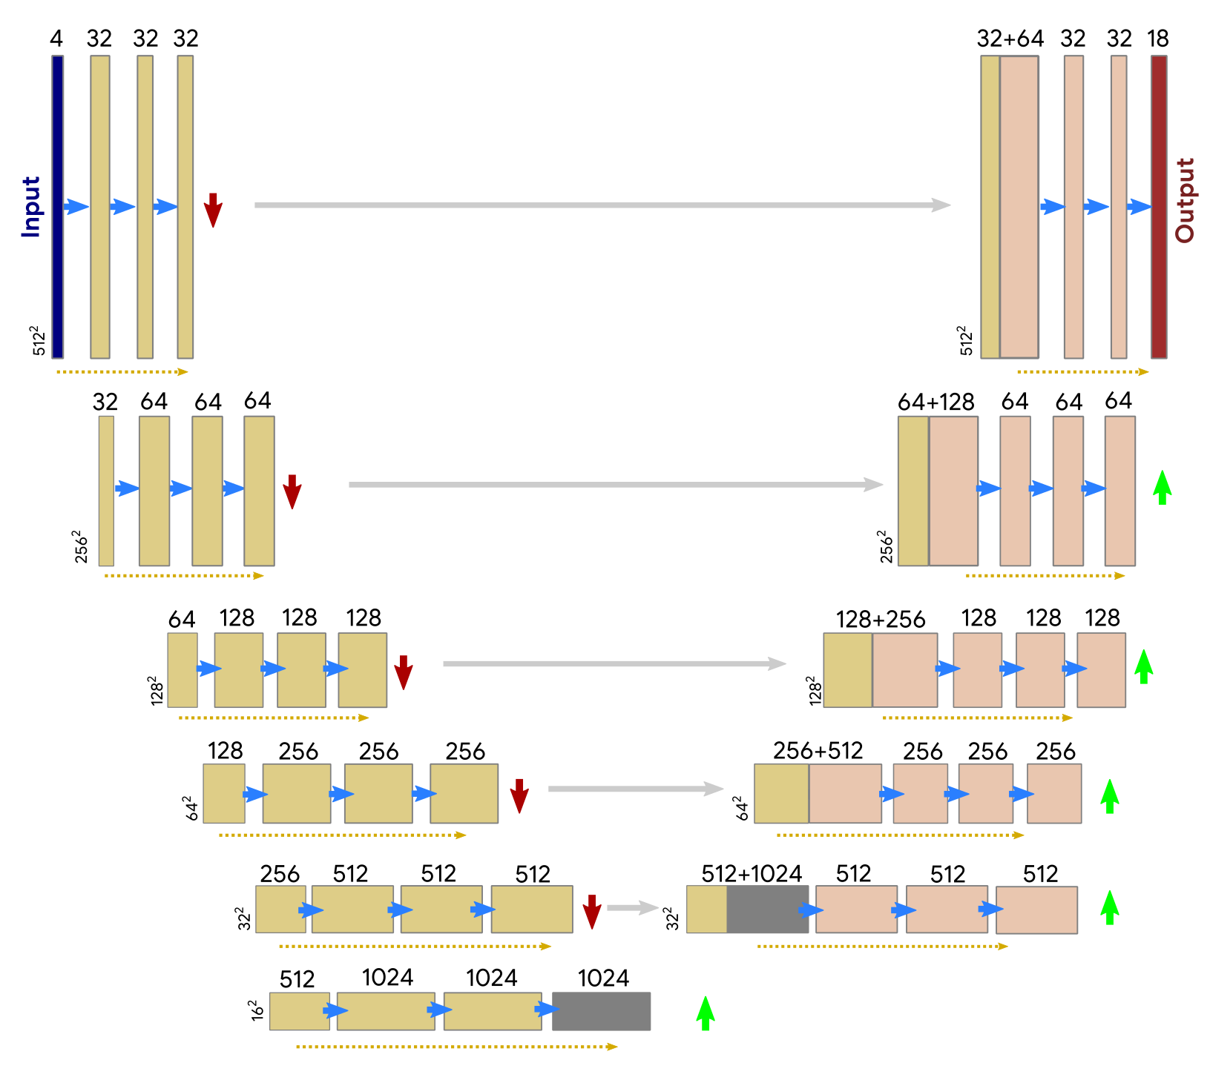
A Purely Data-Driven Baseline: UNet (Regression and Classification)
Regression:
Classification:
3x3 Convolutions
Lateral Connection
Downsampling
Residual Connections
Upsampling
Ayzel et al., 2020. RainNet v1.0: a convolutional neural network for radar-based precipitation nowcasting Geosci. Model Dev.
Agrawal et al., 2019, Machine Learning for Precipitation Nowcasting from Radar Images, NeurIPS Climate Change AI workshop.
Notes:
Our second strong baseline was a UNet encoder–decoder model, used by several of our colleagues. After extensive exploration of U-nets, we made some architectural and loss function changes to improve their performance at longer lead times and heavier precipitation. First, we replace all convolutional layers with residual blocks. We used 6 residual blocks that provided a small but consistent improvement across all prediction thresholds. Second, rather than predicting only a single output and using autoregressive sampling during evaluation, the model would predict all frames in a single forward pass. This somewhat mitigates the excessive blurring found in the literature and improves results on quantitative evaluation.
We tried both regression and classification losses for UNets.

Slide 15
A Purely Data-Driven Baseline: UNet (Regression and Classification)
3x3 Convolutions
Lateral Connection
Downsampling
Good metrics…
and blurred predictions
Residual Connections
Upsampling
Ayzel et al., 2020. RainNet v1.0: a convolutional neural network for radar-based precipitation nowcasting Geosci. Model Dev.
Agrawal et al., 2019, Machine Learning for Precipitation Nowcasting from Radar Images, NeurIPS Climate Change AI workshop.
Notes:
There was a problem: even though UNets would outperform traditional optical flow methods in terms of metrics, they would produce blurred predictions.

Slide 16
A Purely Data-Driven Baseline: UNet (Regression and Classification)
3x3 Convolutions
Lateral Connection
Downsampling
Good metrics…
and blurred predictions
What’s wrong in these models?
Residual Connections
Upsampling
Ayzel et al., 2020. RainNet v1.0: a convolutional neural network for radar-based precipitation nowcasting Geosci. Model Dev.
Agrawal et al., 2019, Machine Learning for Precipitation Nowcasting from Radar Images, NeurIPS Climate Change AI workshop.
Notes:
There was a problem: even though UNets would outperform traditional optical flow methods in terms of metrics, they would produce blurred predictions.

Slide 17
… or why we need generative models
3
Notes:
What happened?

Slide 18
Beware of Simplistic Modeling Assumptions in the Loss!
How are we modeling ?
Regression:
Classification:
Be careful about the objective, especially if the data has underlying stochasticity … as there may be some poor conditional independence assumptions!
h
h
h
w
w
w
t
Notes:
But how does language modeling and generation relate to our problem on precipitation nowcasting?
Recall that the UNet and MetNet models that I described earlier where making the following assumptions for modeling the optimisation objective: joint probabilities over all horizontal and vertical pixels of the generated image, and in some cases, computed for all time steps, with poor assumptions about conditional independence given the context! The optimisation process would optimise the mode of the distribution but would nevertheless assume conditionally independent Gaussian probabilities for mean square error regression, or conditionally independent multinomials for classification.

Slide 19
Beware of Simplistic Modeling Assumptions in the Loss!
Conditional independence assumption: Given the input, two predicted grid cells are independent
Input
Prediction
Input
Notes:
This is what conditional independence assumptions boil down to, in the case of two grid cells, the orange and the green one. If we were given the context input, then under conditional independence assumptions, knowing about the value of one green grid cell would not help us make a better prediction of the value of the orange grid cell. The input context would factor out the conditional probability. And yet, they are related, because of spatial correlations, proximity!
The problem is that even if we manage to train UNets and MetNet and they get good performance metrics, we cannot actually sample from those distributions, which is a problem once we acknowledge that the weather data is inherently stochastic.

Slide 20
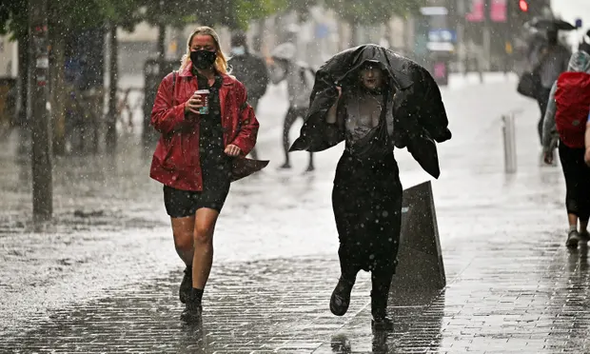
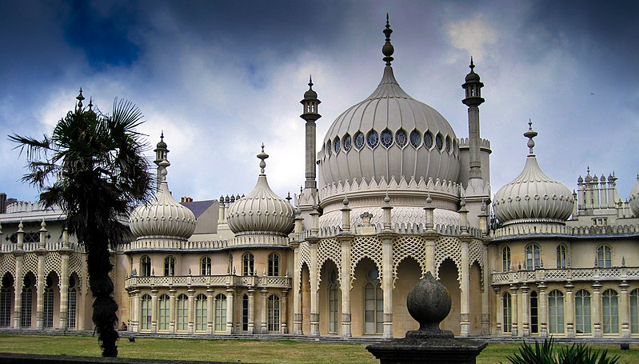
A Thought Experiment
40 km wide
20 km
20 km
Observation at T+30min: Rain in City W!
30 mm/h localised precipitation front
Posterior at T+30min: No rain in City E
60 km/h
60 km/h
P(Rain in City W | T+30min) = 0.5
P(Rain in City E | T+30min) = 0.5
f(London, T+30min) = 15 mm/h
Regression
f(Brighton, T+30min) = 15 mm/h
CSI = 0.5 at 15 mm/h (good metric value)
p(London, 30 mm/h, T+30min) = 0.5
Classification
p(Brighton, 30 mm/h, T+30min) = 0.5
CSI = 0.5 at 30 mm/h (good metric value)
Image credits: Peter Greenhalgh, User:Colin, Wikimedia, Jeff J Mitchell, Getty Images
Notes:
Let me explain the same problem a third time, with this thought experiment that ended up not being included in our paper.
A heavy precipitation front (of 30mm/h), that is also very localised, could move towards London or towards Brighton, on the coast of England not far from London.
That means that at time 0, our estimates of the probability of rain in London at time T+30min is 0.5, and the same goes for Brighton.
But at T+30min, we observe that it is raining in London: what does it mean about Brighton? Because we have a very localised precipitation front, there would probably be no rain in Brighton at all.

Slide 21
A Thought Experiment
40 km wide
20 km
20 km
30 mm/h localised precipitation front
60 km/h
60 km/h
P(Rain in City W | T+30min) = 0.5
P(Rain in City E | T+30min) = 0.5
But what about questions we care about?
Image credits: Peter Greenhalgh, User:Colin, Wikimedia, Jeff J Mitchell, Getty Images
Notes:
Let me explain the same problem a third time, with this thought experiment that ended up not being included in our paper.
A heavy precipitation front (of 30mm/h), that is also very localised, could move towards London or towards Brighton, on the coast of England not far from London.
That means that at time 0, our estimates of the probability of rain in London at time T+30min is 0.5, and the same goes for Brighton.
But at T+30min, we observe that it is raining in London: what does it mean about Brighton? Because we have a very localised precipitation front, there would probably be no rain in Brighton at all.

Slide 22
A Thought Experiment
40 km wide
20 km
20 km
30 mm/h localised precipitation front
60 km/h
60 km/h
P(Rain in City W | T+30min) = 0.5
P(Rain in City E | T+30min) = 0.5
What is the probability of rain at both cities simultaneously at T+30min?
Truth
Regression
Classification
P(Rain in City E and City W) = 0.0
P(Rain in City E and City W) = 1.0
P(Rain in City E and City W) = 0.25
Image credits: Peter Greenhalgh, User:Colin, Wikimedia, Jeff J Mitchell, Getty Images
Notes:
Let me explain the same problem a third time, with this thought experiment that ended up not being included in our paper.
A heavy precipitation front (of 30mm/h), that is also very localised, could move towards London or towards Brighton, on the coast of England not far from London.
That means that at time 0, our estimates of the probability of rain in London at time T+30min is 0.5, and the same goes for Brighton.
But at T+30min, we observe that it is raining in London: what does it mean about Brighton? Because we have a very localised precipitation front, there would probably be no rain in Brighton at all.

Slide 23
A Thought Experiment
40 km wide
20 km
20 km
30 mm/h localised precipitation front
60 km/h
60 km/h
P(Rain in City W | T+30min) = 0.5
P(Rain in City E | T+30min) = 0.5
What is the probability of no rain at City E over the next hour?
Truth
Regression
Classification
P(No Rain in City E) = 0.5
P(No Rain in City E) = 0.0
P(No Rain in City E) = 0.5⁸
Image credits: Peter Greenhalgh, User:Colin, Wikimedia, Jeff J Mitchell, Getty Images
Notes:
Let me explain the same problem a third time, with this thought experiment that ended up not being included in our paper.
A heavy precipitation front (of 30mm/h), that is also very localised, could move towards London or towards Brighton, on the coast of England not far from London.
That means that at time 0, our estimates of the probability of rain in London at time T+30min is 0.5, and the same goes for Brighton.
But at T+30min, we observe that it is raining in London: what does it mean about Brighton? Because we have a very localised precipitation front, there would probably be no rain in Brighton at all.

Slide 24
A Thought Experiment
40 km wide
20 km
20 km
30 mm/h localised precipitation front
60 km/h
60 km/h
P(Rain in City W | T+30min) = 0.5
P(Rain in City E | T+30min) = 0.5
What is the probability of 20mm of rain at City E over the next hour?
Truth
Regression
Classification
P(20mm in City E) = 0.5
P(20mm in City E) = 0.0
P(20mm in City E) = 0.5⁸
Image credits: Peter Greenhalgh, User:Colin, Wikimedia, Jeff J Mitchell, Getty Images
Notes:
Let me explain the same problem a third time, with this thought experiment that ended up not being included in our paper.
A heavy precipitation front (of 30mm/h), that is also very localised, could move towards London or towards Brighton, on the coast of England not far from London.
That means that at time 0, our estimates of the probability of rain in London at time T+30min is 0.5, and the same goes for Brighton.
But at T+30min, we observe that it is raining in London: what does it mean about Brighton? Because we have a very localised precipitation front, there would probably be no rain in Brighton at all.

Slide 25
A Thought Experiment
40 km wide
20 km
20 km
30 mm/h localised precipitation front
60 km/h
60 km/h
P(Rain in City W | T+30min) = 0.5
P(Rain in City E | T+30min) = 0.5
Forecast quality (scores on metrics) is strong,
but forecast value (ability to make better decisions) is poor!
Image credits: Peter Greenhalgh, User:Colin, Wikimedia, Jeff J Mitchell, Getty Images
Notes:
Let me explain the same problem a third time, with this thought experiment that ended up not being included in our paper.
A heavy precipitation front (of 30mm/h), that is also very localised, could move towards London or towards Brighton, on the coast of England not far from London.
That means that at time 0, our estimates of the probability of rain in London at time T+30min is 0.5, and the same goes for Brighton.
But at T+30min, we observe that it is raining in London: what does it mean about Brighton? Because we have a very localised precipitation front, there would probably be no rain in Brighton at all.

Slide 26
From Discriminative to Generative Modeling
What went wrong?
Baseline models directly predict grid cell-wise rain-rate probability
These are discriminative models
We want generative models
Discriminative Model
Generative Model
Realization
Input
Input
Pixelwise Prediction
Realization
But how to model ?
Notes:
How do we fix both the model and the evaluation?
What went wrong with our baseline models is that they directly predict grid cell-wise or pixel-wise rain-rate probability and that they are trained discriminatively, with the conditional independence assumption. They optimise at each pixel location (from the point of view of someone with a garden and who wants to know if it will rain in their garden) without the whole picture of rain across the country (something that meteorologists care about).
What we need are generative models that produce plausible realisations of rain, and derive statistics from them.

Slide 27
Deep Generative Models of Radar
4
Notes:
How do we model them?

Slide 28
A Neural Sampler: Take Inspiration from Ensemble NWPs
N Realizations
Input
Sampler
Would like a model that is 1) consistent across spatial and temporal scales, 2) captures rare events, and 3) properly accounts for uncertainty
From realizations, calculate relevant probabilities (such as accumulation rain over catchment area)
Generative Adversarial Network seems like a good fit
Goodfellow et al., “Generative Adversarial Networks.” NeurIPS 2014.
Notes:
For nowcasting to be useful in these applications the forecast must provide accurate predictions across multiple spatial and temporal scales, account for uncertainty and be verified probabilistically, and perform well on heavier precipitation 17 events that are rarer but more critically affect human life and economy

Slide 29
A Neural Sampler: Take Inspiration from Ensemble NWPs
N Realizations
Generator
Input
Sampler
Would like a model that is 1) consistent across spatial and temporal scales, 2) captures rare events, and 3) properly accounts for uncertainty
From realizations, calculate relevant probabilities (such as accumulation rain over catchment area)
Use models inspired by BigGAN and DVD-GAN
[5] Brock, Donahue, and Simonyan. Large Scale GAN Training for High Fidelity Natural Image Synthesis. ICLR 2019
[6] Clark, Donahue, and Simonyan. Adversarial Video Generation on Complex Datasets. Arxiv 2019
[7] Luc et al., Transformation-based Adversarial Video Prediction on Large-Scale Data. Arxiv 2020.
Notes:
For nowcasting to be useful in these applications the forecast must provide accurate predictions across multiple spatial and temporal scales, account for uncertainty and be verified probabilistically, and perform well on heavier precipitation 17 events that are rarer but more critically affect human life and economy

Slide 30
BigGAN and DVD-GAN
BigGAN
DVD-GAN
Adversarial Training
z
y
z
x_{<t}
z
Real/Fake?
Generator
Generator
Generator
Discriminator
x_{s}
x_{s}
x_{s}
x_{r}
Real Data
Source: https://cs.stanford.edu/people/karpathy/cnnembed/
Notes:
For nowcasting to be useful in these applications the forecast must provide accurate predictions across multiple spatial and temporal scales, account for uncertainty and be verified probabilistically, and perform well on heavier precipitation 17 events that are rarer but more critically affect human life and economy

Slide 31
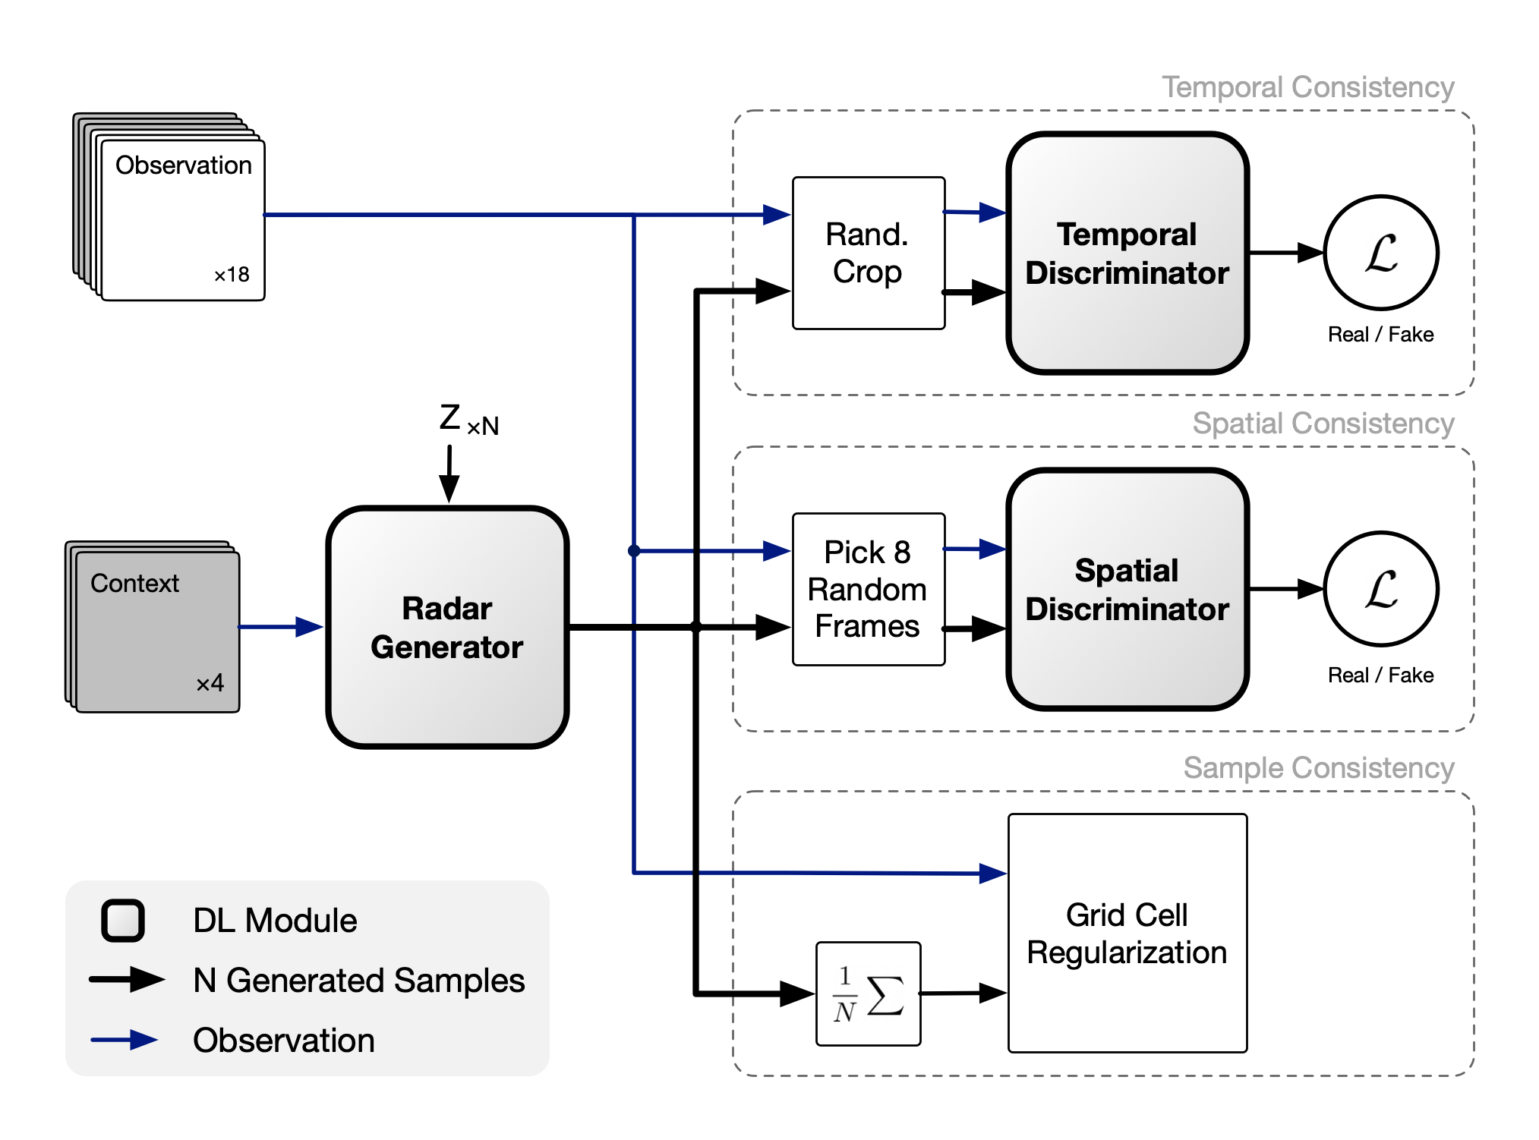
Nowcasting model: conceptual diagram
Notes:
Four consecutive radar observations (the previous 20 min) are used as context for the generator that allows sampling of multiple realizations of future precipitation, each realization being 18 frames (and covering 90 min).
During training, the generator takes inputs that are 256x256 pixels, and outputs 256x256 frames as well.
Learning is driven by two loss functions and a regularization term.

Slide 32
Nowcasting model: conceptual diagram
Spatio-temporal consistency of realisations.
Notes:
The first loss is defined by a temporal discriminator, which is a three-dimensional (3D) convolutional neural network that aims to distinguish observed and generated radar sequences, imposes temporal consistency and penalizes jumpy predictions. The temporal discriminator takes a random 128 × 128 crop out of the generated or real radar sequence.

Slide 33
Nowcasting model: conceptual diagram
Ensures that each frame is spatially consistent
Notes:
The second loss is defined by a spatial discriminator, which is a convolutional neural network that aims to distinguish individual observed radar fields from generated fields, ensuring spatial consistency and discouraging blurry predictions. The spatial discriminator takes a random set of 8 frames, either real or generated (and subsampled by a factor of 2).

Slide 34
Nowcasting model: conceptual diagram
We can also think of this as the primary prediction objective, where the two GAN losses are the actual regularisation
Regularization ensures location accuracy.
Notes:
To improve accuracy, we need to introduce a regularization term that penalizes deviations, at the grid cell resolution, between the real radar sequences and the mean of the predictions given by the model (we compute the mean from multiple samples, multiple realisations). This third term is important for the model to produce location-accurate predictions and improve performance.
As a matter of fact, we can also think of this third objective as the primary prediction objective, where the two GAN losses are regularisation terms to enforce spatial and temporal structures. These two discriminators share similar architectures to existing work in video generation.

Slide 35
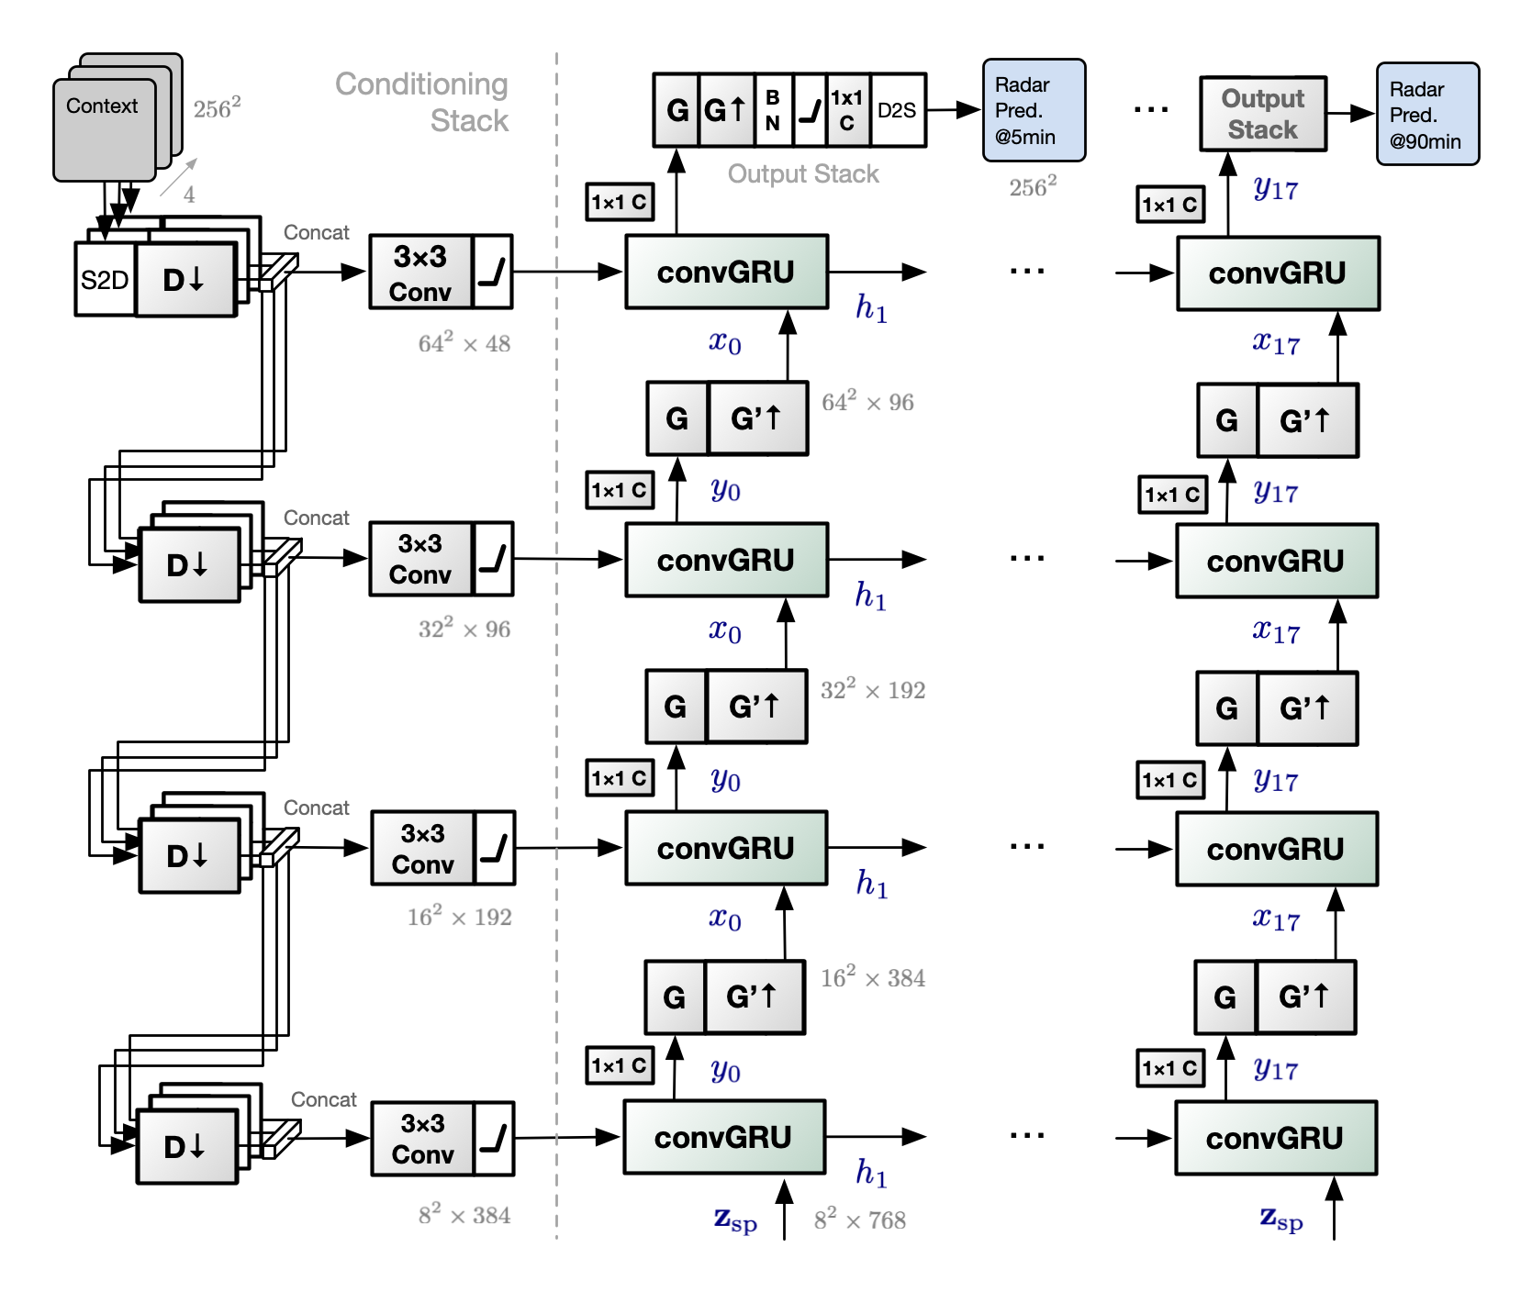
Generator

Slide 36
Generator
Latents account for uncertainty

Slide 37
Generator
Architecture for multiple scales

Slide 38
Generator
But what about rare events?

Slide 39
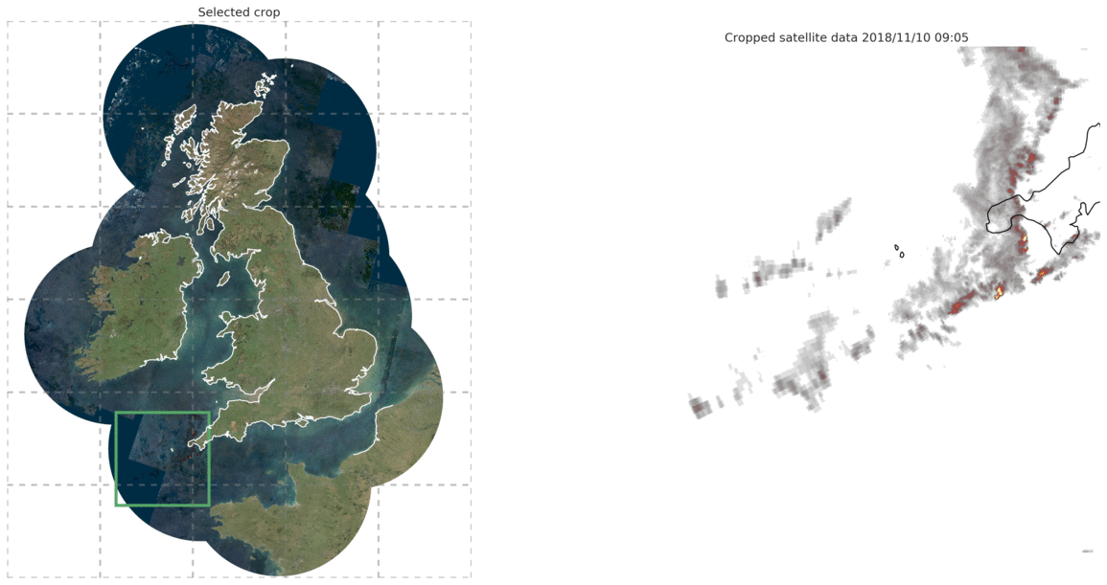
Met Office RadarNet4 Data
Bias sampling towards high average precipitation for training.
Notes:
At training time, we use an importance-sampling scheme to create a dataset that is more representative of heavy precipitation. This enables us to capture rare events.

Slide 40
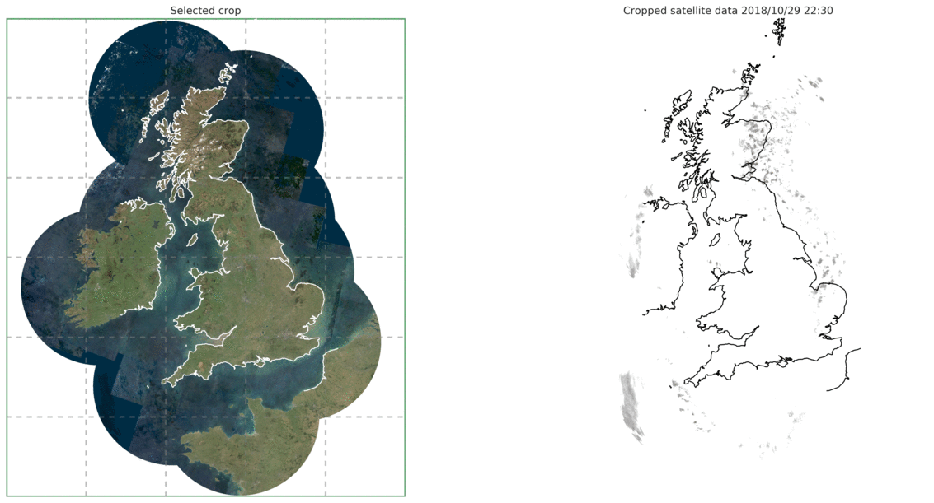
Fully convolutional architecture, enables full-frame evaluation
Test on full 1536 x 1280 UK radar frames (2019) - (for US data: 3584 × 7168 frames)
Notes:
We evaluate our model on a test set from 2019. Because our model is full convolutional, we can apply out of the box onto much larger radar frames, covering the whole UK (or, the whole US in our supplemental experiments). Both the radar conditioning and the latent variables conditioning are convolutional, which allows for training on small crops while having spatio-temporally consistent predictions during evaluation on larger frames.
Unlike some other methods like MetNet, we do not need to tile and stitch smaller predictions to cover the whole frame.
Importantly, once trained, this model allows fast full-resolution nowcasts to be produced, in about a second (using an Nvidia V100 GPU) or 25s on CPU.

Slide 41
Quantitative Verification and its Limits
5
Notes:
I know there are lots of gaps and unanswered questions, which can be answered in our paper, in the very long supplement, and in the pseudocode. Or by reaching out to me!

Slide 42
Critical Success Index (CSI)
DGMR
Deep learning methods outperform PySTEPS.
CSI does not account for blurry predictions.
Notes:
Our first metrics is the Critical Success Index, CSI, which measures the location accuracy of the forecast at various rain rates (we show here 1, 4 and 8 mm per hour). It is a ratio of true positives in the numerator, to the sum of true and false positives as well as false negatives in the denominator.
We can see that all three deep learning systems (UNet, axial attention and the generative model) produce forecasts that are significantly more location-accurate than the PySTEPS baseline (in green). However, we know that UNet and axial attention make blurry predictions, and yet CSI does not account for all the different ways the model can cheat to score better.

Slide 43
Power Spectral Density (PSD)
T+30 min
T+60 min
T+90 min
High-frequency noise
Blurring
DGMR
DGMR
DGMR
30 minute prediction from other DL models has the same resolution as 8kmx8km observations
90 minute prediction from other DL models has the same resolution as 32kmx32km observations
DGMR/PySTEPS has roughly the same resolution as the original 1kmx1km observations
Notes:
That's when the Power Spectral Density metric becomes useful. These PSD plots show that both DGMR (in blue) and PySTEPS (in light green) match the observations (black dotted line) in their spectral characteristics.
PSD plots also show that the predictions from axial attention and UNet have much less small-scale variability (meaning, they are smoother or more blurry) and that it gets worse with increasing prediction horizon.
As these models produce blurred predictions, the effective resolution of the axial attention and UNet nowcasts is far less than the 1 km × 1 km resolution of the data. At T + 90 min, the effective resolution for UNet is 32 km and for axial attention is 16 km, reducing the value of these nowcasts for meteorologists.

Slide 44
Continuous Ranked Probability Score (CRPS)
DGMR
Probabilistic verification using CRPS
Show CRPS aggregated over different scales (like FSS).
Discriminative deep learning methods lack spatial consistency.
Generative methods are spatially consistent.
Notes:
For probabilistic verification, we show here the Continuous Ranked Probability Score (CRPS). CRPS is the difference between the mean error and the mean inter-sample variability (for different realisations). We compute it on the average precipitation rate (across different realisations) and aggregated over regions of increasing size.
When measured at the grid-resolution level, DGMR, PySTEPS and axial attention perform similarly.
As the spatial aggregation is increased, DGMR and PySTEPS provide consistently strong performance, with DGMR performing best on maximum precipitation. The axial attention model is significantly poorer for larger aggregations and underperforms all other methods at aggregation scale 4 km and above, even if we try to rescale its output probabilities.

Slide 45
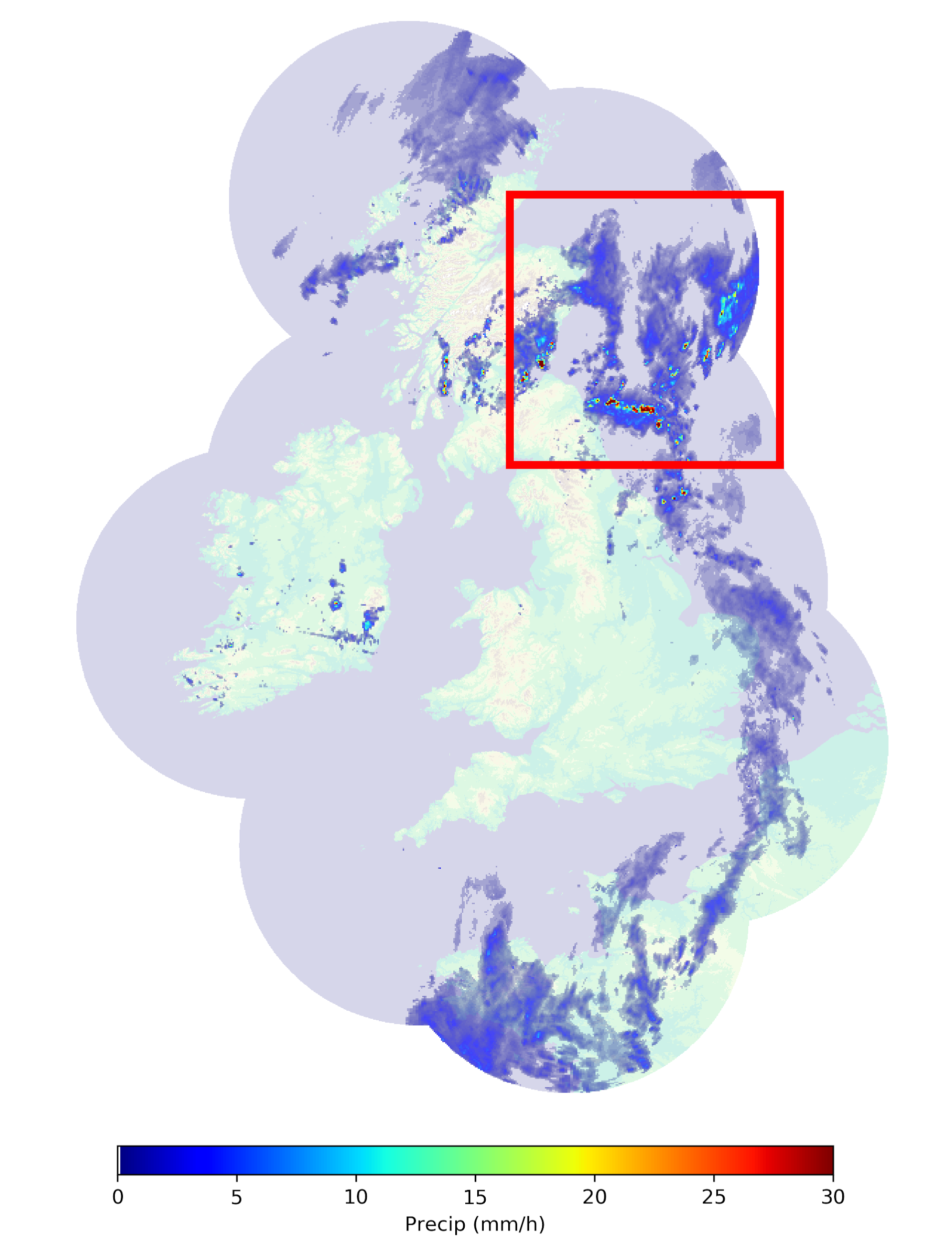
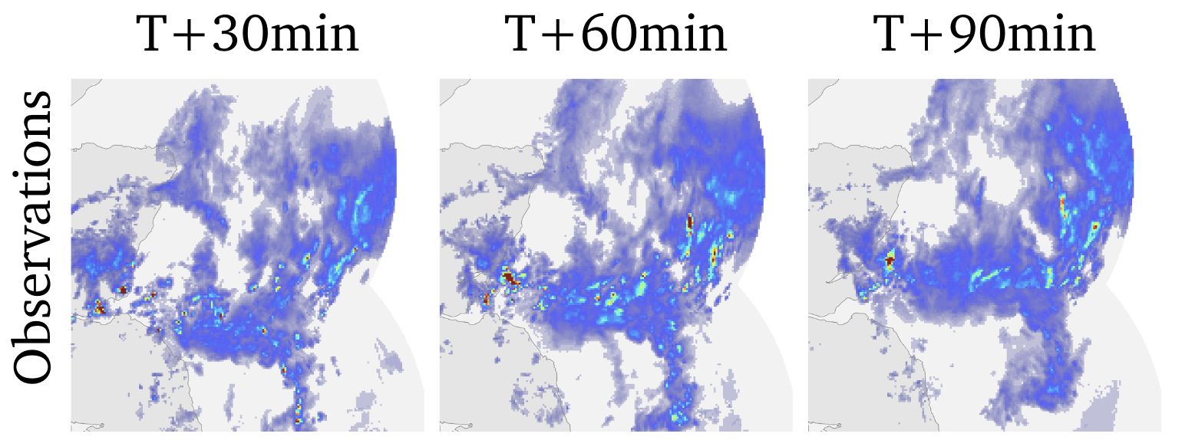
Intercomparison case study
24/06/2019 at 16:15
Important (and difficult) to predict convective cells
Difficult case chosen by the Chief Forecaster (independent of the project team)
Notes:
Let us use a single case study to compare the nowcasting performance of several models. We focus on this difficult case, chosen by the Met Office chief forecaster who was independent of the project team.
The case focuses on convective cells in eastern Scotland with intense showers over land.

Slide 46
Intercomparison case study
24/06/2019 at 16:15
Traditional Nowcasting
Notes:
Traditional method such as PySTEPS essentially try to apply optical flow here but also overestimate the rainfall intensity over time, which is not observed in reality and does not sufficiently cover the spatial extent of the rainfall.

Slide 47
Intercomparison case study
24/06/2019 at 16:15
Deterministic Outputs
Notes:
The UNet model roughly predicts the location of rain, but owing to aggressive blurring, over-predict areas of rain, misses intensity and fails to capture any small-scale structure.

Slide 48
Intercomparison case study
24/06/2019 at 16:15
Deterministic Outputs
. Sonderby et al., MetNet: A Neural Weather Model for Precipitation Forecasting. arXiv 2020.
Notes:
The same can be said of axial attention.

Slide 49
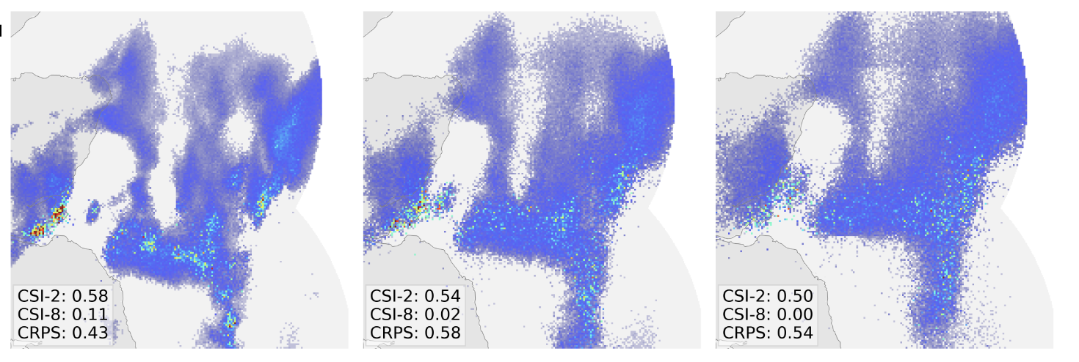
Intercomparison case study
24/06/2019 at 16:15
Pointwise Probabilistic Outputs
. Sonderby et al., MetNet: A Neural Weather Model for Precipitation Forecasting. arXiv 2020.
Notes:
When we try to sample from the logits of the axial attention model, feeding them through a softmax and after having calibrated the temperature on a validation set, we add unstructured noise but do not improve the spatial details of the generated radar image.

Slide 50
Intercomparison case study
24/06/2019 at 16:15
Our Method
DGMR
Notes:
By comparison, DGMR preserves spatial structures, represents the convection events well, and maintains heavy rainfall in
the early prediction

Slide 51
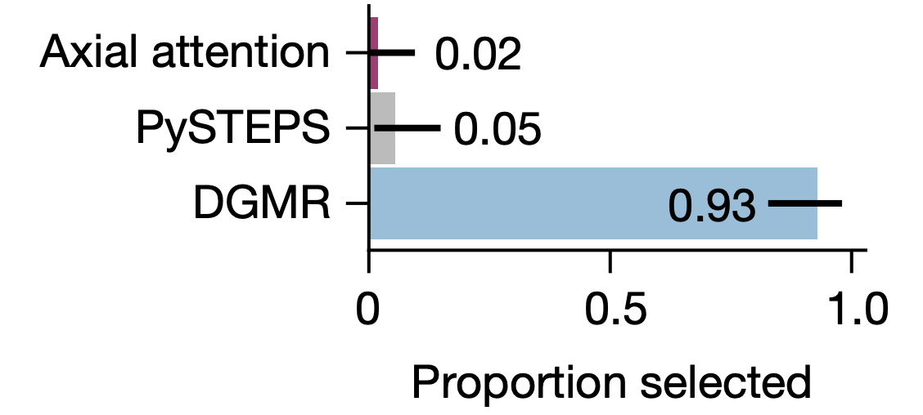
Limitation of quantitative verification
We showed these nowcasts to expert forecasters…
Existing metrics do not capture all the salient properties of a nowcast.
ML methods do not incorporate physical knowledge
ML methods are much more flexible and can game the metrics
Existing metrics do not give us the ability to detect the differences between different approaches.
Expert meteorologists have this knowledge
DGMR
Notes:
Unsurprisingly, when we showed these nowcasts to expert forecasters, they definitely preferred the predictions made by the generative model.
This case study highlights a limitation of using existing metrics to evaluate forecasts. These metrics
implicitly assume that models, such as NWPs and advection-based STEPS, preserve the physical plausibility of forecasts. Deep learning, does not incorporate physical knowledge and is much more flexible, and can game these metrics and outperform other systems, but still fail to produce useful predictions.
We therefore need to be thoughtful about the application of deep learning, because existing metrics do not allow us to discriminate between different approaches.
Expert meteorologists, by contrast, have this knowledge.

Slide 52
Expert Evaluation
6

Slide 53
Experimental psychology for operational meteorology
Controlled study of expert judgments to assess performance of ML models.
Worked with the Met Office Chief Forecaster to design the study and to adjust the type of assessments made.
56 UK Met Office professional meteorologists (anonymised) participated in this study.
Insight:
Are our approaches useful in an operational setting?
Can they inform decisions on the development of new ML approaches?
Notes:
We designed a new type of controlled study of expert judgements to assess the performance of nowcasting methods. We would assess the preference of 56 Met Office expert meteorologists.
We worked with the Met Office Chief Forecaster (who did not participate) to design the study and to adjust the type of assessments. The study in itself was submitted for ethical review by an independent ethics committee.
Our hopes were that using expert verification would provide us with insight into the usefulness of machine learning in an operational setting: could it even inform decisions on the development of new ML approaches for nowcasting?

Slide 54
Protocol Design
Our experiment protocol consisted of two phases
Phase One: a browser based preference rating of images depicting real and simulated radar data.
Phase Two: a retrospective recall and justification of decisions made. Of all participants to complete Phase One, 20% were selected at random to complete Phase Two.
Due to current circumstances, the protocol was completed remotely
Phase One via a browser based form that was generated uniquely for each participant.
We worked with the Chief Forecaster to design the study and to adjust the type of assessments made.

Slide 55
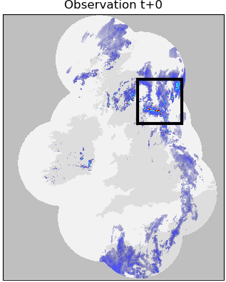
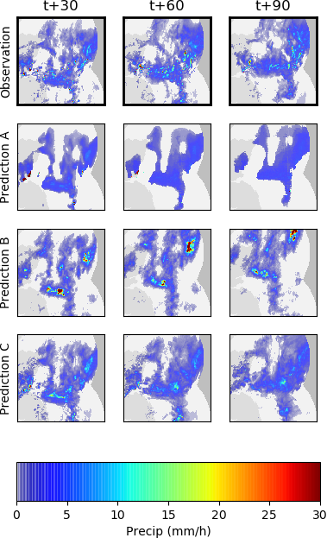
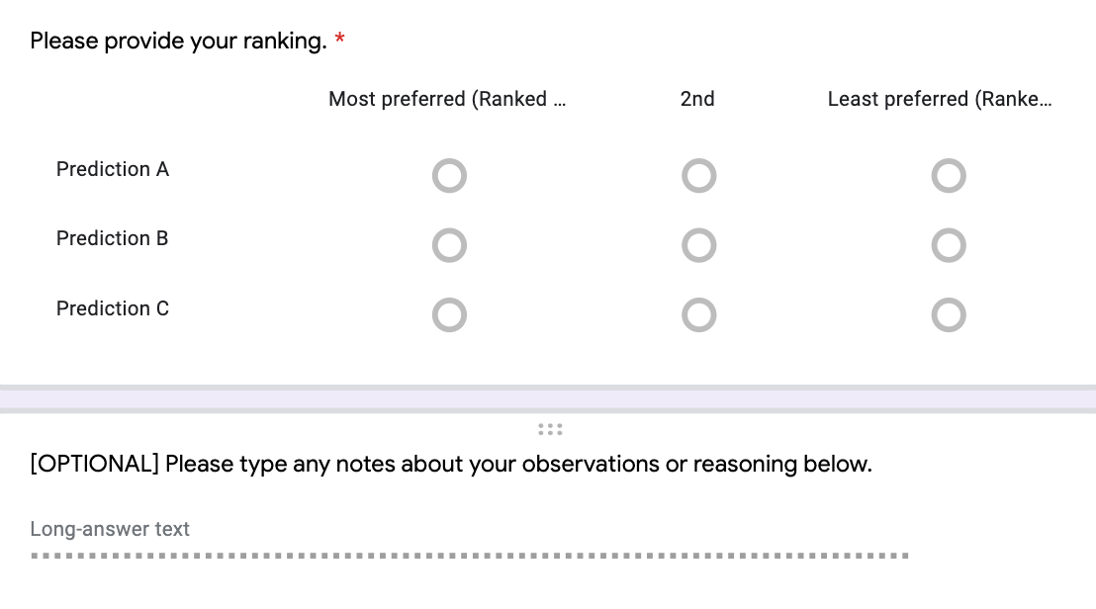
Protocol (phase one): preference ranking
Design decision to limit additional information to control variables.
Notes:
The experimental protocol has two phases. The first one was about preference ranking of predictions coming from three sources.
Participants were provided with a UID before the experiment to preserve their anonymity. They were shown a total of 23 cases of high precipitation data (over 5mm/h or selected by the chief meteorologist) in the following format.
On the left: Observation at T+0, with date, time and geographic context. In the middle: Ground truth at T+30, 60 and 90 minutes. And three comparative approaches to Nowcasting at T+30, 60 and 90 minutes. The optical flow-based system used by the Met Office, STEPS, a deep learning baseline (the axial attention model) and our generative model, always placed in a randomised order. With a colour map scale for reference.
On the right, the form. The participants were then asked to rank the model predictions compared to that known ground truth. They could also leave comments.
In an operational setting, forecasters would often use multiple sources of information to make decisions. But we opt to show radar based plots only, with limited additional information, to ensure we can limit and control variables.

Slide 56
Case Selection
Participants were shown a total of 23 cases. Comprising
10 cases where precipitation levels were >5mm/hour.
10 cases where precipitation levels were >10mm/hour.
3 ‘special’ cases, selected by an expert meteorologist. These cases featured severe or unusual weather events during the past year. (Included in the paper)

Slide 57
Design Decisions
Question phrasing: The language used within the preference ranking question can influence the way in which participants interact with the study. We opted to phrase the question in terms of ‘preference is based on [their] opinion of accuracy and value’.
Additional Information: In an operational setting, forecasters would often use multiple sources of information to make decisions. We opt to show radar based plots only, with limited additional information, to ensure we can limit and control variables.
Participant Selection Criteria: Participants were selected based on the following criteria; must be a professional UK meteorologist, qualified for 6+ months
Notes:
Remi: The constraint of the max number of available experts sets the ensemble size, and the number of variable we can meaningfully investigate.

Slide 58
Results
Key factor: ability to capture well the extent of rain.
Results contrast with the qualitative verification scores:
that did not differentiate between competing approaches
that often favoured models that blur the forecast over time
Notes:
The results were drastic. Most forecasters selected the proposed method as the most preferred, with the next most selected being the STEPS model.
Key factors included the ability to capture well the extent of rain, even when the intensity wasn’t quite right. These results contrast with the qualitative verification scores that don’t give enough indication of difference between competing approaches, and that often favour models that blur the forecast over time.

Slide 59
Transcript Extracts
“I would prefer the model to underdo intensities but get a much better spatial variation.”
“I like things to look slightly realistic even if they’re not in the right place so that I can put some of my own physics knowledge into it.”
“Lower resolution and unrealistic ones can still be useful, but a lot of the time (Axial Attention) didn’t even get the shape right”
“Anything close to reality is really useful, any that track movement is good.”
“This looks much higher detail (sic) compared to what we’re used to at the moment. I’ve been really impressed with the shapes compared with reality. I think they’re probably better than what we’re currently using. The shapes in particular, some of them do look really high resolution (sic).”

Slide 60
Transcript Extracts
“I would prefer the model to underdo intensities but get a much better spatial variation.”
“I like things to look slightly realistic even if they’re not in the right place so that I can put some of my own physics knowledge into it.”
“Lower resolution and unrealistic ones can still be useful, but a lot of the time (Axial Attention) didn’t even get the shape right”
“Anything close to reality is really useful, any that track movement is good.”
“This looks much higher detail (sic) compared to what we’re used to at the moment. I’ve been really impressed with the shapes compared with reality. I think they’re probably better than what we’re currently using. The shapes in particular, some of them do look really high resolution (sic).”

Slide 61
Transcript Extracts
“I would prefer the model to underdo intensities but get a much better spatial variation.”
“I like things to look slightly realistic even if they’re not in the right place so that I can put some of my own physics knowledge into it.”
“Lower resolution and unrealistic ones can still be useful, but a lot of the time (Axial Attention) didn’t even get the shape right”
“Anything close to reality is really useful, any that track movement is good.”
“This looks much higher detail (sic) compared to what we’re used to at the moment. I’ve been really impressed with the shapes compared with reality. I think they’re probably better than what we’re currently using. The shapes in particular, some of them do look really high resolution (sic).”

Slide 62
Transcript Extracts
“I would prefer the model to underdo intensities but get a much better spatial variation.”
“I like things to look slightly realistic even if they’re not in the right place so that I can put some of my own physics knowledge into it.”
“Lower resolution and unrealistic ones can still be useful, but a lot of the time (Axial Attention) didn’t even get the shape right”
“Anything close to reality is really useful, any that track movement is good.”
“This looks much higher detail (sic) compared to what we’re used to at the moment. I’ve been really impressed with the shapes compared with reality. I think they’re probably better than what we’re currently using. The shapes in particular, some of them do look really high resolution (sic).”

Slide 63
Transcript Extracts
“I would prefer the model to underdo intensities but get a much better spatial variation.”
“I like things to look slightly realistic even if they’re not in the right place so that I can put some of my own physics knowledge into it.”
“Lower resolution and unrealistic ones can still be useful, but a lot of the time (Axial Attention) didn’t even get the shape right”
“Anything close to reality is really useful, any that track movement is good.”
“This looks much higher detail (sic) compared to what we’re used to at the moment. I’ve been really impressed with the shapes compared with reality. I think they’re probably better than what we’re currently using. The shapes in particular, some of them do look really high resolution (sic).”

Slide 64
Future for expert assessments
Successful study and insight on:
how we run experimental psychology studies in Atmospheric Sciences
how we gain insight into meteorological decision mechanisms
Operational-driven design
Ensure that ML based products deliver value in an operational context
Notes:
In summary, we were happy about running this operational assessment, and believe that its success could help inform both, how we run experimental psychology studies in Atmospheric Sciences, and how we gain insight into meteorological decision mechanisms.
Most importantly, this operational-driven design aimed at ensuring that ML based products can deliver value in an operational context.

Slide 65
Conclusion
7

Slide 66
Final Thoughts
Nowcasting fills a gap in performance of NWPs in the first 2 forecast hours, highlighting a role for ML fill gaps in existing physics-driven/simulation-based approaches.
Deep Generative models that improves upon the currently used nowcasting methods.
It is suitable for high-intensity events and is also able to provide the probabilistic ensembles required to estimate the evolution of chaotic systems.
Provides genuine decision-making value for use by real-world experts.
First deep learning model significantly preferred to an operational system by professional forecasters.
Interest to the many sectors and the public. Many key environment and climate meetings this year, and we hope to add to those opportunities.

Slide 67
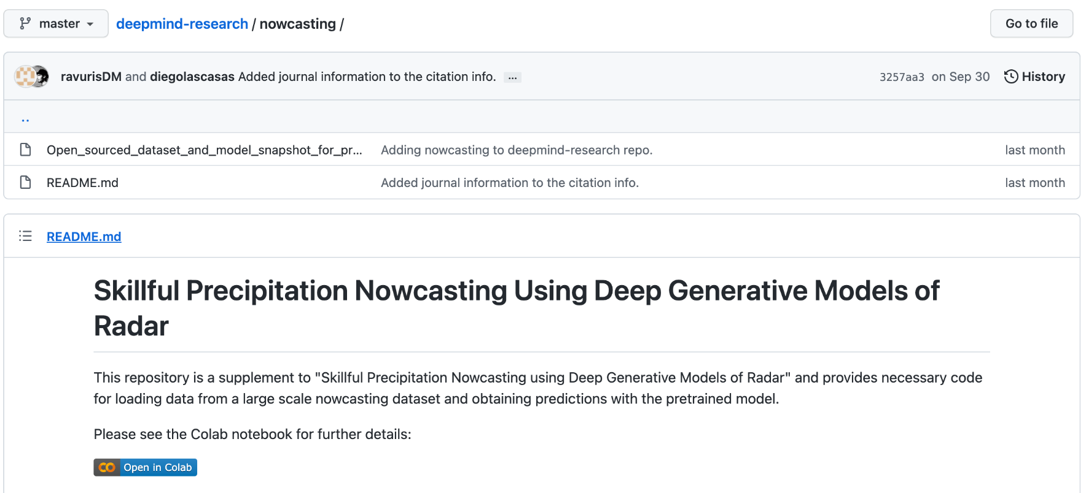
Thank you!
Reach out: ravuris@deepmind.com
UK model, data, and Colab available at: https://github.com/deepmind/deepmind-research/tree/master/nowcasting
Notes:
You can play with our UK model, with corresponding data and colab, as well as read the pseudo-code, on GitHub.

Slide 68
Parting Thought
“All models are wrong, but some are useful”
George Box (Statistician)
Notes:
Precipitation nowcasting.
We know that precipitation nowcasting is the high-resolution forecasting of rainfall up to two hours into the future. It is crucial for weather-dependent decision-making.
Nowcasting informs the operations of a wide variety of sectors, including flood early-warning systems, air traffic control and marine services, emergency services, energy management, etc.
We believe that that the nowcasting problem is interesting from a data science perspective for three distinct reasons:
For nowcasting to be useful in these applications the forecast must first, provide accurate predictions across multiple spatial and temporal scales.
Second, they must account for uncertainty and be verified probabilistically,
and third, perform well on heavier precipitation events that are rarer, but do more critically affect human life and economy.

Slide 69
Parting Thought
“All models forecasts are wrong, but some are useful”
We should think about how to better measure data-driven approaches!
Notes:
Precipitation nowcasting.
We know that precipitation nowcasting is the high-resolution forecasting of rainfall up to two hours into the future. It is crucial for weather-dependent decision-making.
Nowcasting informs the operations of a wide variety of sectors, including flood early-warning systems, air traffic control and marine services, emergency services, energy management, etc.
We believe that that the nowcasting problem is interesting from a data science perspective for three distinct reasons:
For nowcasting to be useful in these applications the forecast must first, provide accurate predictions across multiple spatial and temporal scales.
Second, they must account for uncertainty and be verified probabilistically,
and third, perform well on heavier precipitation events that are rarer, but do more critically affect human life and economy.

