Slide 1
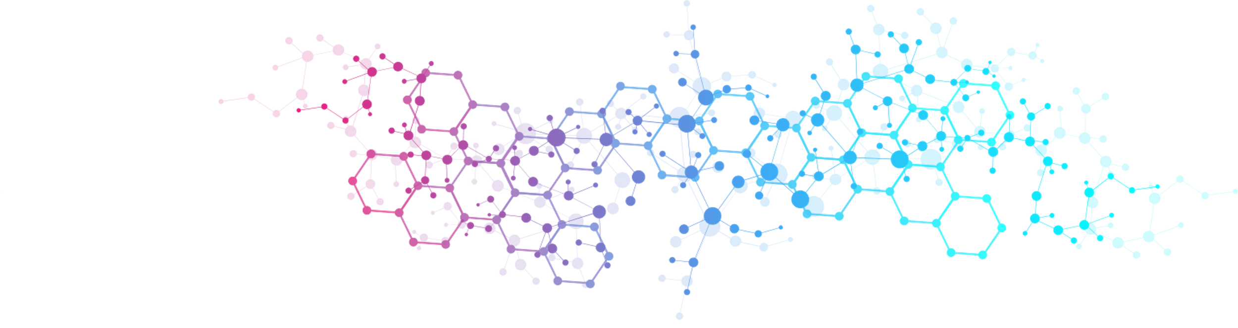

Deep Learning for Molecules and PDEs
Max Welling
Microsoft Research
Universiteit van Amsterdam

Slide 2
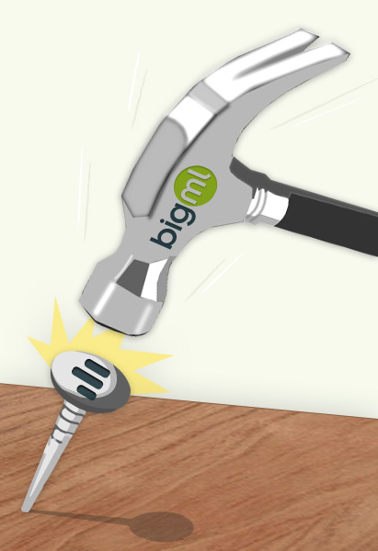
Overview
Introduction Deep Learning Hammers
Molecular Simulation
Neural PDE Solving

Slide 3
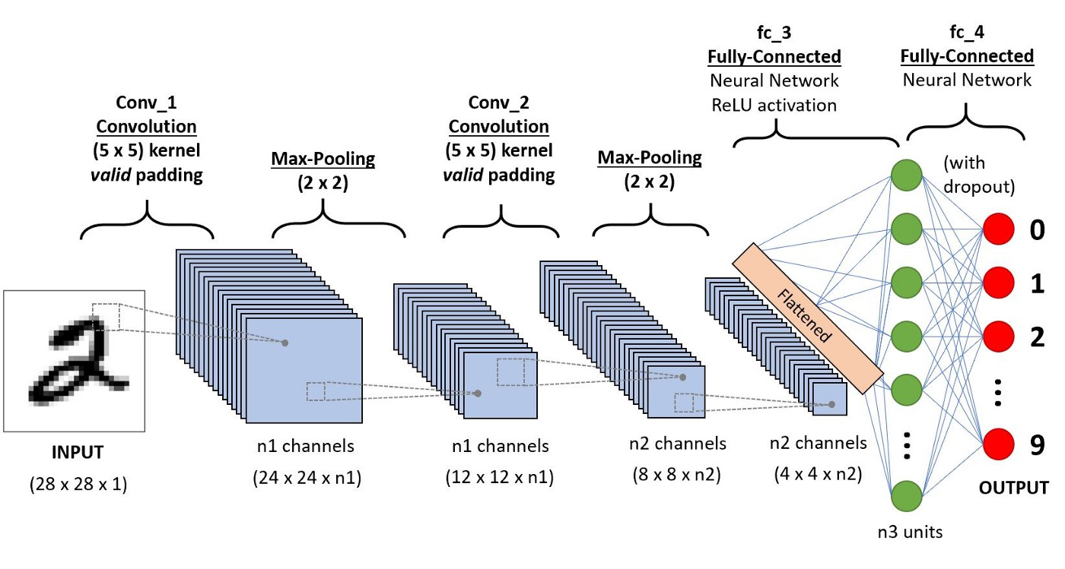
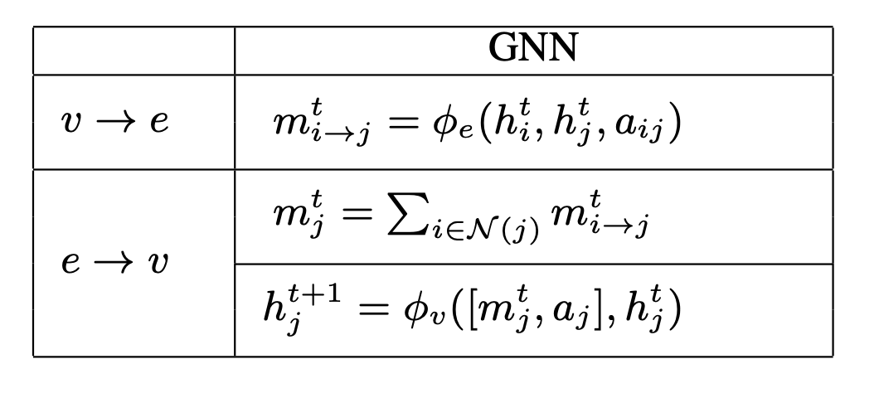
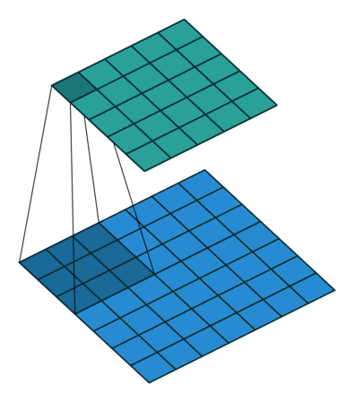
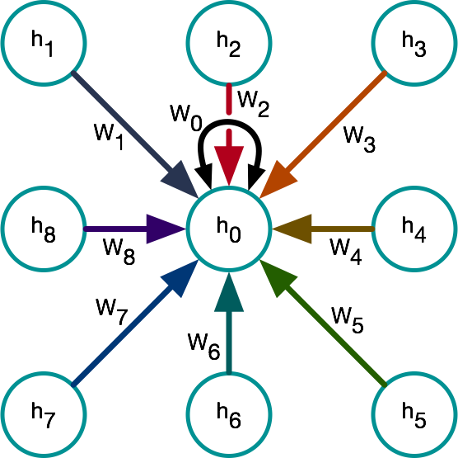
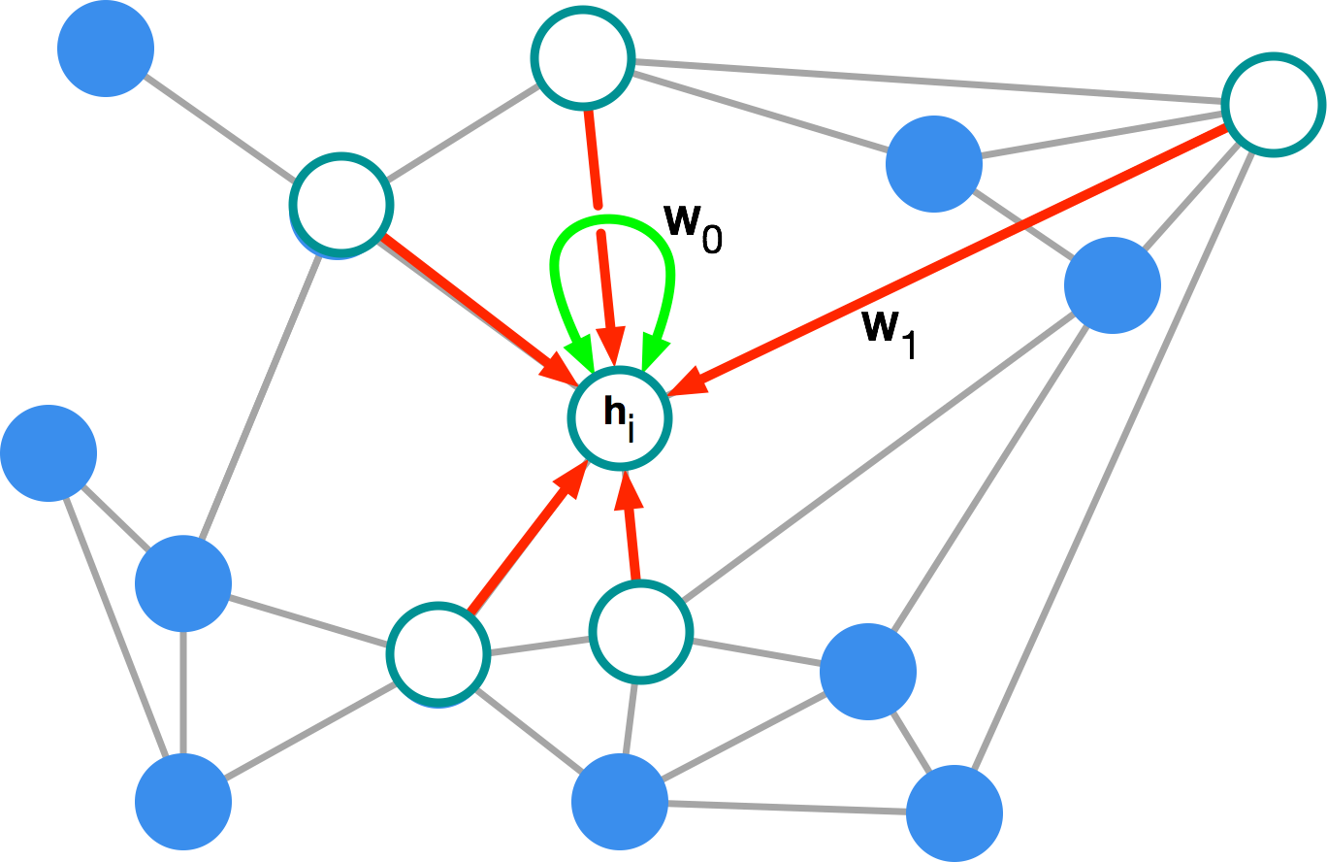
Hammer 1: Graph Neural Networks
Convolutional Neural Network
=
Convolution on a set
Convolution as
message passing
Graph
convolution
Convolution
3

Slide 4
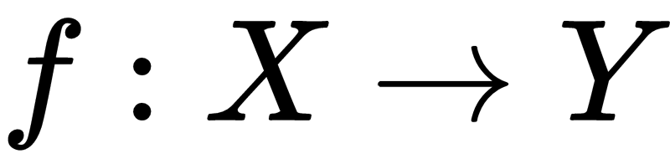
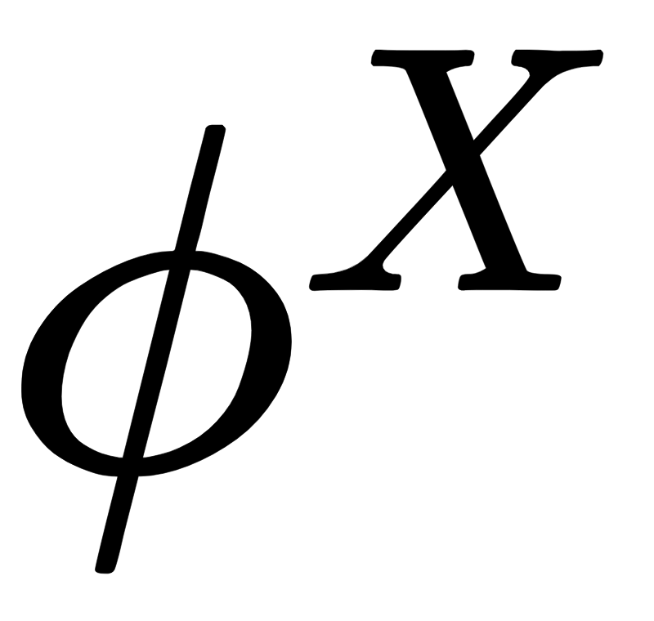
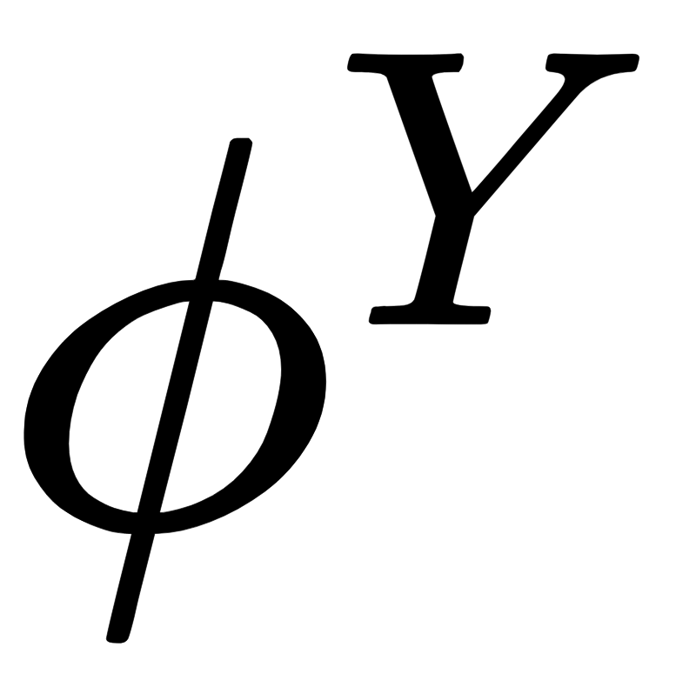
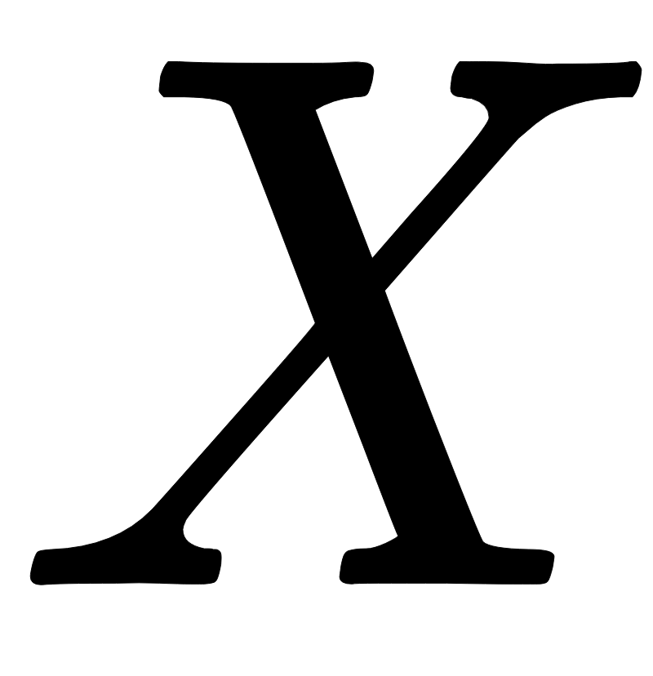
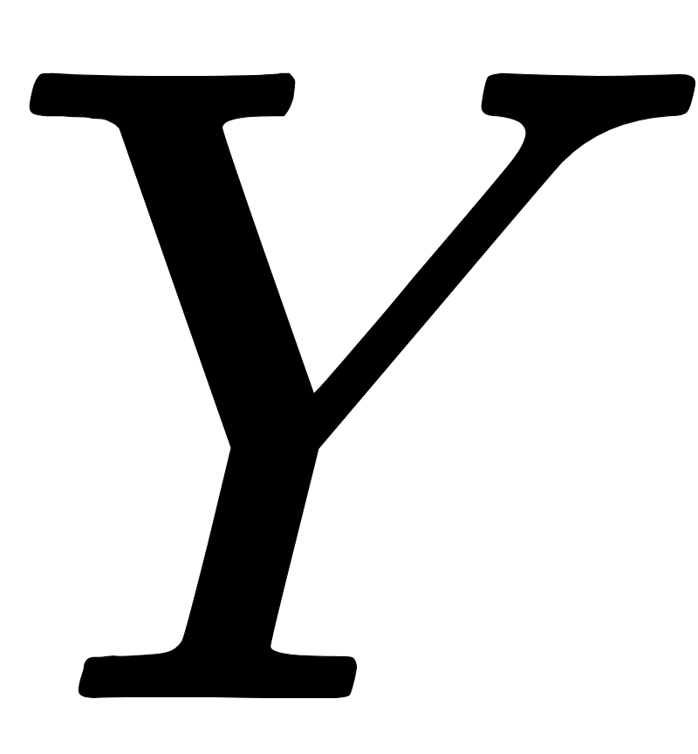

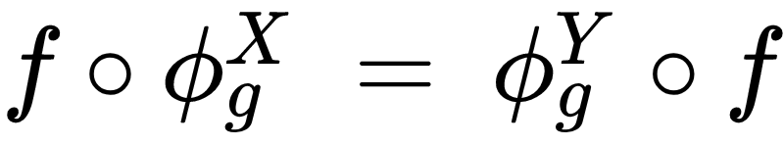
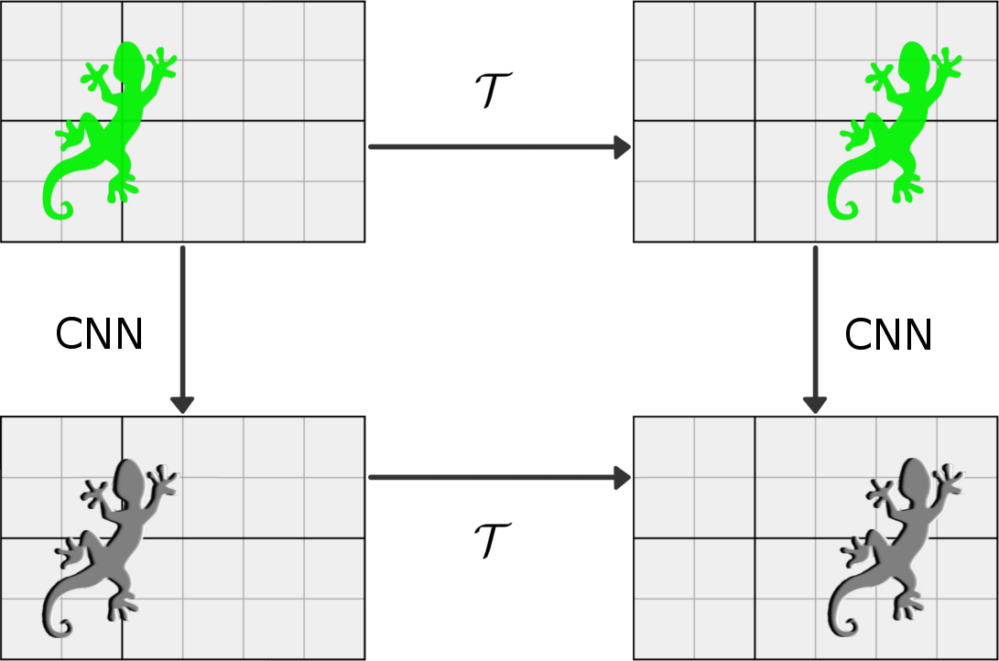
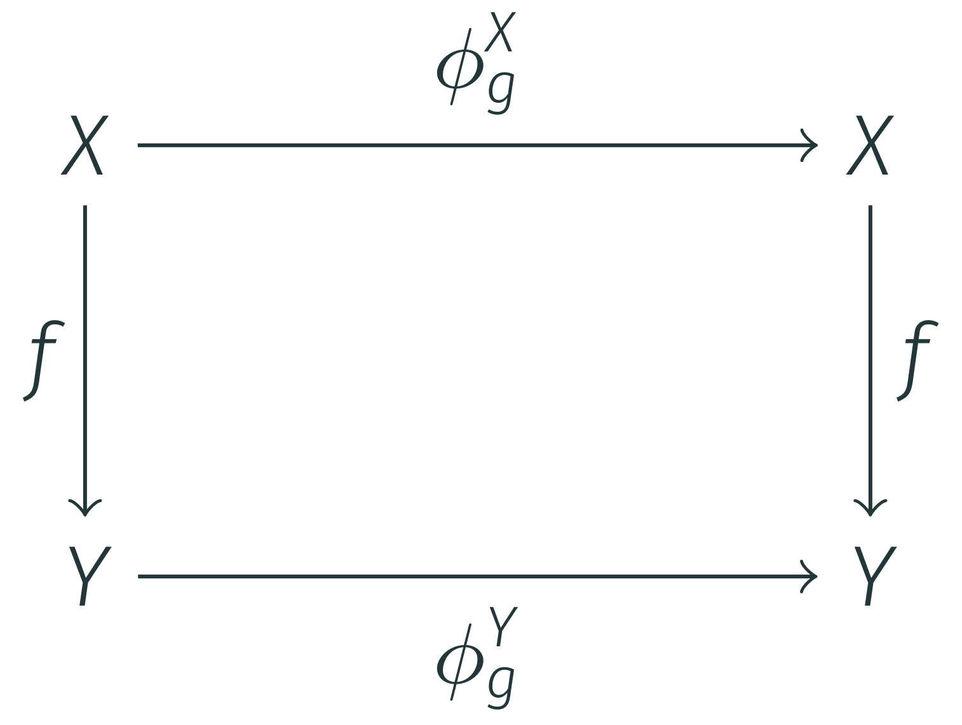
Equivariance
let be a function and and be transformations on and
then is said to be equivariant iff

Slide 5
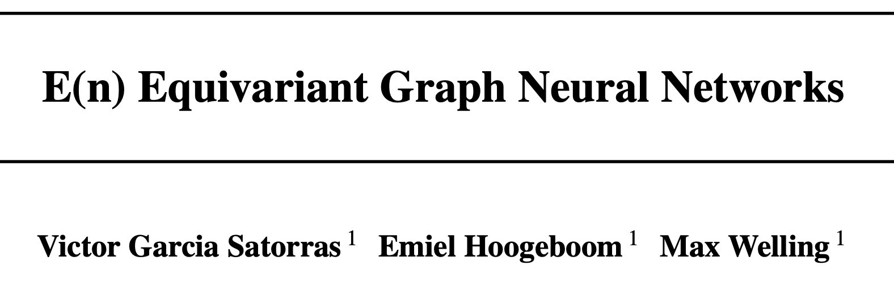
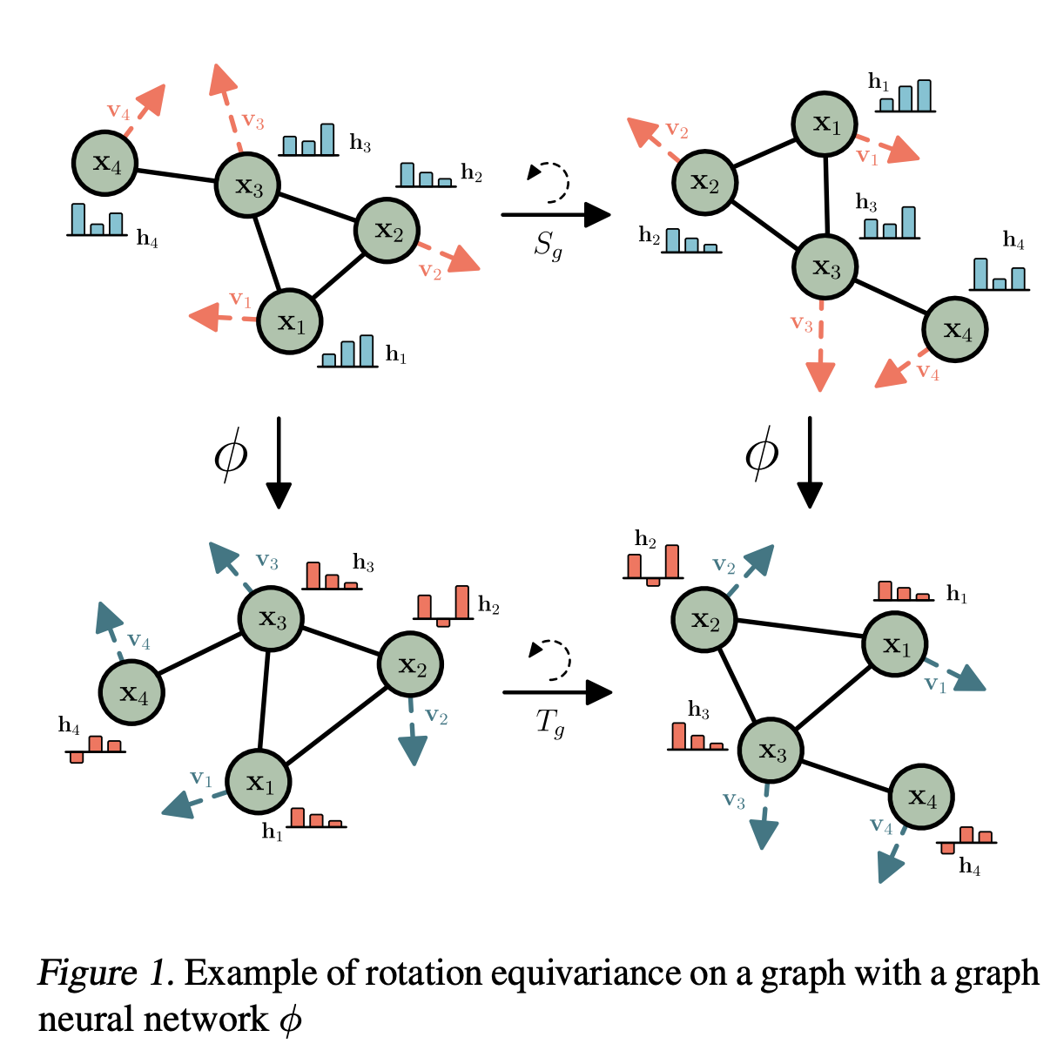
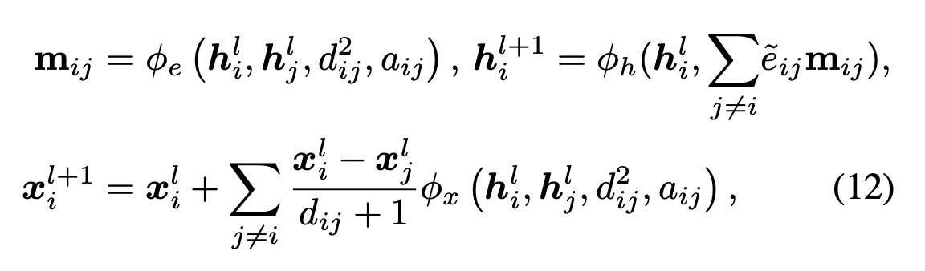
Hammer 2: Equivariant Graph Neural Network

Slide 6
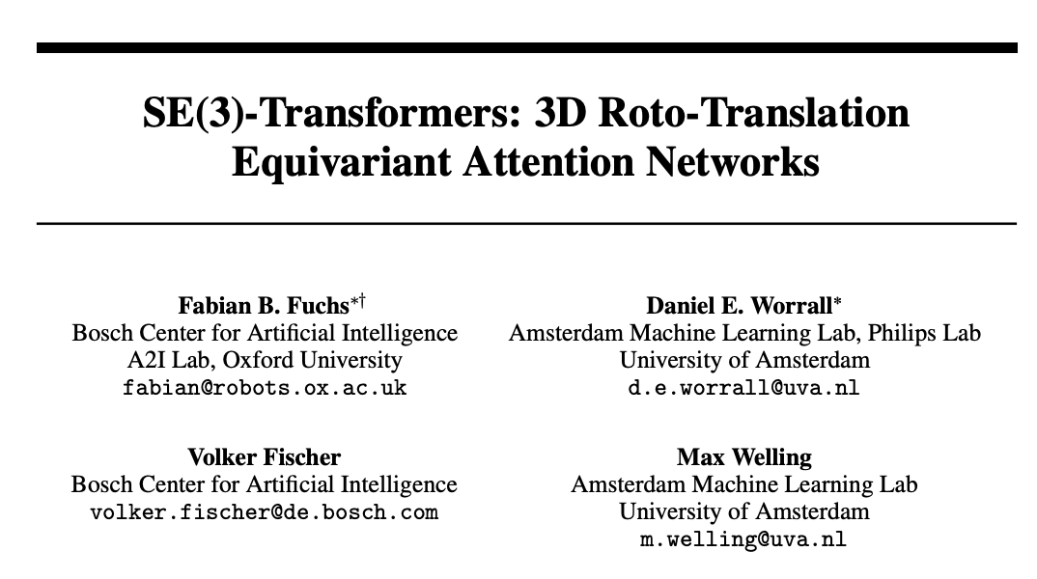
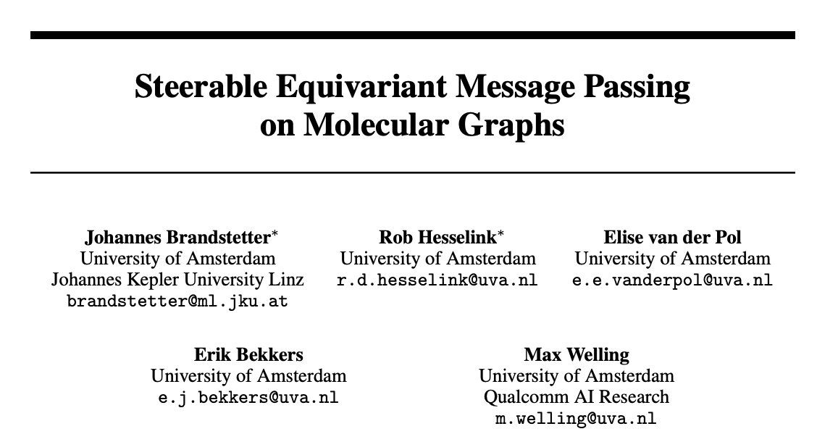
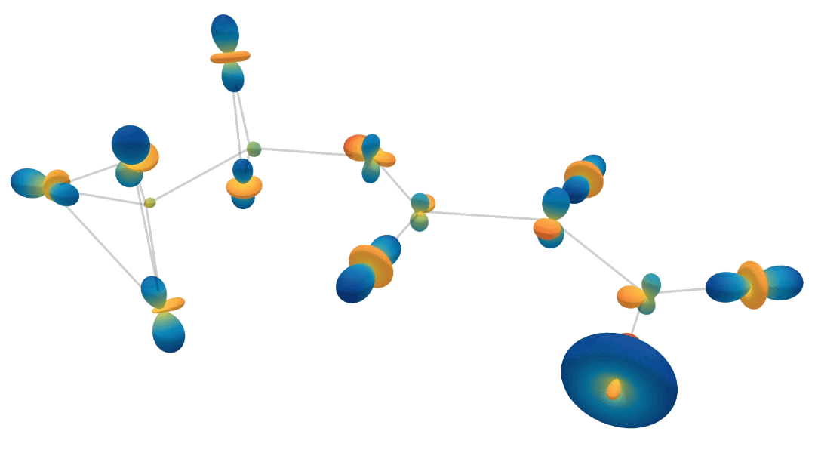
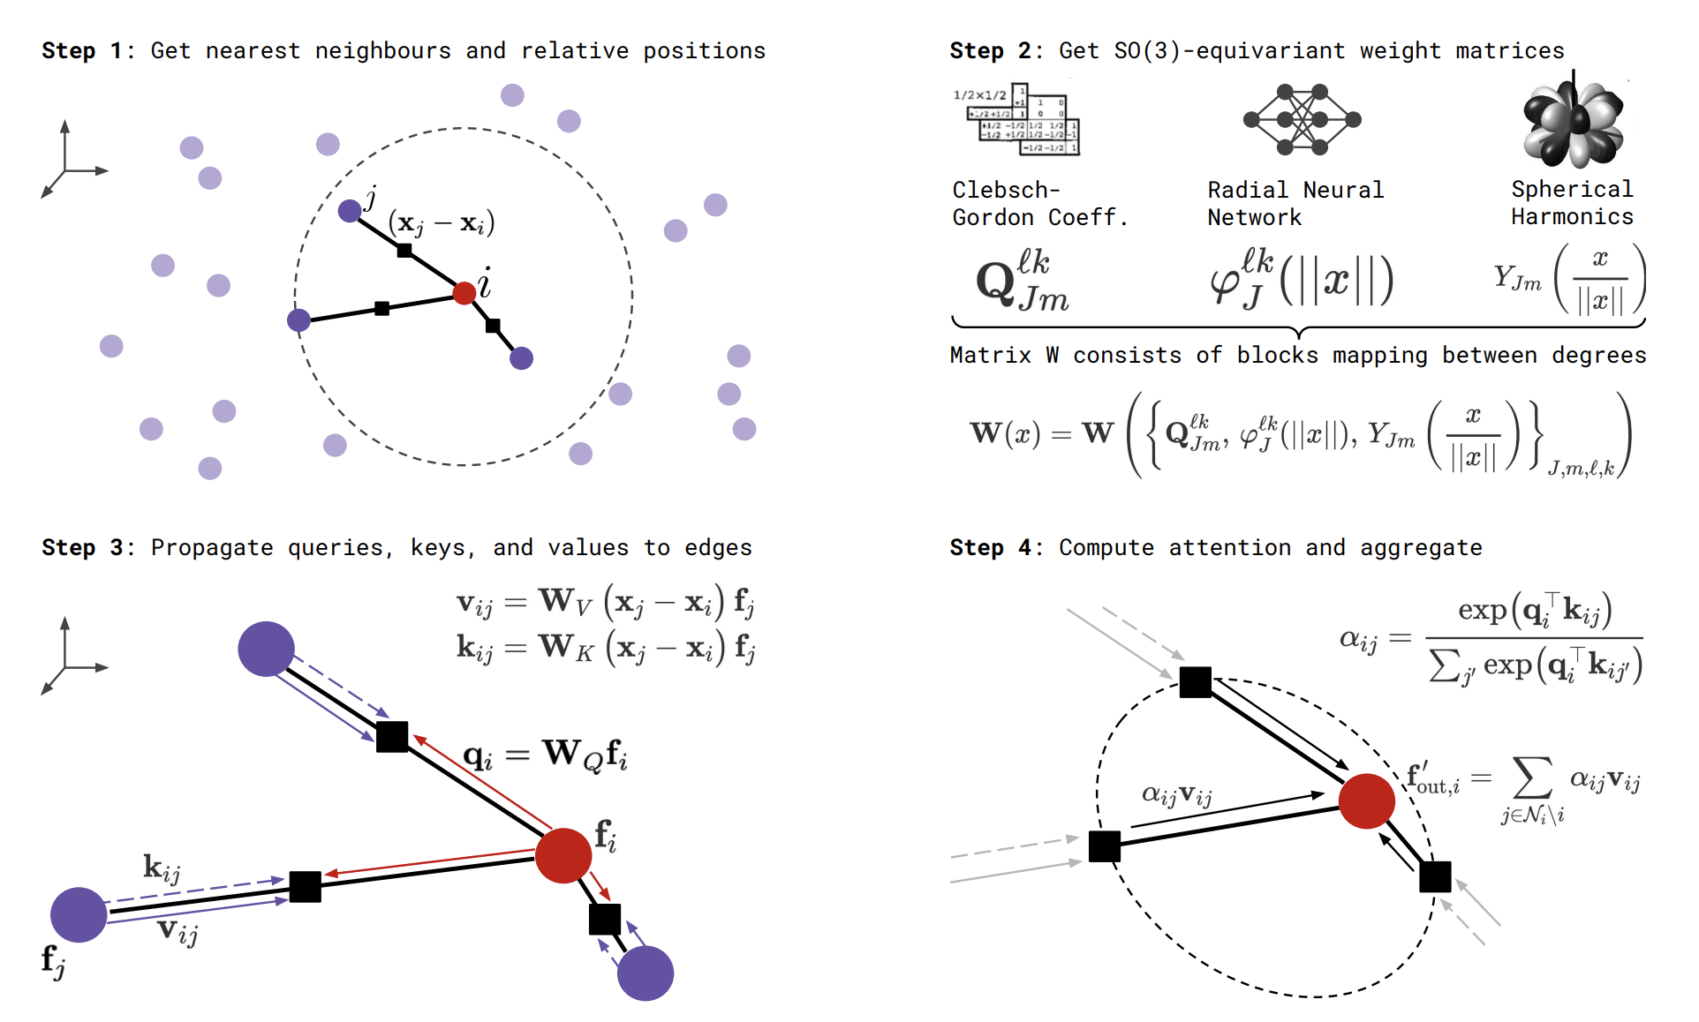
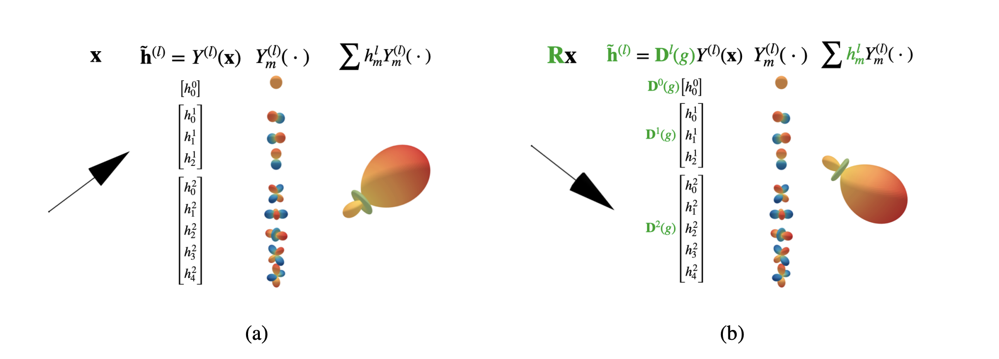
Further Reading Equivariant GNNs
Generalized SE(3) Equivariant GNNs using higher order irreducible representations.

Slide 7
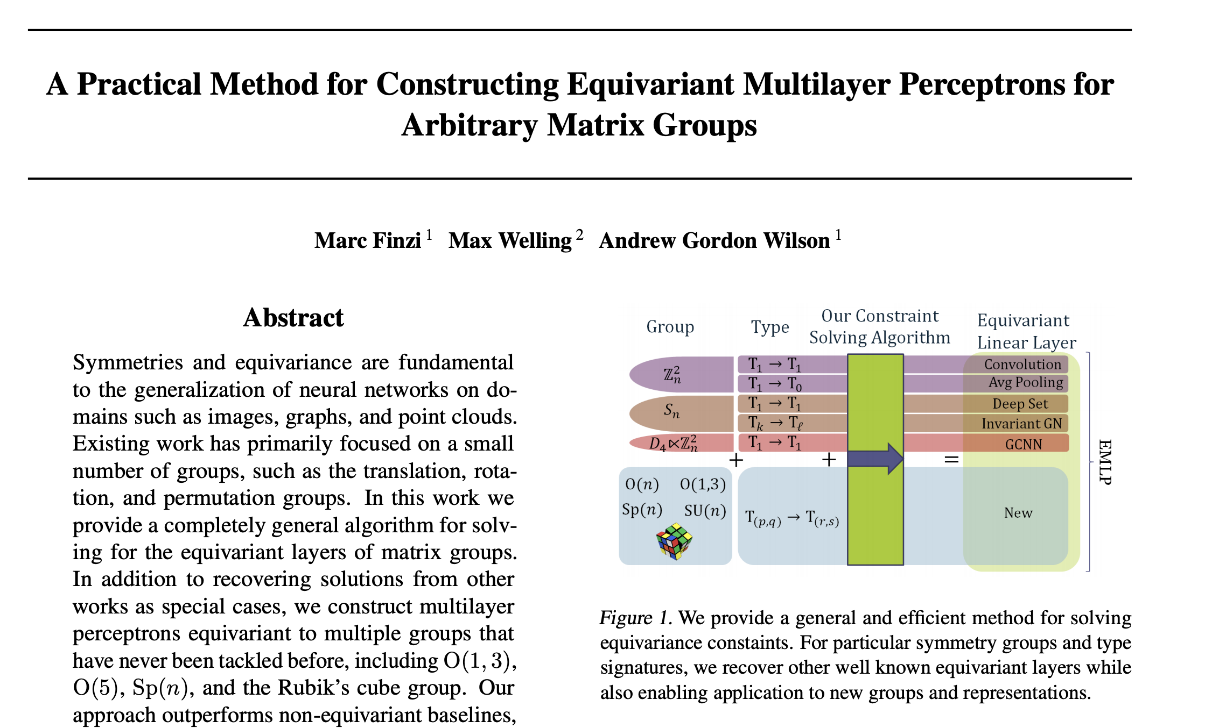
Further Reading Equivariance (+software)
Rubik’s Cube Group has > 4E19 elements
(and 6 generators)
Input: generators of your group in a representation space (Lie algebra, finite group generators)
Output: an equivariant basis of convolutional kernels for that group

Slide 8
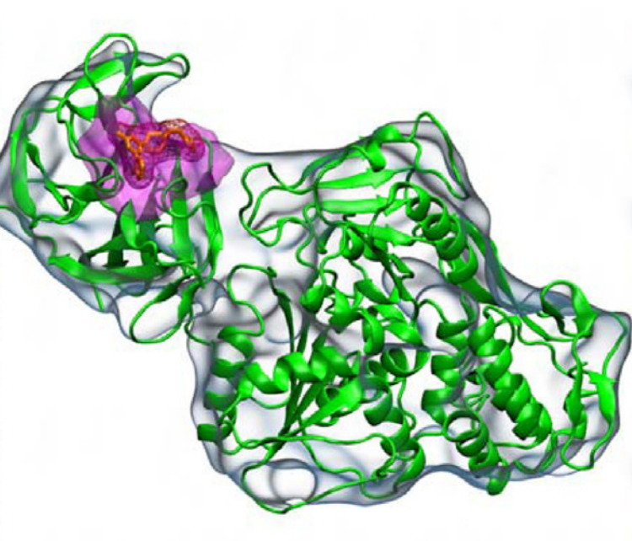
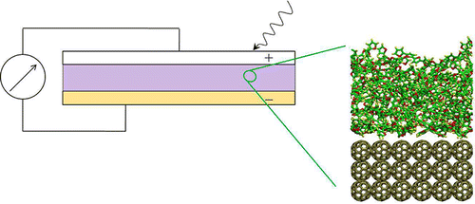
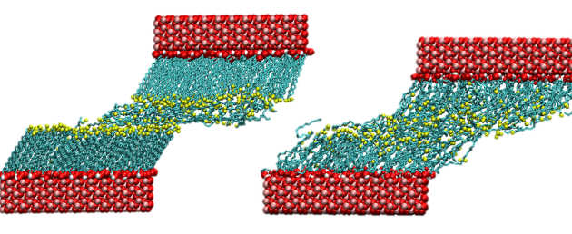
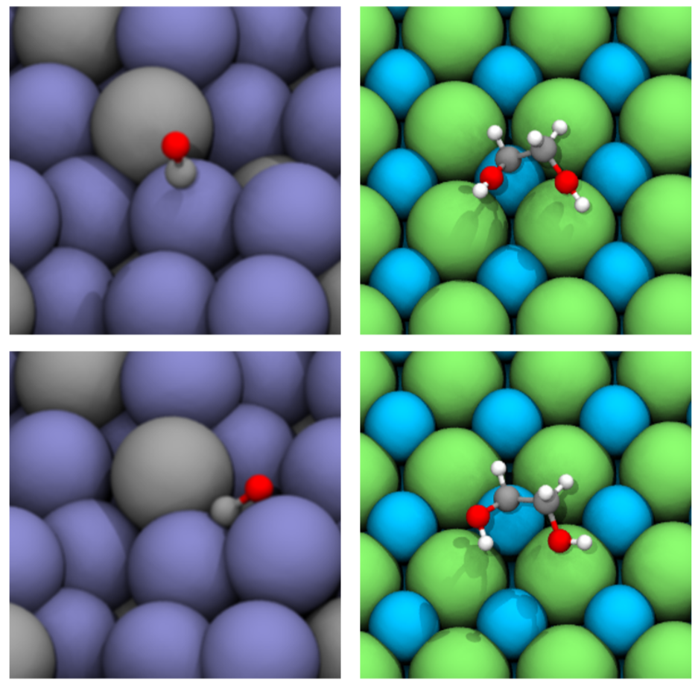
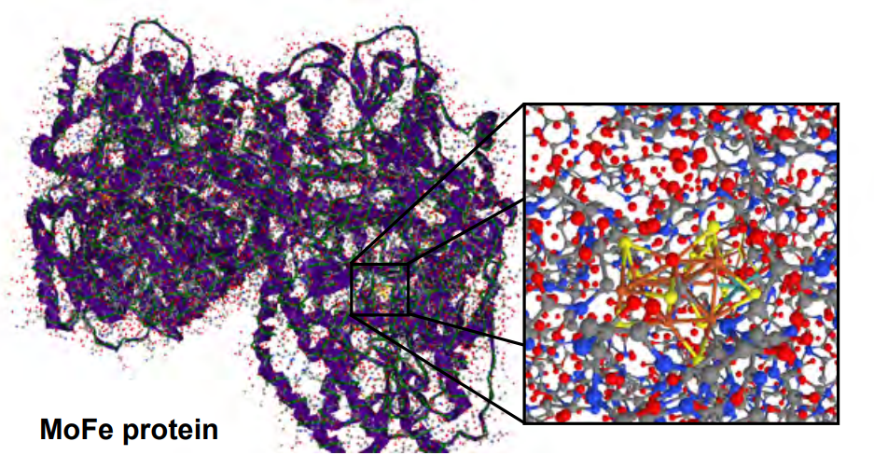
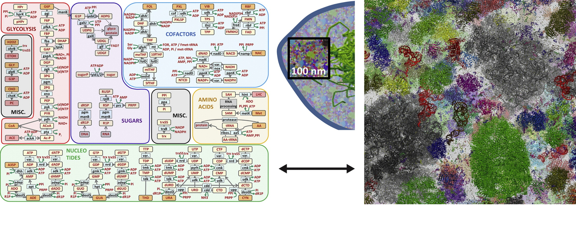
Topic 1: Molecules
Everything material is made of molecules*
Molecules are at the root of solving many of the health, environmental and climate challenges we are facing today.
* Except 4 fundamental forces (electromagnetic force, gravity and strong & weak nuclear forces), and unless you break them up (plasma, quarks/leptons)
Drug discovery
Photovoltaics
Tribology and lubricants
Markus Reiher et al. PNAS 2017;114:29:7555-7560
S.Y Reddy et al. Synthetic Metals 162, 23, 2012, 2117-2124
James Ewen, Tribology Group, Imperial College London
Catalyst design (e.g., fuel cells)
Nitrogen fixation
Whole cell modelling
Lowik Chanussot et al. ACS Catal. 2021, 11, 10, 6059–6072
Michael Feig et al. Mol Graph Model. 2015 May ; 58: 1–9
Shaher Bano Mirza et al. Journal of Molecular Graphics and Modelling 2016

Slide 9

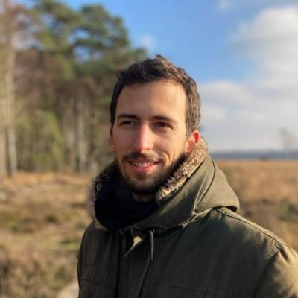
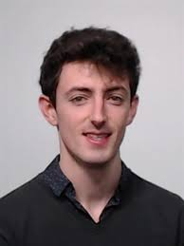
The Brilliant Minds Molecule Generation
Emiel Hoogeboom
Victor Garcia Satorras
Clément Vignac

Slide 10
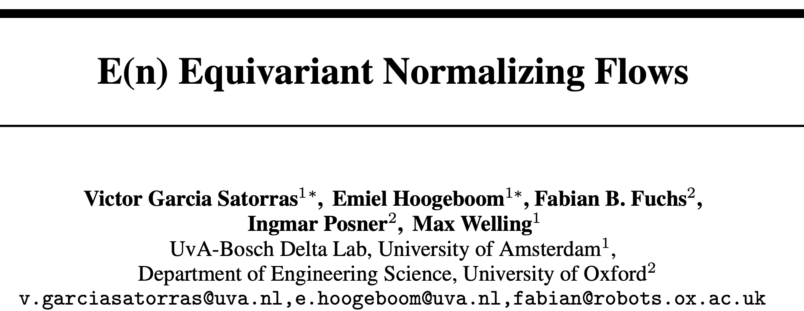
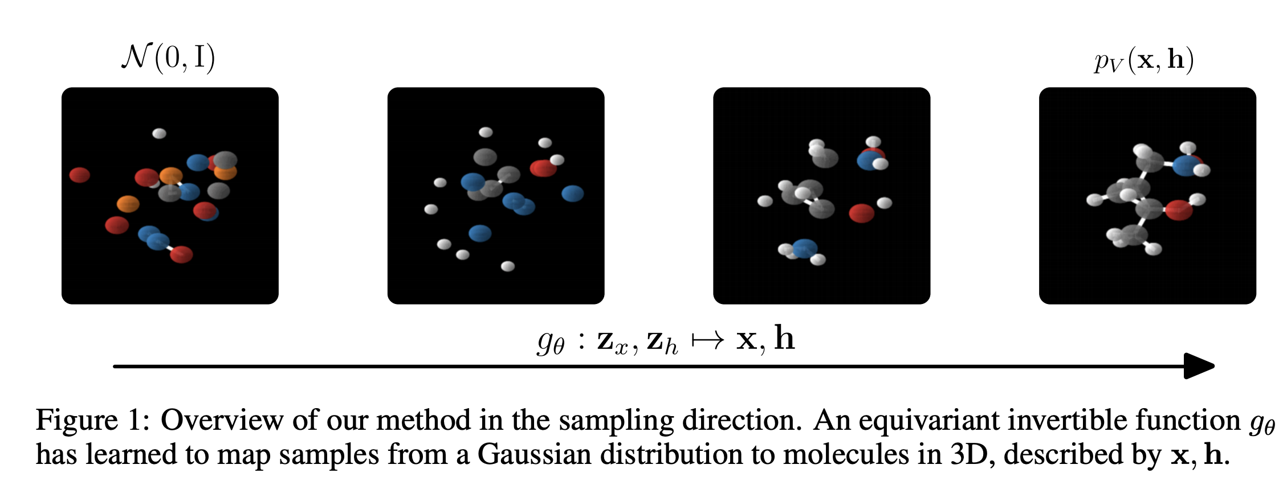
Equivariant Normalizing Flows

Slide 11
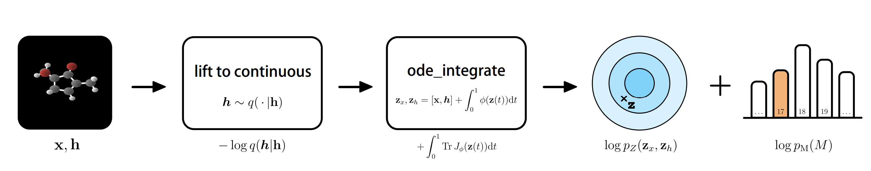
Overview
Dequantization of
discrete variables
Categorical over nr of
atoms in molecule

Slide 12
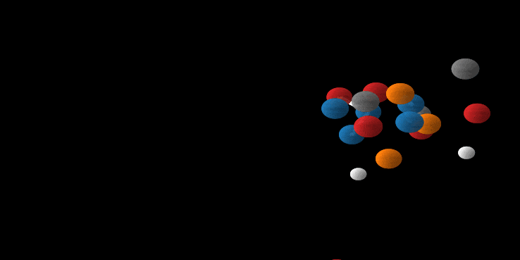
Animation

Slide 13
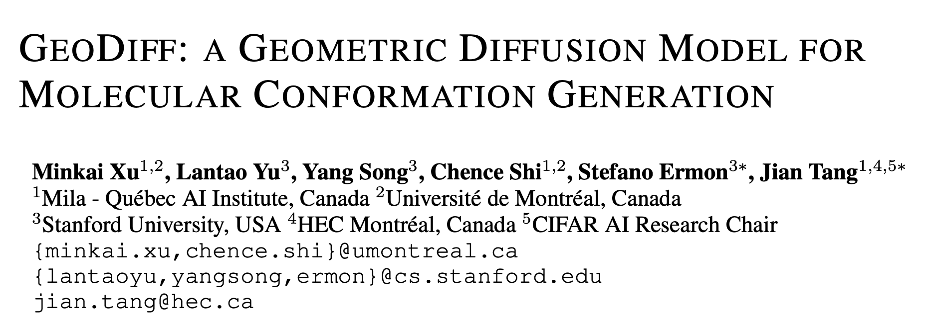
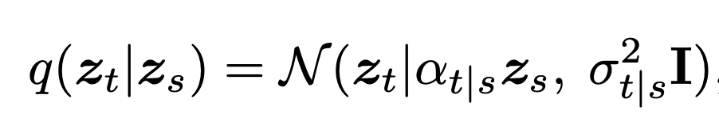
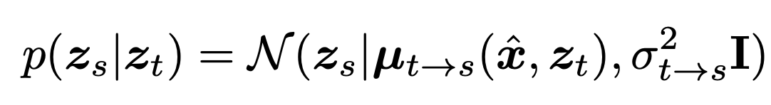


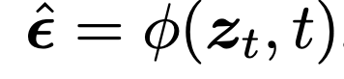
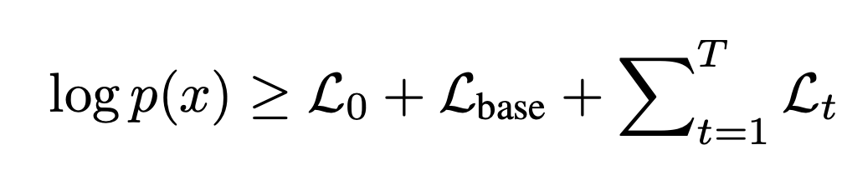
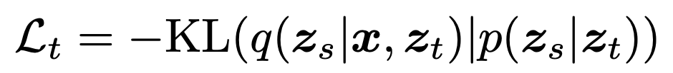
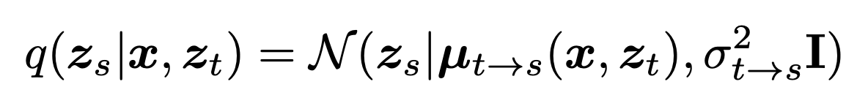
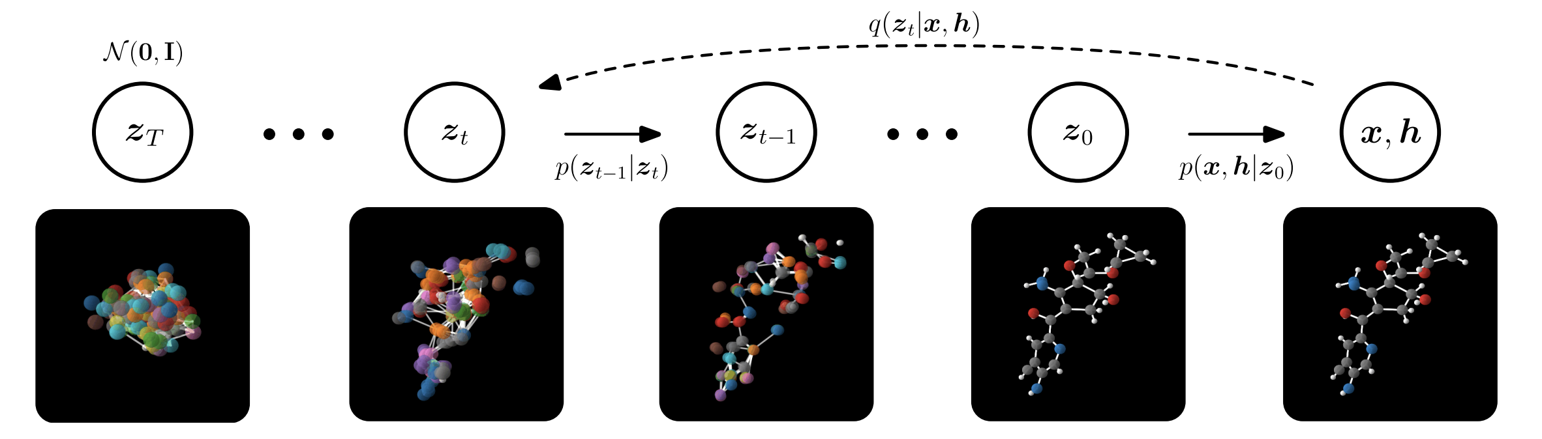
Diffusion Based Generative Models
Encoder (ennoiser)
Decoder (denoiser)
Objective
(EGNN Model)

Slide 14
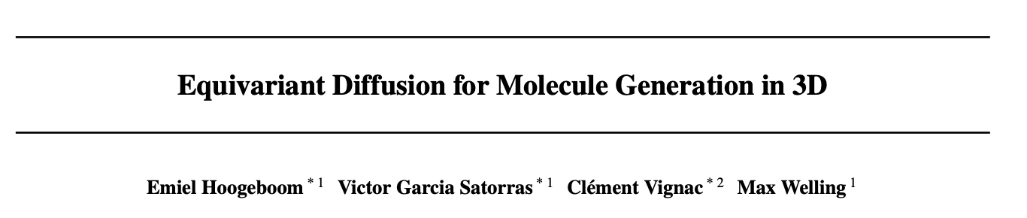
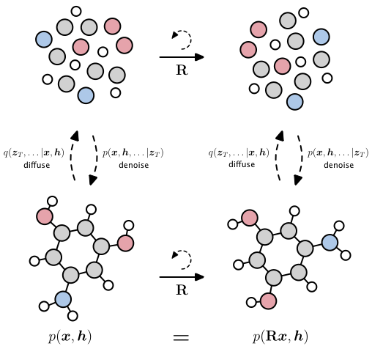
Equivariant Diffusion Models

Slide 15
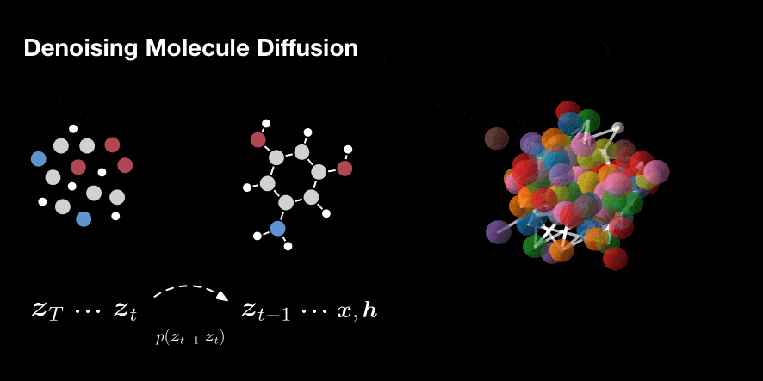
Diffusion Models

Slide 16
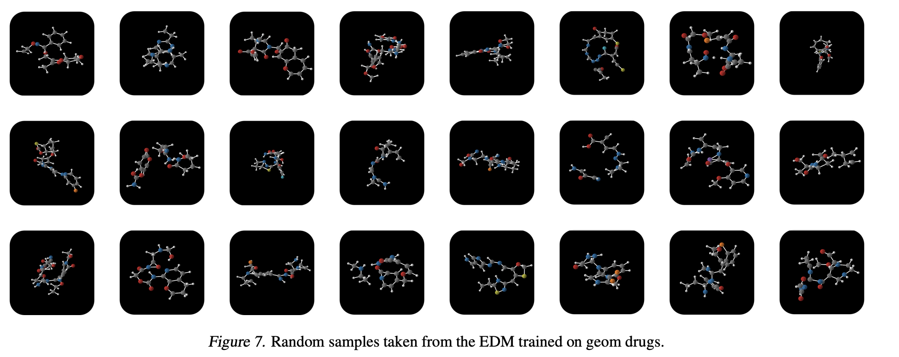
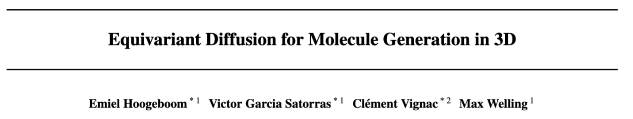
Molecule generation

Slide 17
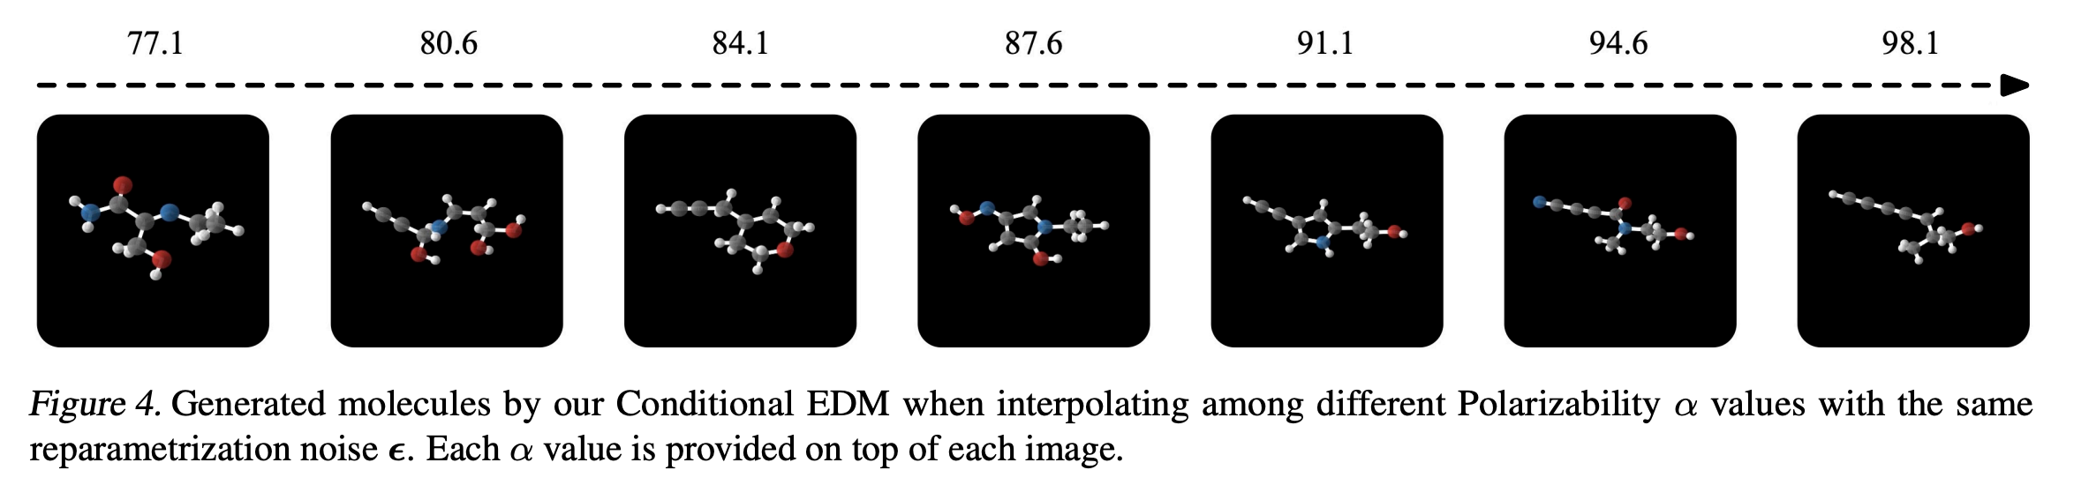

Holy Grail: Conditional Generation
Generate drug molecules with given properties (binds to disease, non-toxic, easy to synthesize)
Generate material with prescribed properties (biodegradable, strong, binds to CO2, catalyzes a reaction)
Proposal distribution in MCMC chain (given current state, skip 8 orders of magnitude in MD simulations)
…
Split data in two subsets
Train property classifier f on A
Train generative model g on B
Generate x~g, test → f(x)
f(random)
f(N)
f(B)

Slide 18
Conditional Generation is Hard (but = holy grail)
Z_{T}
Z_{T}
Y
Y
Y
Sampling
Mixture
Density
Network
Deterministic
NN
…
…
…
…
Z_{t}
Z_{t}
Z_{t}
Z_{t}
N
Sampling
Equilibrium
Distribution
Sampling
Conditional
Distribution
…
…
…
…
X
X
X
X

Slide 19








Topic 2: Partial Differential Equations
PDEs and ODEs are used throughout the sciences to describe the evolution of systems of interest.
Earthquakes
Heart dynamics
Weather prediction
Galaxy collisions
Plasma physics
Airplane design
Electronic structure
Tumor growth

Slide 20


Briilant Minds Neural PDE Solvers
Erik Bekkers
Johannes Brandstetter
Daniel Worrall

Slide 21



Numerical Solvers
Requirements:
  Accuracy
  Stability over long rollouts
  Speed
  Computational cost
  Easy to use
  Uncertainty quantification
  Generalize across:
    Initial conditions
    Boundary conditions
    PDE parameters
    Integration grid resolution
    Integration grid regularity
    Geometry
    Topology
    Dimensionality
  …

Slide 22




Solving PDEs with GNNs
Formulation of a PDE:
Special case: PDE in conservation form:
(change in u is stuff flowing into region
minus stuff flowing out of that region)

Slide 23




Numerical Solvers
Lots of very good solvers around specialized for certain equations (splitter field)
Often, these solvers are very expensive to run (however, they often come with error guarantees)
Neural solvers learn to solve from “data” (from classical solvers) and then generalize to new context.
Classical PDE solvers:
  Grids and cells
  Method of lines
  Finite Difference methods
  Finite volume methods
  …
Neural PDE solvers:
  Neural operator methods
  Autoregressive methods

Slide 24





Two Recent Neural Solvers
FNO: Fourier Neural Operator
AR: Learn stencils
to approximate
derivatives.

Slide 25


Training a Neural PDE solver
Generate ”data” from classical solver.
Train model by minimizing Loss function:
with
We train to predict the right answer
from a noisy input.
Noise is given by numerical integration
errors.
Temporal bundling: predict many
timesteps in together.

Slide 26




Encode – Process - Decode

Slide 27

Experiment
1d parameterized PDE.
Includes heat eqn., Burgers’ eqn. and KdV eqn.
Discretization:
Ground truth = Weno5 + Runge-Kutta

Slide 28

Burger’s equation with Shock waves

Slide 29

Generalizing to new PDEs

Slide 30

Navier Stokes in 2D

Slide 31




Data Augmentation from Symmetries
Neural PDE solvers need expensive data to train a model.
Amortization/learning only makes sense if we can generalize to new ICs, BCs, PDE parameters etc.
We need cheap ways to enlarge our datasets so we can generalize better with less effort.
Solution: exploit symmetries to generate new data from old data!
Symmetries:
KdV Eqn. (periodic BC)

Slide 32


Data Augmentation from Symmetries

Slide 33
Why AI4Science? A Huge Opportunity!
AI4Science
Quantum Computing
Machine Learning
Sustainability
Computational Chemistry
Molecular Biology
Science
Condensed Matter Physics
A convergence of science, modelling technology and applications!
A “golden age” of designing new materials/chemicals/catalysts/drugs?
A Cambrian explosion of new materials?
Exciting applications in highly relevant
domains
Computational Science
Energy
Health
Application
Modeling
Technology
Notes:
Imagine a world where you order
any desired material/drug on demand?

Slide 34

Microsoft Research Amsterdam
Thank you for your attention. Questions?
Notes:
Fourth piece of exciting news: for first time in 25 years, setting up new MSR lab in Europe
Satellite lab of MSR Cambridge, Max Welling will be scientific lead
Particular interest in climate change, so close collaboration with MSR Cambridge and other labs including MSR Asia Beijing,
but we may emphasise drug discovery due to Novartis etc,
with Amsterdam emphasising more sustainability applications, but core research will be across all labs.
We’re hiring – posting roles today – follow up email with further information.

