Slide 1
Some nuclear physics opportunities
with PERLE@Orsay and the perspectives it would open
David Verney – IJCLab Orsay
The electromagnetic probe in nuclear physics
Electron scattering off nuclei (unstable nuclei ?)
PERLE@Orsay as an opportunity

Slide 2
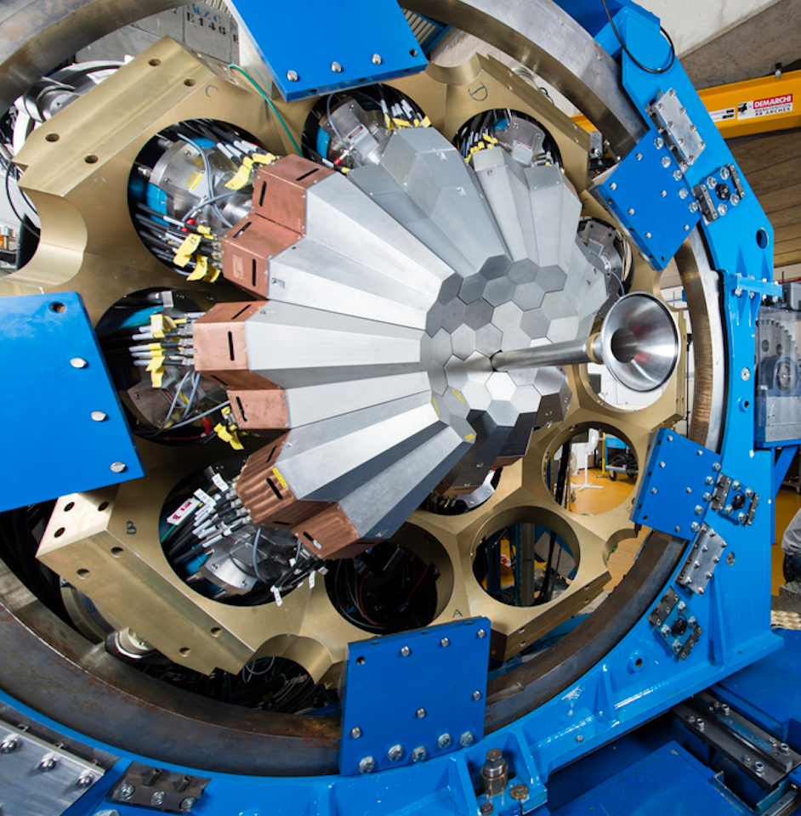
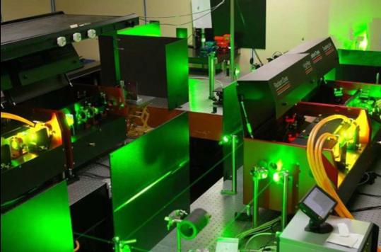
The electromagnetic probes in nuclear physics
• ion manipulation with em fields: mass measurements
• interaction with the hyperfine field : laser spectroscopy, nuclear orientation→ I^{(π)},μ, Q_{s}, δ<r²_{c}>
• γ-spectroscopy : lifetimes, B(Eλ), B(Mλ)
• e- scattering
→ Precision physics, the probe is perfectly known
Ex. AGATA at ALTO, Caen, France
Ex. Double penning trap MLLTrap at ALTO, Orsay

Slide 3
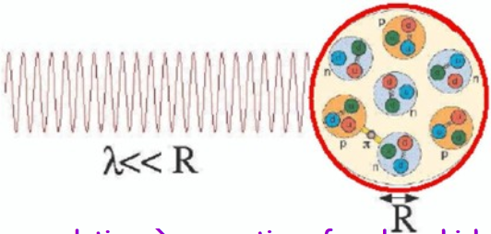
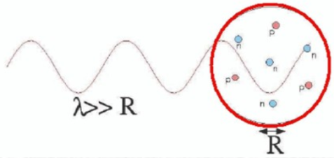
The electromagnetic probes in nuclear physics
• ion manipulation with em fields: mass measurements
• interaction with the hyperfine field : laser spectroscopy, nuclear orientation→ I^{(π)},μ, Q_{s}, δ<r²_{c}>
• γ-spectroscopy : lifetimes, B(Eλ), B(Mλ)
• e- scattering
→ Precision physics, the probe is perfectly known
→ e penetrate deeply without absorption
e momentum transfer q ≈ 1/λ
nuclear physics:
internal structure of the nucleus
E_{e}= 500 MeV → ≈0.5 fm scale
hadron physics:
structure of the nucleon
Single virtual photon exchange (good approximation)

Slide 4
Electron scattering off nuclei
• ion manipulation with em fields: mass measurements
• interaction with the hyperfine field : laser spectroscopy, nuclear orientation→ I^{(π)},μ, Q_{s}, δ<r²_{c}>
• γ-spectroscopy : lifetimes, B(Eλ), B(Mλ)
• e- scattering
→ Precision physics, the probe is perfectly known
→ e penetrate deeply without absorption
Integrated quantities
Spatially dependent quantities

Slide 5
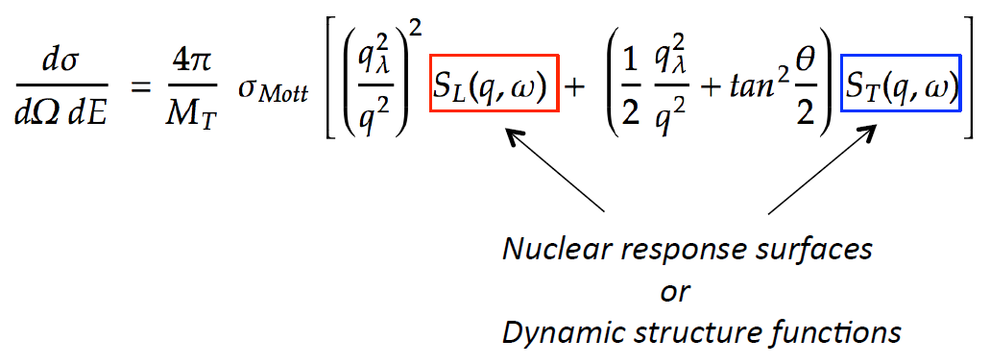
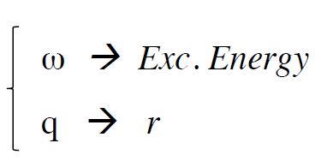
Electron scattering off nuclei
→ Precision physics, the probe is perfectly known
→ e penetrate deeply without absorption
→ what we need to measure

Slide 6
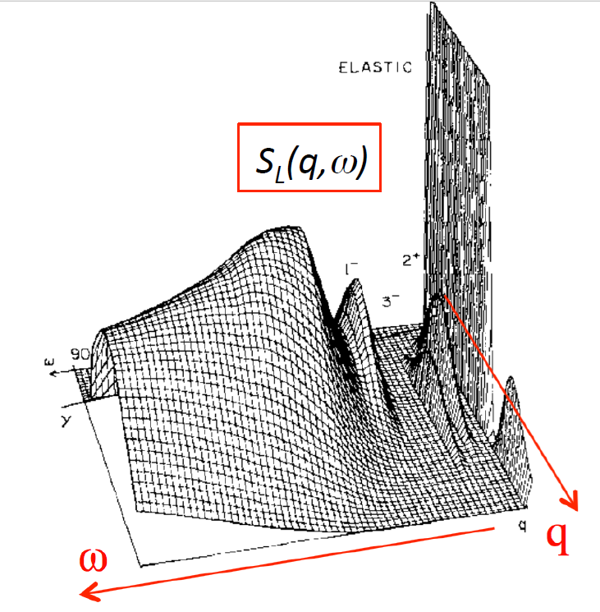
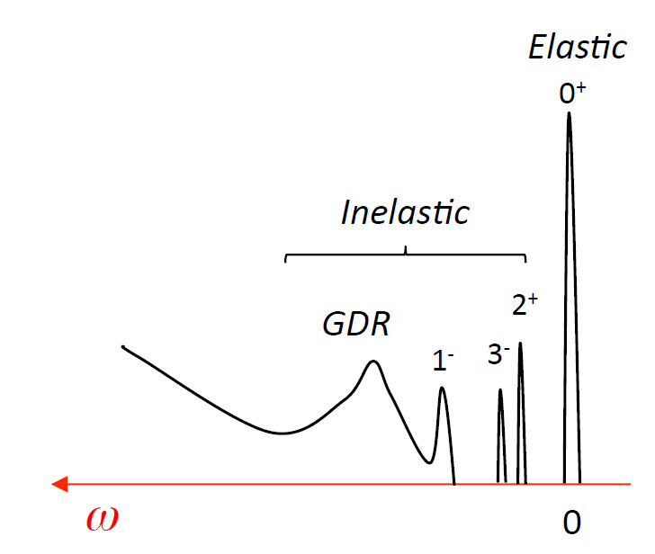
Electron scattering off nuclei
→ Precision physics, the probe is perfectly known
→ e penetrate deeply without absorption
→ what we need to measure

Slide 7
Electron scattering off nuclei
→ Precision physics, the probe is perfectly known
→ e penetrate deeply without absorption
→ what we need to measure

Slide 8
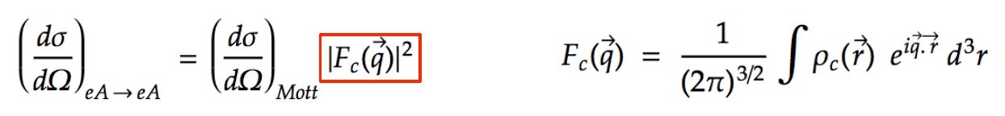
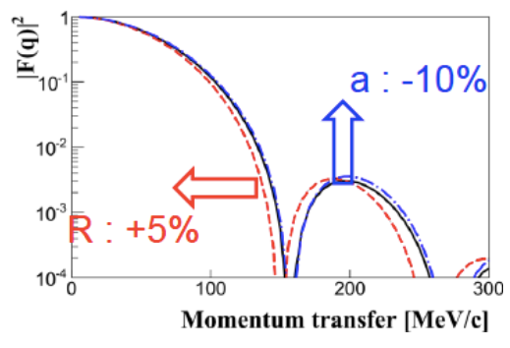
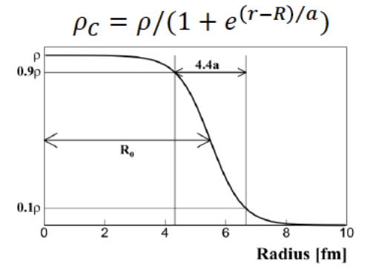
Simple example : elastic scattering
For (ω=0) and J^{π}=0⁺ states
→ access to some aspects of the most fundamental properties of nuclei : saturation properties

Slide 9
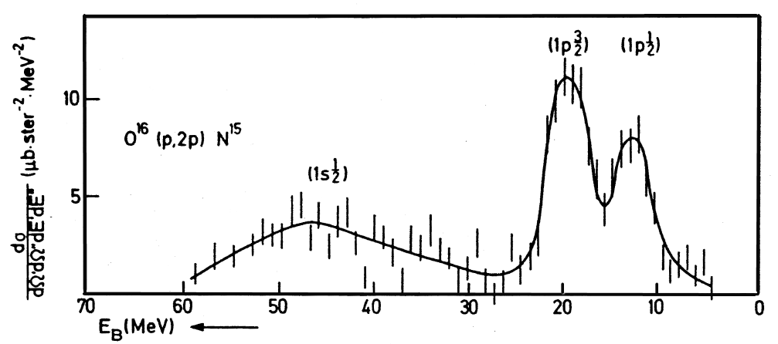
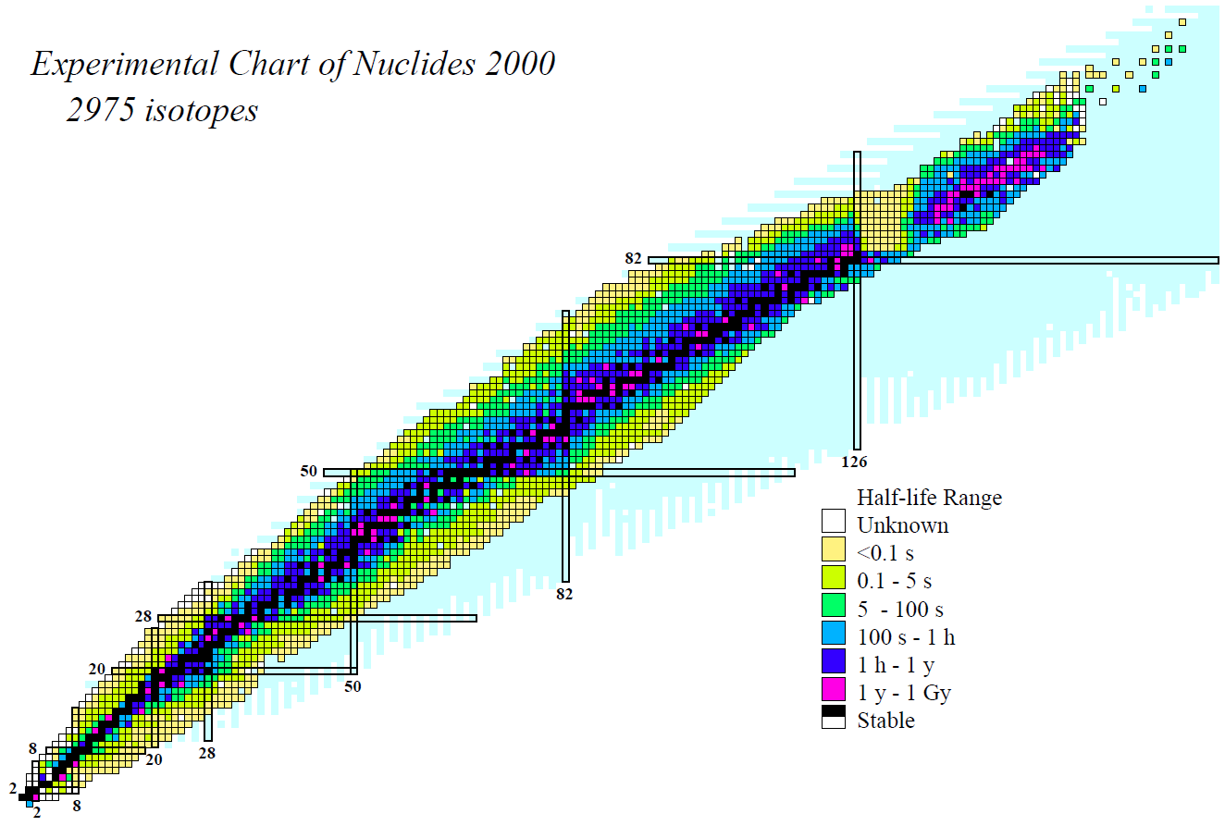
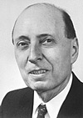
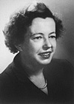
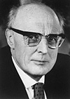
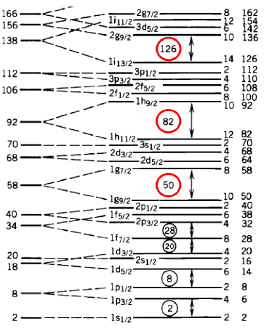
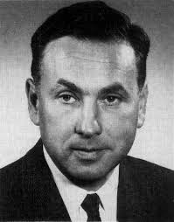


Electron scattering off nuclei
$$ℋ_{CM}=OH+U(r)(\vec{l}∙\vec{s})$$
$$V^{LS}$$
E. P. Wigner
Maria Goeppert-Mayer
J. Hans D. Jensen
82
²⁰⁸Pb
Nobel price 1963
T.A.J. Maris, P. Hillman, and H. Tyren, Nucl. Phys. 7 (1958) 1.
¹⁰⁰Sn
126
in parallel:
50
Nobel price 1961
¹³²Sn
28
82
⁴⁰Ca
R. Hofstadter
1953 : e on Au Stanford
20
¹⁶O
50
⁷⁸Ni
⁴He
⁴⁸Ca
8
28
2
20
8
2

Slide 10
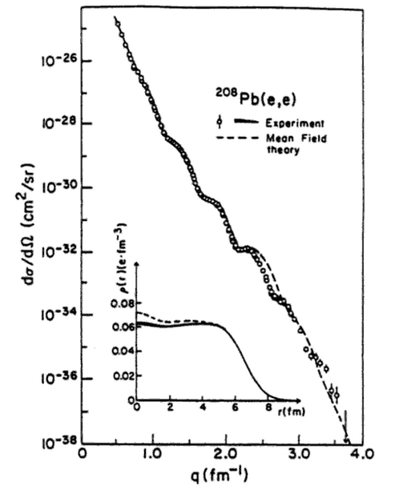
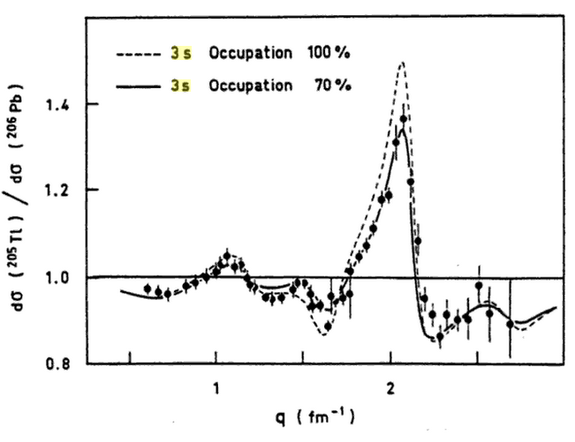
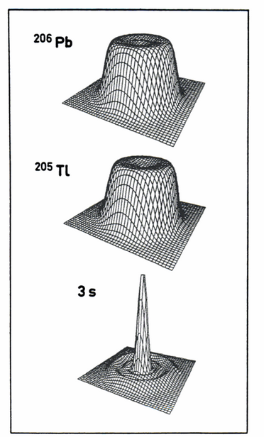
elastic scattering full glory
these measurements have had exceptional moments of glory…on stable nuclei
First “picture” of a “single particle” evolving inside the nucleus
B. Frois et al
in Modern Topics in Electron Scattering
(World Scientific 1991)
revealed in medium effects
(how far a “single particle” is from a free nucleon)
part of the single-particle quenching has well understood origins:
core (collective) couplings, many-body correlations
short-range correlations, non-local part of the potential
kinks, neutron skin and giant haloes formation ?
shell evolution ?
12 orders of magnitude !
B. Frois and Papanicolas Ann. Rev. Nucl. Part. Sci 37 (1987)
Dechargé and Gogny PRC 81 (1980)
Cavedon, Frois, Goutte et al. PRL 49 (1982)
etc…

Slide 11



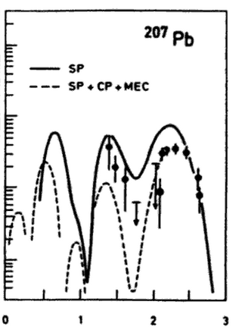


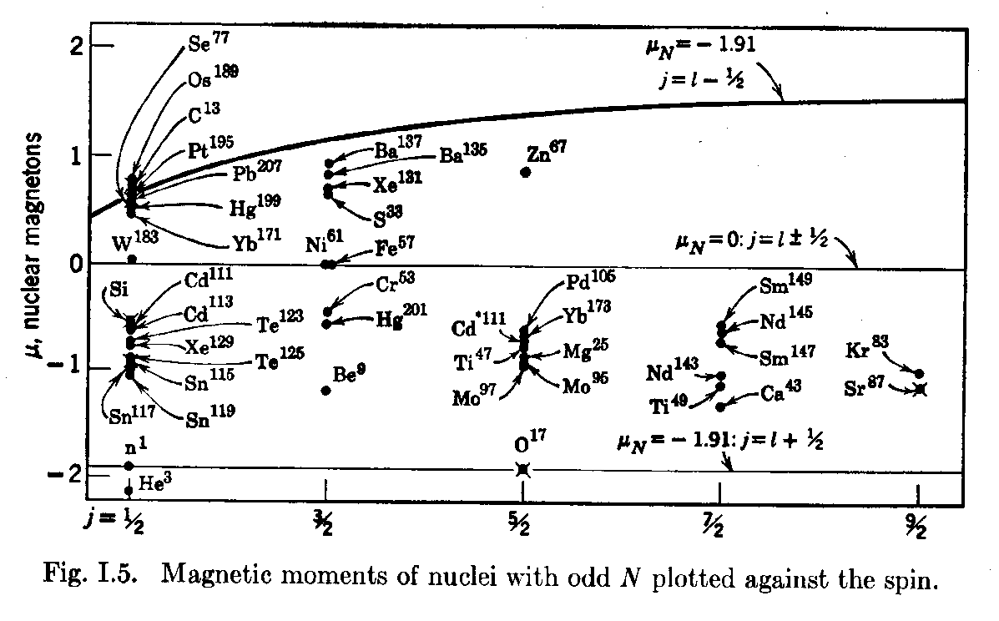

Beyond elastic scattering
A(e,e’) inelastic cross section
point charge nucleus
longitudinal form factor
transverse form factor
recoil factor
charge transition density
current transition density
μ≈F_{M} for q→0 (elastic at 180°)
30% quenching

Slide 12
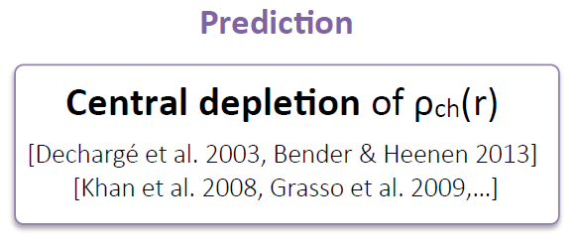
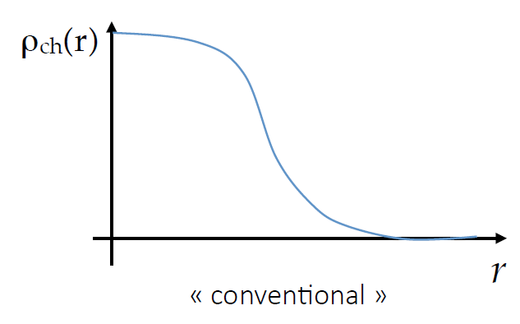
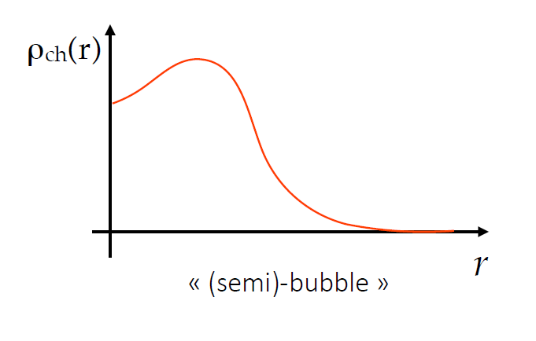
Perspectives for the XXIst century : e-scattering off unstable nuclei
Case for a “flagship" experiment on exotic nuclei : “bubble nuclei”

Slide 13
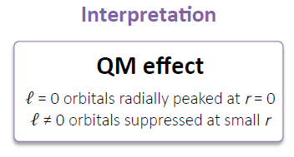
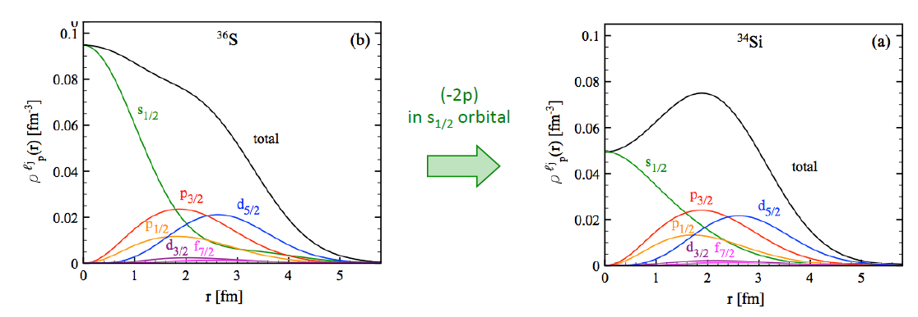
Perspectives for the XXIst century : e-scattering off unstable nuclei
Case for a “flagship" experiment on exotic nuclei : “bubble nuclei”

Slide 14
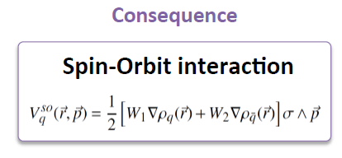
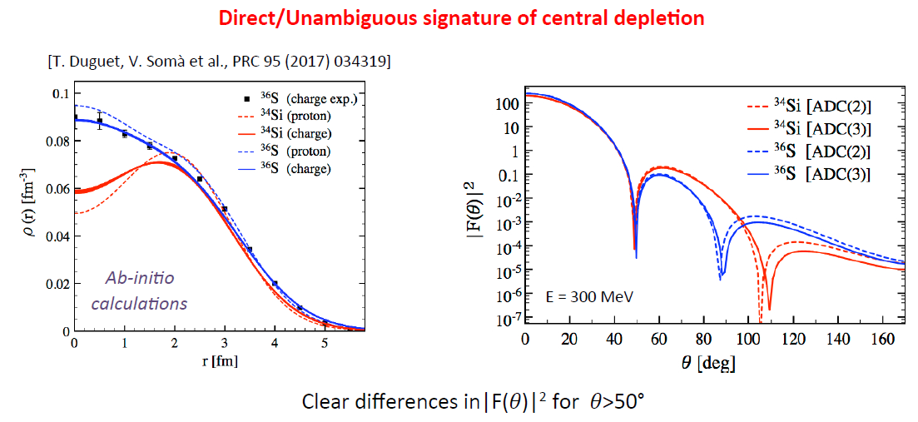
Perspectives for the XXIst century : e-scattering off unstable nuclei
Case for a “flagship" experiment on exotic nuclei : “bubble nuclei”

Slide 15
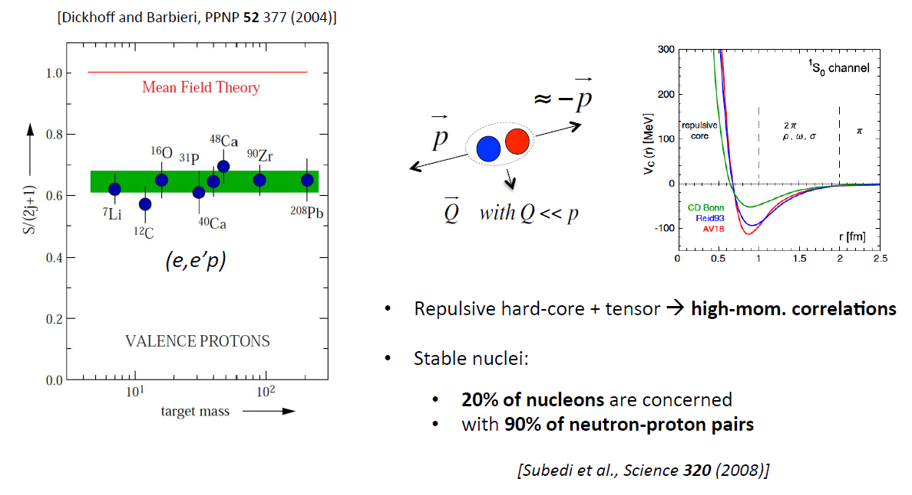
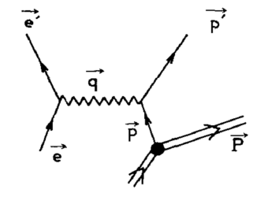
Perspectives for the XXIst century : e-scattering off unstable nuclei
The long term horizon : (e,e’p) quasi-free scattering : short range correlations
Paschalis et al. PLB 800:135110 (2020)

Slide 16
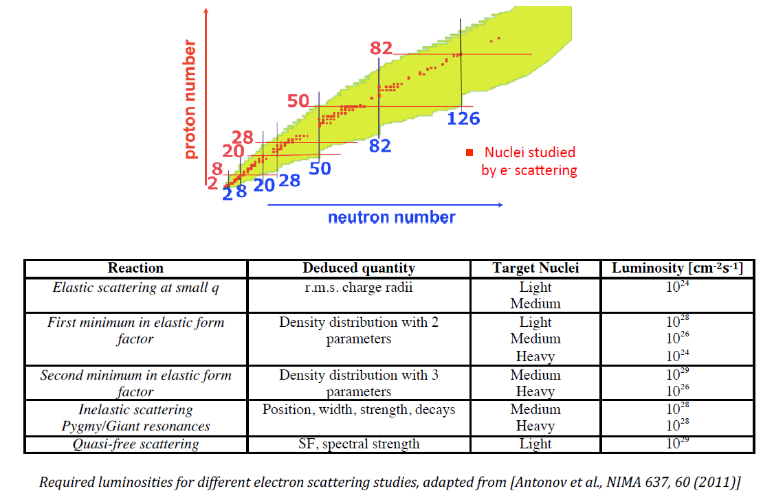
Required luminosities

Slide 17
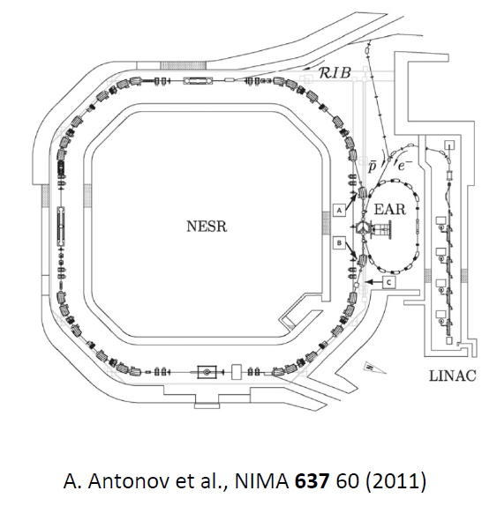
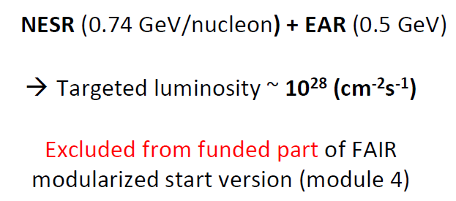
Possible implementations
Two different strategies to address e-RIB scattering
→ double-ring collider : ELISE project at FAIR
→ Self-confining fixed target : SCRIT

Slide 18
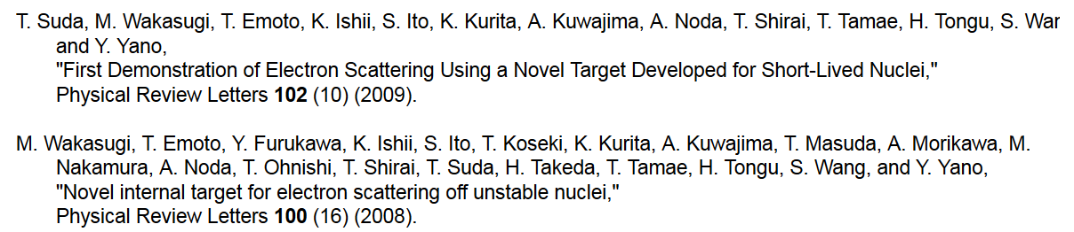
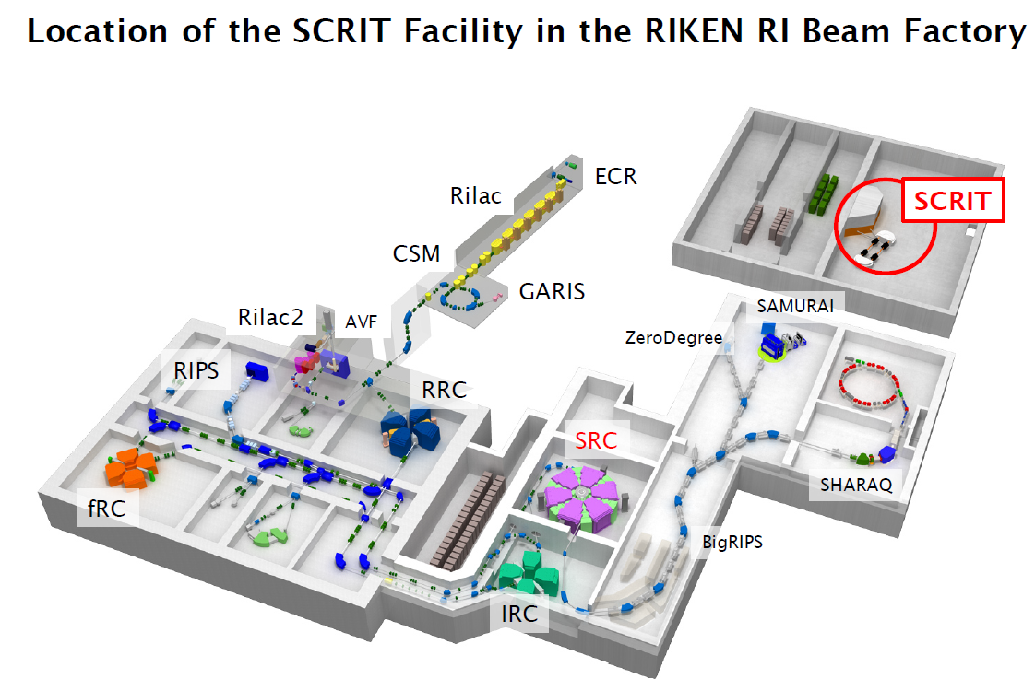
Possible implementations
taken from : M. Wakasugi
Workshop on e-Ion collision at CEA Saclay
(25-27 Apr. 2016)

Slide 19
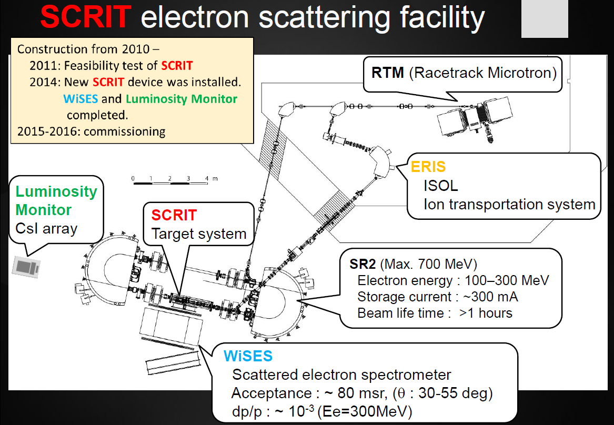
Possible implementations
taken from : T. Tsukuda
Workshop on e-Ion collision at CEA Saclay
(25-27 Apr. 2016)

Slide 20
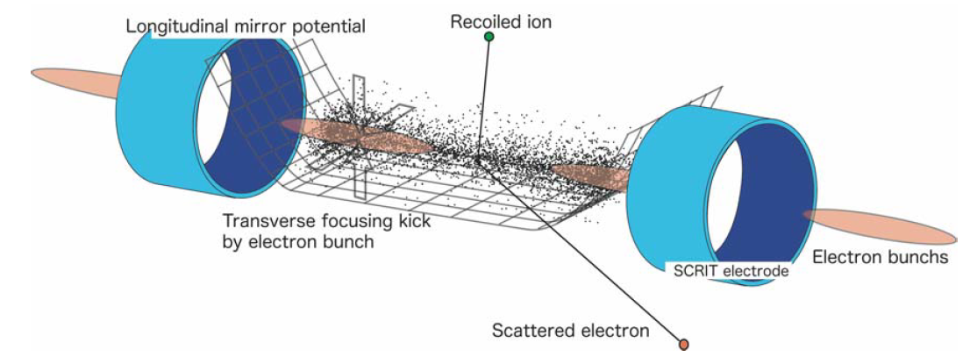
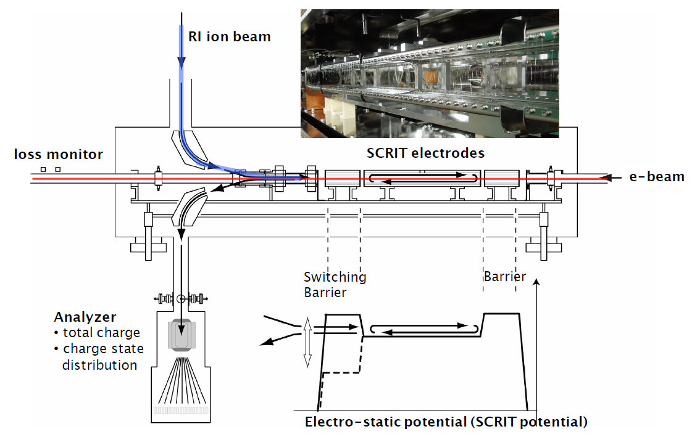
Possible implementations
adapted from : M. Wakasugi
Workshop on e-Ion collision at CEA Saclay
(25-27 Apr. 2016)

Slide 21
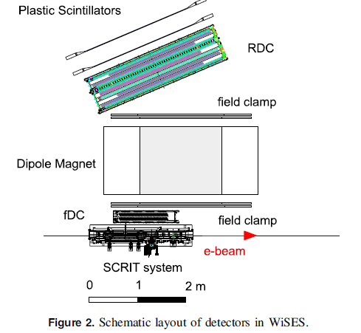
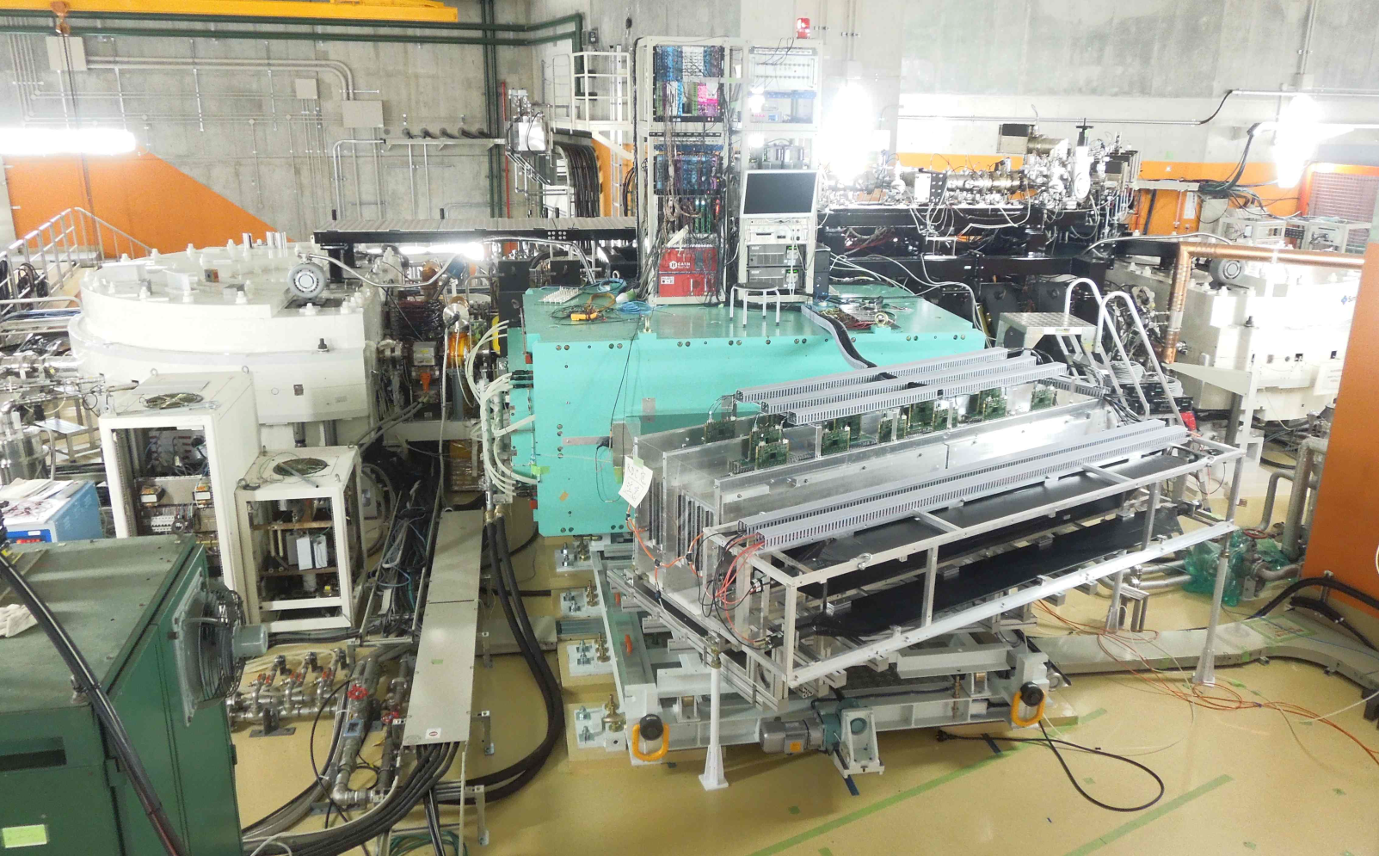
Possible implementations
Rear drift chamber
Dipole : 0.4 T for 150 MeV
Front drift chamber
T Ohnishi et al
Phys. Scr. T166 (2015) 014071

Slide 22
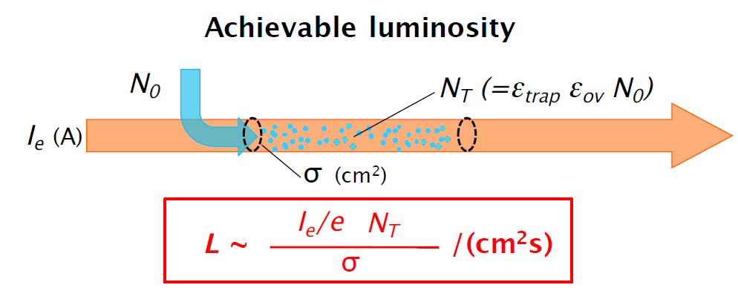
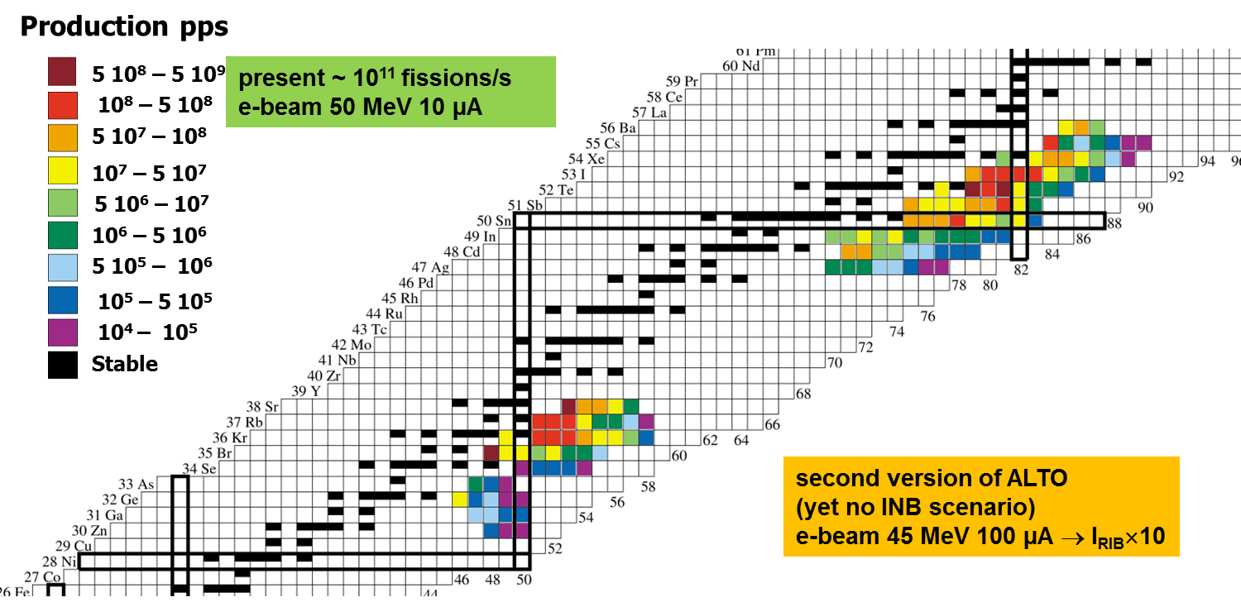
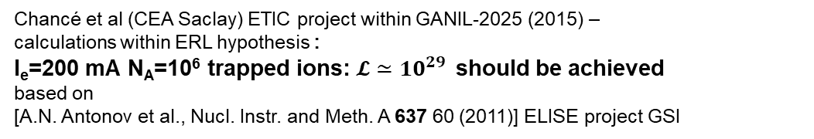
Possible implementations
Chancé et al (CEA Saclay) ETIC project within GANIL-2025 (2015) –
calculations within ERL hypothesis :
I_{e}=200 mA N_{A}=10⁶ trapped ions: $𝓛≃{10}^{29 }$should be achieved
based on
[A.N. Antonov et al., Nucl. Instr. and Meth. A 637 60 (2011)] ELISE project GSI
PERLE@Orsay : 20 mA → $ℒ≃{10}^{28 }$is probably achievable for a 10⁶ trapped RI population on the principle
but the dynamical e-beam-RI coupling should be investigated : first time with a ERL time structure
e-beam instabilities ? impact on ERL operation ?

Slide 23
Possible implementations
PERLE is a high current, multi-turn ERL facility (900 MeV),
designed to study and validate main principles of the Large Hadron Electron Collider (LHeC: 60 GeV)
LHeC would use a 3-pass energy recovery, recirculating linac with 20 GeV per pass and a current of about 10 mA; the RF frequency would be 802 MHz
The Orsay realization of PERLE (called PERLE@Orsay) is a smaller version (500 MeV)
with the same design challenges and the same beam parameters:
Target Parameter | Unit | Value
Injection energy | MeV | 7
Electron beam energy | MeV | 500
Normalised Emittance γε_{x,y} | mm mrad | 6
Average beam current | mA | 20
Bunch charge | pC | 500
Bunch length | mm | 3
Bunch spacing | ns | 25
RF frequency | MHz | 801.58
Duty factor |  | CW
Courtesy W. Kaabi (LAL Orsay)

Slide 24
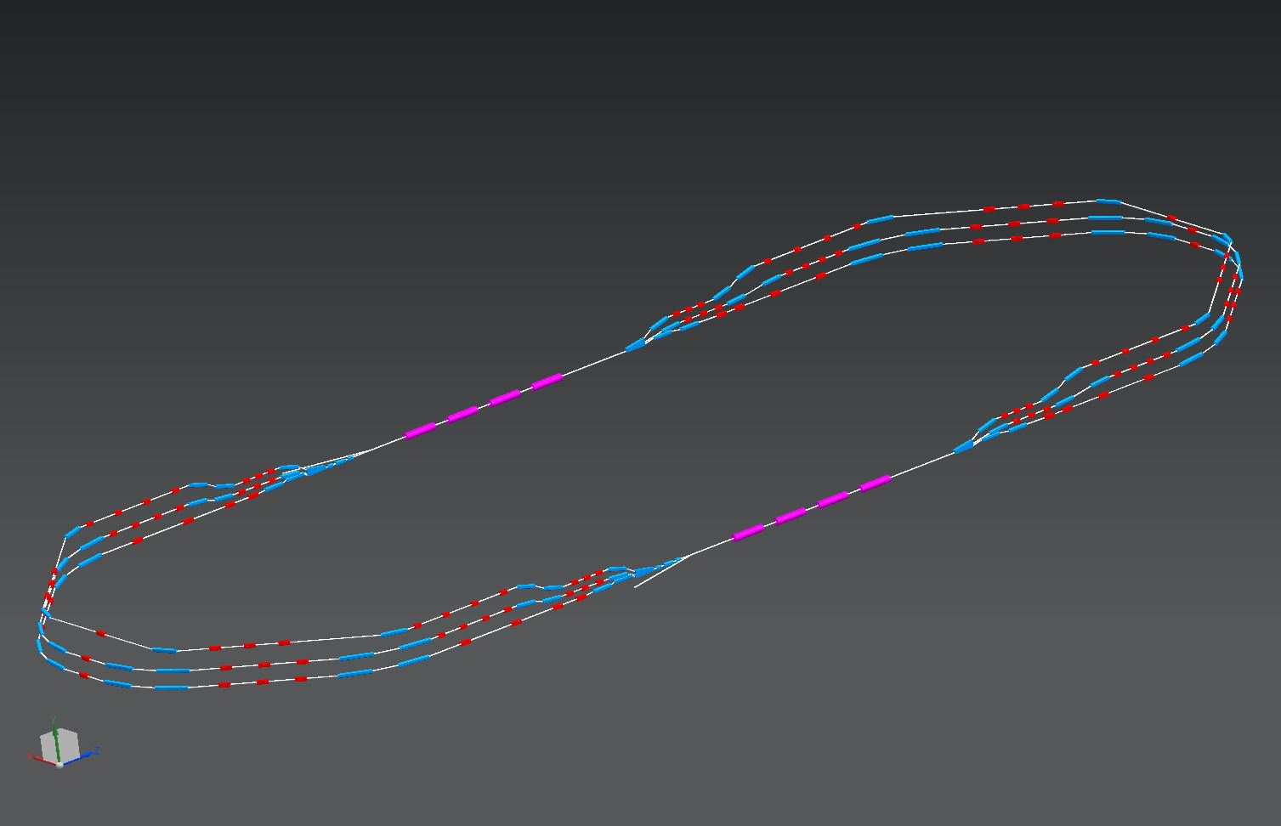
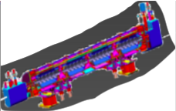
The PERLE@Orsay configuration
2 Linacs (Four 5-Cell 801.58 MHz SC cavities)
3 turns (160 MeV/turn)
Max. beam energy 500 MeV
1 : 3 : 5
1 : 87 MeV
3 : 247 MeV
5 : 407 MeV
DE = 80 MeV
injector
7 MeV
Courtesy W. Kaabi (IJCLab)
2 : 167 MeV
4 : 327 MeV
6 : 487 MeV
DE = 80 MeV
2 : 4 : 6
7 MeV
dump
DC = l_{RF}/2
Footprint: 24 x 5.5 x 0.8 m³

Slide 25
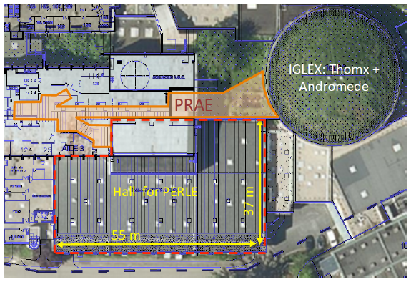
Suggested strategy and perspectives
A nuclear physics project at PERLE@Orsay
DESTIN [DEep STructure Investigation of (exotic) Nuclei]
is for the time being just in idea…
Goals:
• to seize the opportunity of the construction of an ERL prototype on the Paris-Saclay University Campus to build an RI-e-scattering experimental setup (inspired by SCRIT)
• requires to build/move/adapt our existing ALTO ISOL photofission facility in Orsay
• a necessary demonstration step : fixed radioactive target in ERL for the first time
towards a possible more ambitious ERL-based system (→ $𝓛≃{10}^{29 }$) at GANIL
(presently discussed/considered within the French nuclear physics long-range plan)
• realize a sustainable, realistic physics program that would collect the interest of the low-energy nuclear physics community (local, national, international)
(extension and deepening of the existing activity based on the em probe)

