Slide 1
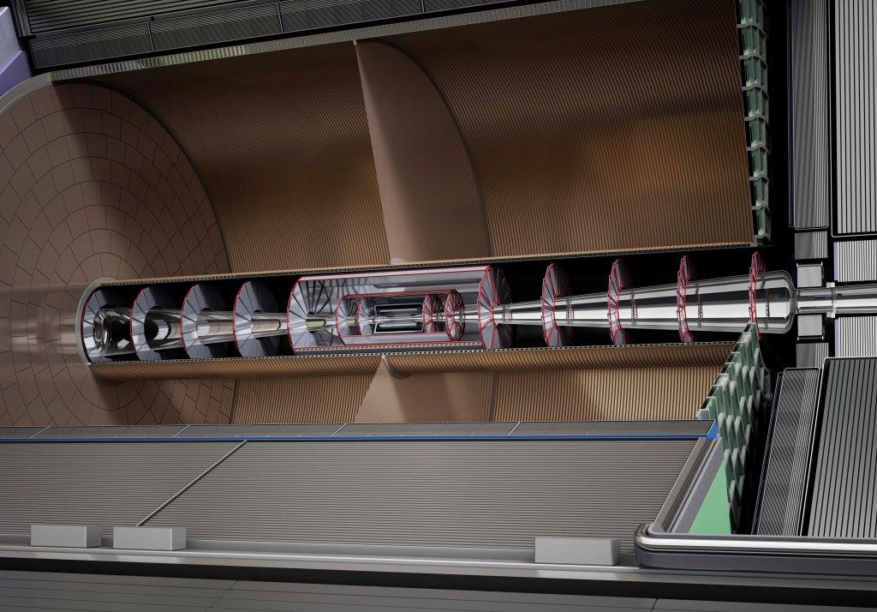

An omni-purpose 3D intermediate tracker for ILD : the TPC
France-Ukraine workshop Oct.22, 2020
Paul Colas

Slide 2
Outline
Motivation and adaptation to the ILC machine
R&D
Recent results
Future developments
Project aspects, costing

Slide 3
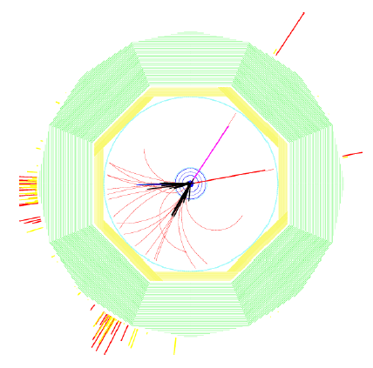
Motivation
e+e- -> HZ, Z->µµ
Need to reconstruct complex multi-track events (jets) in a noisy environment : calls for high segmentation
Also need to reconstruct very accurately high energy tracks from Z recoil to Higgs. This translates into O(10 µm) control of the systematics on sagitta and Δ(1/P)=2.10⁻⁴ GeV ⁻¹
Silicon detectors give point measurement accuracy, but also introduce multiple scattering, while a TPC provides a continuous 3D track reconstruction with minimal matter : useful for V0, kinks, connecting to vertex tracker, other silicon trackers, and to calorimeter.
Also a TPC has dE/dx capability, for K/π separation

Slide 4
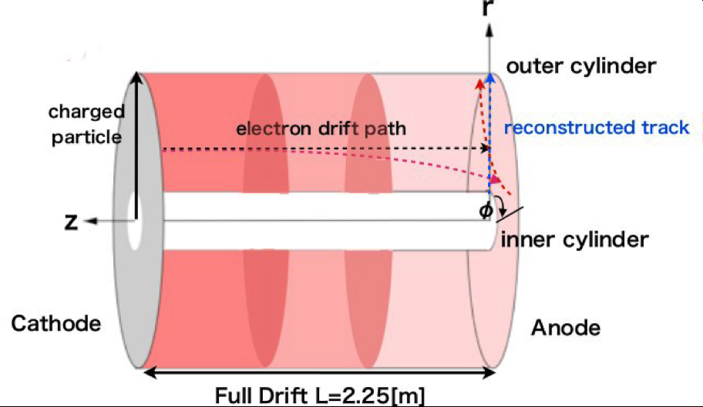
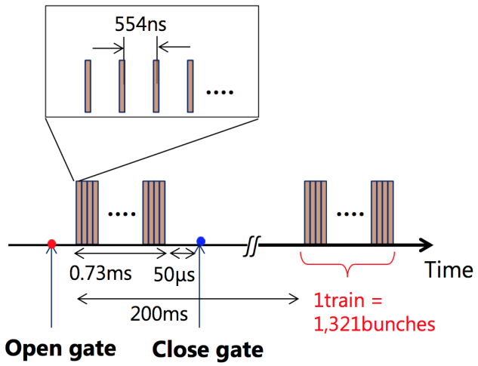
Need for gating
In TPCs, ions are produced and migrate very slowly (1 m/s) . They produce a charge density which can be one or two orders of magnitude above the primary ionization (IBF*Gain). The resulting electric field can be the origin of distortions.
At the ILC, the bunch trains last about 1ms every 200 ms, giving rise to ion disks slowly drifting to the cathode

Slide 5
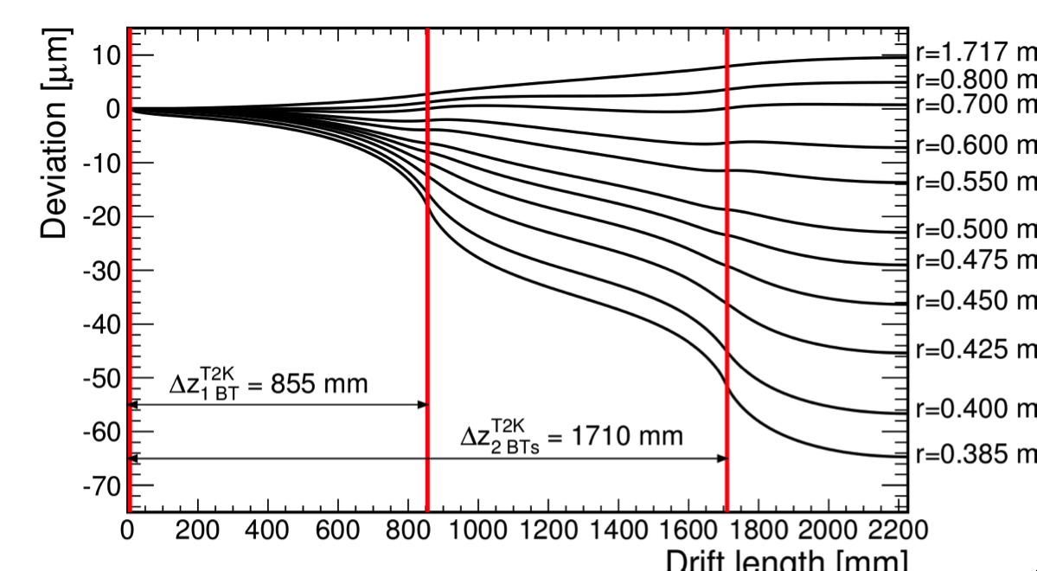
Need for gating
In TPCs, ions are produced and migrate very slowly (1 m/s) . They produce a charge density which can be one or two orders of magnitude above the primary ionization (IBF*Gain). The resulting electric field can be the origin of distortions.
At the ILC, the bunch trains last about 1ms every 200 ms, giving rise to ion disks slowly drifting to the cathode
After 2 disks, the electrons receive a kick of up to 60 µm, too much wrt the systematics

Slide 6
One gating solution: the gating GEM
A. Sugiyama et al.
86 % transparency for electrons demonstrated for Delta V = 4 V
Preservation of the resolution demonstrated in a beam test
Ion blocking expected for DeltaV =-40V

Slide 7
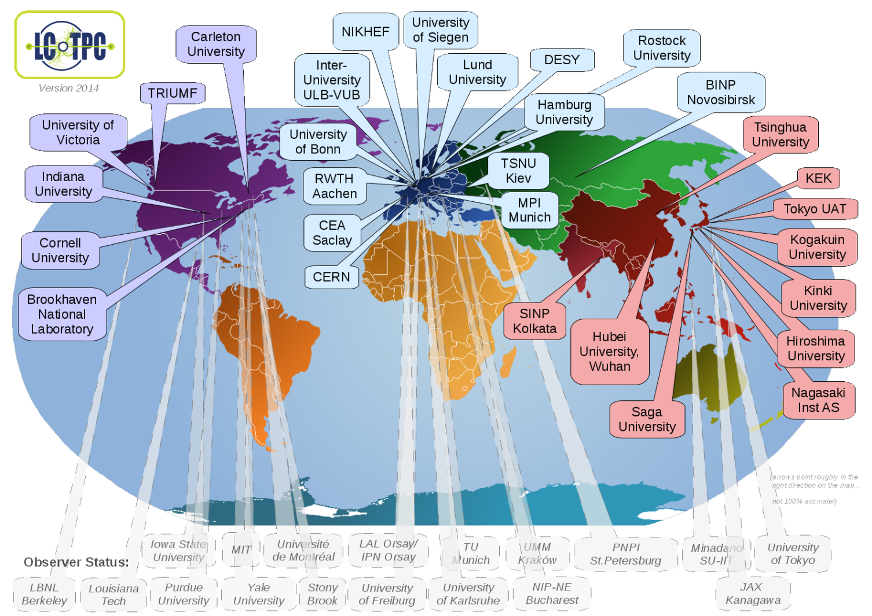
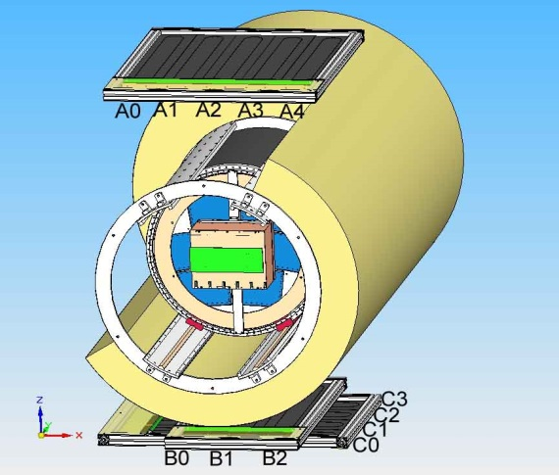
The LCTPC collaboration and the DESY test setup
All the TPC R&D is gathered.
www.lctpc.org
The collaboration shares a test facility at the DESY T24 test beam (Field cage, magnet, endplate, cosmic-ray trigger, ancillaries)
Allows testing/comparing several technologies/ideas with cost-awareness

Slide 8
Technologies
Micromegas : Micromesh gaseous chamber
GEM : Gas Electron Multiplier

Slide 10
The Saclay Micromegas Module
Fully integrated electronics and cooling
PCB equipped with a RC continuous circuit covering the pads (insulator + resisitve foil), to spread the charge, so that several pads are hit and a barycenter can be used to improve the resolution

Slide 11
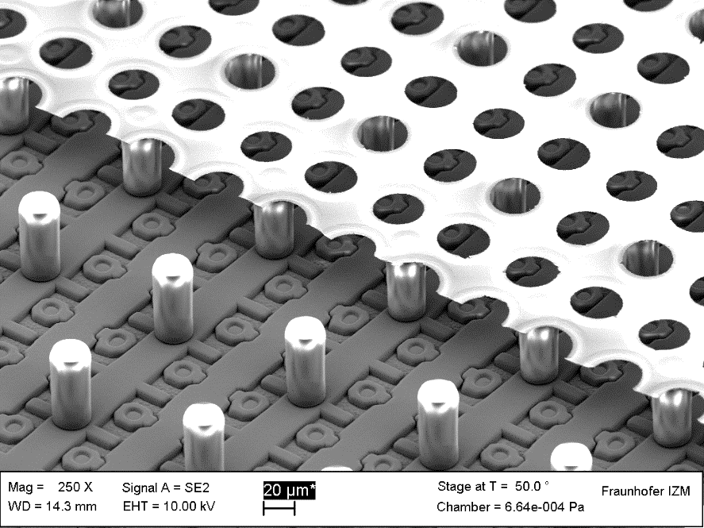
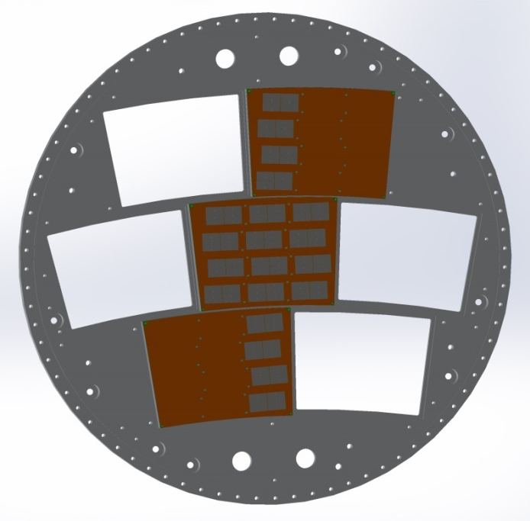
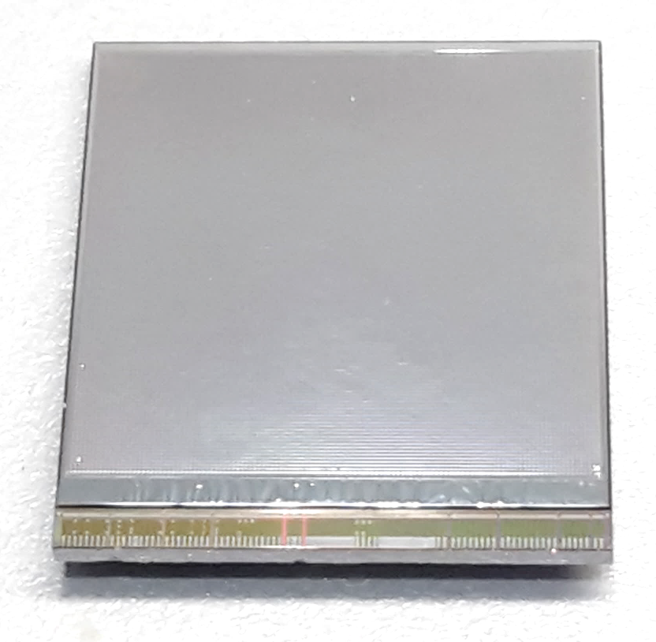
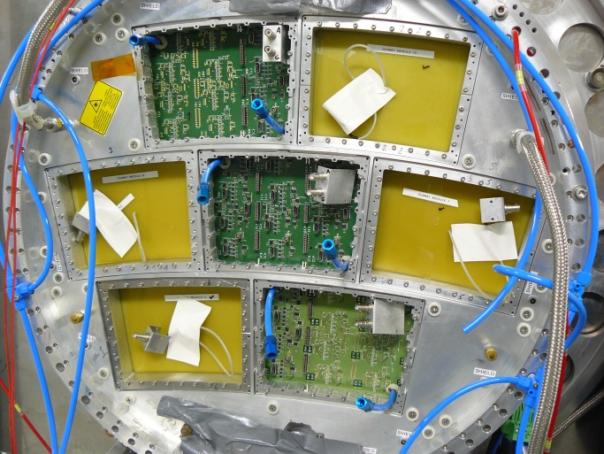
Gridpix : ‘digital TPC’
Reconstruct every ionization electron with a high efficiency. Measure dE/dx by cluster counting
50 µm
Now uses Timepix 3 and chip protection against sparks has been improved.

Slide 12
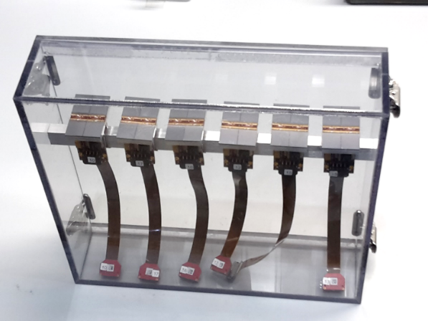
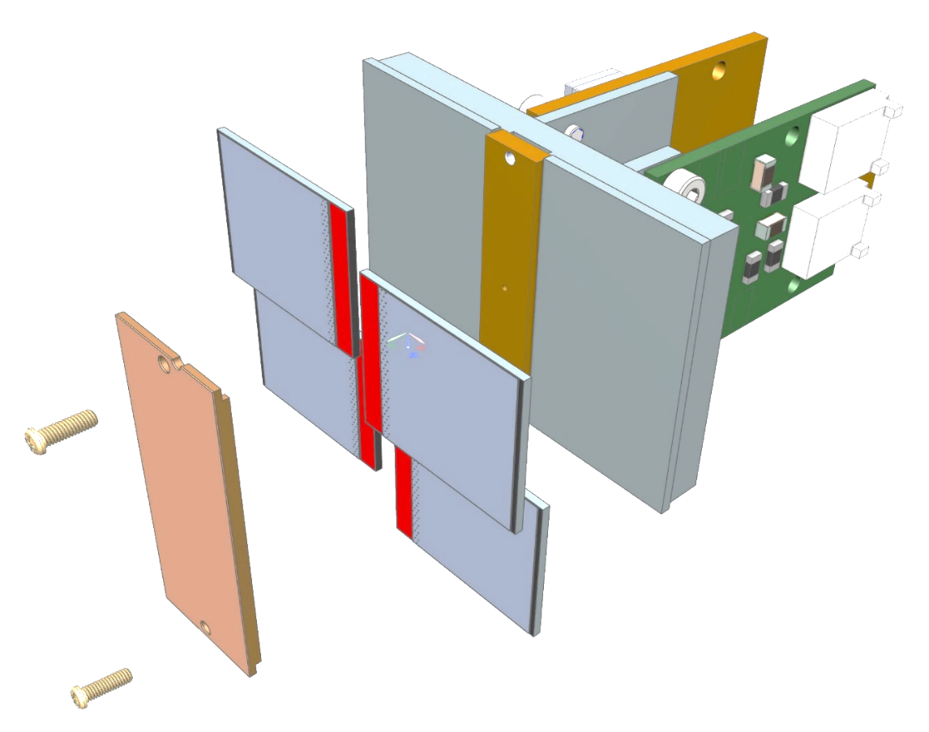
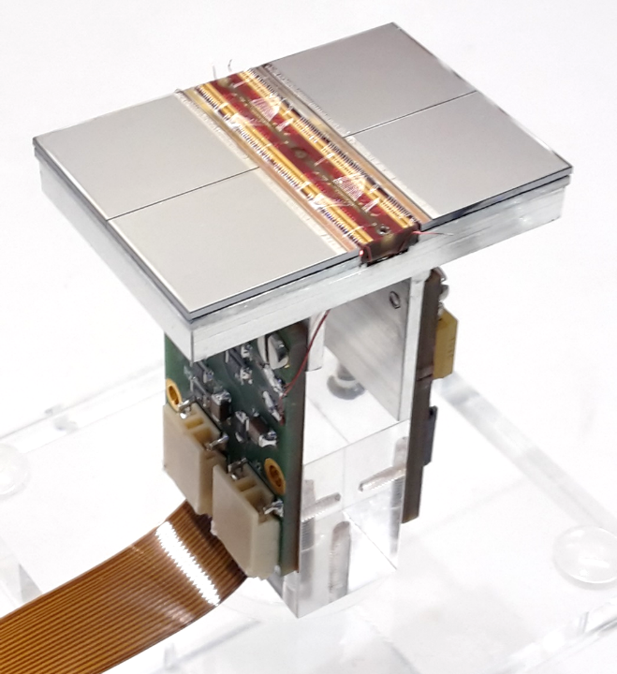
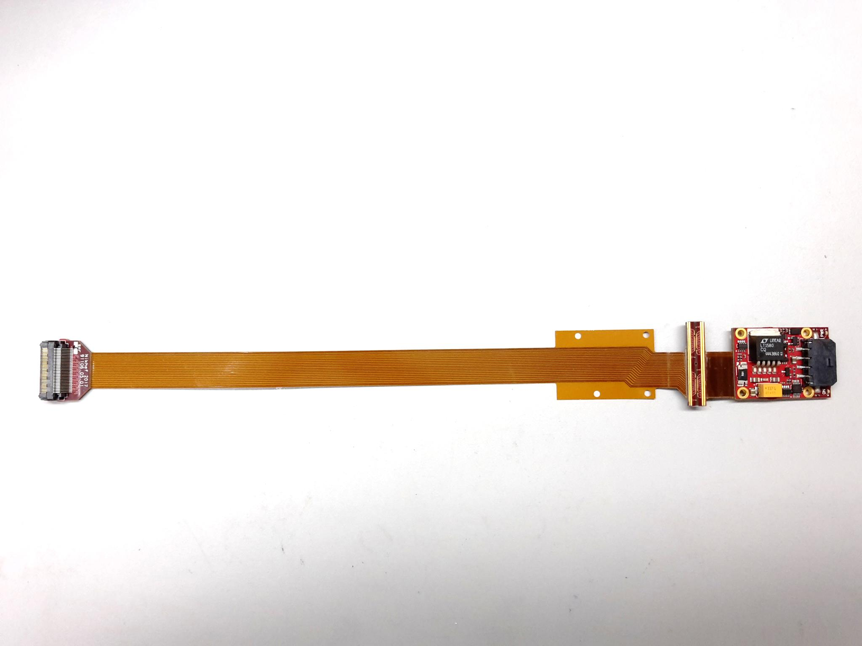
QUAD design and realization
THE NIKHEF-BONN PIXEL MODULE
Four-TimePix3 chips
All services (signal IO, LV power) are located under the detection surface
The area for connections was squeezed to the minimum
Very high precision 10 μm mounting of the chips and guard
QUAD has an sensitive area of 68.9%
DAQ by SPIDR
Tested in a beam in Bonn
Will be tested in DESY in July 2021
39.6 x 28.38 mm
series of QUADs
Guard
TPX3
TPX3
TPX3
TPX3
COld
CArrier

Slide 13
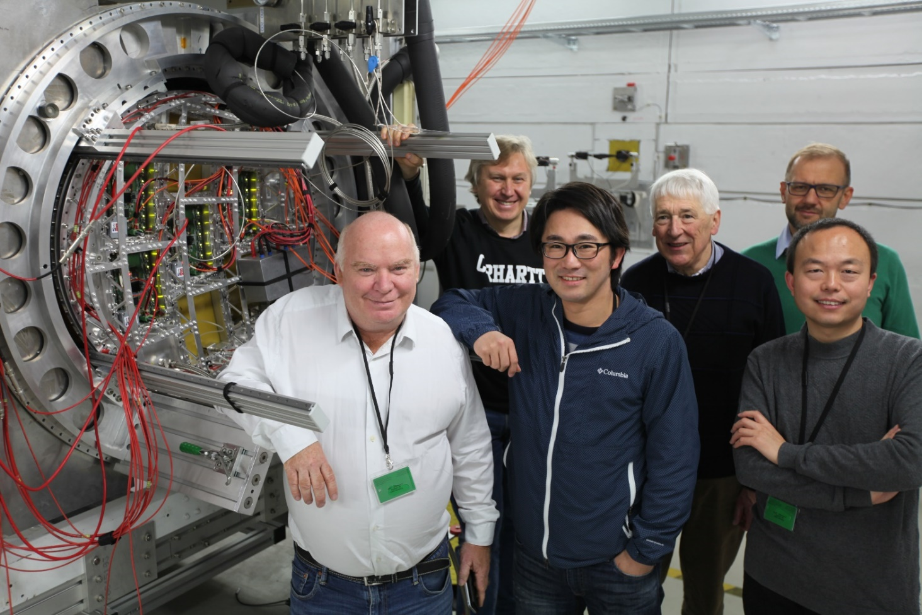
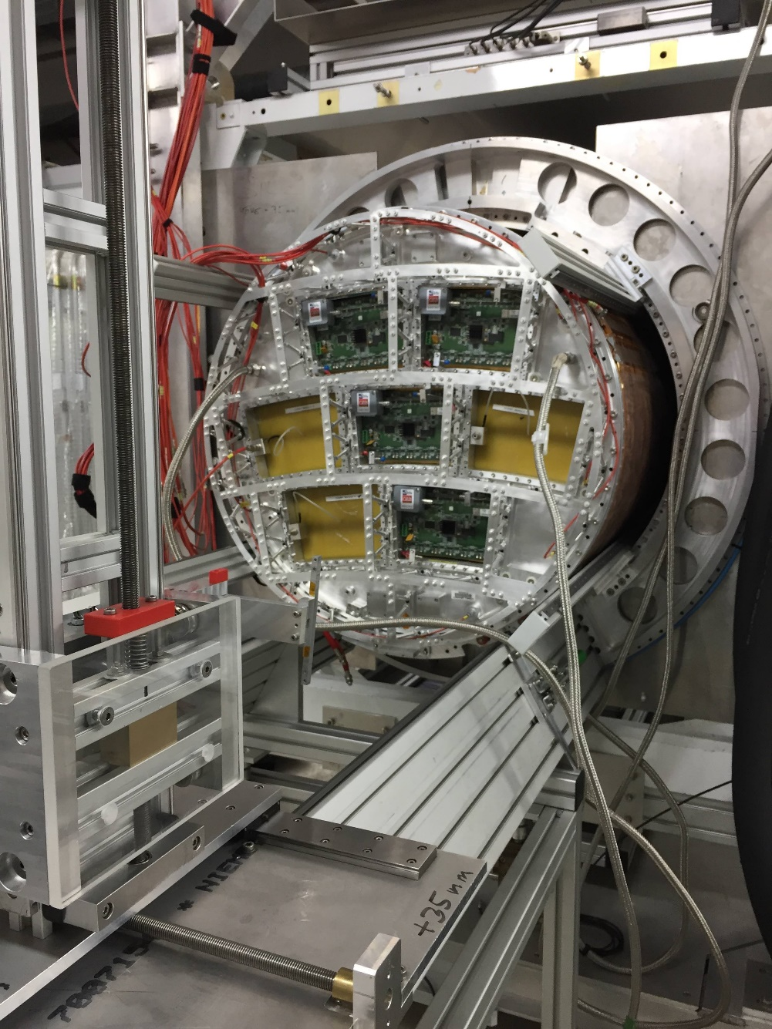
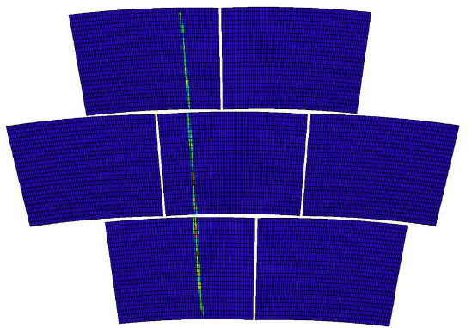
4 new Micromegas modules tested in
November 2018 at DESY, with
New ‘spaceframe’ endplate
1-loop 2-Phase CO2 cooling
Improved mechanics : 99.9% good connections
New scheme : encapsulated resistive anode
E4 E3
E1
E2

Slide 14
Encapsulated Resistive Anode Micromegas
New scheme, to reduce distortions
at the edges of the modules : mesh
at ground (same potential as the frame),
and resistive anode at the +ve HV.
Also encapsulation reduces the EMI.
Another advantage: the amplification
field can be tuned independently of the drift field, providing flexibility.
The gains can be equalized while keeping the drift field very uniform.

Slide 15
Spatial Resolution
Making use of charge sharing with a resistive-capacitive coating of the anode, the rφ resolution is 60 µm at zero drift distance.

Slide 16
dE/dx Resolution
dE/dx provides Particle identification
( π-K separation)
Reaches 5% for a track traversing the TPC

Slide 17
SUPPRESSION OF DISTORTIONS NEAR THE MODULE EDGES
Mean residuals show that the distortions are suppressed in the new grounding scheme (in red) with respect to the previous scheme (in blue)
B=1 Tesla

Slide 18
Cooling
A good candidate for cooling is 2-phase CO2 (large latent heat, low viscosity, 15°C at 55 bar, no water leaking). It has been tested on 7 Micromegas modules.
A 3D-printed cooling plate has been manufactured by additive fabrication. It is under test.
Mechanics
Static deformations under weight and pressure, new solution for TPC fastening

Slide 20
Preparation of the technology choice

Slide 21
Conclusions and future
The MPGD readout has been demonstrated to be the solution for ILD
Integration and technical issues are not being addressed
Gas studies to optimize the gating: study ion mobilities (A. Cortez)
Continued ILD integration studies, scheme to assemble and test the detector in Kitakami. Revision of the costing.
Evaluation of the resources necessary in Kitakami: space and power.
T2K/ND280 is accumulating experience on Encapsulated Resistive Anode Micromegas. Maybe also applied to SAND, the near detector of Dune
Thanks to D. Attié, M. Riallot, S. Ganjour, M. Titov, T. Ogawa, J. Kaminski, R. Diener, and many others for their contribution to the work presented here.

