Slide 1
Development of electron accelerators for nuclear and radiation technologies
V.V. Mytrochenko on behalf of
Science and Research Establishment «Accelerator» of NSC KIPT, Ukraine

Slide 2
Outline
History of electron linacs at KIPT
Collaboration of S&R establishment “Accelerator” of NSC KIPT with IHEP of the Chinese Academy of Sciences
Directions of research on the use of accelerators of electrons for nuclear and radiation technologies
  Photonuclear production of medical radionuclides
  Radiation processing, researches in a field of electron beam interaction with condensed matters
  Studies of photonuclear reactions with multiple emission of nuclides
  Slow positron generation
  Study of the high-frequency dielectric properties at irradiation
  Generation of femtosecond range bunches of electrons
Summary

Slide 3
History of electron linacs at KIPT
The Soviet Union Era
1953 LUE-0.7
1954 LUE-3.5
1956 LUE-30
1958 LUE-90
1963 LUE-300 | 1975-1987 UIC Neutrons, 1969 - 100 MeV storage ring
1964 LUE-40 | Test facility
1965 LUE-2000 | 1983 Stretcher, storage ring (project)
1987 LU-10 | Sterilization

Slide 4
History of electron linacs at NSC KIPT (Ukraine)
At present the Science and Research Establishment «Accelerator» (the structural subdivision of NSC KIPT) is the only organization in Ukraine providing an opportunity for the development of full technological cycle starting from the creation of specialized accelerator to the provision of industrial radiation treatment services. Since 1991 9 electron linacs have been developed or modernized as well commissioned here.
1991 LUE-60 | Injector for SSR-600 storage ring
1992 LIC | Laser initiated gun
1993 KUT-1* | Radiation technology
1993 LU-10 (upgrade)* | Sterilization
1996 EPOC* | Radiation technology
2002 KUT-20 | Isotope production
2004 LUE-40* | Study of photonuclear reactions
2007 KUT-30 (upgraded KUT-20) | Isotope production
2008 LUE-60M* | Injector for NESTOR storage ring
* operational

Slide 5
Developed projects
Normal conducting pulsed recirculator | Upgrade for ANL Chemical division electron linac
SALO –superconducting recirculator | New technology
Several configurations of 100 kW linac within energy range of 80 - 120 MeV | Neutron physics (subcritical assembly driver)
Power Linac 150 MeV, 100 kW | Neutron physics (subcritical assembly driver)
10 MeV, 20 kW Linac* | Radiation processing, researches in a field of electron beam interaction with condensed matters
* Systems of the linac are manufacturing now

Slide 6
Collaboration of S&R production establishment “Accelerator” of NSC KIPT with IHEP of the Chinese Academy of Sciences
  Driver linac for subcritical assembly
NSC KIPT NEUTRON SOURCE
M.I. Ayzatskiy, B.V. Borts, A.N. Vodin, P.A. Demchenko, A.Yu. Zelinskiy, I.M. Karnaukhov, V.A. Kushnir, V.V. Mitrochenko, A.O. Mytsykov, I.M.Neklyudov, S.N. Oleynik, F.A. Peev, G.D. Pugachev, S.A. Soldatov, I.V. Ushakov, Y .Gohar, I. Bolshinsky, Ya.L. Chi, S.L. Pei, S.H. Wang, W.B.Liu
Conception and basic descriptions of a neutron source based on a subcritical uranium assembly driven by a linear electron accelerator are presented. The primary neutrons are produced as a result of photonuclear reactions in a tungsten or natural uranium target.
ISSN 1562-6016. Problems of Atomic Science and Technology 2012. №3(79), C. 3 – 9.

Slide 7
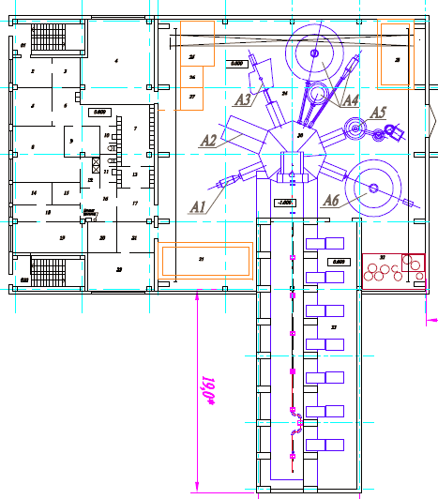
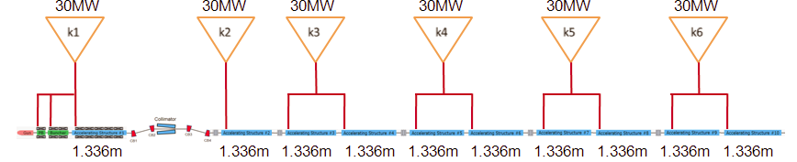
Collaboration of R&D production establishment “Accelerator” of NSC KIPT with IHEP of the Chinese Academy of Sciences
Experience gained from recently carried out researches allowed us to set specification of the linac, as well as to carry out the expertise of the linac project that was developed by IHEP. The linac has been commissioned.

Slide 8
Directions of research on the use of accelerators of electrons for nuclear and radiation technologies
  Photonuclear production of medical radionuclides
Converter
Mo-target
e⁻
RF linac
γ
Energy 40-60 MeV
Beam power 10-20 kW !!!!
Water

Slide 9
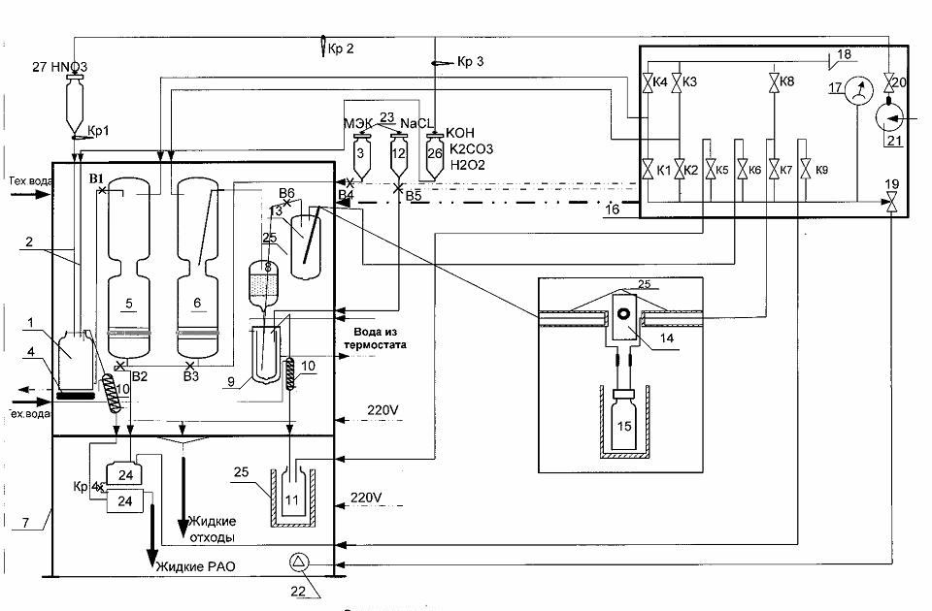
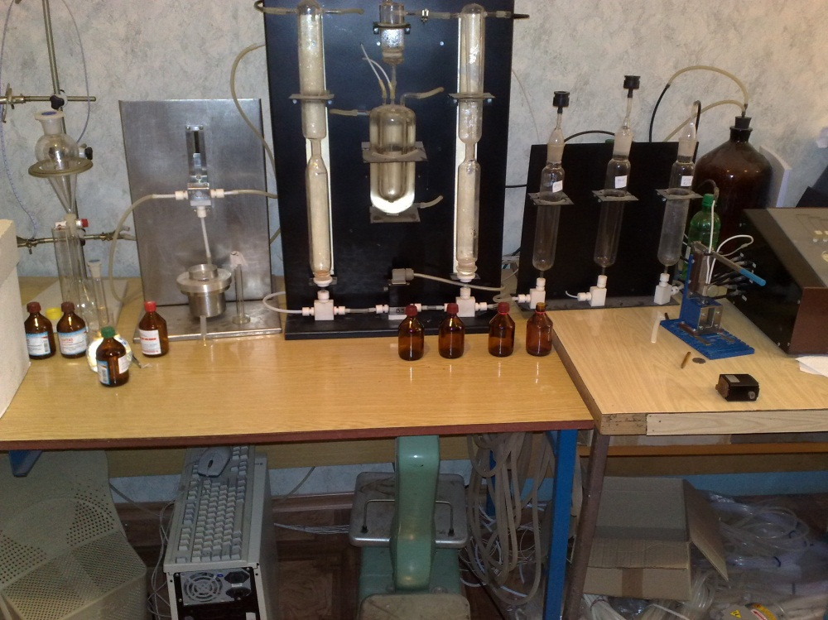
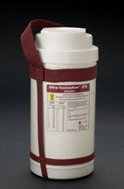
The extraction technetium
generator
(Tomsk, Russia,
Метилэтилкетон)
It is not a standard generator – it is a common one
It will produce Tc each day – transportation to clinics

Slide 10
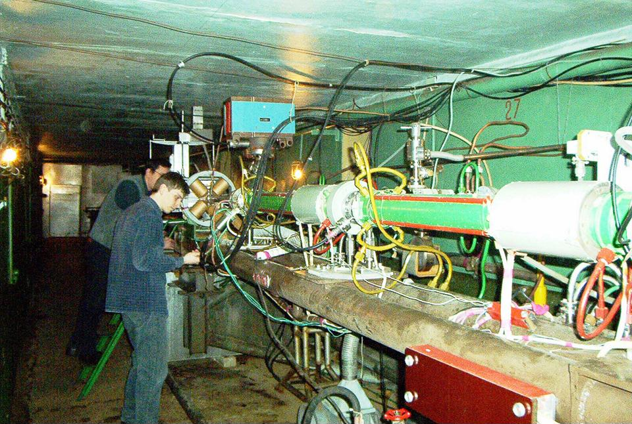
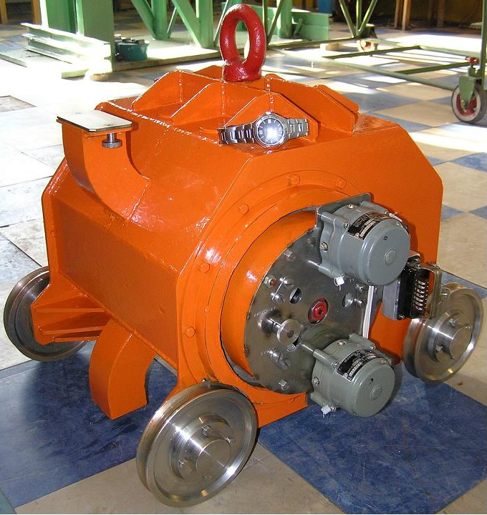
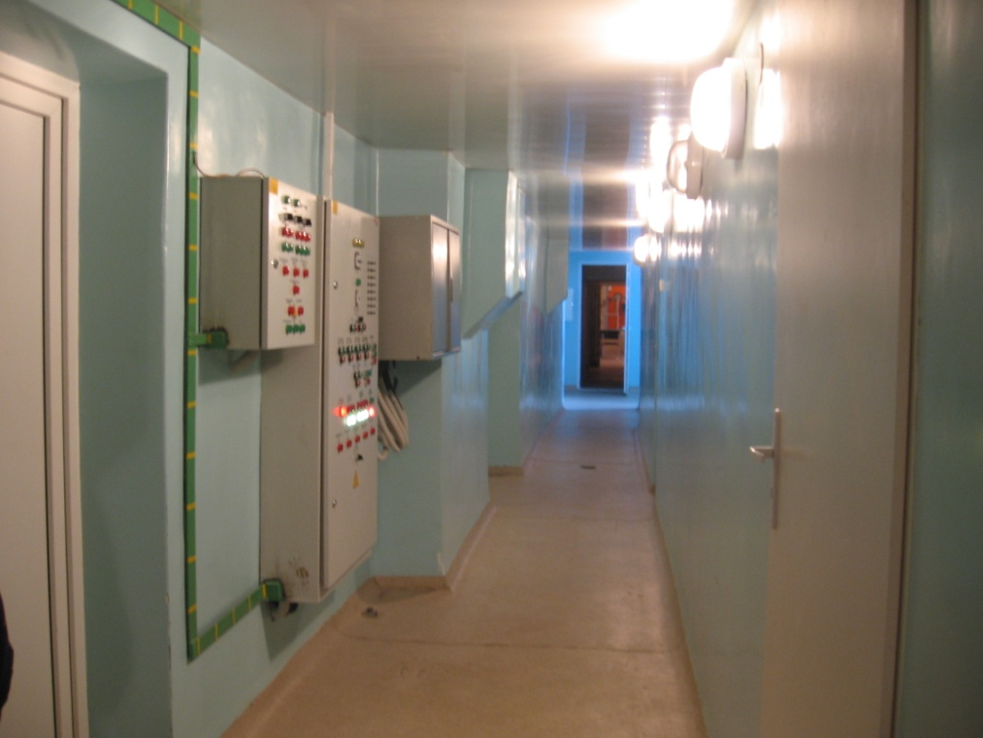
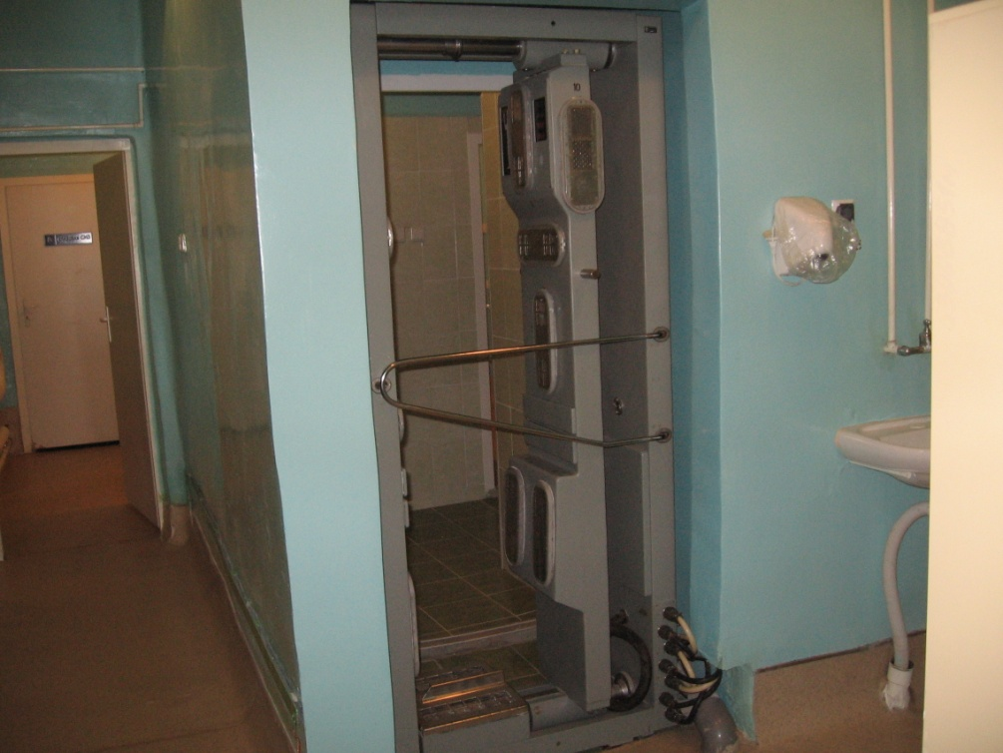
NSC KIPT facility today

Slide 11
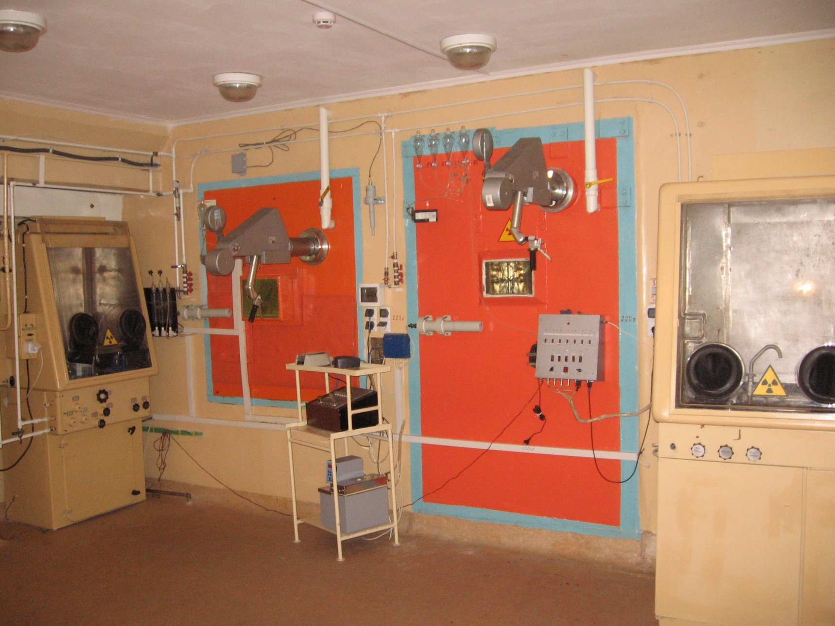
NSC KIPT facility today
11

Slide 12
1. Development or purchasing modern extraction system (extraction of Tc with low concentration)
2. Construction a clean room for bottling Tc99m pertechnetate
3. Production Certification on the base of GMP («Good Manufacturing Practice»)
The project is stopped for the while because of some reasons.
The main reason is the low capacity of technetium market in Ukraine
12

Slide 13
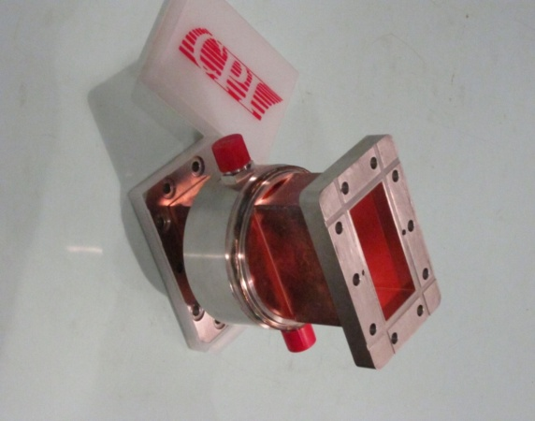
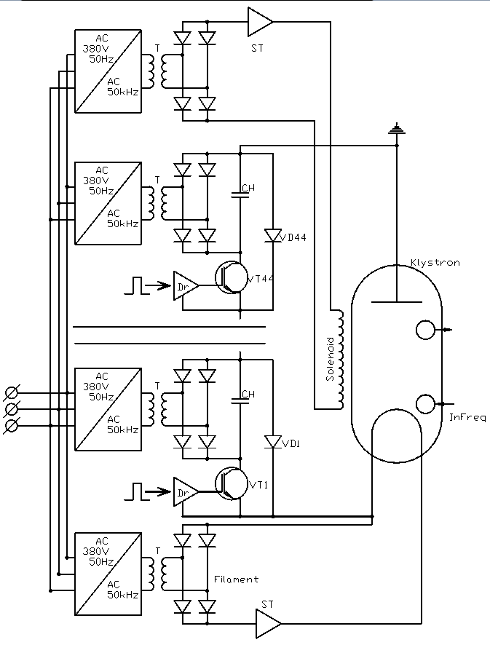
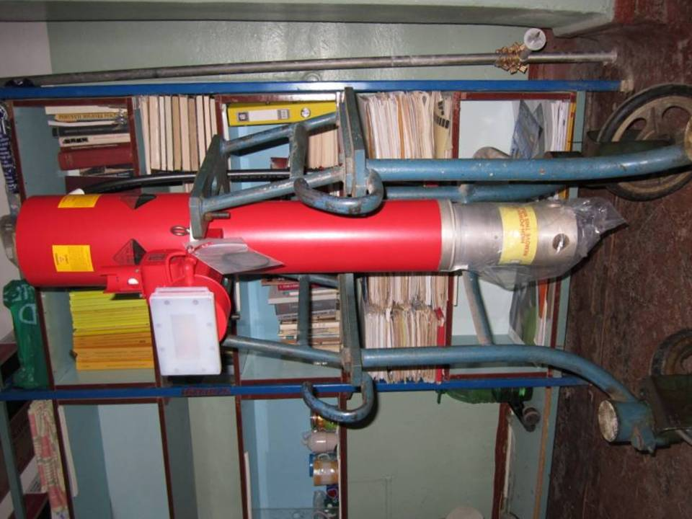
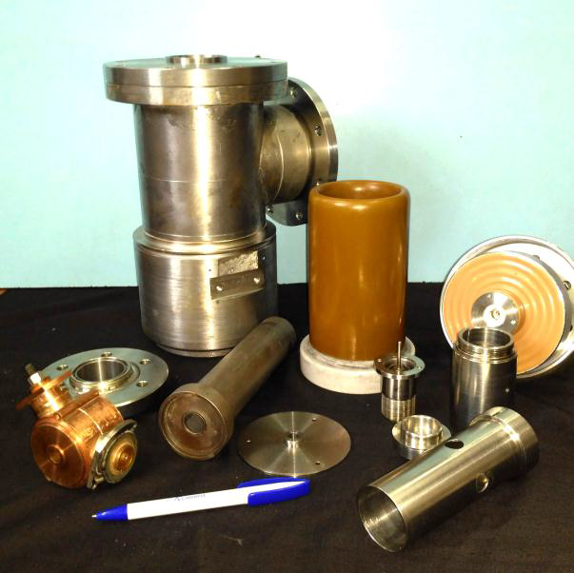
Upgrade for LU-10 Linac
We have CPI 5 MW Klystron, waveguide vacuum window, e-Gun, acceleration section. Solid state modulator is in R&D stage.

Slide 14
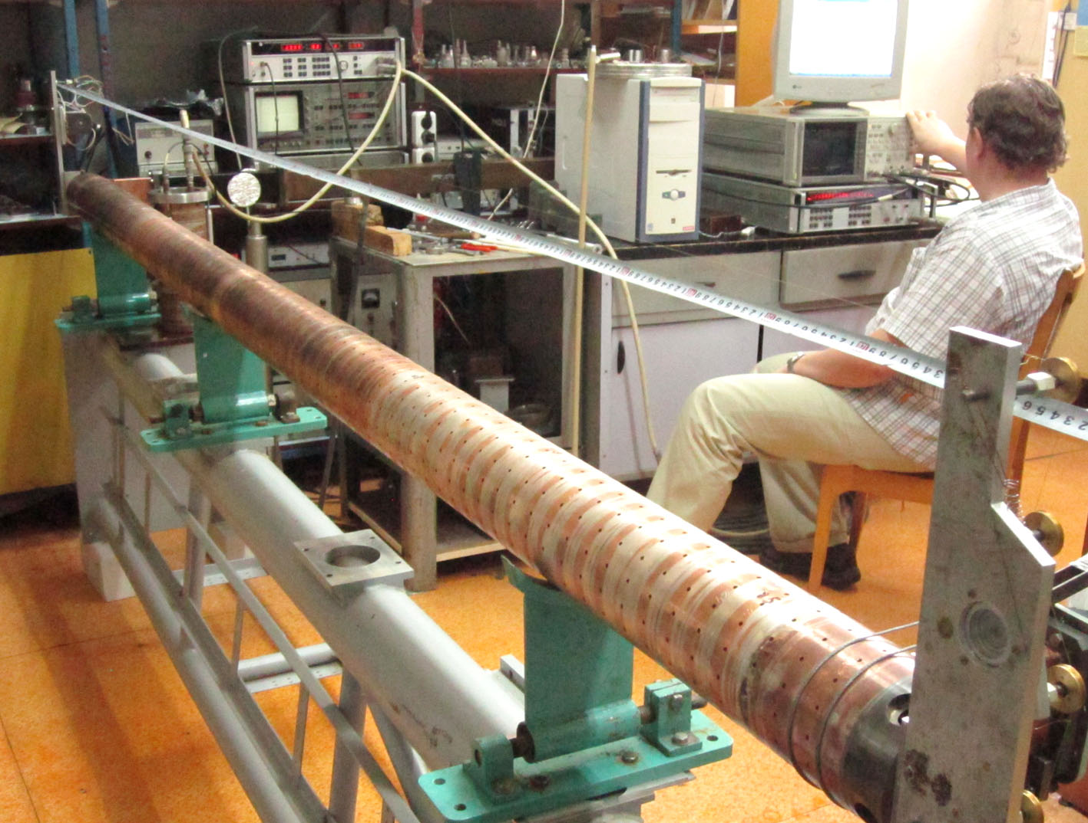
Upgrade for LU-10 Linac – accelerating section (completed)

Slide 15
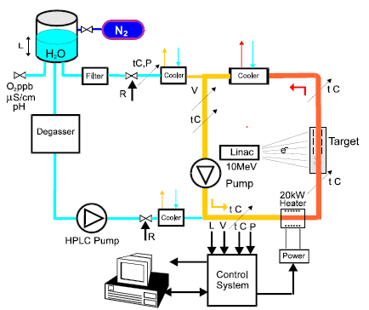
ELECTRON IRRADIATION OF THE MATERIAL SAMPLES OF NEW GENERATION OF NUCLEAR REACTORS IN THE SUPERCRITICAL WATER CONVECTION LOOP
A.S. Bakai, V.N. Boriskin, et. al.

Slide 16
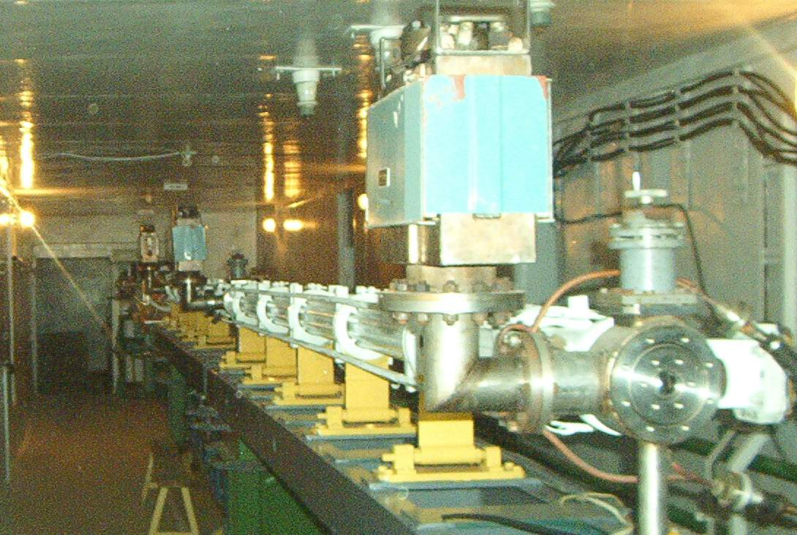
LUE-40 Linac
Year | 2004
Energy, MeV | 30-100
Number of sections | 2
Current-pulse width, μs | 2
Repetition rate, pps | 50
Average current, μA | ≤5
Experimental Nuclear Reaction Data (EXFOR)
At least 19 datasets in EXFOR are based on experiments carried out at LUE-40 within energy range from 35 to 90 MeV

Slide 17
Directions of research on the use of accelerators of electrons for nuclear and radiation technologies (LUE-40 linac)
  Studies of photonuclear reactions with multiple emission of nuclides
O. Bezshyyko, O. Vodin, L. Golinka-Bezshyyko, et. Al. Isomer ratios for products of photonuclear reactions on Rh, EPJ Web of Conferences, 2020, 239, 01026
O. Vodin, O. Bezshyyko, L. Golinka-Bezshyyko, et. Al. Isomer ratios in photonuclear reactions with multiple neutron emission, Problems of Atomic Science and Technology, 2019, vol. 3, p. 38-46

Slide 18
Directions of research on the use of accelerators of electrons for nuclear and radiation technologies (LUE-40 linac)
S.A. Perezhogin , E.V. Bulyak, V.A. Kushnir, et. Al. SOURCE OF POSITRONS ON THE BASE OF LINAC LUE-40, Problems of Atomic Science and Technology, 2020. Vol.3(127), p. 7 -10.
The source of slow (secondary) positrons for solid state physic research.
N.I. Aizatskyi, V.A. Bocharov, N.P. Dikiy et. Al. RESULTS OF STUDY THE INFLUENCE ELECTRON IRRADIATION ON THE HIGH-FREQUENCY DIELECTRIC PROPERTIES OF ZIRCONIA NANOCERAMICS, Problems of Atomic Science and Technology, 2015. Vol.6(100), p. 47 – 51.
Samples were irradiated with electron beam fluences from 2⋅10¹⁶ to 2⋅10¹⁸cm⁻²
V.A. Kushnir, K.Yu. Kramarenko, V.V. Mytrochenko et. Al. DIELECTRIC RF RESONATORS WITH OPEN BOUNDARIES FOR STUDYING RADIATION EFFECT ON ELECTRODYNAMIC CHARACTERISTICS OF SOLID DIELECTRICS, Problems of Atomic Science and Technology, 2020. Vol.3(127), p. 39-44.
To study the effect of radiation on the complex dielectric permittivity (ε and tgδ) of dielectrics with relative accuracy up to Δε/ε∼10⁻⁴ in situ.
M.І. Ayzatsky, K. Yu. Kramarenko, V.A. Kushnir, et. Al. ANALYSIS OF SHORT ELECTRON BUNCHES SHAPING IN A LINAC, Problems of Atomic Science and Technology, 2018. Vol.3(115), p. 81 -85.
The features of short electron bunch shaping via velocity bunching are explored. The basic possibility to obtain bunches with duration less than 1 ps at the LUE-40 linac is shown.

Slide 19
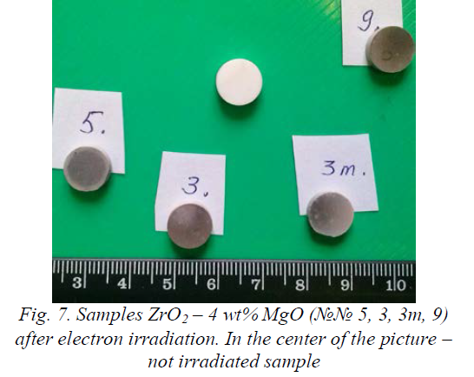
About scintillator sample irradiation
Neutron flux is 5⋅10¹¹ 1/s with average current of 5 μA at 40 MeV beam energy from 4mm Ta converter. At 80 MeV it should be 7. 5⋅10¹¹ 1/s.
We need about 10 hours to get 5⋅10¹⁴ n/cm²
Electron beam fluence 10¹⁸cm⁻²
2 cm

Slide 20
Summary
Areas of our activity are:
  Development of new linear electron accelerators
  Research of periodic electrodynamic system properties and development of different types of accelerating structures
  Beam formation in the electron sources and injector systems
  Acceleration of intense electron beams
  Research of methods of electromagnetic radiation generation in various ranges: from centimeter to hard X-rays
  Development of methods for measuring the accelerated electron beam parameters in vacuum and atmosphere
  Nuclear physics research
  Research of processes in the interaction of ionizing radiation with substances
  Development of nuclear and radiation technologies
  To be one of the Ukrainian leading enterprises in the field of radiation processing of medical and food products

Slide 21
Thank you for attention

