Slide 1
Changement climatique en Chine - les interactions avec la société et la politique de lutte contre le changement climatique
Laurent Li
(laurent.li@lmd.jussieu.fr)
Laboratoire de Météorologie Dynamique (LMD)
Institut Pierre-Simon Laplace (IPSL)
CNRS, UPMC, ENS, Ecole Polytechnique
Paris, France
Basics of Climate in China and relations to human societies
China’s INDC: rationales and impacts

Slide 2
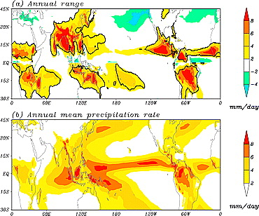
Annual range (a) and annual mean precipitation rate (b). The thick solid lines outline the global monsoon precipitation domain.
The annual range (AR):
The local summer-minus-winter precipitation. Here, summer means JJA in the NH and DJF in the SH.
The global monsoon precipitation domain:
Defined by the region in which the AR exceeds 180 mm and the local summer monsoon precipitation exceeds 35% of annual rainfall.
Wang and Ding (2006, GRL)

Slide 3
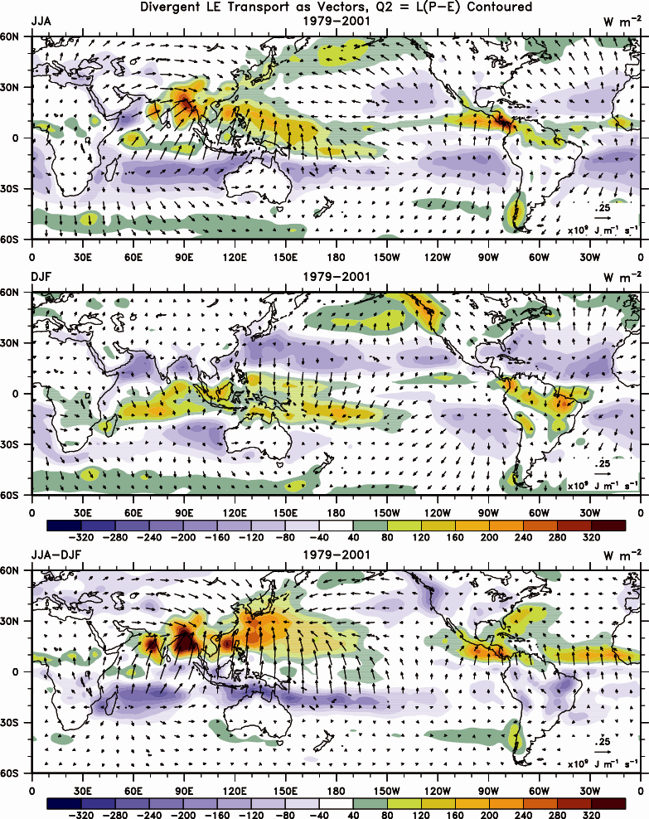
质量守恒令全球季风不同子系统的变化存在关联
Mass conservation is a strong constraint in relating different components of the global monsoon system
(JJA – DJF) Latent heat release (P-E) and water-vapor transport
Courtesy Trenberth and Stepaniak (2004)

Slide 4
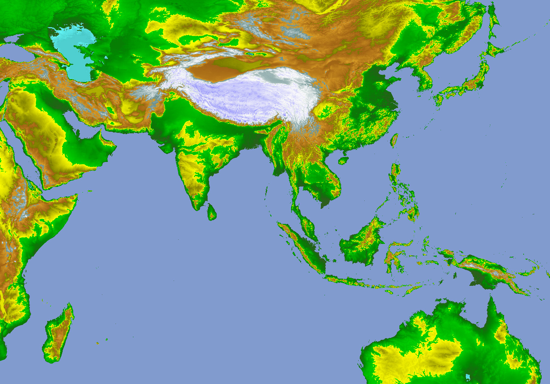
East Asian Summer Monsoon Systems
Cold air from mid-and high lat
Meiyu-Front
Forcing of Tibetan Plateau
D
Northwestern
Pacific
Subtropical
High
Southwest Vortex
Monsoon Low
D
D
Monsoon Trough
Somali Jet
Typhoon
Eastward MJO
Convective Cloud-Cluster
Southeast Trade Wind
Marskerian High
Australian High

Slide 5
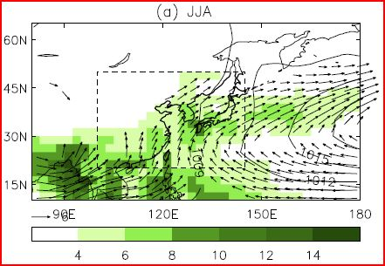
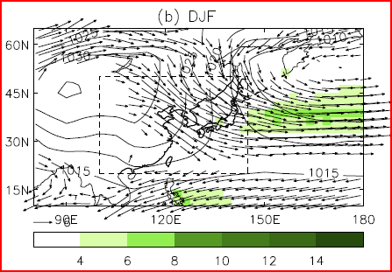
Boo et al 2011, JGR
The 20 year (1979-1999) climatology of precipitation (mm/d, shading), sea level pressure (hPa, solid line), and 850 hPa winds (m/s) in (a) JJA and (b) DJF using GPCP, ERA40, and HadSLP2. Dotted box indicates the East Asia domain for quantitative evaluations. The contour intervals of SLP are 3 hPa in JJA above 1009 hPa and 5 hPa in DJF.

Slide 6
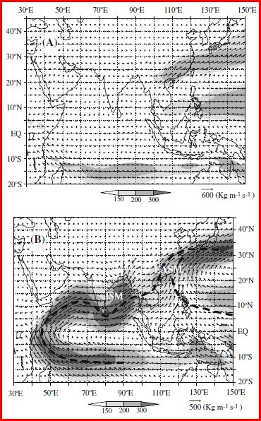
Moisture transport patterns averaged for 1990–1999 during (a) Pre-onset of the ASM (the 6th pentad of March-the 3rd pentad of May), and (b) Post-onset of the ASM (the 5th pentad of May-the 2nd pentad of July).
Cheng et al. 2012; Ding 2004; Ding et al. 2004

Slide 7
Jan
Apr
Jul
Oct
T2m
Pr
Pr StD

Slide 8
Meteorological disasters occur frequently with great losses in China
Great influence and heavy losses in meteorological disasters
4044 deaths
Drought and flood are the major contributors
2.37%
210.5 billion Yuan
Notes:
The meteorological disaster accounts for 71% of all natural disasters in China. In average from 1990 to 2010, each year the meteorological disasters affect about 400 million people and kill more than 4000 people. The annual economic losses reach 210 billion RMB with 2..37% of China’s gross domestic product.

Slide 9
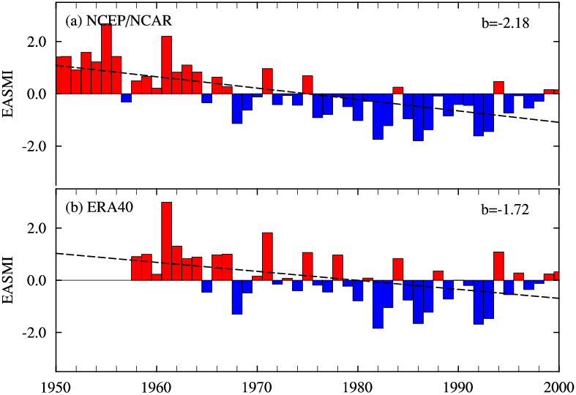
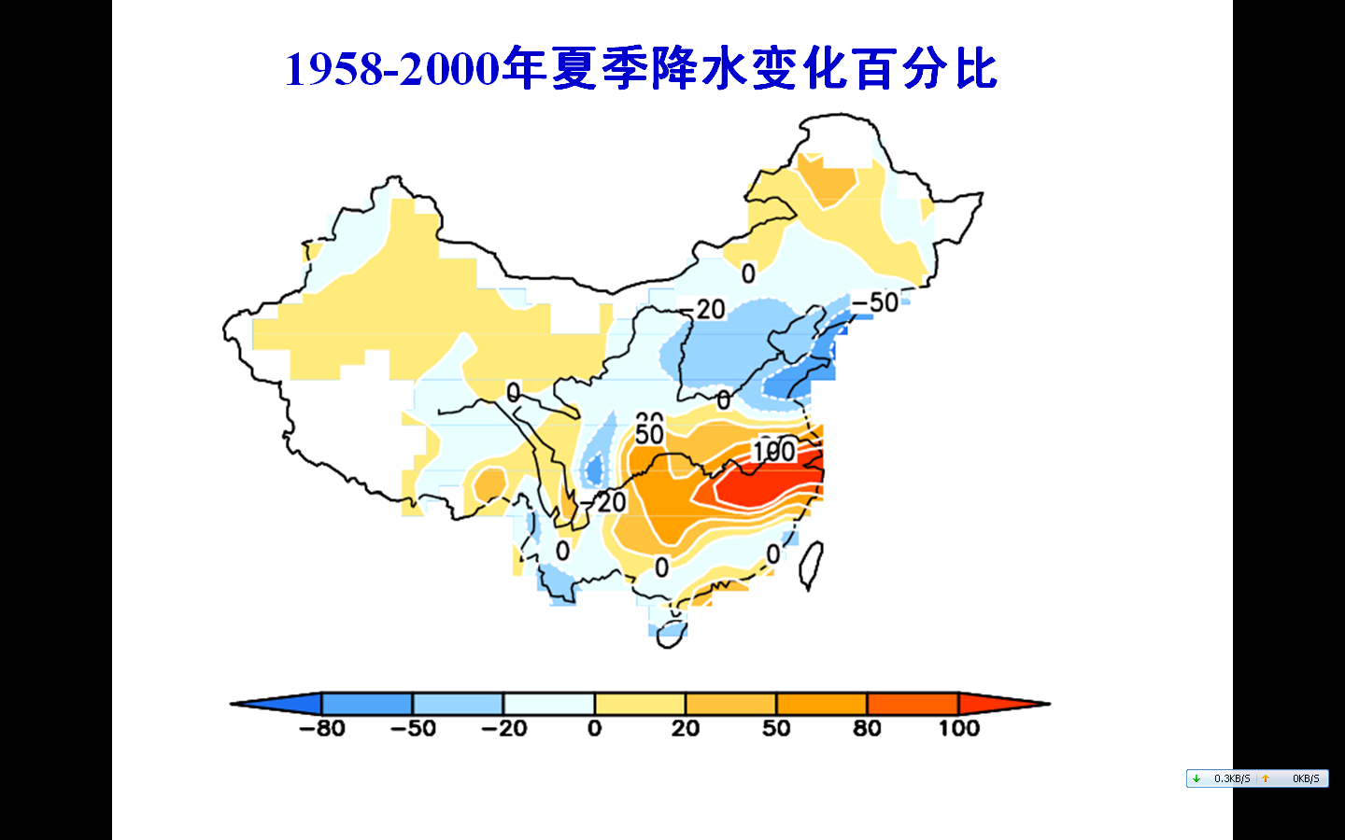
Variation of the East Asian Summer Monsoon during the second half of the 20th century
East Asian Summer Monsoon Index
Decadal variation of rainfall
East Asian Summer Monsoon has strong variabilities at interannual and decadal scales. Since the 1980s, the monsoon diminished in intensity, creating precipitation anomalies (above-normal in the south and below-normal in the north).
Courtesy Dr. T. Zhou

Slide 10
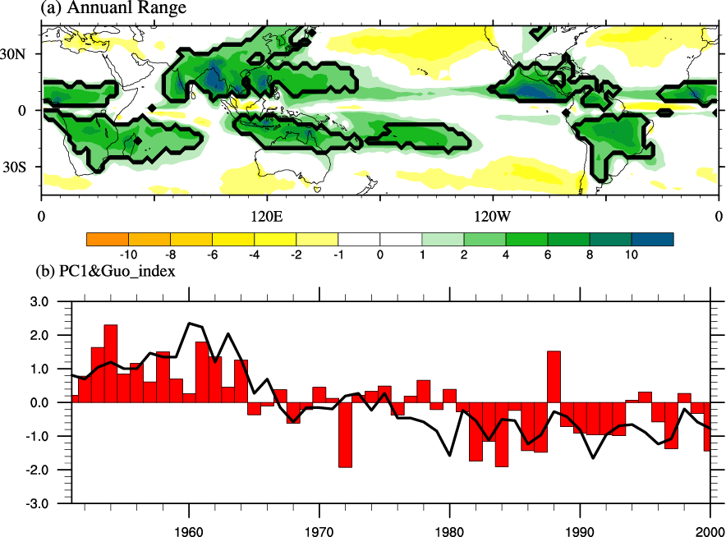
Weakening of EASM and its linkage to the global monsoon
Global Monsoon Domain
Global Monsoon Index
EASM index
(Zhou et al. 2008, GRL; Zhou et al. 2009, Meteor. Z.)

Slide 11
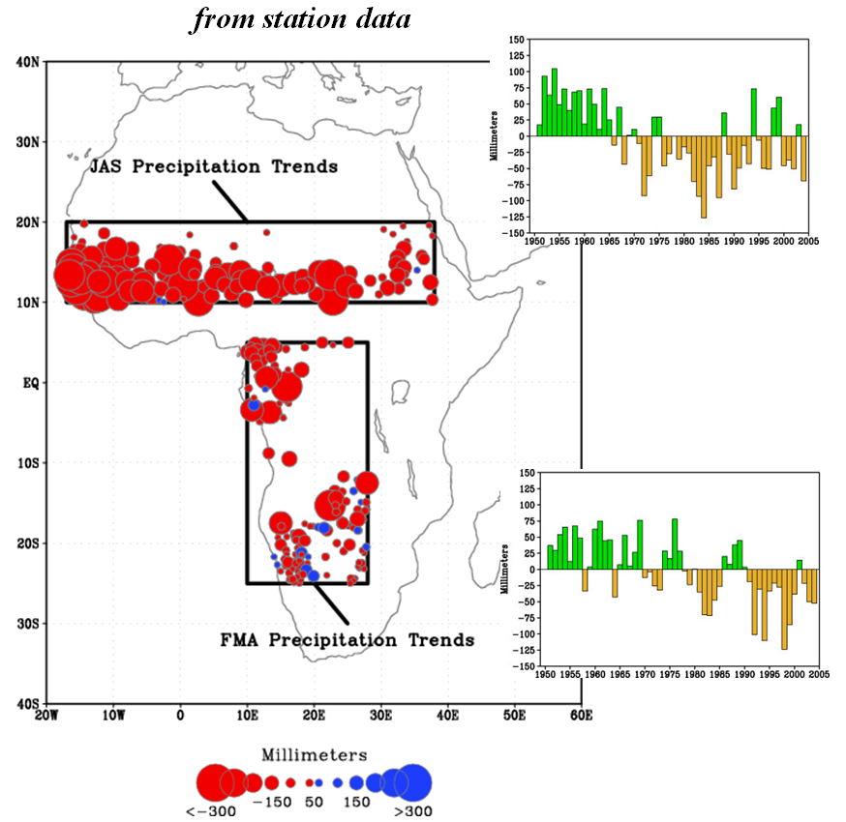
Long-term variation of the African monsoon
EASM index
Courtesy of M. Hoerling et al. (2006)

Slide 12
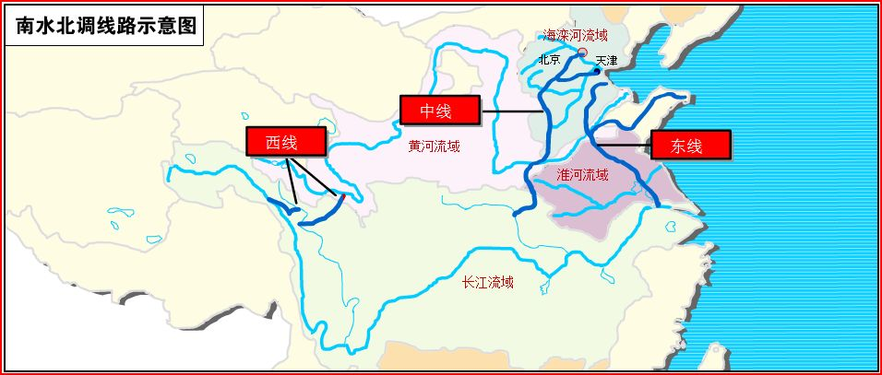
Inter-basins water transfer projects: West / Middle /East
Middle
West
East

Slide 13
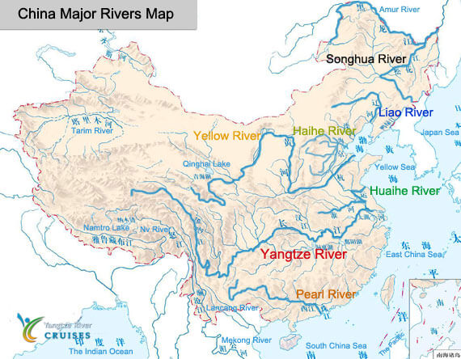
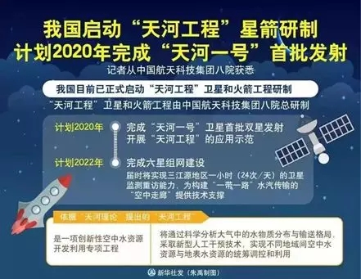
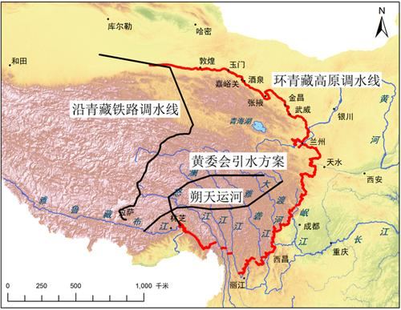
Atmospheric river project (天河工程)
Red flag canals
红旗河 工程

Slide 14
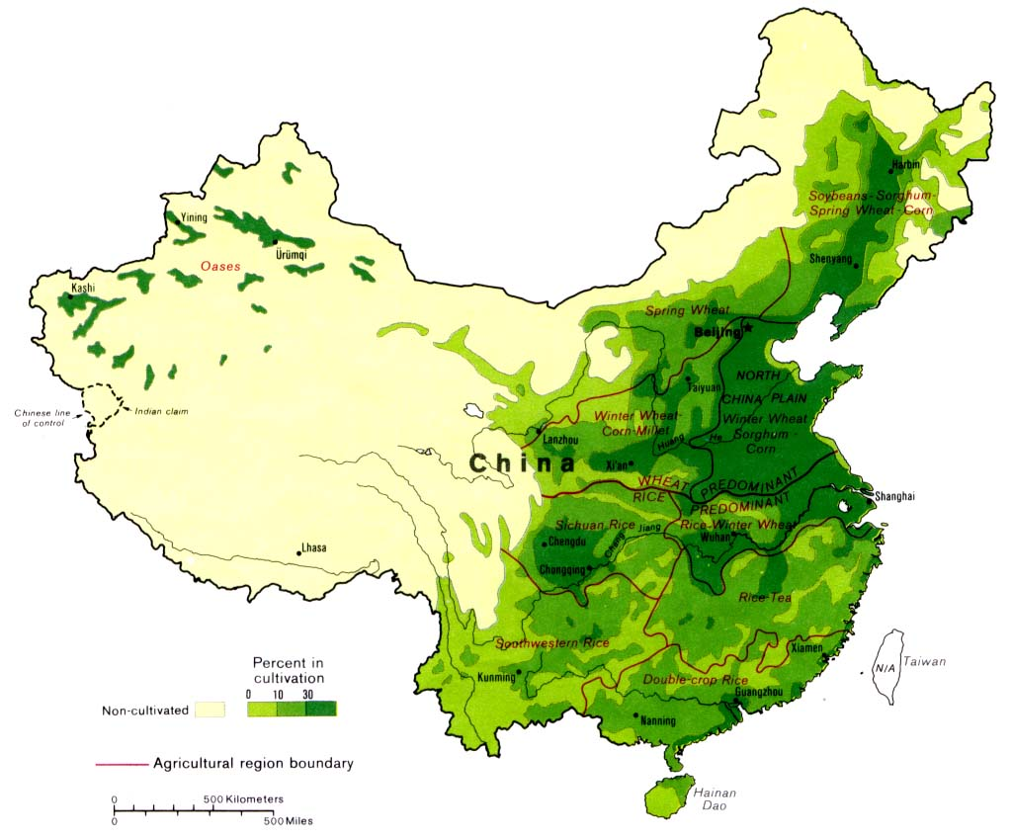
Agricultural regions of Mainland China
Source: Wikipedia / CIA

Slide 15
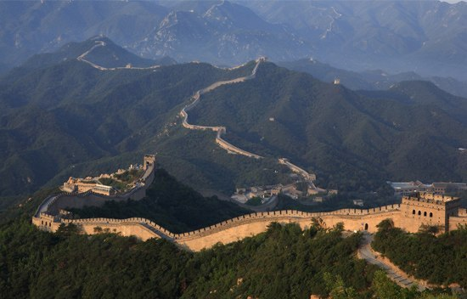
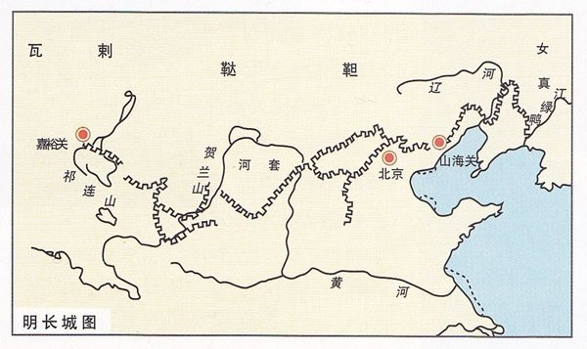
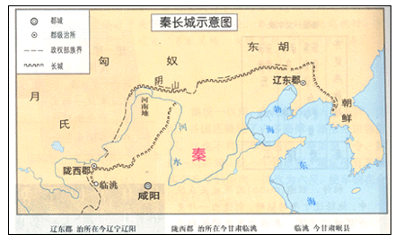
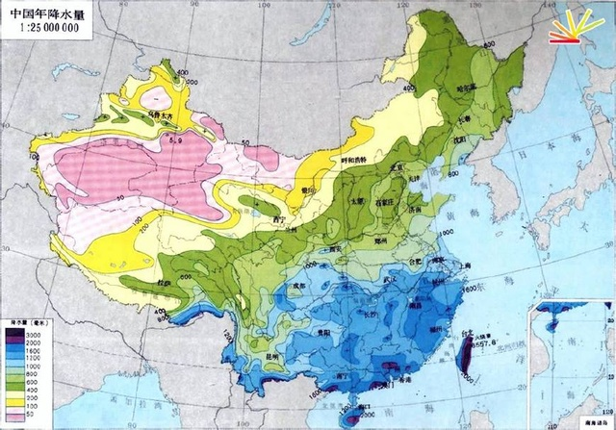
Ming
Qin
Rainfall

Slide 16
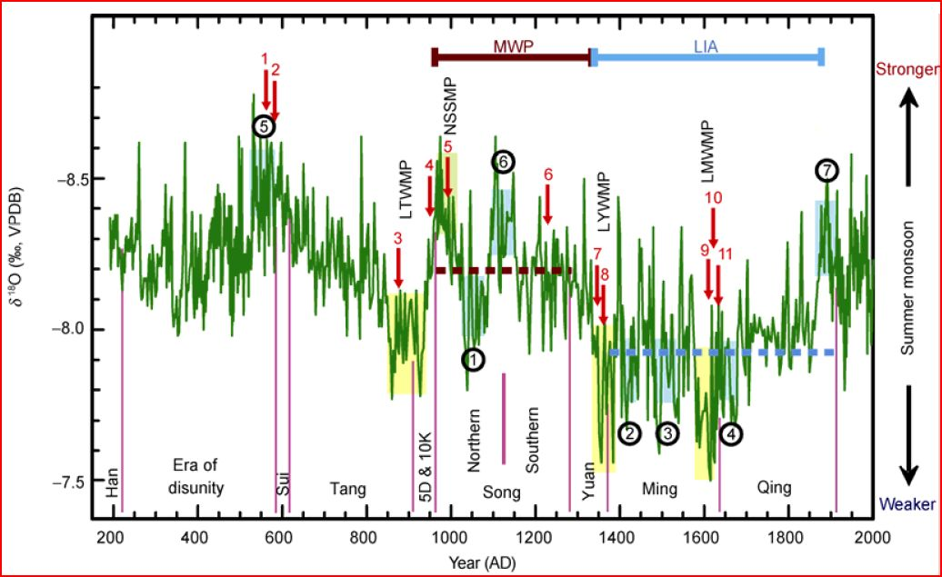
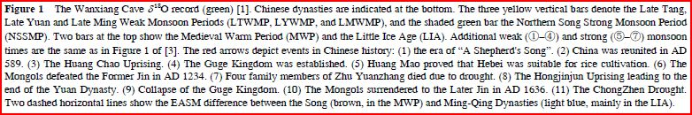
Cheng et al 2010
(Chinese Sci Bull)
Wanxiang Cave, China (33°19′ N, 105°00′ E)

Slide 17
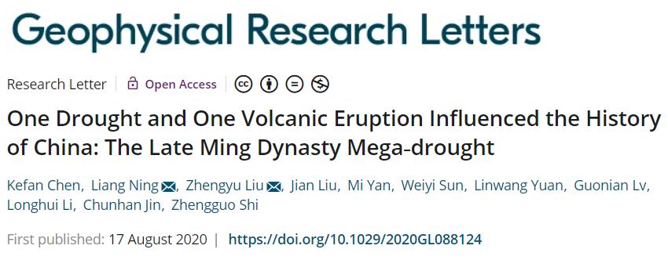
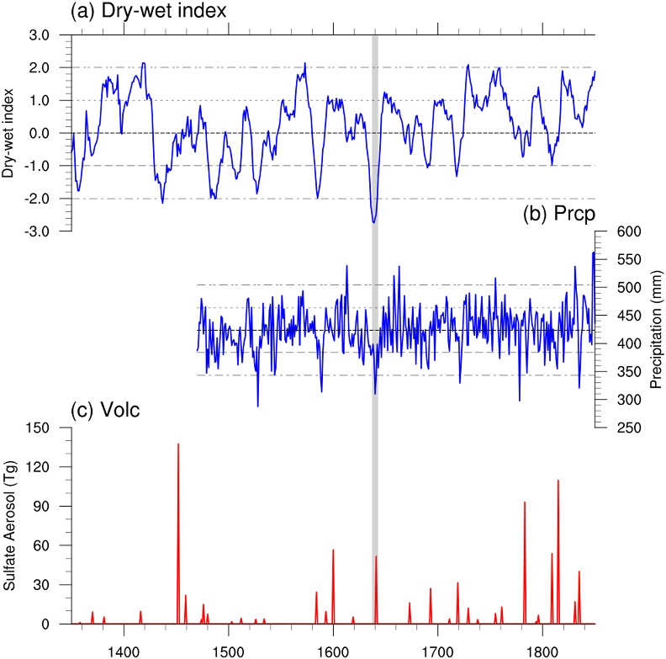
Plain Language Summary: The collapse of the Ming Dynasty at 1644 and, in turn, the historical transition from the Ming Dynasty to Qing Dynasty significantly changed the Chinese history into a long period of conservative policy. The collapse of Ming Dynasty at 1644 is greatly associated with the late Ming Dynasty Megadrought (LMDMD) (1637–1643). In this study, based on paleoclimate reconstructions and climate modeling, we show that the LMDMD is triggered by a natural drought event and is then intensified and extended by the strong volcanic eruption at Mt. Parker in 1641. This “superposition” mechanism of LMDMD and the spatiotemporal characteristics of this drought are reproduced by our volcanic sensitivity experiments with volcanic forcing superimposed on natural drought events, and the results demonstrate that the explosion of Mt. Parker at the end of a natural drought event amplified and extended the drought for 3 years, generating the megadrought. The volcano‐prolonged drought is associated with the failure of East Asia Summer Monsoon (EASM), which is caused directly by the decreasing land‐ocean thermal contrast after the volcanic eruption and indirectly by negative soil moisture feedback as well as weakening and eastward retreating of the West Pacific Subtropical High (WPSH).
Abstract: The late Ming Dynasty Megadrought (LMDMD) (1637–1643) occurred at the end of Ming Dynasty and is the severest drought event in China in the last millennium. This unprecedented drought contributed significantly to the collapse of the Ming Dynasty in 1644, casting profound impacts on Chinese history. Here, the physical mechanism for the LMDMD is studied. Based on paleoclimate reconstructions, we hypothesize that this drought was initially triggered by a natural drought event starting in 1637 and was then intensified and extended by the tropical volcanic eruption at Mount Parker in 1641. This hypothesis is supported by the case study of the Community Earth System Model‐Last Millennium Experiment archive as well as sensitivity experiments with volcanic forcing superimposed on natural drought events. The volcano‐intensified drought was associated with a decreased land‐ocean thermal contrast, a negative soil moisture response, and a weakening and eastward retreating West Pacific Subtropical High.
The LMDMD in reconstructions. (a) The reconstructed DWI from 1350–1850 (Zheng et al., 2006); (b) The reconstructed summer precipitation (Shi et al., 2018) over the North China Plain and the Yangtze and Huaihe river areas (Figure S1) between 1470 and 1850 (unit: mm); (c) the reconstructed sulfate aerosol in period of 1350–1850 (unit:10−5 kg/m2) (Gao et al., 2008).

Slide 18
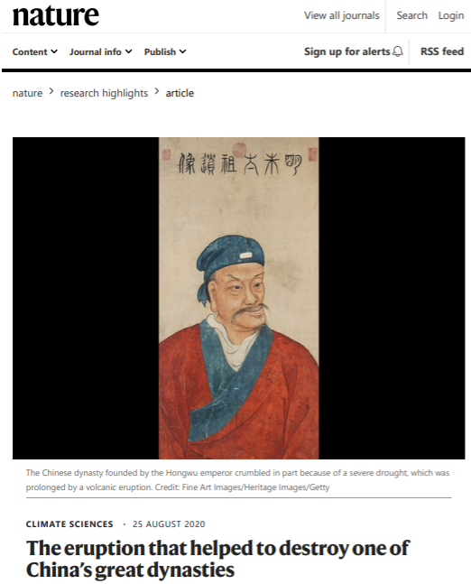

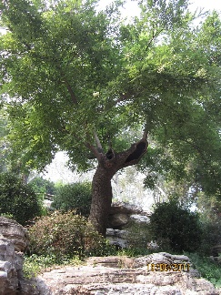
The Chongzhen Emperor (Chinese: 崇禎; 27 January 1611 – 25 April 1644), personal name Zhu Youjian (Chinese: 朱由檢), was the 17th and last Emperor of the Ming dynasty as well as the last ethnic Han to rule over a unified China proper. He reigned from 1627 to 1644. "Chongzhen," the era name of his reign, means "honorable and auspicious".
Zhu Youjian was son of the Taichang Emperor and younger brother of the Tianqi Emperor, whom he succeeded to the throne in 1627. He battled peasant rebellions and was not able to defend the northern frontier against the Manchu. When rebels reached the capital Beijing in 1644, he committed suicide, ending the Ming dynasty. The Manchu formed the succeeding Qing dynasty. (source: Wikipedia)
Cooling particles in a volcanic plume intensified the drought that toppled the Ming dynasty. The collapse of China’s prosperous Ming dynasty, one of the most stable in Chinese history, has been attributed, in part, to the 1641 eruption of a volcano thousands of kilometres from the imperial capital in Beijing. Geoscientists have long known that a mega-drought that parched eastern China between 1637 and 1643 was the most severe to affect the area during the last millennium, but they did not know precisely what made it so bad. Liang Ning at Nanjing Normal University in China, Zhengyu Liu at Ohio State University in Columbus and their colleagues looked at records of past temperatures, as well as ice-core records and climate models, to unravel the mystery. The drought kicked off as a standard dry spell. Four years later, Mount Parker in the Philippines erupted. Volcanic particles blanketed the region, cooling the air more than the ocean’s surface and setting up weather patterns that weakened the East Asian monsoon. The monsoon rains were much lighter than usual and the drought lasted for another three years. The Ming dynasty’s fall ushered in the Qing dynasty, which imposed conservative policies and ruled for nearly three centuries.

Slide 19
Wu et al., 2016: Outburst flood at 1920 BCE supports historicity of China’s Great Flood and the Xia dynasty. Science 05 Aug 2016: Vol. 353, Issue 6299, pp. 579-582. DOI: 10.1126/science.aaf0842
Flood control initiates Chinese civilization: Around four millennia ago, Emperor Yu the Great succeeded in controlling a huge flood in the Yellow River basin. This is considered to have led to the establishment of the Xia dynasty and the start of Chinese civilization. However, the dates of the events and the links between them have remained uncertain and controversial. Using stratigraphic data and radiocarbon dating, Wu et al. verify that the flood occurred and place the start of the Xia dynasty at about 1900 BC, thus reconciling the historical and archaeological chronologies.
Abstract: China’s historiographical traditions tell of the successful control of a Great Flood leading to the establishment of the Xia dynasty and the beginning of civilization. However, the historicity of the flood and Xia remain controversial. Here, we reconstruct an earthquake-induced landslide dam outburst flood on the Yellow River about 1920 BCE that ranks as one of the largest freshwater floods of the Holocene and could account for the Great Flood. This would place the beginning of Xia at ~1900 BCE, several centuries later than traditionally thought. This date coincides with the major transition from the Neolithic to Bronze Age in the Yellow River valley and supports hypotheses that the primary state-level society of the Erlitou culture is an archaeological manifestation of the Xia dynasty.

Slide 20
Wu et al. 2016, Science
Major transition of archaeological cultures in the Yellow River valley around 1900 BCE.
C, culture; LS C, Longshan culture. (A) Distribution of the late Neolithic and early Bronze Age cultures in the Yellow River valley. Blue dashed lines show avulsion of the lower Yellow River channel ~2000 BCE (24). (B) Timeline showing ages of the archaeological cultures and the proposed Great Flood of China.

Slide 21
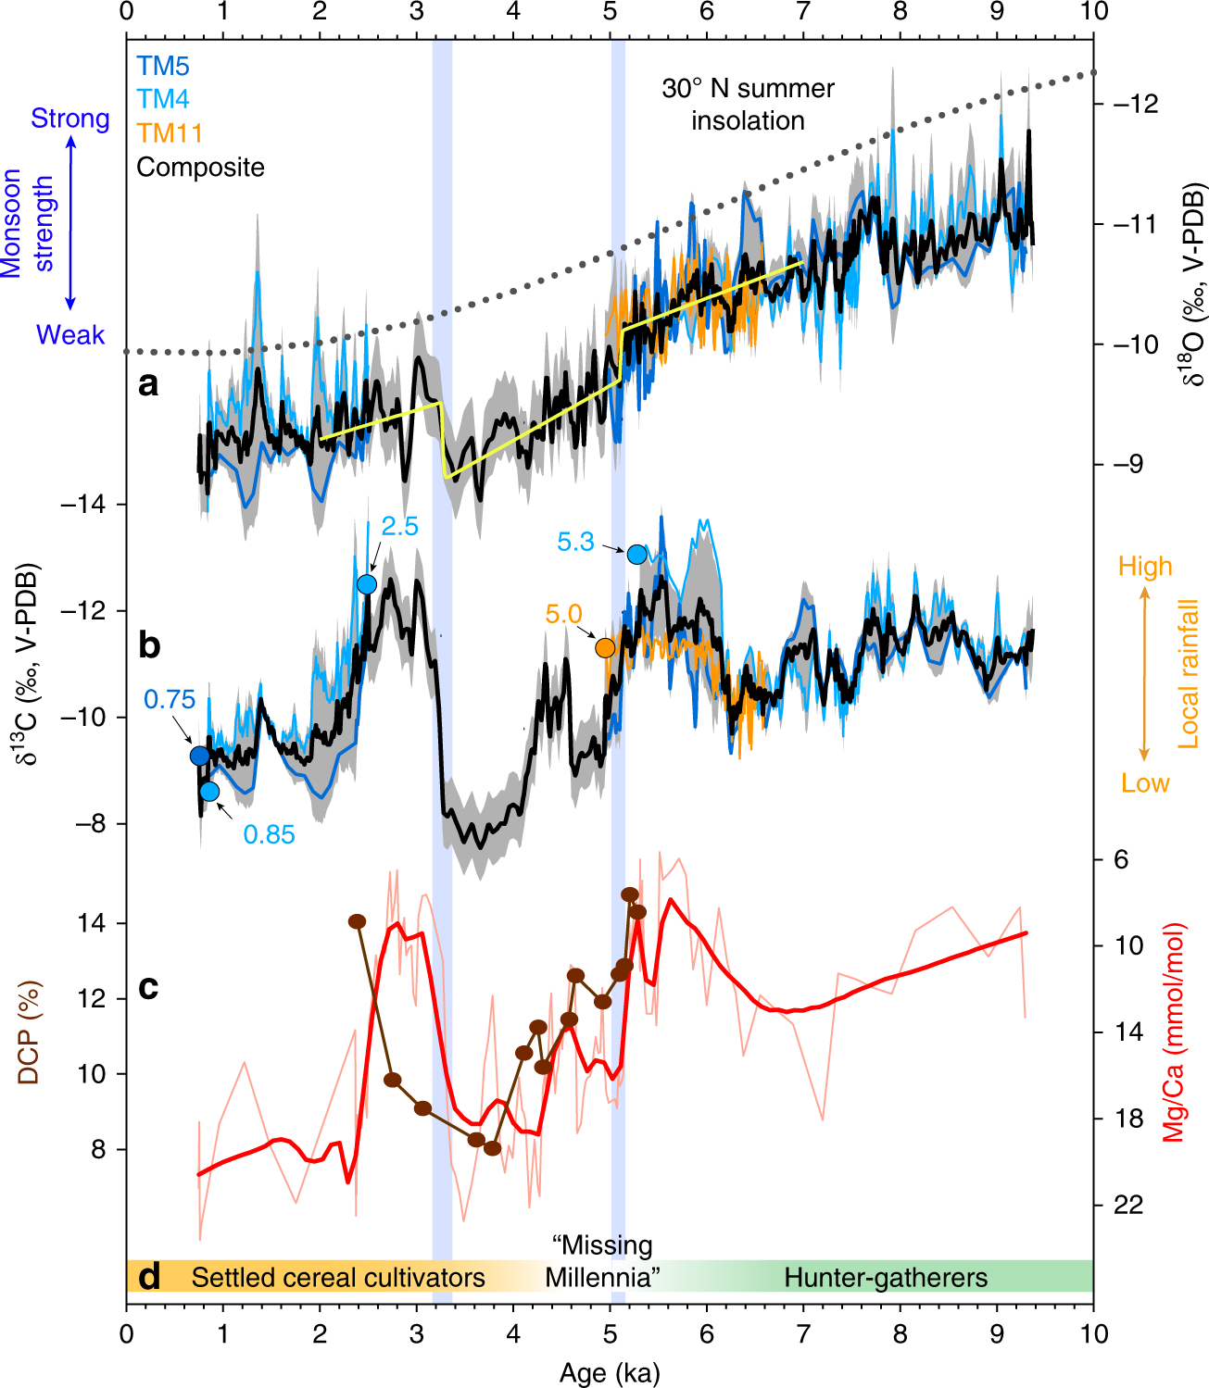
The multiproxy hydroclimate record from northern Laos and cultural shifts in mainland Southeast Asia for the Holocene.
a δ¹⁸O and b δ¹³C for stalagmites TM4 (cyan), TM5 (blue), and TM11 (orange), expressed in per mill (‰) relative to Vienna Peedee Belemnite (V-PDB). Black line represents the composite record constructed by averaging data for the periods of overlap of each stalagmite record. Gray shading indicates the standard deviation for periods of overlap. Yellow curve in panel a shows changepoints calculated using a Bayesian change-point algorithm that employs a probabilistic least-squares method to identify significant regime shifts. Color-coded circles indicate times when the various speleothems stopped and started growing. Prior to averaging, the δ¹⁸O curve of TM11 was offset by −0.6‰. c Mg/Ca and ¹⁴C-inferred dead carbon proportion (DCP) for stalagmite TM5. d Approximate timing of lifestyle changes in mainland Southeast Asia during the Holocene
Griffiths et al., 2020: End of Green Sahara amplified mid- to late Holocene megadroughts in mainland Southeast Asia.
Nature Communications

Slide 22
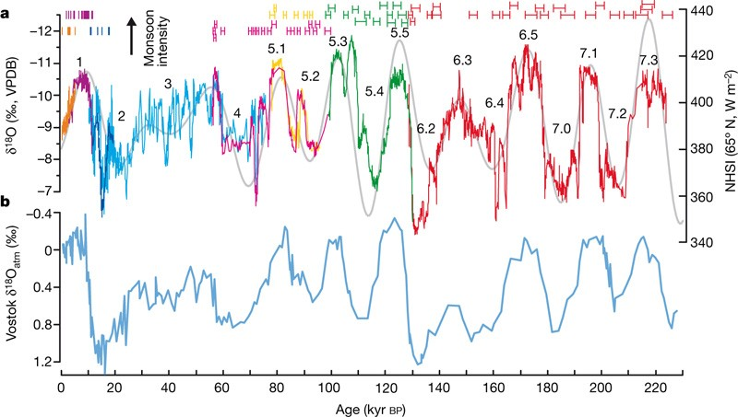
Comparison of Sanbao/Hulu δ18O records with NHSI and atmospheric δ18O record over the past 224 kyr BP. a, Time versus Sanbao δ18O records (red, stalagmite SB11; green, SB23; yellow, SB25-1; pink, SB22; dark blue, SB3; purple, SB10 and orange, SB26) and Hulu cave (blue), and NHSI (Northern Hemisphere summer insolation, 21 July) at 65°N10 (grey). For comparison, the Hulu δ18O record is plotted 1.6‰ more negative to account for the higher Hulu values than Sanbao cave. The 230Th ages and errors (2σ error bars at top) are colour-coded by stalagmites. Numbers indicate the marine isotope stages and substages. b, The atmospheric δ18O record from Vostok ice core, Antarctica
Wang et al. 2008, Nature: Millennial- and orbital-scale changes in the East Asian monsoon over the past 224,000 years

Slide 23
Detection and attribution of Monsoon variation?
An uncertain issue !

Slide 24
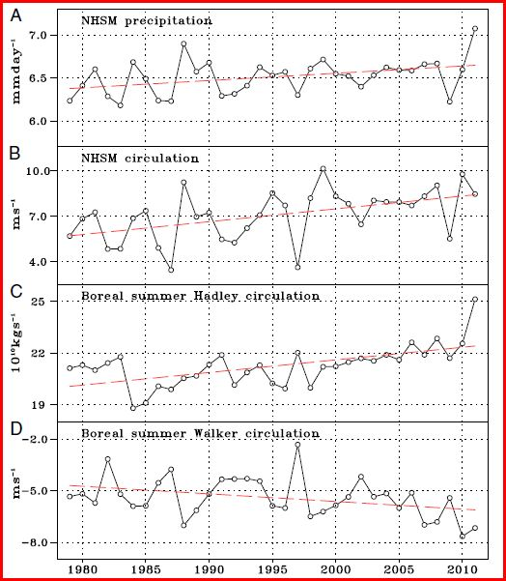
Variability and trends of the NHSM system, and the Hadley and Walker circulation. Time series of boreal summer (MJJAS) mean indices representing (A) NHSM precipitation intensity (mm/d) averaged over the entire NH monsoon rainfall domain; (B) NHSM circulation intensity measured by the vertical shear of zonal wind (850 hPa minus 200 hPa) averaged over 0°–20°N, 120°W–120°E, (r=0.85); (C) Hadley circulation intensity measured by the maximum absolute value of the cross-equatorial, zonal mean meridional mass stream function
(10¹⁰ kg·s−1); and (D) Walker circulation intensity measured by the low-level zonal winds at 850 hPa averaged over the equatorial Pacific (10°S–10°N,
140°E–120°W). The red dashed lines in each panel denote the linear trends.
Wang et al. 2012 PNAS

Slide 25
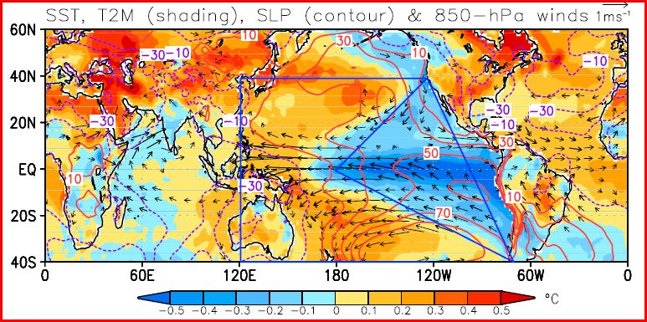
Climate anomalies associated with the NHSM circulation index. Regressed 2-m air temperature anomalies over land and SST anomalies over ocean (shading: °C), sea-level pressure anomalies (contours: Pa) and 850-hPa wind anomalies (vector) with respect to the NHSM circulation (VWS) index for the period of 1979–2010. Wind vectors are significant at 95% confidence level by the Student t test. The blue lines outline the eastern Pacific triangle and western Pacific K-shape regions where the mega-ENSO index is defined. The HadISST and ERAI reanalysis data were used
Wang et al. 2012 PNAS

Slide 26
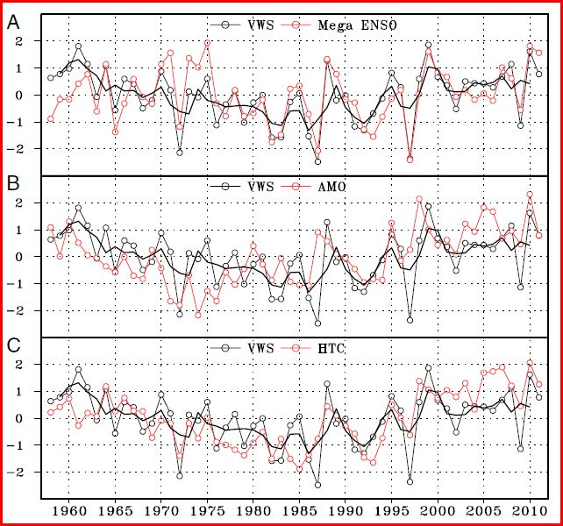
Normalized NHSM circulation index in relation to the mega-ENSO, AMO, and hemispheric thermal contrast (HTC).
normalized mega-ENSO index (r = 0.77).
(B) Normalized AMO index, (r = 0.44).
(C) Normalized HTC index measured by the 2-m air temperature averaged over the NH (0–60°N) minus that over the SH (0–60°S), (r = 0.63).
The thick black lines in each panel denote 3-y running means of NHSM circulation index. The merged ERA-40 (1958–1978) and ERAI (1979–2011) reanalysis datasets were used.
Wang et al. 2012 PNAS

Slide 27
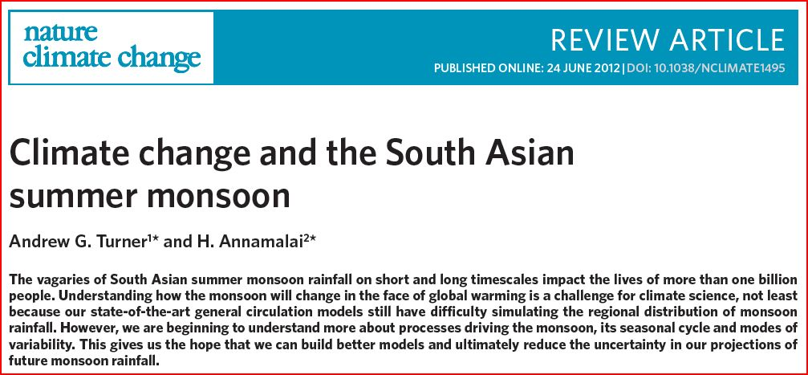

Slide 28
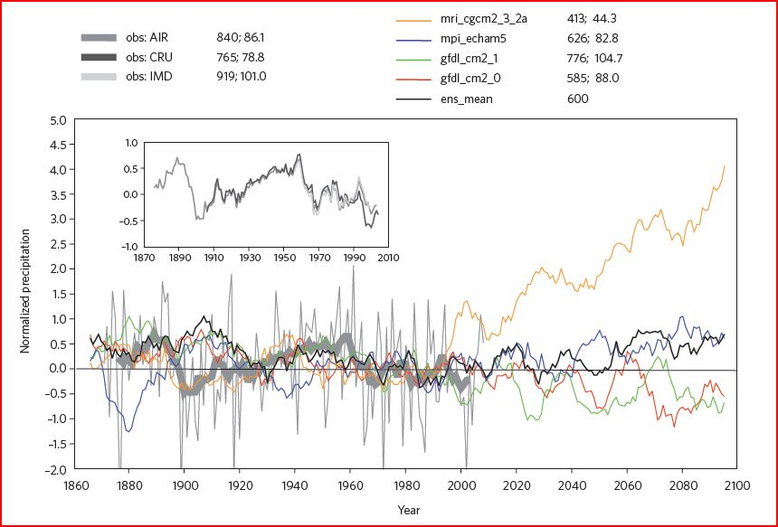
Figure 2 Time series of mean summer (June–September) precipitation averaged over land points within 60–90° E, 7–27° N in the historical (20c3m; 1861–1999) and SRES A1B (2000–2100) future projection CMIP3 experiments. Four models are depicted; the black curve shows their ensemble mean. Observations from the AIR index are also shown for the 1871–2008 period as a proxy for South Asia rainfall. All curves are first normalized by their mean and standard deviation measured over 1961–1999 and are passed through an 11-year moving window. The faint black curve shows the observations without this smoothing. The inset compares the AIR with area-mean averages over the same domain as above from 1951–2004 IMD daily gridded data and 1901–2009 monthly gridded CRU data. The values listed in the legend are for June–September mean rainfall and interannual standard deviation, in mm. Obs, observations.
Turner and Annamalai 2012, Nature Climate Change

Slide 29
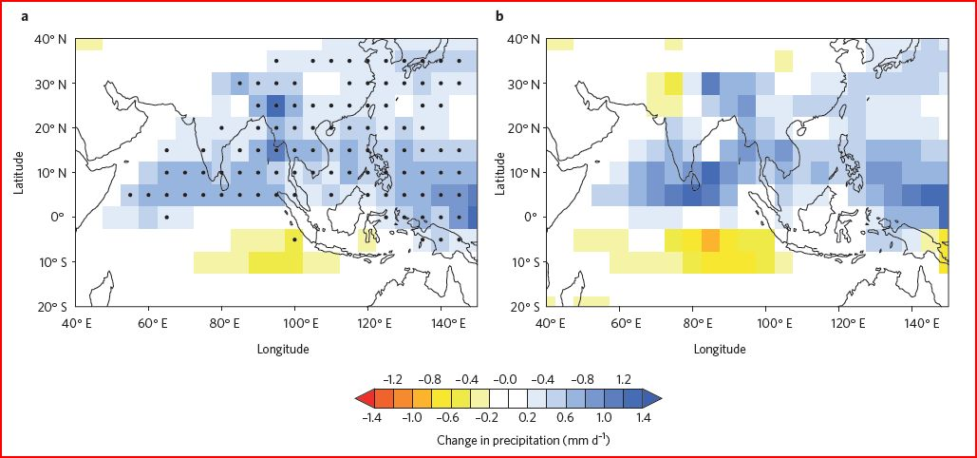
Figure 3 Precipitation response to doubling of carbon dioxide concentrations. Mean summer (June–September) precipitation projections in the 1% per year increasing carbon dioxide experiment (1pctto2x) of the CMIP3 multimodel database after doubling of carbon dioxide concentrations relative to control conditions. a, Mean across 20 models. b, A subset of four of these models judged to reasonably simulate the monsoon seasonal cycle, interannual variability and the teleconnection between monsoon rainfall and ENSO. Models were first bilinearly interpolated onto a common 5° grid to compute ensemble means. Stippling in a indicates where more than two-thirds of the models agree on the sign of change.
Turner and Annamalai 2012, Nature Climate Change

Slide 30
Changes (2071/2100 – 1971/2000, RCP8.5) in surface air temperature (°C)
in global models (upper panels) and regional models (lower panels)

Slide 31
Changes (2071/2100 – 1971/2000, RCP8.5) in rainfall rate(mm/day)
in global models (upper panels) and regional models (lower panels)

Slide 32
Catchment basins of main Asian rivers
(10⁻³)
Amur
Yellow
Yangtse
Huai
Pearl
Red
Mekon
(10⁻³)
(10⁻³)
Water flow discharges for main Asian rivers, simulated for the present-day climate (solid curves) and end of 21st century (dashed lines): a general increase in the North, but stable in the South.

Slide 33
From “An Analysis of China’s INDC” authored by Fu Sha, Zou Ji, Liu Linwei
(China National Center for Climate Change Strategy)
Highlights of the INDC include specific goals such as:
To achieve peak carbon dioxide emissions by approximately 2030, or sooner as best efforts allow
To lower carbon dioxide emissions per unit of GDP by 60% to 65% from 2005 levels
To increase the share of non-fossil fuels in the primary energy mix to approximately 20%
To increase the volume of forest stock by approximately 4.5 billion cubic meters over 2005 levels
Continue to proactively adapt to climate change through: enhanced mechanisms- and capacity-building; the effective management of climate change risks in sector such as agriculture, forestry and water resources and in regions including urban, coastal and ecologically vulnerable areas; improved early warning and emergency response systems and disaster prevention and mitigation mechanisms.

Slide 34
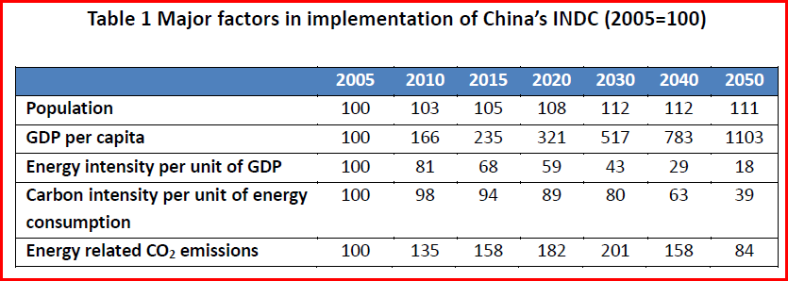
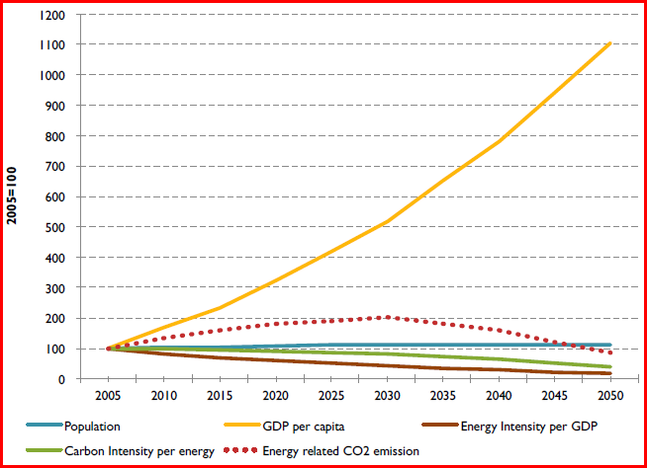

Slide 35
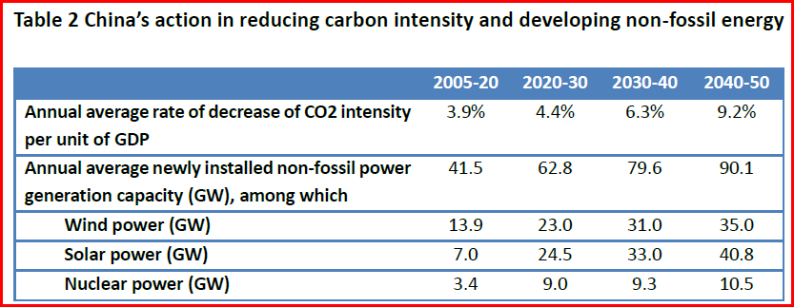

Slide 36
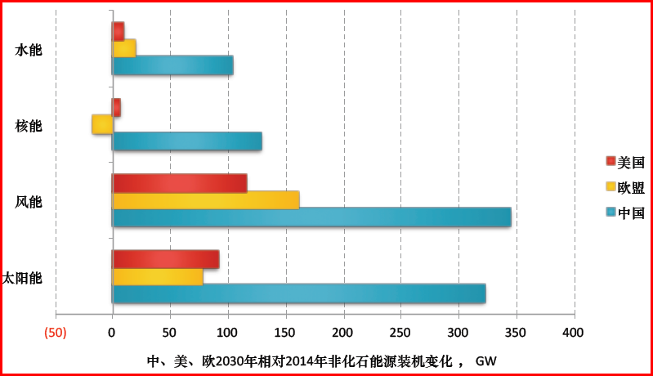
hydro
nuclear
USA
EU
aeolian
China
photovoltaic
Change in non-fossil generation capacity in 2030 compared to 2014 (GW)

Slide 37
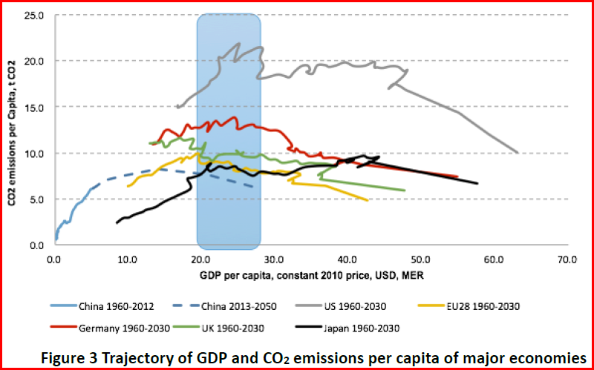

Slide 38
Changement climatique en Chine - les interactions avec la société et la politique de lutte contre le changement climatique
Laurent Li
(laurent.li@lmd.jussieu.fr)
Laboratoire de Météorologie Dynamique (LMD)
Institut Pierre-Simon Laplace (IPSL)
CNRS, UPMC, ENS, Ecole Polytechnique
Paris, France
Basics of Climate in China and relations to human societies
China’s INDC: rationales and impacts

