Slide 1
Energie et développement durable dans le domaine des accélérateurs
(exemples des sources de lumière)
05 October 2023
Roscoff, France
JL Revol
ESRF, Grenoble, 29-30 September 2022

Slide 2
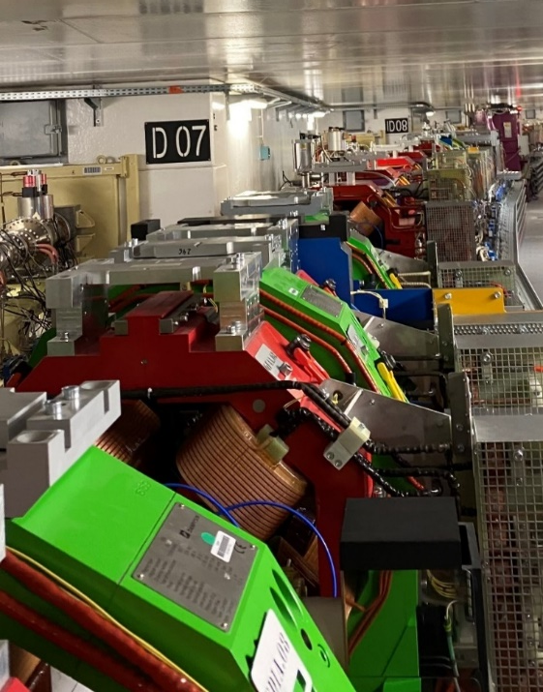
outline
Context
Sustainability for light sources
6th ESSRI workshop
Examples from ESRF, SLS and PETRA IV
Conclusion and outlooks
ESSRI: Energy for Sustainable Science at Research Infrastructures

Slide 3
Definition of sustainability
Sustainability (développent durable) consists of
fulfilling the needs of current generations
without compromising the needs of future generations, while ensuring a balance between
economic development,
environmental care and
social well-being
➔ Sustainability is often limited to energy management mostly driven by …… cost reduction
➔ High energy prices and crisis often help and not hinder decarbonisation

Slide 4
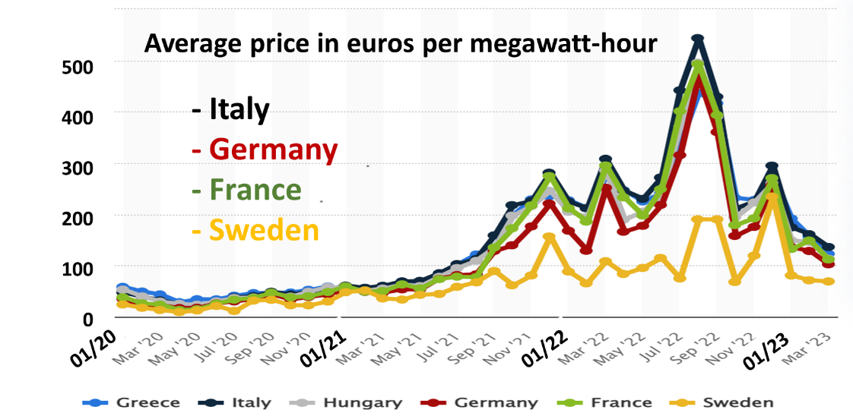
context
Practical experience of climate change due to record temperatures, long drought periods, forest fires, floods
General inflation of energy cost: Covid19, Ukraine invasion, Unpredictable fluctuations on the energy trading exchange
https://indico.esrf.fr/event/2/timetable/#20220929.detailed
Some light sources were obliged to reduce user operation this year (Soleil, Elettra, Solaris…)

Slide 5
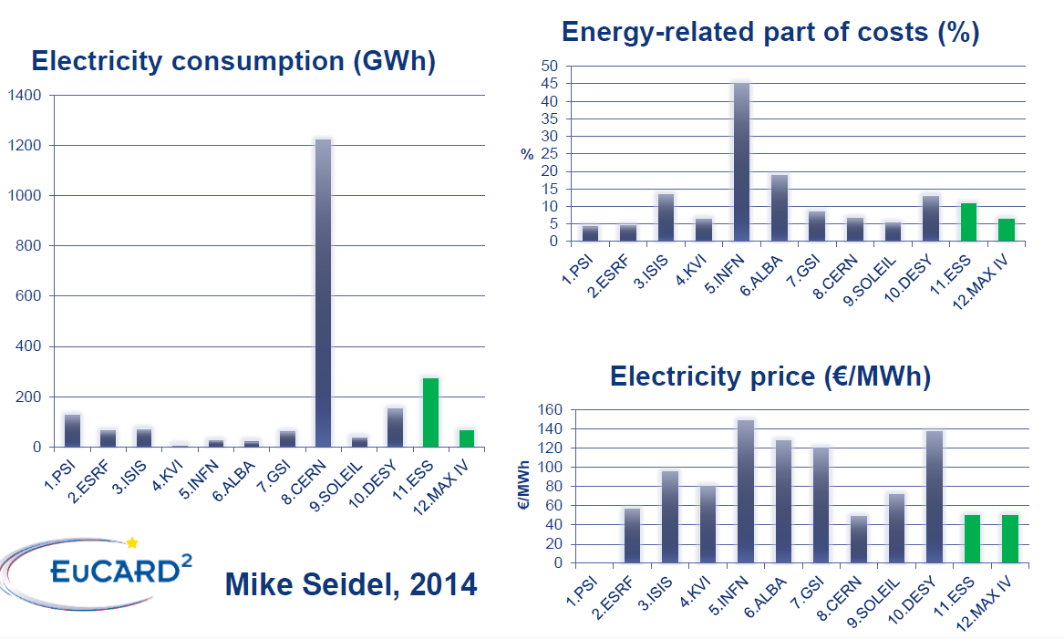
Laboratory survey: energy consumption and energy cost
There will be no future large-scale project without an energy management component, an incentive for energy efficiency and energy recovery among the major objectives
Light sources are not the largest energy consumers but the economical and societal aspects are today key concerns for us

Slide 6
sustainability for a light source
Design Initial construction upgrade and development
Operation
Good Practice
Include efficiency and sustainability as primary specifications
Assess sustainability challenges
Select energy efficient technology within reasonable costs and return on investment for the accelerators and the infrastructure
Reuse of infrastructure, waste and recyclability management of old components
Optimize the running costs Beam parameters, RF power, Injector consumption, Cooling
Adapt the operation schedule towards lower energy consumption User delivery, maintenance and developments
Consumption flexibility to follow the energy availability and prices but difficult with a user program
Promote remote access for users and operation
Travel policies to reduce costs and carbon emission
Balance the infrastructure running cost with investment

Slide 7
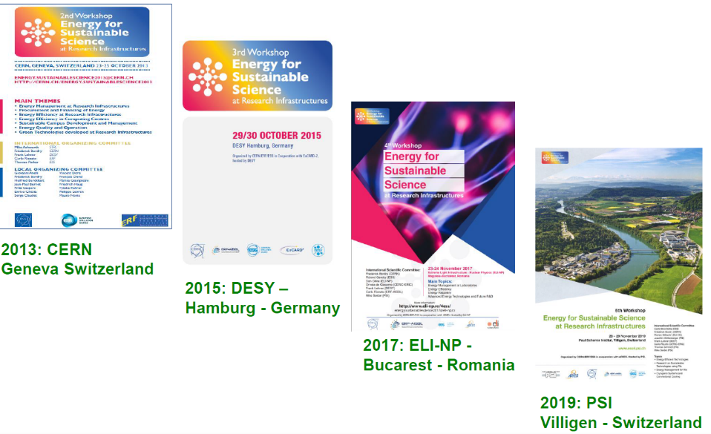
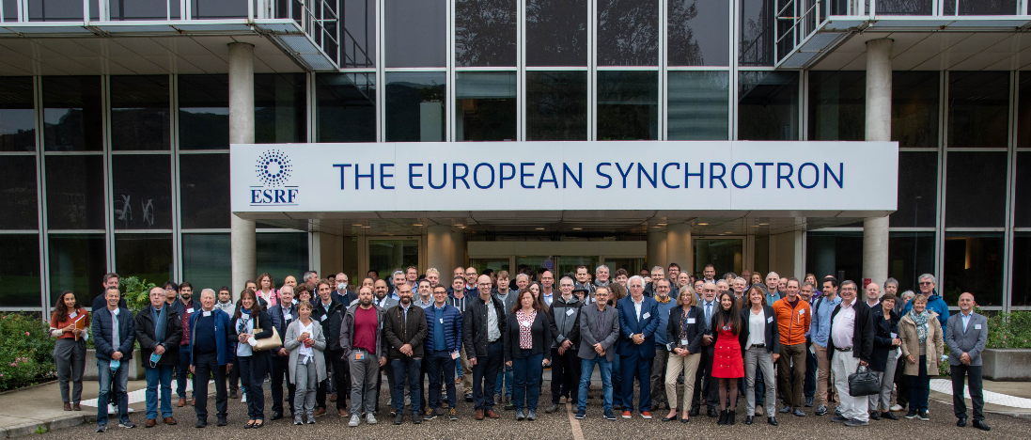
ESSRI Workshop series
The 6th ESSRI workshop in a series and was held at ESRF in Grenoble in September 2022 at the ESRF.
2011: ESS
Lund - Sweden
Main themes:
Energy management at research infrastructures and resulting experience
Sustainability of equipment, materials and resources
Energy-efficient technologies
100 participants coming mostly from Europe,
(a few more participants following the workshop remotely)
International Committee
29 September 2022

Slide 8
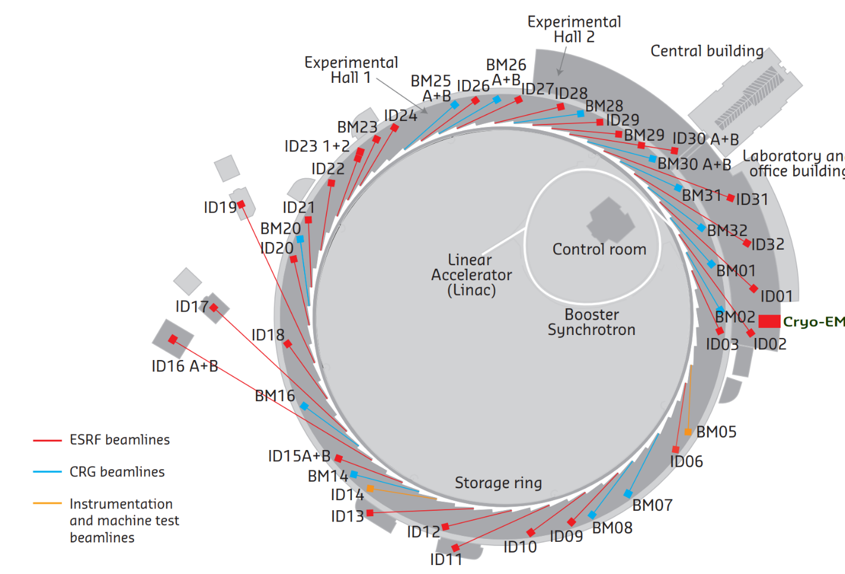
The ESRF case: ESRF fact and figures
Light source in operation since 1994, Grenoble, France
22 partner nations
Budget: 115 million euros, Staff: 700 people
5500 hours of beam delivery
1500 experimental sessions
49 beamlines
Upgrade programme 2009-2023 (2 phases):
New beamlines
Renew infrastructures and support facilities
New storage ring source (EBS)
E- Linac
200 MeV
Booster synchrotron
300m, 4Hz
The Extremely Brilliant Source (EBS) 2015-2020:
Decrease the horizontal emittance
Increase the source brilliance
Increase the source coherence
Keep as much as possible of the infrastructure
Storage Ring
6 GeV, 200 mA
844 m, 32 cells
4000 pm.rad
133 pm.rad

Slide 9
The ESRF case: EBS upgrade lattice
Dipoles-quadrupoles
PM
PM
PM
PM
Dipole
Dipole
Dipole
Dipole
 | Units | ESRF | ESRF-EBS
Energy | GeV | 6 | 6
Circumference | m | 844.4 | 844
Lattice |  | DBA | HMBA
Current | mA | 200 | 200
Lifetime | h | 50 | 25
Emittance H | pm.rad | 4000 | 133
Emittance V | pm.rad | 4 | 10*
31 magnets per cell instead of 17
Free space between magnets (for one cell): 3.4m instead of 8m

Slide 10
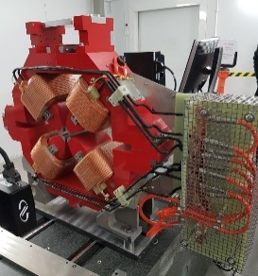
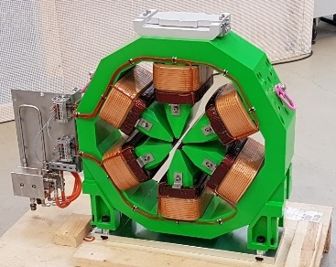
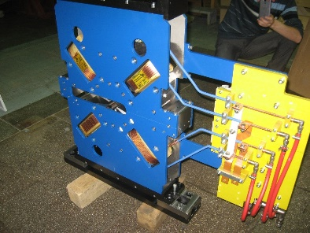
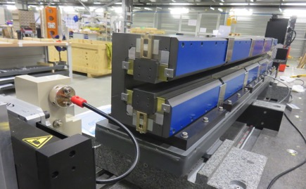
The ESRF case: magnets optimization
Space limitation, Wall plug power, Performance, Procurement, Installation, Operation
Resistive magnets
Permanent magnets
Copper cross section adapted for reasonable current density
~ 3 A/ mm² @ nominal working point
Primarily for fixed field magnets
➔ Dipoles
Wall plug power=0
Affordable technology (and cost)
Experience with insertion device construction
High & Moderate Gradient Quadrupoles
Sextupoles
Octupoles
Sm₂C0₁₇,
➔ Also for septa
(Some) tunability and flexibility should be maintained for the lattice.

Slide 11
The esrf case: Power and energy consumption
ESRF : | 2018 | EBS
Dipoles (D) | 720 kW | 0
Correctors and Steerers | 10 kW | 11 kW
Other magnets | 1625 kW | 1059 kW
Dipole-quadrupoles (DQ) |  | 16%
High gradient quadrupoles (HGQ) |  | 29%
Moderate gradient quadrupoles (MGQ) |  | 44 %
Sextupoles (S) |  | 10%
Octupoles (O) |  | 1%
Total | 2355 kW | 1070 kW
Energy for one year operation ( 7200 H: USM+MDT) | 16.9 GWh | 7.7 GWh
Very positive experience with Permanent Accelerator Magnet for EBS:
Works as expected, passive devices in the storage ring, no maintenance
… and no cabling, no power supply, no cooling, no vibration, easier installation and better operational reliability
Very good stability vs temperature, based on passive compensation
Electrical power required for the EBS magnets ➔ half that of the previous lattice
DQs and HGQs could be permanent magnets (no tuning required), 476 kW additional saving
Storage Ring Total power: 6350 kW [2018] 4100 kW [EBS]
Permanent magnet is convincing for operation,…but the overall sustainability is less obvious considering the extraction and production issues

Slide 12
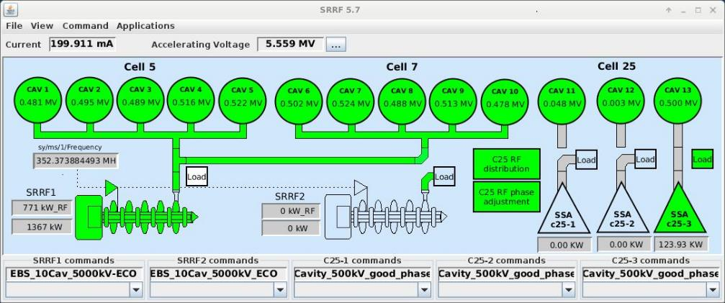
The ESRF case: radio-frequency optimisation
ECO mode (applied since October 2022): Reduction of total accelerating voltage from 6.0 to 5.5 MV
And Increase AC to RF conversion efficiency:
150 kW SSA operated way below nominal power, at 90 …100 kW, where the efficiency was low.
Increase the Klystron power by increasing Cav 1 to 10 voltage from 4.5 to 5.0 MV
Operate with only 1 SSA at 0.5 MV
Efficiency AC ➔ RF:
Klystron: 53%
Present SSA: 47%
New SSA (to replace Klystron): 59%
RESULT:
200 kW AC power savings at 200 mA
Same beam lifetime for typical ID losses
500 kW total savings possible if operation at 100 mA
Storage Ring Total power: 6350 kW [2018] 4100 kW [EBS]

Slide 13
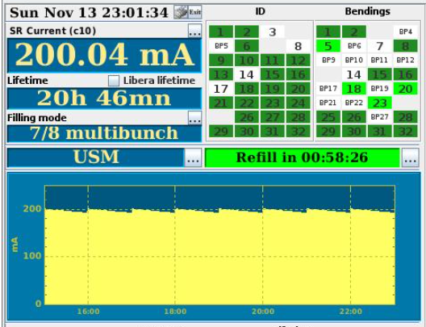
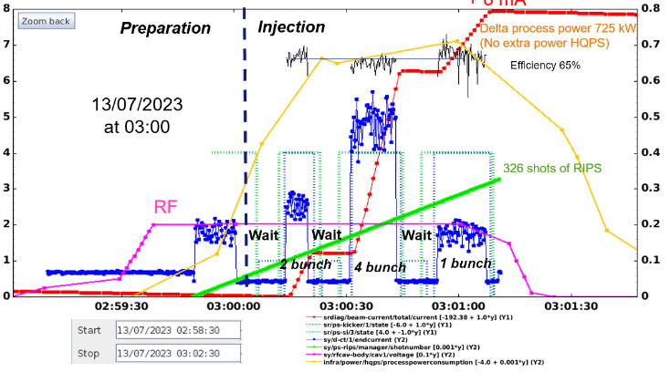
The esrf case: lifetime, injection efficiency and injector usage
EBS parameters:
Beam lifetime larger than 20 hours
Injection efficiency in the order of 70%
Top-up every 1 hour
Typical injection in 2022:
725 kW for the injector during 2 mn. every 1 hour
(45s for preparation, 70s for injection)
➔ 50 kWh
During machine development time, optimisation of the programme and guidelines is imposed for the usage of the injector.

Slide 14
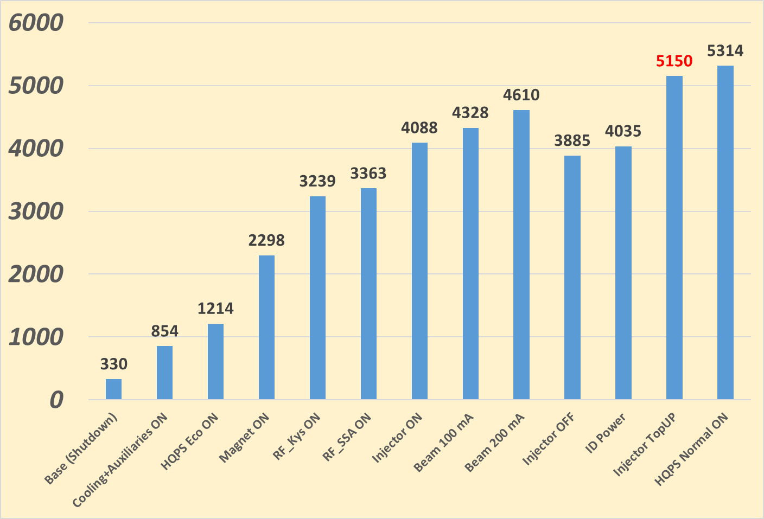
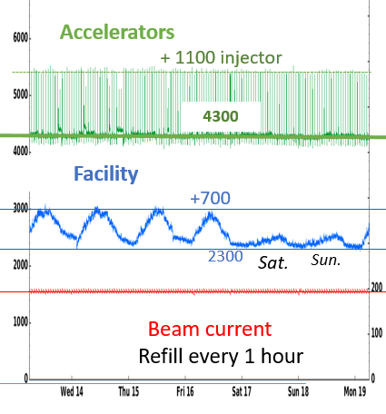
typical power consumption at ESRF
854 kW Base with cooling and auxiliaries ON
Base Power in shutdown: 330 kW
360 kW HQPS consumption mode ECO:
(with transient up to 800 kW when SYRF switched ON )
In normal mode 510 kW (transient 731 kW).
2149 kW Power consumption of the storage ring without beam:
(Magnets: 1084 kW RF: Klystron: 941 kW SSA: 124 kW)
522 kW Beam power at 200 mA 150 kW ID power
-------------
4035 kW Total
725 kW Injector consumption (RF : 176 kW ; Magnets: 560 kW)
One week operation:
4100
Total electricity consumption of the facility:
4100 kW at 200 mA
+ 725 kw every hour for 2 mn for injection (1100 max with transient)
+ 2300 kW base facility consumption for labs, office, Experiments,…
+ 700 kW fluctuation for staff activity

Slide 15
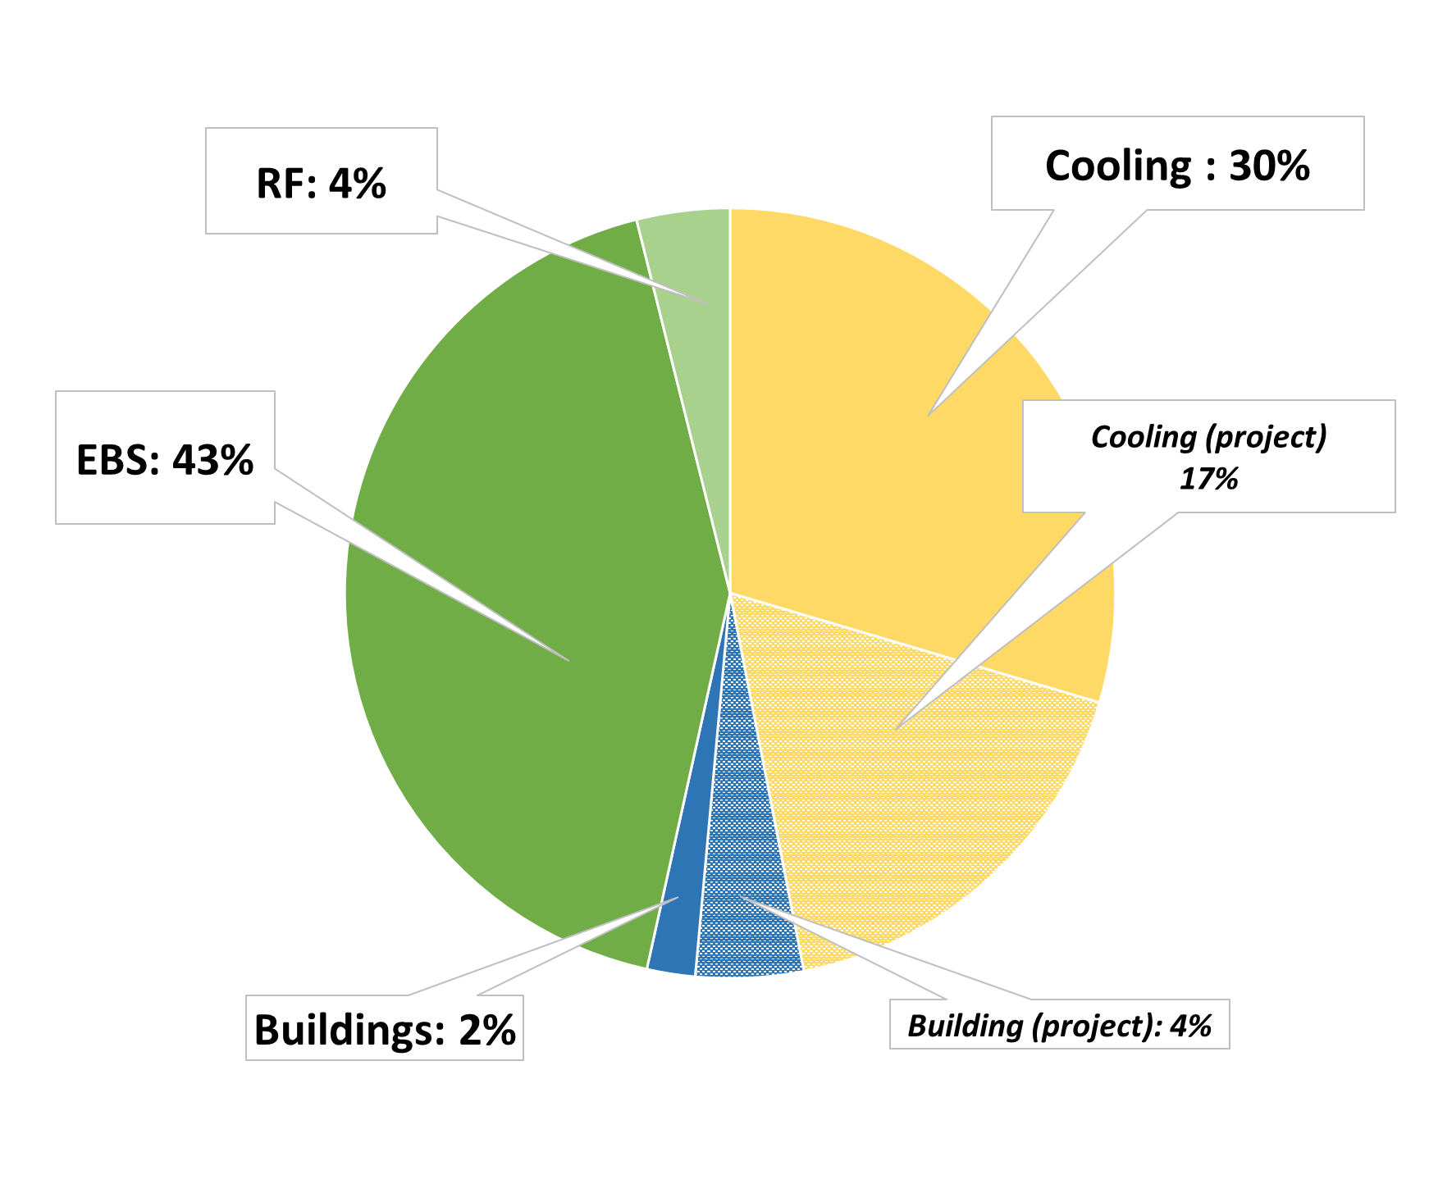
The ESRF case: Energy management at the research infrastructure
Today:
Electricity consumption: 50 GWh / year
Heating consumption: 7.1 GWh / year (District heating network)
Cooling: DRAC River (free cooling)
EBS: 12 GWh of electricity saving
Total energy savings:
25 GWh saving done
6.1 GWh in project
Total savings
Buildings: LED lightning, insulation,…
Cooling: Pumping system, regulations, refrigerators, heating pump..
Accelerators: EBS, RF
Heat recovery project should provide 93 % of the experimental-hall heating
Data centers consumption (3.5% today) will increase in the years to come (heat recovery mandatory)

Slide 16
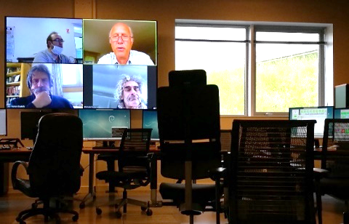
The esrf case: sustainability with a reduction of travels
Full remote access possibilities for users to reduce travel
 | Number of experiments
Year | Total | Onsite | Hybrid | Remote
2018 | 2831 | 2285 | 91 (3%) | 455 (16%) | Prior EBS
2019 |  |  |  |  | Shutdown
2020 |  |  |  |  | COVID
2021 |  |  |  |  | COVID
2022 | 2295 | 1276 | 245 (11%) | 774 (34%) | EBS
Well adapted to repetitive experiments and automated beamlines (macromolecular crystallography, commercial clients..)
Hybrid access is favoured with the presence of experts on site to support the local scientists
Full remote access possibilities to the accelerators to support machine studies and for interventions since COVID pandemic
Incitation to a reduction of the staff professional trips and the use of remote meetings

Slide 17
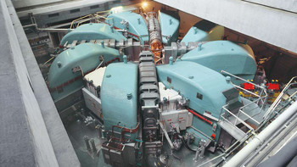
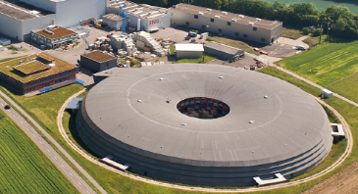
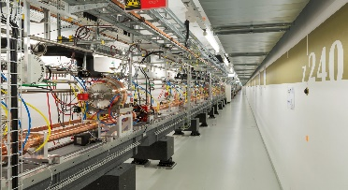
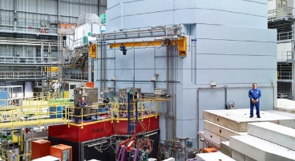
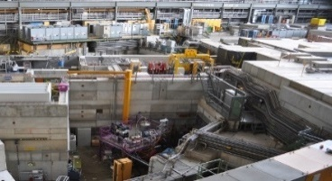
The SLS case: Energy management at PSI
The high-intensity proton accelerator (HIPA)
77 GWh
Total site power consumption: 143 GWh
Total site heat consumption: 5.7 GWh
Synchrotron Light Source SLS
22.6 GWh
Efficiency Measures driven by
PSI Energy Mission
and Federal Energy Law
Planned Upgrade to SLS 2.0
Free Electron Laser SwissFEL
17.4 GWh
Results of Energy Efficiency Measures at PSI (2013-2020)
Number of measures and projects since 2013: 75 (24 Heat; 61 Power)
Yearly saving of el. energy: 7.4 GWh - 6%
Yearly saving of heat consumption: 5.2 GWh -43%
Total yearly investments (average in 7 years): 1.2 Mio CHF
Total yearly savings: 1 Mio CHF
Spallation Neutron Source
SINQ
Muon Source
SµS
Courtesy: D. Reinhard

Slide 18
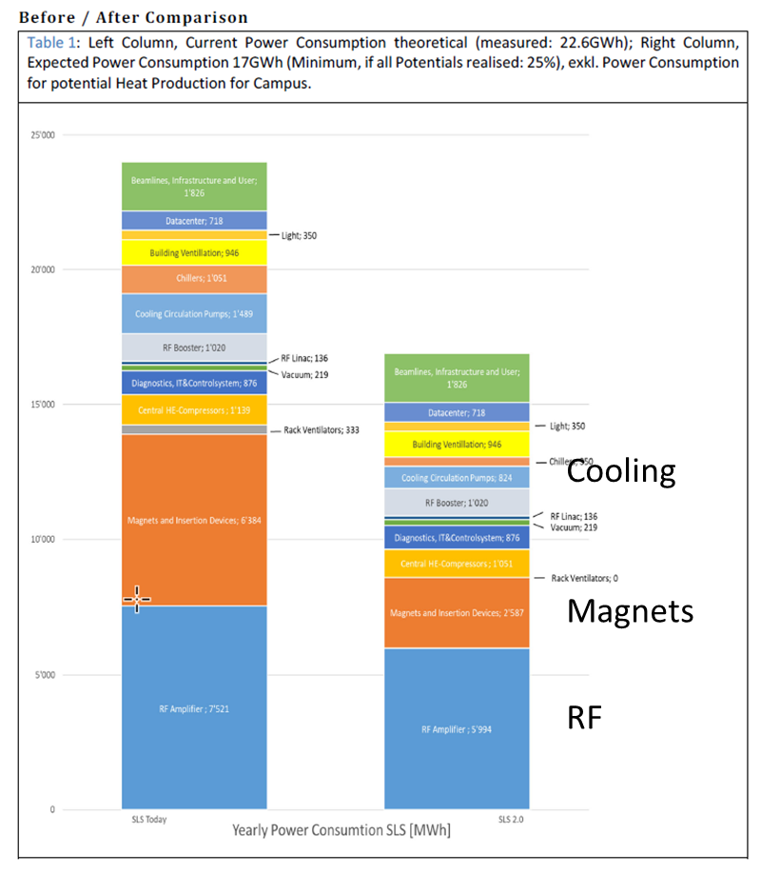
The SLS case: SLS 2.0 upgrade
Energy Efficiency Potentials through:
”New” technologies & developments
Optimizing infrastructure concepts
Adapting to the new boundary conditions
Result:
Increase in peformance (beam quality approx. factor 40)
with a simultaneous
Reduction of -25% energy consumption
Permanent magnets for:
dipoles and reverse bend quads
Replace tubes by SSA for RF power sources
Optimize cooling
Courtesy: D. Reinhard

Slide 19
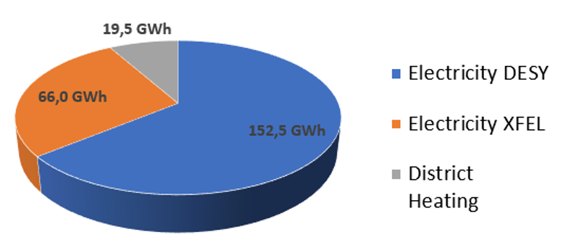
The PETRA IV case: energy management at DESY
Energy consumption at DESY: 238 GWh
Campus-wide activities focus on CO₂ reduction
Electrical power:
from 2023 on 100 % Renewable
55.000 tons CO₂ less per year (compared to 2019)
XFEL: 66 GWh
PETRA: 50.2 GWh
Business trips:
1/3 less travel in total
Sustainability at DESY
Heating:
currently comes from a coal plant nearby
already use waste heat from the cryogenic hall
A group was established to have an overview of the sustainability activities at DESY
DESY has an energy monitoring system to track consumption
Courtesy: Hans-Jorg Eckoldt

Slide 20
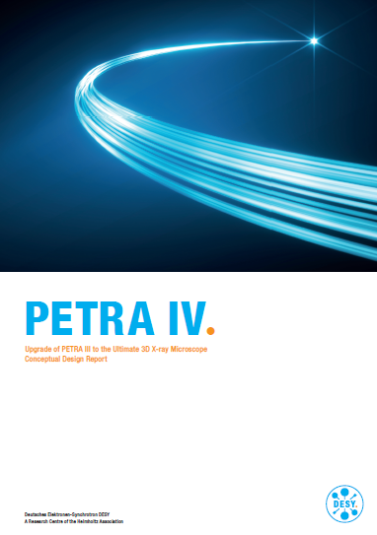
The PETRA IV case: design optimization for sustainability
Highest possible efficiency and energy efficient technology are promises of the CDR
Optimization of PETRA IV Design in terms of energy efficiency and critical materials
Develop and promote remote access and operation, robotics, automation etc. to reduce necessary travel
Integrate waste heat potentials and sources into PETRA IV design
Use of permanent magnets for DL and DQs, optimizing magnet, cabling, power supply operation
Energetic optimization of the air and water temperature
Plasma injector concept at full energy (a potential drivers for future light sources ?)
Courtesy: Hans-Jorg Eckoldt

Slide 21
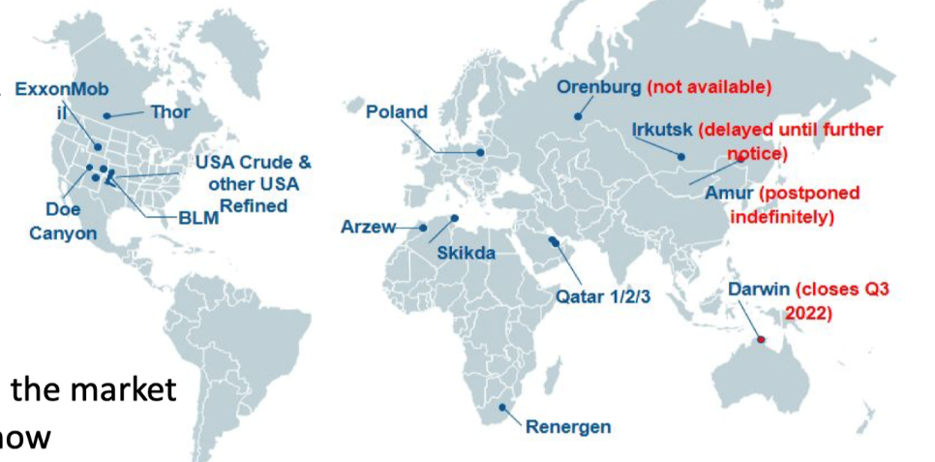
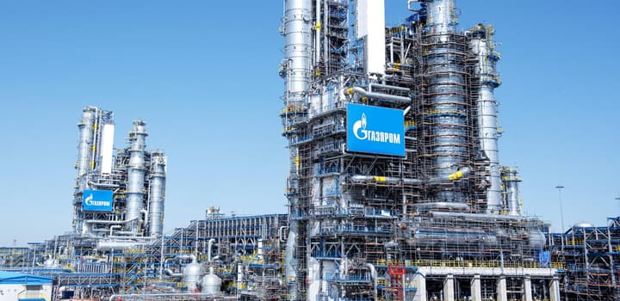
Special case of the Helium crisis
Shortage of helium available on the market
Difficulties of supply for many facilities:
PSI, Soleil,….
Only 14 plants around the world 2-3 plants provide 80% of supply
Multiple supply disruptions:
Gas leaks, fires and explosion
Sanction against Russia
Complex production, technology and operation
Expectation: Price inflation, price volatility, speculation
Helium will become much more expensive subject to periodic crisis
(no availability issue for long term)
Light sources have alternatives to superconductivity:
RF: Single cell HOM damped copper cavities is mature and operational Used at ESRF and SOLEIL will replace its superconducting system
No superconducting technology used at ESRF
Courtesy: Laurent Nadolski, Felix Armborst

Slide 22
Conclusion
The analysis of the situation is clear
Means and tools
are there
What should be next ?
Act on the climate change
Think sustainable
React to the increased energy cost
Reduce and adapt the energy consumption
Have a broader vision of the situation
Technology (or almost there)
Methodology and tools (or almost there)
Investment is often associated to an increase of performance
Funding from national or international agencies for efficiency and sustainability (or emerging)
Conduct new projects and new designs with efficiency and sustainability as primary specifications
Enhance flexibility in the technical, operational, experimental and human behaviour and actions
Measure the “scientific productivity” as a function of the energy consumption and the sustainability

Slide 23
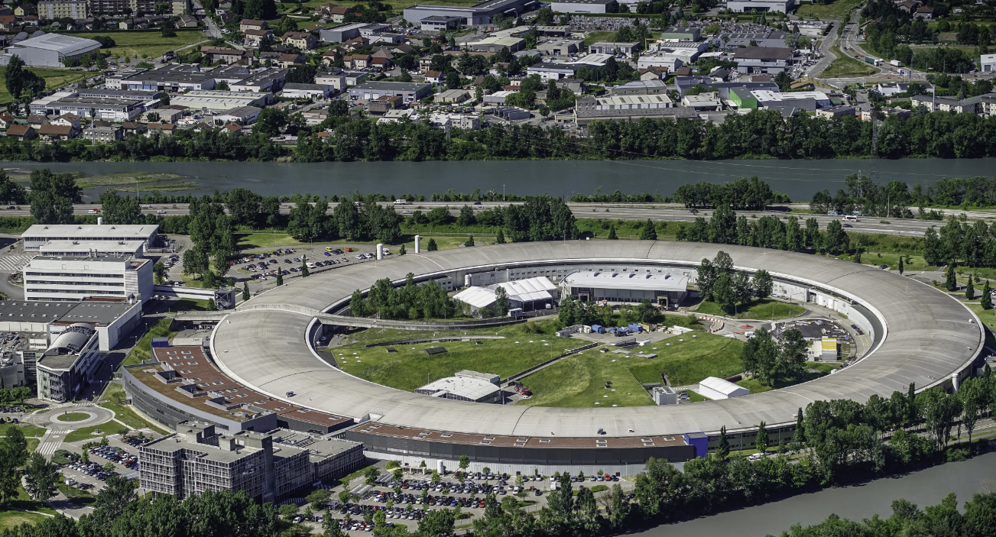
Merci pour votre attention
September, 2024
Madrid.

