Slide 1
Study of a Muon Collider Status and Plans
SFP Journées Accélérateurs Roscoff, 4th October 2023
Christian Carli on behalf of the International Muon Collider Collaboration (IMCC)
Present status of ideas on muon colliders based on several studies in the past and, in particular, the MAP study.

Slide 2
Content
Introduction
Design baseline overview
Muon production and capture
Ionization cooling
Acceleration
Muon collider ring
Neutrino radiation issue
Summary

Slide 3
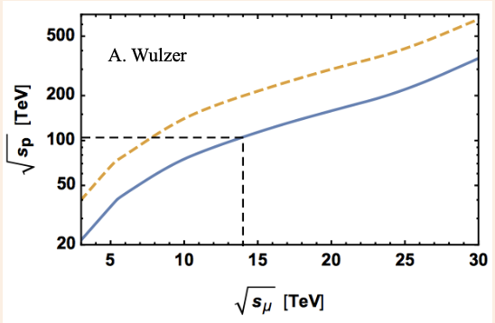
Introduction
High energy lepton colliders precision and discovery machines
Given physics reach with lower energies than for proton colliders
Electron-positron collider energy limited by particle mass
Energy loss from synchrotron radiation for circular colliders
Length for linear colliders
Collide muons – leptons with mass $E_{μ}≈105 \text{MeV}$ in Ring
Lepton circular collider with high magnetic fields
Same (higher) physics reach at lower beam energy than hadron collider
Drawbacks and limitations
Effort to generate useful muon beams, still resulting in large emittance
Low life-time of $T_{μ}≈2.2 μs$ in muon rest frame => Fast (ionization) cooling and acceleration (e.g., by pulsed synchrotrons) => Still majority of muons decay before collisions
Proton and muon collider energy for about equal cross section

Slide 4
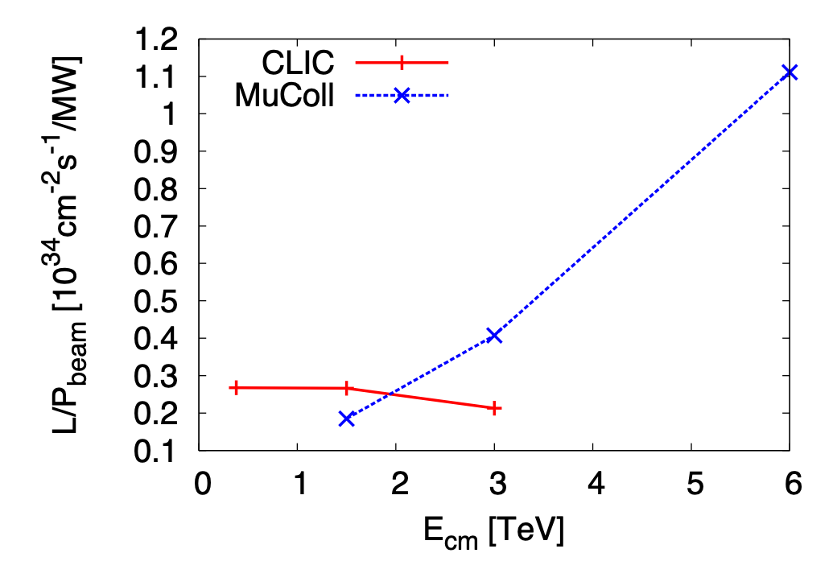
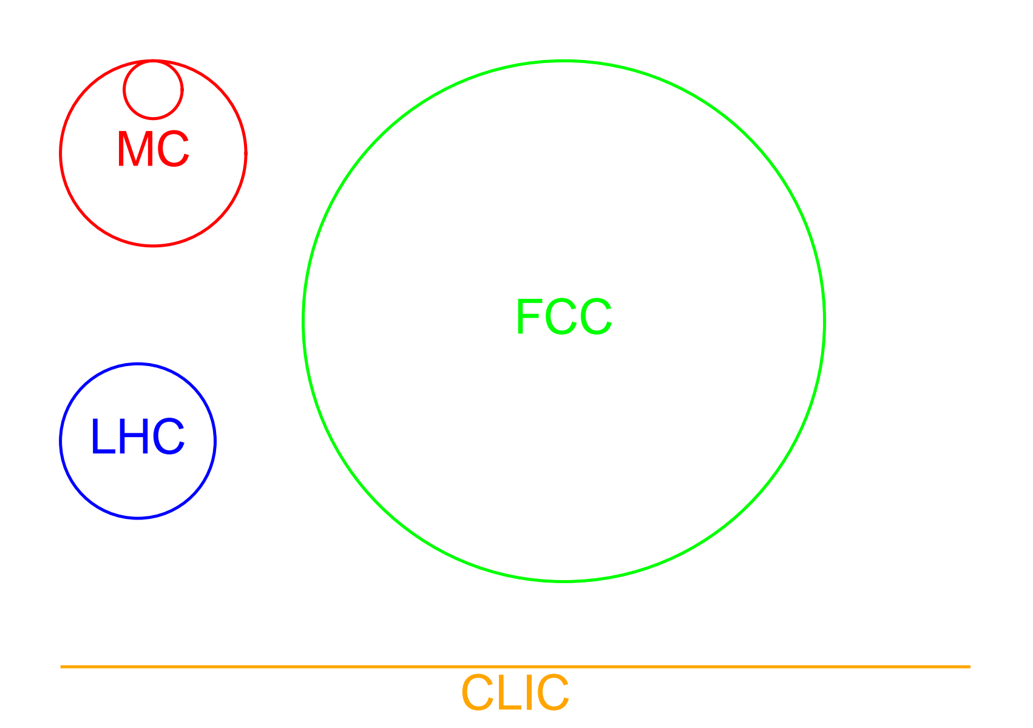
Introduction
Muon collider studies since decades (Russia, US, later at CERN …)
Muon Accelerator Program (MAP) initiative launched in 2011
International Muon Collider Collaboration IMCC working mainly on 10+ TeV scheme
Facility footprints for different high energy physics projects
10 TeV muon collider footprint comparable to 3 TeV CLIC with physics potential comparable to FCC-pp
Luminosity per beam power as function of beam energy
Ratio of luminosity to beam power increases with beam energy
Attractive in particular for high energies

Slide 5
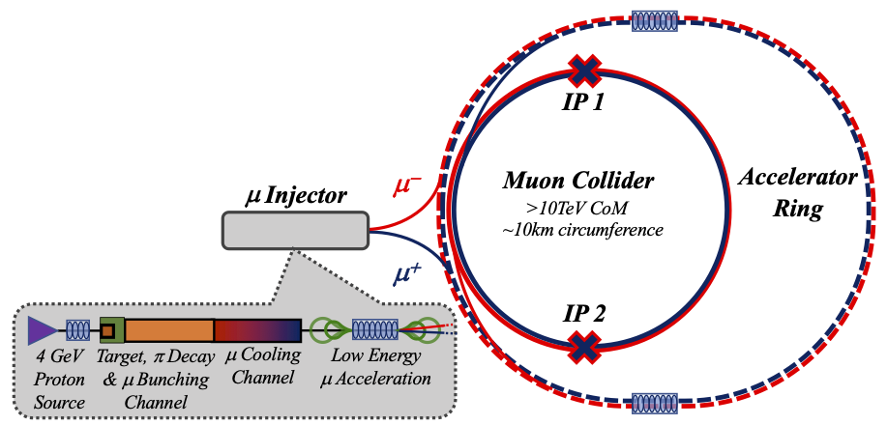
Design Baseline Overview
Short muon beam life-time: => Ionization cooling, fast acceleration, high RF gradients and high field magnets!
Acceleration in a sequence of pulsed synchrotrons
(last one larger than collider)
Collider: tightly packed high field magnets to minimize circumference
and maximize luminosity
Few MW production beam: short intense bunches on target generating
πs decaying into μs.
Target and capture channel: large energy
μ beam transformed
to sequence of bunches
Cooling stages and merging of μ bunches
into one bunch
Low energy acceleration
In recirculating Linacs

Slide 6
Design Baseline Overview
Hour glass
factor
repetition
rate
Sum over succesive encounters
of same bunches with with
decreasing intensies
Integrate lumi per
bunch crossing
$$L=\frac{N^{2}}{4π ε_{ph}β^{∗}}{ f}_{hg} f_{r}\frac{γ{ T}_{μ}}{{2T}_{rev}} = \frac{e c^{2} T_{μ}}{16 π^{2} E_{μ}} \frac{\left(f_{r} N γ\right) N γ }{ ε_{n} ε_{L}}{{ σ}_{δ} \overline{B} f}_{hg}$$
Constant $11.83 {\text{T}}^{−1}$
Incoming beam
Emittances determined by ionization cooling
Luminosity proportional to beam power $∝ \left(f_{r} N γ\right)$
Large bunch population $N$ means low repetition rate
Few collider parameters to work on
Choice of large (average) magnetic field $\overline{B}$ and $σ_{δ}$
Consequence of assumption and optimizations made:
Bunch length $σ_{z}$ and $β^{∗}$ decrease with energy
Lattice design becomes more difficult for higher energies (higher beam rigidity, chromatic effects …)
Assumptions
Bunch length $σ_{z}={ε_{L}}/{\left(γ σ_{δ}\right)}$ given by longitudinal emittance $ε_{L}$ and rms rel. mom. spread
$β^{∗}=σ_{z}$ giving moderate luminosity loss due to hourglass effect $f_{hg}=0.758$
Revolution time $T_{rev}=2π\frac{γ E_{μ}}{e c^{2 }\overline{B}}$ with $\overline{B}$ the average bending field

Slide 7
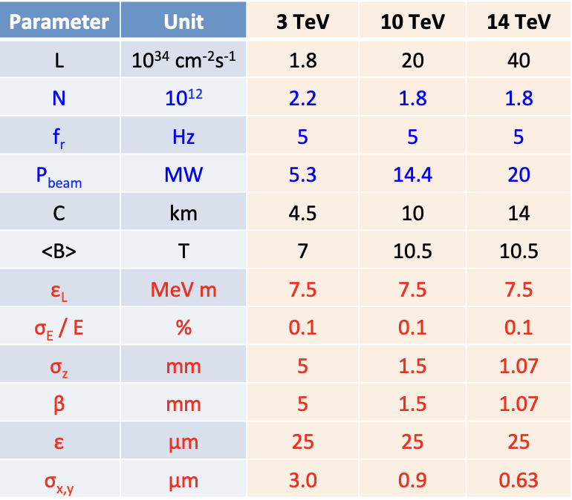
Design Baseline Overview tentative parameter list for IMCC study
High (average) magnetic field
Relative energy spread
kept constant at 10⁻³
Bunch length and β* decreasing with beam energy

Slide 8
Muon Production and Capture
Production beam
A few (1-4) MW proton beam with a few GeV beam energy
Short bunch length of a few ns and lowish repetition rate of f_{r} ≈ 5 Hz
Baseline SC linac followed by accumulator and compressor rings
Target
Options: graphite, liquid metal jet (mercury tested with MERIT experiment or powder)
p + N -> π + X followed by decay with charged πs decaying into μs
Large divergence and energy distribution of muons
Magnetic field taper to collect muons between 50 MeV and 400 MeV
Target in high field ~20 T reduced to ~ 2 T over ~10 m
Compromise to minimize transverse and longitudinal emittances
Magnet and mechanical studies on-going by C. Accettura et al.

Slide 9
Muon Production and Capture
Transformation of large energy spread muon beam into sequence of bunches
Target and drift followed by chicane to remove most unwanted particles
Be absorbed stopping protons in momentum range of selected muons
Drift: generation of correlation between energy and longitudinal position
RF cavity section to create longitudinal structure (bunches)
Muon distribution still becoming longer => RF frequency decreasing over buncher section
Phase-energy rotation: accelerate low energy bunches coming late, decelerate high energy bunches coming early
Appropriate choice of RF frequency and phase
Again frequency varying over over phase-energy rotation section
Result: train of bunches with about equal energy suitable for ionization cooling
From MAP study

Slide 10
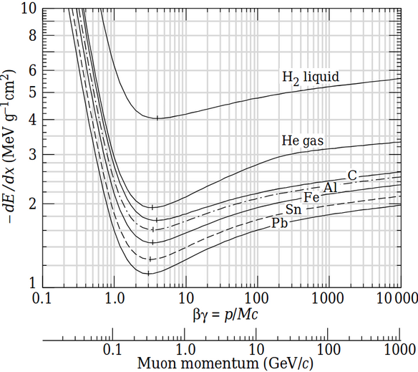
Ionization Cooling Principle
Principle of (transverse) ionization cooling
Absorber: reduction of both the longitudinal and transverse momentum
Cavities: acceleration, i.e., increase of only longitudinal momentum
Net effect: reduction of transverse momentum and, thus, beam cooling
Scattering leads to beam blow-up – need for strong focusing solenoids and low Z absorbers
Longitudinal cooling (or heating)
Dependence of energy loss on energy
Dispersion and wedge shaped absorber
Bending generating dispersion
Absorber slowing down high (low)
momenta more (less)

Slide 11
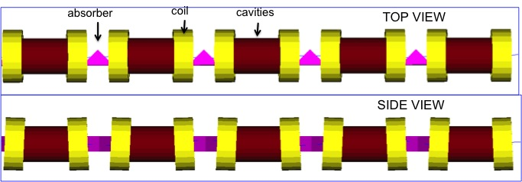
Ionization Cooling 6D Cooling Channels
High field solenoids for focusing
Minimum Twiss betatron function β_{T} at absorber location
Tilting of solenoids
Dispersion from vertical magnetic field for longitudinal cooling
Solenoid polarity reversals
Low Z absorbers: Liquid H₂ and LiH
Cavities in high magnetic field region
6D cooling
Between muon capture and bunch merging
Interleaved with separation of μ⁺ and μ⁻
Between bunch merging and final cooling
From MAP study
Many studies on-going to reproduce and optimize
E. Fol, C. Rogers, B. Stechauner …. .
Last section of 6D cooling after bunch merge

Slide 12
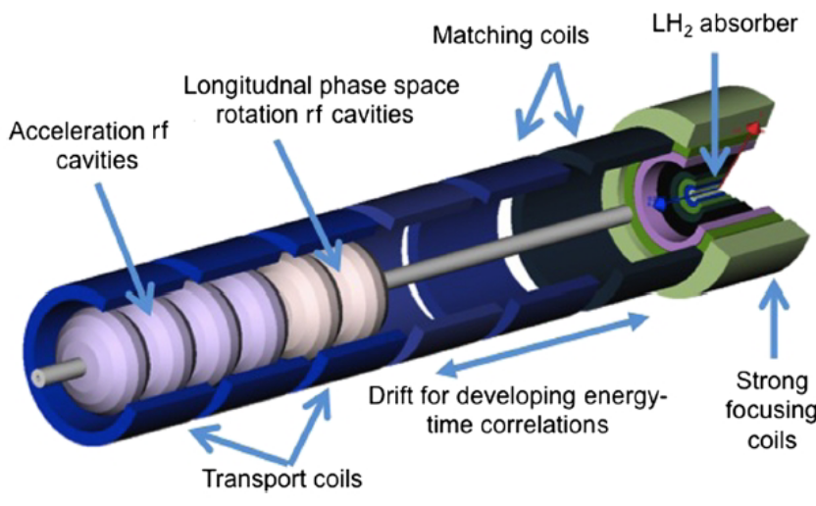
Ionization Cooling Bunch merging and final cooling
Bunch merging – transformation of train of 21 bunches into one bunch
Longitudinal gymnastics combining three bunches, resulting in 7 bunches
Transverse merging
Followed by another 6D cooling channel
Equilibrium transverse emittances too large for collider, small longitudinal emittance
Studies and attempts to optimize on-going
Final cooling channel
Transverse cooling “only” – longitudinal emittance increase
Liquid H₂ absorber in high (now ~40 T) field
Optimizations using machine learning techniques
Theoretical solutions for lower transverse emittances
Not yet confirmed in simulations
Z. Ruihu et. al.
E. Fol, B. Stechauner
From MAP study

Slide 13
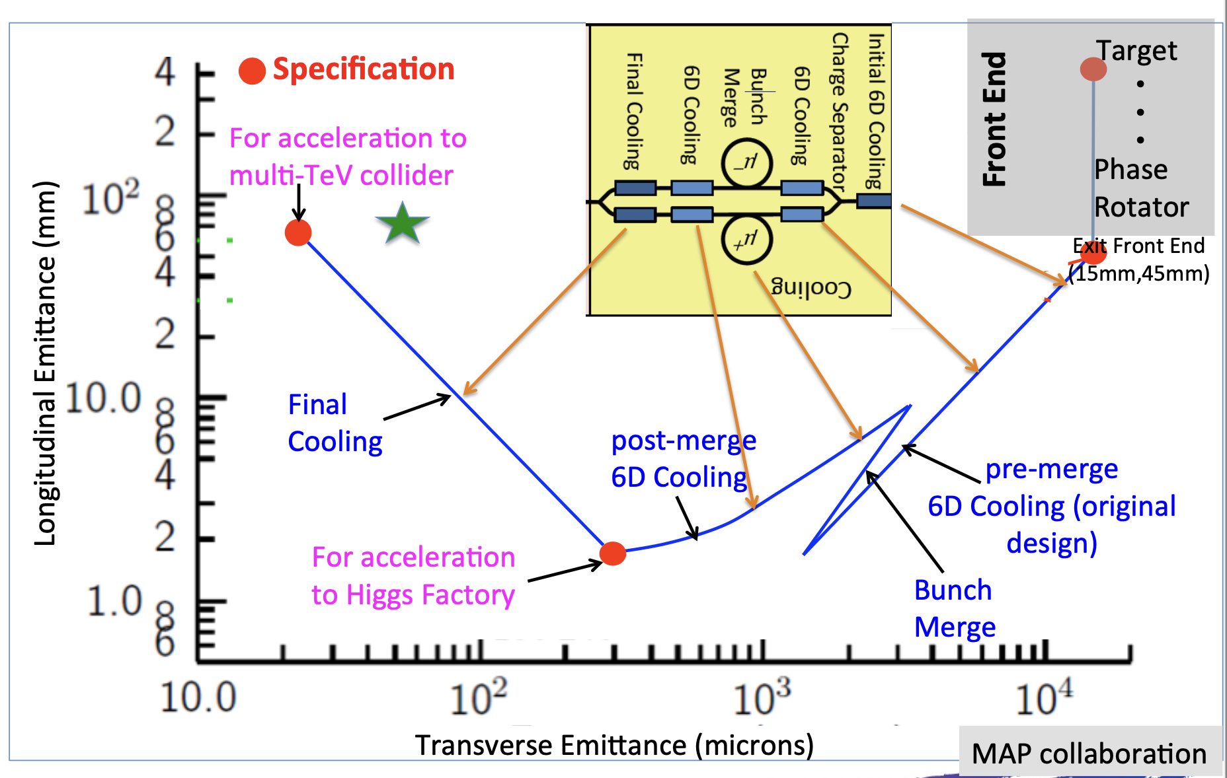
Ionization Cooling Emittance evolution
Efforts on-going to bring emittances
closer to expected values for collider
Simulations
From MAP study

Slide 14
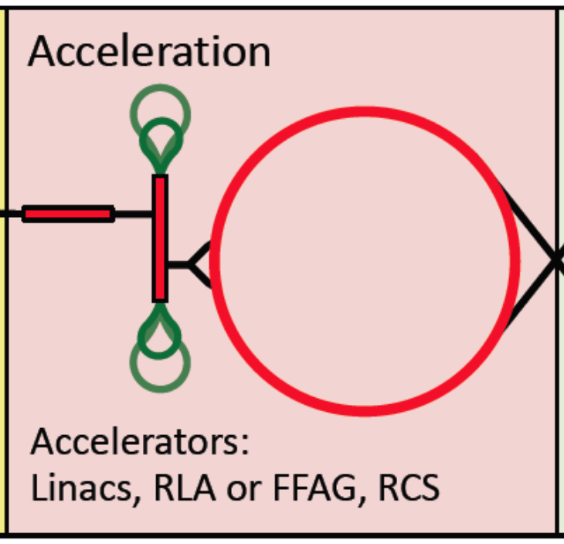
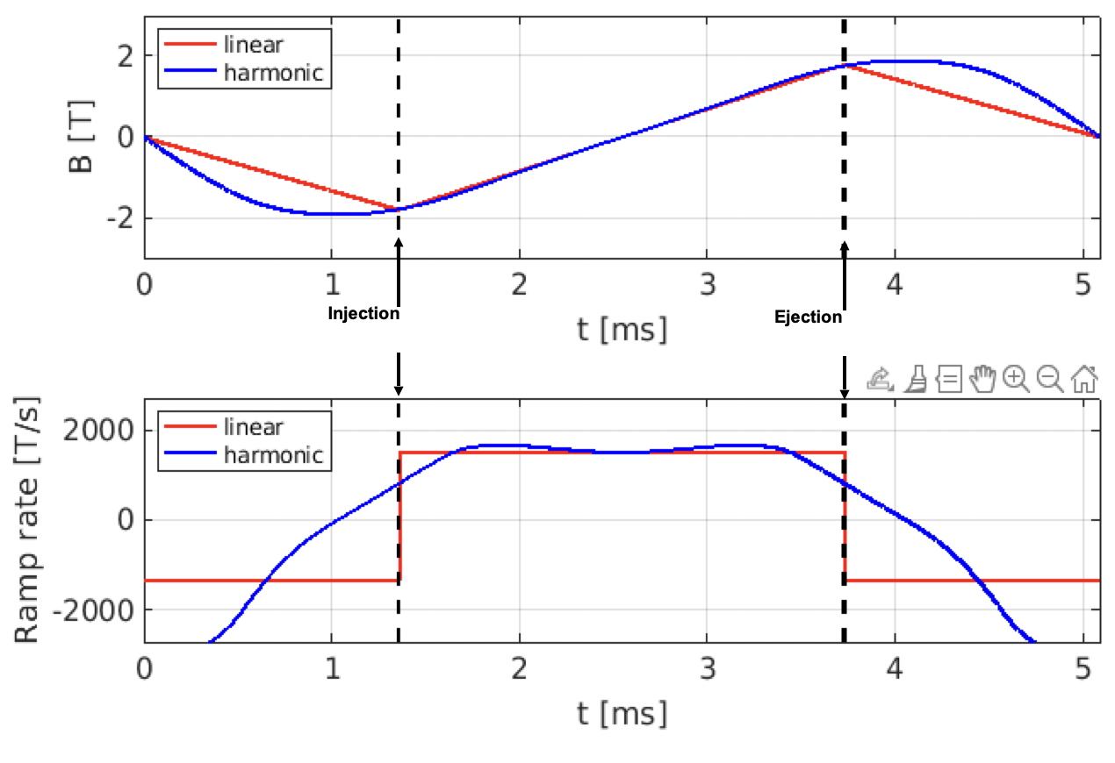
Acceleration
Fast acceleration and high (average) RF gradients needed to avoid muon losses due to decay
Starting with (re-circulating) Linacs
Followed by “pulsed synchrotrons”
Acceleration within few tens of turns!
Combination of static SC bends and pulsed conventional bends (changing polarity)
Ongoing work:
Orbit excursions – minimization of resulting circumference variation for RF, longitudinal dynamics, impedances … .
Magnet powering and Eddy currents a challenge, in particular, for lower energy rings
A. Chancé, F. Batsch, F. Boattini .. .

Slide 15
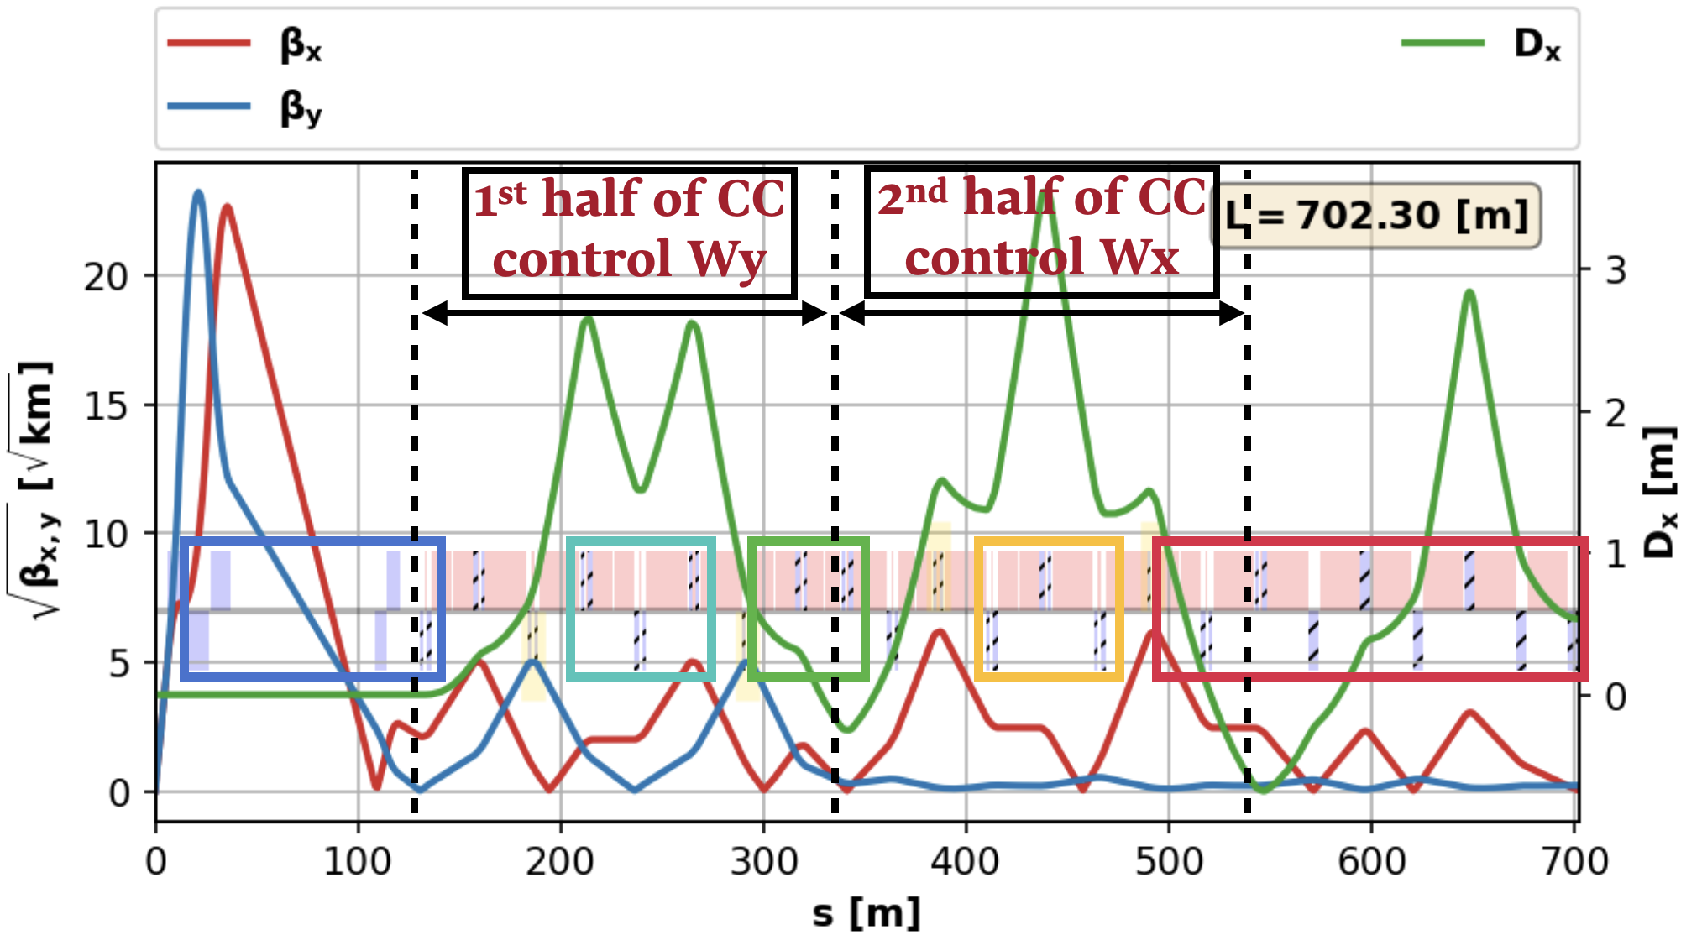
Muon Collider Ring
Interaction region, chromatic compensation and matching
Small $β^{∗}=1.5 \text{mm}$, large momentum spread $σ_{δ}≈{10}^{−3}$ and high beam rigidity
Lead to large maximum Twiss $β$’s and chromatic effects requiring local compensation
Challenge to keep bunch $σ_{z}=1.5 \text{mm}$ for few hundred turns
Except inner triplet only (long) combined functions quads and X-poles
From K. Skoufaris
IP and
Inner triplet
Chromatic compensation
X-poles in dispersive regions
Matching
to arc cells

Slide 16
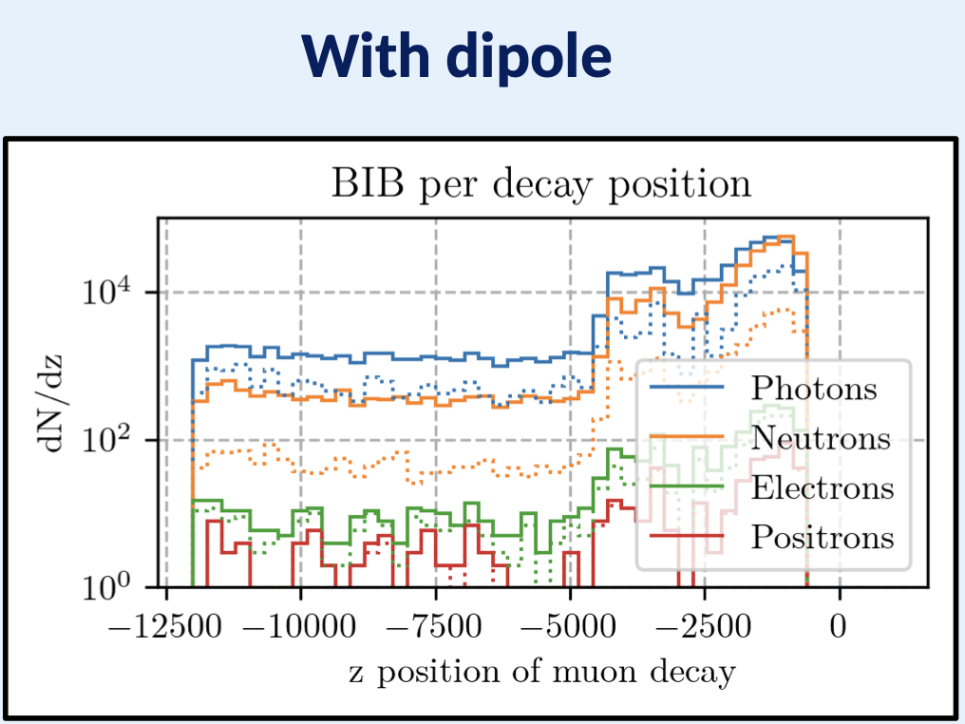
Muon Collider Ring Beam Induced Background (BIB)
D. Calzolari,
A. Lechner et al.
Particles from decays seen by detector
Perturbation for data taking
Nozzle made of W to intercept most decay products
Outer B layer intercept neutrons
Dipolar magnetic field components (within or just after inner triplet) reduce BIB

Slide 17
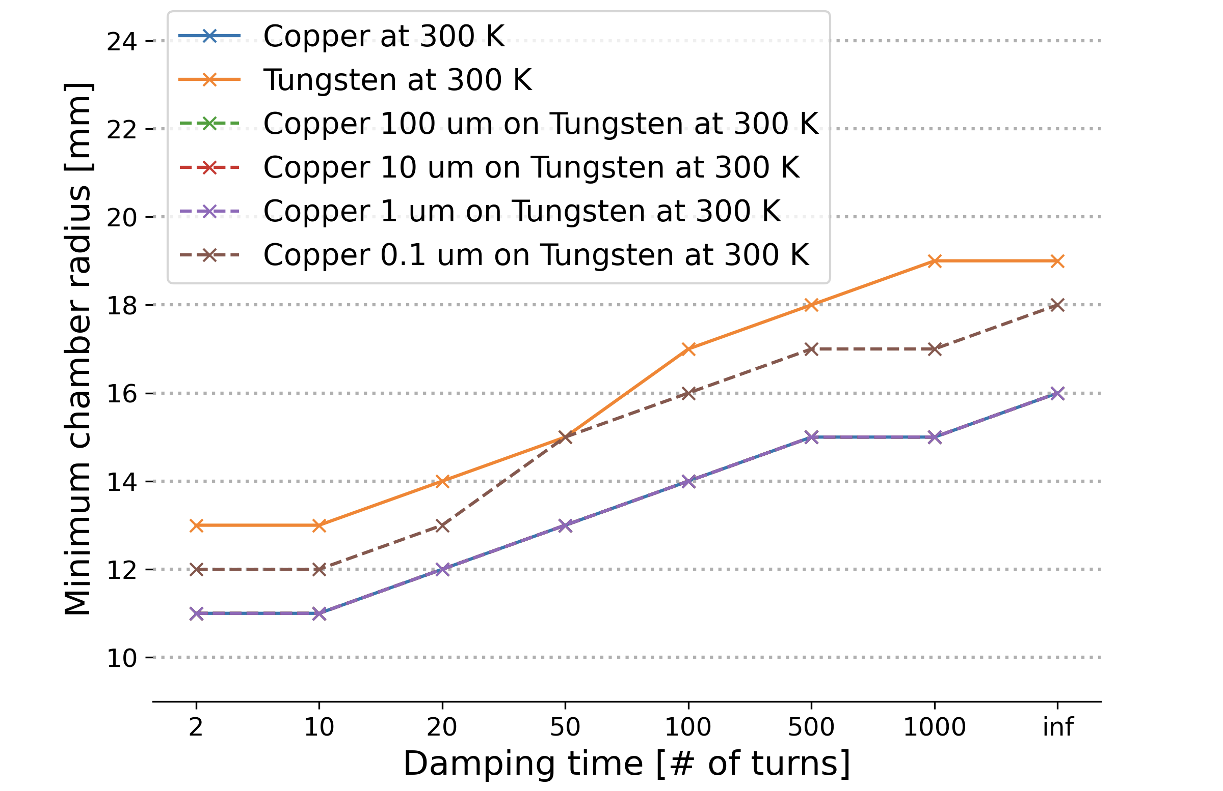
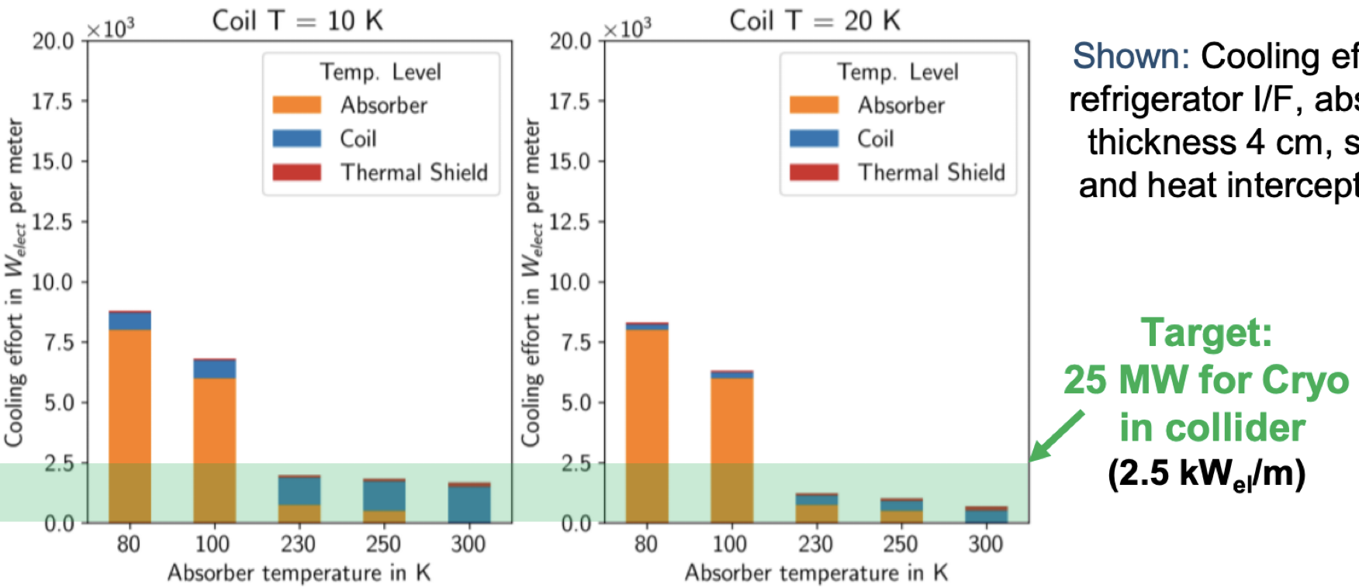
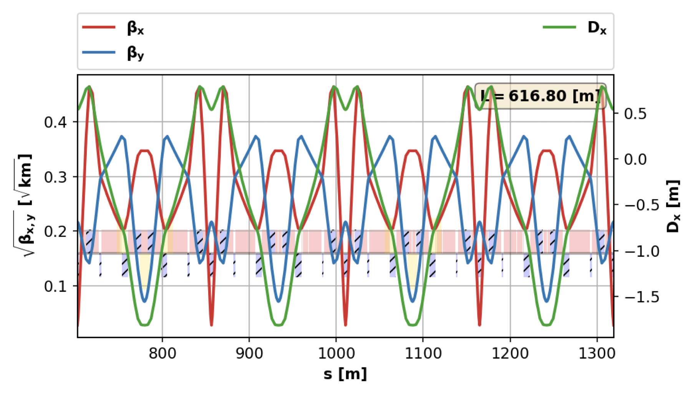
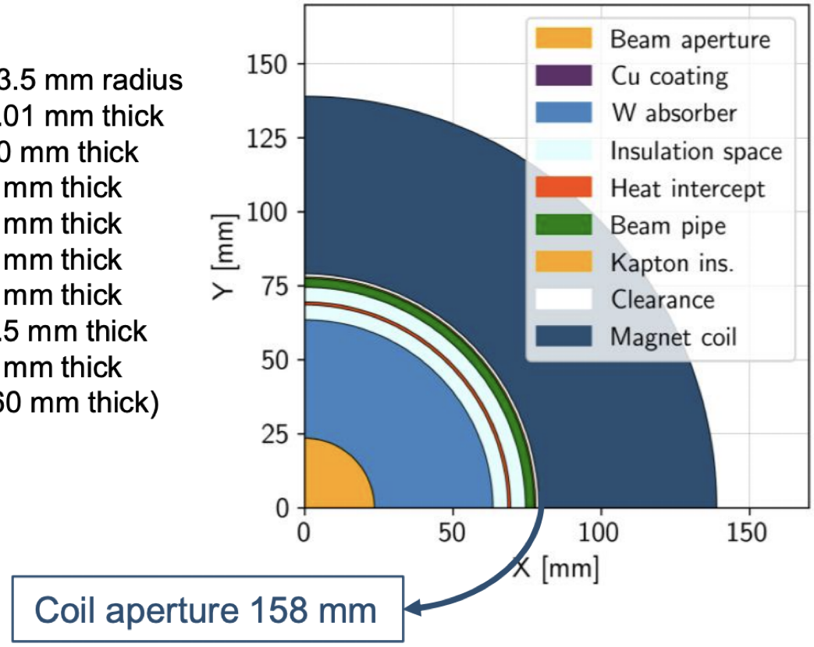
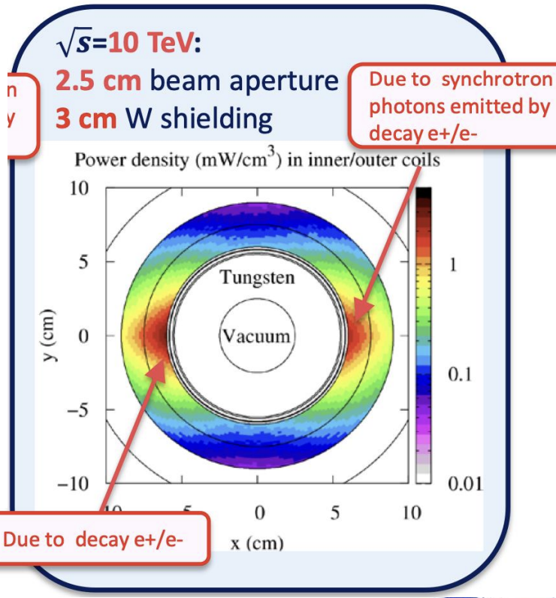
Muon Collider Ring Working together to define radial built
D. Amorim
P. T. Coutinho et al.
Impedance ~20 mm radius with reasonable damper
Wall-plug power for cryogenic
warm absorber
heat shield
A. Lechner et al.
Aperture requirement for beam
Vacuum system – W absorber serves as vacuum chamber
Higher magnetic fields and gradients with smaller apertures
Based on studies by different teams on different aspects
Leading to partly conflicting requirements
Coordinated team effort to define radial build as compromise
40 mm W absorber to limit
magnet heating from decays

Slide 18
Neutrino Radiation Issue
Radiation due to showers generated by neutrinos reaching the earth surface
Matter in front (“shielding”) does not help but makes situation even worse
Narrow radiation “cone”
Mitigation measures to ensure negligible doses
Strong increase with muon energy
Cross sections increase, energy per interaction and smaller opening of cone
Depends on lattice details
Straight sections (other than IR) to be avoided
Thorough study on-going
straight section
length $Δs$
$${\hat{θ}}_{H}$$
$$L_{s}$$
$$L_{s}θ_{V}$$
$$L_{s}Δθ_{H}=L_{s}\left(θ_{H}−{\hat{θ}}_{H}\right)$$
Radiation cone
$$d$$
Collider ring
$$R_{e}$$
$$L_{s}≈\sqrt{2R_{e}d}$$
18
18
Periodic machine deformations in vertical to mitigate

Slide 19
Summary
Muon Collider an attractive option for a future high energy project
Circular lepton collider not limited by synchrotron radiation
Challenges mainly related to effort to generate muon beams and short life-time
Proton drive beam, muon cooling and acceleration, radiation, collider ring design, high field magnets, RF system in high magnetic fields ..
Not as mature as other projects as CLIC, ILC, FCC
Still feasibility to be shown and many R&D topics to be addressed
IMCC aiming at a conceptual design of 10+ TeV com. muon collider
Based on many studies made over several decades and, in particular, MAP
Collaboration with 50+ collaborating institutes (agreement signed by 30+)
Challenging collaboration and coordination between many teams and institutes
Challenging studies ahead of us
Identification of solutions to outstanding issues
Aiming at conceptional design proven to be feasible as input to ESPP
Talk given
on behalf of the IMCC collaboration and using materiel from various sources

Slide 20
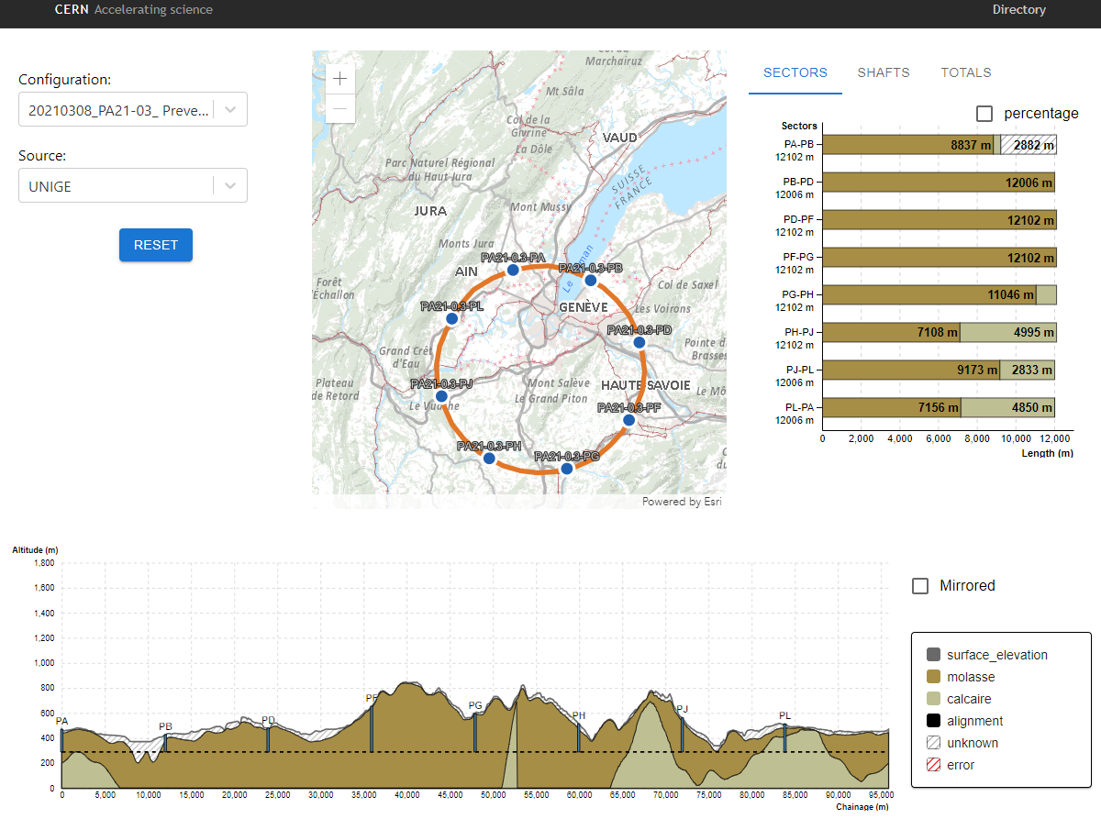
Neutrino Radiation Issue Geoprofiler tool for suitable collider positioning
* Unrealistic positioning, for illustrative purposes only!
Geoprofiler Application – currently focused on geological analysis
Edit and reposition the ring
Detailed knowledge of shape of earth surface
Recalculation of the geology along the tunnel
Positions where tangential to ring reaches earth surface
Information about impacted areas (rights, urbanization …)
* Prototype, for illustrative purposes only!
From
G. Lacerda et al.

Slide 21
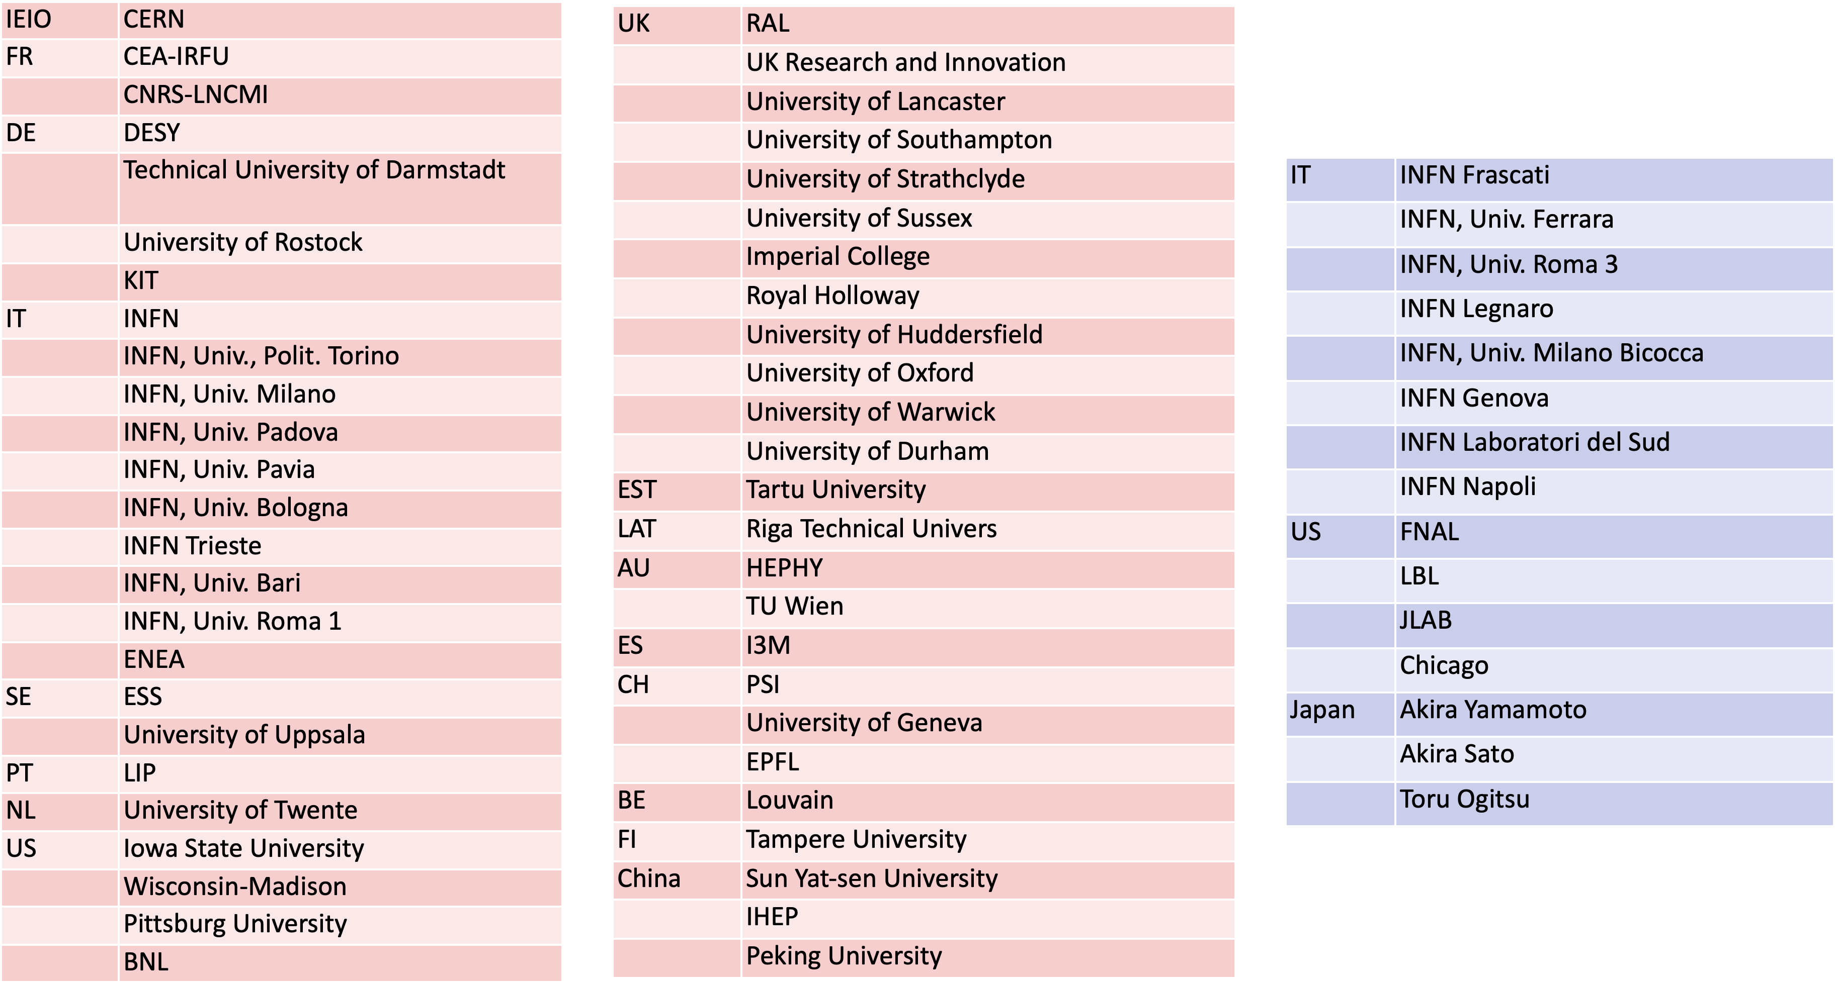
International Muon Collider Collaboration IMCC

Slide 22
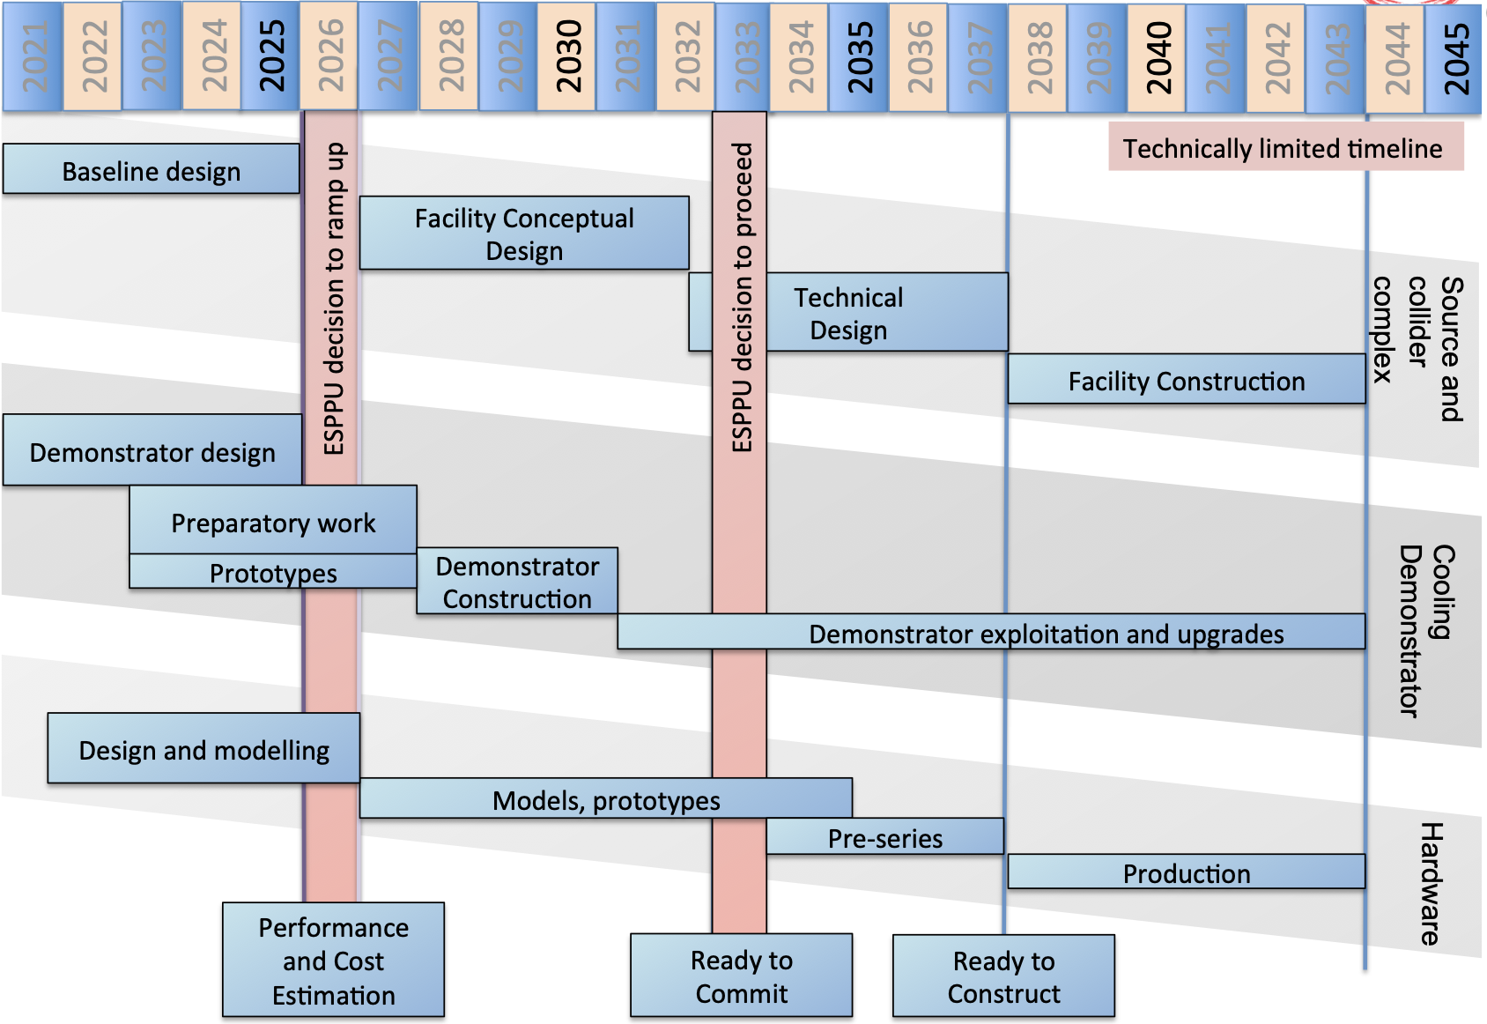
Timeline

